Slide 1
Panel: Future Challenges of Cloud Computing and Web Technologies (with a Big Data slant)
May 8 2013
3rd International Conference on Cloud Computing and Services Science, CLOSER 2013
Eurogress Aachen
Geoffrey Fox
gcf@indiana.edu
http://www.infomall.org http://www.futuregrid.org
School of Informatics and Computing
Digital Science Center
Indiana University Bloomington

Slide 2
Issues of Importance
Economic Imperative: There are a lot of data and a lot of jobs
Progress in Data Science Education: opportunities at universities
Computing Model: Industry adopted clouds which are attractive for data analytics
Research Model: 4th Paradigm; From Theory to Data driven science?
Confusion in a new-old field: lack of consensus academically in several aspects of data intensive computing from storage to algorithms, to processing and education
Progress in Data Intensive Programming Models: MapReduce
Progress in Academic (open source) clouds: OpenStack (US)
Progress in scalable robust Algorithms: new data need better algorithms exposed as Services?
FutureGrid: Develop Experimental Systems

Slide 3
Big Data Ecosystem in One Sentence
Use Clouds running Data Analytics expressed as Services processing Big Data to solve problems in X-Informatics ( or e-X)
X = Astronomy, Biology, Biomedicine, Business, Chemistry, Crisis, Energy, Environment, Finance, Health, Intelligence, Lifestyle, Marketing, Medicine, Pathology, Policy, Radar, Security, Sensor, Social, Sustainability, Wealth and Wellness with more fields (physics) defined implicitly
Spans Industry and Science (research)

Slide 4
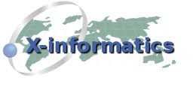
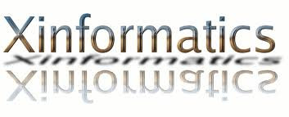
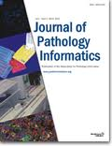
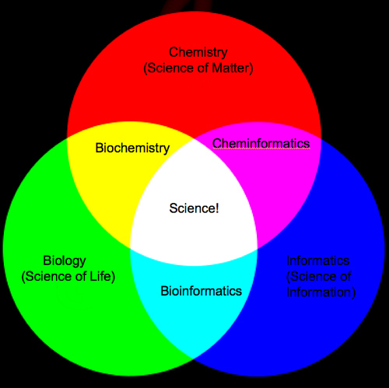
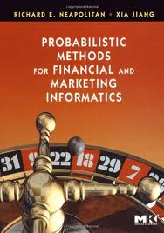
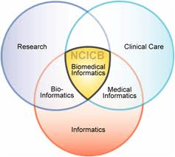
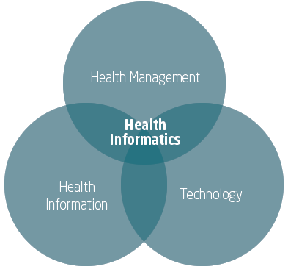
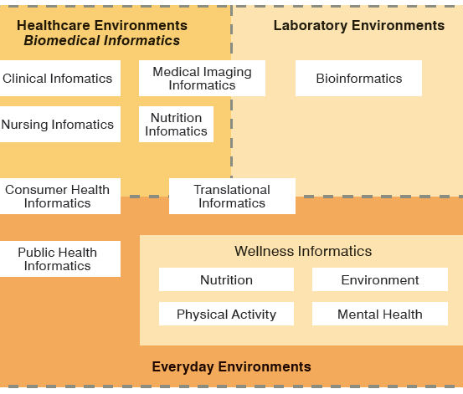
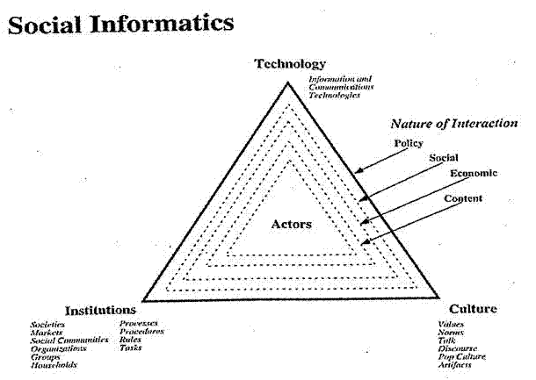
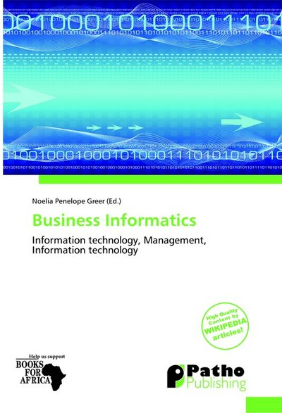
Social Informatics

Slide 5
Education and Training
Microsoft says there will be 14 million cloud jobs around the world by 2015
McKinsey says that there will up to 190,000 nerds and 1.5 million extra managers needed in Data Science by 2018 in USA
Many more jobs than simulation (third paradigm) where computational science not very successful as curriculum
Need curricula to educate people to use/design Clouds running Data Analytics processing Big Data to solve problems in X-Informatics (X= Bio…LifeStyle…Policy…Wealth)
Cover Data curation/management, Analytics (algorithms), run-time (MapReduce, Workflow, NOSQL), Applications
Not many courses aimed at any one aspect of this; let alone everything and their integration
Look at Massive Open Online Courses (MOOCs)

Slide 6
Clouds for Scientific Data Analysis
There has been plenty of trials and several successes from particle physics (LHC) data analysis to genome sequencing
MapReduce/NOSQL with Iterative extensions good for data intensive problems which have very different communication requirements from large scale simulations
Large collective communication v. smallish local messages
However no agreement on good data architecture or even requirements for this either in cloud or on conventional HPC style systems
No agreement on value of commercial clouds as cost effective solution
Need to generate a consensus on data architectures as exists for simulations
Exascale discussion builds on agreed principles

Slide 7
Data Analytics Futures?
Better algorithms contribute as much as better hardware in HPC
PETSc and ScaLAPACK and similar libraries very important in supporting parallel simulations
Need equivalent Data Analytics libraries
Include datamining (Clustering, SVM, HMM, Bayesian Nets …), image processing, information retrieval including hidden factor analysis (LDA), global inference, dimension reduction
Many libraries/toolkits (R, Matlab) and web sites (BLAST) but typically not aimed at scalable high performance algorithms
Should support clouds and HPC; MPI and MapReduce
Iterative MapReduce an interesting runtime; Hadoop has many limitations
Build as Library and/or Services (Software as a Service)
Propose to build community to define & implement SPIDAL or Scalable Parallel Interoperable Data Analytics Library

Slide 8
FutureGrid offers
Computing Testbed as a Service
FutureGrid Uses
Testbed-aaS Tools
Provisioning
Image Management
IaaS Interoperability
NaaS, IaaS tools
Expt management
Dynamic IaaS NaaS
Devops
CS Research Use e.g. test new compiler or storage model
Class Usages e.g. run GPU & multicore
Applications
Software
(Application
Or Usage) SaaS
Cloud e.g. MapReduce
HPC e.g. PETSc, SAGA
Computer Science e.g. Compiler tools, Sensor nets, Monitors
FutureGrid Usages
Computer Science
Applications and understanding Science Clouds
Technology Evaluation including XSEDE testing
Education & Training
Platform PaaS
Infra
structure
IaaS
Software Defined Computing (virtual Clusters)
Hypervisor, Bare Metal
Operating System
Network
NaaS
Software Defined Networks
OpenFlow GENI

Slide 9
FutureGrid Testbed as a Service
FutureGrid is part of XSEDE set up as a testbed with cloud focus
Operational since Summer 2010 (i.e. now in third year of use)
The FutureGrid testbed provides to its users:
Support of Computer Science and Computational Science research
A flexible development and testing platform for middleware and application users looking at interoperability, functionality, performance or evaluation
FutureGrid is user-customizable, accessed interactively and supports Grid, Cloud and HPC software with and without VM’s
A rich education and teaching platform for classes
Offers OpenStack, Eucalyptus, Nimbus, OpenNebula, HPC (MPI) on same hardware moving to software defined systems; supports both classic HPC and Cloud storage

Slide 10
4 Use Types for FutureGrid TestbedaaS
292 approved projects (1734 users) April 6 2013
USA(79%), Puerto Rico(3%- Students in class), India, China, lots of European countries (Italy at 2% as class)
Industry, Government, Academia
Computer science and Middleware (55.6%)
Core CS and Cyberinfrastructure; Interoperability (3.6%) for Grids and Clouds such as Open Grid Forum OGF Standards
New Domain Science applications (20.4%)
Life science highlighted (10.5%), Non Life Science (9.9%)
Training Education and Outreach (14.9%)
Long (24 full semester) and short events
Computer Systems Evaluation (9.1%)
XSEDE (TIS, TAS), OSG, EGI; Campuses

