Slide 1
Efficient Software Defined Systems using Common Core Components
Hyungro Lee
June 25-30, 2017 IEEE CLOUD, Honolulu, HI
School of Informatics and Computing,
Indiana University Bloomington
Notes:
Dockerized software deployment

Slide 2
Background
Nowadays, applications need dynamic computing resources and automated software deployments with plumbing multiple components.
Software Defined Systems (3C) ensures building proper computing environments for applications which provides repeatable software deployments in any platforms.
Container technologies i.e. Docker offer reproducibility of applications since container images preserve software stacks and configurations of applications.
Container scripts i.e. Dockerfile build container images on union mounts to efficiently share same image layers across different containers using read-only mounts.

Slide 3
Problems
Isolated separated space by containers does not share common libraries and packages which a normal system does.
Storing image layers for similar container types creates duplicates of software packages and libraries

Slide 4
Contribution
Dependency analysis of container scripts provides an efficient way of building container image layers with common core components in running multiple (similar) containers
Approaches
  Building Common Core Components (3C) with SVN subcommands i.e. submodule, merge

Slide 5
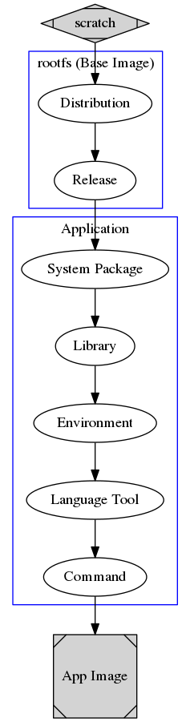
Building Container Images - Dockerfile
Built with container scripts
Order of script commands is important to build a final image on union mounts (DAG graph)

Slide 6
Building Container Images - Dockerfile
Built with container scripts
Order of script commands is important to build a final image on union mounts (DAG graph)
FROM ubuntu:14.04
MAINTAINER Hyungro Lee <hroe.lee@gmail.com>
# Compiler
RUN apt-get update && apt-get install -y build-essential
# required packages
RUN apt-get install -y cmake git libgtk2.0-dev pkg-config libavcodec-dev libavformat-dev libswscale-dev
# optional packages/libraries
RUN apt-get install -y python-dev python-numpy libtbb2 libtbb-dev libjpeg-dev libpng-dev libtiff-dev libjasper-dev libdc1394-22-dev
# Latest OpenCV from Github repository
RUN git clone https://github.com/opencv/opencv.git && \
git clone https://github.com/opencv/opencv_contrib.git && \
cd opencv && \
mkdir build && \
cd build && \
cmake -D CMAKE_BUILD_TYPE=RELEASE \
-D CMAKE_INSTALL_PREFIX=/usr/local \
-D INSTALL_C_EXAMPLES=ON \
-D INSTALL_PYTHON_EXAMPLES=ON
make -j$(nproc) && \
make install
# libdc1394 error: Failed to initialize libdc1394
RUN sed -i -e 's/exit 0/ln \/dev\/null \/dev\/raw1394;exit 0/' /etc/rc.local

Slide 7
Building Common Core Components by submodule: Nginx Container Example
Assumption
  Applications may continue using same (compatible) libraries and tools while they update/change.
Experiment Setup
  Small container images
    Nginx web server
      5 megabytes for itself
      56 megabytes for libraries and tools
  Shared storage for multiple containers
    9 different Nginx container images
    across version changes between 1.9 and 1.13
  Duplicates on libraries/tools
    4 core dependencies (nginx-core, nginx-full, nginx-light, nginx-extras)
    40+ sub dependencies

Slide 8
Building Common Core Components by submodule: Nginx Container Example
Library List for Nginx (80+ libs/tools)
  coreutils
  debconf
  debconf-2.0
  dpkg
  fontconfig-config
  fonts-dejavu-core
  fonts-freefont-ttf
  gcc-5-base
  gsfonts
  gsfonts-x11
  init-system-helpers
  install-info
  libattr1
  libaudit1
  libaudit-common
  libbz2-1.0
  libc6
  libdb5.3
  libexpat1
  libffi6
  libfontconfig1
  libfontenc1
  libfreetype6
  libgcc1
  libgcrypt20
  libgd3
  libgdbm3
  libgeoip1
  libgpg-error0
  libicu55
  libjbig0
  libjpeg8
  libjpeg-turbo8
  liblua5.1-0
  liblzma5
  libncursesw5
  libpam0g
  libpcre3
  libperl5.20
  libpng12-0
  libpython2.7-minimal
  libpython2.7-stdlib
  libpython-stdlib
  libreadline6
  libsqlite3-0
  libssl1.0.0
  libstdc++6
  libtiff5
  libtinfo5
  libvpx2
  libx11-6
  libx11-data
  libxau6
  libxcb1
  libxdmcp6
  libxfont1
  libxml2
  libxpm4
  libxslt1.1
  lsb-base
  mime-support
  nginx-common
  nginx-core
  nginx-extras
  nginx-full
  nginx-light
  perl
  perlapi-5.20.2
  perl-base
  perl-modules
  python
  python2.7
  python2.7-minimal
  readline-common
  ttf-bitstream-vera
  ucf
  x11-common
  xfonts-encodings
  xfonts-utils
  zlib1g
Notes:
One of the trends of building docker images is offering minimal base images to provide lightweight container images.

Slide 9
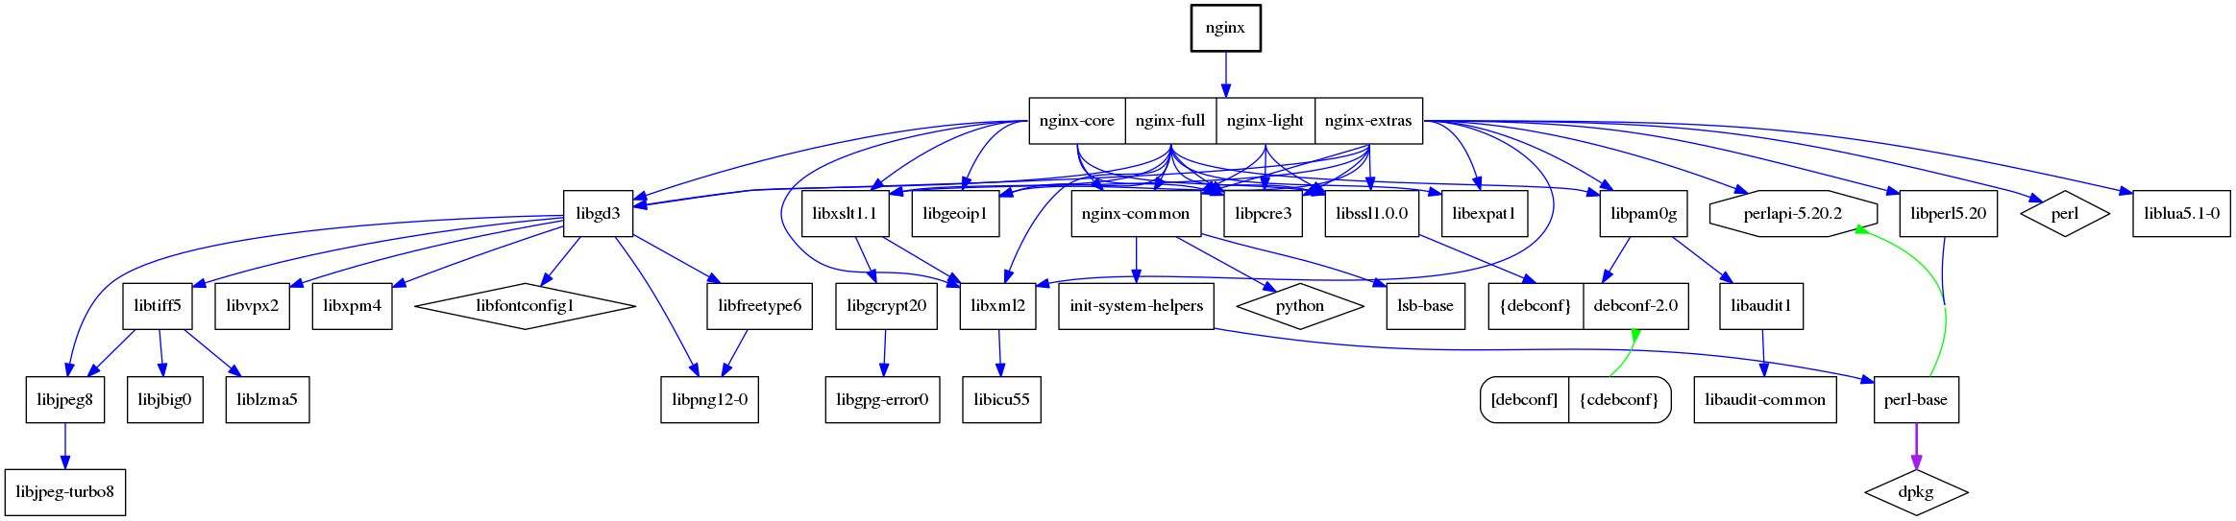
Building Common Core Components by submodule: Nginx Container Example
Library List for Nginx (80+ libs/tools)
  coreutils
  debconf
  debconf-2.0
  dpkg
  fontconfig-config
  fonts-dejavu-core
  fonts-freefont-ttf
  gcc-5-base
  gsfonts
  gsfonts-x11
  init-system-helpers
  install-info
  libattr1
  libaudit1
  libaudit-common
  libbz2-1.0
  libc6
  libdb5.3
  libexpat1
  libffi6
  libfontconfig1
  libfontenc1
  libfreetype6
  libgcc1
  libgcrypt20
  libgd3
  libgdbm3
  libgeoip1
  libgpg-error0
  libicu55
  libjbig0
  libjpeg8
  libjpeg-turbo8
  liblua5.1-0
  liblzma5
  libncursesw5
  libpam0g
  libpcre3
  libperl5.20
  libpng12-0
  libpython2.7-minimal
  libpython2.7-stdlib
  libpython-stdlib
  libreadline6
  libsqlite3-0
  libssl1.0.0
  libstdc++6
  libtiff5
  libtinfo5
  libvpx2
  libx11-6
  libx11-data
  libxau6
  libxcb1
  libxdmcp6
  libxfont1
  libxml2
  libxpm4
  libxslt1.1
  lsb-base
  mime-support
  nginx-common
  nginx-core
  nginx-extras
  nginx-full
  nginx-light
  perl
  perlapi-5.20.2
  perl-base
  perl-modules
  python
  python2.7
  python2.7-minimal
  readline-common
  ttf-bitstream-vera
  ucf
  x11-common
  xfonts-encodings
  xfonts-utils
  zlib1g

Slide 10
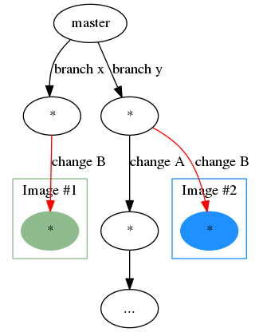
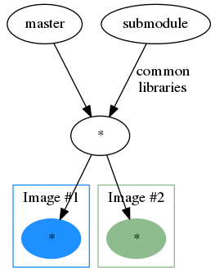
Building Common Core Components by submodule
Separated repository by submodule
  Contains common core components
    Libraries and tools to be shared
Approach
Two images with duplicates
Two images with sharing libraries in common

Slide 11
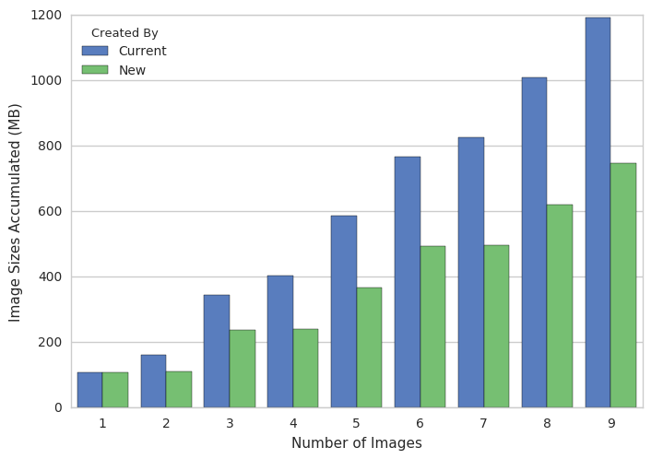
Building Common Core Components by submodule: Nginx Container Example
Current official Nginx images from Docker Hub
  Total: 1191MB over 9 version changes from 1.9 to 1.13
With 3C
  Total: 747.1MB (37.3% improvement)
Details about experiments
  Nginx package - 2.9MB
  Base image:
    jessie 8.7 - 123MB
    jessie 8.5 - 125MB
    stretch-slim - 57MB
  Average Nginx Docker images - 183MB
  All system package installations by apt - 59.1MB
Notes:
[[109, 'Current', '1'], [161.2, 'Current', '2'], [344.2, 'Current', '3'], [403.3, 'Current', '4'], [585.3, 'Current', '5'], [767.3, 'Current', '6'], [826.4, 'Current', '7'], [1008.5, 'Current', '8'], [1191.5, 'Current', '9'], [109, 'New', '1'], [111.9, 'New', '2'], [237.8, 'New', '3'], [240.6, 'New', '4'], [366.5, 'New', '5'], [492.4, 'New', '6'], [495.3, 'New', '7'], [621.2, 'New', '8'], [747.1, 'New', '9']]

Slide 12
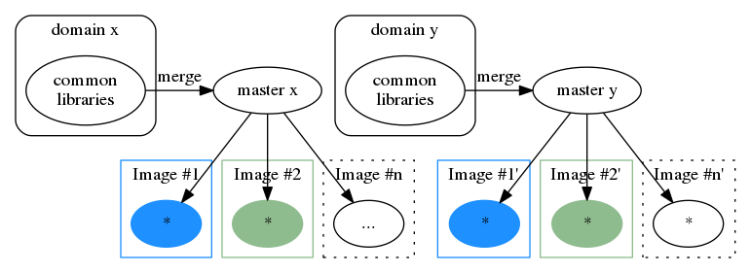
Building Common Core Components by merge
Assumption
  Applications in a similar type have libraries and tools in common.
Experiment Setup
  Classification is required to identify application types i.e. HPC-ABDS
  Survey data is used to recommend list of libraries and tools
    Keyword search is completed from Community sites i.e. github.com and Docker Hub (hub.docker.com)
HPC-ABDS Layers
Github API
Public Container Images
Hub
Notes:
Similar type of areas have lib/tools in common

Slide 13
Software Category from HPC-ABDS
Source: High Performance Computing Enhanced Apache Big Data Stack http://hpc-abds.org/kaleidoscope/

Slide 14
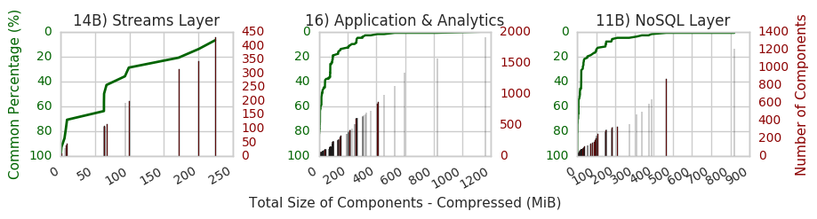
Building Common Core Components by merge
Experiment results
Three layers from HPC-ABDS
  14B) Streams Layer: 200+ dependencies out of 429 total packages are found in the half of container images
  16) Application & Analytics Layer and 11B) NoSQL Layer are similar, most dependencies are found in the half of images

Slide 15
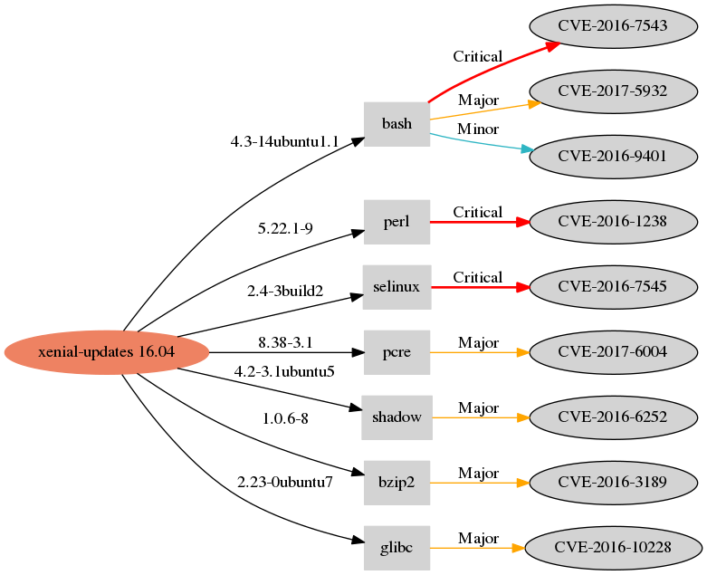
Addressing Security Concerns with Common Core Components
3C provides library metadata with versions i.e. perl 5.22.1-9
The metadata can be used to detect CVE security vulnerabilities of container images without image scanning.
  Review and update major packages which may contain vulnerabilities i.e. glibc, shadow, perl, apt, openssl, systemd, gcc
Example: System Packages with Vulnerabilities*
Example: Vulnerabilities for Ubuntu 16.04 Images
* Obtained from https://banyanops.com/blog/analyzing-docker-hub/

Slide 16
Current Work by Docker Community
    Minimizing container images using Intermediate temporal images
    Builder pattern (two images)
    Multi-image builds (2+ imports)
    Providing latest images
    Docker Automated build

Slide 17
Conclusion
Software Defined Systems uses DevOps tools and Containers to provide automated application deployments in various environments and different platforms
Docker with union mounts shares a base image layer between multiple containers but system libraries and tools are easily duplicated in the additional layer
Common Core Components (3C) with SVN subcommands i.e. submodule and merge aim to reduce the duplicates by providing an individual repository to share dependencies across multiple containers on a same host machine or on a distributed file system
Library metadata by 3C can be used to detect Common Vulnerabilities and Exposures (CVE) without image scanning process

Slide 18
Future Work
Using Container images on distributed file systems on HPC
  E.g. Lustre with burst buffer for top layer of images to accelerate performance of writing on the top layer while sharing read-only layers with multiple containers

Slide 19
Thank you!
Questions?

