Slide 1
Implications of Clouds for eScience and CReSIS
CReSIS
University of Kansas Lawrence
January 4 2011
Geoffrey Fox
gcf@indiana.edu
http://www.infomall.org http://www.futuregrid.org
Director, Digital Science Center, Pervasive Technology Institute
Associate Dean for Research and Graduate Studies, School of Informatics and Computing
Indiana University Bloomington

Slide 2
Talk Components
Important Trends
Clouds and Cloud Technologies
Applications
FutureGrid

Slide 3
Important Trends
Data Deluge in all fields of science
Multicore implies parallel computing important again
  Performance from extra cores – not extra clock speed
  GPU enhanced systems can give big power boost
Clouds – new commercially supported data center model replacing compute grids (and your general purpose computer center)
Light weight clients: Sensors, Smartphones and tablets accessing and supported by backend services in cloud
Commercial efforts moving much faster than academia in both innovation and deployment

Slide 4
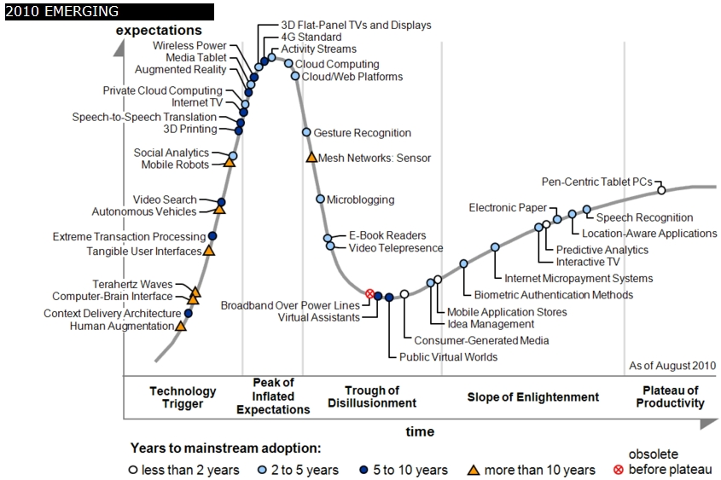
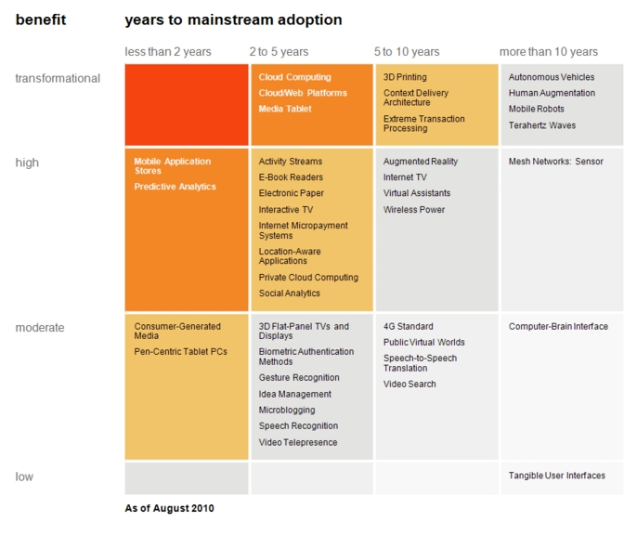

Transformational
High
Moderate
Low
Gartner 2009 Hype Curve
Clouds, Web2.0
Service Oriented Architectures
Cloud Computing
Cloud Web Platforms
Media Tablet

Slide 5



Data Centers Clouds &
Economies of Scale I
Range in size from “edge” facilities to megascale.
Economies of scale
  Approximate costs for a small size center (1K servers) and a larger, 50K server center.
2 Google warehouses of computers on the banks of the Columbia River, in The Dalles, Oregon
Such centers use 20MW-200MW
(Future) each with 150 watts per CPU
Save money from large size, positioning with cheap power and access with Internet
Technology | Cost in small-sized Data Center | Cost in Large Data Center | Ratio
Network | $95 per Mbps/ month | $13 per Mbps/ month | 7.1
Storage | $2.20 per GB/ month | $0.40 per GB/ month | 5.7
Administration | ~140 servers/ Administrator | >1000 Servers/ Administrator | 7.1
Each data center is
11.5 times
the size of a football field

Slide 6


Data Centers, Clouds
& Economies of Scale II
Builds giant data centers with 100,000’s of computers;
~ 200-1000 to a shipping container with Internet access
“Microsoft will cram between 150 and 220 shipping containers filled with data center gear into a new 500,000 square foot Chicago facility. This move marks the most significant, public use of the shipping container systems popularized by the likes of Sun Microsystems and Rackable Systems to date.”

Slide 7
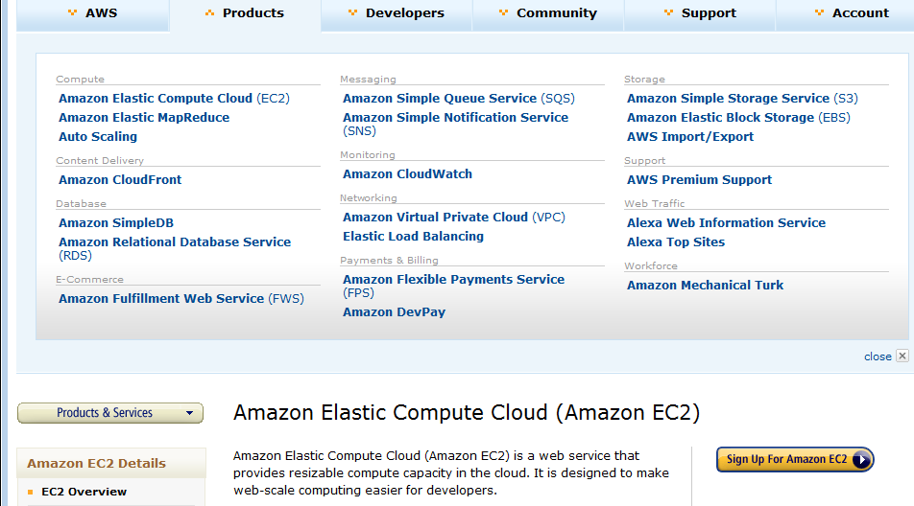
Amazon offers a lot!

Slide 8
















X as a Service
SaaS: Software as a Service imply software capabilities
(programs) have a service (messaging) interface
  Applying systematically reduces system complexity to being linear in number of components
  Access via messaging rather than by installing in /usr/bin
IaaS: Infrastructure as a Service or HaaS: Hardware as a Service – get your computer time with a credit card and with a Web interface
PaaS: Platform as a Service is IaaS plus core software capabilities on which you build SaaS
Cyberinfrastructure is “Research as a Service”
Other Services
Clients

Slide 9








Sensors as a Service
Cell phones are important sensor
Sensors as a Service
Sensor Processing as a Service (MapReduce)

Slide 10
C4 = Continuous Collaborative
Computational Cloud
C4 Education Vision
C4 Education will exploit advanced means of communication, for example, “Tabatars” conference tables , with real-time language translation, contextual awareness of speakers, in terms of the area of knowledge and level of expertise of participants to ensure correct semantic translation, and to ensure that people with disabilities can participate.
C4 EMERGING VISION
While the internet has changed the way we communicate and get entertainment, we need to empower the next generation of engineers and scientists with technology that enables interdisciplinary collaboration for lifelong learning.
Today, the cloud is a set of services that people intently have to access (from laptops, desktops, etc). In 2020 the C4 will be part of our lives, as a larger, pervasive, continuous experience. The measure of success will be how “invisible” it becomes.
C4 Society Vision
While we are no prophets and we can’t anticipate what exactly will work, we expect to have high bandwidth and ubiquitous connectivity for everyone everywhere, even in rural areas (using power-efficient micro data centers the size of shoe boxes)
Notes:
C4 Continuous Collaborative Computational Cloud

Slide 11
Higher Education 2020
Computational Thinking
Modeling
& Simulation
C⁴
Continuous
Collaborative
Computational
Cloud
Stewards of
C⁴ Intelligent Society
C⁴
I
N
T
E
C⁴ Intelligent Economy
C(DE)SE
L
L
C⁴ Intelligent People
Internet &
Cyberinfrastructure
I
G
E
Motivating
Issues
job / education mismatch
Higher Ed rigidity
Interdisciplinary work
Engineering v Science, Little v. Big science
N
C
E
NSF
Educate “Net Generation”
Re-educate pre “Net Generation”
in Science and Engineering
Exploiting and developing C⁴
C⁴ Stewards
C⁴ Curricula, programs
C⁴ Experiences (delivery mechanism)
C⁴ REUs, Internships, Fellowships

Slide 12
Philosophy of
Clouds and Grids
Clouds are (by definition) commercially supported approach to large scale computing
  So we should expect Clouds to replace Compute Grids
  Current Grid technology involves “non-commercial” software solutions which are hard to evolve/sustain
  Maybe Clouds ~4% IT expenditure 2008 growing to 14% in 2012 (IDC Estimate)
Public Clouds are broadly accessible resources like Amazon and Microsoft Azure – powerful but not easy to customize and perhaps data trust/privacy issues
Private Clouds run similar software and mechanisms but on “your own computers” (not clear if still elastic)
  Platform features such as Queues, Tables, Databases currently limited
Services still are correct architecture with either REST (Web 2.0) or Web Services
Clusters are still critical concept for MPI or Cloud software

Slide 13
Grids MPI and Clouds
Grids are useful for managing distributed systems
  Pioneered service model for Science
  Developed importance of Workflow
  Performance issues – communication latency – intrinsic to distributed systems
  Can never run large differential equation based simulations or datamining
Clouds can execute any job class that was good for Grids plus
  More attractive due to platform plus elastic on-demand model
  MapReduce easier to use than MPI for appropriate parallel jobs
  Currently have performance limitations due to poor affinity (locality) for compute-compute (MPI) and Compute-data
  These limitations are not “inevitable” and should gradually improve as in July 13 Amazon Cluster announcement
  Will probably never be best for most sophisticated parallel differential equation based simulations
Classic Supercomputers (MPI Engines) run communication demanding differential equation based simulations
  MapReduce and Clouds replaces MPI for other problems
  Much more data processed today by MapReduce than MPI (Industry Informational Retrieval ~50 Petabytes per day)

Slide 14
Cloud Computing:
Infrastructure and Runtimes
Cloud infrastructure: outsourcing of servers, computing, data, file space, utility computing, etc.
  Handled through Web services that control virtual machine lifecycles.
Cloud runtimes or Platform: tools (for using clouds) to do data-parallel (and other) computations.
  Apache Hadoop, Google MapReduce, Microsoft Dryad, Bigtable, Chubby and others
  MapReduce designed for information retrieval but is excellent for a wide range of science data analysis applications
  Can also do much traditional parallel computing for data-mining if extended to support iterative operations
  MapReduce not usually on Virtual Machines

Slide 15
MapReduce
Data Partitions
Map(Key, Value)
A hash function maps the results of the map tasks to reduce tasks
Reduce(Key, List<Value>)
Reduce Outputs
Implementations (Hadoop – Java; Dryad – Windows) support:
  Splitting of data
  Passing the output of map functions to reduce functions
  Sorting the inputs to the reduce function based on the intermediate keys
  Quality of service

Slide 16






MapReduce “File/Data Repository” Parallelism
Map = (data parallel) computation reading and writing data
Reduce = Collective/Consolidation phase e.g. forming multiple global sums as in histogram
Instruments
Iterative MapReduce
Map Map Map Map
Reduce Reduce Reduce
Communication
Reduce
Portals
/Users
Disks
Map₁
Map₂
Map₃

Slide 17

All-Pairs Using DryadLINQ
125 million distances
4 hours & 46 minutes
Calculate Pairwise Distances (Smith Waterman Gotoh)
Calculate pairwise distances for a collection of genes (used for clustering, MDS)
Fine grained tasks in MPI
Coarse grained tasks in DryadLINQ
Performed on 768 cores (Tempest Cluster)
Moretti, C., Bui, H., Hollingsworth, K., Rich, B., Flynn, P., & Thain, D. (2009). All-Pairs: An Abstraction for Data Intensive Computing on Campus Grids. IEEE Transactions on Parallel and Distributed Systems , 21, 21-36.

Slide 18
Hadoop VM Performance Degradation
Perf. Degradation = (T_{vm} – T_{baremetal})/T_{baremetal}
15.3% Degradation at largest data set size

Slide 19
Cap3 Performance with
Different EC2 Instance Types
Notes:
Instance Type CPU Cores Memory Local Disk Space Cost per hour
Small 1 1.7 GB 250 GB 0.12$
Medium 2 3.5 GB 500 GB 0.24$
Large 4 7 GB 1000 GB 0.48$
Extra Large 8 15 GB 2000 GB 0.96$

Slide 20
Cap3 Cost
Notes:
This is just the cost for the compute instances. In addition to this, there will be minor charges for the data storage for EMR & AzureMR. Also there will be additional minor charges for the queue service and table service for AzureMR.
Cost presented here are amortized for the actual time (time/3600 * num_instances * instance_price_per_hour), assuming the remaining time of the instance hour have been put to useful work.
Note: EMR & Hadoop-EC2 requires one extra node to act as the master node (included in the cost calculation)

Slide 21
SWG Cost
Notes:
This is just the cost for the compute instances. In addition to this, there will be minor charges for the data storage for EMR & AzureMR. Also there will be additional minor charges for the queue service and table service for AzureMR.
Cost presented here are amortized for the actual time (time/3600 * num_instances * instance_price_per_hour), assuming the remaining time of the instance hour have been put to useful work.
Note: EMR & Hadoop-EC2 requires one extra node to act as the master node (included in the cost calculation)

Slide 22
Smith Waterman:
Daily Effect

Slide 23
Hadoop and Matlab
Data Processing: The main application is developed in Matlab, and the data is processed in the following procedure:
Simplify the flight lines using Douglas-Peucker algorithm.
Export the simplified flight lines as Google KML.
Generate radar images.
Combine KML and radar images to the self-contained Google KMZ file.
Generate the overall simplified flight lines and radar images for the on-going visualization project.

Slide 24
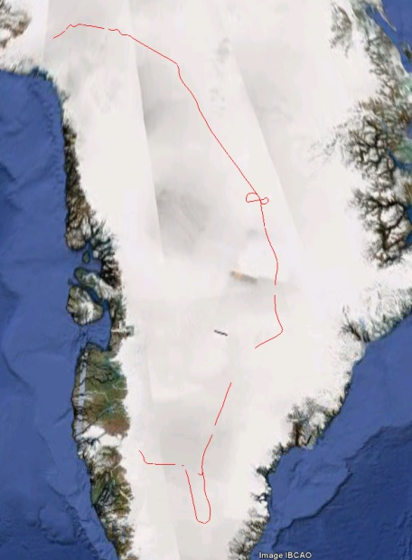
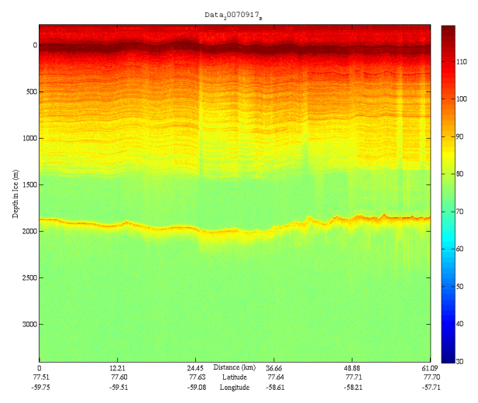
Hadoop and Matlab
Sample Output of 2009-9-17 Flight Line

Slide 25
Hadoop and Matlab
 |  | 1 Flight Line |  |  | 2 Flight Lines |  |  | 3 Flight Lines
 |  | P | S | E | P | S | E | P | S | E
Computing nodes | 3 | 1221 | 100.0% | 1.00 | 2357 | 100.0% | 1.00 | 3431 | 100.0% | 1.00
 | 6 | 644 | 189.6% | 0.95 | 1233 | 191.2% | 0.96 | 1837 | 186.8% | 0.93
 | 9 | 469 | 260.3% | 0.87 | 874 | 269.7% | 0.90 | 1260 | 272.3% | 0.91
 | 12 | 364 | 335.4% | 0.84 | 702 | 335.8% | 0.84 | 1041 | 329.6% | 0.82
 | 15 | 303 | 403.0% | 0.81 | 590 | 399.5% | 0.80 | 847 | 405.1% | 0.81
Hadoop Test Results. P=Processing time (s). S=T(3 nodes)/T (x nodes) relative speedup. E=Efficiency per node, S(nodes)*3/nodes

Slide 26
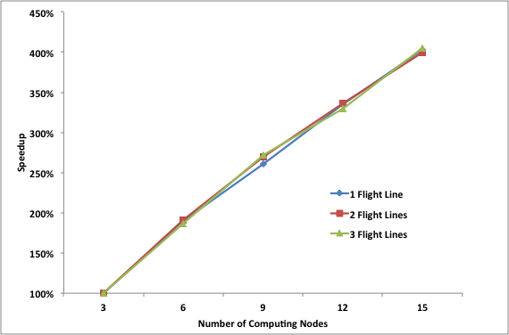
Matlab and Hadoop
Speed up versus number of nodes

Slide 27
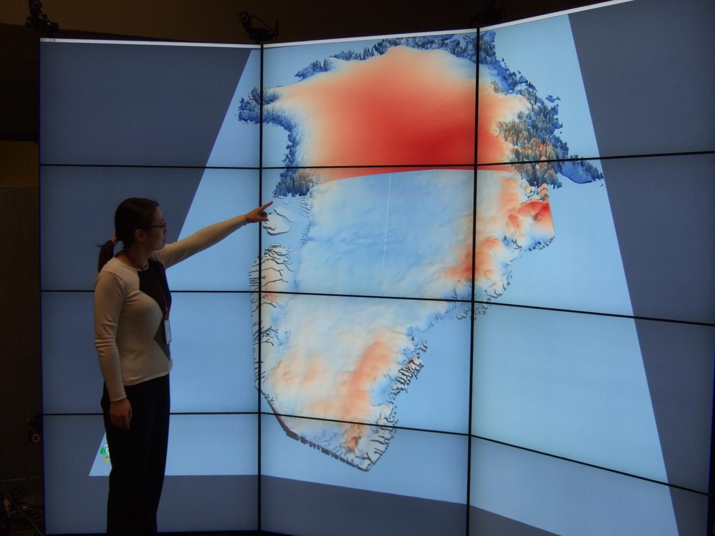
Visualization of Cloud Data
Cross-section View of 2 Surfaces
https://www.cresis.ku.edu/data/greenland

Slide 28
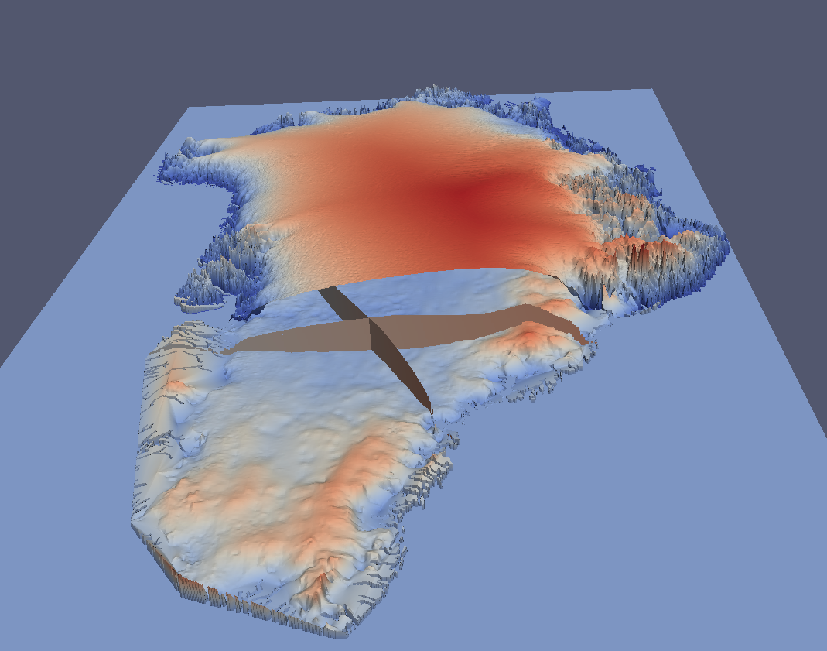
Volume Data: Extract Cross Sections

Slide 29
US Cyberinfrastructure Context
There are a rich set of facilities
  Production TeraGrid facilities with distributed and shared memory
  Experimental “Track 2D” Awards
    FutureGrid: Distributed Systems experiments cf. Grid5000
    Keeneland: Powerful GPU Cluster
    Gordon: Large (distributed) Shared memory system with SSD aimed at data analysis/visualization
  Open Science Grid aimed at High Throughput computing and strong campus bridging

Slide 30
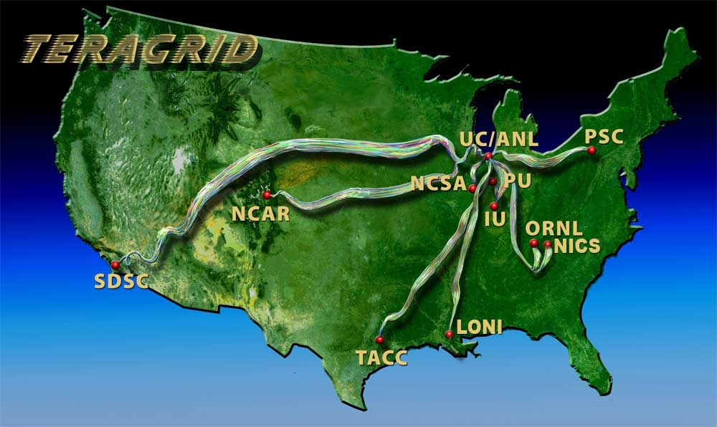
TeraGrid
~2 Petaflops; over 20 PetaBytes of storage (disk and tape), over 100 scientific data collections
UW
Grid Infrastructure Group (UChicago)
UC/ANL
PSC
NCAR
PU
NCSA
Caltech
IU
UNC/RENCI
ORNL
USC/ISI
NICS
SDSC
LONI
TACC
Resource Provider (RP)
Software Integration Partner
Network Hub

Slide 31
FutureGrid key Concepts I
FutureGrid is an international testbed modeled on Grid5000
Supporting international Computer Science and Computational Science research in cloud, grid and parallel computing
  Industry and Academia
  Prototype software development and Education/Training
  Mainly computer science, bioinformatics, education
The FutureGrid testbed provides to its users:
  A flexible development and testing platform for middleware and application users looking at interoperability, functionality and performance, exploring new computing paradigms
  Each use of FutureGrid is an experiment that is reproducible
  A rich education and teaching platform for advanced cyberinfrastructure classes
  Support for users experimentation

Slide 32

FutureGrid key Concepts II
Rather than loading images onto VM’s, FutureGrid supports Cloud, Grid and Parallel computing environments by dynamically provisioning software as needed onto “bare-metal” using Moab/xCAT
  Image library for all the different environments you might like to explore …..
Growth comes from users depositing novel images in library
FutureGrid has ~4000 (will grow to ~5000) distributed cores with a dedicated network and a Spirent XGEM network fault and delay generator
Apply now to use FutureGrid on web site www.futuregrid.org
Image1
Image2
…
ImageN
Choose
Load
Run

Slide 33
FutureGrid and clouds for CReSIS?
Clouds could be used by CReSIS in
  Research
  Education
FutureGrid can be vehicle for
  Supporting CS Research
  Experimenting with cloud approaches for CReSIS data analysis
We could set up a customized ongoing support activity on FutureGrid for CReSIS
We could offer a hands-on tutorial or summer school
  See Jerome Mitchell proposal
ADMI could use FutureGrid well

Slide 34
FutureGrid Partners
Indiana University (Architecture, core software, Support)
  Collaboration between research and infrastructure groups
Purdue University (HTC Hardware)
San Diego Supercomputer Center at University of California San Diego (INCA, Monitoring)
University of Chicago/Argonne National Labs (Nimbus)
University of Florida (ViNE, Education and Outreach)
University of Southern California Information Sciences (Pegasus to manage experiments)
University of Tennessee Knoxville (Benchmarking)
University of Texas at Austin/Texas Advanced Computing Center (Portal)
University of Virginia (OGF, Advisory Board and allocation)
Center for Information Services and GWT-TUD from Technische Universtität Dresden. (VAMPIR)
Red institutions have FutureGrid hardware

Slide 35
Compute Hardware
System type | # CPUs | # Cores | TFLOPS | Total RAM (GB) | Secondary Storage (TB) | Site | Status
IBM iDataPlex | 256 | 1024 | 11 | 3072 | 339* | IU | Operational
Dell PowerEdge | 192 | 768 | 8 | 1152 | 30 | TACC | Operational
IBM iDataPlex | 168 | 672 | 7 | 2016 | 120 | UC | Operational
IBM iDataPlex | 168 | 672 | 7 | 2688 | 96 | SDSC | Operational
Cray XT5m | 168 | 672 | 6 | 1344 | 339* | IU | Operational
IBM iDataPlex | 64 | 256 | 2 | 768 | On Order | UF | Operational
Large disk/memory system TBD | 128 | 512 | 5 | 7680 | 768 on nodes | IU | New System TBD
High Throughput Cluster | 192 | 384 | 4 | 192 |  | PU | Not yet integrated
Total | 1336 | 4960 | 50 | 18912 | 1353

Slide 36
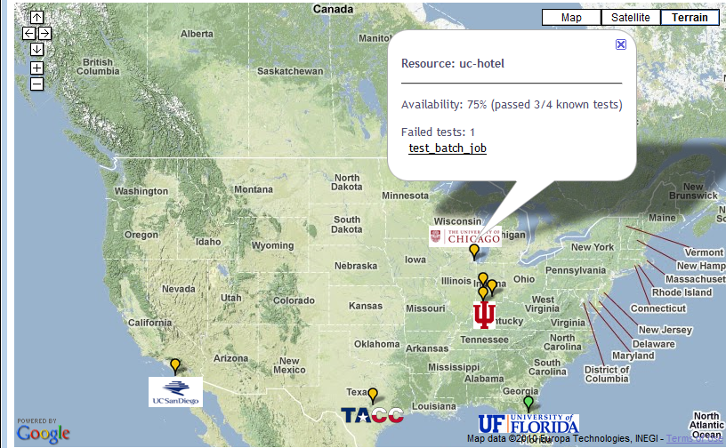

FutureGrid: a Grid/Cloud/HPC Testbed
NID: Network Impairment Device
Private
Public
FG Network

Slide 37

Typical Performance Study
Linux, Linux on VM, Windows, Azure, Amazon Bioinformatics

Slide 38
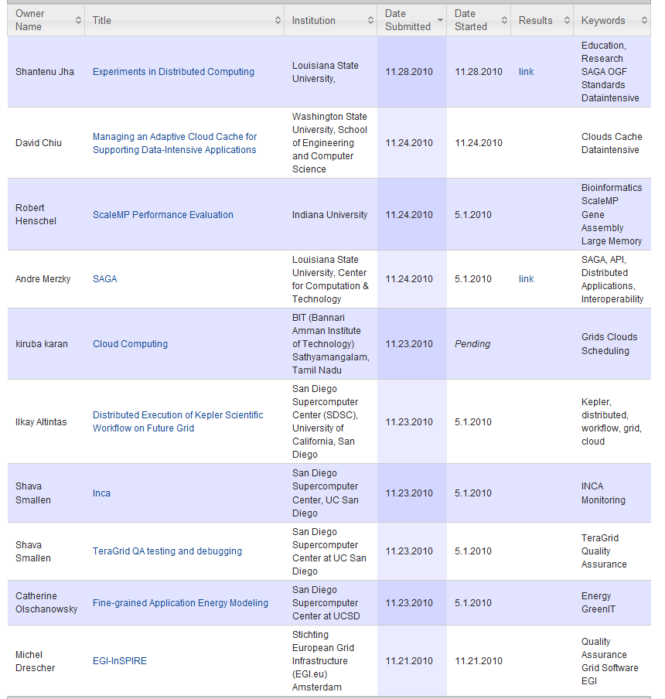
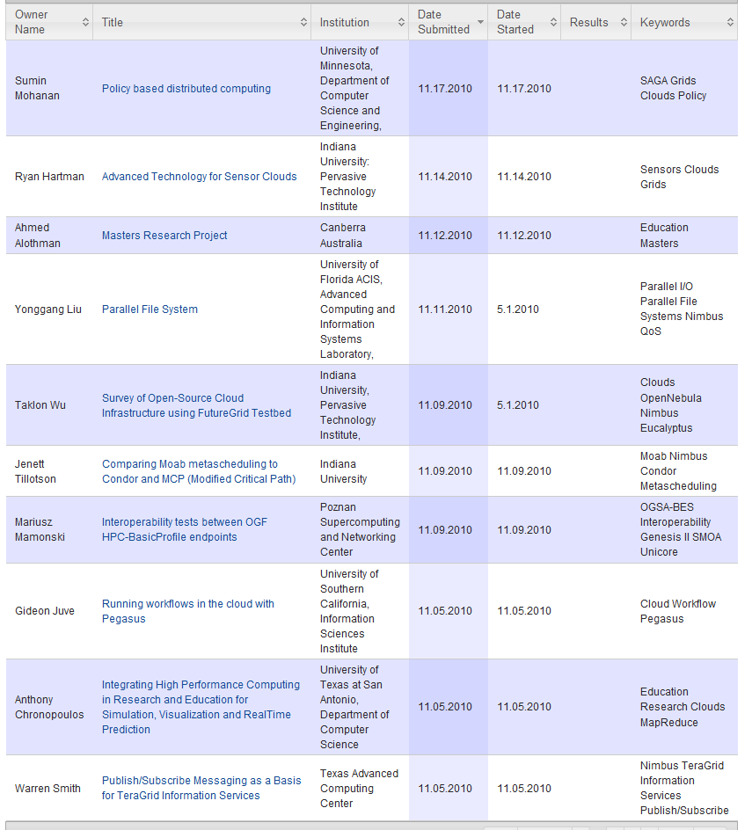
Some Current FutureGrid projects

Slide 39

OGF’10 Demo
SDSC
Rennes
Grid’5000 firewall
UF
Lille
UC
Sophia
ViNe provided the necessary inter-cloud connectivity to deploy CloudBLAST across 5 Nimbus sites, with a mix of public and private subnets.

Slide 40


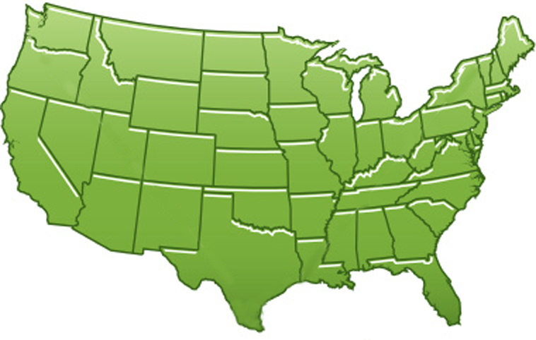















300+ Students learning about Twister & Hadoop
MapReduce technologies, supported by FutureGrid.
July 26-30, 2010 NCSA Summer School Workshop
http://salsahpc.indiana.edu/tutorial
Washington
University
University of
Minnesota
Michigan
State
Johns
Hopkins
Univ.Illinois
at Chicago
Penn
State
IBM Almaden
Research Center
Iowa
Notre
Dame
University of
California at
Los Angeles
Indiana
University
San Diego
Supercomputer
Center
University of
Texas at El Paso
University of
Arkansas
University
of Florida

Slide 41
User Support
Being upgraded now as we get into major use
Regular support: there is a group forming FET or “FutureGrid Expert Team” – initially 13 PhD students and researchers from Indiana University
  User requests project at http://www.futuregrid.org/early-adopter-account-project-registration
  Each user assigned a member of FET when project approved
  Users given accounts when project approved
  FET member and user interact to get going on FutureGrid
  Could have identified CReSIS or ADMI support people
Advanced User Support: limited special support available on request
  Cummins engine simulation supported in this way

