Slide 1
Times they are a-changin'
Clouds and Multicore challenge Computer Science
Computer Science Undergraduate Honors Program
January 12 2009
Geoffrey Fox
Computer Science, Informatics, Physics
Chair Informatics Department
Director Community Grids Laboratory and Digital Science Center
Indiana University Bloomington IN 47404
gcf@indiana.edu
http://www.infomall.org

Slide 2
Abstract
New opportunities (applications) coming from the data deluge (stemming from the web, instruments, sensors, satellites ..) match to new technologies coming from oldish(IBM, Intel, Microsoft) and newish (Amazon, Google) companies.
What does this mean for research and education in computer science?
Is academia still relevant as this innovation is industry driven?
What does it mean for students -- are higher degrees still relevant?
How do we juggle fads and fundamental skills?
How fast should CS undergraduate education change?
How should research change when funding cycles are longer than pace of technology change?
What is research and what is development?
What is all this chatter about interdisciplinary work?

Slide 3
e-moreorlessanything
‘e-Science is about global collaboration in key areas of science, and the next generation of infrastructure that will enable it.’ from inventor of term John Taylor Director General of Research Councils UK, Office of Science and Technology
e-Science is about developing tools and technologies that allow scientists to do ‘faster, better or different’ research
Similarly e-Business captures the emerging view of corporations as dynamic virtual organizations linking employees, customers and stakeholders across the world.
This generalizes to e-moreorlessanything including e-DigitalLibrary, e-PolarScience, e-HavingFun and e-Education
A deluge of data of unprecedented and inevitable size must be managed and understood.
People (virtual organizations), computers, data (including sensors and instruments) must be linked via hardware and software networks
3
Notes:
3

Slide 4
What is Cyberinfrastructure
Cyberinfrastructure is (from NSF) infrastructure that supports distributed research and learning (e-Science, e-Research, e-Education)
  Links data, people, computers
Exploits Internet technology (Web2.0 and Clouds) adding (via Grid technology) management, security, supercomputers etc.
It has two aspects: parallel – low latency (microseconds) between nodes and distributed – highish latency (milliseconds) between nodes
Parallel needed to get high performance on individual large simulations, data analysis etc.; must decompose problem
Distributed aspect integrates already distinct components – especially natural for data (as in biology databases etc.)
4
Notes:
4

Slide 5
Applications, Infrastructure, Technologies
This field is confused by inconsistent use of terminology; I define
Web Services, Grids and (aspects of) Web 2.0 (Clouds) are technologies
Grids represent any sort of managed distributed system
Clouds (Web 2.0) are rapidly becoming preferred commercial Grid and best for anything except high end scientific simulations
These technologies combine and compete to build electronic infrastructures termed e-infrastructure or Cyberinfrastructure
Cyberinfrastructure is high speed network plus enabling software and computers
e-moreorlessanything is an emerging application area of broad importance that is hosted on the infrastructures e-infrastructure or Cyberinfrastructure
e-Science or perhaps better e-Research is a special case of e-moreorlessanything

Slide 6
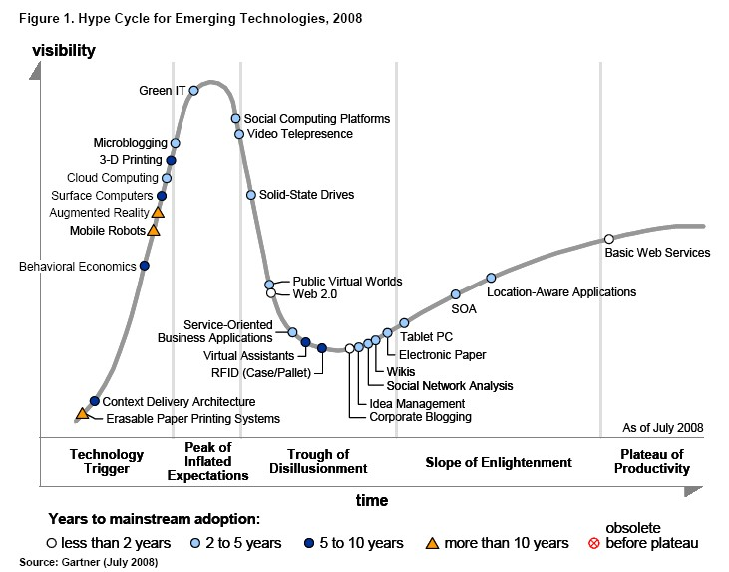
Gartner 2008 Technology Hype Curve
Clouds, Microblogs and Green IT appear
Basic Web Services, Wikis and SOA
becoming mainstream

Slide 7
Relevance of Web 2.0
Web 2.0 can help e-Science in many ways
Its tools (web sites) can enhance scientific collaboration, i.e. effectively support virtual organizations, in different ways from grids
The popularity of Web 2.0 can provide high quality technologies and software that (due to large commercial investment) can be very useful in e-Science and preferable to complex Grid or Web Service solutions
The usability and participatory nature of Web 2.0 can bring science and its informatics to a broader audience
Cyberinfrastructure is research analogue of major commercial initiatives e.g. to important job opportunities for students!
Web 2.0 is major commercial use of computers and “Google/Amazon” farms spurred cloud computing
  Same computer answering your Google query can do bioinformatics
  Can be accessed from a web page with a credit card i.e. as a Service

Slide 8



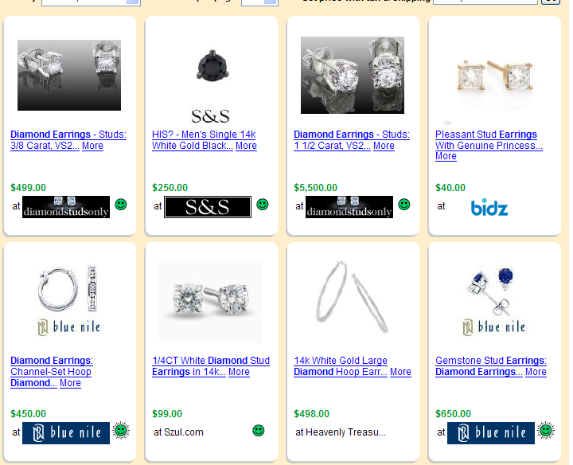
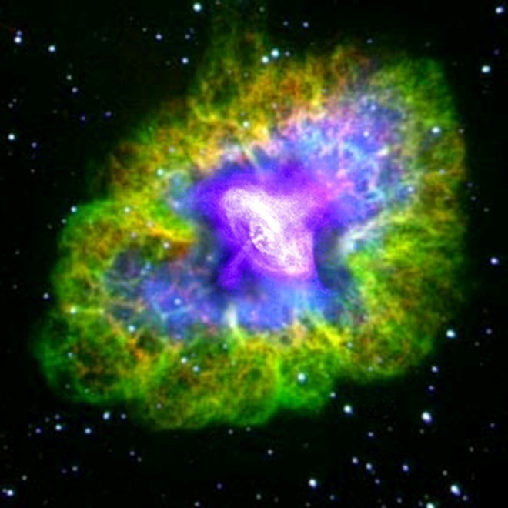

Virtual Observatory Astronomy Grid
Integrate Experiments
Radio
Far-Infrared
Visible
Comparison Shopping is Internet analogy to Integrated Astronomy using similar technology
Dust Map
Visible + X-ray
Galaxy Density Map

Slide 9
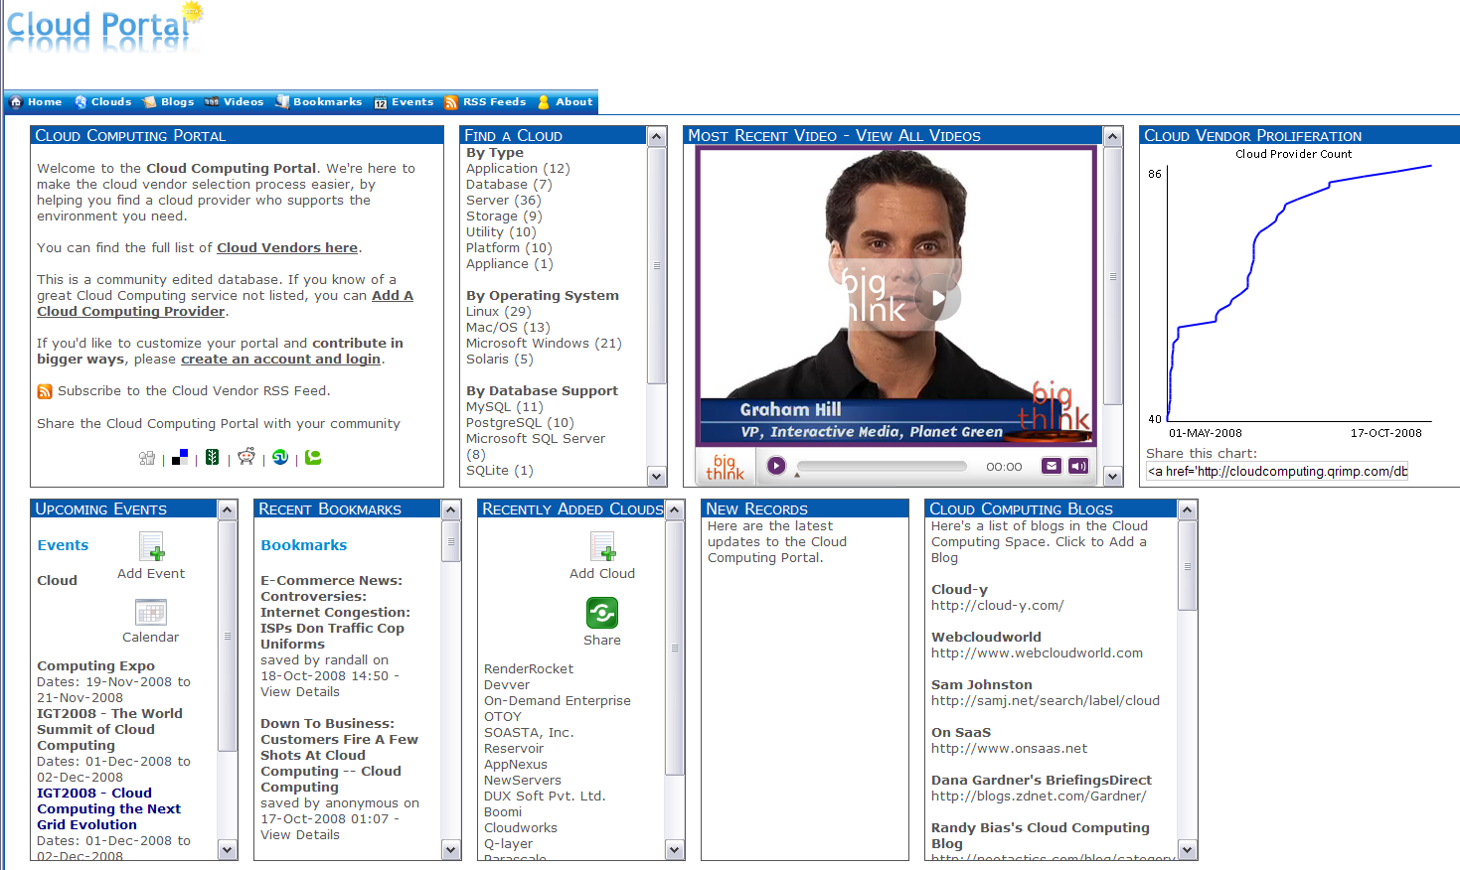
Cloud Computing Resources from Amazon, IBM, Google, Microsoft ……
Computing as a Service from a web page with a credit card

Slide 10
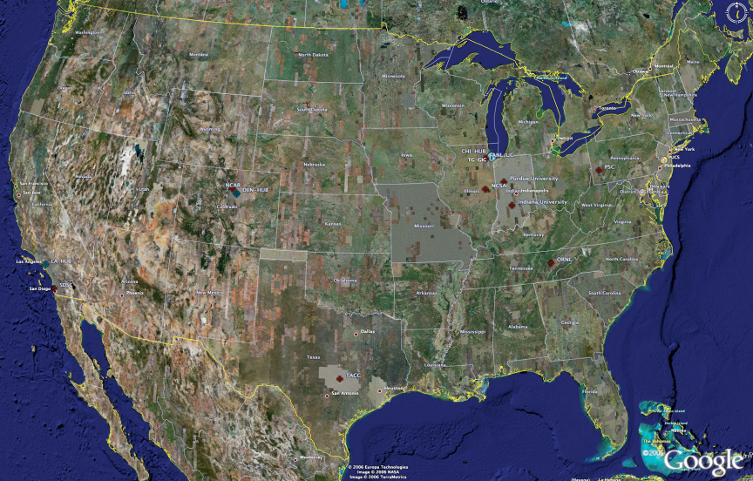
TeraGrid High Performance Computing Systems 2007-8
UC/ANL
PSC
PU
NCAR
NCSA
IU
2008
(~1PF)
ORNL
Tennessee
SDSC
(504TF)
LONI/LSU
TACC
Computational Resources
(size approximate - not to scale)
Slide Courtesy Tommy Minyard, TACC

Slide 11
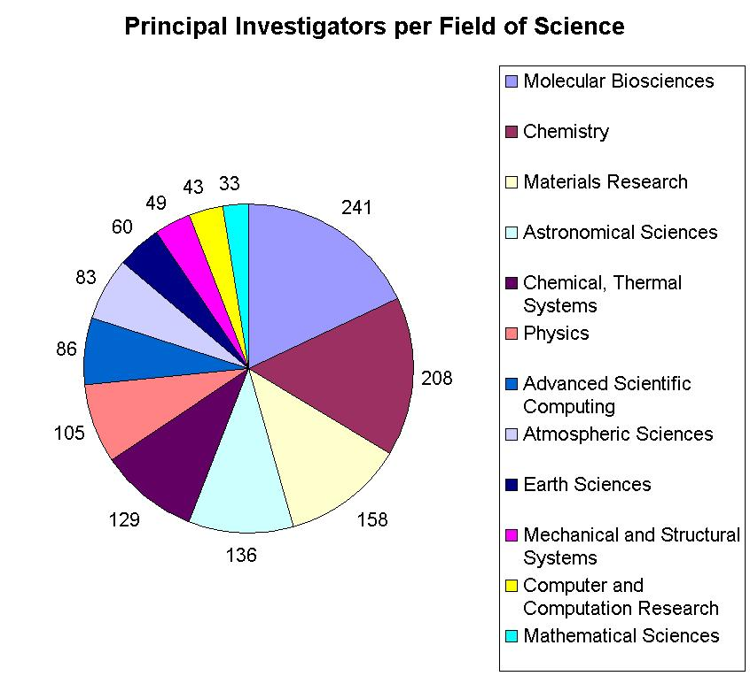

Resources for many disciplines!
> 40,000 processors in aggregate
Resource availability will grow during 2008 at unprecedented rates

Slide 12

Large Hadron Collider CERN, Geneva: 2008 Start
pp √s =14 TeV L=10³⁴ cm⁻² s⁻¹
27 km Tunnel in Switzerland & France
CMS
TOTEM
pp, general
purpose; HI
5000+ Physicists
250+ Institutes
60+ Countries
Atlas
ALICE : HI
LHCb: B-physics
Higgs, SUSY, Extra Dimensions, CP Violation, QG Plasma, … the Unexpected
Challenges: Analyze petabytes of complex data cooperatively
Harness global computing, data & network resources

Slide 13
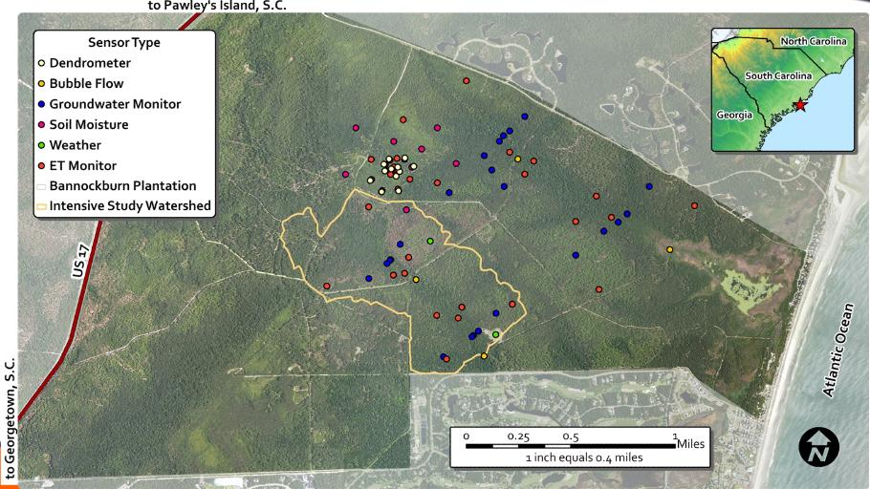
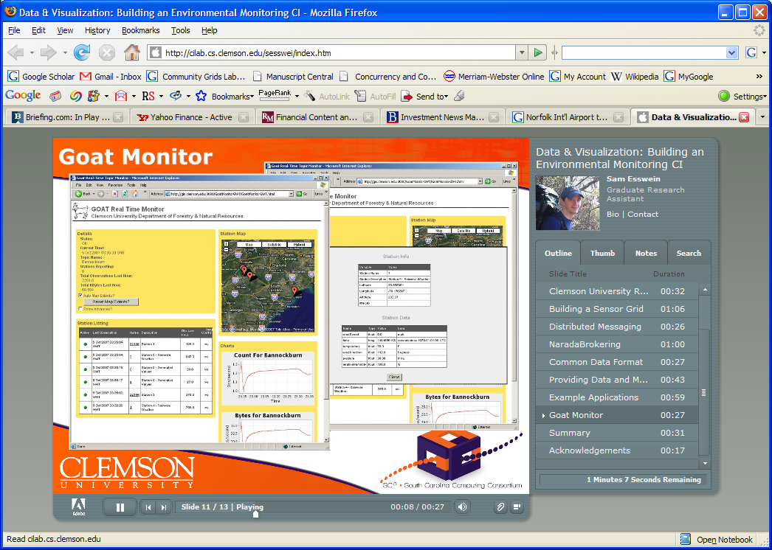
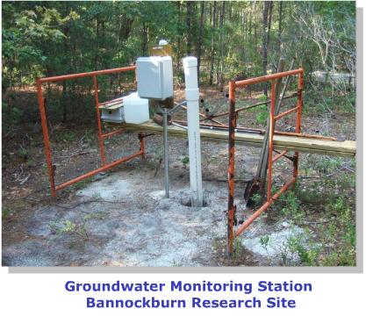
Environmental Monitoring Cyberinfrastructure at Clemson

Slide 14
Sensor Grids Can be Fun
Note sensors are any time dependent source of information and a fixed source of information is just a broken sensor
  SAR Satellites
  Environmental Monitors
  Nokia N800 pocket computers
  RFID tags and readers
  GPS Sensors
  Lego Robots
  RSS Feeds
  Audio/video: web-cams
  Presentation of teacher in distance education
  Text chats of students
  Cell phones

Slide 15

The Sensors on the Fun Grid
Laptop for PowerPoint
2 Robots used
Lego Robot GPS Nokia N800 RFID Tag RFID Reader

Slide 17
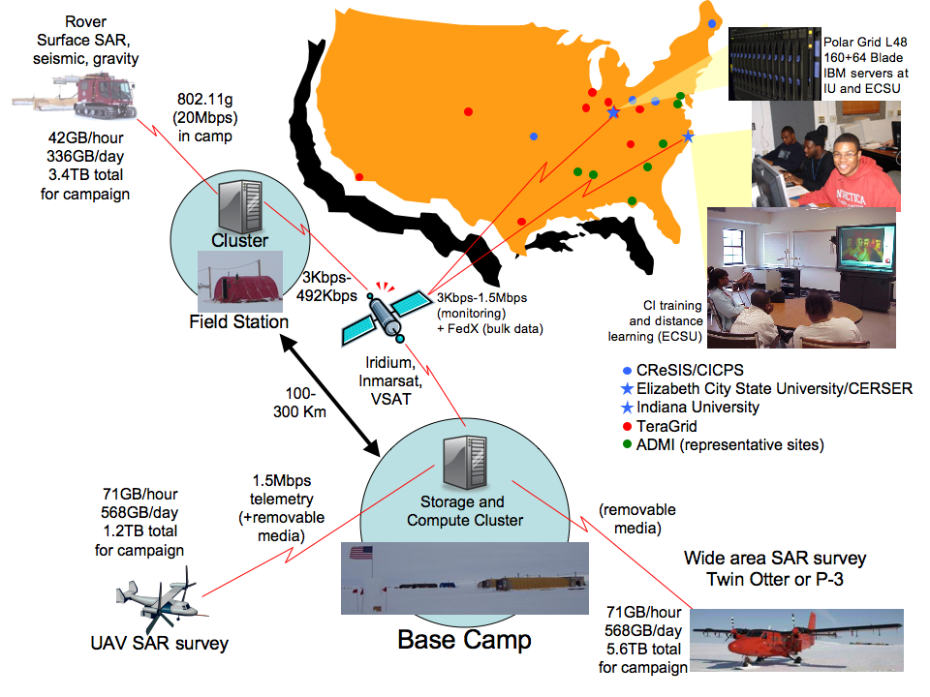

Slide 18
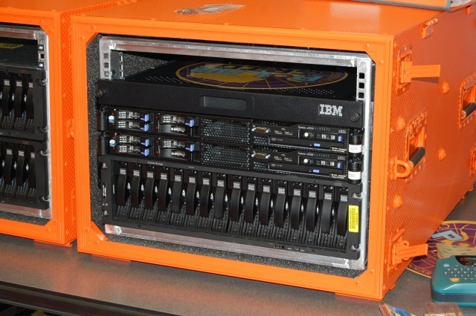
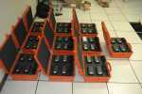
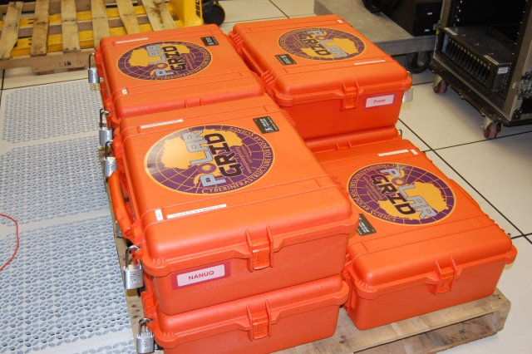
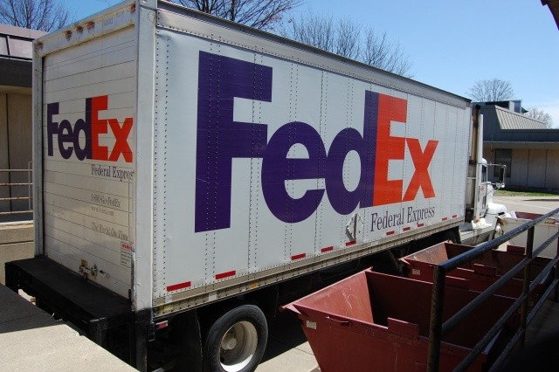
Polar Grid goes to Greenland

Slide 19
The People in Cyberinfrastructure
Web 2.0 can enhance scientific collaboration, i.e. effectively support virtual organizations, in different ways from grids
I expect more resources like MyExperiment from UK, SciVee from SDSC and Connotea from Nature that offer Flickr, YouTube, Facebook, Second Life type capabilities optimized for science
The usability and participatory nature of Web 2.0 can bring science and its informatics to a broader audience
In particular distance collaborative aspects of such Cyberinfrastructure can level playing field; you do not have to be at Harvard etc. to succeed
  e.g. ECSU in CReSIS NSF Science and Technology Center
  Navajo Tech can access TeraGrid Science Gateways

Slide 20
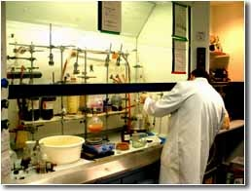
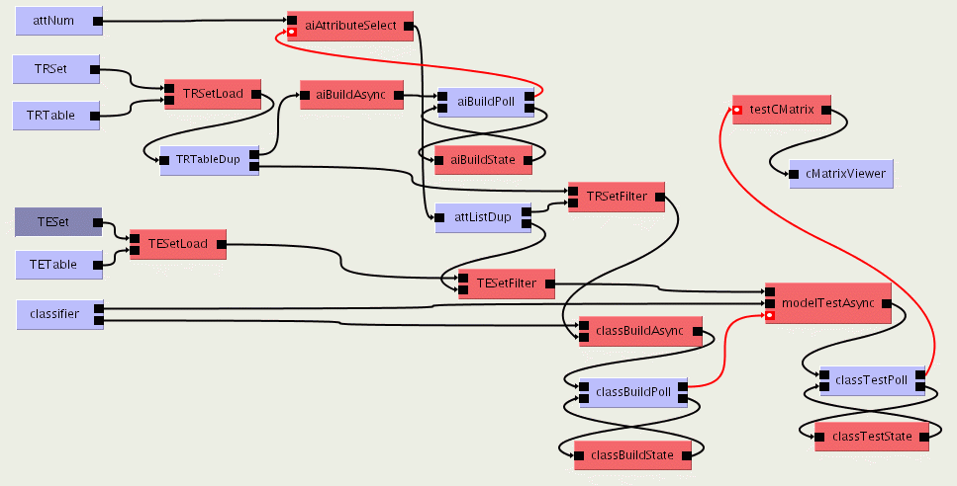

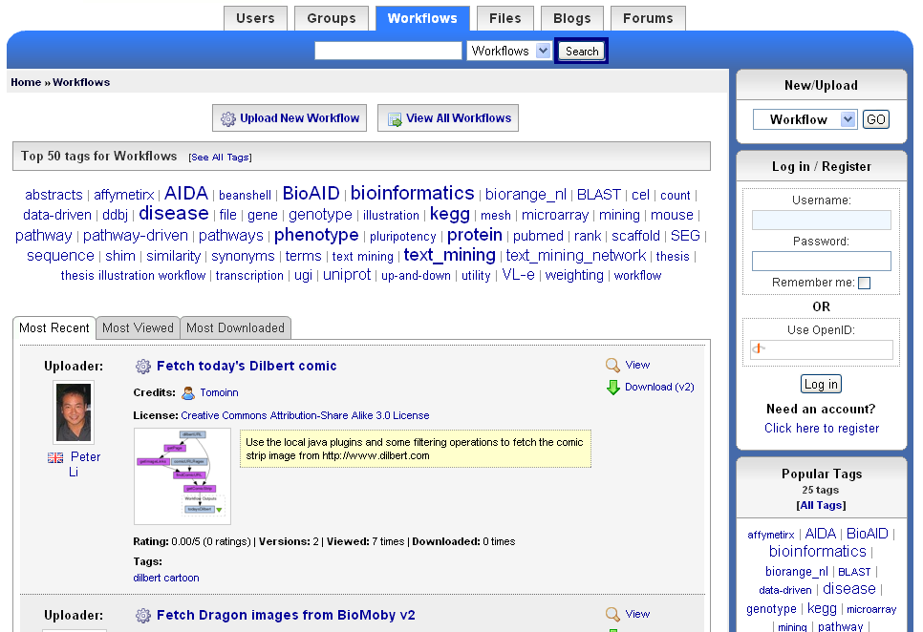
The social process of science 2.0
Virtual Learning Environment
Role of Libraries
and Publishers?
Undergraduate Students
Digital Libraries
scientists
Graduate Students
Reprints
Peer-Reviewed Journal & Conference Papers
experimentation
Technical Reports
Preprints & Metadata
Local
Web
Repositories
Certified Experimental Results & Analyses
Data, Metadata Provenance Workflows
Ontologies

Slide 21
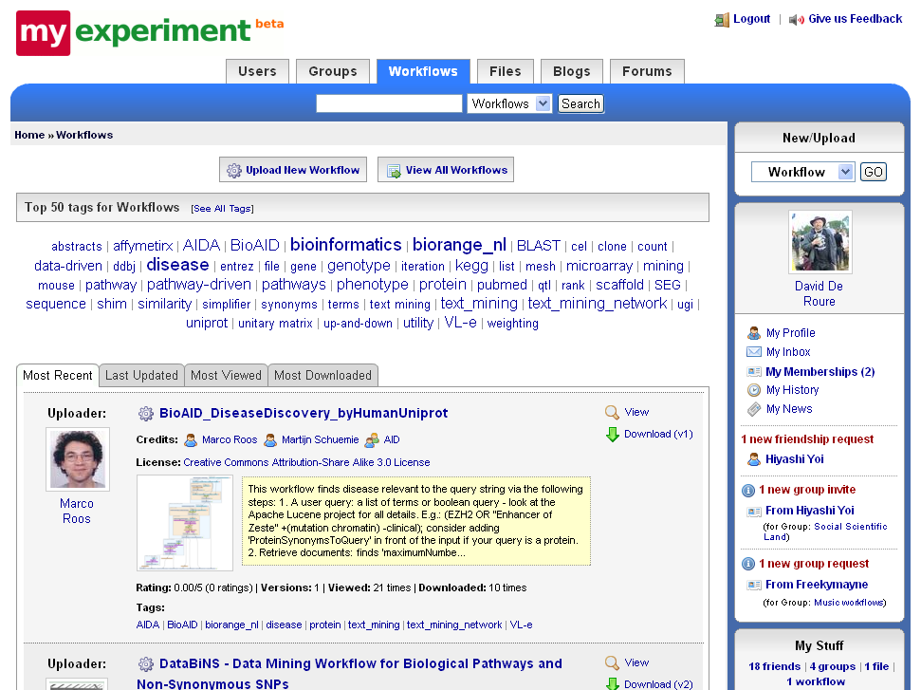

Slide 22
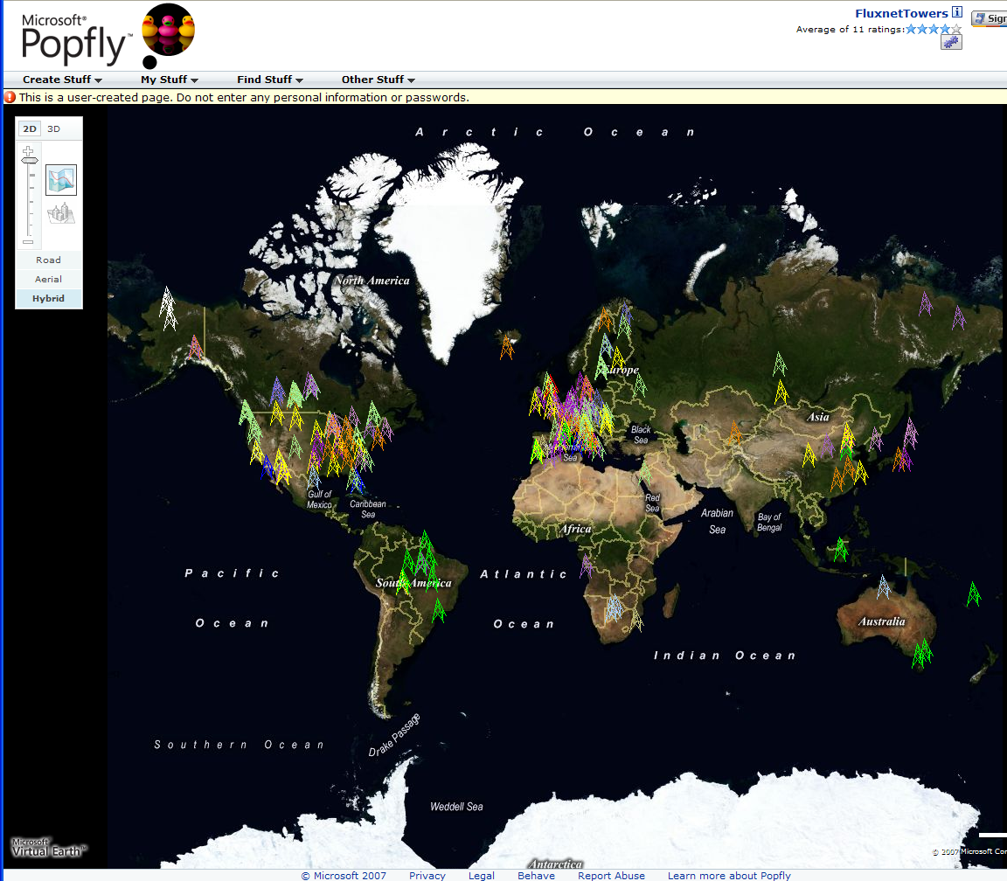
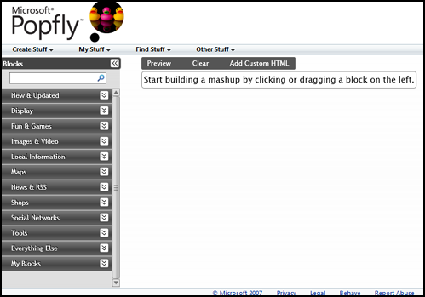
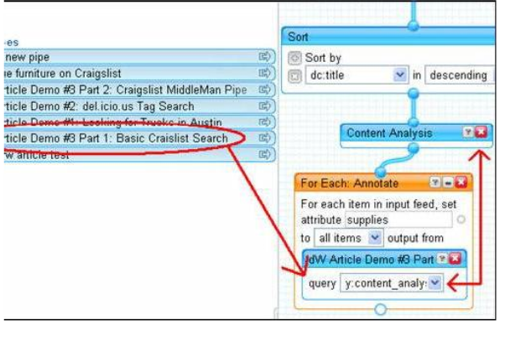
Major Companies entering mashup area
Web 2.0 Mashups (same as workflow in Grids) are likely to drive composition (programming) tools for Grids, Clouds and web
Recently we see Mashup tools like Yahoo Pipes and Microsoft Popfly which have familiar graphical interfaces
Currently only simple examples but tools could become powerful
Yahoo Pipes

Slide 23
Map Reduce
“MapReduce is a programming model and an associated implementation for processing and generating large data sets. Users specify a map function that processes a key/value pair to generate a set of intermediate key/value pairs, and a reduce function that merges all intermediate values associated with the same intermediate key.”
MapReduce: Simplified Data Processing on Large Clusters
Jeffrey Dean and Sanjay Ghemawat
map(key, value)
Applicable to most loosely coupled data parallel applications
The data is split into m parts and the map function is performed on each part of the data concurrently
Each map function produces r number of results
A hash function maps these r results to one ore more reduce functions
The reduce function collects all the results that maps to it and processes them
A combine function may be necessary to combine all the outputs of the reduce functions together
reduce(key, list<value>)
E.g. Word Count
map(String key, String value):
// key: document name
// value: document contents
reduce(String key, Iterator values):
// key: a word
// values: a list of counts

Slide 24
How does MapReduce work?
The framework supports the splitting of data
Outputs of the map functions are passed to the reduce functions
The framework sorts the inputs to a particular reduce function based on the intermediate keys before passing them to the reduce function
An additional step may be necessary to combine all the results of the reduce functions
D1
map
reduce
O1
D2
map
Data
reduce
O2
reduce
Or
Dm
map
data split
map
reduce
Technology from Information Retrieval but applicable to other fields

Slide 25
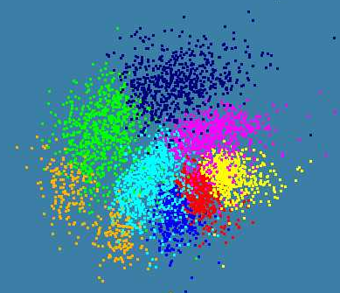
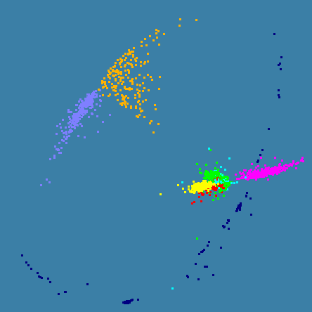
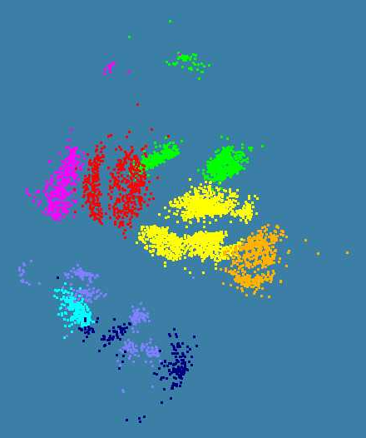
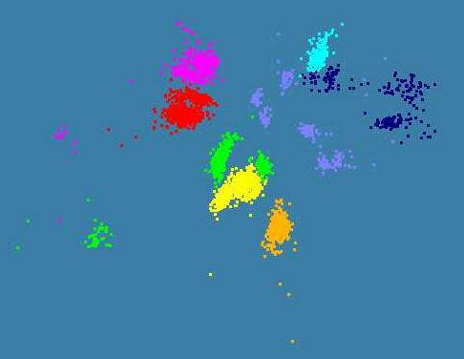
Various Sequence Clustering Results
4500 Points : Pairwise Aligned
3000 Points : Clustal MSA
Kimura2 Distance
4500 Points : Clustal MSA
Map distances to 4D Sphere before MDS

Slide 26
Data Intensive Science?
Science is advanced by observation i.e. analyzing datra from
      Gene Sequencers
      Accelerators
      Telescopes
      Environmental Sensors
      Web Crawlers
This data is “filtered”, “analyzed” (term used in science), “data-mined” (term used in Computer Science) to produce conclusions
The analysis is guided by hypotheses
One can also make models to test hypotheses
These models can be constrained by data from observations – termed data assimilation
  Weather forecasting and Climate prediction are of this type
  Biology, Earthquake prediction have more data analysis/mining

Slide 27
Example of Datamining using models to validate approach

Slide 28
Too much Computing?
Historically both grids and parallel computing have tried to increase computing capabilities by
  Optimizing performance of codes at cost of re-usability
  Exploiting all possible CPU’s such as Graphics co-processors and “idle cycles” (across administrative domains)
  Linking central computers together such as NSF/DoE/DoD supercomputer networks without clear user requirements
Next Crisis in technology area will be the opposite problem – commodity chips will be 32-128way parallel in 5 years time and we currently have no idea how to use them on commodity systems – especially on clients
  Only 2 releases of standard software (e.g. Office) in this time span so need solutions that can be implemented in next 3-5 years
Intel RMS analysis: Gaming and Generalized decision support (data mining) are ways of using these cycles

Slide 29
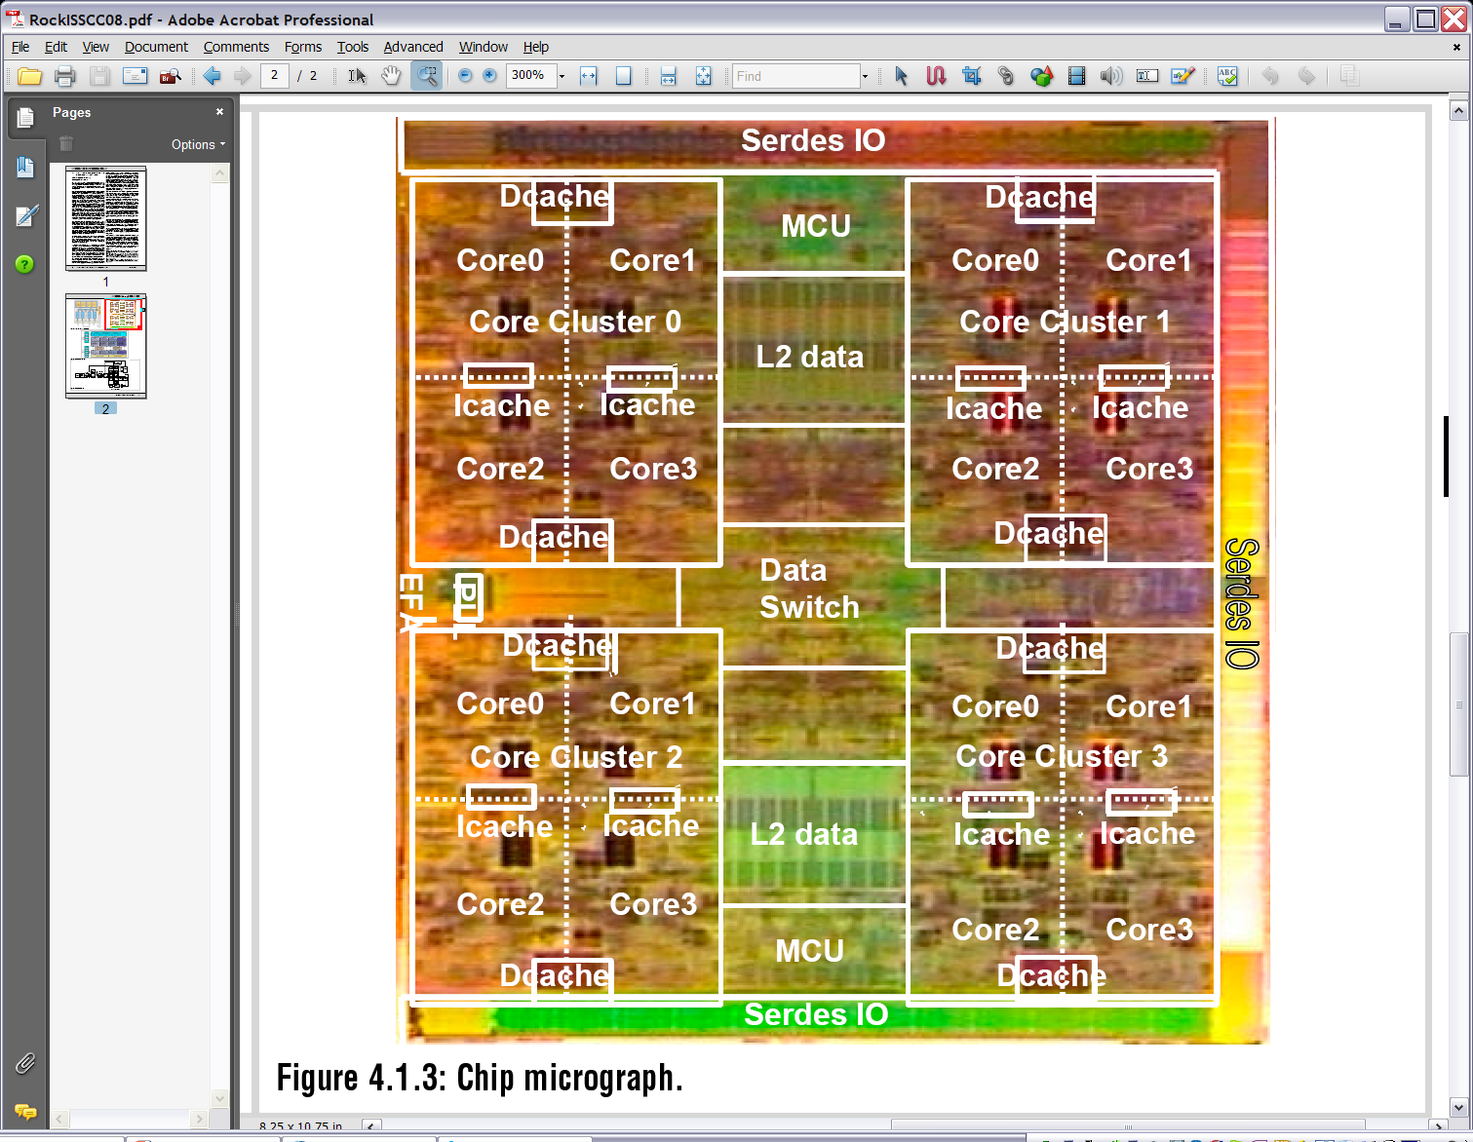
Sun Niagara2

Slide 30
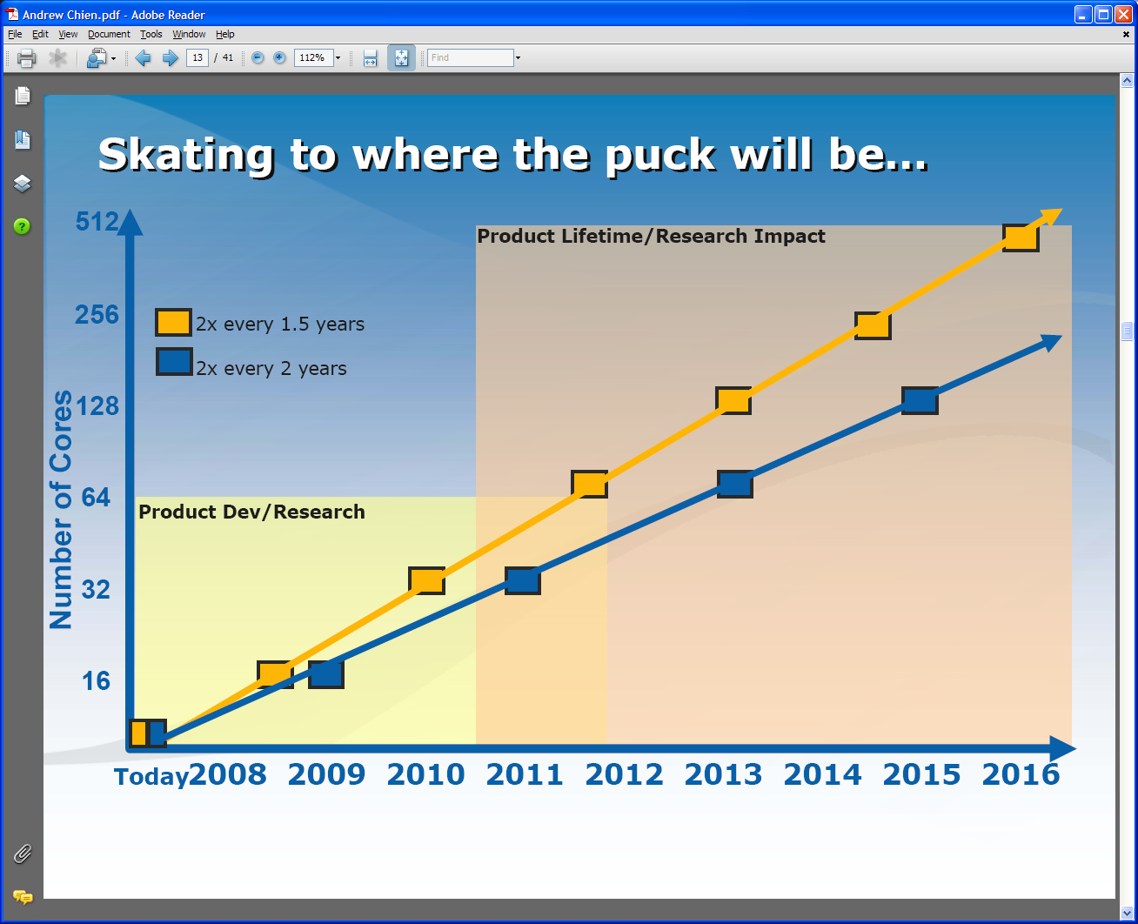
Intel’s Projection
Technology might support:
2010: 16—64 cores 200GF—1 TF
2013: 64—256 cores 500GF– 4 TF
2016: 256--1024 cores 2 TF– 20 TF

Slide 31
Intel’s Application Stack

Slide 32
Too much Data to the Rescue?
Multicore servers have clear “universal parallelism” as many users can access and use machines simultaneously
Maybe also need application parallelism (e.g. datamining) as needed on client machines
Over next years, we will be submerged of course in data deluge
  Scientific observations for e-Science
  Local (video, environmental) sensors
  Data fetched from Internet defining users interests
Maybe data-mining of this “too much data” will use up the “too much computing” both for science and commodity PC’s
  PC will use this data(-mining) to be intelligent user assistant?
  Must have highly parallel algorithms

Slide 33
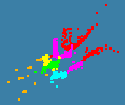
CCR Performance: 8-24 core servers
Parallel
Overhead
≈ 1-efficiency
= (PT(P)/T(1)-1)
On P processors
= (1/efficiency)-1
Parallel
Overhead
≈ 1-efficiency
= (PT(P)/T(1)-1)
On P processors
= (1/efficiency)-1
1 2 4 8 16 24 cores
Dell Intel 6 core chip with 4 sockets : PowerEdge R900,
4x E7450 Xeon Six Cores, 2.4GHz, 12M Cache 1066Mhz FSB
Intel core about 25% faster than Barcelona AMD core
1 2 4 8 16 cores
Curiously performance per core is
(on 2 core Patient2000)
Dell 4 core Laptop 21 minutes
Then Dell 24 core Server 27 minutes
Then my current 2 core Laptop 28 minutes
Finally Dell AMD based 34 minutes
Patient Record Clustering by pairwise O(N²) Deterministic Annealing
“Real” (not scaled) speedup of 14.8 on 16 cores on 4000 points
4-core Laptop
Precision M6400, Intel Core 2 Dual Extreme Edition QX9300 2.53GHz, 1067MHZ, 12M L2
Use Battery 1 Core Speed up 0.78
2 Cores Speed up 2.15
3 Cores Speed up 3.12
4 Cores Speed up 4.08

Slide 34
Parallel Deterministic Annealing Clustering
Scaled Speedup Tests on eight 16-core Systems
(10 Clusters; 160,000 points per cluster per thread)
Parallel Overhead
128-way
64-way
16-way
32-way
48-way
4-way
8-way
2-way
(1,1,1)
(1,1,2)
(1,2,1)
(2,1,1)
(1,2,2)
(1,4,1)
(2,1,2)
(2,2,1)
(4,1,1)
(1,4,2)
(1,8,1)
(2,2,2)
(2,4,1)
(4,1,2)
(4,2,1)
(8,1,1)
(1,8,2)
(2,4,2)
(2,8,1)
(4,2,2)
(4,4,1)
(8,1,2)
(8,2,1)
(1,8,1)
(2,8,2)
(4,4,2)
(8,2,2)
(1,8,6)
(2,4,6)
(1,8,8)
(4,2,8)
(8,1,8)
(2,8,8)
(4,4,8)
(CCR thread,
MPI process,
node)
(1,16,1)
(1,16,4)
(8,2,8)
(16,1,1)
(1,16,2)
(16,1,2)
(1,16,3)
(1,16,8)
(16,1,8)
Parallel Patterns

Slide 35
Implications for research and education in computer science
In old times such as parallel computing and Web 1.0 the initial innovation and research came from academia
  Grids came from academia but failed – partly because of this
“Products” always tended to come from industry
Now innovation is being driven by industry
Industry is ahead of work done in PhD research programs
Industry has more resources
Need to chose academic work carefully
Need to consider more carefully PhD v great industry job

Slide 36
Relevance of academia as recent innovation is industry driven
Academia certainly produces initial students
Most CS faculty are out of touch with current developments
  How many faculty at IU are familiar with web 2.0 technologies and paradigms?
CS safely can tackle problem of “computing for science” as industry will only indirectly address

Slide 37
Implications for students and Relevance of higher degrees
Already discussed key issues
Undergraduate and Master degrees are OK as long as Masters program has a good curriculum
  Unclear how often this is true
Only do PhD if choose a “robust topic” that will survive industry developments and with a savvy faculty member

Slide 38
What are fads and what are fundamental skills
A very interesting topic
  Algorithms – say for hashing or sorting – are fundamental but little new innovation
  Web 2.0 is at forefront of innovation but maybe this forefront will change
When people talk about “Clouds are a Fad” are they correctly identifying ephemeral technology or are they hiding their unwillingness or inability to keep up
Note Computer Science is different Physics
Mother Nature defined what is important in physics during big bang
Computer Science is defined by what Intel can make and how people want to use computers

Slide 39
Process/Speed of change in CS undergraduate education
Graduate education will keep up with change as courses/research somewhat defined by research of faculty
  So a research active faculty will naturally keep PhD and probably masters near the leading edge
Undergraduate education is different as at universities like IU it would be strongly linked to research
On other hand it is also part of education that is most clearly valuable in an Industry innovation driven world
Lot of attention nationally to “rebooting computer science” – most obvious trend is a greater application orientation but not clear this is sufficient

Slide 40
Implications for Research of funding process and technology change
Technology is changing on time period of an order a year but academia has longer time periods
  5 years to get a PhD
  1 year proposal submittal to start time
Students thesis topics can be outdated before finishing
Infrastructure such as TeraGrid uncompetitive with industry already moving to clouds
One could focus on “fundamental questions” but are they really exciting?

Slide 41
Contrasting Research and Development
Research investigates “fundamental issues” while development “builds interesting things” according to fundamental principles established by research
Most PhD topics (with me) are 90% development and 10% research
Need to build a system before you can investigate it and building is always most time consuming
Students often confuse building system with the research
Faculty do not agree about what is an important fundamental issue – are there any?
CS “Systems” PhD’s often run into trouble with theoretical faculty

Slide 42
Interdisciplinary Research
There is much talk about growing importance of interdisciplinary work and in fact this is a trend over last 20 years!
In computer science this means that there is a growing interest in working between computer science and applications and reflects broader use of computing and lowering of opportunities in “pure fundamental issues”
Getting promoted/tenured hard if you interdisciplinary as no peers
  Often easy to get appointed as you are useful

