Slide 1
Cyberinfrastructure and Its Application
California State University Dominguez Hills
Cyberinfrastructure Day
June 25 2011
Geoffrey Fox
gcf@indiana.edu
http://www.infomall.org http://www.futuregrid.org
Director, Digital Science Center, Pervasive Technology Institute
Associate Dean for Research and Graduate Studies, School of Informatics and Computing
Indiana University Bloomington
Notes:
SALSA is
Service Aggregated Linked Sequential Activities

Slide 2
Important Trends
Data Deluge in all fields of science
Multicore implies parallel computing important again
Performance from extra cores – not extra clock speed
GPU enhanced systems can give big power boost
Clouds – new commercially supported data center model replacing compute grids (and your general purpose computer center)
Light weight clients: Sensors, Smartphones and tablets accessing and supported by backend services in cloud
Commercial efforts moving much faster than academia in both innovation and deployment

Slide 3
Big Data in Many Domains
According to one estimate, we created 150 exabytes (billion gigabytes) of data in 2005. This year, we will create 1,200 exabytes
PC’s have ~100 Gigabytes disk and 4 Gigabytes of memory
Size of the web ~ 3 billion web pages: MapReduce at Google was on average processing 20PB per day in January 2008
During 2009, American drone aircraft flying over Iraq and Afghanistan sent back around 24 years’ worth of video footage
http://www.economist.com/node/15579717
New models being deployed this year will produce ten times as many data streams as their predecessors, and those in 2011 will produce 30 times as many
~108 million sequence records in GenBank in 2009, doubling in every 18 months
~20 million purchases at Wal-Mart a day
90 million Tweets a day
Astronomy, Particle Physics, Medical Records …
Most scientific task shows CPU:IO ratio of 10000:1 – Dr. Jim Gray
The Fourth Paradigm: Data-Intensive Scientific Discovery
Large Hadron Collider at CERN; 100 Petabytes to find Higgs Boson
Notes:
For each category, give examples, e.g. Astronomy solon 20 TB night,
http://www.datacenterknowledge.com/archives/2009/12/22/the-data-crunching-powerhouse-behind-avatar/

Slide 6
What is Cyberinfrastructure
Cyberinfrastructure is (from NSF) infrastructure that supports distributed research and learning (e-Science, e-Research, e-Education)
Links data, people, computers
Exploits Internet technology (Web2.0 and Clouds) adding (via Grid technology) management, security, supercomputers etc.
It has two aspects: parallel – low latency (microseconds) between nodes and distributed – highish latency (milliseconds) between nodes
Parallel needed to get high performance on individual large simulations, data analysis etc.; must decompose problem
Distributed aspect integrates already distinct components – especially natural for data (as in biology databases etc.)
6
Notes:
6

Slide 7
e-moreorlessanything
‘e-Science is about global collaboration in key areas of science, and the next generation of infrastructure that will enable it.’ from inventor of term John Taylor Director General of Research Councils UK, Office of Science and Technology
e-Science is about developing tools and technologies that allow scientists to do ‘faster, better or different’ research
Similarly e-Business captures the emerging view of corporations as dynamic virtual organizations linking employees, customers and stakeholders across the world.
This generalizes to e-moreorlessanything including e-DigitalLibrary, e-FineArts, e-HavingFun and e-Education
A deluge of data of unprecedented and inevitable size must be managed and understood.
People (virtual organizations), computers, data (including sensors and instruments) must be linked via hardware and software networks
7
Notes:
7

Slide 8
The Span of Cyberinfrastructure
High definition videoconferencing linking people across the globe
Digital Library of music, curriculum, scientific papers
Flickr, Youtube, Amazon ….
Simulating a new battery design (exascale problem)
Sharing data from world’s telescopes
Using cloud to analyze your personal genome
Enabling all to be equal partners in creating knowledge and converting it to wisdom
Analyzing Tweets…documents to discover which stocks will crash; how disease is spreading; linguistic inference; ranking of institutions

Slide 9
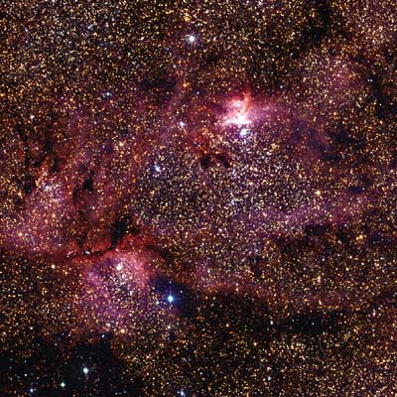
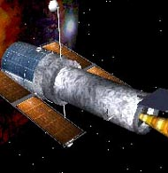
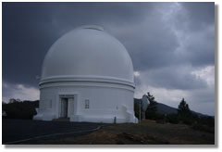
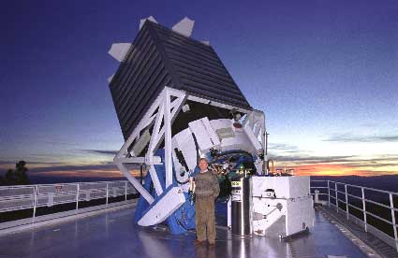
Tracking the Heavens
“The Universe is now being explored systematically, in a panchromatic way, over a range of spatial and temporal scales that lead to a more complete, and less biased understanding of its constituents, their evolution, their origins, and the physical processes governing them.”
Towards a National Virtual Observatory
Hubble Telescope
Palomar Telescope
Sloan Telescope

Slide 10
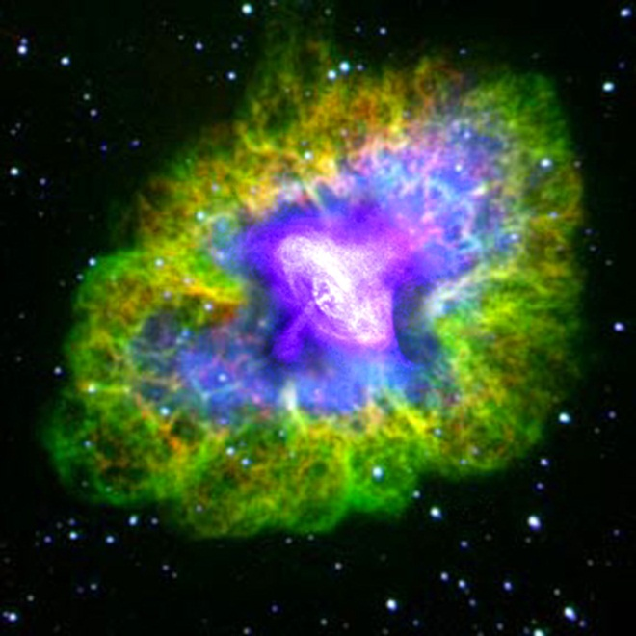
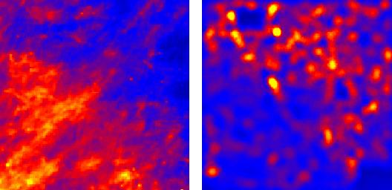
Virtual Observatory Astronomy Grid Integrate Experiments
Radio
Far-Infrared
Visible
Dust Map
Visible + X-ray
Galaxy Density Map

Slide 11
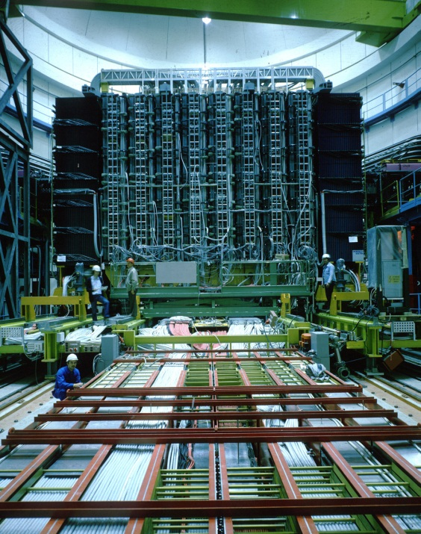
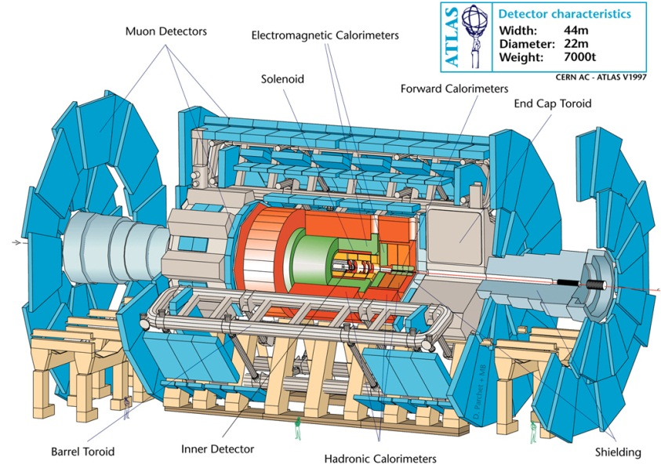
Particle Physics at the CERN LHC
ATLAS at LHC, 2006-2020
150*10⁶ sensors
UA1 at CERN 1981-1989
"hermetic detector"
LHC experimental collaborations (e.g. ATLAS) typically involve over 100 institutes and over 1000 physicists world wide

Slide 12
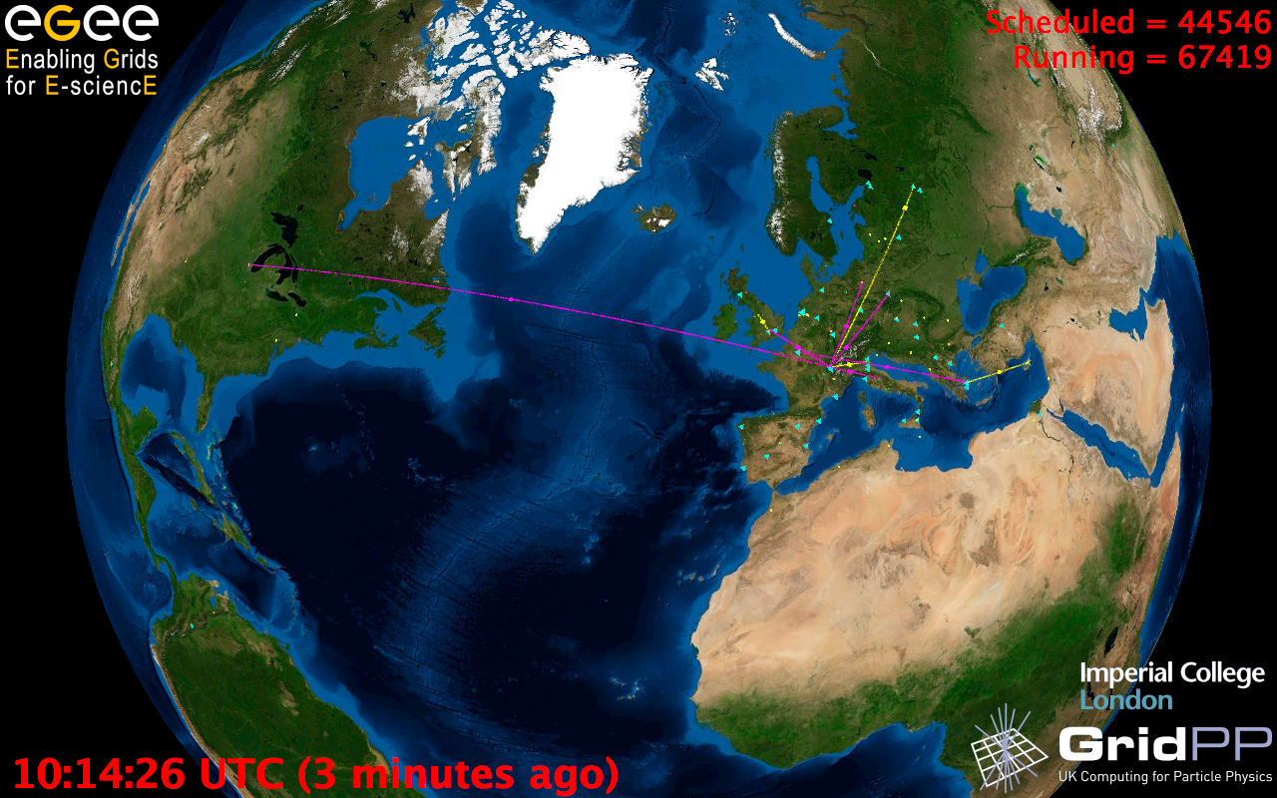
European Grid Infrastructure
Status April 2010 (yearly increase)
10000 users: +5%
243020 LCPUs (cores): +75%
40PB disk: +60%
61PB tape: +56%
15 million jobs/month: +10%
317 sites: +18%
52 countries: +8%
175 VOs: +8%
29 active VOs: +32%

Slide 13
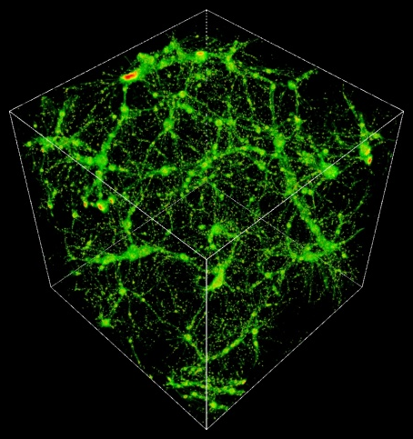
TeraGrid Example: Astrophysics
Science: MHD and star formation; cosmology at galactic scales (6-1500 Mpc) with various components: star formation, radiation diffusion, dark matter
Application: Enzo (loosely similar to: GASOLINE, etc.)
Science Users: Norman, Kritsuk (UCSD), Cen, Ostriker, Wise (Princeton), Abel (Stanford), Burns (Colorado), Bryan (Columbia), O’Shea (Michigan State), Kentucky, Germany, UK, Denmark, etc.
Notes:
The StarGate demo at SC09 combined steps 5 and 6, using 10 Gbps ESnet connection and 10 Gbps Dynamic Circuit Network (DCN) – 150 TB was moved from NICS to ANL for rendering on GPU cluster, results were streamed to OptiPortal at SC – our network tradeoffs include similar options.
The full simulation takes 3 months real time at NICS, moving data to ANL takes 3 nights – moving the data is practical, if it can be made simple and reliable.
http://www.lbl.gov/cs/Archive/news112009.html

Slide 14
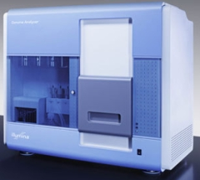
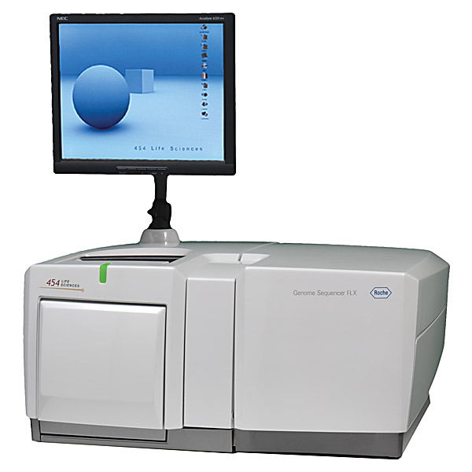
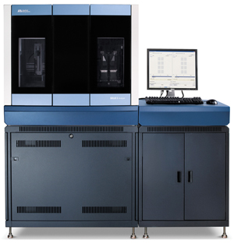
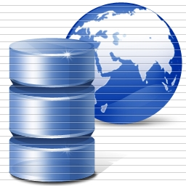
DNA Sequencing Pipeline
Illumina/Solexa Roche/454 Life Sciences Applied Biosystems/SOLiD
Internet
~300 million base pairs per day leading to
~3000 sequences per day per instrument
? 500 instruments at ~0.5M$ each
Read Alignment
Pairwise
clustering
Form block
Pairings
Sequence
alignment
Dissimilarity
Matrix
N(N-1)/2 values
Visualization
Plotviz
FASTA File N Sequences
Blocking
MPI
MDS
MapReduce

Slide 15
100,043 Metagenomics Sequences

Slide 16
Lightweight Cyberinfrastructure to support mobile Data gathering expeditions plus classic central resources (as a cloud)
See talk by Je’aime Powell ECSU

Slide 17
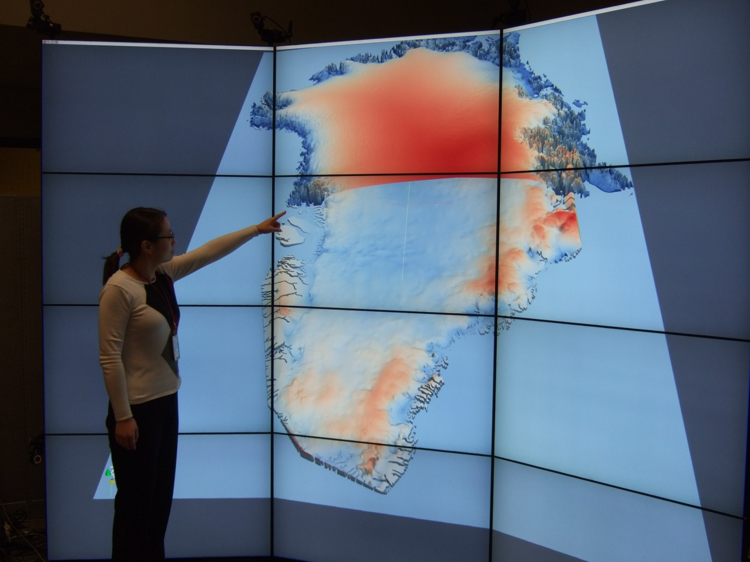
Use of Tiled Screens

Slide 18
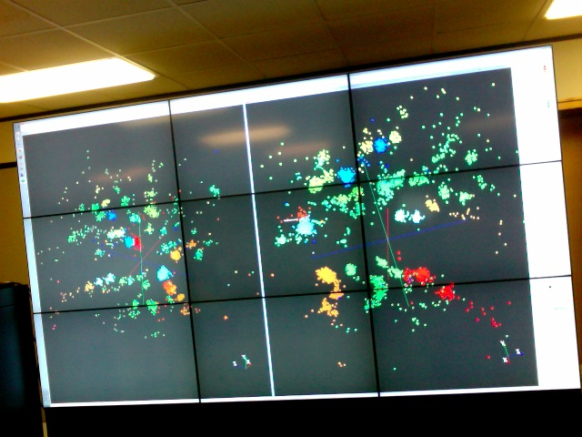

Slide 19
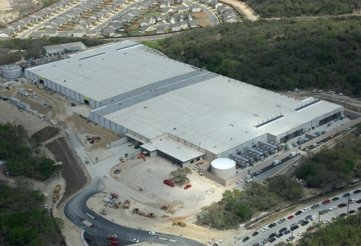
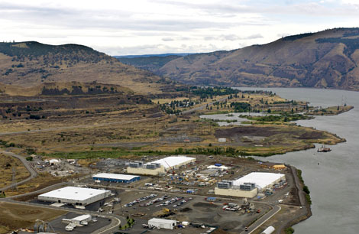
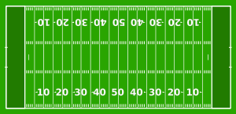
Data Centers Clouds & Economies of Scale I
Range in size from “edge” facilities to megascale.
Economies of scale
Approximate costs for a small size center (1K servers) and a larger, 50K server center.
2 Google warehouses of computers on the banks of the Columbia River, in The Dalles, Oregon
Such centers use 20MW-200MW
(Future) each with 150 watts per CPU
Save money from large size, positioning with cheap power and access with Internet
Technology | Cost in small-sized Data Center | Cost in Large Data Center | Ratio
Network | $95 per Mbps/ month | $13 per Mbps/ month | 7.1
Storage | $2.20 per GB/ month | $0.40 per GB/ month | 5.7
Administration | ~140 servers/ Administrator | >1000 Servers/ Administrator | 7.1
Each data center is
11.5 times
the size of a football field

Slide 20
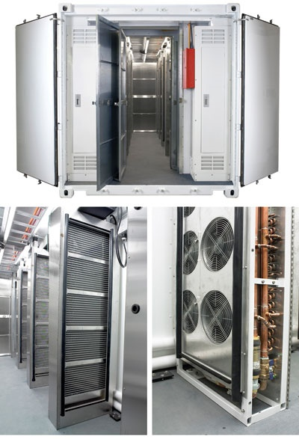
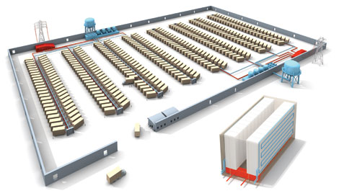
Data Centers, Clouds & Economies of Scale II
Builds giant data centers with 100,000’s of computers; ~ 200-1000 to a shipping container with Internet access
“Microsoft will cram between 150 and 220 shipping containers filled with data center gear into a new 500,000 square foot Chicago facility. This move marks the most significant, public use of the shipping container systems popularized by the likes of Sun Microsystems and Rackable Systems to date.”

Slide 21
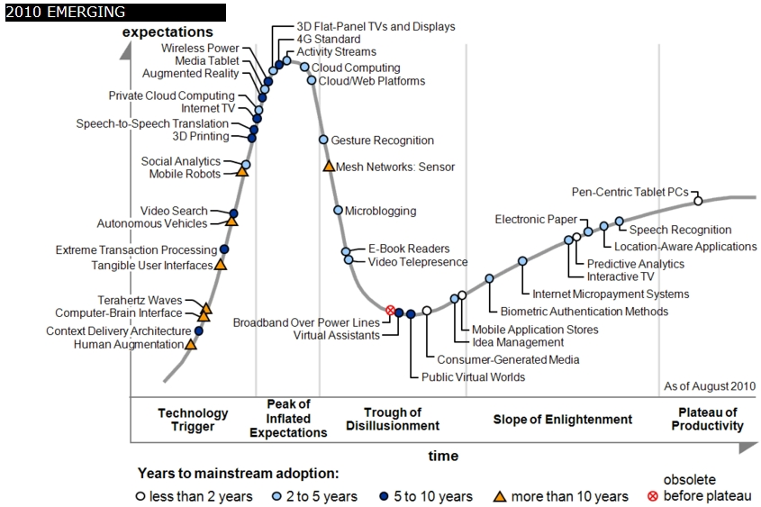
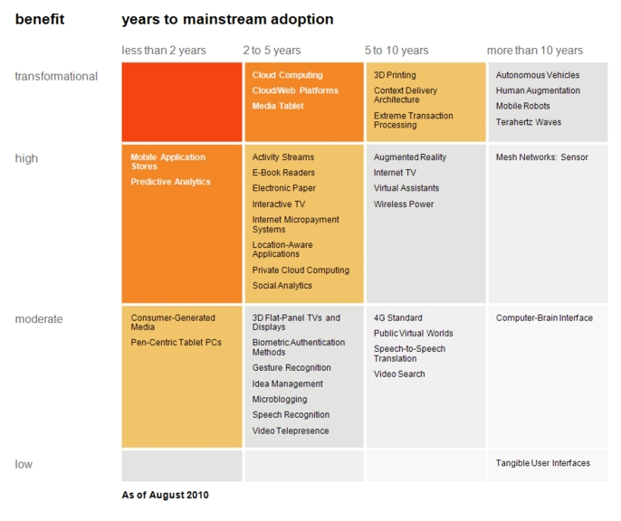
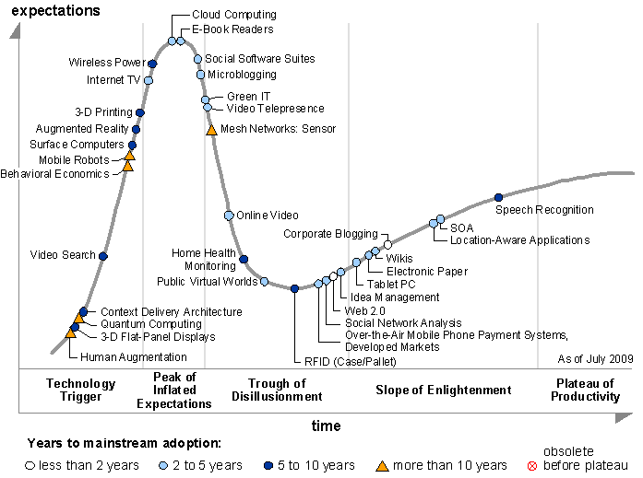
Transformational
High
Moderate
Low
Gartner 2009 Hype Curve
Clouds, Web2.0
Service Oriented Architectures
Cloud Computing
Cloud Web Platforms
Media Tablet

Slide 22
Clouds and Jobs
Clouds are a major industry thrust with a growing fraction of IT expenditure that IDC estimates will grow to $44.2 billion direct investment in 2013 while 15% of IT investment in 2011 will be related to cloud systems with a 30% growth in public sector.
Gartner also rates cloud computing high on list of critical emerging technologies with for example “Cloud Computing” and “Cloud Web Platforms” rated as transformational (their highest rating for impact) in the next 2-5 years.
Correspondingly there is and will continue to be major opportunities for new jobs in cloud computing with a recent European study estimating there will be 2.4 million new cloud computing jobs in Europe alone by 2015.
Cloud computing is an attractive for projects focusing on workforce development. Note that the recently signed “America Competes Act” calls out the importance of economic development in broader impact of NSF projects

Slide 23
C4 = Continuous Collaborative Computational Cloud
C4 EMERGING VISION
While the internet has changed the way we communicate and get entertainment, we need to empower the next generation of engineers and scientists with technology that enables interdisciplinary collaboration for lifelong learning.
Today, the cloud is a set of services that people explicitly have to access (from laptops, desktops, etc.). In 2020 the C4 will be part of our lives, as a larger, pervasive, continuous experience. The measure of success will be how “invisible” it becomes.
C4 Society Vision
We are no prophets and can’t anticipate what exactly will work, but we expect to have high bandwidth and ubiquitous connectivity for everyone everywhere, even in rural areas (using power-efficient micro data centers the size of shoe boxes). Here the cloud will enable business, fun, destruction and creation of regimes (societies)
Education should also embrace C4
Notes:
C4 Continuous Collaborative Computational Cloud

Slide 24
Higher Education 2020
Computational Thinking
Modeling
& Simulation
C⁴
Continuous
Collaborative
Computational
Cloud
C⁴
I
C⁴ Intelligent Society
N
T
E
C⁴ Intelligent Economy
C(DE)SE
L
L
C⁴ Intelligent People
Internet &
Cyberinfrastructure
I
G
E
Motivating Issues job / education mismatch
Higher Ed rigidity
Interdisciplinary work
Engineering v Science, Little v. Big science
N
C
E
NSF
Educate “Net Generation”
Re-educate pre “Net Generation”
in Science and Engineering
Exploiting and developing C⁴
C⁴ Curricula, programs
C⁴ Experiences (delivery mechanism)
C⁴ REUs, Internships, Fellowships
CDESE is Computational and Data-enabled Science and Engineering

Slide 25
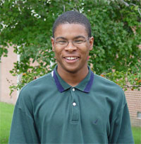
ADMI Cloudy View on Computing Workshop June 2011
Concept and Delivery by Jerome Mitchell:
Undergraduate ECSU,
Masters Kansas, PhD Indiana
Jerome took two courses from IU in this area Fall 2010 and Spring 2011
ADMI: Association of Computer and Information Science/Engineering Departments at Minority Institutions
Offered on FutureGrid (see later)
10 Faculty and Graduate Students from ADMI Universities
The workshop provided information from cloud programming models to case studies of scientific applications on FutureGrid.
At the conclusion of the workshop, the participants indicated that they would incorporate cloud computing into their courses and/or research.

Slide 26
ADMI Cloudy View on Computing Workshop Participants

Slide 27
Workshop Purpose
Introduce ADMI to the basics of the emerging Cloud Computing paradigm
Learn how it came about
Understand its enabling technologies
Understand the computer systems constraints, tradeoffs, and techniques of setting up and using cloud
Teach ADMI how to implement algorithms in the Cloud
Gain competence in cloud programming models for distributed processing of large datasets.
Understand how different algorithms can be implemented and executed on cloud frameworks
Evaluating the performance and identifying bottlenecks when mapping applications to the clouds

Slide 28
3-way Cyberinfrastructure
Use it in faculty, graduate student and undergraduate research
~12 students each summer at IU from ADMI
Teach it as it involves areas of Information Technology with lots of job opportunities
Use it to support distributed learning environment
A cloud backend for course materials and collaboration
Tiled display for visualization
Green computing infrastructure

Slide 29
Some Next Steps
Develop Appliances (Virtual machine based preconfigured computer systems) to support programming laboratories
Offer Cloud Computing course with
Web portal support
FutureGrid or Appliances locally
Distance delivery
Deliver first to ECSU, then other MSI’s
Write proposals with Linda Hayden at ECSU and …
Develop Cloud Computing Certificates and other degree offerings
Masters, Undergraduate, Continuing education …..

Slide 30
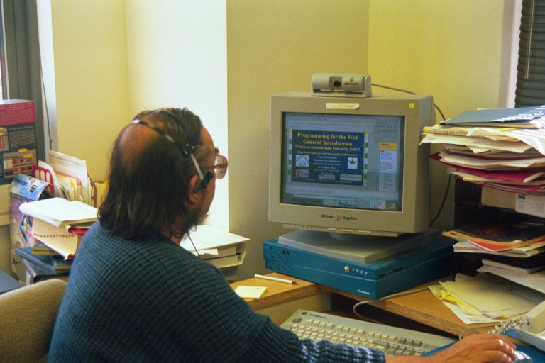
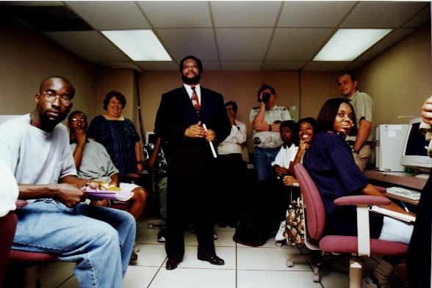
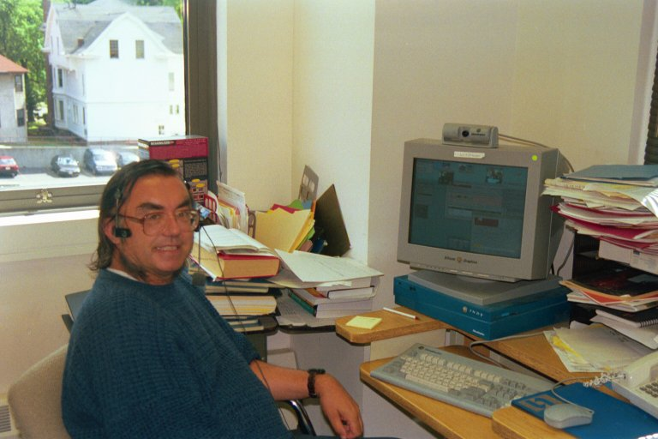
Teaching Jackson State Fall 97 to Fall 2001
JSU
Syracuse

Slide 31
US Cyberinfrastructure Context
There are a rich set of facilities
Production TeraGrid facilities with distributed and shared memory
Experimental “Track 2D” Awards
FutureGrid: Distributed Systems experiments cf. Grid5000
Keeneland: Powerful GPU Cluster
Gordon: Large (distributed) Shared memory system with SSD aimed at data analysis/visualization
Open Science Grid aimed at High Throughput computing and strong campus bridging

Slide 32
FutureGrid key Concepts I
FutureGrid is a 4 year $15M project with 7 clusters at 5 sites across country with 8 funded partners
FutureGrid is a flexible testbed supporting Computer Science and Computational Science experiments in
Innovation and scientific understanding of distributed computing (cloud, grid) and parallel computing paradigms
The engineering science of middleware that enables these paradigms
The use and drivers of these paradigms by important applications
The education of a new generation of students and workforce on the use of these paradigms and their applications
interoperability, functionality, performance or evaluation

Slide 33
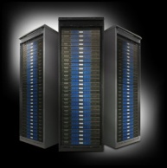
FutureGrid key Concepts II
Rather than loading images onto VM’s, FutureGrid supports Cloud, Grid and Parallel computing environments by dynamically provisioning software as needed onto “bare-metal”
Image library for MPI, OpenMP, Hadoop, Dryad, gLite, Unicore, Globus, Xen, ScaleMP (distributed Shared Memory), Nimbus, Eucalyptus, OpenNebula, KVM, Windows …..
Growth comes from users depositing novel images in library
Each use of FutureGrid is an experiment that is reproducible
Developing novel software to support these goals which build on Grid5000 in France
Image1
Image2
…
ImageN
Choose
Load
Run

Slide 34
FutureGrid Partners
Indiana University (Architecture, core software, Support)
Purdue University (HTC Hardware)
San Diego Supercomputer Center at University of California San Diego (INCA, Monitoring)
University of Chicago/Argonne National Labs (Nimbus)
University of Florida (ViNE, Education and Outreach)
University of Southern California Information Sciences (Pegasus to manage experiments)
University of Tennessee Knoxville (Benchmarking)
University of Texas at Austin/Texas Advanced Computing Center (Portal)
University of Virginia (OGF, Advisory Board and allocation)
Center for Information Services and GWT-TUD from Technische Universtität Dresden. (VAMPIR)
Red institutions have FutureGrid hardware

Slide 35
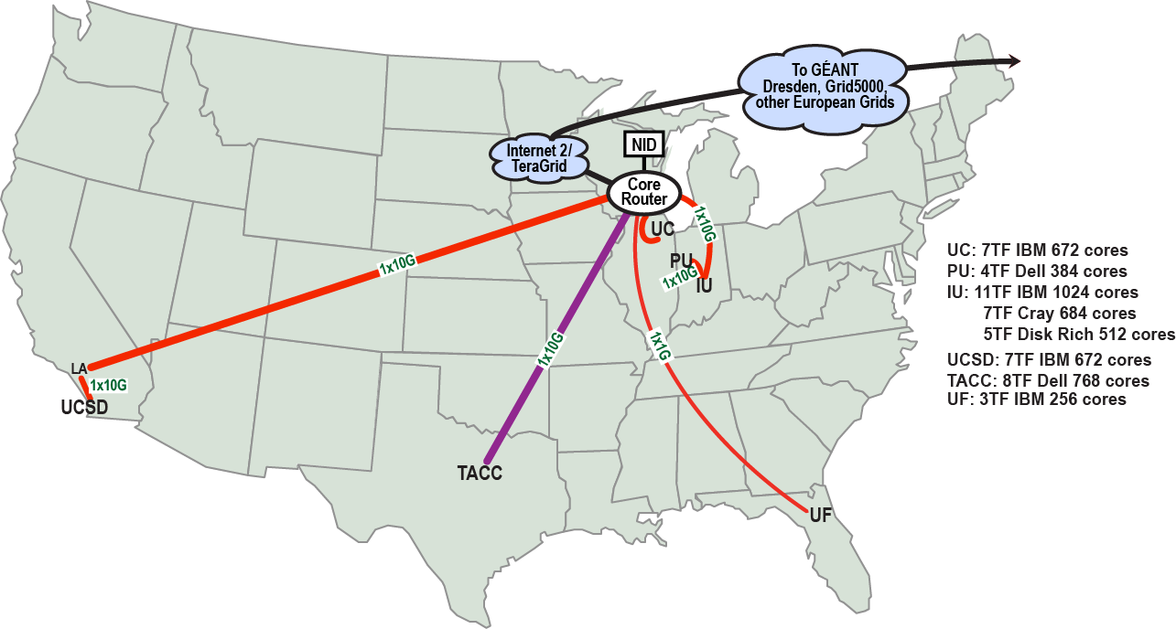
FutureGrid: a Grid/Cloud/HPC Testbed
NID: Network Impairment Device
Private Public
FG Network

Slide 36
5 Use Types for FutureGrid
Training Education and Outreach
Semester and short events; promising for outreach
Interoperability test-beds
Grids and Clouds; OGF really needed this
Domain Science applications
Life science highlighted
Computer science
Largest current category
Computer Systems Evaluation
TeraGrid (TIS, TAS, XSEDE), OSG, EGI

Slide 37
Education & Outreach on FutureGrid
Build up tutorials on supported software
Support development of curricula requiring privileges and systems destruction capabilities that are hard on conventional TeraGrid
Offer suite of appliances (customized VM based images) supporting online laboratories
Supporting several workshops including Virtual Summer School on “Big Data” July 26-30 2010; TeraGrid ‘10 “Cloud technologies, data-intensive science and the TG” August 2010; CloudCom conference tutorials Nov 30-Dec 3 2010; ADMI Cloudy View of Computing workshop June 2011
Experimental class use at Indiana, Florida and LSU

