Slide 1
Collaboration in the Cloud and online education environments
The 2013 International Conference on Collaboration Technologies and Systems CTS2013
May 22 2013 Sheraton San Diego
Geoffrey Fox
gcf@indiana.edu
Informatics, Computing and Physics
Indiana University Bloomington

Slide 2
Abstract
Cloud computing is attractive from several points of view for next generation online education. It supports shared information repositories as well as sharing the real time and asynchronous interaction between teachers and learners. The promise of virtual universities in the cloud has been highlighted by the growing interest in MOOC’s (massive open online courses) which are naturally hosted on clouds. The basic delivery model of MOOC’s is reasonably traditional with the scaling of clouds added. However MOOC’s emphasize new collaboration models for the interaction between mentors (graders, teachers) and students. Further “laboratories” are typically used in many classes and we discuss the use of clouds to support computing labs attached to computer science and related classes. We suggest that MOOC technology can be used in different ways. Rather than single classes aimed at many students, we suggest that an alternative is multiple classes customized for different communities. Here we have a MOOC lesson repository (in the cloud) and technology like Google Course Builder to construct different “play lists” corresponding to the different classes. This has been implicitly used in past with “PowerPoint” presentations placed on the web and then re-used in different ways However often PowerPoint is hard to re-use and it seems more promising to re-use the MOOC lesson with presentation and recorded lecture

Slide 3
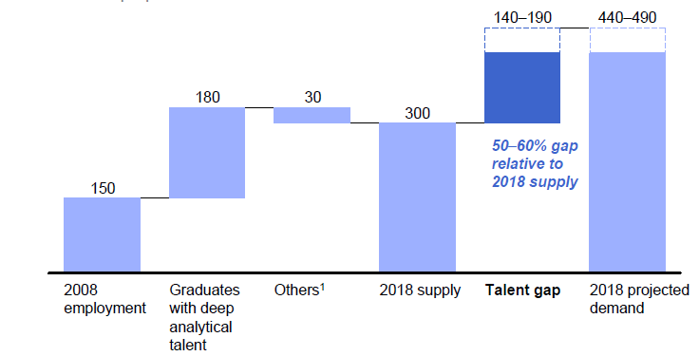
McKinsey Institute on Big Data Jobs
My motivation for a MOOC Even more jobs in clouds
There will be a shortage of talent necessary for organizations to take advantage of big data. By 2018, the United States alone could face a shortage of 140,000 to 190,000 people with deep analytical skills as well as 1.5 million managers and analysts with the know-how to use the analysis of big data to make effective decisions.

Slide 4
Massive Open Online Courses (MOOC)
MOOC’s are very “hot” these days with Udacity and Coursera as start-ups; perhaps over 100,000 participants
Relevant to Data Science as this is a new field with few courses at most universities
Typical model is collection of short prerecorded segments (talking head over PowerPoint) of length 3-15 minutes
These “lesson objects” can be viewed as “songs”
Google Course Builder (python open source) builds customizable MOOC’s as “playlists” of “songs”
Tells you to capture all material as “lesson objects”
We are aiming to build a repository of many “songs”; used in many ways – tutorials, classes …

Slide 5
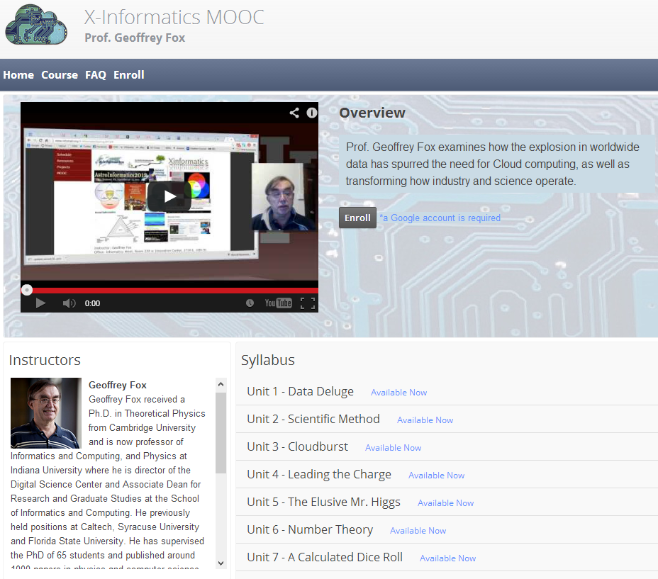
http://x-informatics.appspot.com/course
Complete end of June

Slide 6
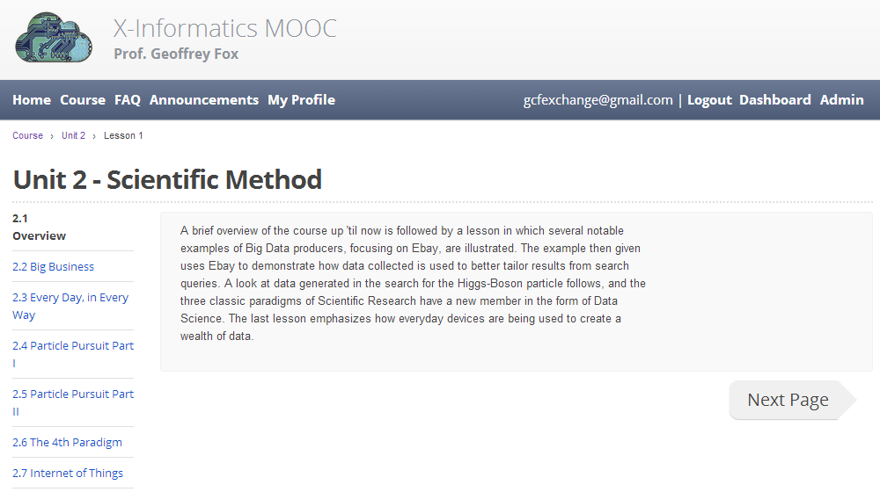
Seven ~10 minutes lesson objects in this lecture
IU wants us to close caption if use in real course

Slide 7
Customizable MOOC’s I
We could teach one class to 100,000 students or 2,000 classes to 50 students
The 2,000 class choice has 2 useful features
One can use the usual (electronic) mentoring/grading technology
One can customize each of 2,000 classes for a particular audience given their level and interests
One can even allow student to customize – that’s what one does in making play lists in iTunes
Both models can be supported by a repository of lesson objects (3-15 minute video segments) in the cloud
The teacher can choose from existing lesson objects and add their own to produce a new customized course with new lessons contributed back to repository

Slide 8
Cloud MOOC Repository
http://iucloudsummerschool.appspot.com/preview
91 lesson objects

Slide 9
Customizable MOOC’s II
The 3-15 minute Video over PowerPoint of MOOC lesson object’s is easy to re-use
Qiu (IU)and Hayden (ECSU Elizabeth City State University) will customize a module
Starting with Qiu’s cloud computing course at IU
Adding material on use of Cloud Computing in Remote Sensing (area covered by ECSU course)
This is a model for adding cloud curricula material to diverse set of universities
Defining how to support computing labs associated with MOOC’s with FutureGrid or appliances + Virtual Box
Appliances scale as download to student’s client
Virtual machines essential

Slide 10
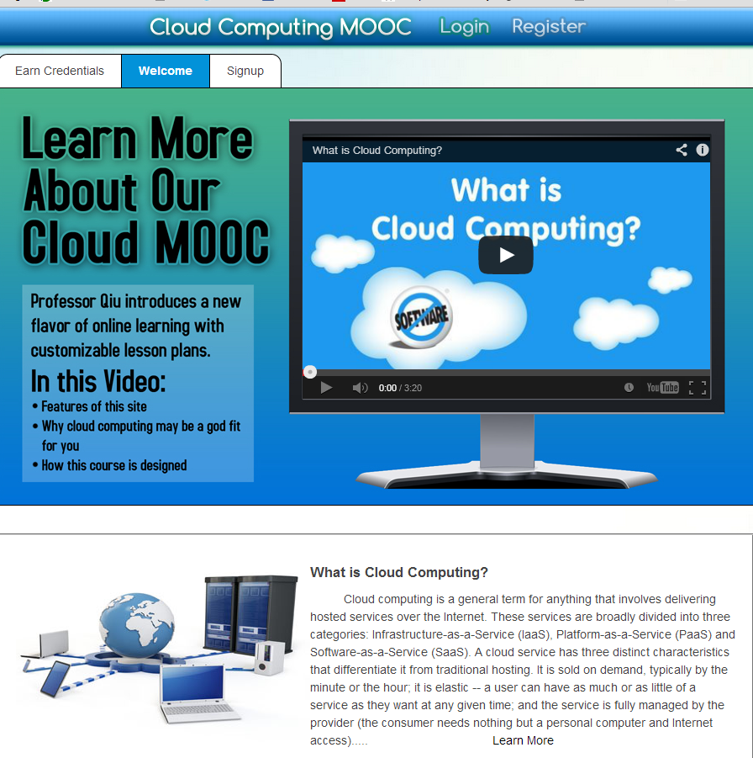
Can of course build many different interfaces
Songs stored on YouTube
Songs prepared with Adobe Presenter on Laptop

Slide 11
Two limits where MOOC’s are Compelling
High volume courses (CS/Ph/Chem/Bio101…) where scalability of MOOC’s make them attractive to reach a lot of students
Niche areas where there is some student interest but either no faculty expertise or not enough students to justify traditional courses
Offer to many institutions simultaneously

Slide 12
Hermit’s Cave Virtual University
I proposed in 1999 misjudging pace of online education: One can place faculty in their favorite location (e.g. remote cave) and universities provide structure to give “credentials” while faculty teach
Maybe some populate repository; others actually deliver courses
Note Google Course Builder has no need for local resources except for faculty client (laptop) – entire course stored in the cloud
So we can radically change university system with a major cross institution virtual education and as well research component
Enabled by cloud plus high performance reliable networking
Lets set up community to define and build the virtual university MOOC repository and other needed activities

Slide 13
Mentoring / Grading
We should aim at simplicity; attractive at moment is a mix of multi-topic forum plus more interactive Hangouts or equivalent (5-12 people)
https://www.youtube.com/watch?v=M3jcSCA9_hM

Slide 14
This is all very simple
Correct but that’s good
Internet successes are from simple ideas done very well
MOOC’s are a very old idea
http://www.old-npac.org/users/gcf/cps615intro96/index.html does a playlist on audio + PowerPoint in 1996
But they didn’t work well before due to network
In general MOOC’s less sophisticated than much online education?

Slide 15
3-way Clouds and Universities
Use clouds in faculty, graduate student and undergraduate research
Clouds for Scientific data analysis
Core cloud technologies (MapReduce, Virtualization)
Teach clouds as it involves areas of Information Technology with lots of job opportunities
Use clouds to support distributed learning environment
A cloud backend for course materials and collaboration as in MOOC repository
Green computing infrastructure

Slide 16
C4 = Continuous Collaborative Computational Cloud
C4 EMERGING VISION
While the internet has changed the way we communicate and get entertainment, we need to empower the next generation of engineers and scientists with technology that enables interdisciplinary collaboration for lifelong learning.
Today, the cloud is a set of services that people explicitly have to access (from laptops, desktops, etc.). In 2020 the C4 will be part of our lives, as a larger, pervasive, continuous experience. The measure of success will be how “invisible” it becomes.
C4 Society Vision
We are no prophets and can’t anticipate what exactly will work, but we expect to have high bandwidth and ubiquitous connectivity for everyone everywhere, even in rural areas (using power-efficient micro data centers the size of shoe boxes). Here the cloud will enable business, fun, destruction and creation of regimes (societies)
Wandering through life with a tablet/smartphone hooked to cloud
Education should embrace C4 just as students do
http://www.nsf.gov/od/oci/taskforces/TaskForceReport_Learning.pdf
Notes:
C4 Continuous Collaborative Computational Cloud

Slide 17
Higher Education 2020
Computational Thinking
MOOC’s are part of C4 Educational Vision
Modeling
& Simulation
C⁴
Continuous
Collaborative
Computational
Cloud
C⁴
I
C⁴ Intelligent Society
N
T
E
C⁴ Intelligent Economy
C(DE)SE
L
L
C⁴ Intelligent People
Internet &
Cyberinfrastructure
I
G
E
Motivating Issues job / education mismatch
Higher Ed rigidity
Interdisciplinary work
Engineering v Science, Little v. Big science
N
C
E
NSF
Educate “Net Generation”
Re-educate pre “Net Generation”
in Science and Engineering
Exploiting and developing C⁴
CDESE is Computational and Data-enabled Science and Engineering
C⁴ Curricula, programs
C⁴ Experiences (delivery mechanism)
C⁴ REUs, Internships, Fellowships

