Slide 1
A Distributed Framework for Collaborative Annotation of Streams
Tao Huang, Shrideep Pallickara, Geoffrey Fox
Community Grids Lab
Indiana University, Bloomington
{taohuang, spallick, gcf}@indiana.edu

Slide 2
Outline
Analysis of existing Collaboration and Annotation Systems
System Objectives
System Design and Implementation
Experiment Results
Future Work and Conclusion

Slide 3
Collaboration Systems
Multimedia based collaboration
Industry
Academic
Digital document based collaboration

Slide 4
Annotation Systems
Microsoft: MRAS
Asynchronous Q/A on lecture videos
IBM : VideoAnnEx
Mpeg-7 based annotation
Support distributed annotation
University of Queensland : Vannotea
Similar to VideoAnnEx with more flexibility on annotation metadata
Indiana University CGL: eSports
Extend annotation forms from texts to images and video clips
Aimed at distance coaching

Slide 5
Limitations of existing systems
MRAS and VideoAnnEx
Asynchronous communication and searching in annotation
Vannotea and eSports
Annotation on real time video streams in distributed environments
None of them supports annotation on other types of data streams

Slide 6
Objectives
Support annotation on live or prerecorded data streams regardless their types
Relatively tolerant to possible failures
Support saving, sharing and searching annotations among distributed users
Easy to extend

Slide 7
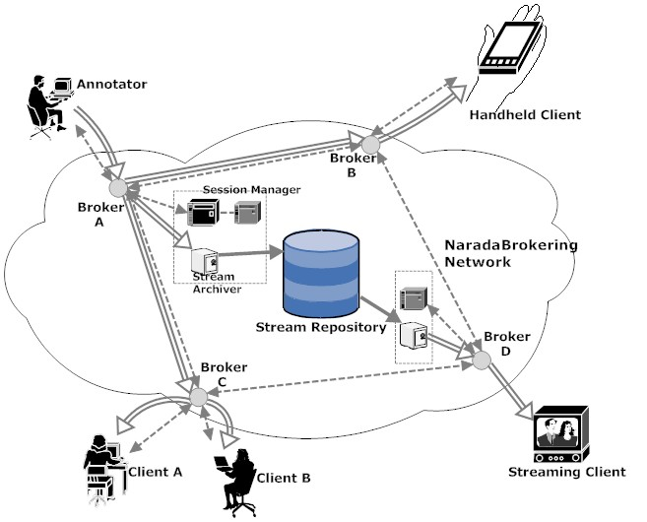
System Architecture
Distributed annotation clients over the NaradaBrokering Network.
Session management with two recovery strategies
Distributed stream archiving and replaying
Easy to add support to handheld and streaming clients

Slide 8
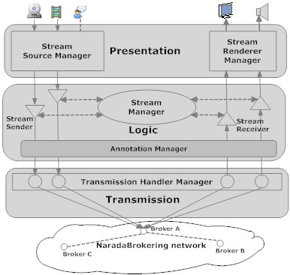
Decoupled Functions in Layers
Presentation layer
GUI, Stream Source/Renderer Managers
The Logic layer
Stream manager manages all active senders and receivers
Annotation manager associates and synchronizes content streams with annotation streams.
The Transmission
Creating and managing actual data transmission

Slide 9
Stream Processing Interfaces
Define the generic behaviors of real time data streams
Start, Stop, Pause and so on
Existing Stream Sources/Renderers
Audio/Video
Screen capture
File capture
Easy to write own source/renderer pairs

Slide 10
Annotation management
Annotation and Stream data are stored in remote storage
Annotation metadata is stored in plain XML files
Only Time an Layout information are stored currently
Local Annotation metadata will be synchronized with remote storage before being used to replay

Slide 11
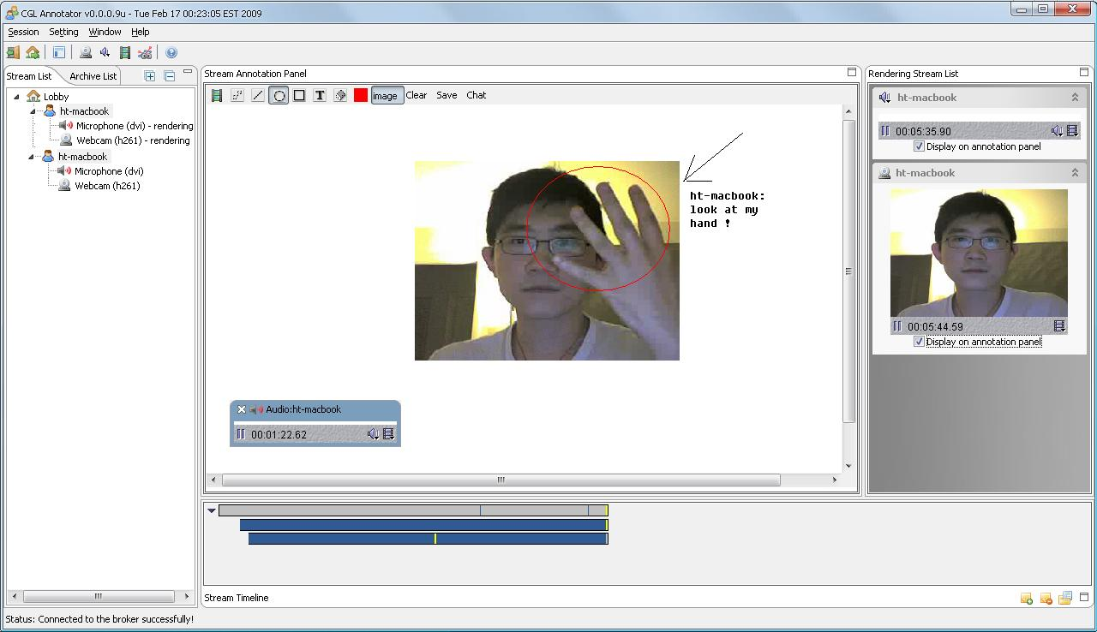
Client Interface
Center Annotation
Panel
Stream List
Panel
Client List
Stream Progress Panel

Slide 12
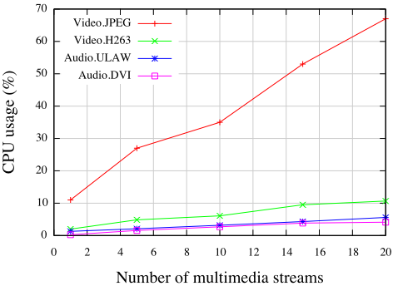
Preliminary Test 1

Slide 13
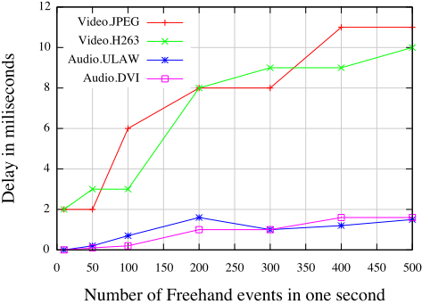
Preliminary Test 2

Slide 14
Conclusion
Woks well with data streams of small payloads(<2KB) under high stress circumstances
Delays are under a reasonable level, which will not cause any synchronization problems

Slide 15
Summary
Support collaborative annotation on multimedia streams in Sync/Async way
Stream Processing Interfaces make it easy to extend current system

Slide 16
Future Work
Add more types of stream sources/renderers
Research on security issues in annotation distribution
Standardize annotation metadata format into Mpeg-7
A user friendly Web 2.0 portal to access/manage annotation and stream data

Slide 17
Questions?
Thanks

