Slide 1
Parallelizing Data Analytics
INTERNATIONAL ADVANCED RESEARCH WORKSHOP
ON HIGH PERFORMANCE COMPUTING
From Clouds and Big Data to Exascale and Beyond
Cetraro (Italy)
July 10 2014
Geoffrey Fox
gcf@indiana.edu
http://www.infomall.org
School of Informatics and Computing
Digital Science Center
Indiana University Bloomington

Slide 2
Abstract
We discuss a variety of large scale optimization/data analytics including deep learning, clustering, image processing, information retrieval, collaborative filtering and dimension reduction.
We describe parallelization challenges and nature of kernel operations.
We cover both batch and streaming operations and give some measured performance on both MPI and MapReduce frameworks.
Use context of SPIDAL (Scalable Parallel Interoperable Data Analytics Library)

Slide 3
SPIDAL

Slide 4
Machine Learning in Network Science, Imaging in Computer Vision, Pathology, Polar Science
Algorithm | Applications | Features | Status | Parallelism
Graph Analytics
Community detection | Social networks, webgraph | Graph . | P-DM | GML-GrC
Subgraph/motif finding | Webgraph, biological/social networks |  | P-DM | GML-GrB
Finding diameter | Social networks, webgraph |  | P-DM | GML-GrB
Clustering coefficient | Social networks |  | P-DM | GML-GrC
Page rank | Webgraph |  | P-DM | GML-GrC
Maximal cliques | Social networks, webgraph |  | P-DM | GML-GrB
Connected component | Social networks, webgraph |  | P-DM | GML-GrB
Betweenness centrality | Social networks | Graph, Non-metric, static | P-Shm | GML-GRA
Shortest path | Social networks, webgraph |  | P-Shm
Spatial Queries and Analytics
Spatial relationship based queries | GIS/social networks/pathology informatics | Geometric | P-DM | PP
Distance based queries |  |  | P-DM | PP
Spatial clustering |  |  | Seq | GML
Spatial modeling |  |  | Seq | PP
GML Global (parallel) ML
GrA Static GrB Runtime partitioning

Slide 5
Some specialized data analytics in SPIDAL
Algorithm | Applications | Features | Status | Parallelism
Core Image Processing
Image preprocessing | Computer vision/pathology informatics | Metric Space Point Sets, Neighborhood sets & Image features | P-DM | PP
Object detection & segmentation |  |  | P-DM | PP
Image/object feature computation |  |  | P-DM | PP
3D image registration |  |  | Seq | PP
Object matching |  | Geometric | Todo | PP
3D feature extraction |  |  | Todo | PP
Deep Learning
Learning Network, Stochastic Gradient Descent | Image Understanding, Language Translation, Voice Recognition, Car driving | Connections in artificial neural net | P-DM | GML
aa
PP Pleasingly Parallel (Local ML)
Seq Sequential Available
GRA Good distributed algorithm needed
Todo No prototype Available
P-DM Distributed memory Available
P-Shm Shared memory Available

Slide 6
Some Core Machine Learning Building Blocks
Algorithm | Applications | Features | Status | //ism
DA Vector Clustering | Accurate Clusters | Vectors | P-DM | GML
DA Non metric Clustering | Accurate Clusters, Biology, Web | Non metric, O(N²) | P-DM | GML
Kmeans; Basic, Fuzzy and Elkan | Fast Clustering | Vectors | P-DM | GML
Levenberg-Marquardt Optimization | Non-linear Gauss-Newton, use in MDS | Least Squares | P-DM | GML
SMACOF Dimension Reduction | DA- MDS with general weights | Least Squares, O(N²) | P-DM | GML
Vector Dimension Reduction | DA-GTM and Others | Vectors | P-DM | GML
TFIDF Search | Find nearest neighbors in document corpus | Bag of “words” (image features) | P-DM | PP
All-pairs similarity search | Find pairs of documents with TFIDF distance below a threshold
 |  |  | Todo | GML
Support Vector Machine SVM | Learn and Classify | Vectors | Seq | GML
Random Forest | Learn and Classify | Vectors | P-DM | PP
Gibbs sampling (MCMC) | Solve global inference problems | Graph | Todo | GML
Latent Dirichlet Allocation LDA with Gibbs sampling or Var. Bayes | Topic models (Latent factors) | Bag of “words” | P-DM | GML
Singular Value Decomposition SVD | Dimension Reduction and PCA | Vectors | Seq | GML
Hidden Markov Models (HMM) | Global inference on sequence models | Vectors | Seq | PP & GML

Slide 7
Introduction to SPIDAL
Here discuss Global Machine Learning as part of SPIDAL (Scalable Parallel Interoperable Data Analytics Library)
Focus on 4 big data analytics
  Dimension Reduction (Multi Dimensional Scaling)
  Levenberg-Marquardt Optimization
  Clustering: similar to Gaussian Mixture Models, PLSI (probabilistic latent semantic indexing), LDA (Latent Dirichlet Allocation)
  Deep Learning (not discussed much)
Surprisingly little packaged scalable GML
  Mahout low performance
  R largely sequential (best for local machine learning LML)
  MLlib just starting

Slide 8
Parallelism
All use parallelism over data points
  Entities to cluster or map to Euclidean space
Except deep learning which has parallelism over pixel plane in neurons not over items in training set
  as need to look at small numbers of data items at a time in Stochastic Gradient Descent
Maximum Likelihood or χ² both lead to structure like
Minimize sum ∑_{items=1}^{N} (Positive nonlinear function of unknown parameters for item i)
All solved iteratively with (clever) first or second order approximation to shift in objective function
  Sometimes steepest descent direction; sometimes Newton
  Have classic Expectation Maximization structure

Slide 9
Parameter “Server”
Note learning networks have huge number of parameters (11 billion in Stanford work) so that inconceivable to look at second derivative
Clustering and MDS have lots of parameters but can be practical to look at second derivative and use Newton’s method to minimize
Parameters are determined in distributed fashion but are typically needed globally
  MPI use broadcast and “AllCollectives”
  AI community: use parameter server and access as needed

Slide 10
Some Important Cases
Need to cover non vector semimetric and vector spaces for clustering and dimension reduction (N points in space)
Vector spaces have Euclidean distance and scalar products
  Algorithms can be O(N) and these are best for clustering but for MDS O(N) methods may not be best as obvious objective function O(N²)
MDS Minimizes Stress
σ(X) = Σ_{i<j=1}^{N} weight(i,j) (δ(i, j) - d(X_{i} , X_{j}))²
Semimetric spaces just have pairwise distances defined between points in space δ(i, j)
Note matrix solvers all use conjugate gradient – converges in 5-100 iterations – a big gain for matrix with a million rows. This removes factor of N in time complexity
Ratio of #clusters to #points important; new ideas if ratio >~ 0.1

Slide 11
Deterministic Annealing
Algorithms

Slide 12

Some Motivation
Big Data requires high performance – achieve with parallel computing
Big Data sometimes requires robust algorithms as more opportunity to make mistakes
Deterministic annealing (DA) is one of better approaches to robust optimization
  Started as “Elastic Net” by Durbin for Travelling Salesman Problem TSP
  Tends to remove local optima
  Addresses overfitting
  Much Faster than simulated annealing
Physics systems find true lowest energy state if you anneal i.e. you equilibrate at each temperature as you cool
Uses mean field approximation, which is also used in “Variational Bayes” and “Variational inference”

Slide 13
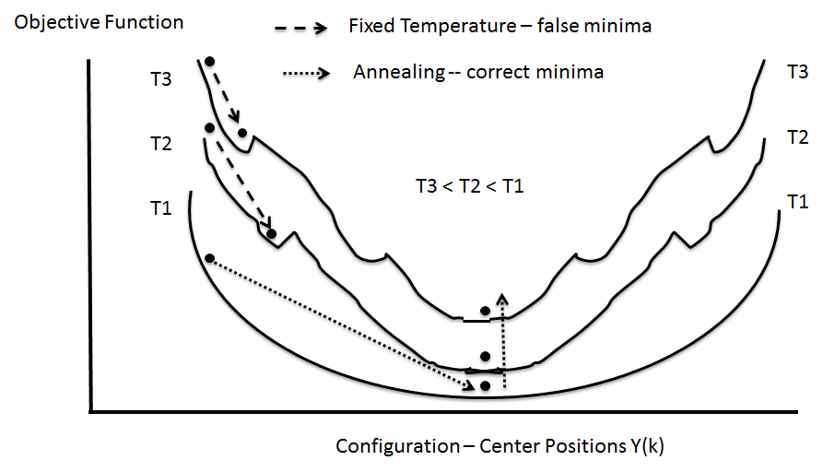
(Deterministic) Annealing
Find minimum at high temperature when trivial
Small change avoiding local minima as lower temperature
Typically gets better answers than standard libraries- R and Mahout
And can be parallelized and put on GPU’s etc.

Slide 14
General Features of DA
In many problems, decreasing temperature is classic multiscale – finer resolution (√T is “just” distance scale)
In clustering √T is distance in space of points (and centroids), for MDS scale in mapped Euclidean space
T = ∞, all points are in same place – the center of universe
For MDS all Euclidean points are at center and distances are zero. For clustering, there is one cluster
As Temperature lowered there are phase transitions in clustering cases where clusters split
  Algorithm determines whether split needed as second derivative matrix singular
Note DA has similar features to hierarchical methods and you do not have to specify a number of clusters; you need to specify a final distance scale

Slide 15
Basic Deterministic Annealing
H(χ) is objective function to be minimized as a function of parameters χ (as in Stress formula given earlier for MDS)
Gibbs Distribution at Temperature T
P(χ) = exp( - H(χ)/T) / ∫ dχ exp( - H(χ)/T)
Or P(χ) = exp( - H(χ)/T + F/T )
Replace H(χ) by a smoothed version; the Free Energy combining Objective Function and Entropy
F = < H - T S(P) > = ∫ dχ {P(χ)H + T P(χ) lnP(χ)}
Simulated annealing performs these integrals by Monte Carlo
Deterministic annealing corresponds to doing integrals analytically (by mean field approximation) and is much much faster
In each case temperature is lowered slowly – say by a factor 0.95 to 0.9999 at each iteration

Slide 16
Some Uses of Deterministic Annealing
Clustering
  Vectors: Rose (Gurewitz and Fox)
  Clusters with fixed sizes and no tails (Proteomics team at Broad)
  No Vectors: Hofmann and Buhmann (Just use pairwise distances)
Dimension Reduction for visualization and analysis
  Vectors: GTM Generative Topographic Mapping
  No vectors SMACOF: Multidimensional Scaling) MDS (Just use pairwise distances)
Can apply to HMM & general mixture models (less study)
  Gaussian Mixture Models
  Probabilistic Latent Semantic Analysis with Deterministic Annealing DA-PLSA as alternative to Latent Dirichlet Allocation for finding “hidden factors”

Slide 17
Examples of current IU algorithms

Slide 18
Some Clustering Problems at Indiana
Analysis of Mass Spectrometry data to find peptides by clustering peaks (Broad Institute)
  ~0.5 million points in 2 dimensions (one experiment) -- ~ 50,000 clusters summed over charges
Metagenomics – 0.5 million (increasing rapidly) points NOT in a vector space – hundreds of clusters per sample
Pathology Images >50 Dimensions
Social image analysis is in a highish dimension vector space
  10-50 million images; 1000 features per image; million clusters
Finding communities from network graphs coming from Social media contacts etc.
  No vector space; can be huge in all ways

Slide 19
Background on LC-MS
Remarks of collaborators – Broad Institute
Abundance of peaks in “label-free” LC-MS enables large-scale comparison of peptides among groups of samples.
In fact when a group of samples in a cohort is analyzed together, not only is it possible to “align” robustly or cluster the corresponding peaks across samples, but it is also possible to search for patterns or fingerprints of disease states which may not be detectable in individual samples.
This property of the data lends itself naturally to big data analytics for biomarker discovery and is especially useful for population-level studies with large cohorts, as in the case of infectious diseases and epidemics.
With increasingly large-scale studies, the need for fast yet precise cohort-wide clustering of large numbers of peaks assumes technical importance.
In particular, a scalable parallel implementation of a cohort-wide peak clustering algorithm for LC-MS-based proteomic data can prove to be a critically important tool in clinical pipelines for responding to global epidemics of infectious diseases like tuberculosis, influenza, etc.

Slide 20
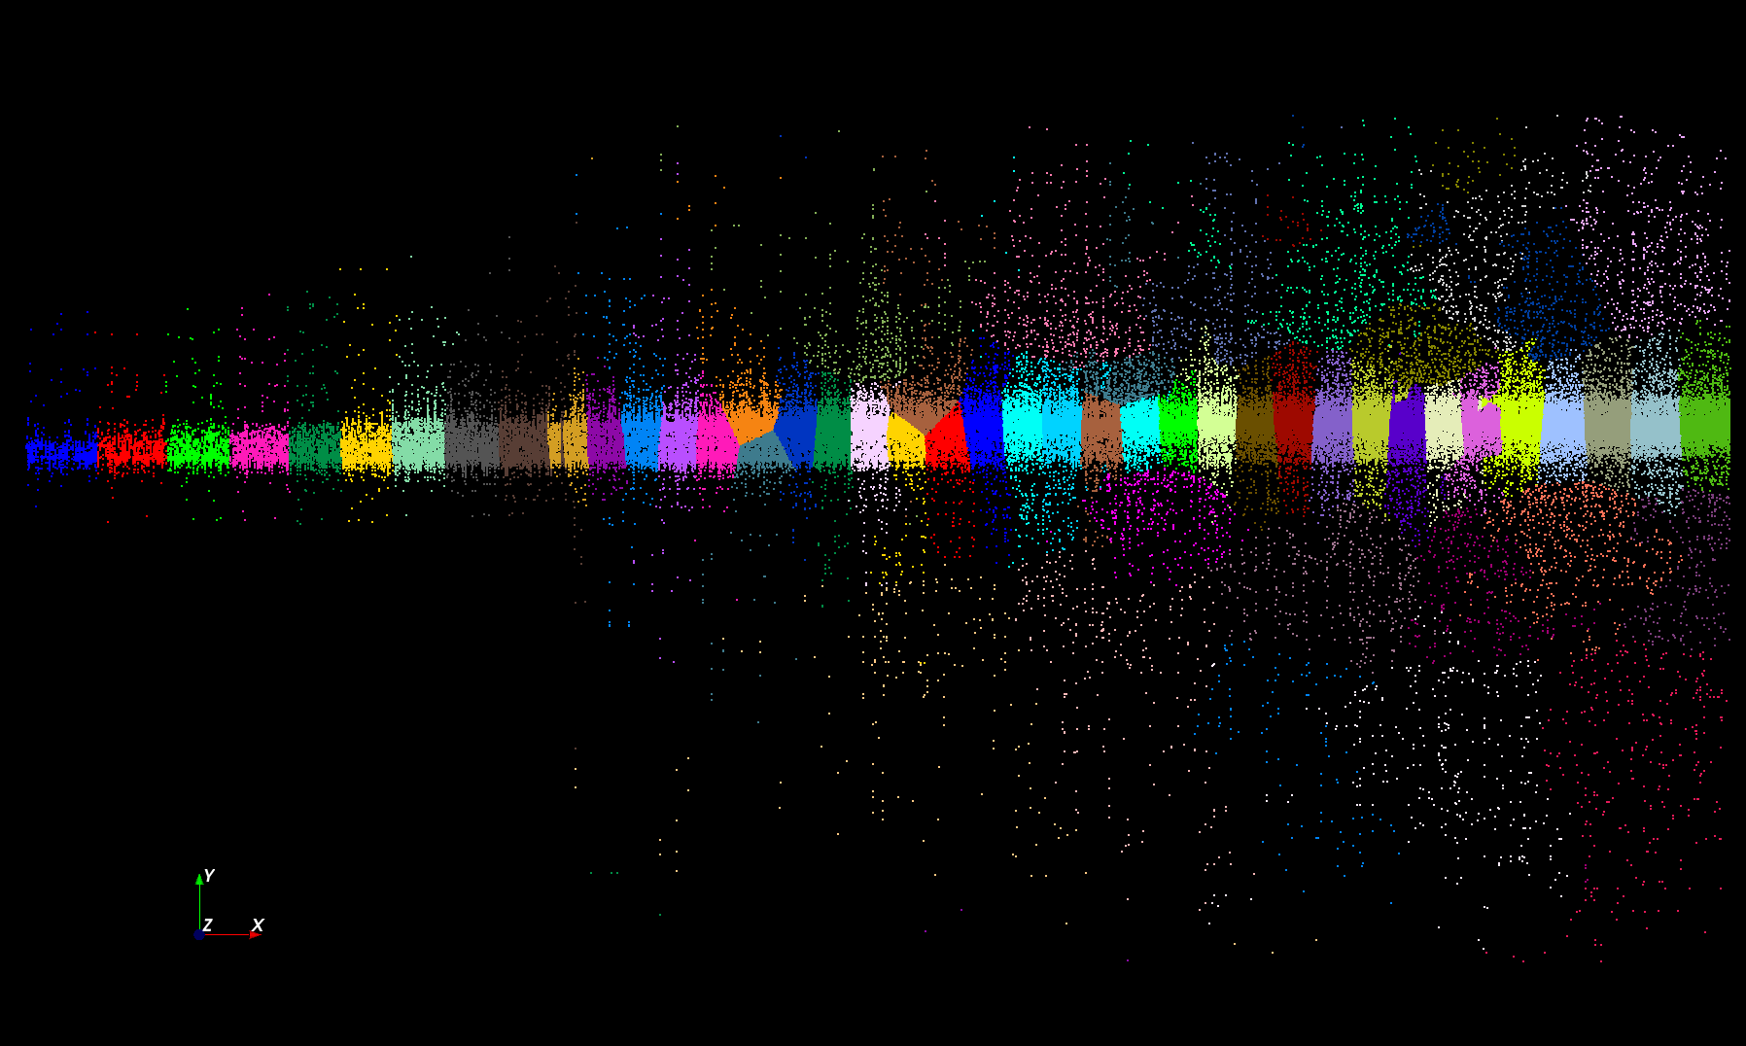
Proteomics 2D DA Clustering T= 25000 with 60 Clusters (will be 30,000 at T=0.025)

Slide 21
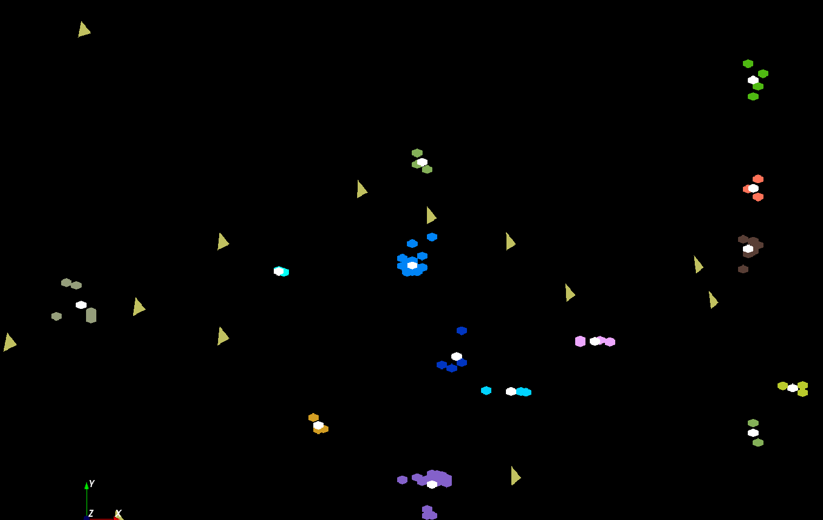
The brownish triangles are sponge peaks outside any cluster.
The colored hexagons are peaks inside clusters with the white hexagons being determined cluster center
Fragment of 30,000 Clusters
241605 Points

Slide 22
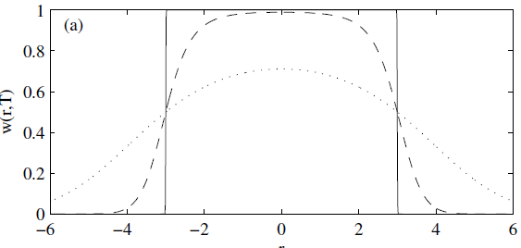
Trimmed Clustering
Clustering with position-specific constraints on variance: Applying redescending M-estimators to label-free LC-MS data analysis (Rudolf Frühwirth , D R Mani and Saumyadipta Pyne) BMC Bioinformatics 2011, 12:358
H_{TCC} = ∑_{k=0}^{K} ∑_{i=1}^{N} M_{i}(k) f(i,k)
  f(i,k) = (X(i) - Y(k))²/2σ(k)² k > 0
  f(i,0) = c² / 2 k = 0
The 0’th cluster captures (at zero temperature) all points outside clusters (background)
Clusters are trimmed
(X(i) - Y(k))²/2σ(k)² < c² / 2
Relevant when well
defined errors
T = 1
T ~ 0
T = 5
Distance from cluster center

Slide 23
Cluster Count v. Temperature for 2 Runs
All start with one cluster at far left
T=1 special as measurement errors divided out
DA2D counts clusters with 1 member as clusters. DAVS(2) does not

Slide 24
Speedups for several runs on Tempest from 8-way through 384 way MPI parallelism with one thread per process. We look at different choices for MPI processes which are either inside nodes or on separate nodes

Slide 25
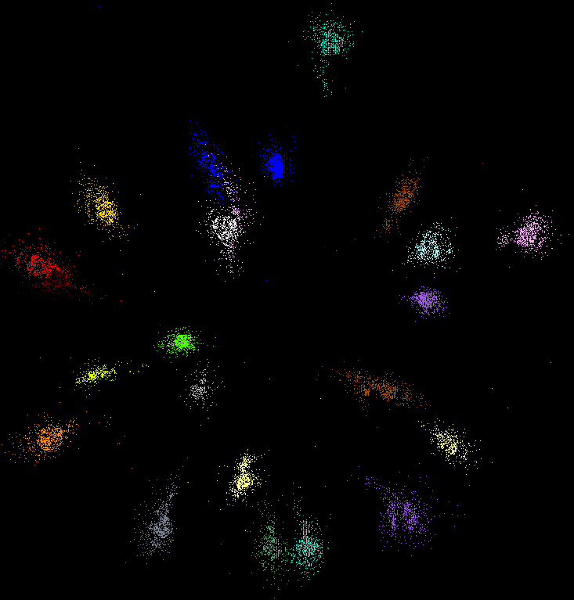
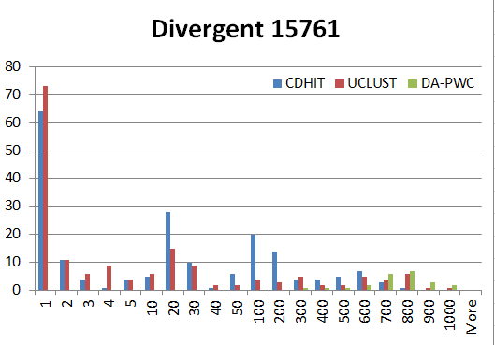
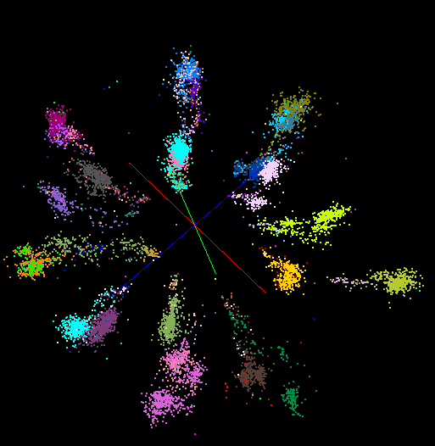
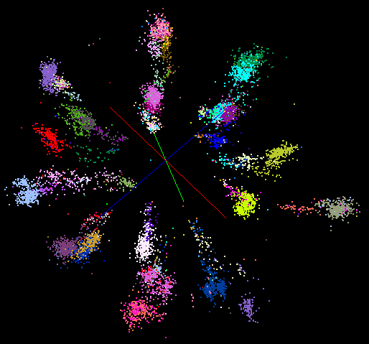
“Divergent” Data Sample
23 True Sequences
DA-PWC
UClust
CDhit
Divergent Data Set UClust (Cuts 0.65 to 0.95)
DAPWC 0.65 0.75 0.85 0.95
Total # of clusters 23 4 10 36 91
Total # of clusters uniquely identified 23 0 0 13 16
(i.e. one original cluster goes to 1 uclust cluster )
Total # of shared clusters with significant sharing 0 4 10 5 0
(one uclust cluster goes to > 1 real cluster)
Total # of uclust clusters that are just part of a real cluster 0 4 10 17(11) 72(62)
(numbers in brackets only have one member)
Total # of real clusters that are 1 uclust cluster 0 14 9 5 0
but uclust cluster is spread over multiple real clusters
Total # of real clusters that have 0 9 14 5 7
significant contribution from > 1 uclust cluster

Slide 26
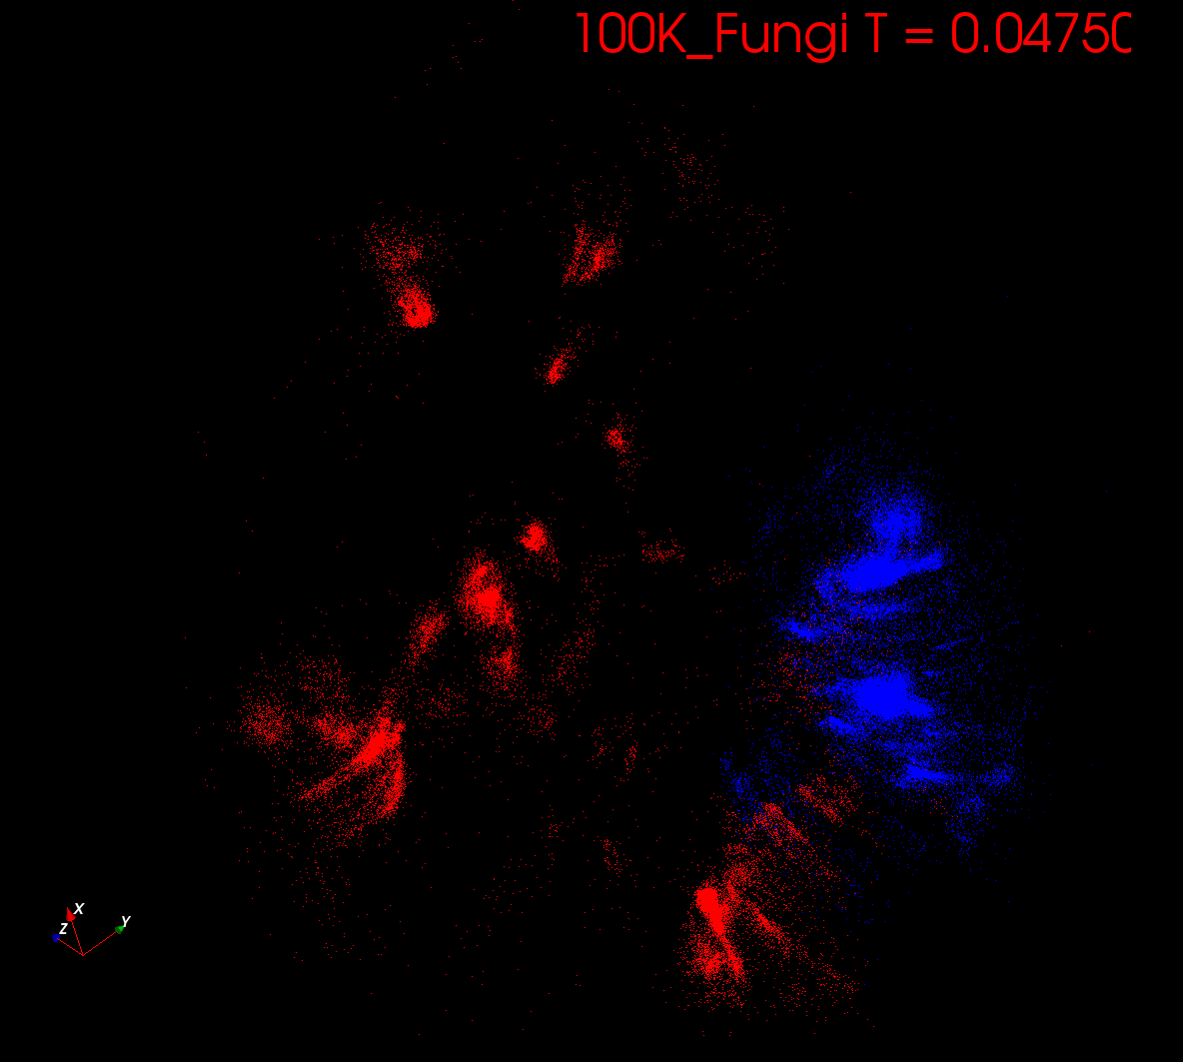
Start at T= “∞” with 1 Cluster
Decrease T, Clusters emerge at instabilities

Slide 27
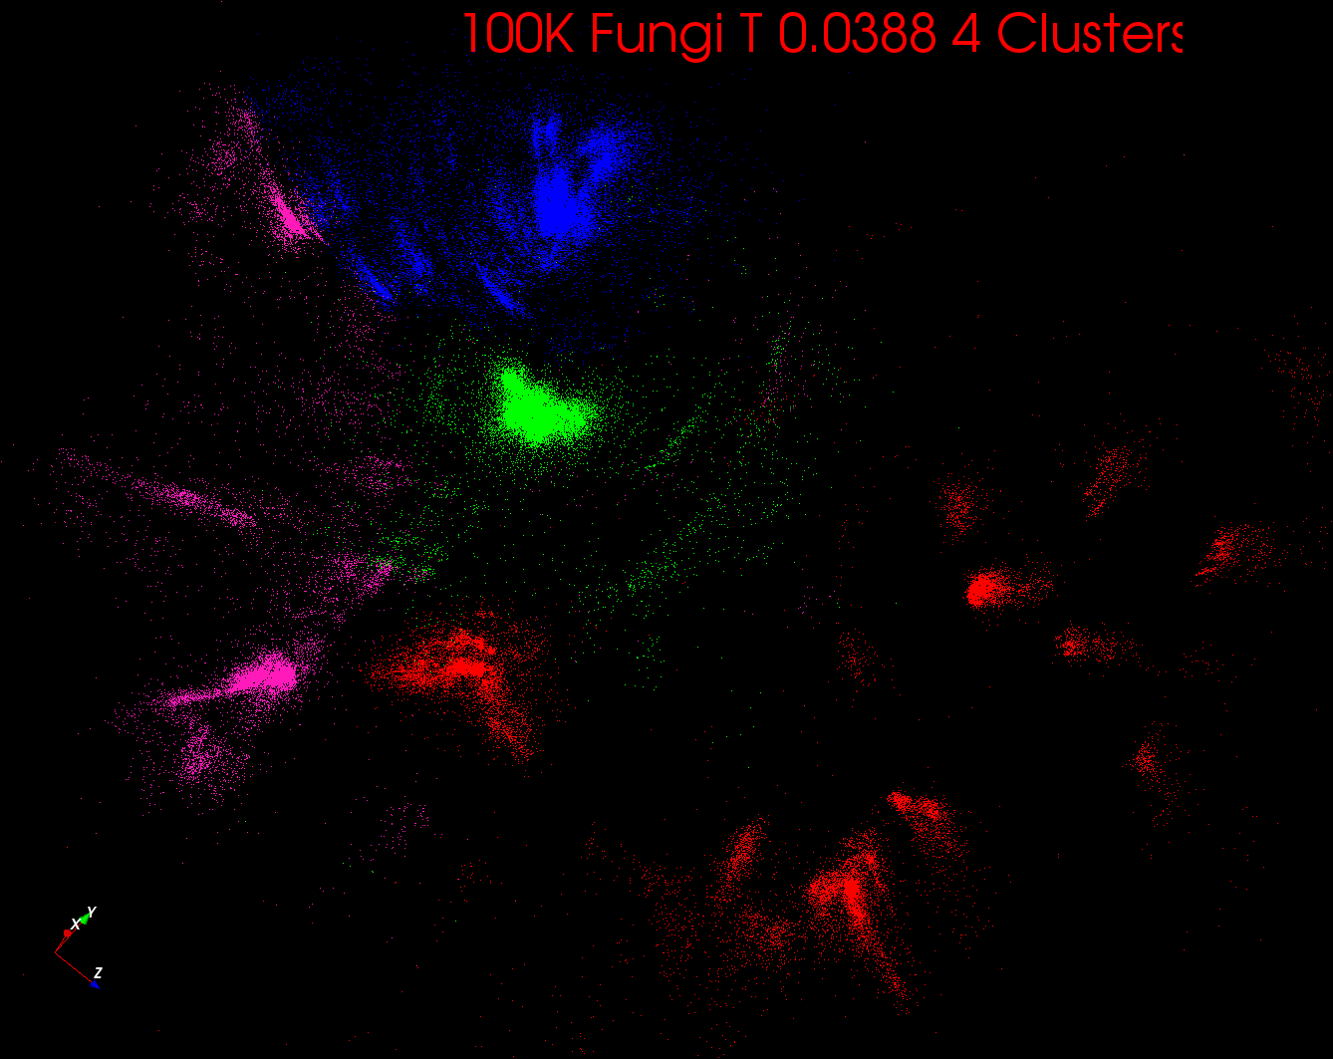

Slide 28
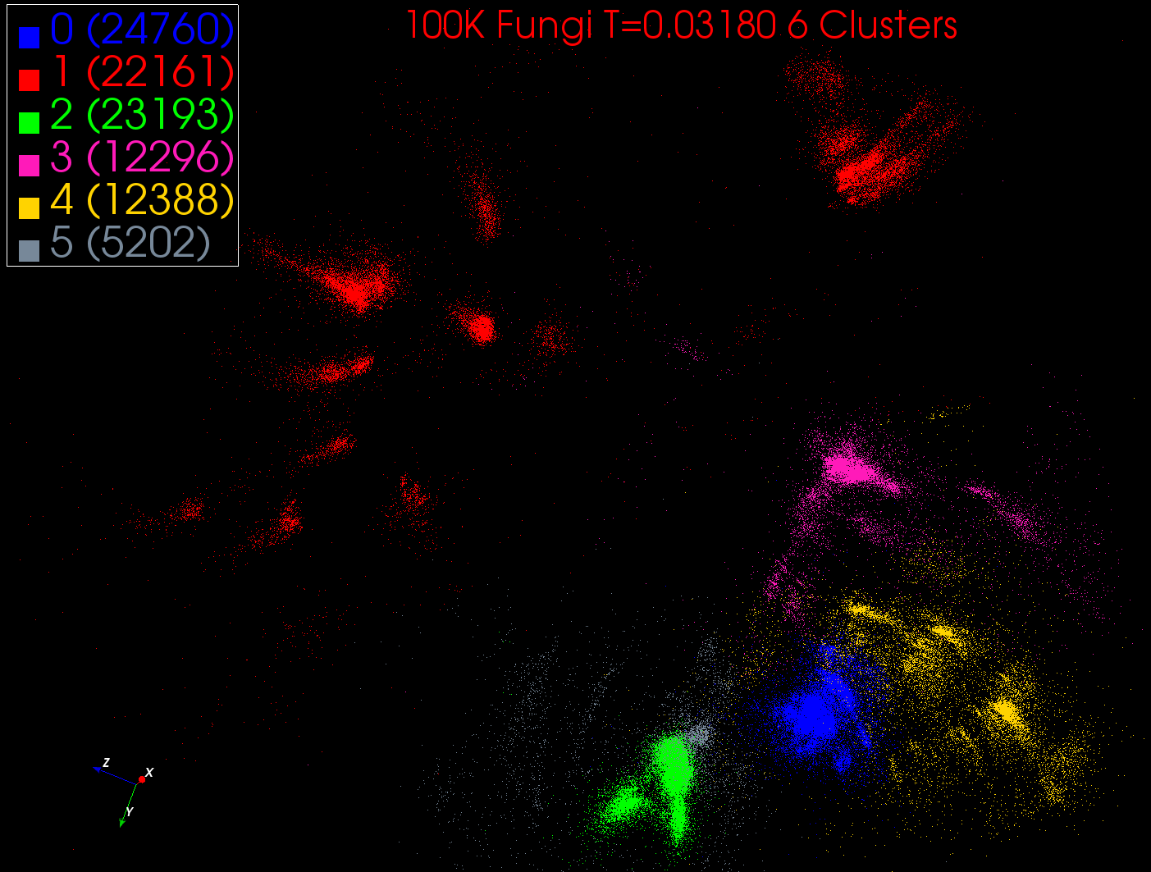

Slide 29
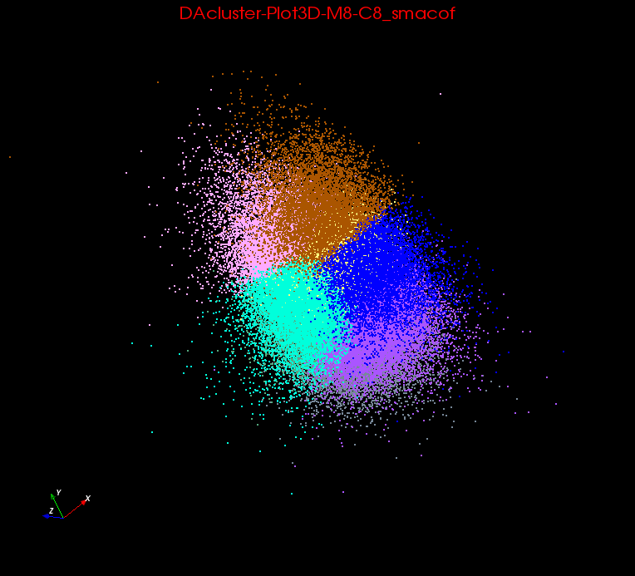
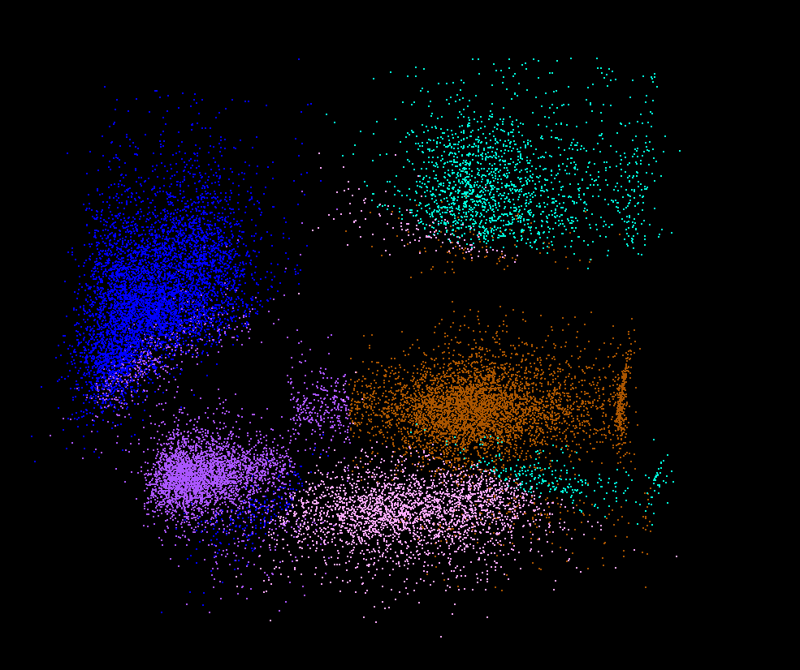
Clusters v. Regions
Lymphocytes 4D
Pathology 54D
In Lymphocytes clusters are distinct
In Pathology, clusters divide space into regions and sophisticated methods like deterministic annealing are probably unnecessary

Slide 30

Protein Universe Browser for COG Sequences with a few illustrative biologically identified clusters

Slide 31
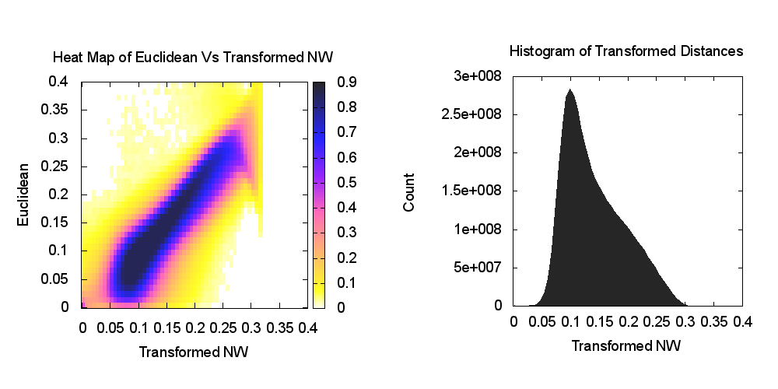
Heatmap of biology distance (Needleman-Wunsch) vs 3D Euclidean Distances
If d a distance, so is f(d) for any monotonic f. Optimize choice of f

Slide 32
WDA SMACOF MDS (Multidimensional Scaling) using Harp on IU Big Red 2
Parallel Efficiency: on 100-300K sequences
Best available MDS (much better than that in R)
Java
Harp (Hadoop plugin) described by Qiu earlier
Cores =32 #nodes
Conjugate Gradient (dominant time) and Matrix Multiplication

Slide 33
Non metric DA-PWC Deterministic Annealing Clustering Speed up
Small 12000 point clustering
Note code(s) converted from C# to Java

Slide 34
More sophisticated algorithms

Slide 35
More Efficient Parallelism
The canonical model is correct at start but each point does not really contribute to each cluster as damped exponentially by exp( - (X_{i}- Y(k))² /T )
For Proteomics problem, on average only 6.45 clusters needed per point if require (X_{i}- Y(k))² /T ≤ ~40 (as exp(-40) small)
So only need to keep nearby clusters for each point
As average number of Clusters ~ 20,000, this gives a factor of ~3000 improvement
Further communication is no longer all global; it has nearest neighbor components and calculated by parallelism over clusters

Slide 36
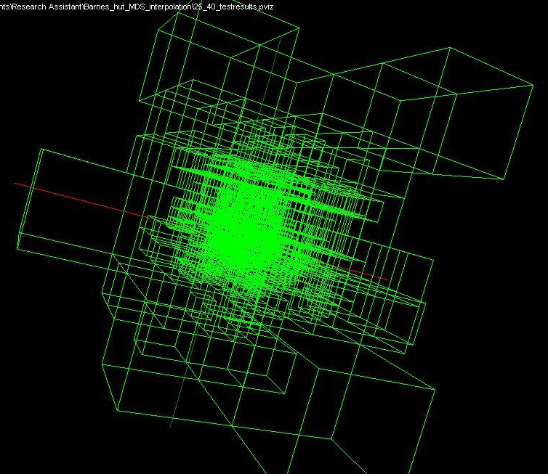
Use Barnes Hut OctTree, originally developed to make O(N²) astrophysics O(NlogN), to give similar speedups in machine learning

Slide 37
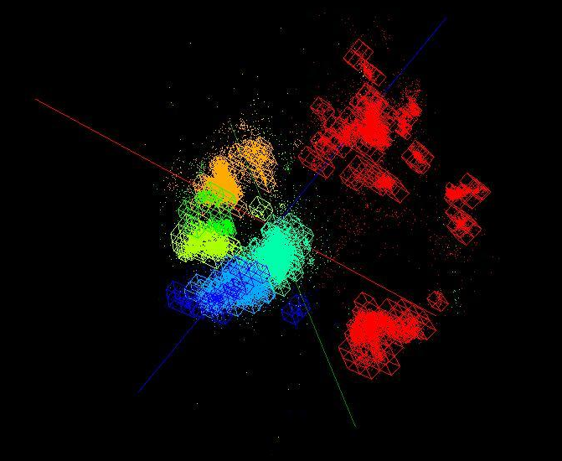
OctTree for 100K sample of Fungi
We use OctTree for logarithmic interpolation (streaming data)

Slide 38
Some Futures
Always run MDS. Gives insight into data
  Leads to a data browser as GIS gives for spatial data
Claim is algorithm change gave as much performance increase as hardware change in simulations. Will this happen in analytics?
  Today is like parallel computing 30 years ago with regular meshs. We will learn how to adapt methods automatically to give “multigrid” and “fast multipole” like algorithms
Need to start developing the libraries that support Big Data
  Understand architectures issues
  Have coupled batch and streaming versions
  Develop much better algorithms
Please join SPIDAL (Scalable Parallel Interoperable Data Analytics Library) community

