Slide 1
Returning to Java Grande:
High Performance Architecture for Big Data
INTERNATIONAL ADVANCED RESEARCH WORKSHOP
ON HIGH PERFORMANCE COMPUTING
From Clouds and Big Data to Exascale and Beyond
Cetraro (Italy)
July 7 2014
Geoffrey Fox
gcf@indiana.edu
http://www.infomall.org
School of Informatics and Computing
Digital Science Center
Indiana University Bloomington

Slide 2
Abstract
Here we use a sample of over 50 big data applications to identify characteristics of data intensive applications and to deduce needed runtime and architectures.
We propose a big data version of the famous Berkeley dwarfs and NAS parallel benchmarks as the kernel big data applications.
We suggest that one must unify HPC with the well known Apache software stack that is well used in modern cloud computing and surely is most widely used data processing framework in the “real world”.
We give some examples including clustering, deep-learning and multi-dimensional scaling. This work suggests the value of a high performance Java (Grande) runtime that supports simulations and big data.

Slide 3
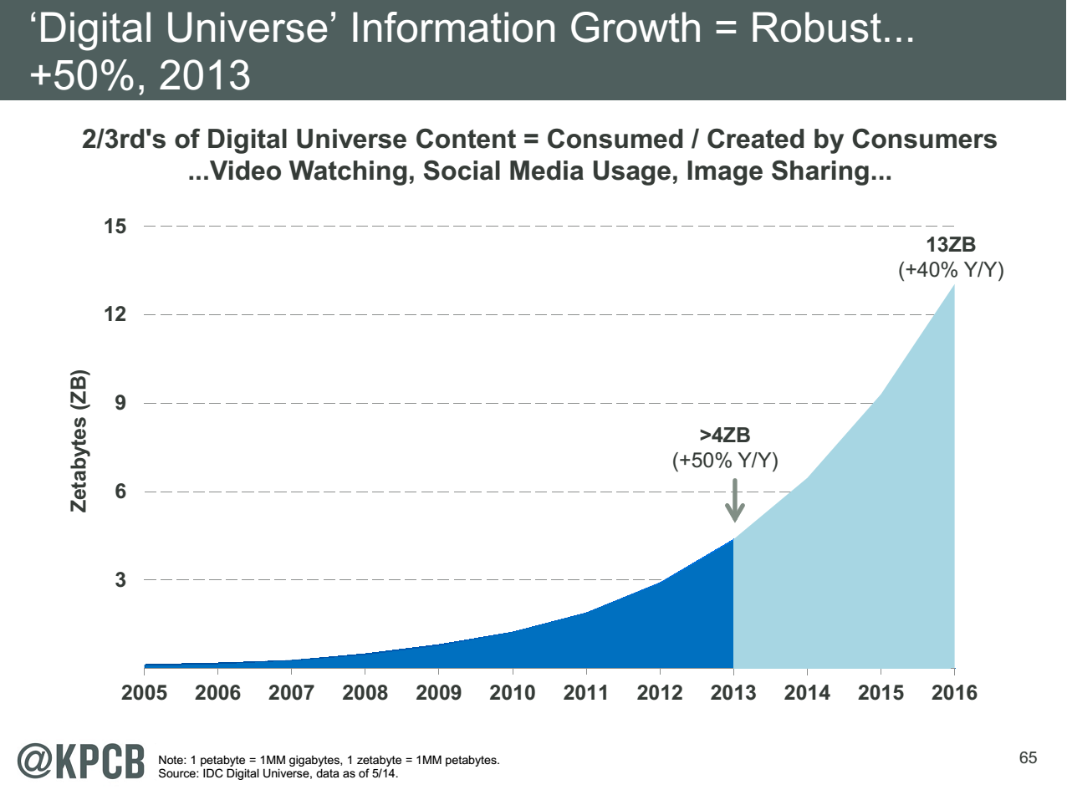
Note largest science ~100 petabytes = 0.000025 total
http://www.kpcb.com/internet-trends

Slide 4
NIST Big Data Use Cases
Led by Chaitin Baru, Bob Marcus, Wo Chang

Slide 5

Use Case Template
26 fields completed for 51 areas
Government Operation: 4
Commercial: 8
Defense: 3
Healthcare and Life Sciences: 10
Deep Learning and Social Media: 6
The Ecosystem for Research: 4
Astronomy and Physics: 5
Earth, Environmental and Polar Science: 10
Energy: 1

Slide 6
51 Detailed Use Cases: Contributed July-September 2013
Covers goals, data features such as 3 V’s, software, hardware
26 Features for each use case
Biased to science
http://bigdatawg.nist.gov/usecases.php
https://bigdatacoursespring2014.appspot.com/course (Section 5)
Government Operation(4): National Archives and Records Administration, Census Bureau
Commercial(8): Finance in Cloud, Cloud Backup, Mendeley (Citations), Netflix, Web Search, Digital Materials, Cargo shipping (as in UPS)
Defense(3): Sensors, Image surveillance, Situation Assessment
Healthcare and Life Sciences(10): Medical records, Graph and Probabilistic analysis, Pathology, Bioimaging, Genomics, Epidemiology, People Activity models, Biodiversity
Deep Learning and Social Media(6): Driving Car, Geolocate images/cameras, Twitter, Crowd Sourcing, Network Science, NIST benchmark datasets
The Ecosystem for Research(4): Metadata, Collaboration, Language Translation, Light source experiments
Astronomy and Physics(5): Sky Surveys including comparison to simulation, Large Hadron Collider at CERN, Belle Accelerator II in Japan
Earth, Environmental and Polar Science(10): Radar Scattering in Atmosphere, Earthquake, Ocean, Earth Observation, Ice sheet Radar scattering, Earth radar mapping, Climate simulation datasets, Atmospheric turbulence identification, Subsurface Biogeochemistry (microbes to watersheds), AmeriFlux and FLUXNET gas sensors
Energy(1): Smart grid

Slide 7

Part of Property Summary Table

Slide 8
Big Data Patterns – the Ogres

Slide 9
Would like to capture “essence of these use cases”
“small” kernels, mini-apps
Or Classify applications into patterns
Do it from HPC background not database viewpoint
e.g. focus on cases with detailed analytics
Section 5 of my class https://bigdatacoursespring2014.appspot.com/preview classifies 51 use cases with ogre facets

Slide 10
HPC Benchmark Classics
Linpack or HPL: Parallel LU factorization for solution of linear equations
NPB version 1: Mainly classic HPC solver kernels
  MG: Multigrid
  CG: Conjugate Gradient
  FT: Fast Fourier Transform
  IS: Integer sort
  EP: Embarrassingly Parallel
  BT: Block Tridiagonal
  SP: Scalar Pentadiagonal
  LU: Lower-Upper symmetric Gauss Seidel

Slide 11
13 Berkeley Dwarfs
Dense Linear Algebra
Sparse Linear Algebra
Spectral Methods
N-Body Methods
Structured Grids
Unstructured Grids
MapReduce
Combinational Logic
Graph Traversal
Dynamic Programming
Backtrack and Branch-and-Bound
Graphical Models
Finite State Machines
First 6 of these correspond to Colella’s original.
Monte Carlo dropped.
N-body methods are a subset of Particle in Colella.
Note a little inconsistent in that MapReduce is a programming model and spectral method is a numerical method.
Need multiple facets!

Slide 12
51 Use Cases: What is Parallelism Over?
People: either the users (but see below) or subjects of application and often both
Decision makers like researchers or doctors (users of application)
Items such as Images, EMR, Sequences below; observations or contents of online store
  Images or “Electronic Information nuggets”
  EMR: Electronic Medical Records (often similar to people parallelism)
  Protein or Gene Sequences;
  Material properties, Manufactured Object specifications, etc., in custom dataset
  Modelled entities like vehicles and people
Sensors – Internet of Things
Events such as detected anomalies in telescope or credit card data or atmosphere
(Complex) Nodes in RDF Graph
Simple nodes as in a learning network
Tweets, Blogs, Documents, Web Pages, etc.
  And characters/words in them
Files or data to be backed up, moved or assigned metadata
Particles/cells/mesh points as in parallel simulations

Slide 13
51 Use Cases: Low-Level (Run-time) Computational Types
PP(26): Pleasingly Parallel or Map Only
MR(18 +7 MRStat): Classic MapReduce
MRStat(7): Simple version of MR where key computations are simple reduction as coming in statistical averages
MRIter(23): Iterative MapReduce or MPI
Graph(9): complex graph data structure needed in analysis
Fusion(11): Integrate diverse data to aid discovery/decision making; could involve sophisticated algorithms or could just be a portal
Streaming(41): some data comes in incrementally and is processed this way
(Count) out of 51

Slide 14
51 Use Cases: Higher-Level Computational Types or Features
Classification(30): divide data into categories
S/Q/Index(12): Search and Query
CF(4): Collaborative Filtering
LML - Local ML(36): Local Machine Learning (Independent for each entity)
GML - Global ML(23): Deep Learning, Clustering, LDA, PLSI, MDS, Large Scale Optimizations as in Variational Bayes, Lifted Belief Propagation, Stochastic Gradient Descent, L-BFGS, Levenberg-Marquardt (Sometimes call EGO or Exascale Global Optimization – scalable parallel algorithm)
Workflow: (Left out of analysis but ~universal)
GIS(16): Geotagged data and often displayed in ESRI, Microsoft Virtual Earth, Google Earth, GeoServer etc.
HPC(5): Classic large-scale simulation of cosmos, materials, etc. generates big data
Agent(2): Simulations of models of data-defined macroscopic entities represented as agents
Not Independent

Slide 15
Global Machine Learning aka EGO – Exascale Global Optimization
Typically maximum likelihood or χ² with a sum over the N data items – documents, sequences, items to be sold, images etc. and often links (point-pairs). Usually it’s a sum of positive numbers as in least squares
Covering clustering/community detection, mixture models, topic determination, Multidimensional scaling, (Deep) Learning Networks
PageRank is “just” parallel linear algebra
Note many Mahout algorithms are sequential – partly as MapReduce limited; partly because parallelism unclear
  MLLib (Spark based) better
SVM and Hidden Markov Models do not use large scale parallelization in practice?
Detailed papers on particular parallel graph algorithms
Name invented at Argonne-Chicago workshop

Slide 16
Image and Internet of Things based Applications

Slide 17
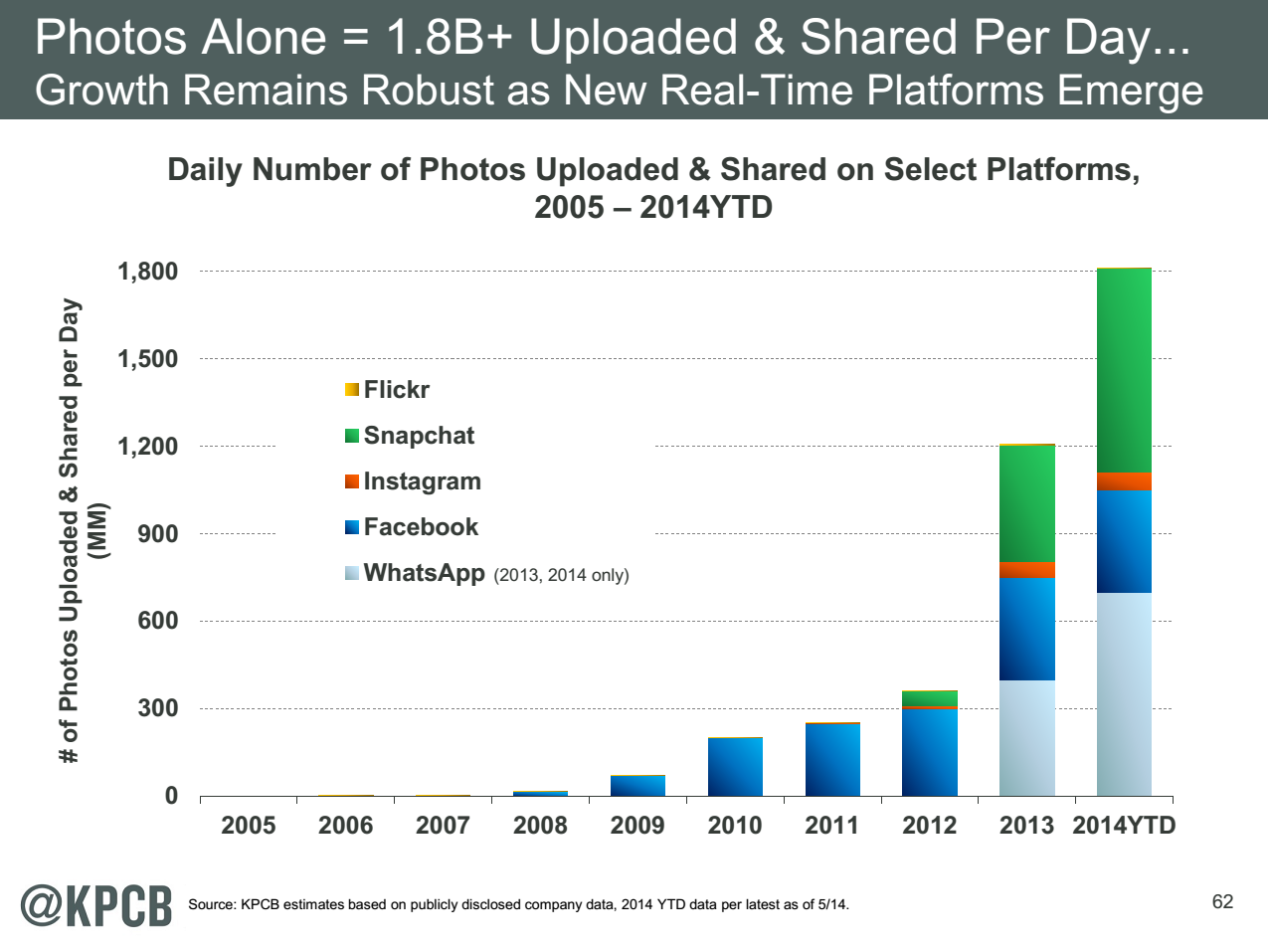
http://www.kpcb.com/internet-trends

Slide 18
9 Image-based Use Cases
17:Pathology Imaging/ Digital Pathology: PP, LML, MR for search becoming terabyte 3D images, Global Classification
18: Computational Bioimaging (Light Sources): PP, LML Also materials
26: Large-scale Deep Learning: GML Stanford ran 10 million images and 11 billion parameters on a 64 GPU HPC; vision (drive car), speech, and Natural Language Processing
27: Organizing large-scale, unstructured collections of photos: GML Fit position and camera direction to assemble 3D photo ensemble
36: Catalina Real-Time Transient Synoptic Sky Survey (CRTS): PP, LML followed by classification of events (GML)
43: Radar Data Analysis for CReSIS Remote Sensing of Ice Sheets: PP, LML to identify glacier beds; GML for full ice-sheet
44: UAVSAR Data Processing, Data Product Delivery, and Data Services: PP to find slippage from radar images
45, 46: Analysis of Simulation visualizations: PP LML ?GML find paths, classify orbits, classify patterns that signal earthquakes, instabilities, climate, turbulence

Slide 19
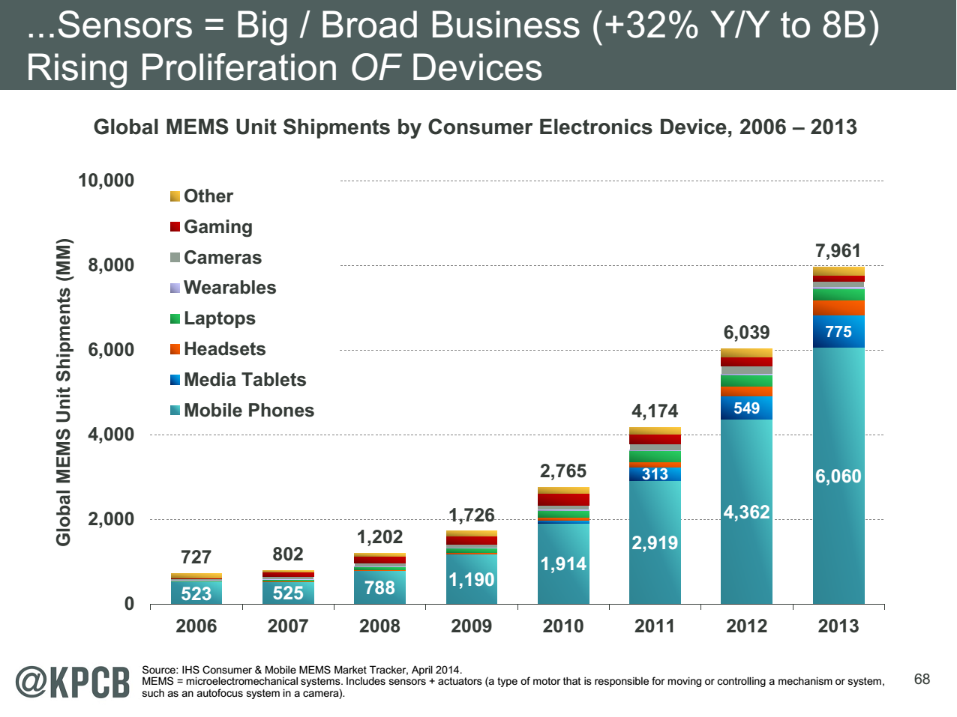
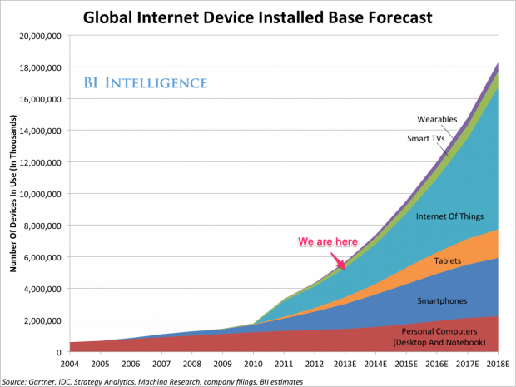
http://www.kpcb.com/internet-trends

Slide 20
Internet of Things and Streaming Apps
It is projected that there will be 24 (Mobile Industry Group) to 50 (Cisco) billion devices on the Internet by 2020.
The cloud natural controller of and resource provider for the Internet of Things.
Smart phones/watches, Wearable devices (Smart People), “Intelligent River” “Smart Homes and Grid” and “Ubiquitous Cities”, Robotics.
Majority of use cases are streaming – experimental science gathers data in a stream – sometimes batched as in a field trip. Below is sample
10: Cargo Shipping Tracking as in UPS, Fedex PP GIS LML
13: Large Scale Geospatial Analysis and Visualization PP GIS LML
28: Truthy: Information diffusion research from Twitter Data PP MR for Search, GML for community determination
39: Particle Physics: Analysis of LHC Large Hadron Collider Data: Discovery of Higgs particle PP Local Processing Global statistics
50: DOE-BER AmeriFlux and FLUXNET Networks PP GIS LML
51: Consumption forecasting in Smart Grids PP GIS LML

Slide 21
HPC-ABDS
Integrating High Performance Computing with Apache Big Data Stack
Shantenu Jha, Judy Qiu, Andre Luckow

Slide 22
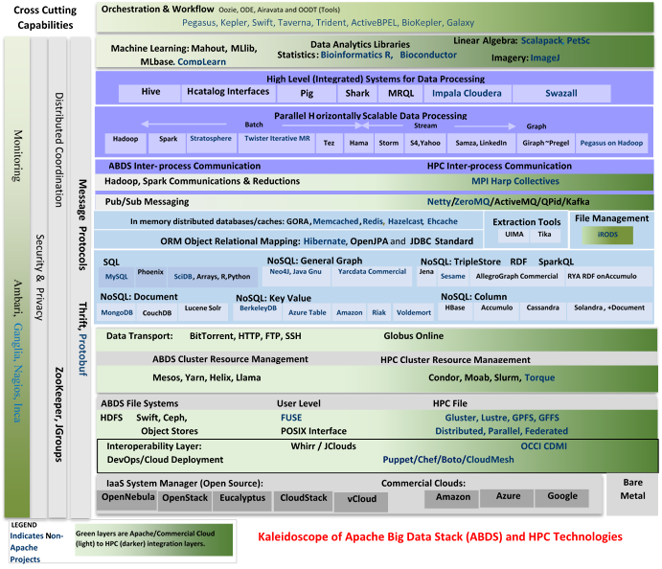

Slide 23
HPC-ABDS
~120 Capabilities
>40 Apache
Green layers have strong HPC Integration opportunities
Goal
Functionality of ABDS
Performance of HPC

Slide 24
Cross-Cutting Functionalities
Message Protocols
Distributed Coordination
Security & Privacy
Monitoring
~120 HPC-ABDS Software capabilities in 17 functionalities
Workflow-Orchestration
Application and Analytics: Mahout, MLlib, R…
High level Programming
Basic Programming model and runtime SPMD, Streaming, MapReduce, MPI
Inter process communication Collectives, point-to-point, publish-subscribe
In-memory databases/caches
Object-relational mapping
SQL and NoSQL, File management
Data Transport
Cluster Resource Management
File systems
DevOps
IaaS Management from HPC to hypervisors
Kaleidoscope of Apache Big Data Stack (ABDS) and HPC Technologies

Slide 25
SPIDAL (Scalable Parallel Interoperable Data Analytics Library)
Getting High Performance on Data Analytics
On the systems side, we have two principles:
  The Apache Big Data Stack with ~120 projects has important broad functionality with a vital large support organization
  HPC including MPI has striking success in delivering high performance,
  however with a fragile sustainability model
There are key systems abstractions which are levels in HPC-ABDS software stack where Apache approach needs careful integration with HPC
  Resource management
  Storage
  Programming model -- horizontal scaling parallelism
  Collective and Point-to-Point communication
  Support of iteration
  Data interface (not just key-value)
In application areas, we define application abstractions to support:
  Graphs/network
  Geospatial
  Genes
  Images, etc.

Slide 26

HPC-ABDS Hourglass
HPC ABDS
System (Middleware)
120 Software Projects
System Abstractions/standards
Data format
Storage
HPC Yarn for Resource management
Horizontally scalable parallel programming model
Collective and Point-to-Point communication
Support of iteration (in memory databases)
Application Abstractions/standards
Graphs, Networks, Images, Geospatial ….
SPIDAL (Scalable Parallel Interoperable Data Analytics Library) or High performance Mahout, R, Matlab…
High performance
Applications

Slide 27
Useful Set of Analytics Architectures
Pleasingly Parallel: including local machine learning as in parallel over images and apply image processing to each image
- Hadoop could be used but many other HTC, Many task tools
Search: including collaborative filtering and motif finding implemented using classic MapReduce (Hadoop)
Map-Collective or Iterative MapReduce using Collective Communication (clustering) – Hadoop with Harp, Spark …..
Map-Communication or Iterative Giraph: (MapReduce) with point-to-point communication (most graph algorithms such as maximum clique, connected component, finding diameter, community detection)
  Vary in difficulty of finding partitioning (classic parallel load balancing)
Shared memory: thread-based (event driven) graph algorithms (shortest path, Betweenness centrality)
Ideas like workflow are “orthogonal” to this

Slide 28
Facets of the Ogres

Slide 29
Application Class Facet of Ogres
Classification (30) divide data into categories
Search Index and query (12)
Maximum Likelihood or χ² minimizations
Expectation Maximization (often Steepest descent)
Local (pleasingly parallel) Machine Learning (36) contrasted to
(Exascale) Global Optimization (23) (such as Learning Networks, Variational Bayes and Gibbs Sampling)
Do they Use Agents (2) as in epidemiology (swarm approaches)?
Higher-Level Computational Types or Features in earlier slide also has
CF(4): Collaborative Filtering in Core Analytics Facet
and two categories in data source and style
GIS(16): Geotagged data and often displayed in ESRI, Microsoft Virtual Earth, Google Earth, GeoServer etc.
HPC(5): Classic large-scale simulation of cosmos, materials, etc. generates big data

Slide 30
Problem Architecture Facet of Ogres (Meta or MacroPattern)
Pleasingly Parallel – as in BLAST, Protein docking, some (bio-)imagery including Local Analytics or Machine Learning – ML or filtering pleasingly parallel, as in bio-imagery, radar images (pleasingly parallel but sophisticated local analytics)
Classic MapReduce for Search and Query
Global Analytics or Machine Learning requiring iterative programming models
Problem set up as a graph as opposed to vector, grid
SPMD (Single Program Multiple Data)
Bulk Synchronous Processing: well-defined compute-communication phases
Fusion: Knowledge discovery often involves fusion of multiple methods.
Workflow (often used in fusion)
Note problem and machine architectures are related
Slight expansion of an earlier slides on:
Major Analytics Architectures in Use Cases
Pleasingly parallel
Search (MapReduce)
Map-Collective
Map-Communication as in MPI
Shared Memory
Low-Level (Run-time) Computational Types used to label 51 use cases
PP(26): Pleasingly Parallel
MR(18 +7 MRStat): Classic MapReduce
MRStat(7)
MRIter(23)
Graph(9)
Fusion(11)
Streaming(41) In data source
Notes:
Big dwarfs are Ogres
Implement Ogres in ABDS+

Slide 31
4 Forms of MapReduce
(a) Map Only
(b) Classic MapReduce
(c) Iterative Map Reduce or Map-Collective
(d) Point to Point
Input
Input
Iterations
Input
map
map
map
P_{ij}
reduce
reduce
Output
BLAST Analysis
Local Machine Learning
Pleasingly Parallel
High Energy Physics (HEP) Histograms
Distributed search
Expectation maximization Clustering e.g. K-means
Linear Algebra, PageRank
Classic MPI
PDE Solvers and particle dynamics
Domain of MapReduce and Iterative Extensions
MPI
Giraph
All of them are Map-Communication?

Slide 32
One Facet of Ogres has Computational Features
Flops per byte;
Communication Interconnect requirements;
Is application (graph) constant or dynamic?
Most applications consist of a set of interconnected entities; is this regular as a set of pixels or is it a complicated irregular graph?
Is communication BSP or Asynchronous? In latter case shared memory may be attractive;
Are algorithms Iterative or not?
Data Abstraction: key-value, pixel, graph, vector
  Are data points in metric or non-metric spaces?
Core libraries needed: matrix-matrix/vector algebra, conjugate gradient, reduction, broadcast

Slide 33
Data Source and Style Facet of Ogres
(i) SQL
(ii) NOSQL based
(iii) Other Enterprise data systems (10 examples from Bob Marcus)
(iv) Set of Files (as managed in iRODS)
(v) Internet of Things
(vi) Streaming and
(vii) HPC simulations
(viii) Involve GIS (Geographical Information Systems)
Before data gets to compute system, there is often an initial data gathering phase which is characterized by a block size and timing. Block size varies from month (Remote Sensing, Seismic) to day (genomic) to seconds or lower (Real time control, streaming)
There are storage/compute system styles: Shared, Dedicated, Permanent, Transient
Other characteristics are needed for permanent auxiliary/comparison datasets and these could be interdisciplinary, implying nontrivial data movement/replication
Notes:
Big dwarfs are Ogres
Implement Ogres in ABDS+

Slide 34
Analytics Facet (kernels) of the Ogres

Slide 35
Core Analytics Facet of Ogres (microPattern) I
Map-Only
Pleasingly parallel - Local Machine Learning
MapReduce: Search/Query
Summarizing statistics as in LHC Data analysis (histograms)
Recommender Systems (Collaborative Filtering)
Linear Classifiers (Bayes, Random Forests)
Global Analytics
Nonlinear Solvers (structure depends on objective function)
  Stochastic Gradient Descent SGD
  (L-)BFGS approximation to Newton’s Method
  Levenberg-Marquardt solver
Map-Collective I (need to improve/extend Mahout, MLlib)
Outlier Detection, Clustering (many methods),
Mixture Models, LDA (Latent Dirichlet Allocation), PLSI (Probabilistic Latent Semantic Indexing)

Slide 36
Core Analytics Facet of Ogres (microPattern) II
Map-Collective II
Use matrix-matrix,-vector operations, solvers (conjugate gradient)
SVM and Logistic Regression
PageRank, (find leading eigenvector of sparse matrix)
SVD (Singular Value Decomposition)
MDS (Multidimensional Scaling)
Learning Neural Networks (Deep Learning)
Hidden Markov Models
Map-Communication
Graph Structure (Communities, subgraphs/motifs, diameter, maximal cliques, connected components)
Network Dynamics - Graph simulation Algorithms (epidemiology)
Asynchronous Shared Memory
Graph Structure (Betweenness centrality, shortest path)

Slide 37
Parallel Global Machine Learning Examples
Initial SPIDAL entries

Slide 38
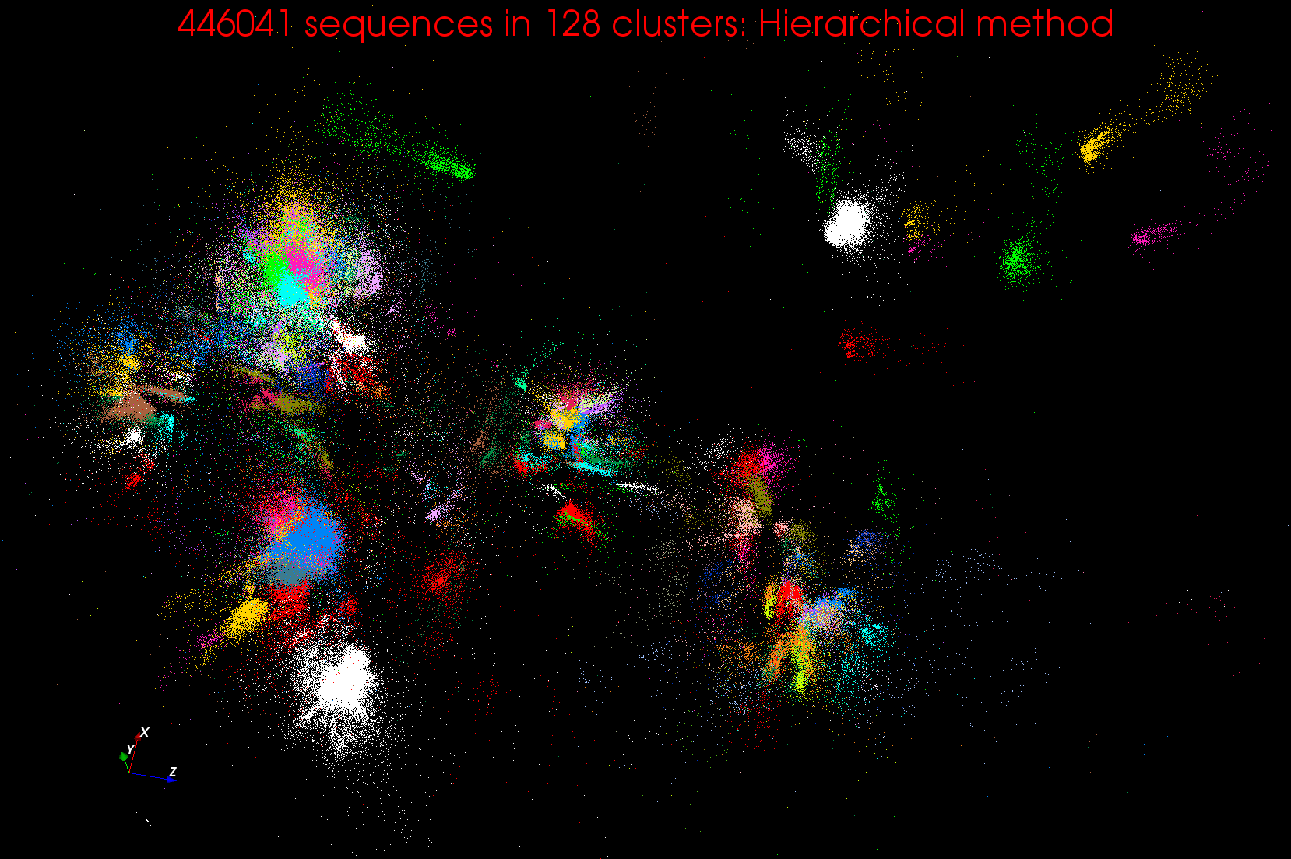
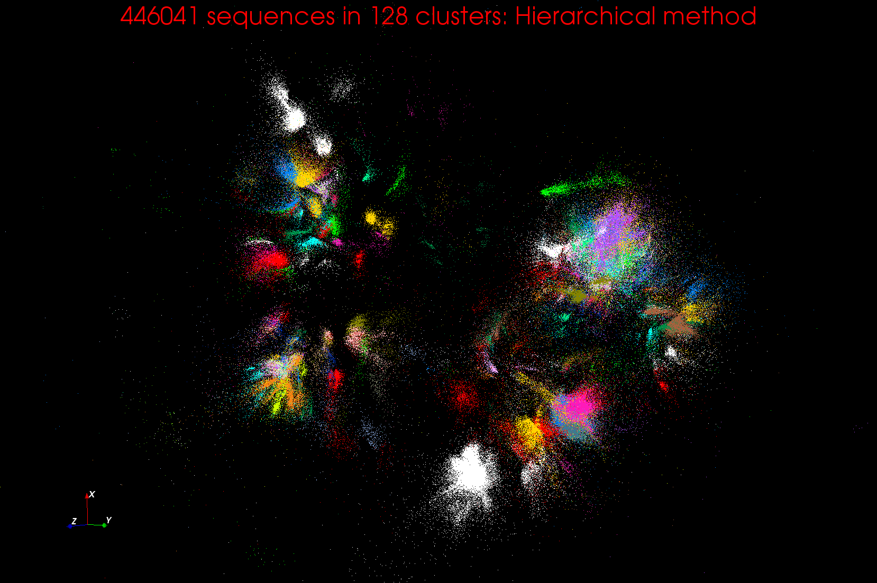
Clustering and MDS Large Scale O(N²) GML

Slide 39
Cluster Count v. Temperature for LC-MS Data Analysis
All start with one cluster at far left
T=1 special as measurement errors divided out
DA2D counts clusters with 1 member as clusters. DAVS(2) does not

Slide 40
WDA SMACOF MDS (Multidimensional Scaling) using Harp on IU Big Red 2
Parallel Efficiency: on 100-300K sequences
Best available MDS (much better than that in R)
Java
Harp (Hadoop plugin) described by Qiu later
Cores =32 #nodes
Conjugate Gradient (dominant time) and Matrix Multiplication

Slide 41
Increasing Communication
Identical Computation
Mahout and Hadoop MR – Slow due to MapReduce
Python slow as Scripting; MPI fastest
Spark Iterative MapReduce, non optimal communication
Harp Hadoop plug in with ~MPI collectives

Slide 42
Comparing Data Intensive and Simulation Problems

Slide 43
Comparison of Data Analytics with Simulation I
Pleasingly parallel often important in both
Both are often SPMD and BSP
  Non-iterative MapReduce is major big data paradigm
  not a common simulation paradigm except where “Reduce” summarizes pleasingly parallel execution
Big Data often has large collective communication
  Classic simulation has a lot of smallish point-to-point messages
Simulation dominantly sparse (nearest neighbor) data structures
  “Bag of words (users, rankings, images..)” algorithms are sparse, as is PageRank
  Important data analytics involves full matrix algorithms

Slide 44
Comparison of Data Analytics with Simulation II
There are similarities between some graph problems and particle simulations with a strange cutoff force.
  Both Map-Communication
Note many big data problems are “long range force” as all points are linked.
  Easiest to parallelize. Often full matrix algorithms
  e.g. in DNA sequence studies, distance δ(i, j) defined by BLAST, Smith-Waterman, etc., between all sequences i, j.
  Opportunity for “fast multipole” ideas in big data.
In image-based deep learning, neural network weights are block sparse (corresponding to links to pixel blocks) but can be formulated as full matrix operations on GPUs and MPI in blocks.
In HPC benchmarking, Linpack being challenged by a new sparse conjugate gradient benchmark HPCG, while I am diligently using non- sparse conjugate gradient solvers in clustering and Multi-dimensional scaling.

Slide 45
Java Grande

Slide 46
Java Grande
We once tried to encourage use of Java in HPC with Java Grande Forum but Fortran, C and C++ remain central HPC languages.
  Not helped by .com and Sun collapse in 2000-2005
The pure Java CartaBlanca, a 2005 R&D100 award-winning project, was an early successful example of HPC use of Java in a simulation tool for non-linear physics on unstructured grids.
Of course Java is a major language in ABDS and as data analysis and simulation are naturally linked, should consider broader use of Java
Using Habanero Java (from Rice University) for Threads and mpiJava or FastMPJ for MPI, gathering collection of high performance parallel Java analytics
  Converted from C# and sequential Java faster than sequential C#
So will have either Hadoop+Harp or classic Threads/MPI versions in Java Grande version of Mahout

Slide 47
Performance of MPI Kernel Operations
Pure Java as in FastMPJ slower than Java interfacing to C version of MPI

Slide 48
Lessons / Insights
Integrate (don’t compete) HPC with “Commodity Big data” (Google to Amazon to Enterprise Data Analytics)
  i.e. improve Mahout; don’t compete with it
  Use Hadoop plug-ins rather than replacing Hadoop
Enhanced Apache Big Data Stack HPC-ABDS has ~120 members
Opportunities at Resource management, Data/File, Streaming, Programming, monitoring, workflow layers for HPC and ABDS integration
Data intensive algorithms do not have the well developed high performance libraries familiar from HPC
Global Machine Learning or (Exascale Global Optimization) particularly challenging
Strong case for high performance Java (Grande) run time supporting all forms of parallelism

