Slide 1
Application and Software Classifications that motivate Big Data and Big Simulation Convergence
HPC 2016 HIGH PERFORMANCE COMPUTING
FROM CLOUDS AND BIG DATA TO EXASCALE AND BEYOND
June 27- July 1 2016 Cetraro
http://www.hpcc.unical.it/hpc2016/
Geoffrey Fox
June 28, 2016
gcf@indiana.edu
http://www.dsc.soic.indiana.edu/, http://spidal.org/ http://hpc-abds.org/kaleidoscope/
Department of Intelligent Systems Engineering
School of Informatics and Computing, Digital Science Center
Indiana University Bloomington

Slide 2
Abstract
We combine NAS Parallel Benchmarks, Berkeley Dwarfs, the Computational Giants of NRC Massive Data Analysis Report and the NIST Big Data use cases to get an application classification -- the convergence diamonds that links Big Data and Big Simulation in a unified framework.
We combine this with High Performance Computing enhanced Apache Big Data software Stack HPC-ABDS and suggest a simple approach to computing systems that support data management, analytics, visualization and simulations without sacrificing performance.
We describe a set of "software defined" application exemplars using an Ansible DevOps tool Cloudmesh

Slide 3
NIST Big Data Initiative
Use Cases and Properties
Led by Chaitin Baru, Bob Marcus, Wo Chang

Slide 4
51 Detailed Use Cases: Contributed July-September 2013
Covers goals, data features such as 3 V’s, software, hardware
Government Operation(4): National Archives and Records Administration, Census Bureau
Commercial(8): Finance in Cloud, Cloud Backup, Mendeley (Citations), Netflix, Web Search, Digital Materials, Cargo shipping (as in UPS)
Defense(3): Sensors, Image surveillance, Situation Assessment
Healthcare and Life Sciences(10): Medical records, Graph and Probabilistic analysis, Pathology, Bioimaging, Genomics, Epidemiology, People Activity models, Biodiversity
Deep Learning and Social Media(6): Driving Car, Geolocate images/cameras, Twitter, Crowd Sourcing, Network Science, NIST benchmark datasets
The Ecosystem for Research(4): Metadata, Collaboration, Language Translation, Light source experiments
Astronomy and Physics(5): Sky Surveys including comparison to simulation, Large Hadron Collider at CERN, Belle Accelerator II in Japan
Earth, Environmental and Polar Science(10): Radar Scattering in Atmosphere, Earthquake, Ocean, Earth Observation, Ice sheet Radar scattering, Earth radar mapping, Climate simulation datasets, Atmospheric turbulence identification, Subsurface Biogeochemistry (microbes to watersheds), AmeriFlux and FLUXNET gas sensors
Energy(1): Smart grid
Published by NIST as http://nvlpubs.nist.gov/nistpubs/SpecialPublications/NIST.SP.1500-3.pdf
“Version 2” being prepared
26 Features for each use case Biased to science

Slide 5
Features of 51 Use Cases I
PP (26) “All” Pleasingly Parallel or Map Only
MR (18) Classic MapReduce MR (add MRStat below for full count)
MRStat (7) Simple version of MR where key computations are simple reduction as found in statistical averages such as histograms and averages
MRIter (23) Iterative MapReduce or MPI (Flink, Spark, Twister)
Graph (9) Complex graph data structure needed in analysis
Fusion (11) Integrate diverse data to aid discovery/decision making; could involve sophisticated algorithms or could just be a portal
Streaming (41) Some data comes in incrementally and is processed this way
Classify (30) Classification: divide data into categories
S/Q (12) Index, Search and Query

Slide 6
Features of 51 Use Cases II
CF (4) Collaborative Filtering for recommender engines
LML (36) Local Machine Learning (Independent for each parallel entity) – application could have GML as well
GML (23) Global Machine Learning: Deep Learning, Clustering, LDA, PLSI, MDS,
  Large Scale Optimizations as in Variational Bayes, MCMC, Lifted Belief Propagation, Stochastic Gradient Descent, L-BFGS, Levenberg-Marquardt . Can call EGO or Exascale Global Optimization with scalable parallel algorithm
Workflow (51) Universal
GIS (16) Geotagged data and often displayed in ESRI, Microsoft Virtual Earth, Google Earth, GeoServer etc.
HPC (5) Classic large-scale simulation of cosmos, materials, etc. generating (visualization) data
Agent (2) Simulations of models of data-defined macroscopic entities represented as agents

Slide 7
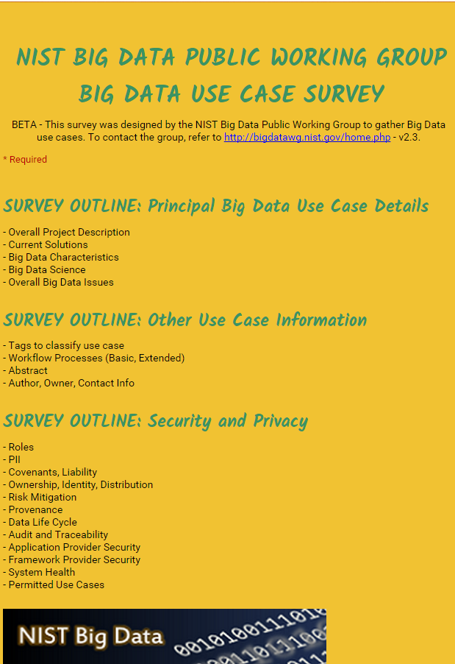
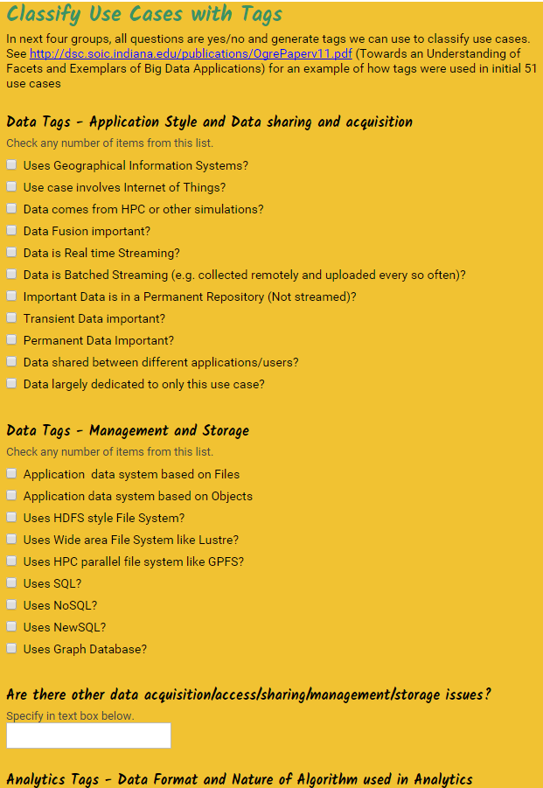
http://hpc-abds.org/kaleidoscope/survey/
Online Use Case Form

Slide 8
Data and Model in Big Data and Simulations
Need to discuss Data and Model as problems combine them, but we can get insight by separating which allows better understanding of Big Data - Big Simulation “convergence” (or differences!)
Big Data implies Data is large but Model varies (Judy Qiu talk)
  e.g. LDA with many topics or deep learning has large model
  Clustering or Dimension reduction can be quite small in model size
Simulations can also be considered as Data and Model
  Model is solving particle dynamics or partial differential equations
  Data could be small when just boundary conditions
  Data large with data assimilation (weather forecasting) or when data visualizations are produced by simulation
Data often static between iterations (unless streaming); Model varies between iterations

Slide 9
7 Computational Giants of
NRC Massive Data Analysis Report
http://www.nap.edu/catalog.php?record_id=18374 Big Data Models?
G1: Basic Statistics e.g. MRStat
G2: Generalized N-Body Problems
G3: Graph-Theoretic Computations
G4: Linear Algebraic Computations
G5: Optimizations e.g. Linear Programming
G6: Integration e.g. LDA and other GML
G7: Alignment Problems e.g. BLAST

Slide 10
HPC (Simulation) Benchmark Classics
Linpack or HPL: Parallel LU factorization
for solution of linear equations; HPCG
NPB version 1: Mainly classic HPC solver kernels
  MG: Multigrid
  CG: Conjugate Gradient
  FT: Fast Fourier Transform
  IS: Integer sort
  EP: Embarrassingly Parallel
  BT: Block Tridiagonal
  SP: Scalar Pentadiagonal
  LU: Lower-Upper symmetric Gauss Seidel
Simulation Models

Slide 11
13 Berkeley Dwarfs
Dense Linear Algebra
Sparse Linear Algebra
Spectral Methods
N-Body Methods
Structured Grids
Unstructured Grids
MapReduce
Combinational Logic
Graph Traversal
Dynamic Programming
Backtrack and
Branch-and-Bound
Graphical Models
Finite State Machines
Largely Models for Data or Simulation
First 6 of these correspond to Colella’s original. (Classic simulations)
Monte Carlo dropped.
N-body methods are a subset of Particle in Colella.
Note a little inconsistent in that MapReduce is a programming model and spectral method is a numerical method.
Need multiple facets to classify use cases!

Slide 12
Classifying Use cases

Slide 13
Classifying Use Cases
Take 51 NIST and other use cases → derive multiple specific features
Generalize and systematize with features termed “facets”
50 Facets (Big Data) termed Ogres divided into 4 sets or views where each view has “similar” facets
Add simulations and look separately at Data and Model gives 64 Facets describing Big Simulation and Data termed Convergence Diamonds looking at either data or model or their combination
Allows one to study coverage of benchmark sets and architectures

Slide 15
64 Features in 4 views for Unified Classification of Big Data and Simulation Applications
Both
Simulations
Analytics
(Model for Big Data)
(Nearly all Data)
(All Model)
(Mix of Data and Model)
(Nearly all Data+Model)

Slide 16
Convergence Diamonds and their 4 Views I
One view is the overall problem architecture or macropatterns which is naturally related to the machine architecture needed to support application.
  Unchanged from Ogres and describes properties of problem such as “Pleasing Parallel” or “Uses Collective Communication”
The execution (computational) features or micropatterns view, describes issues such as I/O versus compute rates, iterative nature and regularity of computation and the classic V’s of Big Data: defining problem size, rate of change, etc.
  Significant changes from ogres to separate Data and Model and add characteristics of Simulation models. e.g. both model and data have “V’s”; Data Volume, Model Size
  e.g. O(N²) Algorithm relevant to big data or big simulation model

Slide 17
Convergence Diamonds and their 4 Views II
The data source & style view includes facets specifying how the data is collected, stored and accessed. Has classic database characteristics
  Simulations can have facets here to describe input or output data
  Examples: Streaming, files versus objects, HDFS v. Lustre
Processing view has model (not data) facets which describe types of processing steps including nature of algorithms and kernels by model e.g. Linear Programming, Learning, Maximum Likelihood, Spectral methods, Mesh type,
  mix of Big Data Processing View and Big Simulation Processing View and includes some facets like “uses linear algebra” needed in both: has specifics of key simulation kernels and in particular includes facets seen in NAS Parallel Benchmarks and Berkeley Dwarfs
Instances of Diamonds are particular problems and a set of Diamond instances that cover enough of the facets could form a comprehensive benchmark/mini-app set
Diamonds and their instances can be atomic or composite

Slide 18
HPC-ABDS

Slide 19
HPC-ABDS

Slide 20
Implementing HPC-ABDS
Building high performance data analytics library in NSF14-43054 Dibbs SPIDAL building blocks (my next talk Thursday)
Use C++, Python or Java Grande as languages
Software Philosophy – enhance existing ABDS; not standalone software
  Use Heron, Storm, Hadoop, Spark, Flink, Hbase, Yarn, Mesos
  Define MPI community as source of best-possible inter-process communication; need to enhance MPI distribution as HPC nearest neighbor and big data mainly collectives
  Spark, Flink, Heron are best distributed computing dataflow engines that differ on streaming support?
  Judy Qiu will describe Harp as HPC Hadoop plug-in
Working with Apache; how should one do this?
  Establish a standalone HPC project
  Join existing Apache projects and contribute HPC enhancements
Simple Apache experiment with Twitter (Apache) Heron to build HPC Heron that supports science use cases (big images) based on earlier work with Storm

Slide 21
Functionality of 21 HPC-ABDS Layers
Message Protocols:
Distributed Coordination:
Security & Privacy:
Monitoring:
IaaS Management from HPC to hypervisors:
DevOps:
Interoperability:
File systems:
Cluster Resource Management:
Data Transport:
A) File management
B) NoSQL
C) SQL
In-memory databases & caches / Object-relational mapping / Extraction Tools
Inter process communication Collectives, point-to-point, publish-subscribe, MPI:
A) Basic Programming model and runtime, SPMD, MapReduce:
B) Streaming:
A) High level Programming:
B) Frameworks
Application and Analytics:
Workflow-Orchestration:

Slide 22
Typical Big Data Pattern 2. Perform real time analytics on data source streams and notify users when specified events occur
Specify filter
Filter Identifying Events
Fetch streamed Data
Post Selected Events
Streaming Data
Posted Data
Identified Events
Streaming Data
Streaming Data
Archive
Repository
Storm (Heron), Kafka, Hbase, Zookeeper

Slide 23
Typical Big Data Pattern 5A. Perform interactive analytics on observational scientific data
Science Analysis Code, Mahout, R, SPIDAL
Grid or Many Task Software, Hadoop, Spark, Giraph, Pig …
Data Storage: HDFS, Hbase, File Collection
Direct Transfer
Transport batch of data to primary analysis data system
Streaming Twitter data for Social Networking
Local Accumulate and initial computing
NIST examples include LHC, Remote Sensing, Astronomy and Bioinformatics
Record Scientific Data in “field”

Slide 24
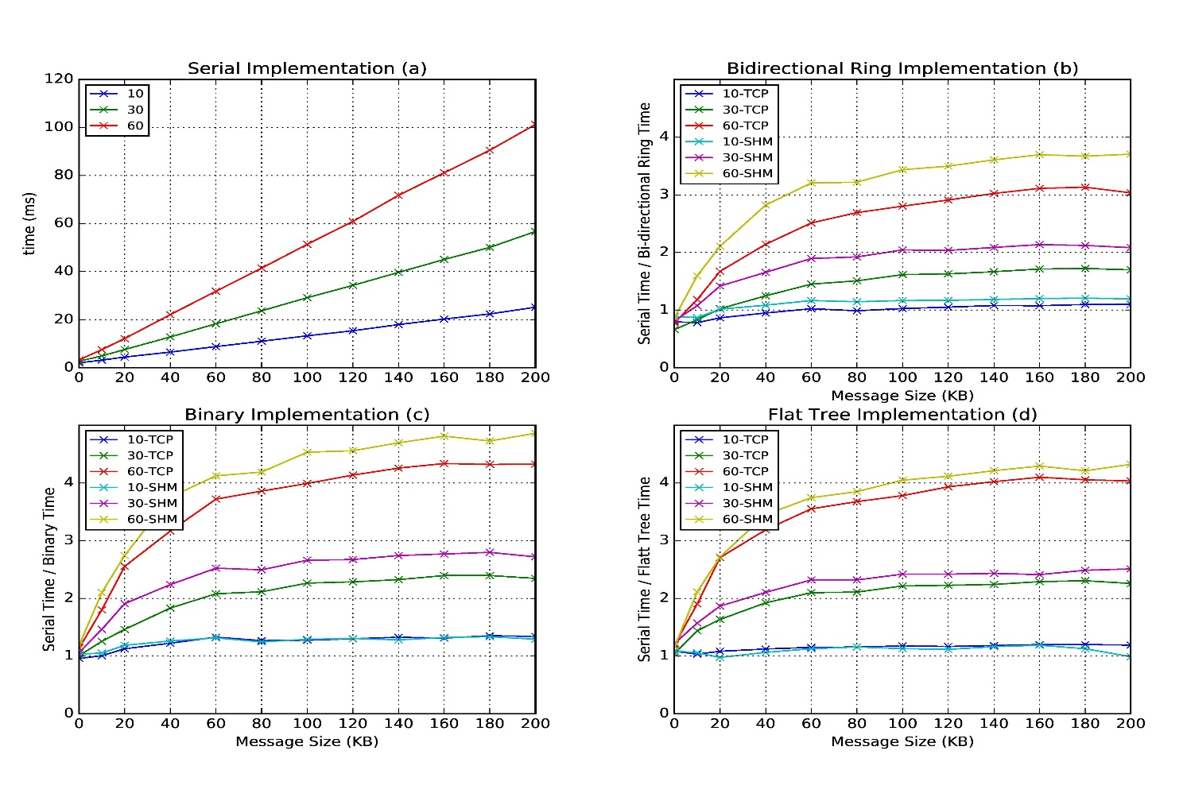
Improvement of Storm (Heron) using HPC communication algorithms
Improvedment/Serial
For 3 algorithms

Slide 25
HPC-ABDS Activities of NSF14-43054
Level 17: Orchestration: Apache Beam (Google Cloud Dataflow)
Level 16: Applications: Datamining for molecular dynamics, Image processing for remote sensing and pathology, graphs, streaming, bioinformatics, social media, financial informatics, text mining
Level 16: Algorithms: Generic and application specific; SPIDAL Library
Level 14: Programming: Storm, Heron (Twitter replaces Storm), Hadoop, Spark, Flink. Improve Inter- and Intra-node performance; science data structures
Level 13: Runtime Communication: Enhanced Storm and Hadoop (Spark, Flink, Giraph) using HPC runtime technologies, Harp
Level 11: Data management: Hbase and MongoDB integrated via use of Beam and other Apache tools; enhance Hbase
Level 9: Cluster Management: Integrate Pilot Jobs with Yarn, Mesos, Spark, Hadoop; integrate Storm and Heron with Slurm
Level 6: DevOps: Python Cloudmesh virtual Cluster Interoperability

Slide 26
Typical Convergence Architecture
Running same HPC-ABDS software across all platforms but data management machine has different balance in I/O, Network and Compute from “model” machine
Model has similar issues whether from Big Data or Big Simulation.
Data Management Model for Big Data
and Big Simulation

Slide 27

Java Performance with Optimization
128 24 core Haswell nodes on SPIDAL DA-MDS Code
Speedup compared to 1 process per node on 48 nodes
Best MPI; inter and intra node
MPI; inter/intra node; Java not optimized
Best Threads intra node; MPI inter node
HPC Enhancement ~factor of 10

Slide 28
Converged Failure in HPF Blackhole?
Or where big data differs from simulations?
Database community looks at big data job as a dataflow of (SQL) queries and filters
Apache projects like Pig, MRQL and Flink (Volker Markl) aim at automatic query optimization by dynamic integration of queries and filters including iteration and different data analytics functions
Going back to ~1993, High Performance Fortran HPF compilers optimized set of array and loop operations for large scale parallel execution
HPF worked fine for initial simple regular applications but ran into trouble for cases where parallelism hard (irregular, dynamic)
Will same happen in Big Data world?
Straightforward to parallelize k-means clustering but sophisticated algorithms like Elkans method (use triangle inequality) and fuzzy clustering are much harder (but not used much NOW)
Will Big Data technology run into HPF-style trouble with growing use of sophisticated data analytics?

Slide 29
Constructing HPC-ABDS Exemplars
This is one of next steps in NIST Big Data Working Group
Jobs are defined hierarchically as a combination of Ansible (preferred over Chef or Puppet as Python) scripts
Scripts are invoked on Infrastructure (Cloudmesh Tool)
INFO 524 “Big Data Open Source Software Projects” IU Data Science class required final project to be defined in Ansible and decent grade required that script worked (On NSF Chameleon and FutureSystems)
  80 students gave 37 projects with ~15 pretty good such as
  “Machine Learning benchmarks on Hadoop with HiBench”, Hadoop/YARN, Spark, Mahout, Hbase
  “Human and Face Detection from Video”, Hadoop, Spark, OpenCV, Mahout, MLLib
Build up curated collection of Ansible scripts defining use cases for benchmarking, standards, education https://docs.google.com/document/d/1OCPO2uqOkADvoxynRyZwh5IyFQ2_m1fkpBVMo3UBblg
Fall 2015 class INFO 523 introductory data science class was less constrained; students just had to run a data science application
  140 students: 45 Projects (NOT required) with 91 technologies, 39 datasets

Slide 30
Cloudmesh Interoperability DevOps Tool
Model: Define software configuration with tools like Ansible (Chef, Puppet); instantiate on a virtual cluster
Save scripts not virtual machines and let script build applications
Cloudmesh is an easy-to-use command line program/shell and portal to interface with heterogeneous infrastructures taking script as input
  It first defines virtual cluster and then instantiates script on it
Supports OpenStack, AWS, Azure, SDSC Comet, virtualbox, libcloud supported clouds as well as classic HPC and Docker infrastructures
  Has an abstraction layer that makes it possible to integrate other IaaS frameworks
Managing VMs across different IaaS providers is easier
Demonstrated interaction with various cloud providers:
  FutureSystems, Chameleon Cloud, Jetstream, CloudLab, Cybera, AWS, Azure, virtualbox
Status: AWS, and Azure, VirtualBox, Docker need improvements; we focus currently on SDSC Comet and NSF resources that use OpenStack
HPC Cloud Interoperability Layer

Slide 31
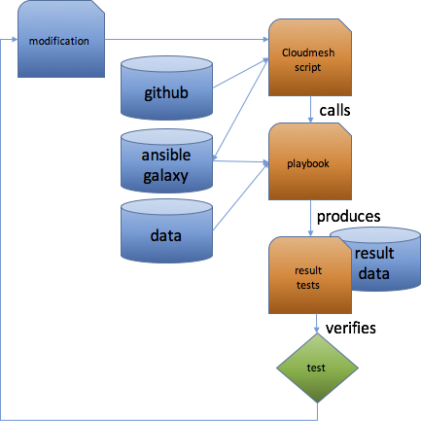
Structure of “Software Defined”
Big Data Exemplars
Github (Ansible Galaxy) collects basic Ansible roles
Exemplar (student project) may add specialized roles and defines a project Ansible playbook executed by a Cloudmesh cm script such as
  cm launcher hibench —parameterA=40 —parameterB=xyz ….
  —cloud=chameleon
Typical Playbook is short
  include role python
  include role hadoop
  include role pig
  include role fetch data
  include role execute benchmark
Figure illustrates testing a new
infrastructure or code change

Slide 32
Components in Big Data HPC Convergence
Applications, Benchmarks and Libraries
  51 NIST Big Data Use Cases, 7 Computational Giants of the NRC Massive Data Analysis, 13 Berkeley dwarfs, 7 NAS parallel benchmarks
  Unified discussion by separately discussing data & model for each application;
  64 facets– Convergence Diamonds -- characterize applications
  Characterization identifies hardware and software features for each application across big data, simulation; “complete” set of benchmarks (NIST)
Software Architecture and its implementation
  HPC-ABDS: Cloud-HPC interoperable software: performance of HPC (High Performance Computing) and the rich functionality of the Apache Big Data Stack.
  Added HPC to Hadoop, Storm, Heron, Spark; will add to Beam and Flink
  Work in Apache model contributing code
Run same HPC-ABDS across all platforms but “data management” nodes have different balance in I/O, Network and Compute from “model” nodes
  Optimize to data and model functions as specified by convergence diamonds
  Do not optimize for simulation and big data
Convergence Language: Make C++, Java, Scala, Python … perform well

