Slide 1
Implementing parts of HPC-ABDS in a multi-disciplinary collaboration
HPC 2016 HIGH PERFORMANCE COMPUTING
FROM CLOUDS AND BIG DATA TO EXASCALE AND BEYOND
June 27- July 1 2016 Cetraro
http://www.hpcc.unical.it/hpc2016/
Geoffrey Fox
June 30, 2016
gcf@indiana.edu
http://www.dsc.soic.indiana.edu/, http://spidal.org/ http://hpc-abds.org/kaleidoscope/
Department of Intelligent Systems Engineering
School of Informatics and Computing, Digital Science Center
Indiana University Bloomington

Slide 2
Abstract
We introduce the High Performance Computing enhanced Apache Big Data software Stack HPC-ABDS and give several examples of advantageously linking HPC and ABDS.
In particular we discuss a Scalable Parallel Interoperable Data Analytics Library SPIDAL that is being developed to embody these ideas and is the HPC-ABDS instantiation of well known Apache libraries Mahout and MLlib.
SPIDAL covers some core machine learning, image processing, graph, simulation data analysis and network science kernels. It is a collaboration between teams at Arizona, Emory, Indiana (lead), Kansas, Rutgers, Virginia Tech, and Utah universities.
We give examples of data analytics running on HPC systems including details on persuading Java to run fast.

Slide 3
SPIDAL Project
Datanet: CIF21 DIBBs: Middleware and High Performance Analytics Libraries for Scalable Data Science
NSF14-43054 started October 1, 2014
Indiana University (Fox, Qiu, Crandall, von Laszewski)
Rutgers (Jha)
Virginia Tech (Marathe)
Kansas (Paden)
Stony Brook (Wang)
Arizona State (Beckstein)
Utah (Cheatham)
A co-design project: Software, algorithms, applications

Slide 4
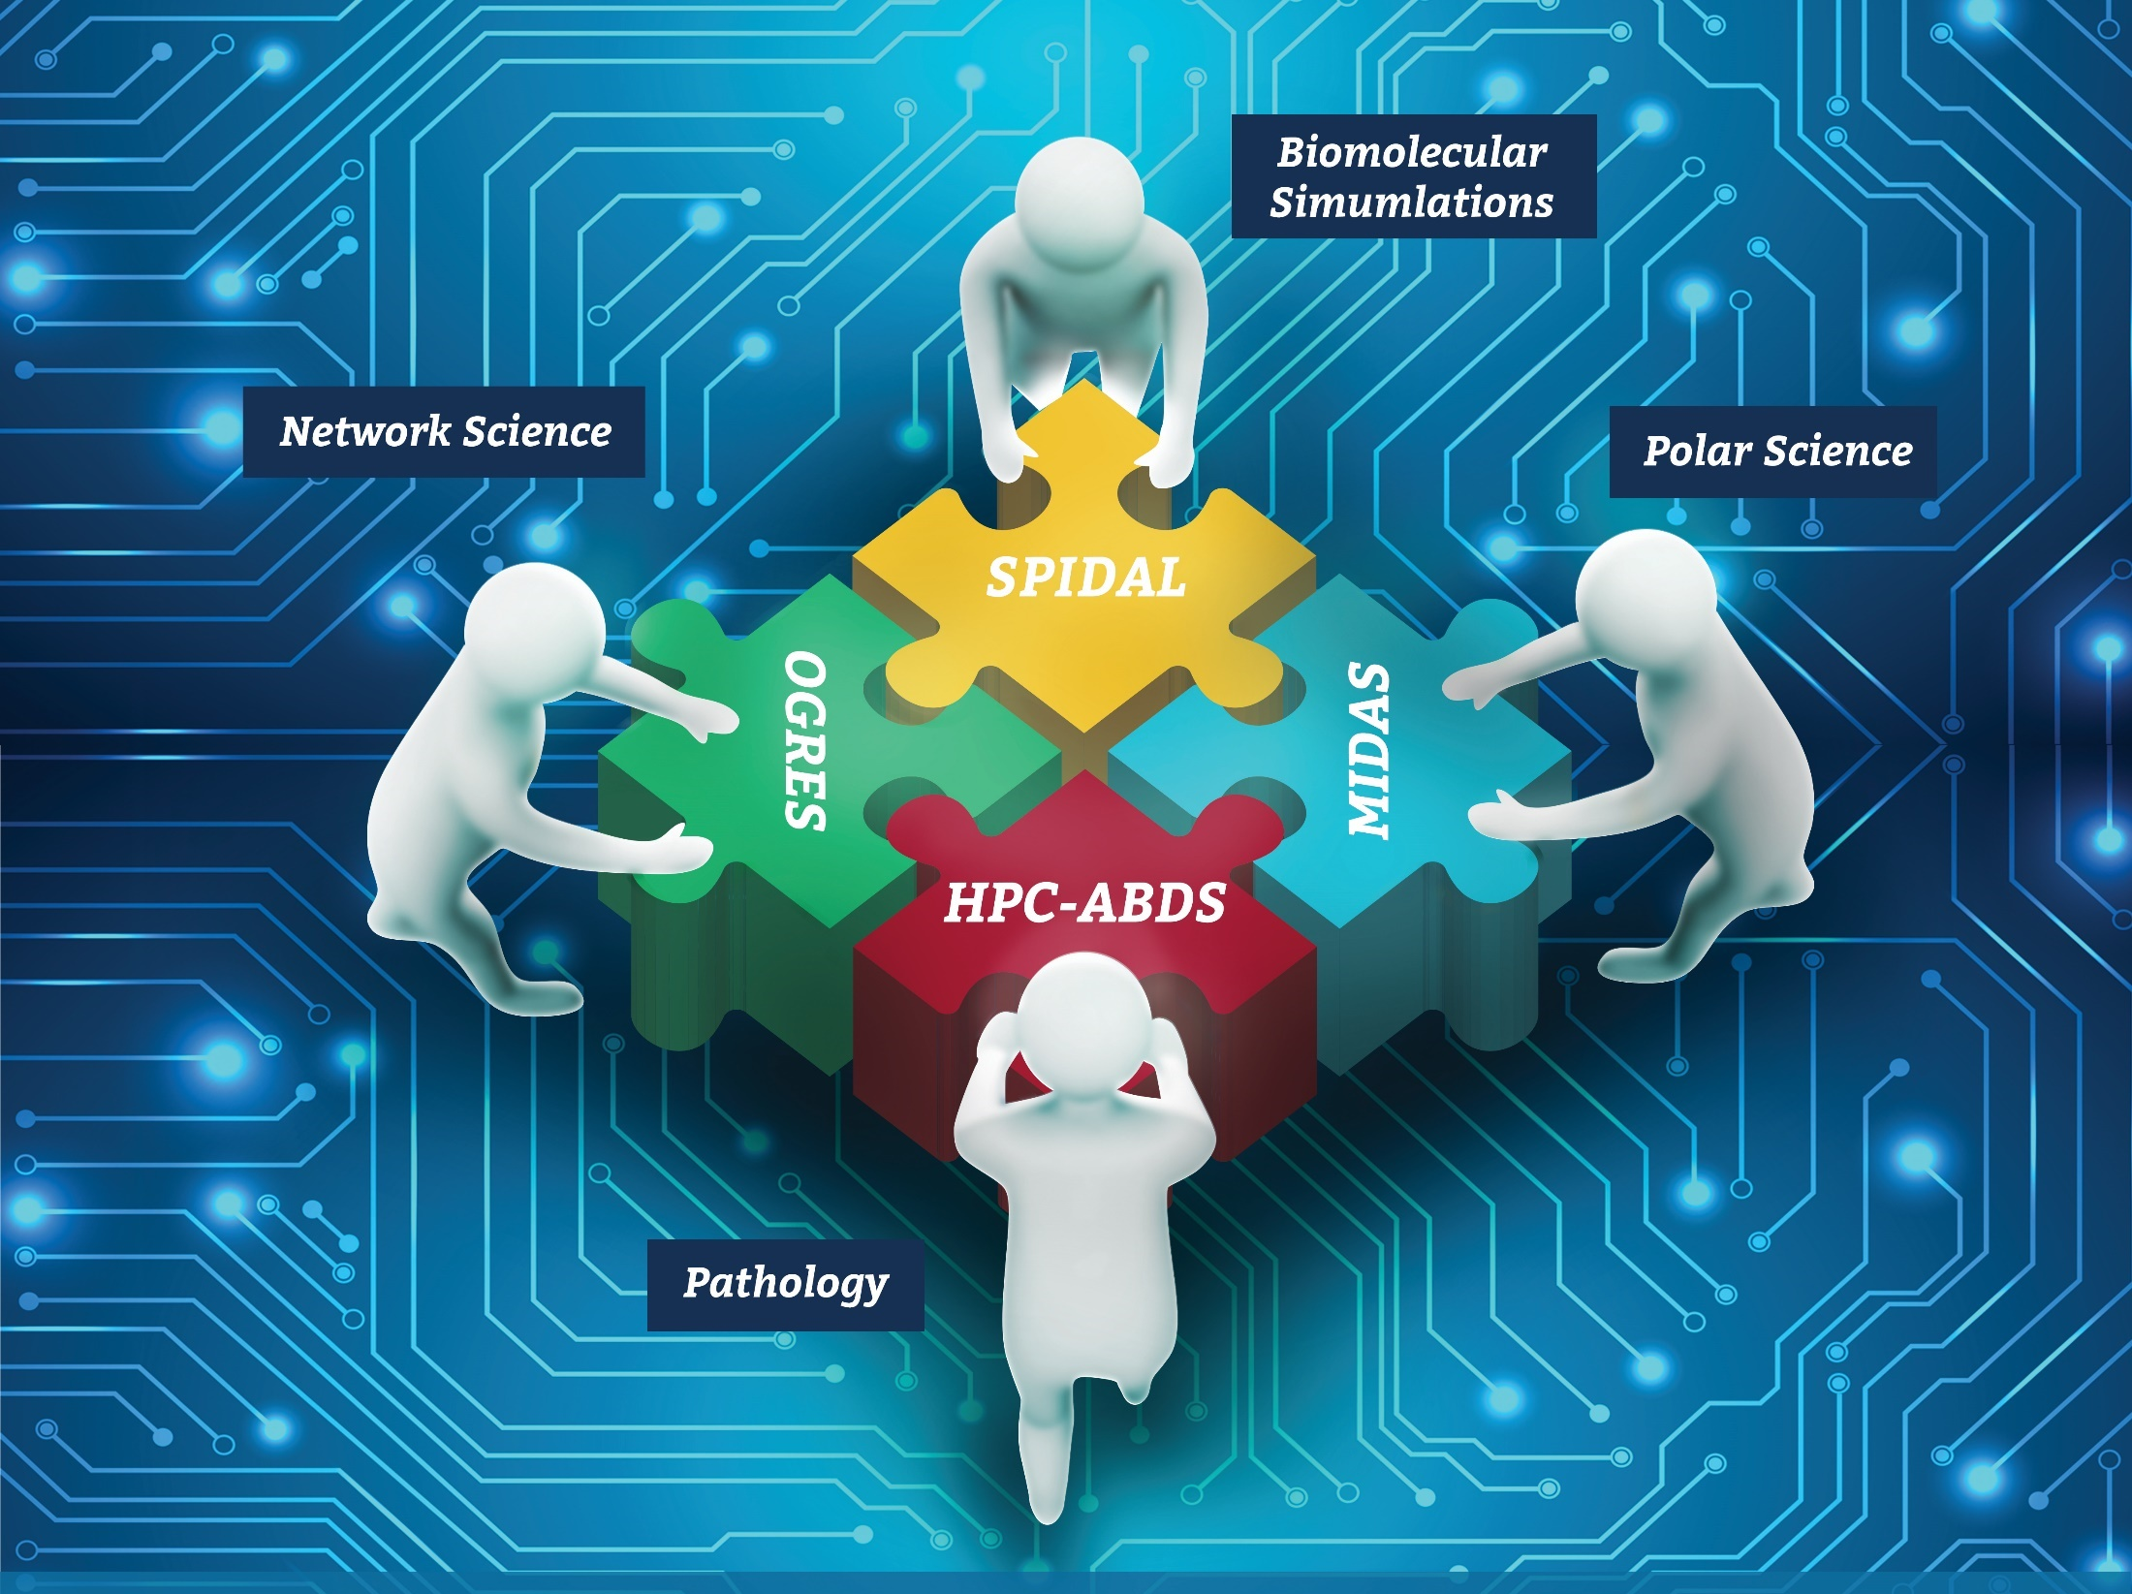




Co-designing Building Blocks Collaboratively
Software: MIDAS
HPC-ABDS

Slide 5
Main Components of SPIDAL Project
Design and Build Scalable High Performance Data Analytics Library
SPIDAL (Scalable Parallel Interoperable Data Analytics Library): Scalable Analytics for:
  Domain specific data analytics libraries – mainly from project.
  Add Core Machine learning libraries – mainly from community.
  Performance of Java and MIDAS Inter- and Intra-node.
NIST Big Data Application Analysis – features of data intensive Applications.
HPC-ABDS: Cloud-HPC interoperable software performance of HPC (High Performance Computing) and the rich functionality of the commodity Apache Big Data Stack.
MIDAS: Integrating Middleware – from project.
Applications: Biomolecular Simulations, Network and Computational Social Science, Epidemiology, Computer Vision, Geographical Information Systems, Remote Sensing for Polar Science and Pathology Informatics, Streaming for robotics, streaming stock analytics
Implementations: HPC as well as clouds (OpenStack, Docker)

Slide 6
HPC-ABDS

Slide 7
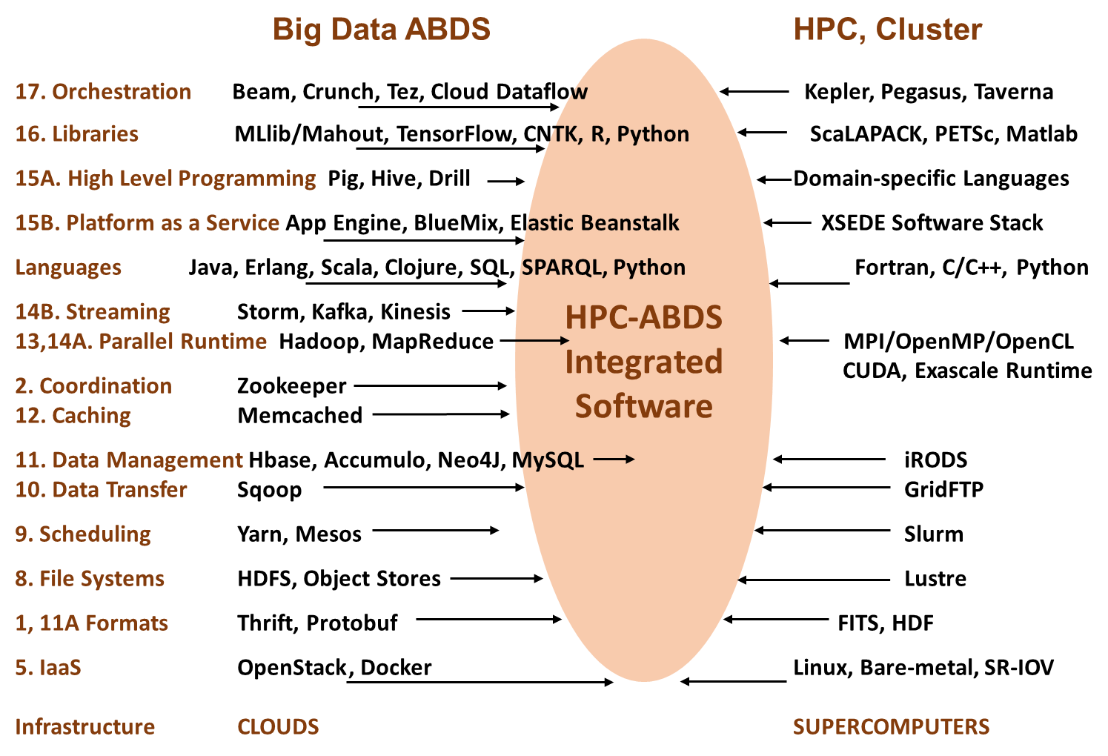

Slide 8
HPC-ABDS Mapping of Activities
Green is MIDAS
Black is SPIDAL
Level 17: Orchestration: Apache Beam (Google Cloud Dataflow) integrated with Heron/Flink and Cloudmesh on HPC cluster
Level 16: Applications: Datamining for molecular dynamics, Image processing for remote sensing and pathology, graphs, streaming, bioinformatics, social media, financial informatics, text mining
Level 16: Algorithms: Generic and custom for applications SPIDAL
Level 14: Programming: Storm, Heron (Twitter replaces Storm), Hadoop, Spark, Flink. Improve Inter- and Intra-node performance; science data structures
Level 13: Runtime Communication: Enhanced Storm and Hadoop (Spark, Flink, Giraph) using HPC runtime technologies, Harp
Level 11: Data management: Hbase and MongoDB integrated via use of Beam and other Apache tools; enhance Hbase
Level 9: Cluster Management: Integrate Pilot Jobs with Yarn, Mesos, Spark, Hadoop; integrate Storm and Heron with Slurm
Level 6: DevOps: Python Cloudmesh virtual Cluster Interoperability

Slide 9
Java Grande
Revisited on 3 data analytics codes
Clustering
Multidimensional Scaling
Latent Dirichlet Allocation all sophisticated algorithms

Slide 10
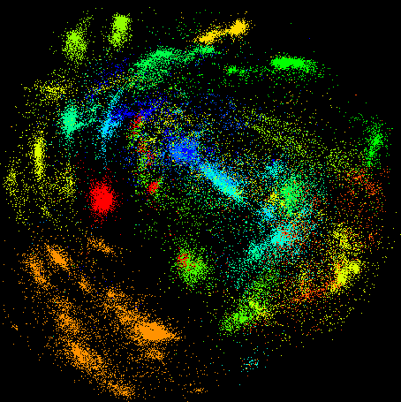
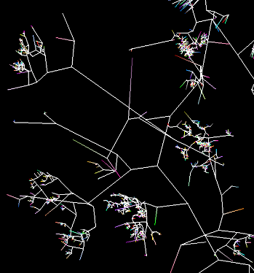

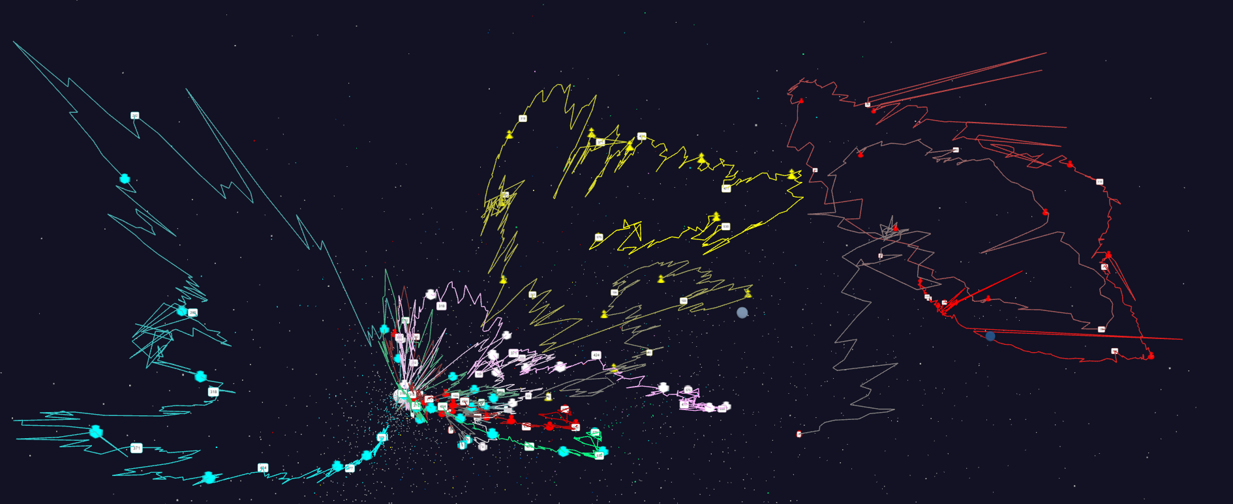
Some large scale analytics
100,000 fungi
Sequences
Eventually
120 clusters
3D phylogenetic
tree
LCMS Mass Spectrometer Peak Clustering. Sample of 25 million points. 700 clusters
Jan 1 2004 → December 2015
Daily Stock Time Series in 3D

Slide 11
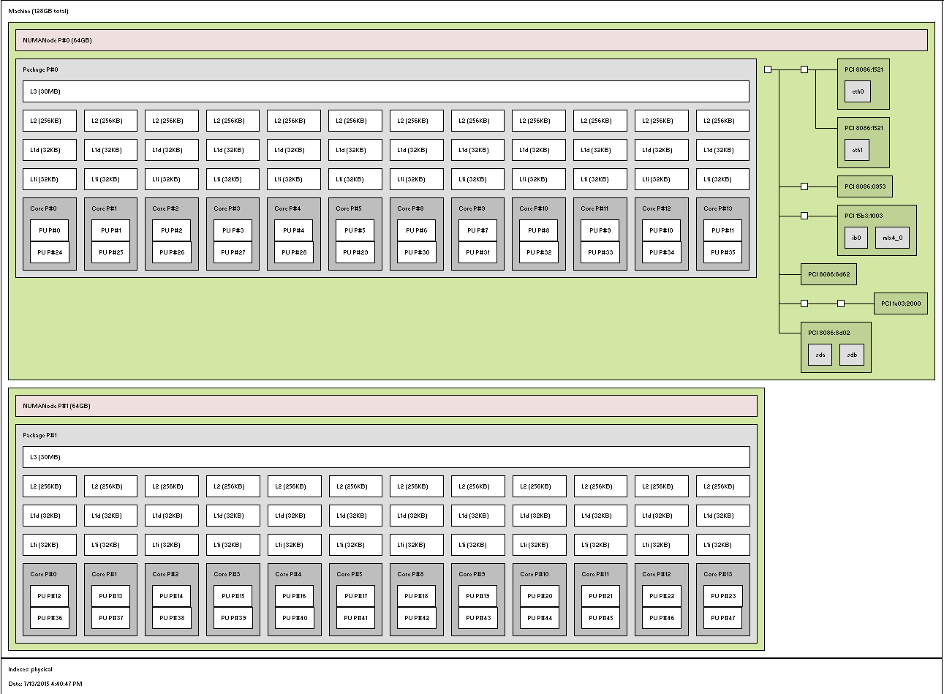
MPI, Fork-Join and Long Running Threads
Quite large number of cores per node in simple main stream clusters
  E.g. 1 Node in Juliet 128 node HPC cluster
    2 Sockets, 12 or 18 Cores each, 2 Hardware threads per core
    L1 and L2 per core, L3 shared per socket
Denote Configurations TxPxN for N nodes each with P processes and T threads per process
  Many choices in T and P
  Choices in Binding of processes and threads
  Choices in MPI where best seems to be SM “shared memory” with all messages for node combined in node shared memory
Socket 0
1 Core – 2 HTs
Socket 1

Slide 12
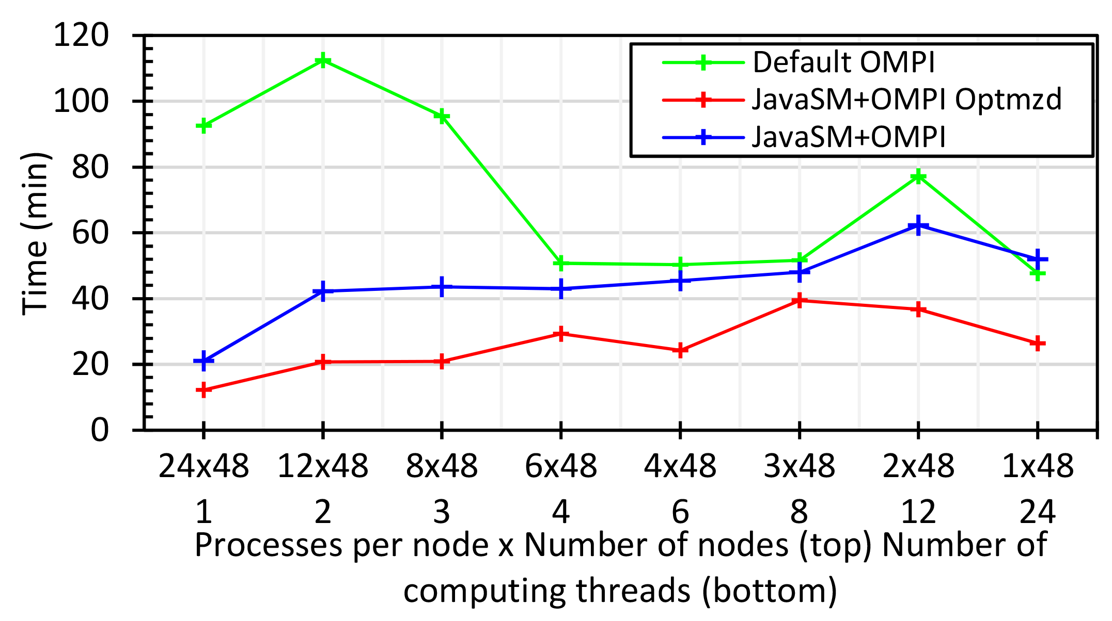
Java MPI performs better than Threads I
48 24 core Haswell nodes 200K DA-MDS Dataset size
Default MPI much worse than threads
Optimized MPI using shared memory node-based messaging is much better than threads (default OMPI does not support SM for needed collectives)
All MPI
All Threads

Slide 13
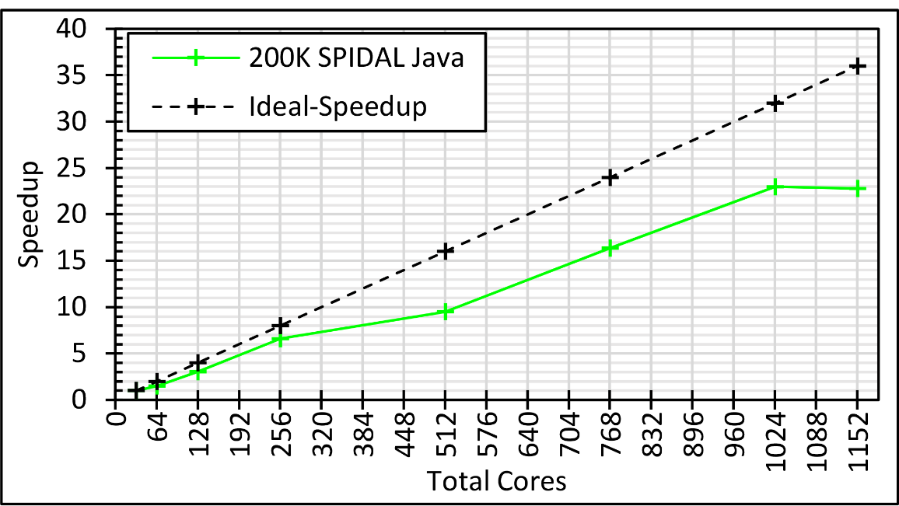
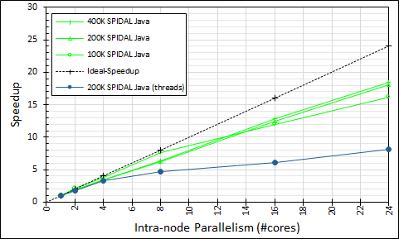
Intra-node Parallelism
All Processes: 32 nodes with 1-36 cores each; speedup compared to 32 nodes with 1 process; optimized Java
Processes (Green) and Threads (Blue) on 48 nodes with 1-24 cores; speedup compared to 48 nodes with 1 process; optimized Java

Slide 14

Java MPI performs better than Threads II
128 24 core Haswell nodes on SPIDAL DA-MDS Code
Speedup compared to 1 process per node on 48 nodes
Best MPI; inter and intra node
MPI; inter/intra node; Java not optimized
Best Threads intra node; MPI inter node

Slide 15
MPI, Fork-Join and Long Running Threads
K-Means 1 million 2D points and 1k centers
Case 0: FJ threads
  Proc bound to T cores using MPI
  Threads inherit the same binding
Case 1: LRT threads
  Procs and threads are both unbound
Case 2: LRT threads
  Similar to Case 0 with LRT threads
Case 3: LRT threads
  Proc bound to all cores (= non bound)
  Each worker thread is bound to a core
P0,P1..,P7
C0
C1
C2
C3
C4
C5
C6
C7
Socket 0
Socket 1
All Threads
All MPI
Fork Join
LRT
Differ in helper threads

Slide 16
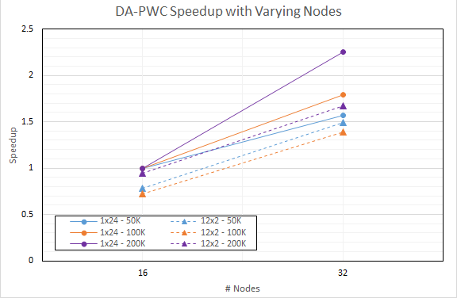
DA-PWC Non Vector Clustering
Speedup referenced to 1 Thread, 24 processes, 16 nodes
Increasing problem size
Circles 24 processes
Triangles: 12 threads, 2 processes on each node

Slide 17
MIDAS

Slide 18
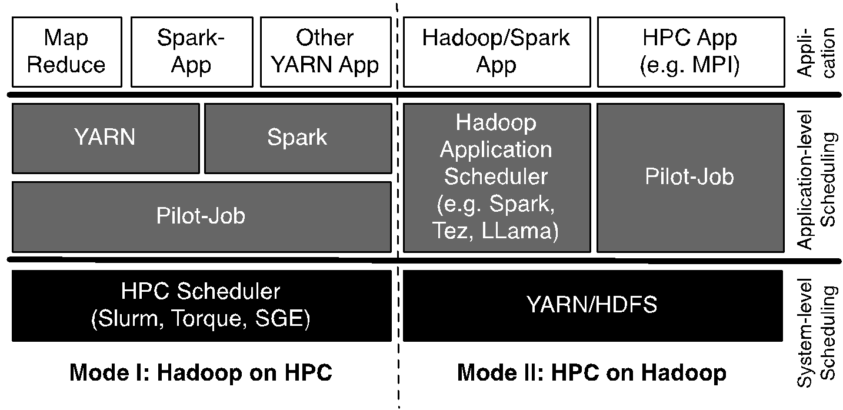
Pilot-Hadoop/Spark Architecture
HPC into Scheduling Layer
http://arxiv.org/abs/1602.00345

Slide 19
Harp (Hadoop Plugin) brings HPC to ABDS
Basic Harp: Iterative HPC communication; scientific data abstractions
Careful support of distributed data AND distributed model
Avoids parameter server approach but distributes model over worker nodes and supports collective communication to bring global model to each node
Applied first to Latent Dirichlet Allocation LDA with large model and data
See Qiu’s talk Wednesday
HPC into Programming/communication Layer

Slide 20
Workflow in HPC-ABDS
HPC familiar with Taverna, Pegasus, Kepler, Galaxy … but ABDS has many workflow systems with recently Crunch, NiFi and Beam (open source version of Google Cloud Dataflow)
  Use ABDS for sustainability reasons?
  ABDS approaches are better integrated than HPC approaches with ABDS data management like Hbase and are optimized for distributed data.
Heron, Spark and Flink provide distributed dataflow runtime
Beam prefers Flink as runtime and supports streaming and batch data
Use extensions of Harp as parallel computing interface and Beam as streaming/batch support of parallel workflows

Slide 21
SPIDAL Algorithms
Core
Optimization
Graph
Domain Specific

Slide 22
SPIDAL Algorithms – Core I
Several parallel core machine learning algorithms; need to add SPIDAL Java optimizations to complete parallel codes except MPI MDS
  https://www.gitbook.com/book/esaliya/global-machine-learning-with-dsc-spidal/details
O(N²) distance matrices calculation with Hadoop parallelism and various options (storage MongoDB vs. distributed files), normalization, packing to save memory usage, exploiting symmetry
WDA-SMACOF: Multidimensional scaling MDS is optimal nonlinear dimension reduction enhanced by SMACOF, deterministic annealing and Conjugate gradient for non-uniform weights. Used in many applications
  MPI (shared memory) and MIDAS (Harp) versions
MDS Alignment to optimally align related point sets, as in MDS time series
WebPlotViz data management (MongoDB) and browser visualization for 3D point sets including time series. Available as source or SaaS
MDS as χ² using Manxcat. Alternative more general but less reliable solution of MDS. Latest version of WDA-SMACOF usually preferable
Other Dimension Reduction: SVD, PCA, GTM to do

Slide 23
SPIDAL Algorithms – Core II
Latent Dirichlet Allocation LDA for topic finding in text collections; new algorithm with MIDAS runtime outperforming current best practice
DA-PWC Deterministic Annealing Pairwise Clustering for case where points aren’t in a vector space; used extensively to cluster DNA and proteomic sequences; improved algorithm over other published. Parallelism good but needs SPIDAL Java
DAVS Deterministic Annealing Clustering for vectors; includes specification of errors and limit on cluster sizes. Gives very accurate answers for cases where distinct clustering exists. Being upgraded for new LC-MS proteomics data with one million clusters in 27 million size data set
K-means basic vector clustering: fast and adequate where clusters aren’t needed accurately
Elkan’s improved K-means vector clustering: for high dimensional spaces; uses triangle inequality to avoid expensive distance calcs
Future work – Classification: logistic regression, Random Forest, SVM, (deep learning); Collaborative Filtering, TF-IDF search and Spark MLlib algorithms
Harp-DaaL extends Intel DAAL’s local batch mode to multi-node distributed modes
  Leveraging Harp’s benefits of communication for iterative compute models

Slide 24
SPIDAL Algorithms – Optimization I
Manxcat: Levenberg Marquardt Algorithm for non-linear χ² optimization with sophisticated version of Newton’s method calculating value and derivatives of objective function. Parallelism in calculation of objective function and in parameters to be determined. Complete – needs SPIDAL Java optimization
Viterbi algorithm, for finding the maximum a posteriori (MAP) solution for a Hidden Markov Model (HMM). The running time is O(n*s²) where n is the number of variables and s is the number of possible states each variable can take. We will provide an "embarrassingly parallel" version that processes multiple problems (e.g. many images) independently; parallelizing within the same problem not needed in our application space. Needs Packaging in SPIDAL
Forward-backward algorithm, for computing marginal distributions over HMM variables. Similar characteristics as Viterbi above. Needs Packaging in SPIDAL

Slide 25
SPIDAL Algorithms – Optimization II
Loopy belief propagation (LBP) for approximately finding the maximum a posteriori (MAP) solution for a Markov Random Field (MRF). Here the running time is O(n²*s²*i) in the worst case where n is number of variables, s is number of states per variable, and i is number of iterations required (which is usually a function of n, e.g. log(n) or sqrt(n)). Here there are various parallelization strategies depending on values of s and n for any given problem.
  We will provide two parallel versions: embarrassingly parallel version for when s and n are relatively modest, and parallelizing each iteration of the same problem for common situation when s and n are quite large so that each iteration takes a long time.
  Needs Packaging in SPIDAL
Markov Chain Monte Carlo (MCMC) for approximately computing marking distributions and sampling over MRF variables. Similar to LBP with the same two parallelization strategies. Needs Packaging in SPIDAL

Slide 26
SPIDAL Graph Algorithms
Subgraph Mining: Finding patterns specified by a template in graphs
  Reworking existing parallel VT algorithm Sahad with MIDAS middleware giving HarpSahad which runs 5 (Google) to 9 (Miami) times faster than original Hadoop version
Triangle Counting: PATRIC improved memory use (factor of 25 lower) and good MPI scaling
Random Graph Generation: with particular degree distribution and clustering coefficients. new DG method with low memory and high performance, almost optimal load balancing and excellent scaling.
  Algorithms are about 3-4 times faster than the previous ones.
Last 2 need to be packaged for SPIDAL using MIDAS (currently MPI)
Community Detection: current work
Old version
SPIDAL
Harp
Pure Hadoop
Old New
VT

Slide 27
Applications
Network Science: start on graph algorithms earlier
General Discussion of Images
Remote Sensing in Polar regions: image processing
Pathology: image processing
Spatial search and GIS for Public Health
Biomolecular simulations
  Path Similarity Analysis
  Detect continuous lipid membrane leaflets in a MD simulation

Slide 28
Imaging Applications: Remote Sensing, Pathology, Spatial Systems
Both Pathology/Remote sensing working on 2D moving to 3D images
Each pathology image could have 10 billion pixels, and we may extract a million spatial objects per image and 100 million features (dozens to 100 features per object) per image. We often tile the image into 4K x 4K tiles for processing. We develop buffering-based tiling to handle boundary-crossing objects. For each typical study, we may have hundreds to thousands of images
Remote sensing aimed at radar images of ice and snow sheets; as data from aircraft flying in a line, we can stack radar 2D images to get 3D
2D problems need modest parallelism “intra-image” but often need parallelism over images
3D problems need parallelism for an individual image
Use many different Optimization algorithms to support applications (e.g. Markov Chain, Integer Programming, Bayesian Maximum a posteriori, variational level set, Euler-Lagrange Equation)
Classification (deep learning convolution neural network, SVM, random forest, etc.) will be important

Slide 29
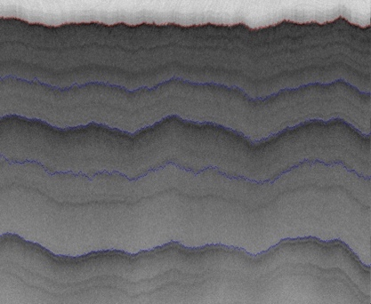
2D Radar Polar Remote Sensing
Need to estimate structure of earth (ice, snow, rock) from radar signals from plane in 2 or 3 dimensions.
Original 2D analysis (called [11]) used Hidden Markov Methods; better results using MCMC (our solution)
Extending to snow radar layers

Slide 30
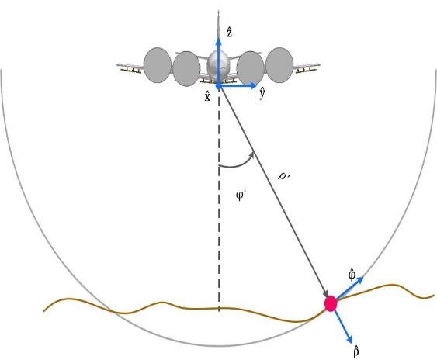
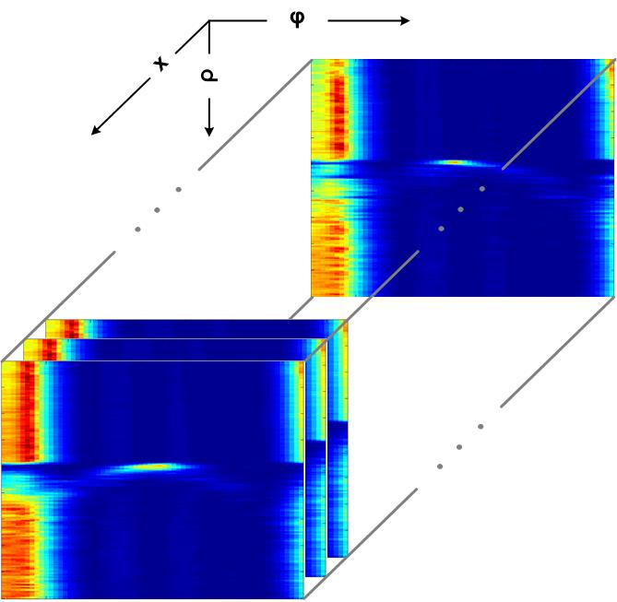
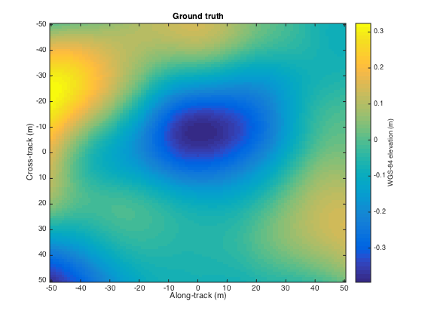
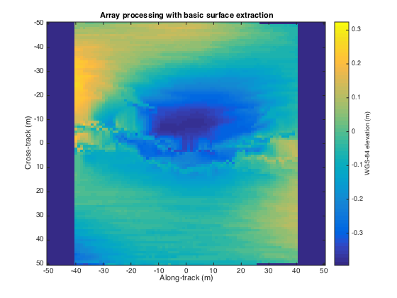
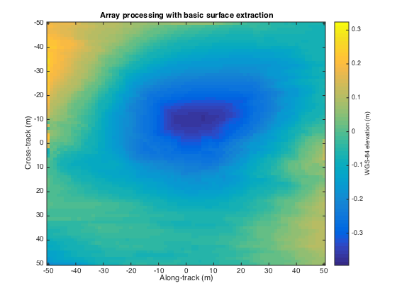
3D Radar Polar Remote Sensing
Uses Loopy belief propagation LBP to analyze 3D radar images
Radar gives a cross-section view, parameterized by angle and range, of the ice structure, which yields a set of 2-d tomographic slices (right) along the flight path.
Each image represents a 3d depth map, with along track and cross track dimensions on the x-axis and y-axis respectively, and depth coded as colors.
Reconstructing bedrock in 3D, for (left) ground truth, (center) existing algorithm based on maximum likelihood estimators, and (right) our technique based on a Markov Random Field formulation.

Slide 31
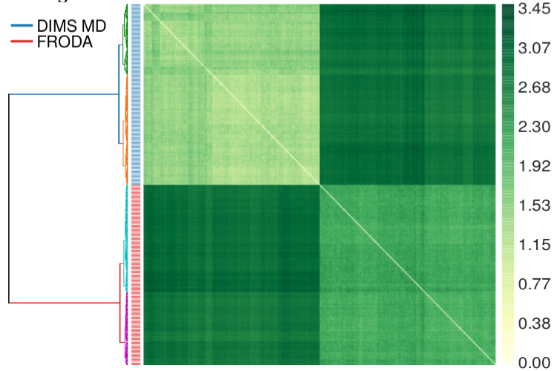
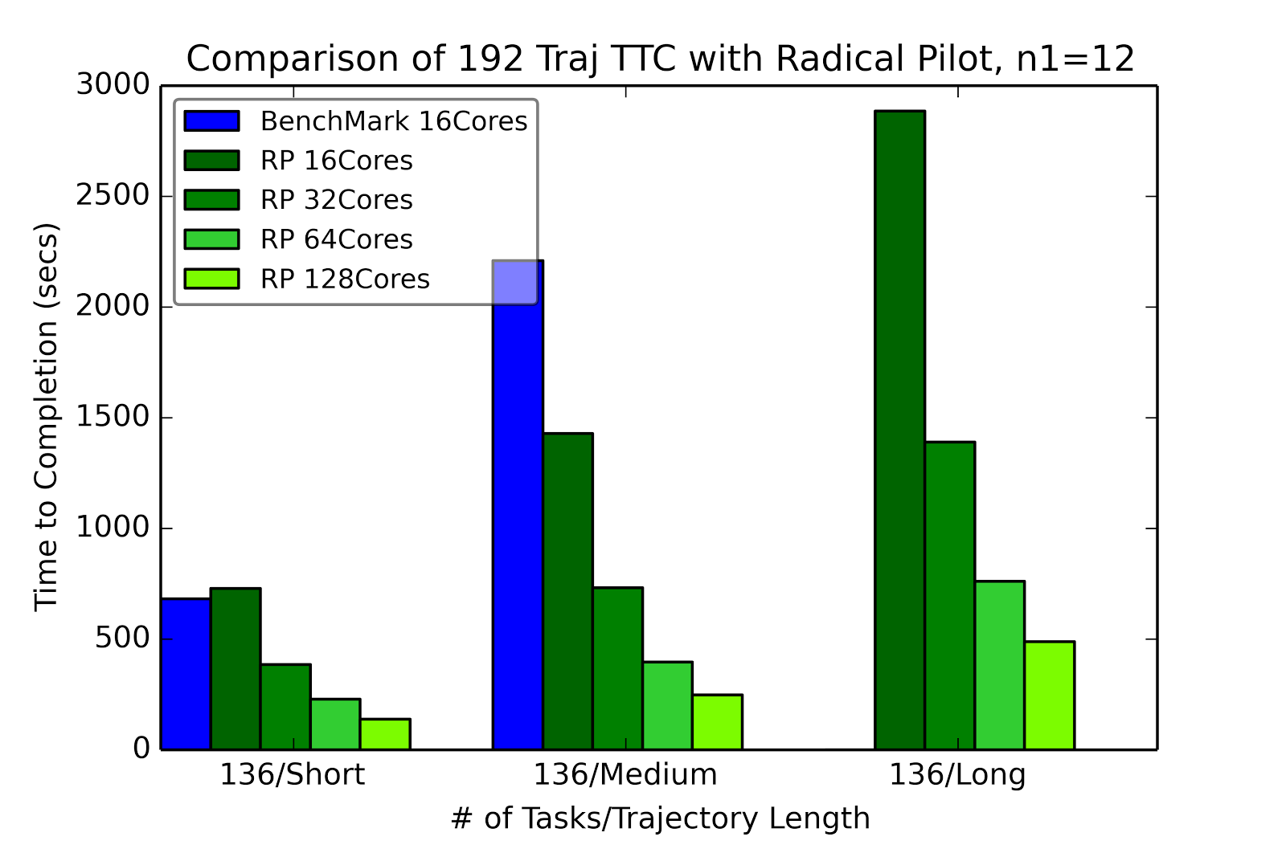
RADICAL-Pilot Hausdorff distance: all-pairs problem
Clustered distances for two methods for sampling macromolecular transitions (200 trajectories each) showing that both methods produce distinctly different pathways.
RADICAL Pilot benchmark run for three different test sets of trajectories, using 12x12 “blocks” per task.
Should use general SPIDAL library

