Slide 1


High-Performance Big Data Computing Environments
HPC 2018
HIGH PERFORMANCE COMPUTING FROM CLOUDS AND BIG DATA TO EXASCALE AND BEYOND
An International Advanced Workshop, Cetraro, July 2, 2018
Geoffrey Fox,
Department of Intelligent Systems Engineering, Indiana University
gcf@indiana.edu, http://www.dsc.soic.indiana.edu/, http://spidal.org/
Work with Judy Qiu, Supun Kamburugamuva, Shantenu Jha, Kannan Govindarajan, Pulasthi Wickramasinghe, Gurhan Gunduz, Ahmet Uyar

Slide 2
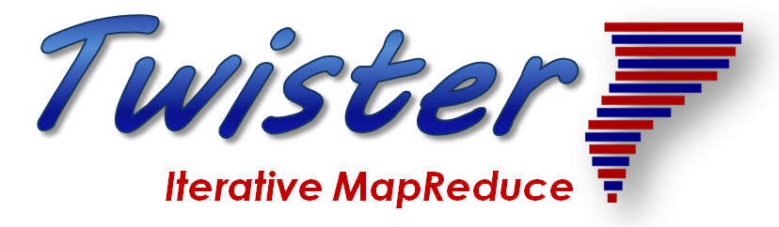
Structure of Applications
2
http://www.iterativemapreduce.org/

Slide 3
Distinctive Features of Applications
Ratio of data to model sizes: vertical axis on next slide
Importance of Synchronization – ratio of inter-node communication to node computing: horizontal axis on next slide
Sparsity of Data or Model; impacts value of GPU’s or vector computing
Irregularity of Data or Model
Geographic distribution of Data as in edge computing; use of streaming (dynamic data) versus batch paradigms
Dynamic model structure as in some iterative algorithms

Slide 4
Big Data and Simulation Difficulty in Parallelism
Size of Synchronization constraints
Loosely Coupled
Tightly Coupled
HPC Clouds: Accelerators
High Performance Interconnect
HPC Clouds/Supercomputers
Memory access also critical
Commodity Clouds
Size of Disk I/O
MapReduce as in scalable databases
Global Machine Learning
e.g. parallel clustering
Deep Learning
Graph Analytics e.g. subgraph mining
LDA
Pleasingly Parallel
Often independent events
Unstructured Adaptive Sparse
Current major Big Data category
Linear Algebra at core (often not sparse)
Structured Adaptive Sparse
Parameter sweep simulations
Largest scale simulations
Just two problem characteristics
There is also data/compute distribution seen in grid/edge computing
Exascale Supercomputers

Slide 5
Local and Global Machine Learning
Many applications use LML or Local machine Learning where machine learning (often from R or Python or Matlab) is run separately on every data item such as on every image
But others are GML Global Machine Learning where machine learning is a basic algorithm run over all data items (over all nodes in computer)
  maximum likelihood or χ² with a sum over the N data items – documents, sequences, items to be sold, images etc. and often links (point-pairs).
  GML includes Graph analytics, clustering/community detection, mixture models, topic determination, Multidimensional scaling, (Deep) Learning Networks
Note Facebook may need lots of small graphs (one per person and ~LML) rather than one giant graph of connected people (GML)

Slide 6
Requirements
On general principles parallel and distributed computing have different requirements even if sometimes similar functionalities
  Apache stack ABDS typically uses distributed computing concepts
  For example, Reduce operation is different in MPI (Harp) and Spark
Large scale simulation requirements are well understood BUT
Big Data requirements are not agreed but there are a few key use types
  Pleasingly parallel processing (including local machine learning LML) as of different tweets from different users with perhaps MapReduce style of statistics and visualizations; possibly Streaming
  Database model with queries again supported by MapReduce for horizontal scaling
  Global Machine Learning GML with single job using multiple nodes as classic parallel computing
  Deep Learning certainly needs HPC – possibly only multiple small systems
Current workloads stress 1) and 2) and are suited to current clouds and to Apache Big Data Software (with no HPC)
  This explains why Spark with poor GML performance can be so successful

Slide 7
Features of High Performance Big Data Processing Systems
Application Requirements: The structure of application clearly impacts needed hardware and software
  Pleasingly parallel
  Workflow
  Global Machine Learning
Data model: SQL, NoSQL; File Systems, Object store; Lustre, HDFS
Distributed data from distributed sensors and instruments (Internet of Things) requires Edge computing model
  Device – Fog – Cloud model and streaming data software and algorithms
Hardware: node (accelerators such as GPU or KNL for deep learning) and multi-node architecture configured as AI First HPC Cloud;
  Disks speed and location
This implies software requirements
Analytics
Data management
Streaming or Repository access or both

Slide 10
Five Major Application Structures
Global Machine Learning
Always Classic Cloud Workload
Add High Performance Big Data Workload
Note Problem and System Architecture ae similar as efficient execution says they must match

Slide 11
Integrating HPC and Apache Programming Environments
Harp-DAAL with a kernel Machine Learning library exploiting the Intel node library DAAL and HPC style communication collectives within the Hadoop ecosystem. The broad applicability of Harp-DAAL is supporting many classes of data-intensive computation, from pleasingly parallel to machine learning and simulations. Main focus is launching from Hadoop
Twister2 is a toolkit of components that can be packaged in different ways
  Integrated batch or streaming data capabilities familiar from Apache Hadoop, Spark, Heron and Flink but with high performance.
  Separate bulk synchronous and data flow communication;
  Task management as in Mesos, Yarn and Kubernetes
  Dataflow graph execution models
  Launching of the Harp-DAAL library
  Streaming and repository data access interfaces,
  In-memory databases and fault tolerance at dataflow nodes. (use RDD to do classic checkpoint-restart)

Slide 12
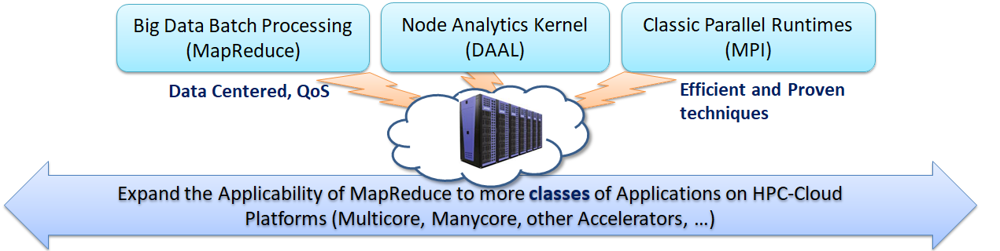
Harp-DAAL: A HPC-Cloud convergence framework for productivity and performance
Harp is an Hadoop plug-in offering highly optimized Map collective operations plus support of computation models covering much machine learning
Harp-DAAL seamlessly integrates Intel’s DAAL node Data Analytics Library
  DAAL: SubGraph Mining, K-means, Matrix Factorization, Recommender System (ALS), Singular Value Decomposition (SVD), QR Decomposition, Neural Network, Covariance, Low Order Moments, Naive Bayes Reduce, Linear Regression, Ridge Regression, Principal Component Analysis (PCA)
  No DAAL yet: DA-MDS Multi-dimensional Scaling (DA is Deterministic Annealing), Directed Force Dimension, Irregular DAVS Clustering, DA Semimetric Clustering, Multi-class Logistic Regression, SVM, Latent Dirichlet Allocation, Random Forest

Slide 13
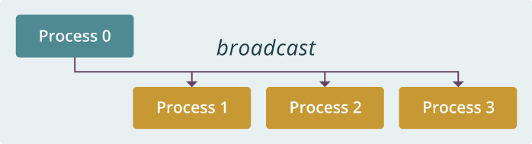
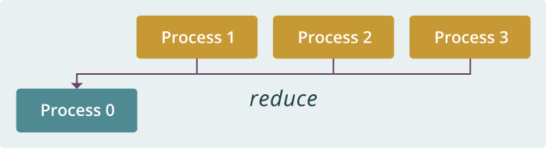
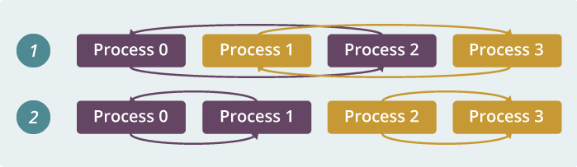
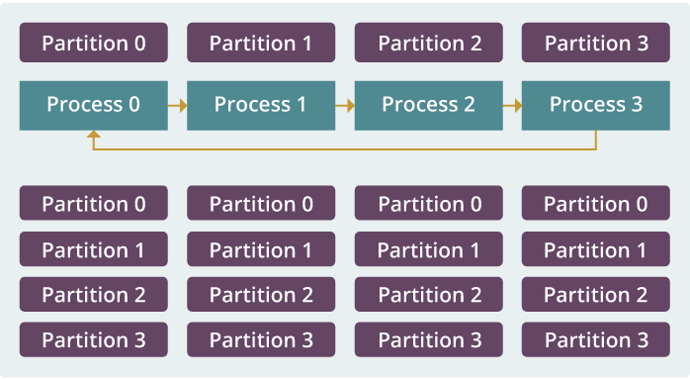
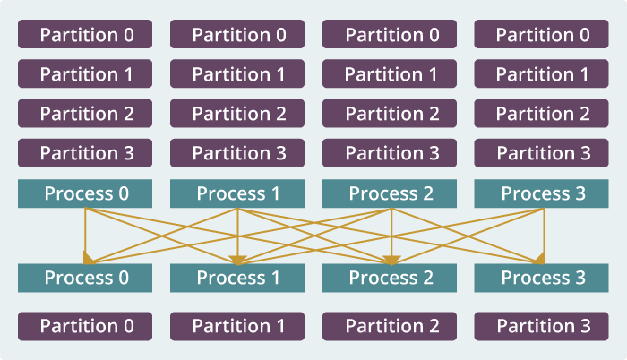
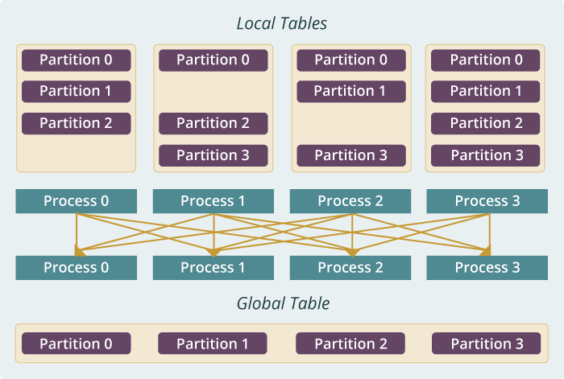
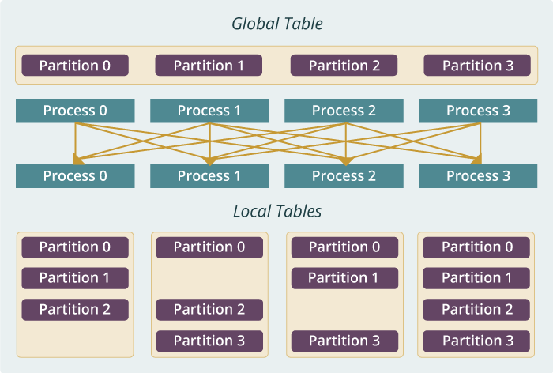
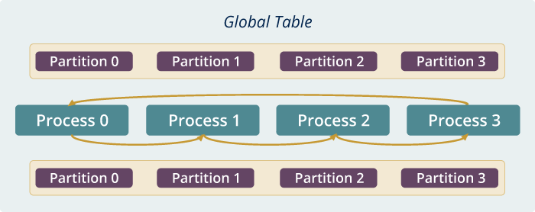
Run time software for Harp
broadcast
reduce
allreduce
allgather
regroup
push & pull
rotate
Map Collective Run time merges MapReduce and HPC

Slide 14
AI First Platforms as in
“An important shift from a mobile first world to an
AI first world,” declared Google CEO Sundar Pichai, summarizing the Google I/O 2017 keynote yesterday
Comparing Spark, Flink and MPI
2
http://www.iterativemapreduce.org/

Slide 15
Machine Learning with MPI, Spark and Flink
Three algorithms implemented in three runtimes
  Multidimensional Scaling (MDS)
  Terasort
  K-Means (drop as no time and looked at later)
Implementation in Java
  MDS is the most complex algorithm - three nested parallel loops
  K-Means - one parallel loop
  Terasort - no iterations
With care, Java performance ~ C performance
Without care, Java performance << C performance (details omitted)

Slide 16



Multidimensional Scaling: 3 Nested Parallel Sections
Kmeans also bad – see later
Flink
Spark
MPI
MPI Factor of 20-200 Faster than Spark/Flink
MDS execution time with 32000 points on varying number of nodes. Each node runs 20 parallel tasks
Spark, Flink No Speedup
MDS execution time on 16 nodes with 20 processes in each node with varying number of points

Slide 17


Terasort
Sorting 1TB of data records
Terasort execution time in 64 and 32 nodes. Only MPI shows the sorting time and communication time as other two frameworks doesn't provide a clear method to accurately measure them. Sorting time includes data save time.
MPI-IB - MPI with Infiniband
Partition the data using a sample and regroup

Slide 18
Ways of adding AI First High Performance
Fix performance issues in Spark, Heron, Hadoop, Flink etc.
  Messy as some features of these big data systems intrinsically slow in some (not all) cases
  All these systems are “monolithic” and difficult to deal with individual components
Execute HPBDC from classic big data system with custom communication environment – approach of Harp for the relatively simple Hadoop environment
Provide a native Mesos/Yarn/Kubernetes/HDFS high performance execution environment with all capabilities of Spark, Hadoop and Heron – goal of Twister2
Execute with MPI in classic (Slurm, Lustre) HPC environment
Add modules to existing frameworks like Scikit-Learn or Tensorflow either as new capability or as a higher performance version of existing module.

Slide 19
Twister2: “Next Generation Grid - Edge – HPC Cloud” Programming Environment
Analyze the runtime of existing systems
  Hadoop, Spark, Flink, Pregel Big Data Processing
  OpenWhisk and commercial FaaS
  Storm, Heron, Apex Streaming Dataflow
  Kepler, Pegasus, NiFi workflow systems
  Harp Map-Collective, MPI and HPC AMT asynchronous many task runtime like DARMA
  And approaches such as GridFTP and CORBA/HLA (!) for wide area data links
Most systems are monolithic and make
choices that are sometimes non-optimal
Build a toolkit with components that can
have multiple implementations such as
  Static or dynamic scheduling
  Dataflow or BSP communication

Slide 20
Twister2 Components I
Area | Component | Implementation | Comments: User API
Architecture Specification | Coordination Points | State and Configuration Management; Program, Data and Message Level | Change execution mode; save and reset state
 | Execution Semantics | Mapping of Resources to Bolts/Maps in Containers, Processes, Threads | Different systems make different choices - why?
 | Parallel Computing | Spark Flink Hadoop Pregel MPI modes | Owner Computes Rule
Job Submission | (Dynamic/Static) Resource Allocation | Plugins for Slurm, Yarn, Mesos, Marathon, Aurora | Client API (e.g. Python) for Job Management
Task System | Task migration | Monitoring of tasks and migrating tasks for better resource utilization | Task-based programming with Dynamic or Static Graph API; FaaS API; Support accelerators (CUDA,KNL)
 | Elasticity | OpenWhisk
 | Streaming and FaaS Events | Heron, OpenWhisk, Kafka/RabbitMQ
 | Task Execution | Process, Threads, Queues
 | Task Scheduling | Dynamic Scheduling, Static Scheduling, Pluggable Scheduling Algorithms
 | Task Graph | Static Graph, Dynamic Graph Generation

Slide 21
Twister2 Components II
Area | Component | Implementation | Comments
Communication API | Messages | Heron | This is user level and could map to multiple communication systems
 | Dataflow Communication | Fine-Grain Twister2 Dataflow communications: MPI,TCP and RMA Coarse grain Dataflow from NiFi, Kepler? | Streaming, ETL data pipelines; Define new Dataflow communication API and library
 | BSP Communication Map-Collective | Conventional MPI, Harp | MPI Point to Point and Collective API
Data Access | Static (Batch) Data | File Systems, NoSQL, SQL | Data API
 | Streaming Data | Message Brokers, Spouts
Data Management | Distributed Data Set | Relaxed Distributed Shared Memory(immutable data), Mutable Distributed Data | Data Transformation API; Spark RDD, Heron Streamlet
Fault Tolerance | Check Pointing | Upstream (streaming) backup; Lightweight; Coordination Points; Spark/Flink, MPI and Heron models | Streaming and batch cases distinct; Crosses all components
Security | Storage, Messaging, execution | Research needed | Crosses all Components

Slide 22
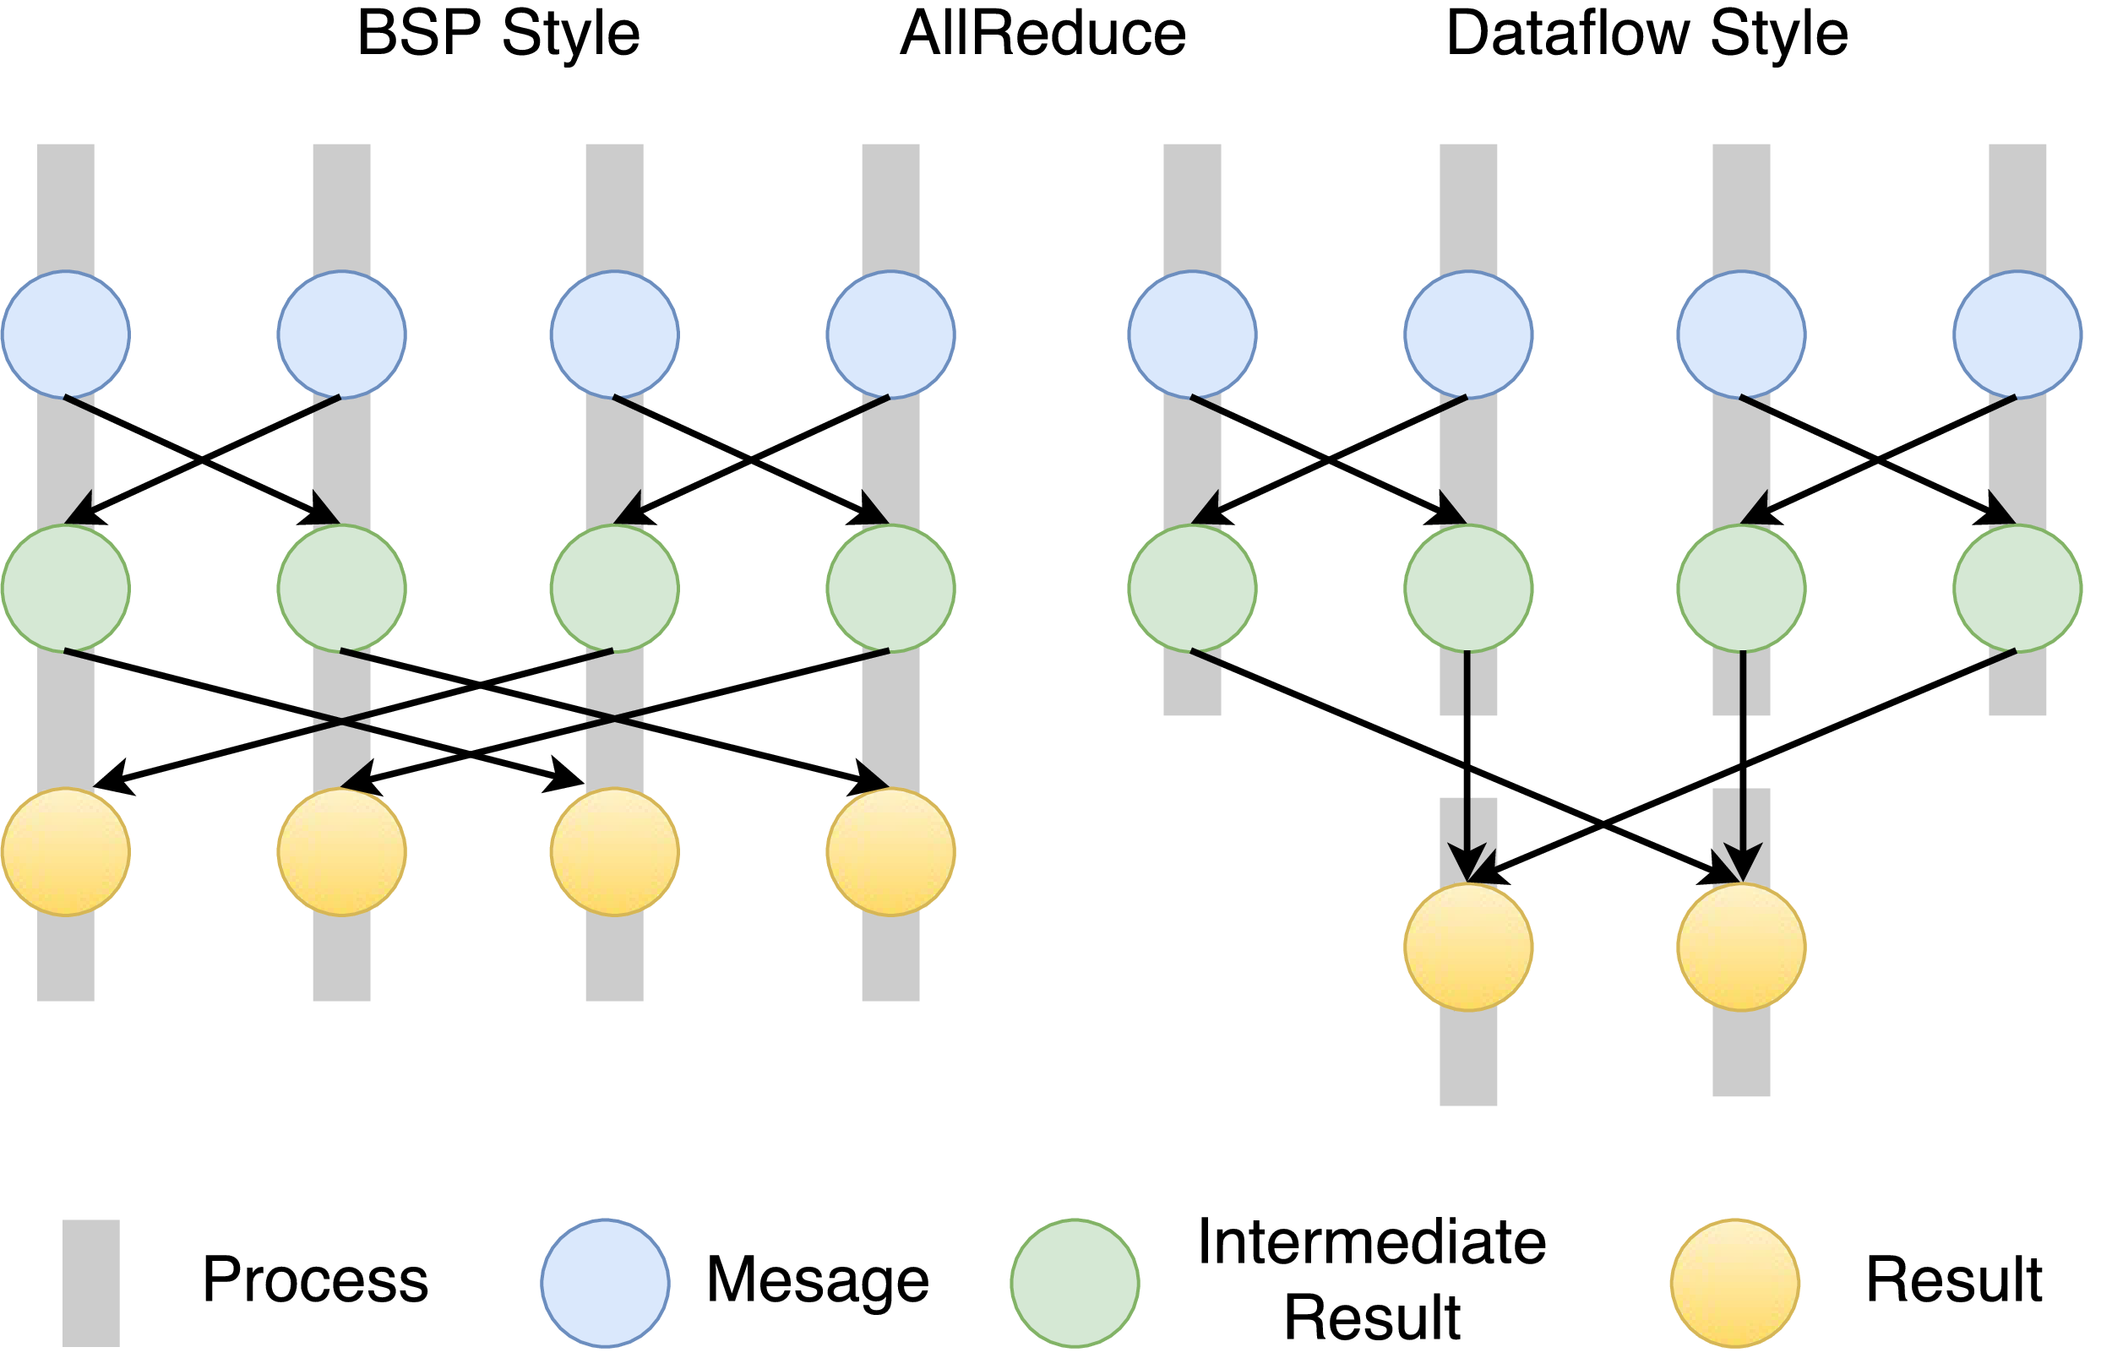
Twister2 Dataflow Communications
Twister:Net offers two communication models
BSP (Bulk Synchronous Processing) message-level communication using TCP or MPI separated from its task management plus extra Harp collectives
DFW a new Dataflow library built using MPI software but at data movement not message level
  Non-blocking
  Dynamic data sizes
  Streaming model
    Batch case is modeled as a finite stream
  The communications are between a set of
  tasks in an arbitrary task graph
  Key based communications
  Data-level Communications spilling to disks
  Target tasks can be different from source tasks

Slide 23
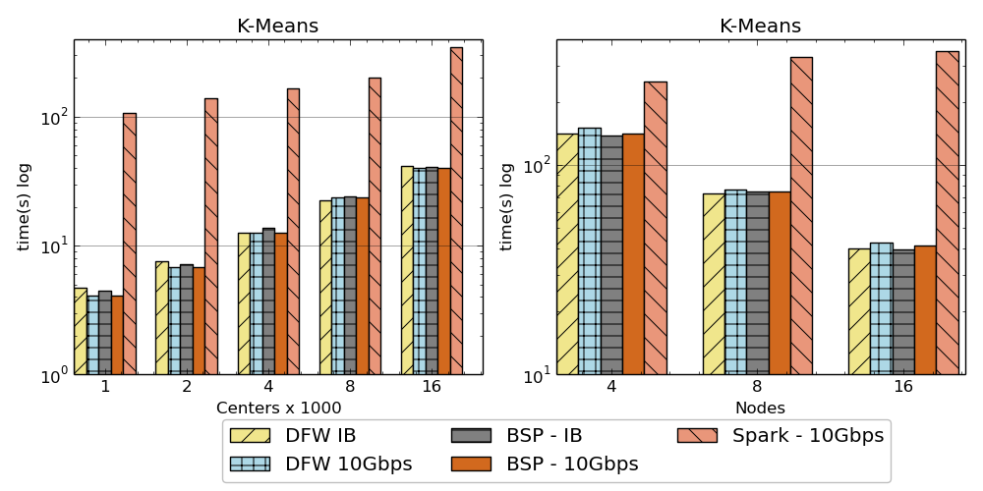
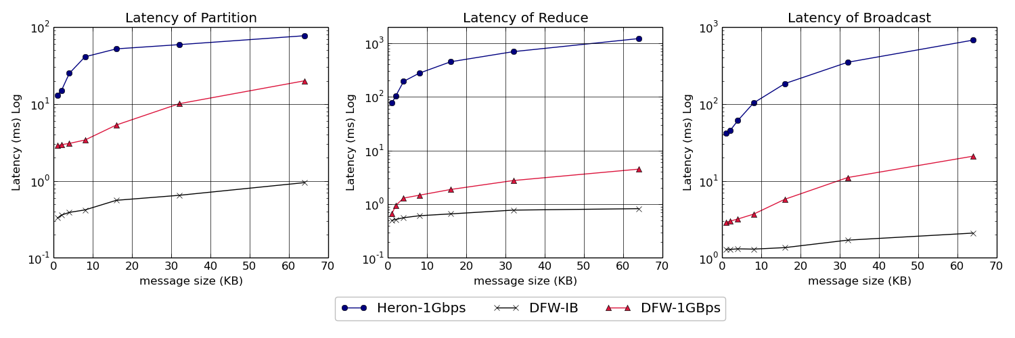
Twister:Net and Apache Heron and Spark
Left: K-means job execution time on 16 nodes with varying centers, 2 million points with 320-way parallelism. Right: K-Means wth 4,8 and 16 nodes where each node having 20 tasks. 2 million points with 16000 centers used.
Latency of Apache Heron and Twister:Net DFW (Dataflow) for Reduce, Broadcast and Partition operations in 16 nodes with 256-way parallelism

Slide 24
Implementing Twister2 in detail III
2
http://www.iterativemapreduce.org/
State

Slide 25

Dataflow at Different Grain sizes
Coarse Grain Dataflows links jobs in such a pipeline
Visualization
Dimension
Reduction
Data preparation
Clustering
But internally to each job you can also elegantly express algorithm as dataflow but with more stringent performance constraints
Corresponding to classic Spark K-means Dataflow
P = loadPoints()
C = loadInitCenters()
for (int i = 0; i < 10; i++) {
T = P.map().withBroadcast(C)
C = T.reduce() }
Internal Execution
Dataflow Nodes
Reduce
Iterate
HPC
Communication
Maps
Iterate

Slide 26
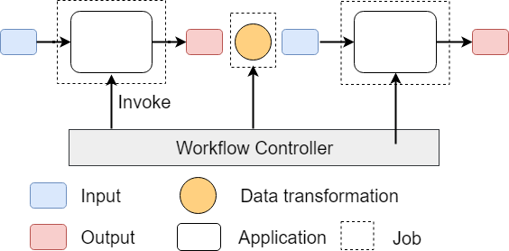
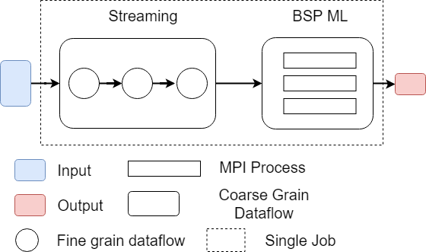
Workflow vs Dataflow: Different grain sizes and different performance trade-offs
The fine-grain dataflow can expand from Edge to Cloud
Coarse-grain Dataflow
Workflow Controlled by Workflow Engine or a Script
Fine-grain dataflow application running as a single job

Slide 27
Fault Tolerance and State
Similar form of check-pointing mechanism is used already in HPC and Big Data
  although HPC informal as doesn’t typically specify as a dataflow graph
  Flink and Spark do better than MPI due to use of database technologies; MPI is a bit harder due to richer state but there is an obvious integrated model using RDD type snapshots of MPI style jobs
Checkpoint after each stage of the dataflow graph (at location of intelligent dataflow nodes)
  Natural synchronization point
  Let’s allows user to choose when to checkpoint (not every stage)
  Save state as user specifies; Spark just saves Model state which is insufficient for complex algorithms

Slide 28
Futures
Implementing Twister2
AI First High Performance Big Data Computing
2
http://www.iterativemapreduce.org/

Slide 29
Twister2 Timeline: End of August 2018
Twister:Net Dataflow Communication API
  Dataflow communications with MPI or TCP
Harp for Machine Learning (Custom BSP Communications)
  Rich collectives
  Around 30 ML algorithms
HDFS Integration
Task Graph
  Streaming - Storm model
  Batch analytics - Hadoop
Deployments on Docker, Kubernetes, Mesos (Aurora), Nomad, Slurm

Slide 30
Twister2 Timeline: End of December 2018
Native MPI integration to Mesos, Yarn
Naiad model based Task system for Machine Learning
Link to Pilot Jobs
Fault tolerance as in Heron and Spark
  Streaming
  Batch
Hierarchical dataflows with Streaming, Machine Learning and Batch integrated seamlessly
Data abstractions for streaming and batch (Streamlets, RDD)
Workflow graphs (Kepler, Spark) with linkage defined by Data Abstractions (RDD)
End to end applications

Slide 31
Twister2 Timeline: After December 2018
Dynamic task migrations
RDMA and other communication enhancements
Integrate parts of Twister2 components as big data systems enhancements (i.e. run current Big Data software invoking Twister2 components)
  Heron (easiest), Spark, Flink, Hadoop (like Harp today)
Support different APIs (i.e. run Twister2 looking like current Big Data Software)
  Hadoop
  Spark (Flink)
  Storm
Refinements like Marathon with Mesos etc.
Function as a Service and Serverless
Support higher level abstractions
  Twister:SQL (major Spark use case)

Slide 32
Summary of High-Performance Big Data Computing Environments
Integration of current (Apache) Big Data and HPC technologies
  Integration of Big Data and Big Simulation
  Integration of edge to cloud or streaming to batch technologies
We have built a high performance data analysis library SPIDAL supported by an Hadoop plug-in Harp with computation models
We have integrated HPC into many Apache systems with HPC-ABDS with rich set of communication collectives as in Harp
We have done a preliminary analysis of the different runtimes of Hadoop, Spark, Flink, Storm, Heron, Naiad, DARMA (HPC Asynchronous Many Task) and identified key components
There are different technologies for different circumstances but can be unified by high level abstractions such as communication/data/task/workflow API’s
Apache systems use dataflow communication which is natural for distributed systems but slower for classic parallel computing. We suggest Twister:Net
  No standard dataflow library (why?). Add Dataflow primitives in MPI-4?
HPC could adopt some of tools of Big Data as in Coordination Points (dataflow nodes), State management (fault tolerance) with RDD (datasets)
Could integrate dataflow and workflow in a cleaner fashion
Twister2 can offer major Spark Hadoop Heron capabilities with clean high performance

