Slide 1
Data Analysis from Cores to Clouds
HPC 2008 High Performance Computing and Grids
Cetraro Italy July 3 2008
Geoffrey Fox, Seung-Hee Bae, Neil Devadasan, Jaliya Ekanayake, Rajarshi Guha, Marlon Pierce, Shrideep Pallickara, Xiaohong Qiu, David Wild, Huapeng Yuan
Community Grids Laboratory, Research Computing UITS, School of Informatics and POLIS Center Indiana University
George Chrysanthakopoulos, Henrik Frystyk Nielsen
Microsoft Research, Redmond WA
gcf@indiana.edu
http://grids.ucs.indiana.edu/ptliupages/presentations/

Slide 2
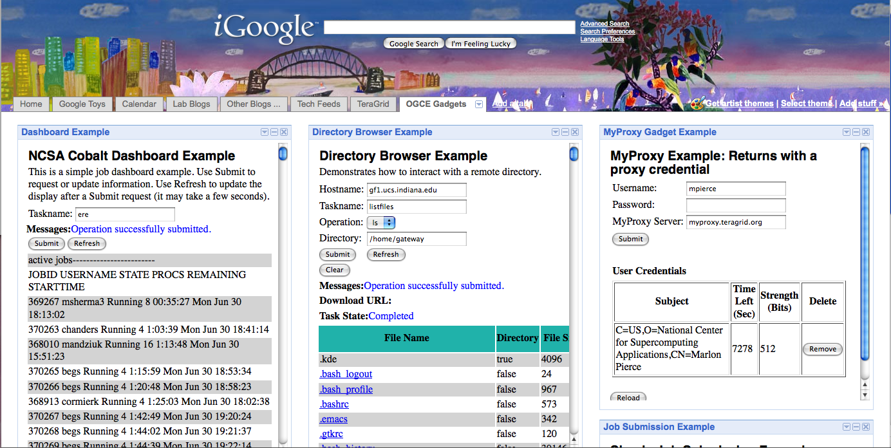
GTLAB Applications as Google Gadgets: MOAB dashboard, remote directory browser, and proxy management.

Slide 3
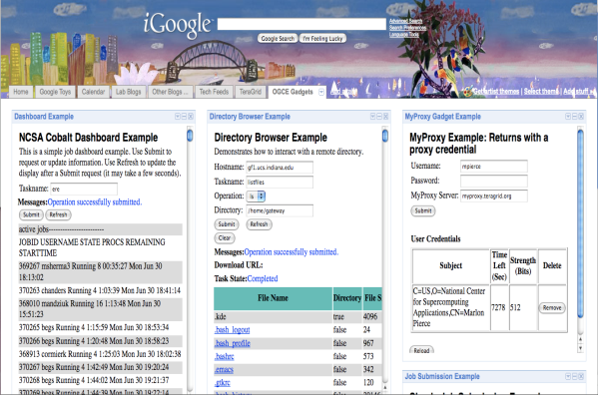

Gadget containers aggregate content from multiple providers. Content is aggregated on the client by the user. Nearly any web application can be a simple gadget (as Iframes)
GTLAB interfaces to Gadgets or Portlets
Gadgets do not need GridSphere
Other Gadgets
Providers
Tomcat + GTLAB Gadgets
Other Gadgets
Providers
RSS Feed, Cloud, etc
Services
Grid and Web Services
(TeraGrid, OSG, etc)
Social Network
Services (Orkut, LinkedIn,etc)

Slide 4
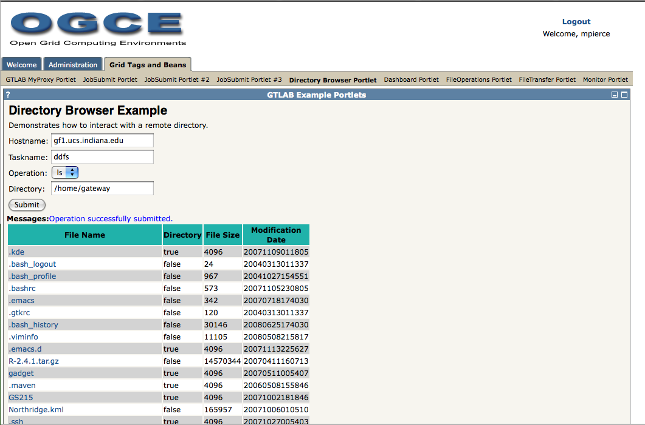
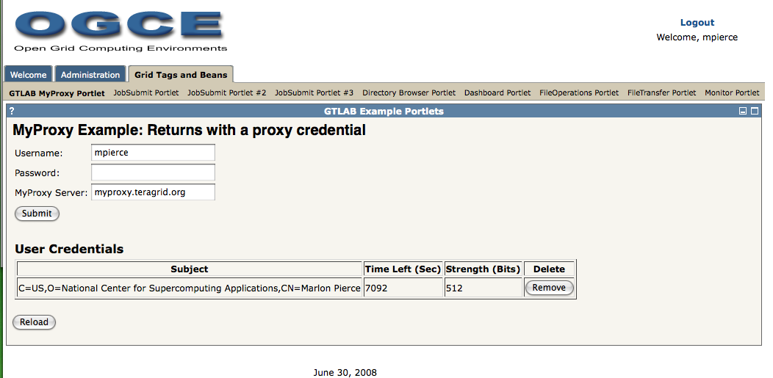
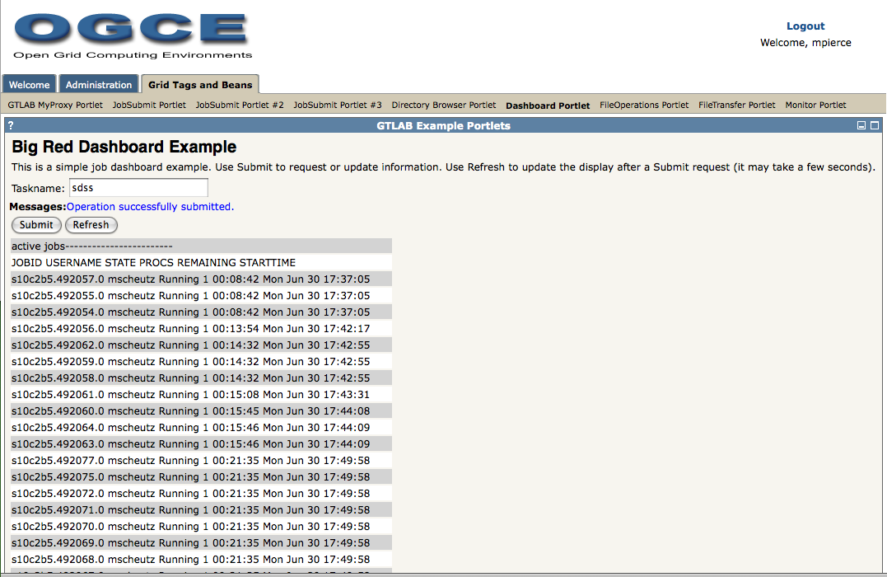
Various GTLAB applications deployed as portlets:
Remote directory browsing, proxy management, and LoadLeveler queues.

Slide 5
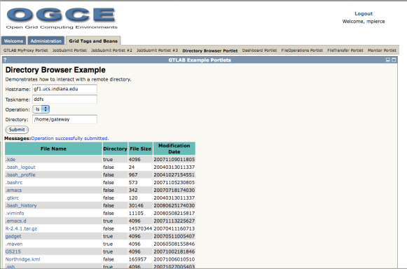
Last time, I discussed Web 2.0 and we have made some progress
Portlets become Gadgets
Common science gateway architecture. Aggregation is in the portlet container. Users have limited selections of components.
HTML/HTTP
Tomcat
+
Portlets and Container
SOAP/HTTP
Grid and Web Services
(TeraGrid, OSG, etc)
Grid and Web Services
(TeraGrid, OSG, etc)
Grid and Web Services
(TeraGrid, OSG, etc)

Slide 6


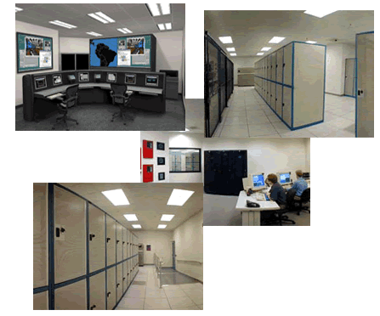
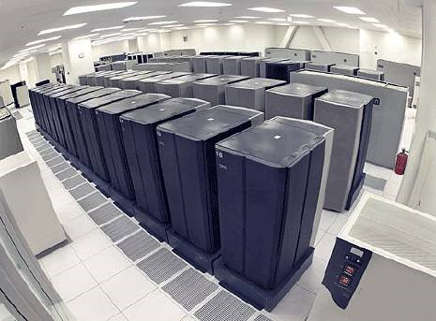
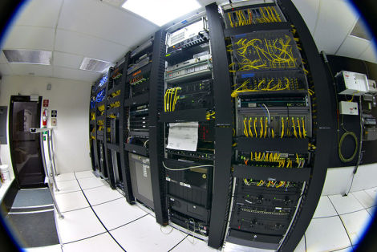
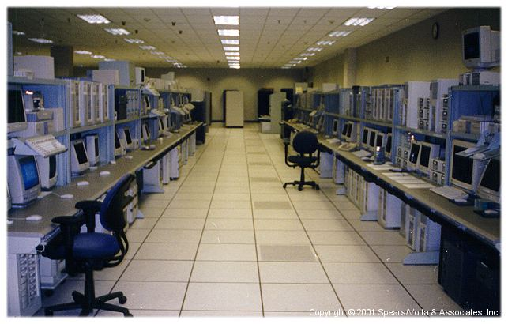

Google lolcat invisible hand if you think this is totally bizarre
I’M IN UR CLOUD
INVISIBLE COMPLEXITY

Slide 7
Introduction
Many talks have emphasized the data deluge
Here we look at data analysis on both single systems, parallel clusters and distributed systems (clouds, grids)
Intel RMS analysis highlights data-mining as one key multicore application
  We will be flooded with cores and data in near future
Google MapReduce illustrates data-oriented workflow
Note that focus on data analysis is relatively recent (e.g. in bioinformatics) and in era dominated by fast sequential computers
  Many key algorithms (e.g. in R library) such as HMM, SVM, MDS, Gaussian Modeling, Clustering do not have good available parallel implementations/algorithms

Slide 8
Parallel Computing 101
Traditionally think about SPMD Single Program Multiple Data
However most problems are a collection of SPMD parallel applications (workflows)
FPMD – Few Programs Multiple Data with many more concurrent units than independent program codes
Measure performance with Fractional Overhead
f = PT(P)/T(1) - 1 ≈ 1- efficiency ε
T(P) Time on P cores/processors
f tends to be linear in overheads as linear in T(P)
f = 0.1 is efficiency ε = 0.91

Slide 9
Threading Multicore Runtime System
Assume that we can use workflow/Mashup technology to implement coarse-grain integration (macro-parallelism)
  Latencies of 25 μs to 10’s of ms (disk, network) whereas micro-parallelism has latency of a few μs
For threading on multicore, we implement micro-parallelism using Microsoft CCR (Concurrency and Coordination Runtime) as it supports both MPI rendezvous and dynamic (spawned) threading style of parallelism http://msdn.microsoft.com/robotics/
  Uses ports like CSP
CCR Supports exchange of messages between threads using named ports and has primitives like:
  FromHandler: Spawn threads without reading ports
  Receive: Each handler reads one item from a single port
  MultipleItemReceive: Each handler reads a prescribed number of items of a given type from a given port. Note items in a port can be general structures but all must have same type.
  MultiplePortReceive: Each handler reads a one item of a given type from multiple ports.
CCR has fewer primitives than MPI but can implement MPI collectives efficiently
SALSA

Slide 10
Parallel Data Analysis
Data Analysis is naturally MIMD FPMD data parallel
MPI
CCR Ports
Trackers
Disk HTTP
MPI
CCR Ports
Trackers
Disk HTTP
MPI
CCR Ports
Trackers
Disk HTTP
MPI
CCR Ports
Trackers
Disk HTTP
MPI is long running processes with Rendezvous for message exchange/
synchronization
CCR (Multi Threading) uses short or long
running threads communicating via shared memory
CGL MapReduce is long running processing with asynchronous distributed synchronization
Yahoo Hadoop uses short running processes communicating via disk and tracking processes

Slide 11
General Problem Classes
N data points X(x) in D dimensional space OR points with dissimilarity δ_{ij} defined between them
  Unsupervised Modeling
Find clusters without prejudice
Model distribution as clusters formed from Gaussian distributions with general shape
  Dimensional Reduction/Embedding
Given vectors, map into lower dimension space “preserving topology” for visualization: SOM and GTM
Given δ_{ij} associate data points with vectors in a Euclidean space with Euclidean distance approximately δ_{ij} : MDS (can anneal) and Random Projection
All can use multi-resolution annealing
Data Parallel over N data points X(x)
SALSA
Notes:
11

Slide 12
Deterministic Annealing
Minimize Free Energy F = E-TS where E objective function (energy) and S entropy.
Reduce temperature T logarithmically; T= ∞ is dominated by Entropy, T small by objective function
  S regularizes E in a natural fashion
In simulated annealing, use Monte Carlo but in deterministic annealing, use mean field averages
<F> = ∫ exp(-E₀/T) F over the Gibbs distribution
P₀ = exp(-E₀/T) using an energy function E₀ similar to E but for which integrals can be calculated
E₀ = E for clustering and related problems
General simple choice is E₀ = ∑ (x_{i} - μ_{i})² where x_{i} parameters to be annealed
  E.g. MDS has quartic E and replace this by quadratic E₀

Slide 13

N data points E(x) in D dim. space and Minimize F by EM
  Deterministic Annealing Clustering (DAC)
a(x) = 1/N or generally p(x) with Σ p(x) =1
g(k)=1 and s(k)=0.5
T is annealing temperature varied down from ∞ with final value of 1
Vary cluster center Y(k)
K starts at 1 and is incremented by algorithm; pick resolution NOT number of clusters
My 4th most cited article but little used; probably as no good software compared to simple K-means
Avoid local minima
SALSA
Notes:
13

Slide 14
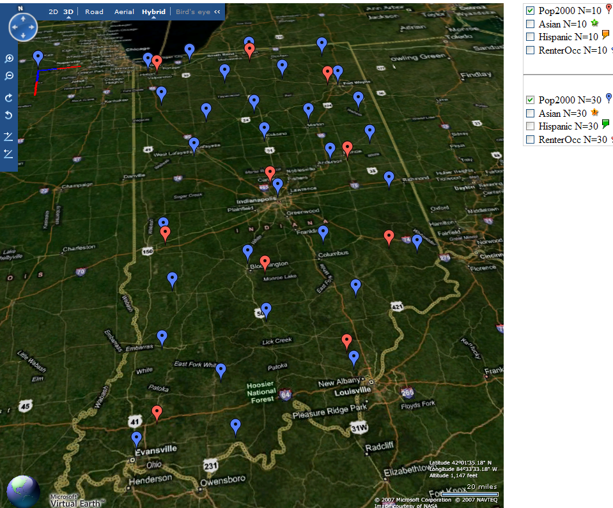
Deterministic Annealing Clustering of Indiana Census Data
Decrease temperature (distance scale) to discover more clusters
Distance Scale
Temperature^{0.5}

Slide 15
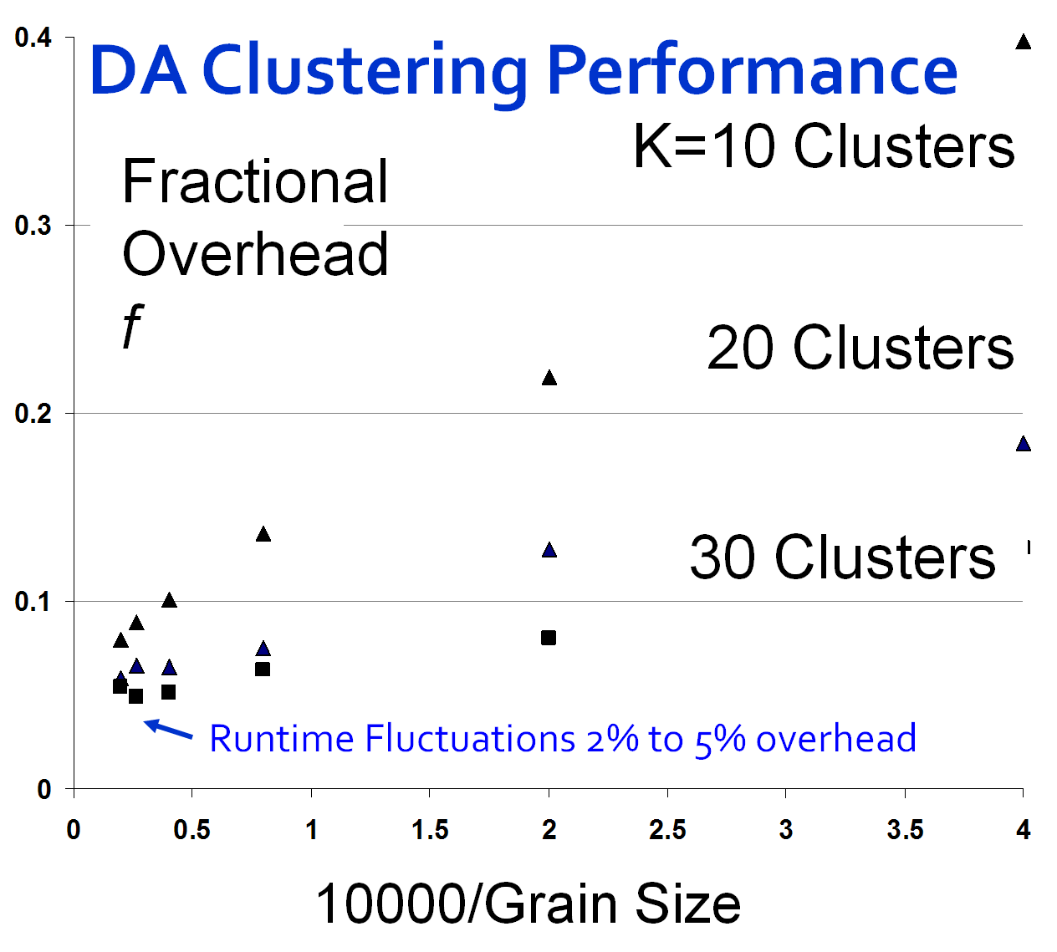
Computation ∝ Grain Size n . #Clusters K
Overheads are
Synchronization: small with CCR
Load Balance: good
Memory Bandwidth Limit: → 0 as K → ∞
Cache Use/Interference: Important
Runtime Fluctuations: Dominant large n, K
All our “real” problems have f ≤ 0.05 and
speedups on 8 core systems greater than 7.6
GTM is Dimensional Reduction
SALSA
Notes:
15

Slide 16
Parallel Programming Strategy
“Main Thread” and Memory M
MPI/CCR/DSS
From other nodes
MPI/CCR/DSS
From other nodes
0
m₀
1
m₁
2
m₂
3
m₃
4
m₄
5
m₅
6
m₆
7
m₇
Subsidiary threads t with memory m_{t}
Use Data Decomposition as in classic distributed memory but use shared memory for read variables. Each thread uses a “local” array for written variables to get good cache performance
Multicore and Cluster use same parallel algorithms but different runtime implementations; algorithms are
        Accumulate matrix and vector elements in each process/thread
        At iteration barrier, combine contributions (MPI_Reduce)
        Linear Algebra (multiplication, equation solving, SVD)
SALSA

Slide 17
MPI Exchange Latency in µs (20-30 µs computation between messaging)
Machine | OS | Runtime | Grains | Parallelism | MPI Latency
Intel8c:gf12 (8 core 2.33 Ghz) (in 2 chips) | Redhat | MPJE(Java) | Process | 8 | 181
 |  | MPICH2 (C) | Process | 8 | 40.0
 |  | MPICH2:Fast | Process | 8 | 39.3
 |  | Nemesis | Process | 8 | 4.21
Intel8c:gf20 (8 core 2.33 Ghz) | Fedora | MPJE | Process | 8 | 157
 |  | mpiJava | Process | 8 | 111
 |  | MPICH2 | Process | 8 | 64.2
Intel8b (8 core 2.66 Ghz) | Vista | MPJE | Process | 8 | 170
 | Fedora | MPJE | Process | 8 | 142
 | Fedora | mpiJava | Process | 8 | 100
 | Vista | CCR (C#) | Thread | 8 | 20.2
AMD4 (4 core 2.19 Ghz) | XP | MPJE | Process | 4 | 185
 | Redhat | MPJE | Process | 4 | 152
 |  | mpiJava | Process | 4 | 99.4
 |  | MPICH2 | Process | 4 | 39.3
 | XP | CCR | Thread | 4 | 16.3
Intel(4 core) | XP | CCR | Thread | 4 | 25.8
Messaging CCR versus MPI C# v. C v. Java
SALSA
Notes:
17

Slide 18
8 Node 2-core Windows Cluster: CCR & MPI.NET
Execution Time ms
Label | ||ism | MPI | CCR | Nodes
1 | 16 | 8 | 2 | 8
2 | 8 | 4 | 2 | 4
3 | 4 | 2 | 2 | 2
4 | 2 | 1 | 2 | 1
5 | 8 | 8 | 1 | 8
6 | 4 | 4 | 1 | 4
7 | 2 | 2 | 1 | 2
8 | 1 | 1 | 1 | 1
9 | 16 | 16 | 1 | 8
10 | 8 | 8 | 1 | 4
11 | 4 | 4 | 1 | 2
12 | 2 | 2 | 1 | 1
Run label
2 CCR Threads 1 Thread 2 MPI Processes per node
8 4 2 1 8 4 2 1 8 4 2 1 nodes
Parallel Overhead f
Scaled Speed up: Constant data points per parallel unit (1.6 million points)
Speed-up = ||ism P/(1+f)
f = PT(P)/T(1) - 1
≈ 1- efficiency
Run label
Notes:
Each run is about 1000 MPI synchronization points per run
Many MPI calls at each synchronization point
See earlier for runtime fluctuations
Negative overhead just says fluctuation in T(1)
Windows runtime fluctuations serious on many nodes as synchronization makes fluctuations on one node affect all nodes
Note execution time multiplied by P in overhead so small fluctuations in runtime magnified in f

Slide 19
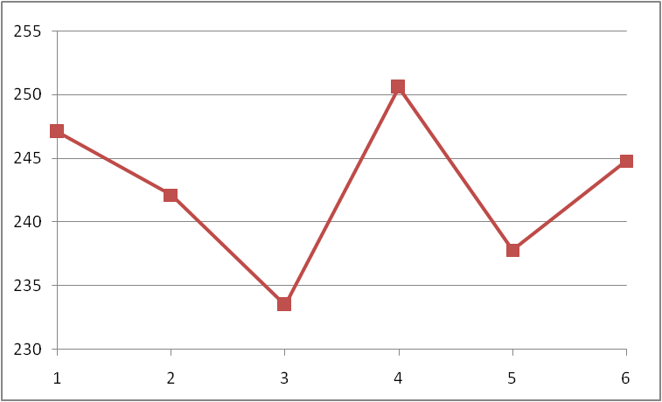
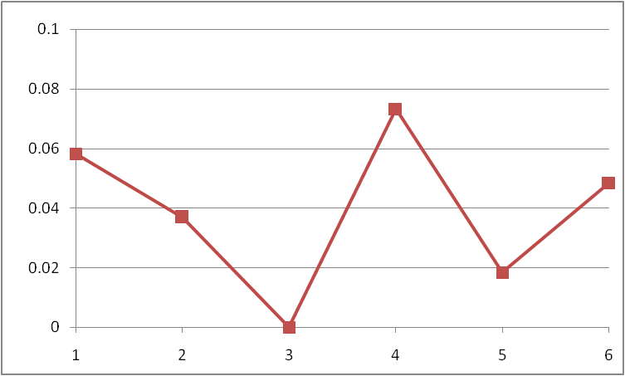
1 Node 4-core Windows Opteron: CCR & MPI.NET
Execution Time ms
Label | ||ism | MPI | CCR | Nodes
1 | 4 | 1 | 4 | 1
2 | 2 | 1 | 2 | 1
3 | 1 | 1 | 1 | 1
4 | 4 | 2 | 2 | 1
5 | 2 | 2 | 1 | 1
6 | 4 | 4 | 1 | 1
2% fluctuations
0.2% fluctuations
Run label
CCR Threads
4 2 1 2 1 1
1 1 1 2 2 4
MPI Processes
Scaled Speed up: Constant data points per parallel unit (0.4 million points)
Speed-up = ||ism P/(1+f)
f = PT(P)/T(1) - 1
≈ 1- efficiency
MPI uses REDUCE, ALLREDUCE (most used) and BROADCAST
Parallel Overhead f
Run label
Notes:
We will extend to 8 core Windows clusters
We will extend by averaging over many runs
Here CCR a little better than MPI

Slide 20
Overhead versus Grain Size
Speed-up = (||ism P)/(1+f) Parallelism P = 16 on experiments here
f = PT(P)/T(1) - 1 ≈ 1- efficiency
Fluctuations serious on Windows
We have not investigated fluctuations directly on clusters where synchronization between nodes will make more serious
MPI somewhat better performance than CCR; probably because multi threaded implementation has more fluctuations
Need to improve initial results with averaging over more runs
8 MPI Processes
2 CCR threads per process
Parallel Overhead f
16 MPI Processes
100000/Grain Size(data points per parallel unit)
Notes:
Overhead does not go to zero as 1/n tends to infinity due to fluctuations
Data on first slide is SMALLEST 100000/n
n is amount of data in parallel unit

Slide 21
Map Reduce
“MapReduce is a programming model and an associated implementation for processing and generating large data sets. Users specify a map function that processes a key/value pair to generate a set of intermediate key/value pairs, and a reduce function that merges all intermediate values associated with the same intermediate key.”
MapReduce: Simplified Data Processing on Large Clusters
Jeffrey Dean and Sanjay Ghemawat
map(key, value)
Applicable to most loosely coupled data parallel applications
The data is split into m parts and the map function is performed on each part of the data concurrently
Each map function produces r number of results
A hash function maps these r results to one ore more reduce functions
The reduce function collects all the results that maps to it and processes them
A combine function may be necessary to combine all the outputs of the reduce functions together
reduce(key, list<value>)
E.g. Word Count
map(String key, String value):
// key: document name
// value: document contents
reduce(String key, Iterator values):
// key: a word
// values: a list of counts

Slide 22
How does it work?
The framework supports the splitting of data
Outputs of the map functions are passed to the reduce functions
The framework sorts the inputs to a particular reduce function based on the intermediate keys before passing them to the reduce function
An additional step may be necessary to combine all the results of the reduce functions
D1
map
reduce
O1
D2
map
Data
reduce
O2
reduce
Or
Dm
map
data split
map
reduce

Slide 23
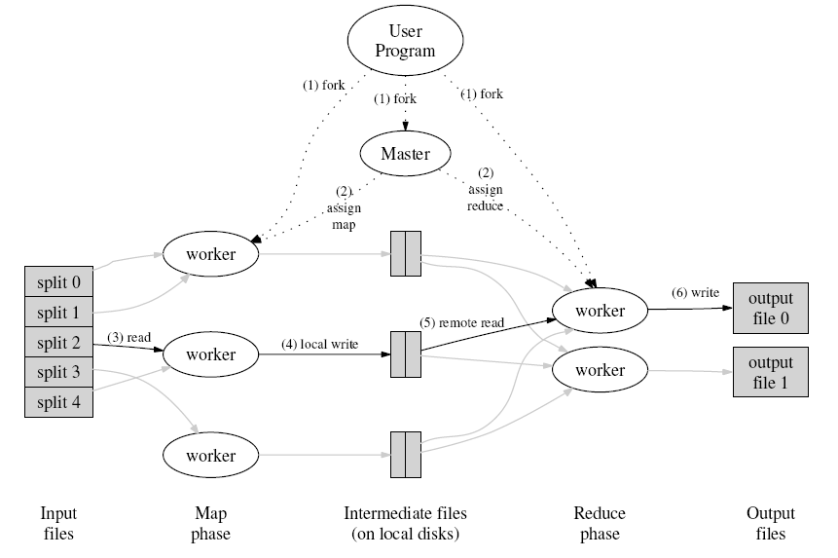
Google’s Implementation
E.g. Word Count
map(String key, String value):
// key: document name
// value: document contents
for each word w in value:
EmitIntermediate(w, "1");
reduce(String key, Iterator values):
// key: a word
// values: a list of counts
int result = 0;
for each v in values:
result += ParseInt(v);
Emit(AsString(result));
Key Points
  Data(Inputs) and the outputs are stored in the Google File System (GFS)
  Intermediate results are stored on local discs
  Framework, retrieves these local files and calls the reduce function
  Framework handles the failures of map and reduce functions

Slide 24
Hadoop (Apache’s map-reduce)
A
B
Data is distributed in the data/computing nodes
Name Node maintains the namespace of the entire file system
Name Node and Data Nodes are part of the Hadoop Distributed File System (HDFS)
Job Client
  Compute the data split
  Get a JobID from the Job Tracker
  Upload the job specific files (map, reduce, and other configurations) to a directory in HDFS
  Submit the jobID to the Job Tracker
Job Tracker
  Use the data split to identify the nodes for map tasks
  Instruct TaskTrackers to execute map tasks
  Monitor the progress
  Sort the output of the map tasks
  Instruct the TaskTracker to execute reduce tasks
1
1
2
2
DN
TT
DN
TT
Data/Compute Nodes
C
D
3
4
4
3
DN
TT
DN
TT
Name Node
Job Tracker
Job Client
Data Block
DN
Data Node
TT
Task Tracker
Point to Point Communication

Slide 25
CGL Map Reduce
A map-reduce run time that supports iterative map reduce by keeping intermediate results in-memory and using long running threads
A combine phase is introduced to merge the results of the reducers
Intermediate results are transferred directly to the reducers(eliminating the overhead of writing intermediate results to the local files)
A content dissemination network is used for all the communications
API supports both traditional map reduce data analyses and iterative map-reduce data analyses
Fixed Data
Variable Data
map
reduce
combine

Slide 26
CGL Map Reduce - The Architecture
Data/Compute Nodes
Map reduce daemon starts the map and reduce workers
map and reduce workers are reusable for a given computation
Fixed data and other properties are loaded to the map and reduce workers at the startup time
MRClient submits the map and reduce jobs
MRClient performs the combine operation
MRManager manages the map-reduce sessions
Intermediate results are directly routed to the appropriate reducers and also to MRClient
D1
m
Dn-2
m
r
r
D2
m
Dn-1
m
m
r
m
r
D3
Dn
MRD
MRD
Content Dissemination Network
MRClient
MRManager
Data Splits
MRD
Map Reduce Daemon
m
Map Worker
r
Reduce Worker

Slide 27
CGL Map Reduce - Implementation
Implemented using Java
NaradaBrokering is used for the content dissemination
NaradaBrokering has APIs for both Java and C++
CGL Map Reduce supports map and reduce functions written in different languages; currently Java and C++
Can also implement algorihm using MPI and indeed “compile” Mapreduce programs to efficient MPI

Slide 28
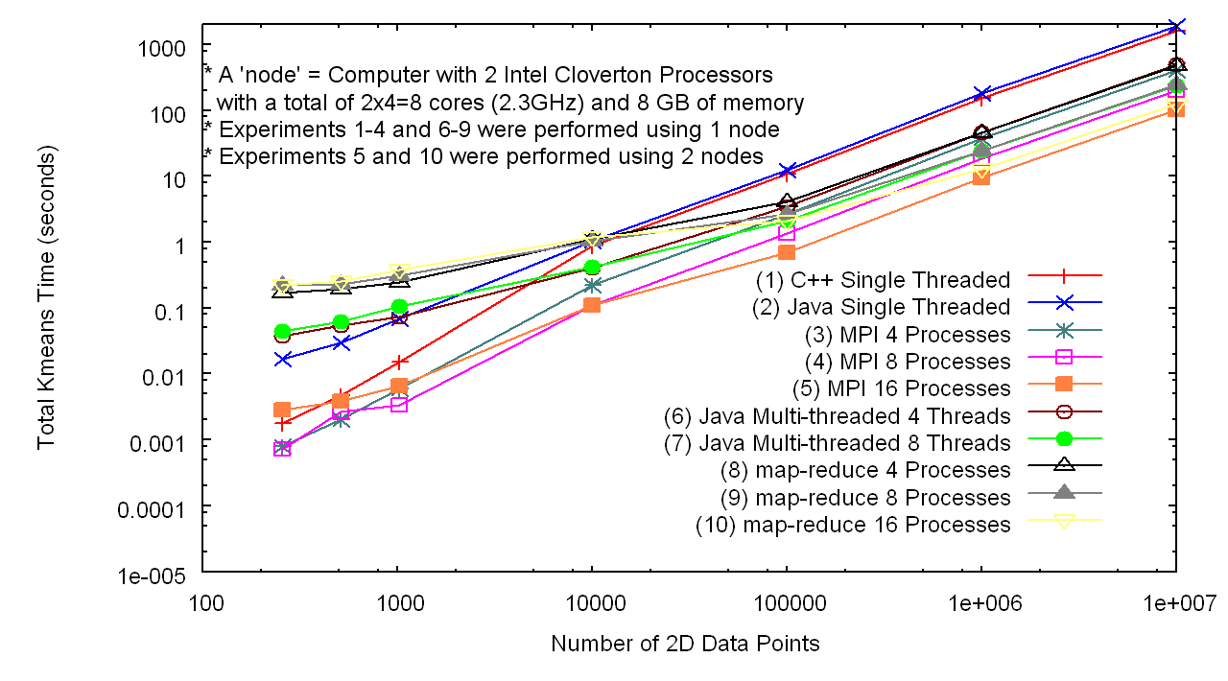
Initial Results - Performance
In memory Map Reduce based Kmeans Algorithm is used to cluster 2D data points
Compared the performance against both MPI (C++) and the Java multi-threaded version of the same algorithm
The experiments are performed on a cluster of multi-core computers
Number of Data Points

Slide 29
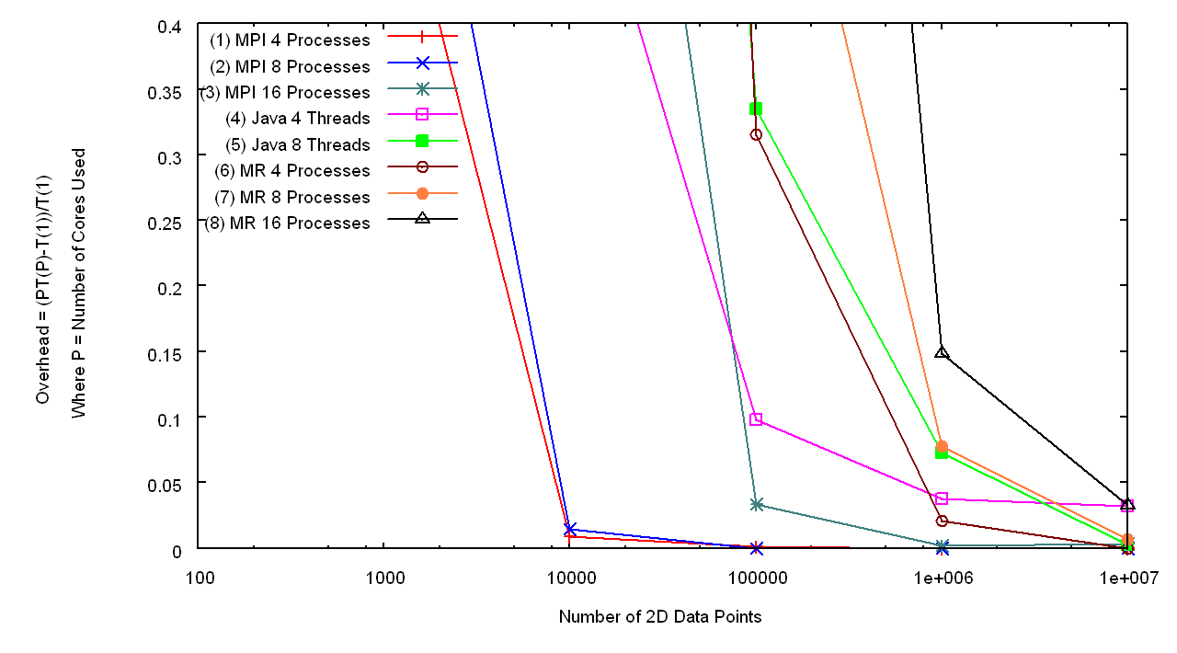
Initial Results – Overhead I
Overhead of the map-reduce runtime for the different data sizes
Java
Java
MR
MR
MR
MPI
MPI
Number of Data Points

Slide 30
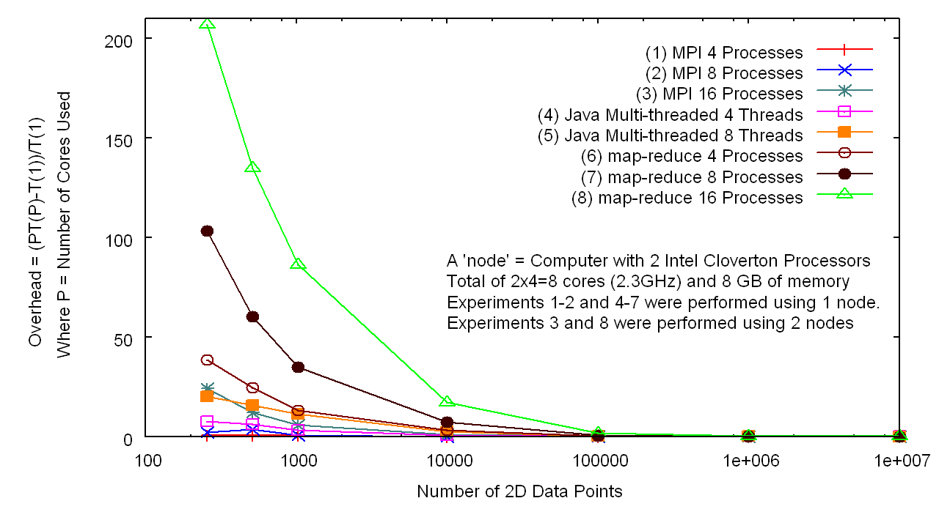
Initial Results – Overhead II
Overhead of the algorithms for the different data sizes
MR
MR
MPI
Java
MPI
Number of Data Points

Slide 31
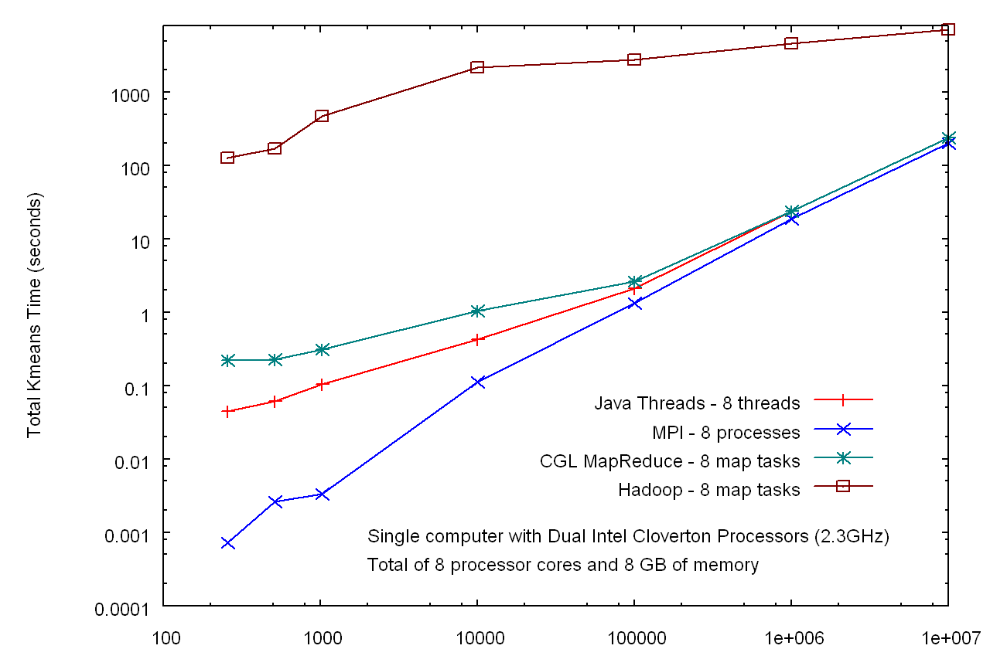
Initial Results – Hadoop v In Memory MapReduce
Factor of 30
HADOOP
Factor of 10⁵
CGL MapReduce
Java
MPI
Number of Data Points

Slide 32
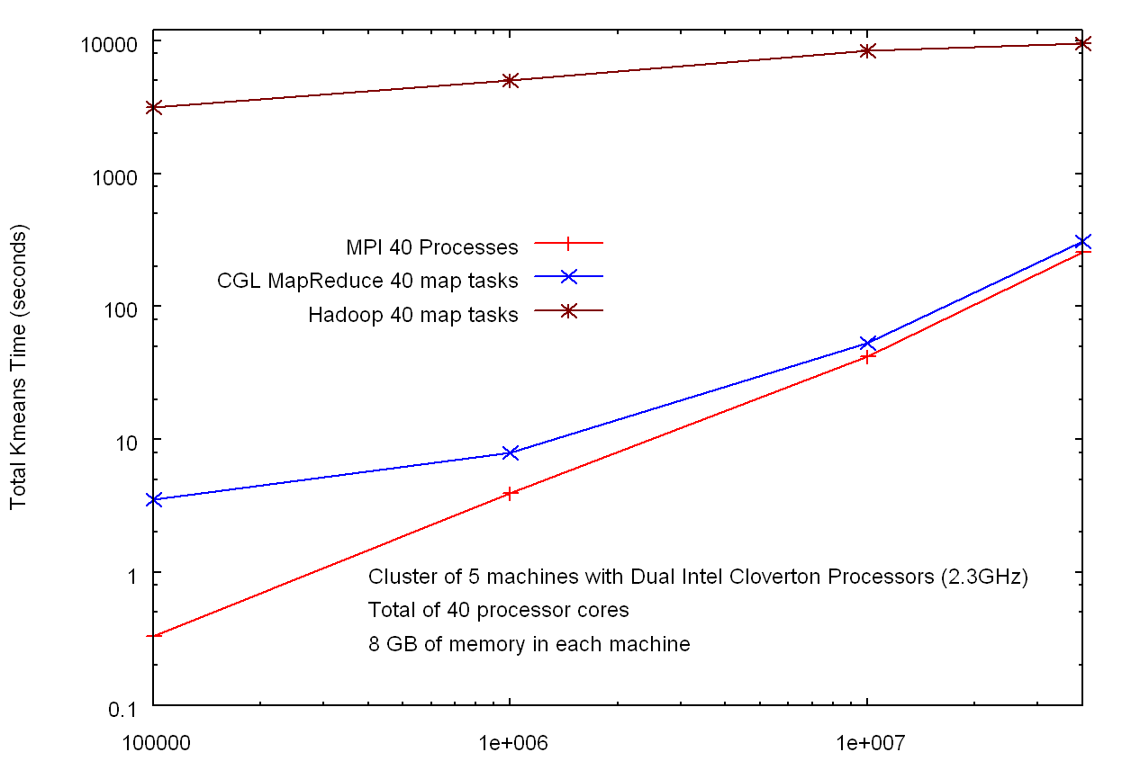
Initial Results – Hadoop v In Memory MapReduce
HADOOP
Factor of 30
Factor of 10³
CGL MapReduce
MPI
Number of Data Points

Slide 33
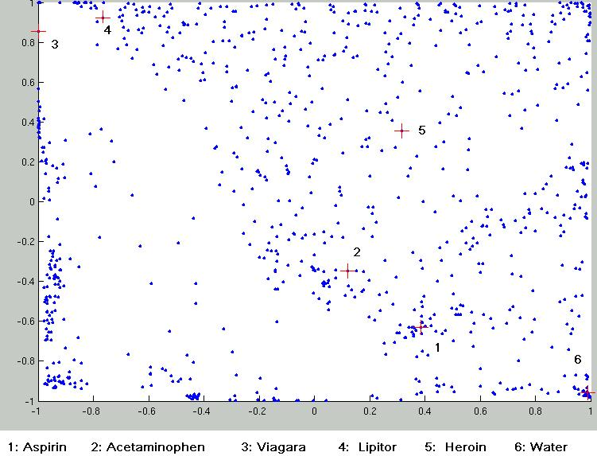
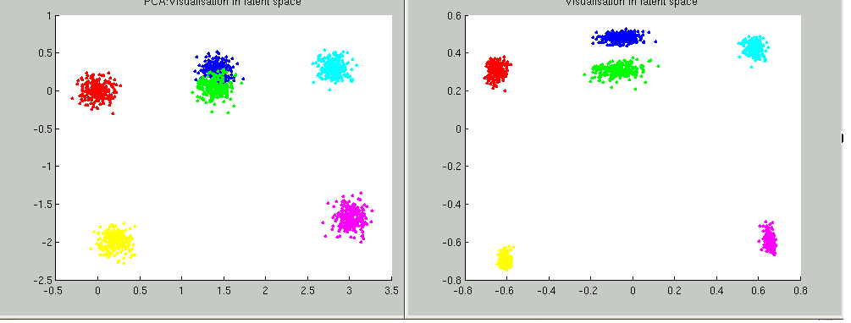
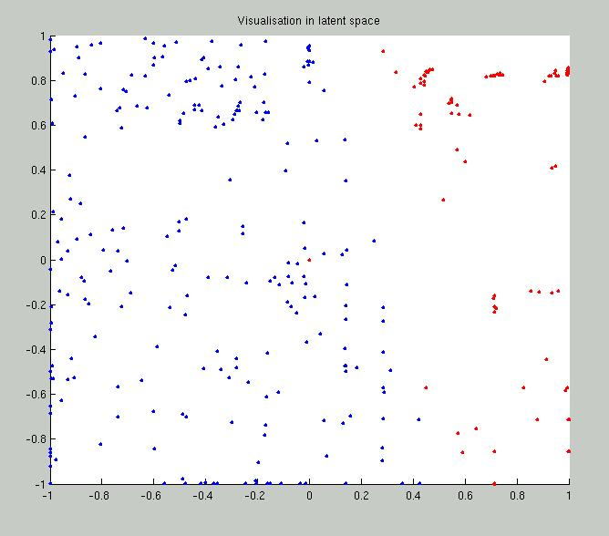
Parallel Generative Topographic Mapping GTM
Reduce dimensionality preserving topology and perhaps distances
Here project to 2D
GTM Projection of PubChem: 10,926,94 compounds in 166 dimension binary property space takes 4 days on 8 cores. 64X64 mesh of GTM clusters interpolates PubChem. Could usefully use 1024 cores! David Wild will use for GIS style 2D browsing interface to chemistry
PCA
GTM
Linear PCA v. nonlinear GTM on 6 Gaussians in 3D
PCA is Principal Component Analysis
GTM Projection of 2 clusters of 335 compounds in 155 dimensions
SALSA
Notes:
33

Slide 34
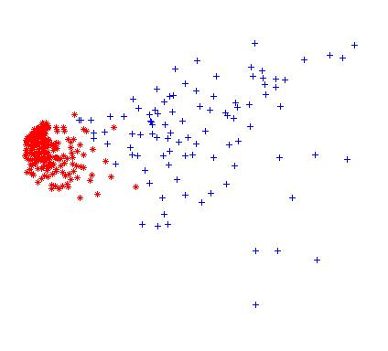
Multidimensional Scaling MDS
Minimize Stress
σ(X) = Σ_{i<j=1}^{n} weight(i,j) (δ_{ij} - d(X_{i} , X_{j}))²
δ_{ij} are input dissimilarities and d(X_{i} , X_{j}) the Euclidean distance squared in embedding space (2D here)
SMACOF or Scaling by minimizing a complicated function is clever steepest descent algorithm
Use GTM to initialize SMACOF
SMACOF
GTM

Slide 35
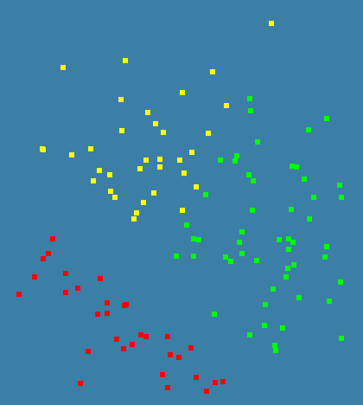
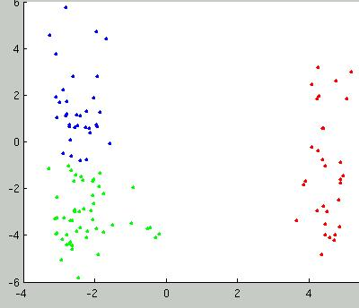
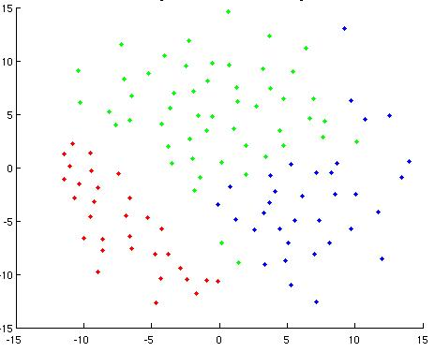
Deterministic Annealing for Pairwise Clustering
Developed (partially) by Hofmann and Buhmann in 1997 but little or no application
Applicable in cases where no (clean) vectors associated with points
H_{PC} = 0.5 ∑_{i=1}^{N} ∑_{j=1}^{N} d(i, j) ∑_{k=1}^{K} M_{i}(k) M_{j}(k) / C(k)
M_{i}(k) is probability that point I belongs to cluster k
C(k) = ∑_{i=1}^{N} M_{i}(k) is number of points in k’th cluster
M_{i}(k) ∝ exp( -ε_{i}(k)/T ) with Hamiltonian ∑_{i=1}^{N} ∑_{k=1}^{K} M_{i}(k) ε_{i}(k)
3D MDS
3 Clusters in sequences of length ≈ 300
PCA
2D MDS

Slide 36
Some Conclusions
Data Analysis runs well on parallel clusters, multicore and distributed systems
Windows machines have large runtime fluctuations that affects scaling to large systems
Current caches make efficient programming hard
Can use FPMD threading (CCR), processes (MPI) and asynchronous MIMD (Hadoop) with different tradeoffs
Probably can get advantages of Hadoop (fault tolerance and asynchronicity) using checkpointed MPI/In memory MapReduce
CCR competitive performance to MPI with simpler semantics and broader applicability (including dynamic search)
Many parallel data analysis algorithms to explore
  Clustering and Modeling
  Support Vector Machines SVM
  Dimension Reduction MDS GTM
  Hidden Markov Models
SALSA

