Slide 1
Cloud Futures Panel
gcf@indiana.edu, http://www.dsc.soic.indiana.edu, http://spidal.org
CLOUD2019, Milan Italy
Panel Chair: Geoffrey Fox, July 9, 2019

Slide 2
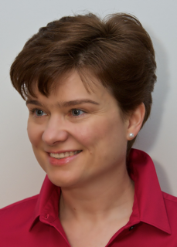
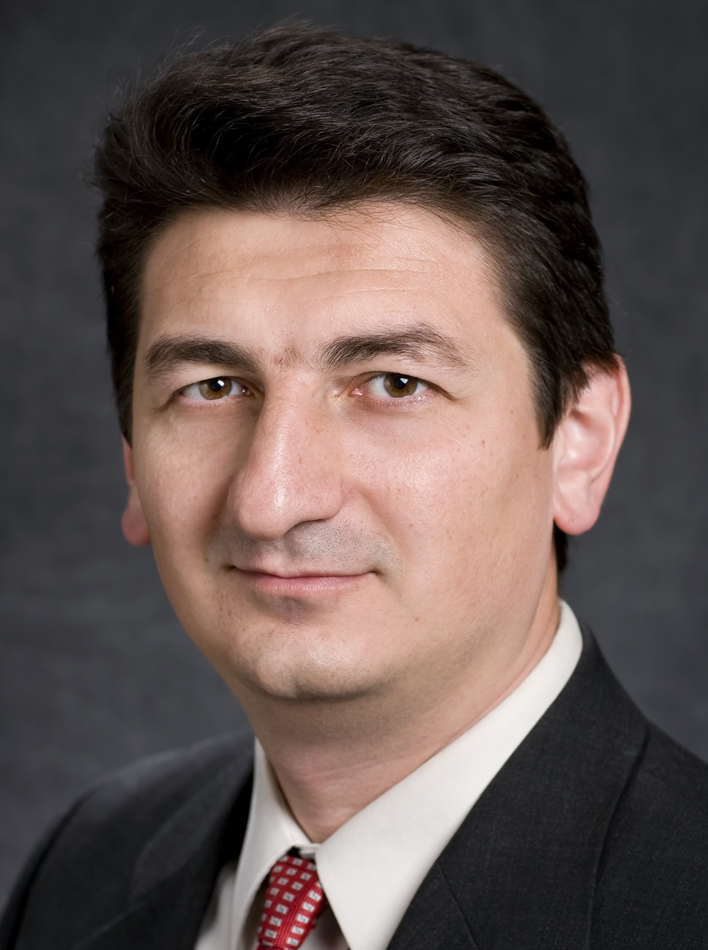
Participants
Kate Keahey, Argonne National Laboratory
Tevfik Kosar, SUNY University of Buffalo
Haiying Shen, University of Virginia

Slide 3
Charge to Panelists
What are exciting future areas of cloud-related research
And/or discuss the future importance of clouds to support research (in all areas from biology to computer science) and how clouds should be used
Note background remarks
Clouds will be 94% of Enterprise Computing in 2021 running on 50 million servers; so clouds are equivalent to data centers?
Cloud academic computing is not growing? Should we combine with Bigdata community (At this meeting, many papers in distinct Cloud Bigdata conferences could be moved to other conference)
Importance of Cloud-Edge connection (panel on Thursday)
Should Clouds and Supercomputers be distinct? (accelerators, disks on nodes, high speed internal networks)

Slide 4
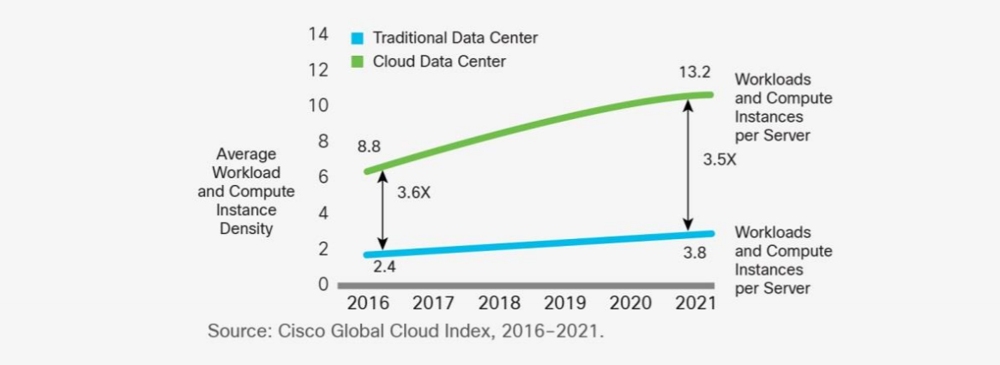
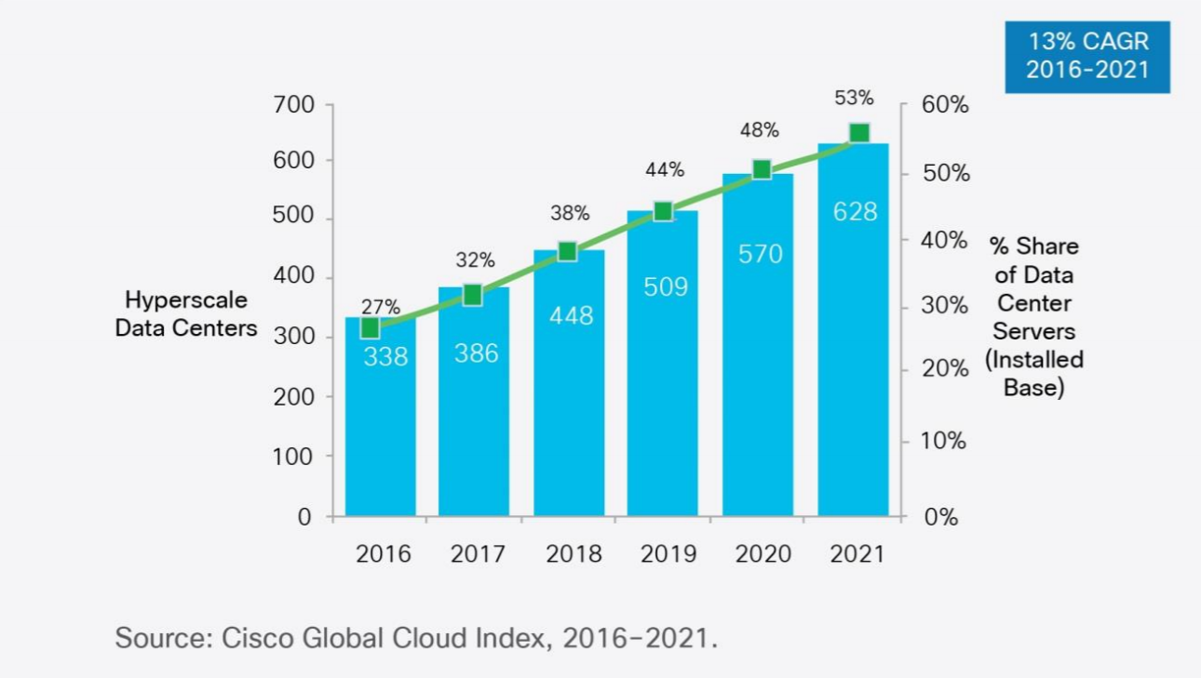
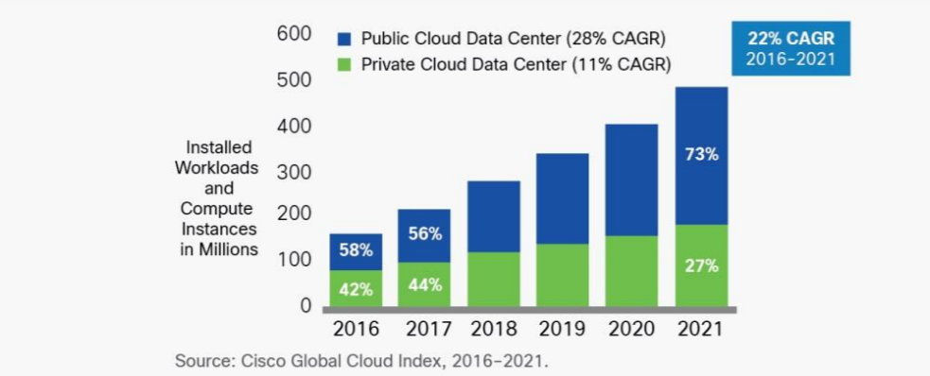
Dominance of Cloud Computing
Number of instances per server
94 percent of workloads and compute instances will be processed by cloud data centers (22% CAGR) by 2021-- only six percent will be processed by traditional data centers (-5% CAGR).
Hyperscale data centers will grow from 338 in number at the end of 2016 to 628 by 2021. They will represent 53 percent of all installed data center servers by 2021. They form a distributed Compute (on data) grid with some 50 million servers
Analysis from CISCO https://www.cisco.com/c/en/us/solutions/collateral/service-provider/global-cloud-index-gci/white-paper-c11-738085.html updated November 2018
Number of Cloud Data Centers
Number of Public or Private Cloud Data Center Instances

Slide 5
Papers Submitted: Comparing 4 Conference Types
SumCI: SC, eScience, CCGrid, IPDPS
SumCloud: IEEE Cloud, Cloudcom
Notes:
Summary

Slide 6
H5-index for Conferences: AI, Big Data, Cloud, Systems, Other
158 CVPR: Conference on Computer Vision and Pattern Recognition
101 NeurIPS: Neural Information Processing Systems
98 ECCV: European Conference on Computer Vision
91 ICML: International Conference on Machine Learning
89 ICCV: International Conference on Computer Vision
85 CHI: Computer Human Interaction
80 INFOCOM: Joint Conference of the Computer and Communications Societies
77 WWW: International World Wide Web Conferences
73 VLDB: International Conference on Very Large Databases
73 SIGKDD: International Conference on Knowledge discovery and data mining
71 ICRA: International Conference on Robotics and Automation
56 AAAI: Assoc. Adv. AI Conference on Artificial Intelligence
54 ISCA: International Symposium on Computer Architecture
50 IROS: International Conference on Intelligent Robots and Systems
50 ASPLOS: International Conference on Architectural Support for Programming Languages and Operating Systems
47 SC: International Conference on High Performance Computing, Networking, Storage and Analysis
46 HPCA: International Symposium on High Performance Computer Architecture
45 IJCAI: International Joint Conference on Artificial Intelligence
43 BMVC: British Machine Vision Conference
43 IPDPS: International Symposium on Parallel & Distributed Processing
41 MICRO: International Symposium on Microarchitecture
39 CLOUD: International Conference on Cloud Computing
39 OSDI: Symposium on Operating Systems Design and Implementation
37 OOPSLA: SIGPLAN International Conference on Object-Oriented Programming, Systems, Languages, and Applications
37 PPOPP: SIGPLAN Symposium on Principles & Practice of Parallel Programming
37 CCGrid: International Symposium on Cluster Computing and the Grid
34 ICIP: International Conference on Image Processing
34 ICPR: International Conference on Pattern Recognition
30 SoCC: Symposium on Cloud Computing
29 ECAI: European Conference on Artificial Intelligence
29 HPDC: International Symposium on High Performance Distributed Computing
28 CloudCom: International Conference on Cloud Computing Technology and Science
26 ICS: International Conference on Supercomputing
25 Big Data: International Conference on Big Data
21 CLUSTER: International Conference on Cluster Computing
21 SPAA: Symposium on Parallelism in Algorithms and Architectures
20 ICPP: International Conference on Parallel Processing
18 ICCSA: International Conference on Computational Science and Its Applications
15 SBAC-PAD: International Symposium on Computer Architecture and High Performance Computing
14 DS-RT: International Symposium on Distributed Simulation and Real-Time Applications
Note Cloud (this conference) has strong H5 index
Some didn’t make h5-index cut of >=12
Notes:
Escience below cut
H5 shows dominance of AI

Slide 7
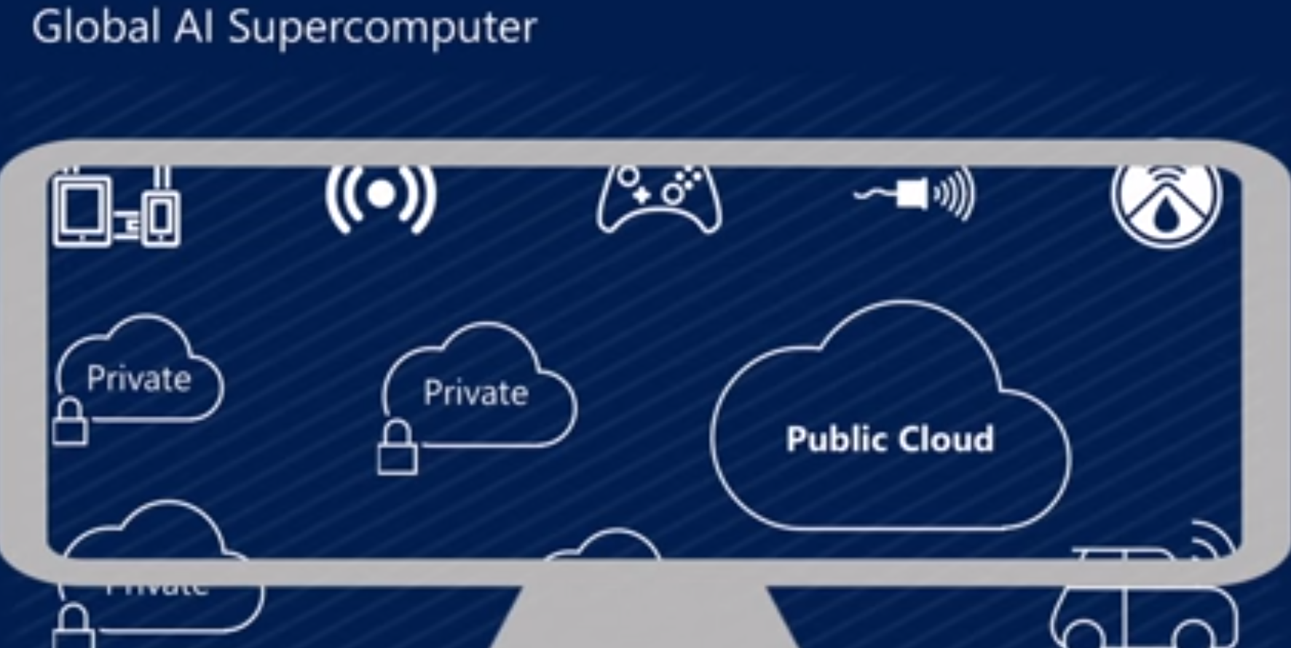
Microsoft Summer 2018: Global AI Supercomputer
By Donald Kossmann

