Slide 1
Cloud Futures Panel -- Future cloud-related research
Haiying (Helen) Shen
Department of Computer Science
Department of Engineering Systems and Environment Department of Electrical & Computer Engineering
Data Science Institute
University of Virginia, USA

Slide 2
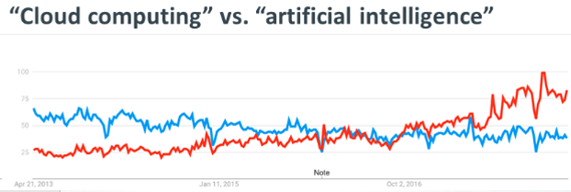
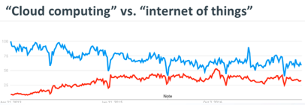
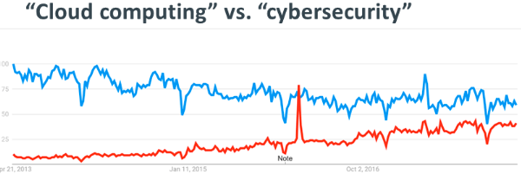
Past Five Years
Cloud computing was one of four trends that are expected to feature heavily in IT conversations (CompTIA’s IT Industry Outlook 2018)
2013
2018
Google Trends information

Slide 3
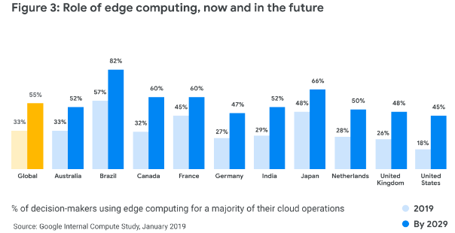
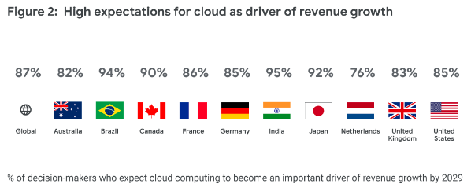
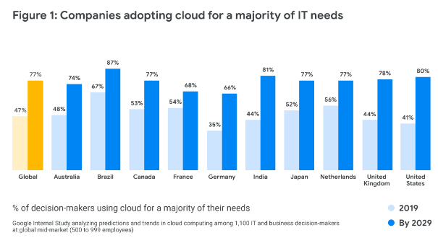
Next Ten Years
Cloud already plays and will continue playing a key role in enterprise technology

Slide 4
Latest Research Topics

Slide 5
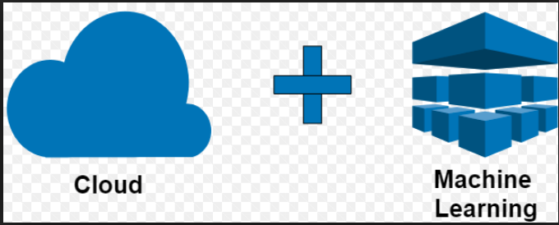
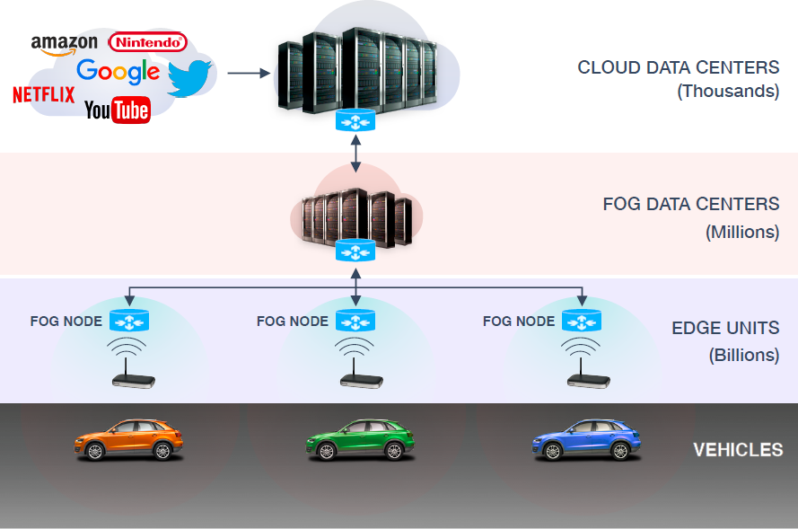
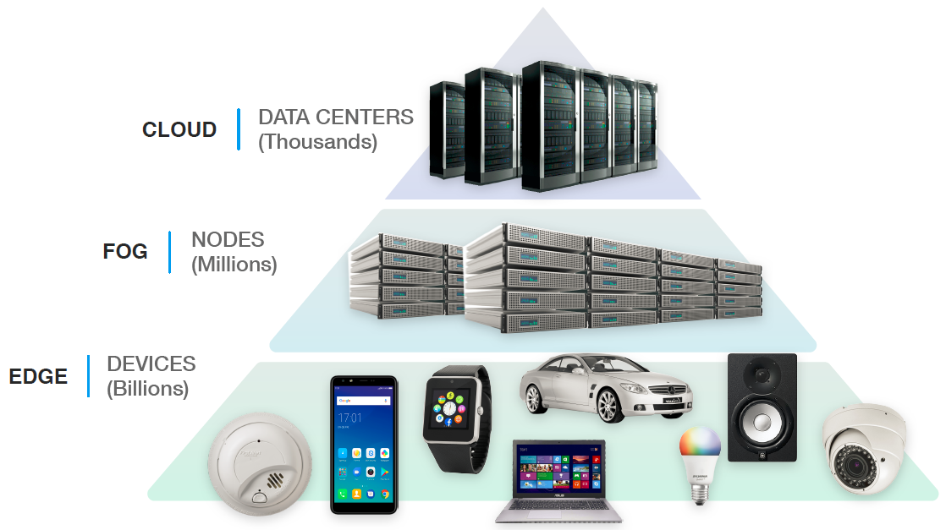
Future Cloud-related Research
Advance cloud computing to support efficient ML/AI
Integrate database research to cloud computing
Advance cloud computing for online analytics
……
Advance cloud computing to support CPS/IoT
Advance cloud computing for big data analytics
Coordinate cloud computing and edge computing

Slide 6
Future Cloud-related Research - Interdisciplinary Research
Data Analytics
Cloud computing
Cloud Scale Data Analytics
Big Data
CPS/IoT
Machine Learning/AI
Data mining community
Distributed system & Cloud communities
Edge Computing
Cloud
Security
Supporting Science and
Engineering Research
Green Computing

Slide 7
Future Importance of Clouds to Support Research
Serve
Feedback
Meet demands
High performance
Different demands from different areas (e.g., bioscience, business, social networks, public policy)
Lower costs of data storage and processing

Slide 8
Thank you!
Haiying Shen
hs6ms@virginia.edu
University of Virginia

