Slide 1
Cloud Futures
Kate Keahey
Mathematics and CS Division, Argonne National Laboratory
CASE, University of Chicago
keahey@anl.gov
July 9, 2019
Cloud 2019

Slide 2
ChameleoN: Cloud research on A Cloud
We like to change: testbed that adapts itself to your experimental needs
Deep reconfigurability (bare metal) and isolation (CHI) – but also ease of use (KVM)
CHI: power on/off, reboot, custom kernel, serial console access, etc.
We want to be all things to all people: balancing large-scale and diverse
Large-scale: ~large homogenous partition (~15,000 cores), 5 PB of storage distributed over 2 sites (now +1!) connected with 100G network…
…and diverse: ARMs, Atoms, FPGAs, GPUs, Corsa switches, etc.
Cloud on cloud: leveraging mainstream cloud technologies
Powered by OpenStack with bare metal reconfiguration (Ironic) + “special sauce”
Chameleon team contribution recognized as official OpenStack component
We live to serve: open, production testbed for Computer Science Research
Started in 10/2014, testbed available since 07/2015, renewed in 10/2017
Currently 3,000+ users, 500+ projects, 100+ institutions

Slide 3
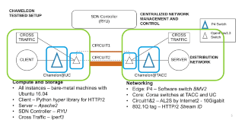
Networks and Data
Challenges
Cloud resources are by definition remote: how can they be closer?
Managing bandwidth, managing routing, understanding
BigData, real-time, by-deadline delivery
Opportunities
Programmable networks, new hardware, new architectures, new protocols
Directions and Support
Multi-tenant networking, isolation/stitching (creating isolated L2 circuits), high bandwidth, BYOC (Bring Your Own Controller (isolated user controlled virtual OpenFlow switches), integration with commercial provider networks
Divyashri Bhat, UMass Amherst
Notes:
How can I move the data to compute “on demand”? i.e., by deadline – if I am connected to a remote resource by a 100G network it is no longer remote – depends on whether I am the only person using the 100G – managing band

Slide 4
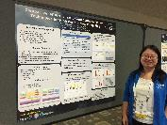
The Battle for control
Challenges
Growing need for interactive usage
Co-scheduling required to support interactions in complex environments
Resource scarcity (e.g., Chameleon blog: “Save the planet, use fewer IPs”)
How can we do it efficiently?
Opportunities
Demonstrated appeal of on-demand usage
Many examples of defining both the shape and the timing of resource availability
Directions and Support
Perfecting the container, time-bound resource management, negotiation protocols, merging traditional HPC and time-sensitive cloud resources
Yuyu Zhou,
University of Pittsburgh
Notes:
Allocatable resources, point to the paper, point to the blog on Ips,
Address should HPC and clouds be distinct

Slide 5
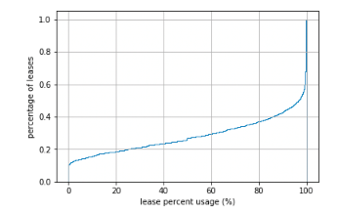
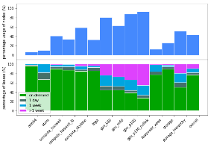
The price we pay
Challenges
Controlled use of resources is expensive
Money is not always the solution
Opportunities
Need/requirement for differentiated resource availability
Directions and Support
Resource management in non-monetary economies, developing methods for resource sharing in academia, bridging the gap between academic and commercial clouds
Cloud 2019 Paper (Thursday @ 14:00 PM) : “Managing Allocatable Resources”
Notes:
Also include logistics

Slide 6
Rinse and repeat
Challenges
Today’s research endeavors are complex and they are proportionately difficult to reproduce – yet because of that complexity it is more important that we can reproduce them to leverage existing work effectively
Opportunities
Orchestration in the cloud
Reproducibility as side-effect
Reproducibility by default: towards integration of notebooks and testbeds
Directions and Support
Jupyter and Chameleon integration, research on experimental containers, what is the most effective way of sharing research?
Screencast of a complex experiment: https://vimeo.com/297210055

Slide 7
We’re here to change
Chameleon:
www.chameleoncloud.org

