Slide 1
What’s Hot in Clouds?
Analyze (superficially) the ~140 Papers/Short papers/Workshops/Posters/Demos in CloudCom
Each paper may fall in more than one category
Core Cloud/Virtualization/Reliability 26 plus ~2 keynotes and 5 tutorials
Applications 40 plus 1 (adopting clouds) panel plus ? keynotes
Scheduling /resource allocation 16
Security/Privacy 25 plus 1 Panel plus 1 Keynote
MapReduce 31 plus 3 tutorials
Other Programming models (e.g. workflow) 9
Storage 14 plus 2 tutorials
Discovery/semantics 5
Portal/clients 7
Interoperability/Federation 3 plus 1 panel
Green IT 6

Slide 2
Enable your work on hot topics with FutureGrid
CloudCom 2010 Conference
Indianapolis
November 30 2010
Geoffrey Fox
gcf@indiana.edu
http://www.infomall.org http://www.futuregrid.org
Director, Digital Science Center, Pervasive Technology Institute
Associate Dean for Research and Graduate Studies, School of Informatics and Computing
Indiana University Bloomington

Slide 3
FutureGrid key Concepts I
FutureGrid is an international testbed modeled on Grid5000
Supporting international Computer Science and Computational Science research in cloud, grid and parallel computing
Industry and Academia
Note most current use Education, Computer Science Systems and Biology/Bioinformatics
Very different from TeraGrid or DEISA use
The FutureGrid testbed provides to its users:
A flexible development and testing platform for middleware and application users looking at interoperability, functionality and performance
Each use of FutureGrid is an experiment that is reproducible
A rich education and teaching platform for advanced cyberinfrastructure classes
Apply now to use FutureGrid on web site www.futuregrid.org

Slide 4
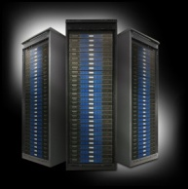
FutureGrid key Concepts II
Rather than loading images onto VM’s, FutureGrid supports Cloud, Grid and Parallel computing environments by dynamically provisioning software as needed onto “bare-metal” using Moab/xCAT
Image library for MPI, OpenMP, Hadoop, Dryad, gLite, Unicore, Globus, Xen, ScaleMP (distributed Shared Memory), Nimbus, Eucalyptus, OpenNebula, KVM, Windows …..
Growth comes from users depositing novel images in library
FutureGrid has ~4000 (will grow to ~5000) distributed cores with a dedicated network and a Spirent XGEM network fault and delay generator
Image1
Image2
…
ImageN
Choose
Load
Run

Slide 5
Dynamic Provisioning Results
Number of nodes
Time elapsed between requesting a job and the jobs reported start time on the provisioned node. The numbers here are an average of 2 sets of experiments.

Slide 6
FutureGrid Partners
Indiana University (Architecture, core software, Support)
Collaboration between research and infrastructure groups
Purdue University (HTC Hardware)
San Diego Supercomputer Center at University of California San Diego (INCA, Monitoring)
University of Chicago/Argonne National Labs (Nimbus)
University of Florida (ViNE, Education and Outreach)
University of Southern California Information Sciences (Pegasus to manage experiments)
University of Tennessee Knoxville (Benchmarking)
University of Texas at Austin/Texas Advanced Computing Center (Portal)
University of Virginia (OGF, Advisory Board and allocation)
Center for Information Services and GWT-TUD from Technische Universtität Dresden. (VAMPIR)
Red institutions have FutureGrid hardware

Slide 7
FutureGrid Organization
PI
Advisory Committee
Executive Committee
PI and co-PI’s
Project Manager
Operations and Change Management Committee
Software Architect
Computers and
Network
Software
User Support
Training
Education
Outreach
Core
Basic Support
Performance
Advanced
User Support
Images/
Appliances
Portal
Web Site
Systems Management

Slide 8
Compute Hardware
System type | # CPUs | # Cores | TFLOPS | Total RAM (GB) | Secondary Storage (TB) | Site | Status
IBM iDataPlex | 256 | 1024 | 11 | 3072 | 339* | IU | Operational
Dell PowerEdge | 192 | 768 | 8 | 1152 | 30 | TACC | Operational
IBM iDataPlex | 168 | 672 | 7 | 2016 | 120 | UC | Operational
IBM iDataPlex | 168 | 672 | 7 | 2688 | 96 | SDSC | Operational
Cray XT5m | 168 | 672 | 6 | 1344 | 339* | IU | Operational
IBM iDataPlex | 64 | 256 | 2 | 768 | On Order | UF | Operational
Large disk/memory system TBD | 128 | 512 | 5 | 7680 | 768 on nodes | IU | New System TBD
High Throughput Cluster | 192 | 384 | 4 | 192 |  | PU | Not yet integrated
Total | 1336 | 4960 | 50 | 18912 | 1353

Slide 9
Storage Hardware
System Type | Capacity (TB) | File System | Site | Status
DDN 9550 (Data Capacitor) | 339 | Lustre | IU | Existing System
DDN 6620 | 120 | GPFS | UC | New System
SunFire x4170 | 96 | ZFS | SDSC | New System
Dell MD3000 | 30 | NFS | TACC | New System
Will add substantially more disk on node and at IU and UF as shared storage

Slide 10
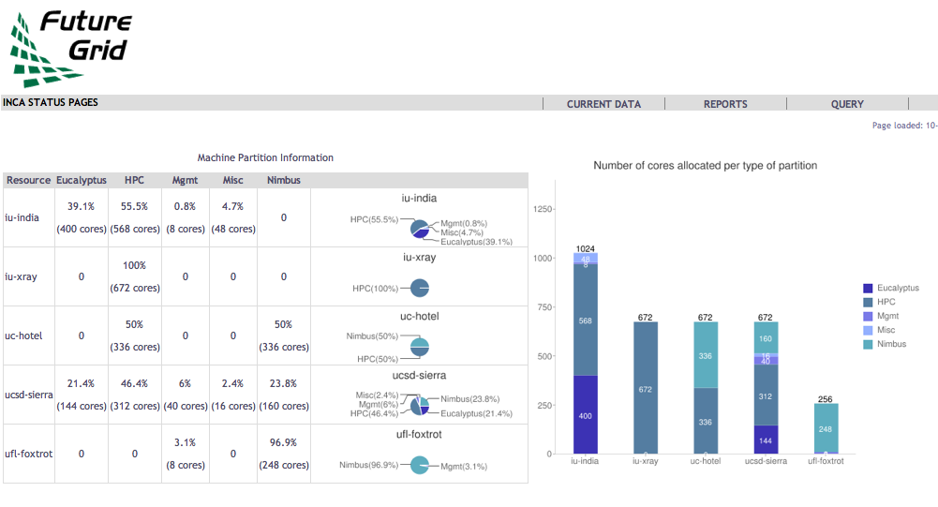
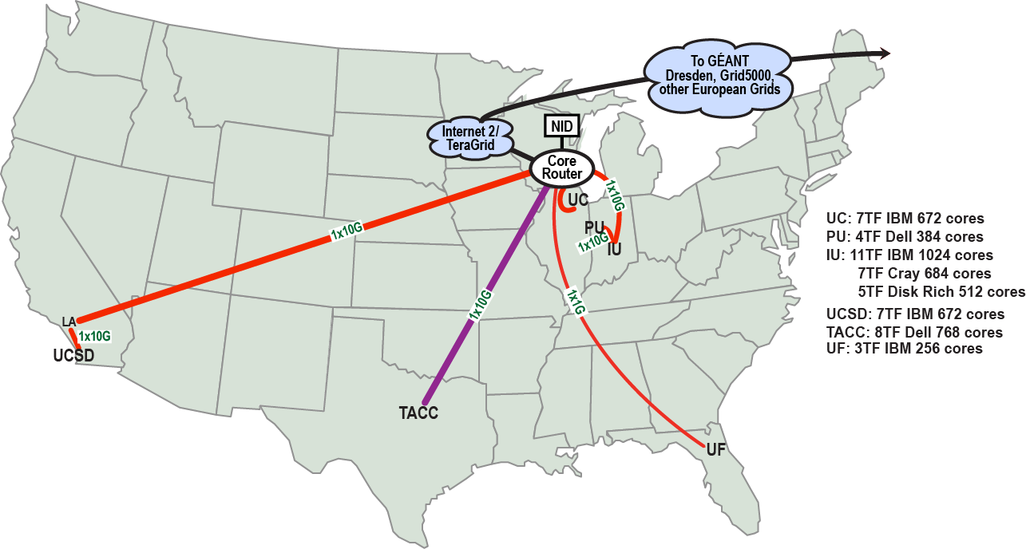
FutureGrid: a Grid/Cloud/HPC Testbed
NID: Network Impairment Device
Private Public
FG Network

Slide 11
Network & Internal Interconnects
FutureGrid has dedicated network (except to TACC) and a network fault and delay generator
Can isolate experiments on request; IU runs Network for NLR/Internet2
(Many) additional partner machines will run FutureGrid software and be supported (but allocated in specialized ways)
Machine | Name | Internal Network
IU Cray | xray | Cray 2D Torus SeaStar
IU iDataPlex | india | DDR IB, QLogic switch with Mellanox ConnectX adapters Blade Network Technologies & Force10 Ethernet switches
SDSC iDataPlex | sierra | DDR IB, Cisco switch with Mellanox ConnectX adapters Juniper Ethernet switches
UC iDataPlex | hotel | DDR IB, QLogic switch with Mellanox ConnectX adapters Blade Network Technologies & Juniper switches
UF iDataPlex | foxtrot | Gigabit Ethernet only (Blade Network Technologies; Force10 switches)
TACC Dell | alamo | QDR IB, Mellanox switches and adapters Dell Ethernet switches

Slide 12
Network Impairment Device
Spirent XGEM Network Impairments Simulator for jitter, errors, delay, etc
Full Bidirectional 10G w/64 byte packets
up to 15 seconds introduced delay (in 16ns increments)
0-100% introduced packet loss in .0001% increments
Packet manipulation in first 2000 bytes
up to 16k frame size
TCL for scripting, HTML for manual configuration

Slide 13
FutureGrid Usage Model
The goal of FutureGrid is to support the research on the future of distributed, grid, and cloud computing
FutureGrid will build a robustly managed simulation environment and test-bed to support the development and early use in science of new technologies at all levels of the software stack: from networking to middleware to scientific applications
The environment will mimic TeraGrid and/or general parallel and distributed systems – FutureGrid is part of TeraGrid (but not part of formal TeraGrid process for first two years)
Supports Grids, Clouds, and classic HPC
It will mimic commercial clouds (initially IaaS not PaaS)
Expect FutureGrid PaaS to grow in importance
FutureGrid can be considered as a (small ~5000 core) Science/Computer Science Cloud but it is more accurately a virtual machine or bare-metal based simulation environment
This test-bed will succeed if it enables major advances in science and engineering through collaborative development of science applications and related software

Slide 14
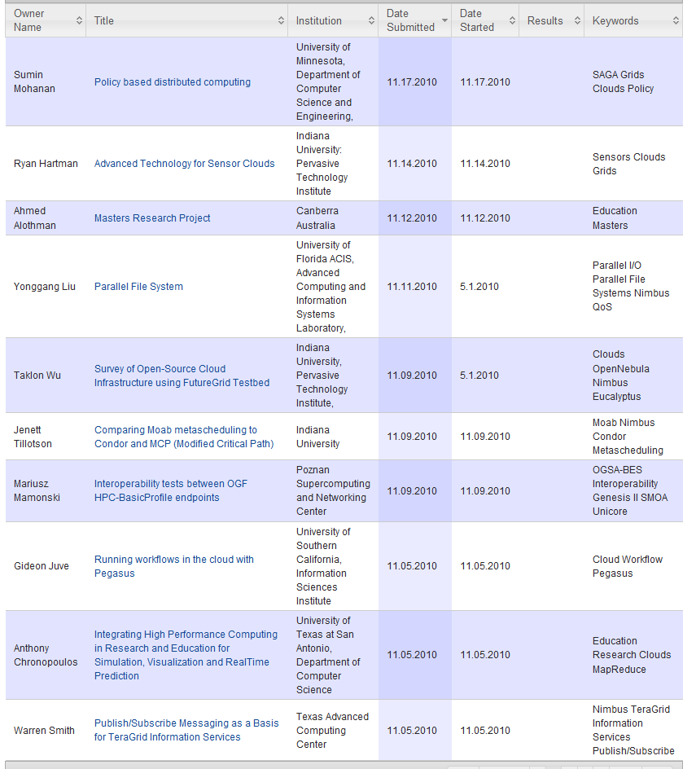
Some Current FutureGrid projects

Slide 15
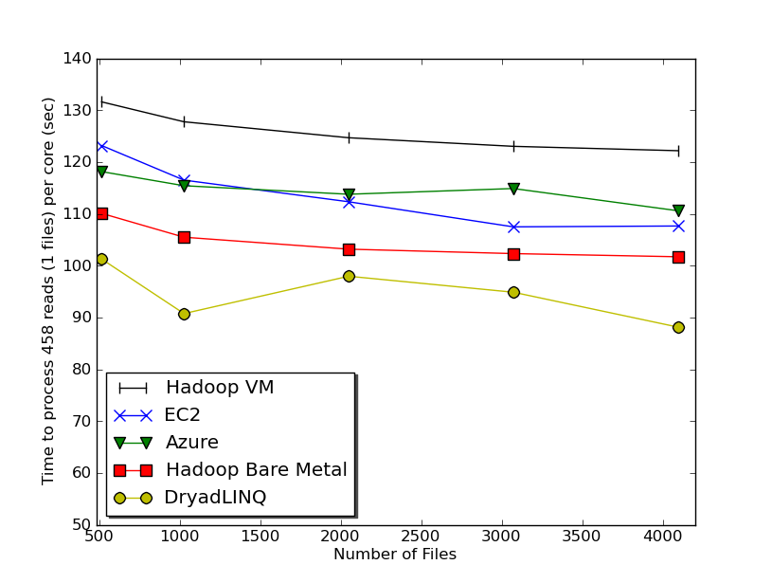
Typical Performance Study
Linux, Linux on VM, Windows, Azure, Amazon Bioinformatics

Slide 16
OGF’10 Demo
SDSC
Rennes
Grid’5000 firewall
UF
Lille
UC
Sophia
ViNe provided the necessary inter-cloud connectivity to deploy CloudBLAST across 5 Nimbus sites, with a mix of public and private subnets.

Slide 17
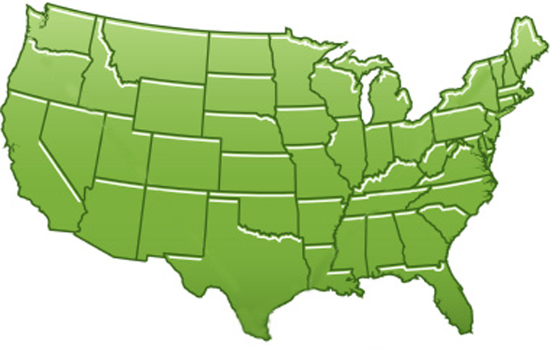
300+ Students learning about Twister & Hadoop
MapReduce technologies, supported by FutureGrid.
July 26-30, 2010 NCSA Summer School Workshop
http://salsahpc.indiana.edu/tutorial
Washington
University
University of
Minnesota
Michigan
State
Johns
Hopkins
Univ.Illinois
at Chicago
Iowa
State
Penn
State
IBM Almaden
Research Center
Notre
Dame
University of
California at
Los Angeles
Indiana
University
San Diego
Supercomputer
Center
University of
Texas at El Paso
University of
Arkansas
University
of Florida

Slide 18
Education on FutureGrid
Build up tutorials on supported software
Support development of curricula requiring privileges and systems destruction capabilities that are hard to grant on conventional TeraGrid
Offer suite of appliances (customized VM based images) supporting online laboratories
Supporting ~200 students in Virtual Summer School on “Big Data” July 26-30 with set of certified images – first offering of FutureGrid 101 Class; TeraGrid ‘10 “Cloud technologies, data-intensive science and the TG”; CloudCom conference tutorials Nov 30-Dec 3 2010
Experimental class use fall semester at Indiana, Florida and LSU

Slide 19
User Support
Being upgraded now as we get into major use
Regular support: there is a group forming FET or “FutureGrid Expert Team” – initially 12 PhD students and researchers from Indiana University
User requests project at http://www.futuregrid.org/early-adopter-account-project-registration
Each user assigned a member of FET when project approved
Users given accounts when project approved
FET member and user interact to get going on FutureGrid
Advanced User Support: limited special support available on request

Slide 20
Software Components
Portals including “Support” “use FutureGrid” “Outreach”
Monitoring – INCA, Power (GreenIT)
Experiment Manager: specify/workflow
Image Generation and Repository
Intercloud Networking ViNE
Virtual Clusters built with virtual networks
Performance library
Rain or Runtime Adaptable InsertioN Service: Schedule and Deploy images
Security (including use of isolated network), Authentication, Authorization,

Slide 21
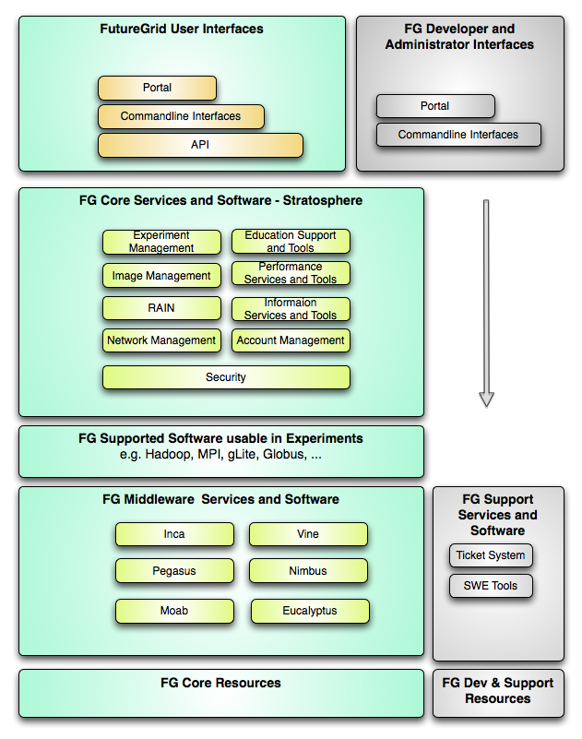
FutureGrid Layered Software Stack
User Supported Software usable in Experiments e.g. OpenNebula, Kepler, Other MPI, Bigtable

Slide 22
Experiments I
Project
Elementary unit of “request” for a users. It is similar to an allocation in a supercomputing center. A user can have many projects.
Experiment.
Elementary unit of “execution” to be used to verify goals of the project.
Experiments may be organized in a tree or direct acyclic Graph (DAG) and contain other experiments.
An example of an experiment is running a Hadoop job as part of an academic class. If we view the class as a project, then each submitted student job would be viewed as an experiment.
Experiment metadata:
experiment session,
the resource configuration ,
the resources used (apparatus),
the images used,
deployment specific attributes,
the application used,
the results of the experiments (typically files and data), and
the expected duration of the experiment.

Slide 23
Experiments II
Experiment Apparatus (or template)
Often it is desirable to conduct parameter studies or repetitive experiments with the same setup in regards to resources used.
We refer to such a configuration as an ``experiment apparatus''. Such an apparatus allows the users to conveniently reuse the same setup without reconfiguration of the FutureGrid resources for different experiments.
Experiment Session
Apparatus needs to be augmented with specific metadata to define a full experiment session

Slide 24
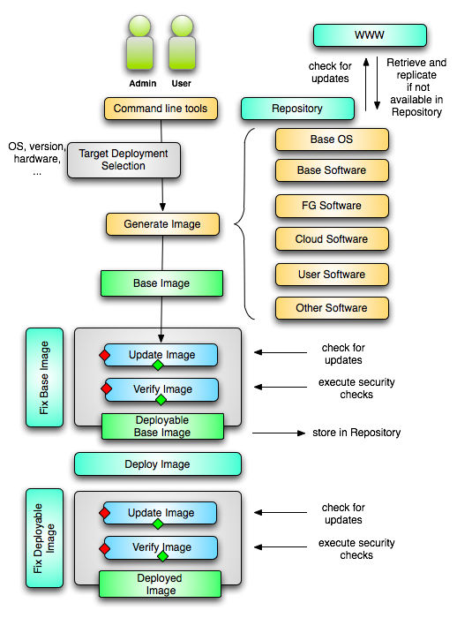
Image Creation
Creating deployable image
User chooses one base mages
User decides who can access the image; what additional software is on the image
Image gets generated; updated; and verified
Image gets deployed
Deployed image gets continuously
Updated; and verified
Note: Due to security requirement an image must be customized with authorization mechanism
limit the number of images through the strategy of "cloning" them from a number of base images.
users can build communities that encourage reuse of "their" images
features of images are exposed through metadata to the community
Administrators will use the same process to create the images that are vetted by them
Customize images in CMS

Slide 25
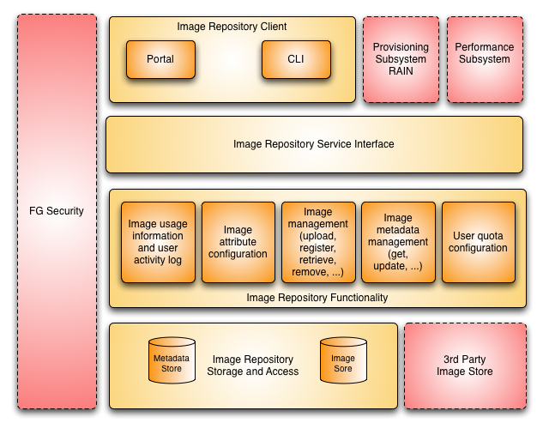
Image Repository

Slide 26
Dynamic provisioning Examples
Give me a virtual cluster with 30 nodes based on Xen
Give me 15 KVM nodes each in Chicago and Texas linked to Azure and Grid5000
Give me a Eucalyptus environment with 10 nodes
Give 32 MPI nodes running on first Linux and then Windows
Give me a Hadoop environment with 160 nodes
Give me a 1000 BLAST instances linked to Grid5000
Run my application on Hadoop, Dryad, Amazon and Azure … and compare the performance

Slide 27
From Dynamic Provisioning to “RAIN”
In FG dynamic provisioning goes beyond the services offered by common scheduling tools that provide such features.
Dynamic provisioning in FutureGrid means more than just providing an image
adapts the image at runtime and provides besides IaaS, PaaS, also SaaS
We call this “raining” an environment
Rain = Runtime Adaptable INsertion Configurator
Users want to ``rain'' an HPC, a Cloud environment, or a virtual network onto our resources with little effort.
Command line tools supporting this task.
Integrated into Portal
Example ``rain'' a Hadoop environment defined by an user on a cluster.
fg-hadoop -n 8 -app myHadoopApp.jar …
Users and administrators do not have to set up the Hadoop environment as it is being done for them

Slide 28
FG RAIN Command
fg-rain –h hostfile –iaas nimbus –image img
fg-rain –h hostfile –paas hadoop …
fg-rain –h hostfile –paas dryad …
fg-rain –h hostfile –gaas gLite …
fg-rain –h hostfile –image img
Authorization is required to use fg-rain without virtualization.

Slide 29
Rain in FutureGrid

Slide 30
Reprovisioning based on prior state
The user submits a job to a general queue. This job specifies an OS (re-used stateless image) type attached to it.
The queue evaluates the OS requirement.
If an available node has OS already running, run the job there.
If there are no OS types available, reprovision an available node and submit the job to the new node.
Repeat the provisioning steps if the job requires multiple processors (such as a large MPI job).
Use case: reusing the same stateless image between usages

Slide 31
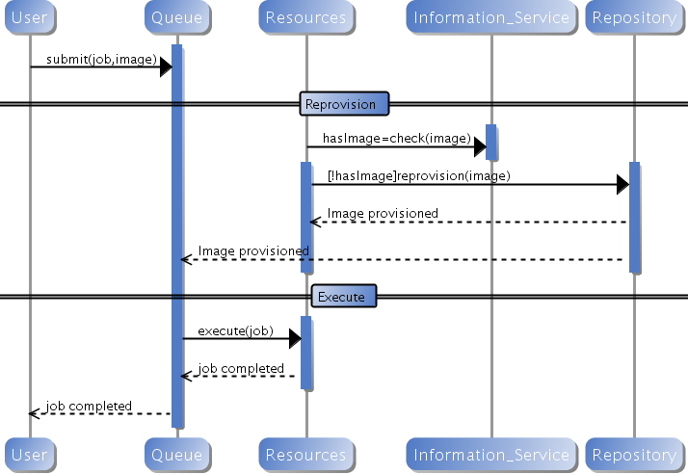
Generic Reprovisioning

Slide 32
Manage your own VO queue
This use case illustrates how a group of users or a Virtual Organization (VO) can handle their own queue to specifically tune their application environment to their specification.
A VO sets up a new queue, and provides an Operating System image that is associated to this image.
FG can aid in image creation through the use of advanced scripts and a configuration management tool.
A user within the VO submits a job to the VO queue.
The queue is evaluated, and determines if can reuse existing node or need to re-provision idle node
Repeat the provisioning steps if multiple processors are required (such as an MPI job).
Use case: Provide queues called MPI, Genesis or Hadoop for the associated user community. Provisioning is hidden from the users.

Slide 33
FutureGrid Viral Growth Model
Users apply for a project
Users improve/develop some software in project
This project leads to new images which are placed in FutureGrid repository
Project report and other web pages document use of new images
Images are used by other users
And so on ad infinitum ………

Slide 34
FutureGrid Interaction with Commercial Clouds
We support experiments that link Commercial Clouds and FutureGrid with one or more workflow environments and portal technology installed to link components across these platforms
We support environments on FutureGrid that are similar to Commercial Clouds and natural for performance and functionality comparisons
These can both be used to prepare for using Commercial Clouds and as the most likely starting point for porting to them
One example would be support of MapReduce-like environments on FutureGrid including Hadoop on Linux and Dryad on Windows HPCS which are already part of FutureGrid portfolio of supported software
We develop expertise and support porting to Commercial Clouds from other Windows or Linux environments
We support comparisons between and integration of multiple commercial Cloud environments – especially Amazon and Azure in the immediate future
We develop tutorials and expertise to help users move to Commercial Clouds from other environments

