Slide 1
Cloud Panel Session
CloudCom 2009
Beijing Jiaotong University
Beijing December 2 2009
Geoffrey Fox
gcf@indiana.edu http://salsaweb.ads.iu.edu/salsa
Community Grids Laboratory
Pervasive Technology Institute
Indiana University
Notes:
SALSA is
Service Aggregated Linked Sequential Activities

Slide 2
Panel Topics
What does cloud computing mean from your perspective?
How is your approach to cloud computing better than that of others? Some controversial views would be fine.
What is your grand vision for cloud computing and what are the major research challenges that will need to be overcome?
What do you think is the role of academia and industry in addressing those challenges? Should certain challenges be addressed primarily in industry? What are the opportunities for academics?

Slide 3
What does cloud computing mean?
I define Cloud Computing as “Whatever large scale computing is supported commercially”
Platform as a Service defines commercially supported software
“Grid Initiative” produced several interesting systems/technologies but little commercial interest
Not clear how existing Grid Systems (e.g. TeraGrid) and technologies (e.g. workflow engines) evolve and even can be sustained
Need to build scientific computing environments around commercial best practice developing “academic” enhancements only when necessary
Expect both public and private clouds to be useful

Slide 4
How is your approach to cloud computing better than that of others?
MapReduce++ will support a broader range of applications than current Hadoop and Dryad
Commercial cloud solutions are very impressive and expect growing use by scientists
FutureGrid not better than other clouds – it is helping users develop Grid and Cloud systems and applications

Slide 5
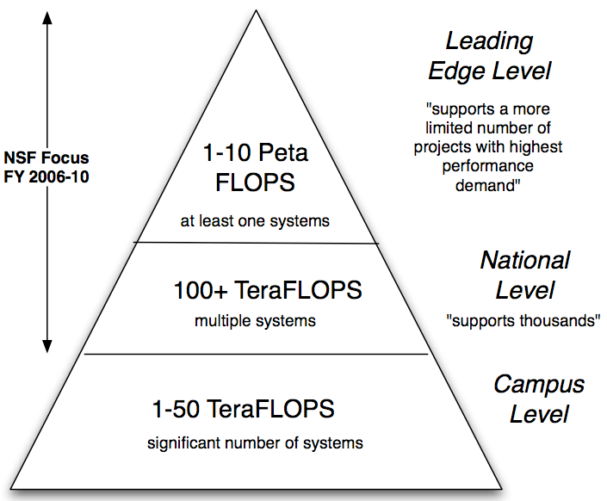
What is your grand vision for cloud computing and what are the major research challenges that will need to be overcome?
Computing Environment for Science will consist of
MPI engines for classic important large scale simulation
Clouds for large number of medium size jobs (middle of Branscomb Pyramid)
Local machines as now
Integration of components? Simulation on MPI engine and data processing in cloud?
How to support cluster applications?
How to integrate threading and GPU’s

Slide 6
What do you think is the role of academia and industry in addressing those challenges?
Industry will develop clouds for “sweet spots” in revenue generating computing
Academia needs to identify role of clouds in science in both simulation and data analysis
Support of MPI and role of MapReduce obvious issues
Probably clouds are attractive for campus (university) computing systems
Industry and Academia should work on broad research issues in all areas of computing for the future
Location issues importance for performance (data—computer and computer—computer for parallel computing)
Security
Simplicity – I am a bit suspicious of research agendas that complicate clouds

Slide 7
FutureGrid is a new part of TeraGrid

