Slide 1
Some Remarks for Cloud Forward Internet2 Workshop
How does the advent of cloud technologies impact researchers on campuses?
What are the current enablers and barriers to the adoption of cloud technologies and services in academic research computing?
What are changes that are currently occurring or need to occur on campuses to support and/or promote the use of cloud technologies and services for research?
What disciplines and applications are considered “cloud ready” or are already actively run in a cloud environment?
Washington DC, Westin Hotel, December 7-8 2016
Geoffrey Fox, Gregor von Laszewski
December 7, 2016
gcf@indiana.edu
http://www.dsc.soic.indiana.edu/, http://spidal.org/ http://hpc-abds.org/kaleidoscope

Slide 2
1: Cloud Technologies and Approaches Good
Concepts such as IaaS, PaaS, SaaS Infrastructure, Platform and Software as a Service broadly useful outside clouds
Improve user experience and system maintainability
MPI, Kepler, Pegasus etc. aaS
As discussed later, use “software defined systems” (DevOps) to define and achieve interoperability
All computing environments should exploit this including non-cloud systems in XSEDE
“Apache Big Data System” ABDS very powerful environment offering high functionality and a good software sustainability model
Offers a uniform parallel computing model across Big Data and simulations – converge HPC and Big Data
HPC-ABDS adds the performance of HPC to ABDS giving you best of both worlds with for example Java as high performance (see BDEC report)
Should work more closely with Apache Foundation
Support of Cloud Technologies hard as much systems staff not trained although huge numbers of students trained in this area (and very few trained in HPC)

Slide 3
HPC-ABDS

Slide 4
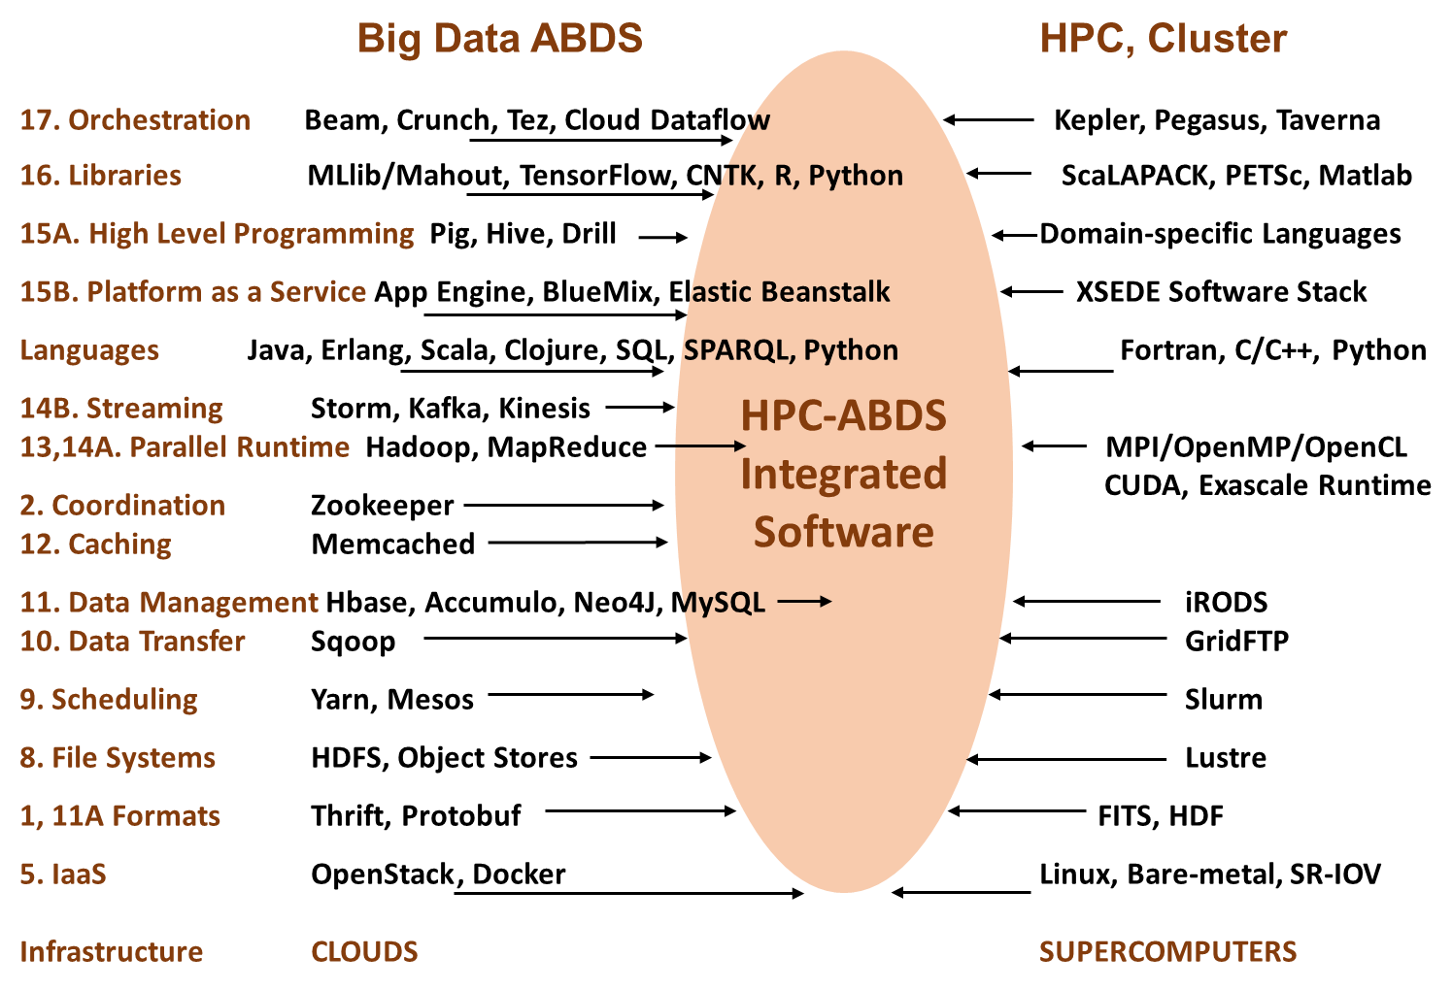

Slide 5
Harp (Hadoop Plugin) brings HPC to ABDS
Basic Harp: Iterative HPC communication; scientific data abstractions
Careful support of distributed data AND distributed model
Avoids parameter server approach but distributes model over worker nodes and supports collective communication to bring global model to each node
Applied first to Latent Dirichlet Allocation LDA with large model and data
Judy Qiu
MapReduce Model
MapCollective Model
MapReduce Applications
MapCollective Applications
M
M
M
M
M
M
M
M
MapReduce V2
Harp
Shuffle
Collective Communication
R
R
YARN
Also have done or working on HPC for Flink, Storm and Heron

Slide 6
How does the advent of cloud technologies impact researchers on campuses?
Pros
Cons
Fast adoption of novel software stacks with SaaS
Access to bigger infrastructure
Reduces cost for IT budget
Allows focus on research not infrastructure
Adoption of great programming frameworks such as MapReduce (ABDS)
Changes in IT expertise in organization can be hard
Missing Expertise everywhere
Adoption of possibly already deployed higher level services without consideration of performance and cost impact – Hadoop often very low performance
Emerging Systems can be flaky

Slide 7
What are the current enablers and barriers to the adoption of cloud technologies and services in academic research computing?
Enablers
Barriers
Virtual machine management is difficult if you are not expert
State of the art frameworks may contain errors
Expectation on cloud is maybe too high, cloud does not do many things for you
Previously a sysadmin did much of what you now need to do yourself
Data model; centralized?
Availability of IaaS
Availability of images
Availability of educational material
High functionality of (ABDS) stacks

Slide 8
2: Virtualization Framework?
OpenStack provides a sophisticated secure environment with significant overheads in management, execution and usability
Docker is simpler with better performance and usability and less execution overhead. Docker best at node not core level
XSEDE Comet offers virtualization without requiring OpenStack and Docker; it uses KVM hypervisor with SR-IOV for high performance
Comet supports powerful concept of a virtual cluster which is useful if need many nodes (cores) for an individual job
Big Data implies that need parallel computing and probably many nodes for individual jobs
So Docker or Comet architecture more natural for big data?
Present an interoperability view for user that hides virtualization technology but preserves capabilities; again suggests use of DevOps and software Defined Systems
Cloudmesh (Gregor von Laszewski) supports all 3 IaaS models using Software Defined Systems

Slide 9
3. Software Defined Systems
Significant advantages in specifying job software with scripts such as Chef, Puppet, Ansible – “Software Defined Systems” (SDS)
Choose Ansible as Python based
Less voluminous than machine images; easier to ensure latest version; easy to recreate image on demand after crashes
In work with NIST, we looked at 87 applications from two of our “big data on cloud” classes and from NIST itself (6)
The 6 NIST use cases need 27 Ansible roles (distinct software subsystems) and full set of 87 needed 62 separate roles (average 4.75 roles per use case)
https://docs.google.com/spreadsheets/d/1e8-pzWn-7lz47-gIAra0VzCX6IkAypa8Cu5YG5MES_4
With NIST Public Big Data group, looking at mapping SDS to system architecture
Preparing Ansible specifications of many subsystems and use cases
Note many public Ansible roles (Andible Galaxy collection) do NOT expose full functionality of software and/or have errors
Microservices, Cloud 3.0 and serverless computing will make SDS even more important https://youtu.be/iNN9KAsQ3G8?t=8m Amin Vahdat (Google)
Amazon Lambda, Google Cloud Functions, Microsoft Azure Functions, IBM OpenWhisk; WOSC2017 workshop June 2017

Slide 10
Ansible Roles and Re-use in 6 NIST use cases
ID | 6 NIST Use Cass | Hadoop | Mesos | Spark | Storm | Pig | Hive | Drill | HDFS | HBase | Mysql | MongoDB | RethinkDB | Mahout | D3, Tableau | nltk | MLlib | Lucene/Solr | OpenCV | Python | Java | maven | Ganglia | Nagios | spark supervisord | zookeeper | AlchemyAPI | R
1 | NIST Fingerprint Matching | x |  | x |  |  | x | x |  | x | x |  |  |  |  |  |  |  |  |  | x | x | x | x | x | x
2 | Human and Face Detection |  | x | x |  |  |  |  |  |  |  |  |  |  |  |  |  |  | x | x |  |  |  |  |  | x
3 | Twitter Analysis |  |  |  | x |  |  |  |  | x |  | x |  |  | x | x |  |  |  | x | x |  |  |  |  | x | x | x
4 | Analytics for Healthcare Data/Health Informatics | x |  | x |  |  |  |  |  | x |  |  |  | x | x |  | x | x |  |  | x |  |  |  |  | x
5 | Spatial Big Data/Spatial Statistics/Geographic Information Systems | x |  | x |  |  |  |  |  |  |  |  |  | x | x |  | x |  |  |  | x | x
6 | Data Warehousing and Data Mining | x |  | x |  | x | x |  |  | x |  | x |  | x | x |  | x | x |  |  | x |  |  |  |  | x
count |  | 4 | 1 | 5 | 1 | 1 | 2 | 1 | 0 | 4 | 1 | 2 | 0 | 3 | 4 | 1 | 3 | 2 | 1 | 2 | 5 | 2 | 3 | 1 | 1 | 5 | 1 | 1

Slide 11
What are changes that are currently occurring or need to occur on campuses to support and/or promote the use of cloud technologies and services for research?
Strong education and training being developed not only on the application of the technologies, but also the deployment
Use of DevOps technologies
Universal adoption of MapReduce (Spark/Hadoop/Storm)
We observe switch from virtual machines to containers
Portability
Performance
Easy of deployment
Problem: security if in shared environment, in research often not an issue
Todays software stacks may not be that easy to deploy, We work in Cloudmesh to change this
cm hadoop –n 100 …. Deploys Hadoop on 100 servers

