Slide 1
IEEE Services Conference Federation (SCF 2017) Keynote Panel 2: Cloud Computing Status and Future
Hilton Hotel Honolulu Tapa Ballroom 2
June 26, 2017
Geoffrey Fox
gcf@indiana.edu
http://www.dsc.soic.indiana.edu/,
Department of Intelligent Systems Engineering
School of Informatics and Computing, Digital Science Center
Indiana University Bloomington

Slide 2
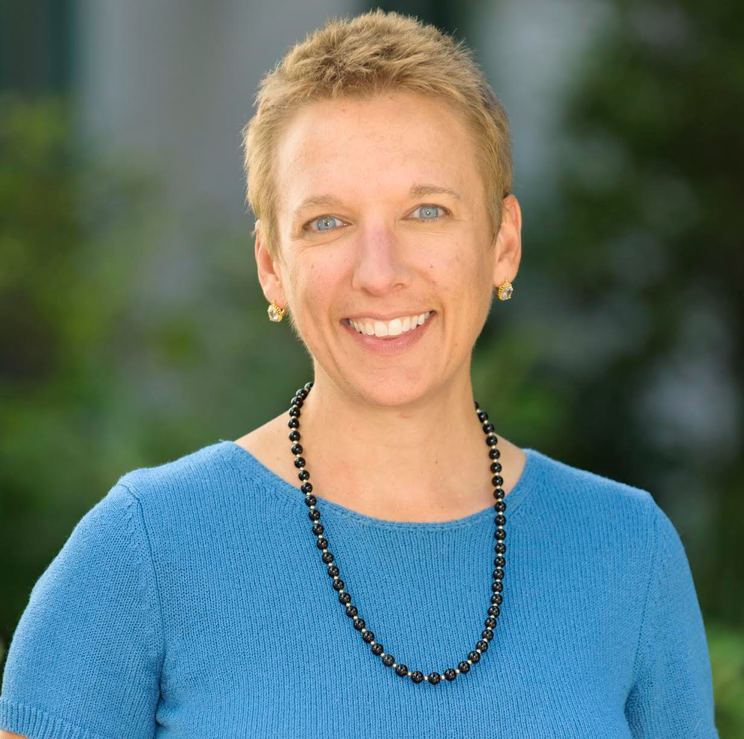
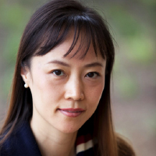
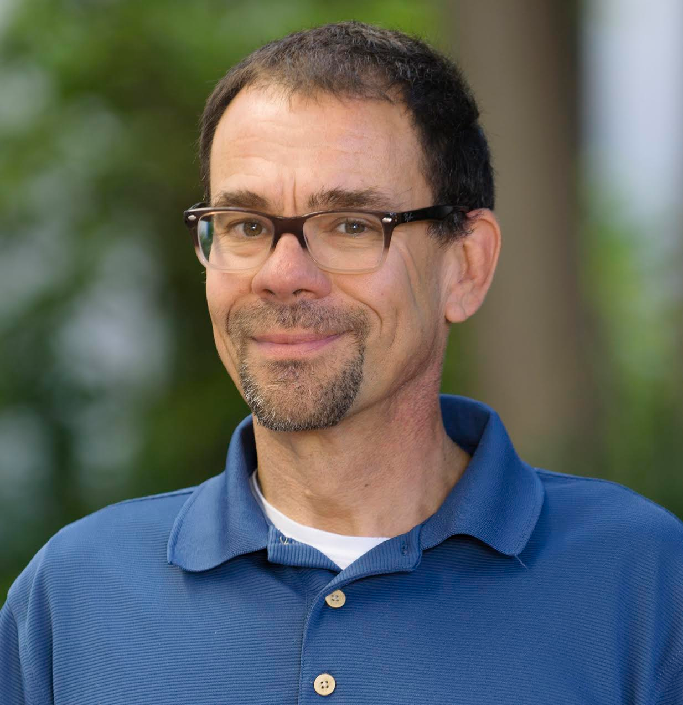
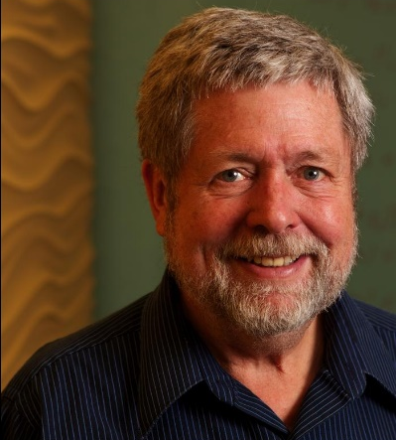
Panel Members
Chandra Krintz: Professor of Computer Science at UC Santa Barbara and Chief Scientist at AppScale Systems Inc. Has gotten NSF CAREER award, the CRA-W Anita Borg Early Career Award (BECA), and selection as IoT Pioneer by Connected World.
Judy Qiu: Associate Professor of Intelligent Systems Engineering in the School of Informatics and Computing at Indiana University; leads the Intel Parallel Computing Center at IU. She is the recipient of a NSF CAREER Award in 2012
Rich Wolski: Professor of Computer Science at UC Santa Barbara and co-founder of Eucalyptus Systems Inc. He is IEEE Fellow, got NSF CAREER award, and selected as a Cloud Computing Pioneer by Information Week.
Dennis Gannon: Professor Emeritus in the School of Informatics and Computing at Indiana University. From 2008 until he retired in 2014 he was with Microsoft Research, most recently as the Director of Cloud Research Strategy.

Slide 3
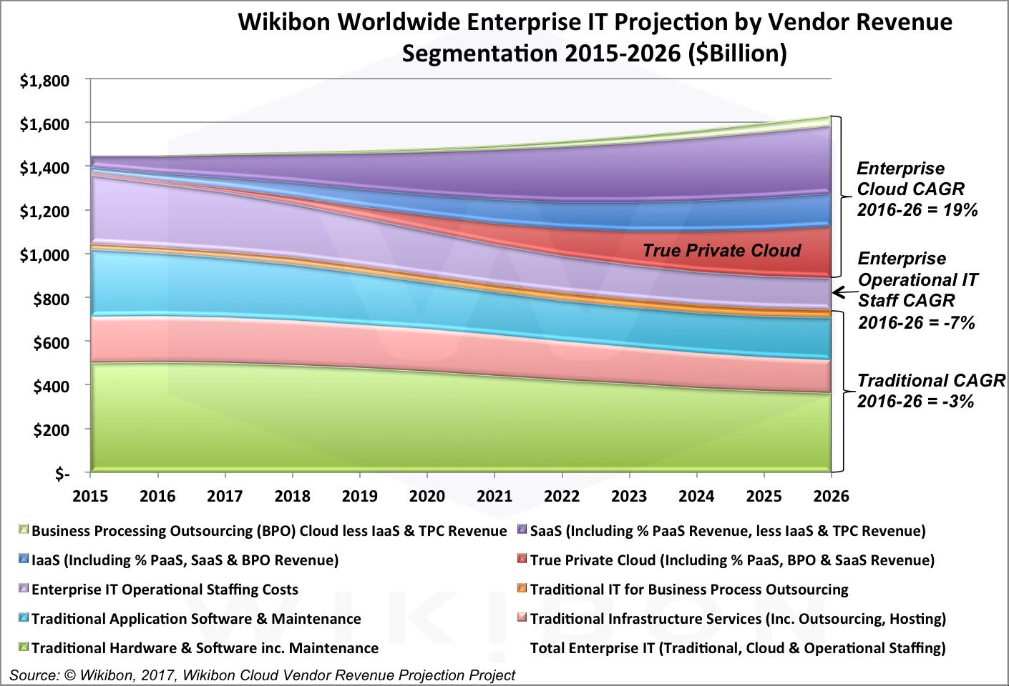
Cloud Computing is Thriving in Industry for Providers and Users! Enterprise IT Clouds v. Non Clouds
Cloud + to $800B
Non Cloud -

Slide 4
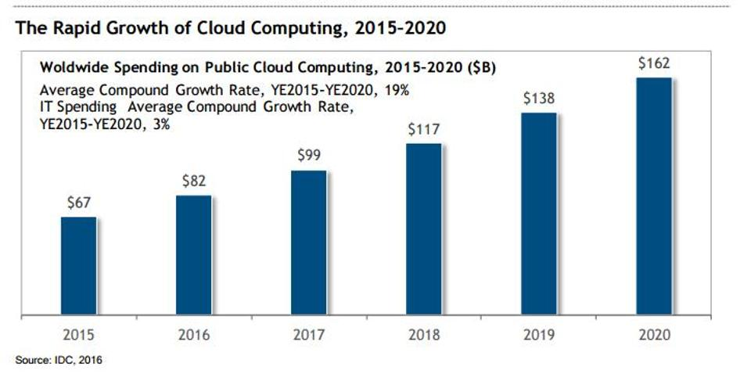
IDC Public Cloud Computing Expenditures
Cloud $162B

Slide 5
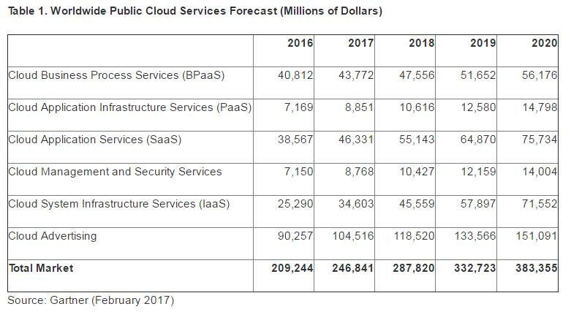
Gartner on Public Clouds
Cloud $383B

Slide 6
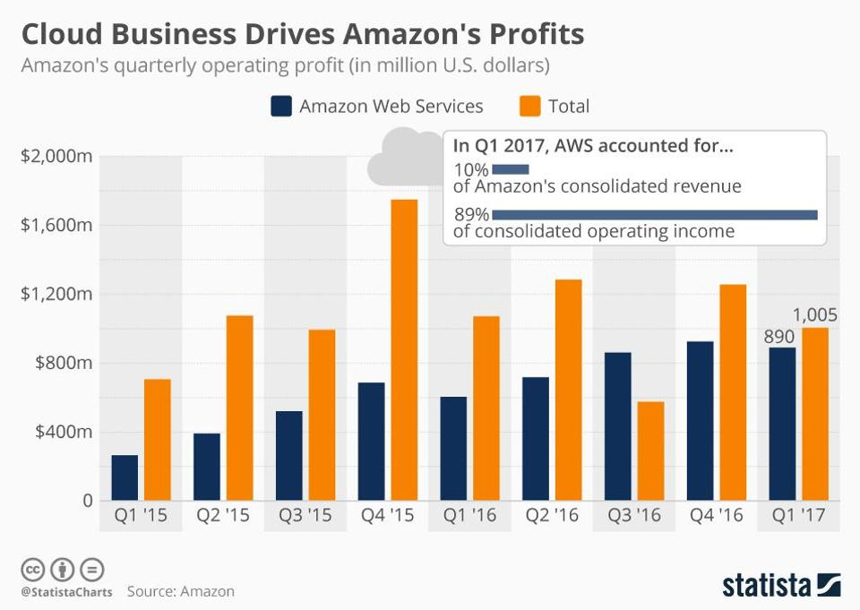
Amazon’s e-commerce is a blip on AWS

Slide 7
BDO Technology CFO Survey on what matters to them: Clouds, IoT, AI …
https://www.forbes.com/sites/louiscolumbus/2017/04/29/roundup-of-cloud-computing-forecasts-2017

Slide 8
Charge to the Panel I
Examine Possible Topics. These can be looked from either an industry or scientific research perspective or of course, both.
In terms of Hardware and Software architecture, how are public clouds different from a general data center -- given one can get HPC clusters, GPU's, FPGA's, large and small memories from clouds?
People talk about "convergence" such as that between simulation and big data analysis. Will this be realized on clouds and if so, how? Would it be heterogeneous hardware and software but all called "cloud". Would it be with uniform software such as using MPI to solve all problems? Usually, solutions are in between extremes -- if so what middle ground do you see?
What computing is not or will not be possible in clouds? Where do classic medium size compute providers such as a University Center position themselves? Are there/Will there be exascale clouds? This is sort of expanding on recent Cloud Forward workshop report “The Future of Cloud for Academic Research Computing” https://www.researchgate.net/publication/317835476_The_Future_of_Cloud_for_Academic_Research_Computing

Slide 9
Charge to Panel II
How do clouds "work" in a scientific research environment with many large distributed datasets (as in NASA and NIH data centers) that may need to be joined in an interdisciplinary study?
Are cloud-native applications important? What are good and bad ways of building them?
How important are hot trends such as Docker, Serverless Computing, edge/fog computing, event-driven computing, Function as a Service?
What are important points around security in clouds?
What are important academic research issues in Cloud arena?
How will public clouds change in next 3-5 years? Will they grow/shrink in terms of size/scope?
You have been appointed the director of a brand new cloud resource which will be fully operational 2 years from now. How would you design it?
You have been appointed chief data scientist for a top 10 University. You are feeding requirements to the IT provisioning part of University. What will you recommend as components of internal and external (public cloud) IT infrastructure?
Repeat question above for a top 10 industry chief data scientist.

