Slide 1
Science Clouds and Campus Clouds
CloudSlam Virtual Meeting
7pm April 24 2009
Geoffrey Fox
gcf@indiana.edu www.infomall.org
Community Grids Laboratory,
Chair Department of Informatics
School of Informatics
Indiana University

Slide 2
e-moreorlessanything
‘ e-Science is about global collaboration in key areas of science, and the next generation of infrastructure that will enable it.’ from inventor of term John Taylor Director General of Research Councils UK, Office of Science and Technology
e-Science is about developing tools and technologies that allow scientists to do ‘faster, better or different’ research
Similarly e-Business captures the emerging view of corporations as dynamic virtual organizations linking employees, customers and stakeholders across the world.
This generalizes to e-moreorlessanything including e-Musuem, e-SocialScience, e-HavingFun and e-Education
A deluge of data of unprecedented and inevitable size must be managed and understood.
People (virtual organizations), computers, data (including sensors and instruments) must be linked via hardware and software networks
2
Notes:
2

Slide 3
What is Cyberinfrastructure
Cyberinfrastructure is (from NSF) infrastructure that supports distributed research and learning (e-Science, e-Research, e-Education)
  Links data, people, computers
Exploits Internet technology (Web2.0 and Clouds) adding (via Grid technology) management, security, supercomputers etc.
It has two aspects: parallel – low latency (microseconds) between nodes and distributed – highish latency (milliseconds) between nodes
Parallel needed to get high performance on individual large simulations, data analysis etc.; must decompose problem
Distributed aspect integrates already distinct components – especially natural for data (as in biology databases etc.)
3
Notes:
3

Slide 4
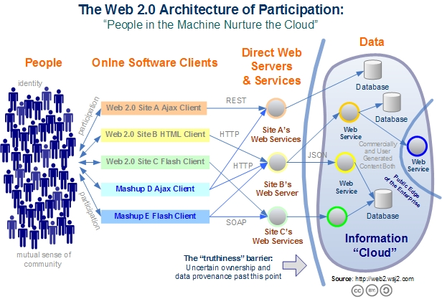
Web 2.0 Systems illustrate Cyberinfrastructure
Captures the incredible development of interactive Web sites enabling people to create and collaborate

Slide 5
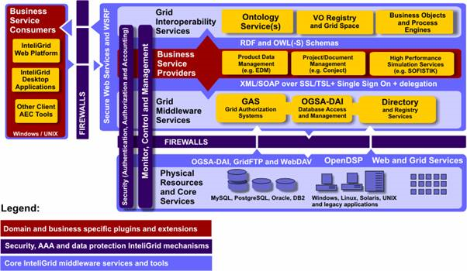
Typical Grid Architecture from
Google Search on OGSA Grid Architecture

Slide 6
Relevance of Web 2.0 to Academia
Web 2.0 can help e-Research in many ways
Its tools (web sites) can enhance scientific collaboration, i.e. effectively support virtual organizations, in different ways from grids
The popularity of Web 2.0 can provide high quality technologies and software that (due to large commercial investment) can be very useful in e-Research and preferable to complex Grid or Web Service solutions
The usability and participatory nature of Web 2.0 can bring science and its informatics to a broader audience
Cyberinfrastructure is research analogue of major commercial initiatives e.g. to important job opportunities for students!
Web 2.0 is major commercial use of computers and “Google/Amazon” farms spurred cloud computing
  Same computer answering your Google query can do bioinformatics
  Can be accessed from a web page with a credit card i.e. as a Service

Slide 7
Too much Computing?
Historically both grids and parallel computing have tried to increase computing capabilities by
  Optimizing performance of codes at cost of re-usability
  Exploiting all possible CPU’s such as Graphics co-processors and “idle cycles” (across administrative domains)
  Linking central computers together such as NSF/DoE/DoD supercomputer networks without clear user requirements
Next Crisis in technology area will be the opposite problem – commodity chips will be 32-128way parallel in 5 years time and we currently have no idea how to use them on commodity systems – especially on clients
  Only 2 releases of standard software (e.g. Office) in this time span so need solutions that can be implemented in next 3-5 years

Slide 8
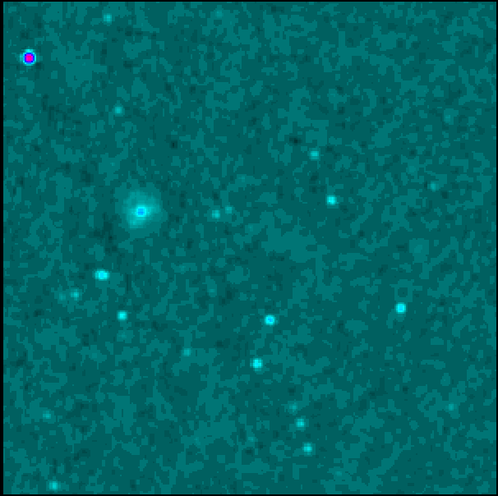
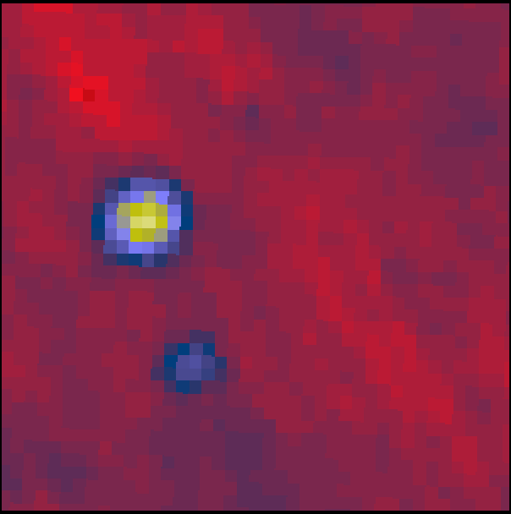
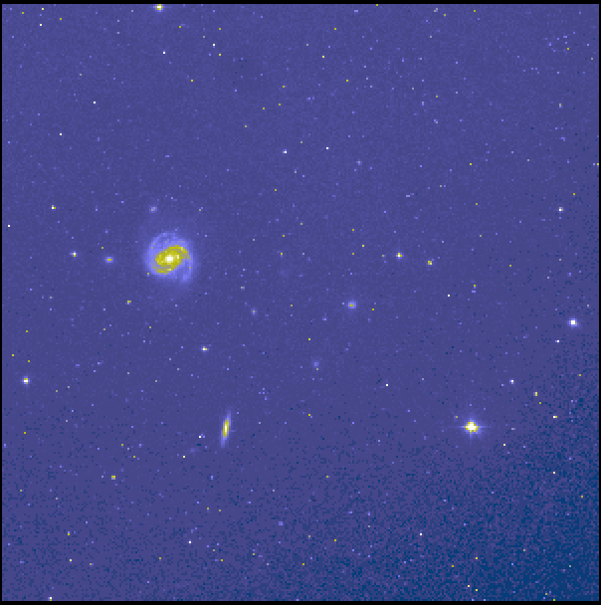
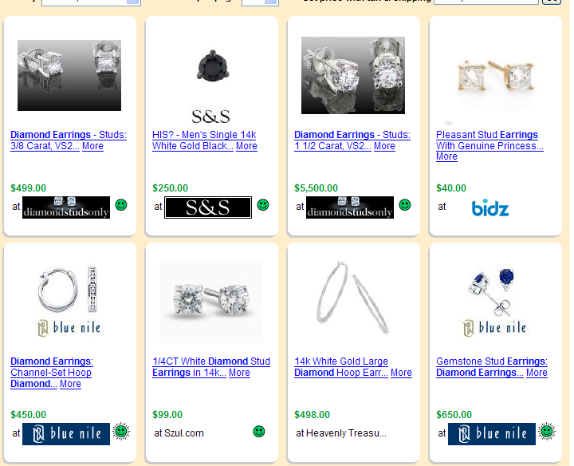
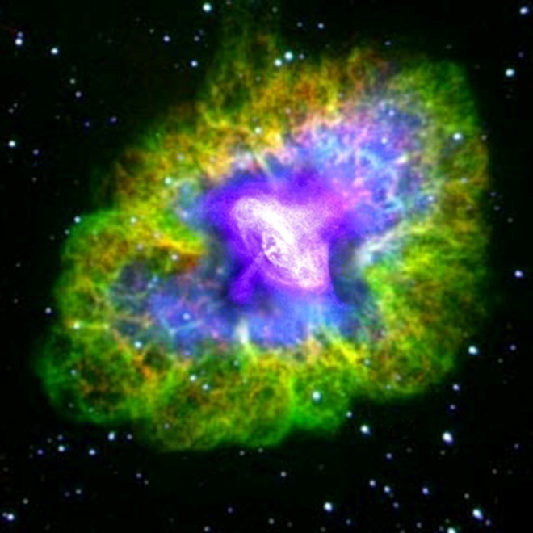
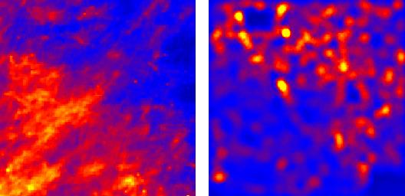
Virtual Observatory in Astronomy uses
Cyberinfrastructure to Integrate Experiments
Radio
Far-Infrared
Visible
Comparison Shopping is Internet analogy to Integrated Astronomy using similar technology
Dust Map
Visible + X-ray
Galaxy Density Map

Slide 9
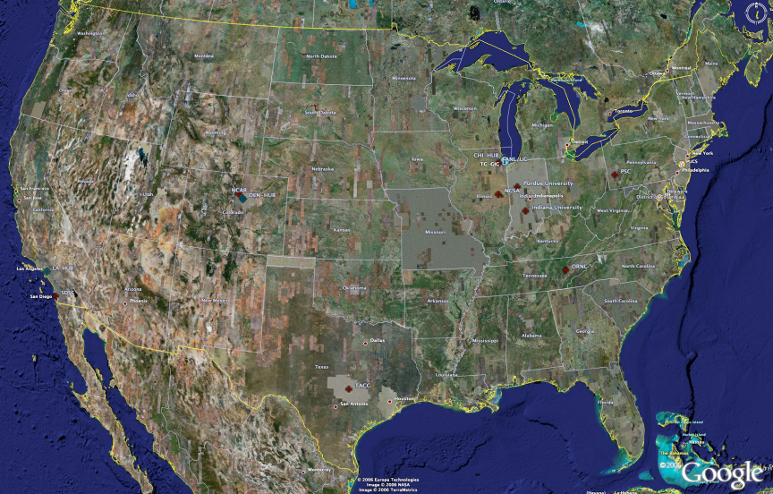
TeraGrid High Performance Computing Systems 2007-9
UC/ANL
PSC
PU
NCAR
NCSA
IU
2008
(~1PF)
ORNL
Tennessee
SDSC
(504TF)
LONI/LSU
TACC
Computational Resources
(size approximate - not to scale)
Slide Courtesy Tommy Minyard, TACC

Slide 10
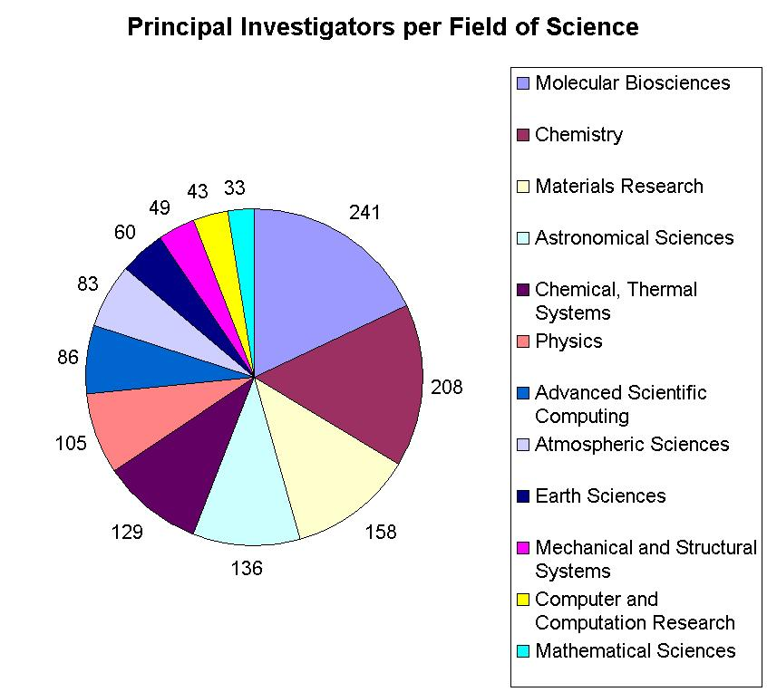

Resources for many disciplines!
> 40,000 processors in aggregate
Resource availability grew during 2008 at unprecedented rates

Slide 11

Large Hadron Collider CERN, Geneva: 2008 Start
pp √s =14 TeV L=10³⁴ cm⁻² s⁻¹
27 km Tunnel in Switzerland & France
CMS
TOTEM
pp, general
purpose; HI
5000+ Physicists
250+ Institutes
60+ Countries
Atlas
ALICE : HI
LHCb: B-physics
Higgs, SUSY, Extra Dimensions, CP Violation, QG Plasma, … the Unexpected
Challenges: Analyze petabytes of complex data cooperatively
Harness global computing, data & network resources

Slide 12
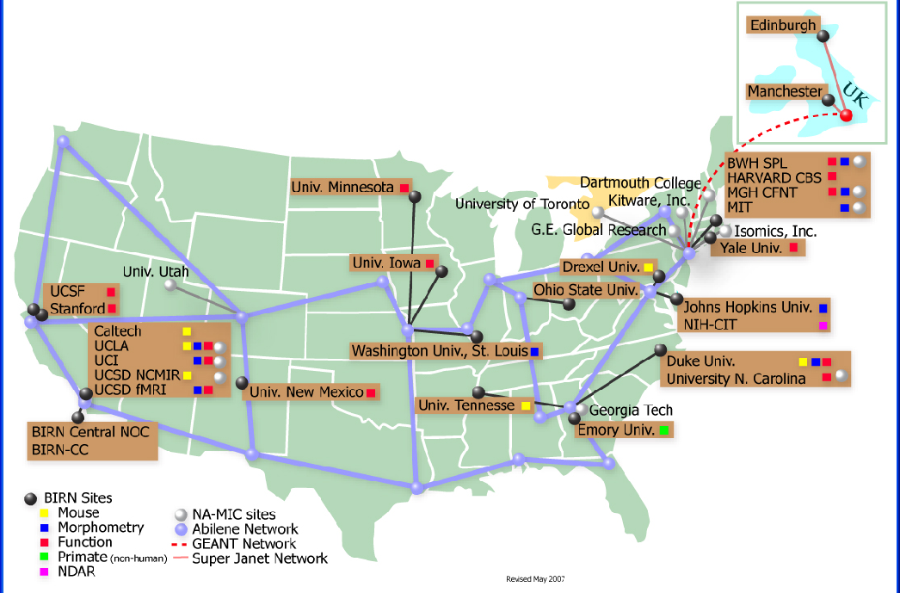
BIRN Bioinformatics Research Network

Slide 13
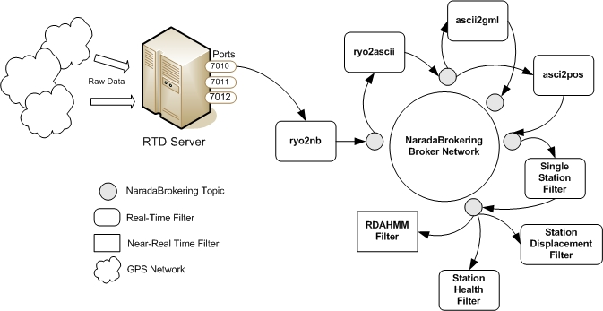
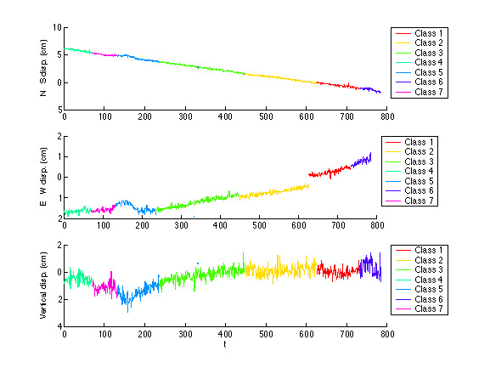
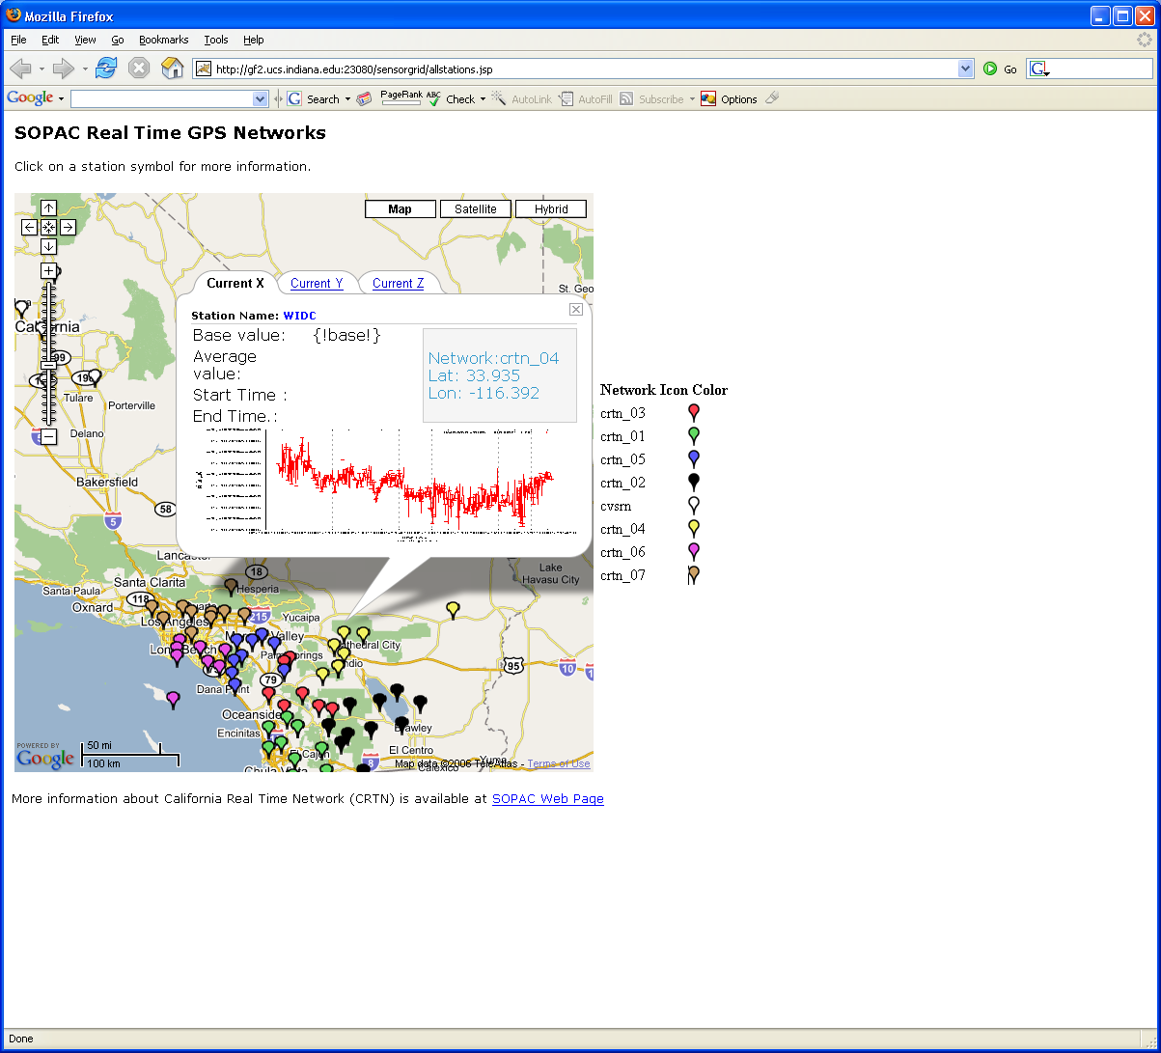
Grid Workflow Datamining in Earth Science
Grid services controlled by workflow process real time data from ~70 GPS Sensors in Southern California
NASA GPS
Earthquake
Streaming Data
Support
Archival
Transformations
Data Checking
Hidden Markov
Datamining (JPL)
Real Time
Display (GIS)
13
Notes:
13

Slide 14
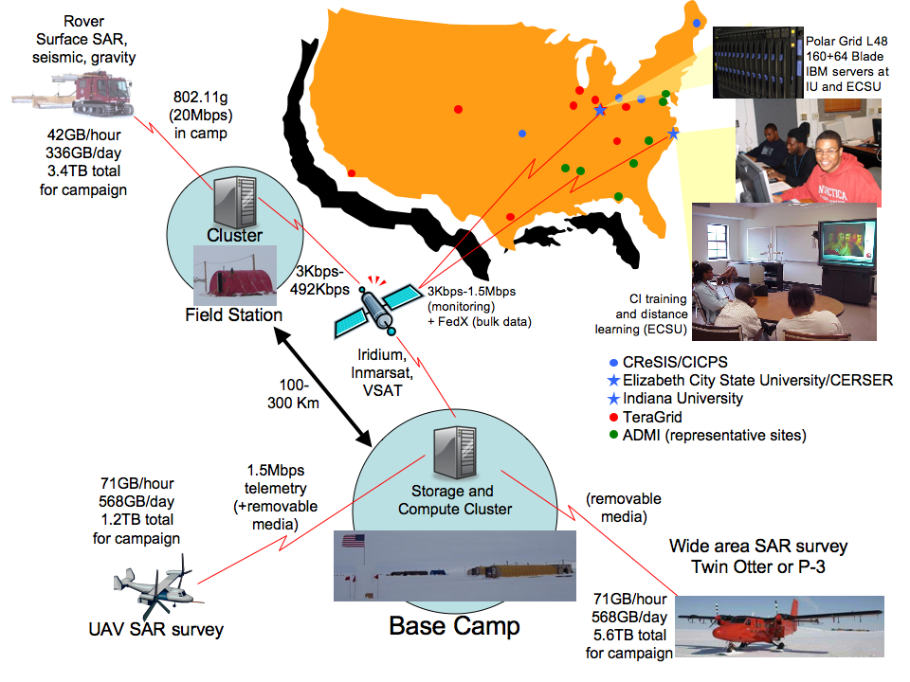

Slide 15
Clouds v Grids Philosophy
Clouds are (by definition) commercially supported approach to large scale computing
  So we should expect Clouds to replace Compute Grids
  Current Grid technology involves “non-commercial” software solutions which are hard to evolve/sustain
  Grid approaches to distributed data and sensors still valid
Informational Retrieval is major data intensive commercial application so we can expect technologies from this field (Dryad, Hadoop) to be relevant for related scientific (File/Data parallel) applications
  Technologies still immature but can be expected to rapidly become mainstream

Slide 16
Science and Campus Clouds
Large scale parallel computing best on specialized machines such as those on TeraGrid – clouds just slow down closely coupled components as virtualization runs counter to close coupling
Workflows of “pleasingly parallel” jobs cover much of science including Bioinformatics and run well on clouds
Clouds offer easier entry points for general user seen as most campus applications are “small” and do not involve parallel computing
  Condor/Grid Tools not designed to support MPI
  All Education is better on clouds
Campus Grids naturally become campus clouds
Science increasingly data dominated (data intensive) and clouds offer in Hadoop/Dryad new architectures

Slide 17
Data Intensive (Science) Applications
1) Data starts on some disk/sensor/instrument
  It needs to be partitioned; often partitioning natural from source of data
2) One runs a filter of some sort extracting data of interest and (re)formatting it
  Pleasingly parallel with often “millions” of jobs
  Communication latencies can be many milliseconds and can involve disks
3) Using same (or map to a new) decomposition, one runs a parallel application that could require iterative steps between communicating processes or could be pleasing parallel
  Communication latencies may be at most some microseconds and involves shared memory or high speed networks
Workflow links 1) 2) 3) with multiple instances of 2) 3)
  Pipeline or more complex graphs
Filters are “Maps” or “Reductions” in MapReduce language

Slide 18
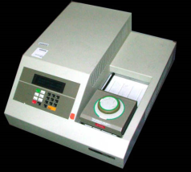

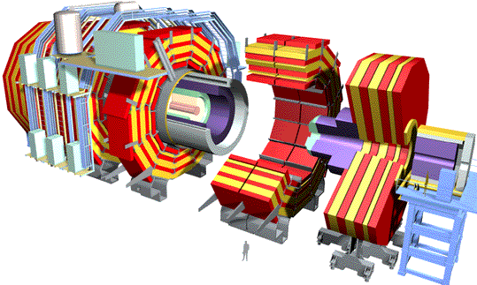




“File/Data Repository” Parallelism
Instruments
Map = (data parallel) computation reading and writing data
Reduce = Collective/Consolidation phase e.g. forming multiple global sums as in histogram
Communication via Messages/Files
Portals
/Users
Disks
Map₁
Map₂
Map₃
Reduce
Computers/Disks

Slide 19
Data Analysis Examples
LHC Particle Physics analysis: File parallel over events
  Filter1: Process raw event data into “events with physics parameters”
  Filter2: Process physics into histograms
  Reduce2: Add together separate histogram counts
  Information retrieval similar parallelism over data files
Bioinformatics - Gene Families: Data parallel over sequences
  Filter1: Calculate similarities (distances) between sequences
  Filter2: Align Sequences (if needed)
  Filter3: Cluster to find families
  Filter 4/Reduce4: Apply Dimension Reduction to 3D
  Filter5: Visualize

Slide 20
MapReduce implemented
by Hadoop using files for communication or CGL-MapReduce using in memory queues as “Enterprise bus” (pub-sub)
H
Y
n
Y
Example: Word Histogram
Start with a set of words
Each map task counts number of occurrences in each data partition
Reduce phase adds these counts
map(key, value)
U
U
S
4n
S
reduce(key, list<value>)
M
4n
M
D
n
D
Dryad supports general dataflow – currently communicate via files; will use queues
X
n
X
U
N
U
N

Slide 21
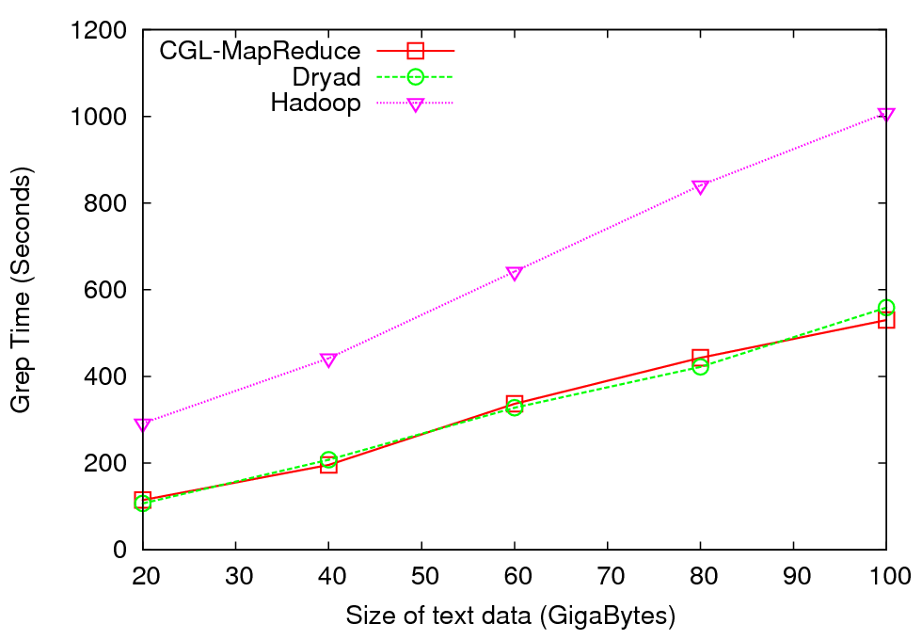
Distributed Grep - Performance
Performs “grep” operation on a collection of documents
Results not normalized for machine performance
CGL-MapReduce and Hadoop both used all the cores of 4 gridfarm nodes while Dryad used only 1 core per node in four nodes of Barcelona.
Abstraction of real Information Retrieval use of Dryad

Slide 22
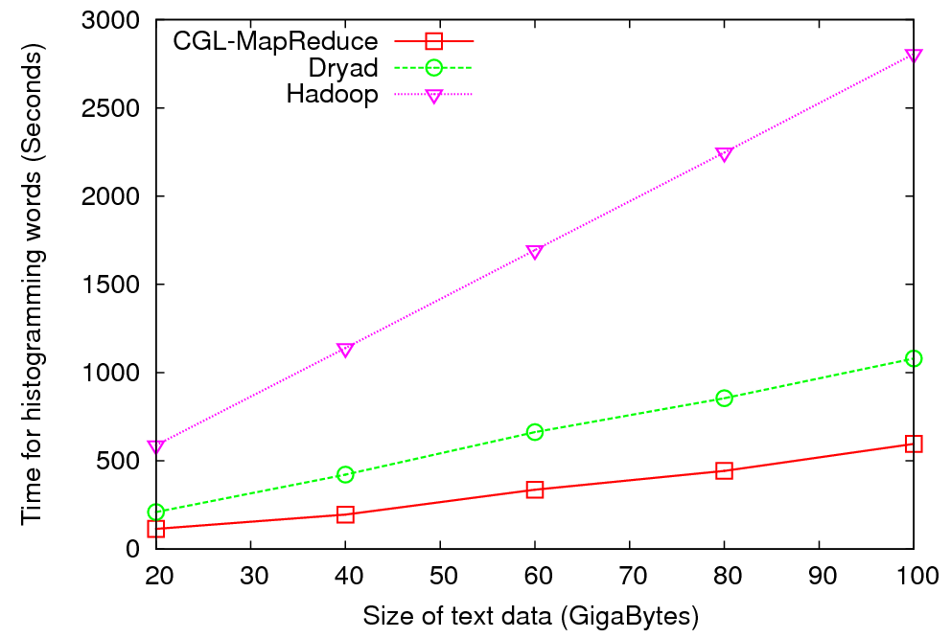
Histogramming of Words- Performance
Perform a “histogramming” operation on a collection of documents
Results not normalized for machine performance
Also, CGL-MapReduce and Hadoop both used all the cores of 4 gridfarm nodes while Dryad used only 1 core per node in four nodes of Barcelona

Slide 23
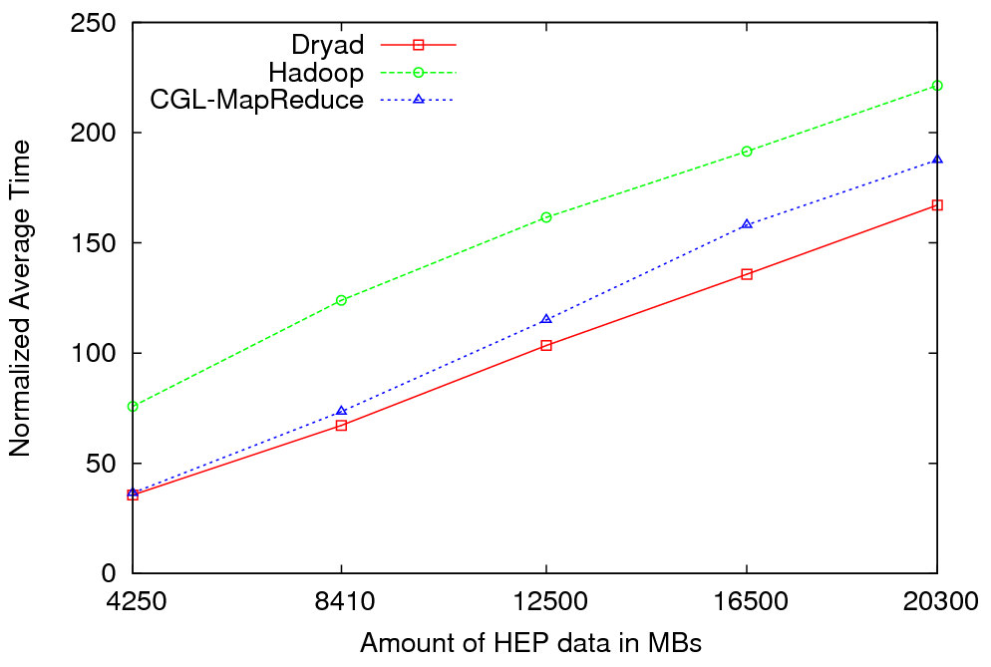

Particle Physics (LHC) Data Analysis
MapReduce for LHC data analysis
LHC data analysis, execution time vs. the volume of data (fixed compute resources)
Root running in distributed fashion allowing analysis to access distributed data – computing next to data
LINQ not optimal for expressing final merge

Slide 24

Reduce Phase of Particle Physics “Find the Higgs” using Dryad
Combine Histograms produced by separate Root “Maps” (of event data to partial histograms) into a single Histogram delivered to Client

Slide 25
Cluster Configuration
Configurations | CGL-MapReduce and Hadoop | Dryad
Number of nodes and processor cores | 4 Nodes => 4x8 =32 processor cores | 4 Nodes => 4x8 =32 processor cores
Processors | Quad Core Intel Xeon E5335 – 2 processors 2000.12 MHz | Quad Core AMD Opteron 2356 – 2 processors 2.29 GHz
Memory | 16GB | 16GB
Operating System | Red Hat Enterprise Linux 4 | Windows Server 2008 (HPC Edition)
Language | Java | C#
Data Placement | Hadoop -> Hadoop Distributed File System (HDFS) CGL-MapReduce -> Shared File System (NFS) | Individual nodes with shared directories
Note: Our current version of Dryad can only run one PN process per node. Therefore we have configured, Hadoop and CGL-MapReduce to use only one parallel task in each node.

Slide 26
Notes on Performance
Speed up = T(1)/T(P) = ε (efficiency ) P
  with P processors
Overhead f = (PT(P)/T(1)-1) = (1/ε -1)
is linear in overheads and usually best way to record results if overhead small
For MPI communication f ∝ ratio of data communicated to calculation complexity = n^{-0.5} for matrix multiplication where n (grain size) matrix elements per node
MPI Communication Overheads decrease in size as problem sizes n increase (edge over area rule)
Dataflow communicates all data – Overhead does not decrease
Scaled Speed up: keep grain size n fixed as P increases
Conventional Speed up: keep Problem size fixed n ∝ 1/P
VMs and Windows Threads have runtime fluctuation /synchronization overheads

Slide 27
Comparison of MPI and Threads on Classic parallel Code
Parallel Overhead
≈ 1-efficiency
= (PT(P)/T(1)-1)
On P processors
= (1/efficiency)-1
24-way
Speedup = 24/(1+f)
16-way
2-way
4-way
8-way
1-way
Speedup 28
MPI 1 2 1 4 2 1 8 4 2 1 16 8 4 2 1 24 12 8 6 4 3 2 1 Processes
CCR 1 1 2 1 2 4 1 2 4 8 1 2 4 8 16 1 2 3 4 6 8 12 24 Threads
4 Intel Six Core Xeon E7450 2.4GHz 48GB Memory 12M L2 Cache
3 Dataset sizes

Slide 28
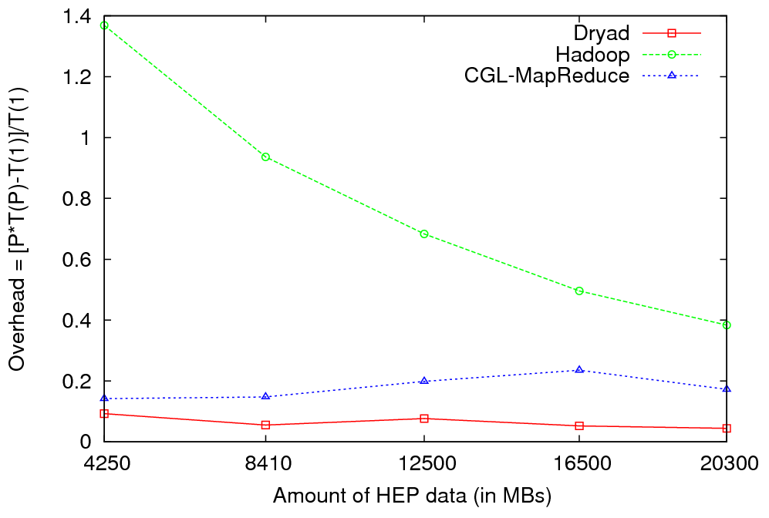
HEP Data Analysis - Overhead
Overhead of Different Runtimes vs. Amount of Data Processed

Slide 29
Some Other File/Data Parallel Examples from Indiana University Biology Dept
EST (Expressed Sequence Tag) Assembly: 2 million mRNA sequences generates 540000 files taking 15 hours on 400 TeraGrid nodes (CAP3 run dominates)
MultiParanoid/InParanoid gene sequence clustering: 476 core years just for Prokaryotes
Population Genomics: (Lynch) Looking at all pairs separated by up to 1000 nucleotides
Sequence-based transcriptome profiling: (Cherbas, Innes) MAQ, SOAP
Systems Microbiology (Brun) BLAST, InterProScan
Metagenomics (Fortenberry, Nelson) Pairwise alignment of 7243 16s sequence data took 12 hours on TeraGrid
All can use Dryad or Hadoop

Slide 30
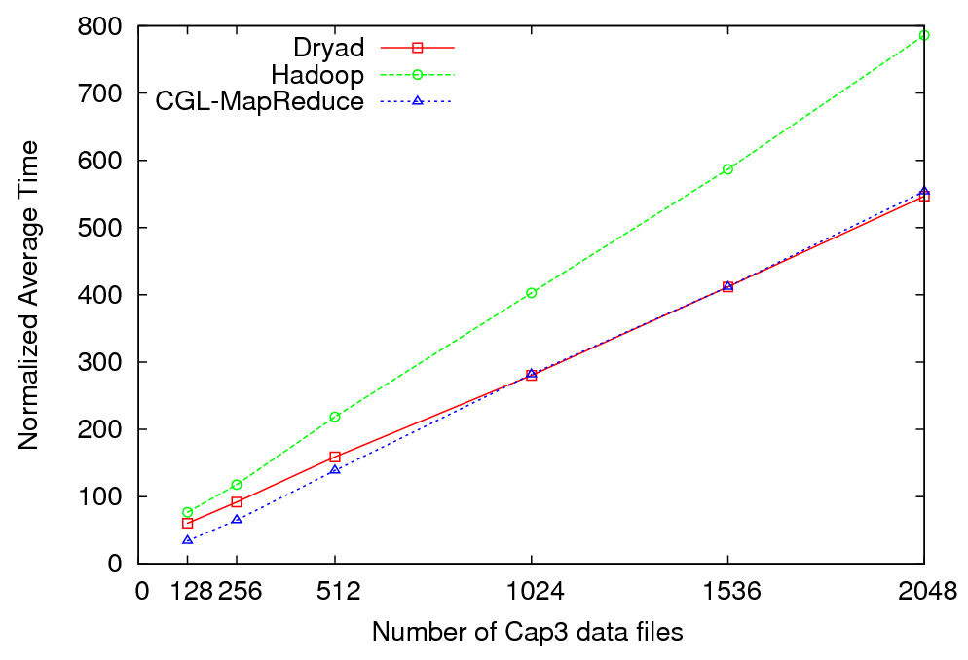
Cap3 Data Analysis - Performance
Normalized Average Time vs. Amount of Data Processed

Slide 31
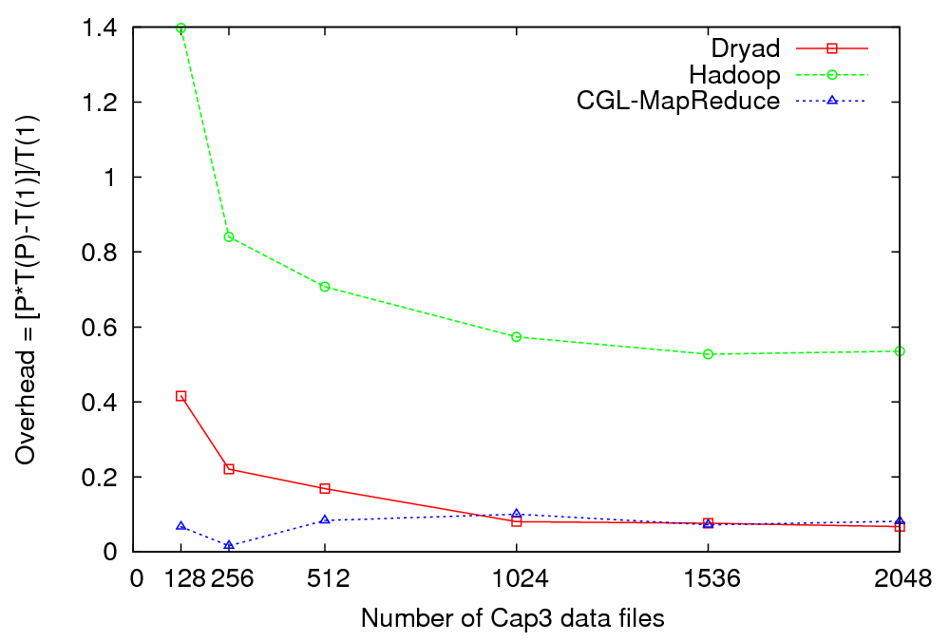
Cap3 Data Analysis - Overhead
Overhead of Different Runtimes vs. Amount of Data Processed

Slide 32
The many forms of MapReduce
MPI, Hadoop, Dryad, (Web or Grid) services, workflow (Taverna .. Mashup .. BPEL), (Enterprise) Service Buses all consist of execution units exchanging messages
They differ in performance, long v short lived processes, communication mechanism, control v data communication, fault tolerance, user interface, flexibility (dynamic v static processes) etc.
As MPI can do all parallel problems, so can Hadoop, Dryad … (famous paper on MapReduce for datamining)
MPI is “data-parallel”, it is actually “memory-parallel” as “owner computes” rule says “computer evolves points in its memory”
Dryad and Hadoop support “File/Repository-parallel” (attach computing to data on disk) which is natural for vast majority of experimental science
Dryad/Hadoop typically transmit all the data between steps (maps) by either queues or files (process lasts as long as map does)
MPI will only transmit needed state changes using rendezvous semantics with long running processes which is higher performance but less dynamic and less fault tolerant

Slide 33
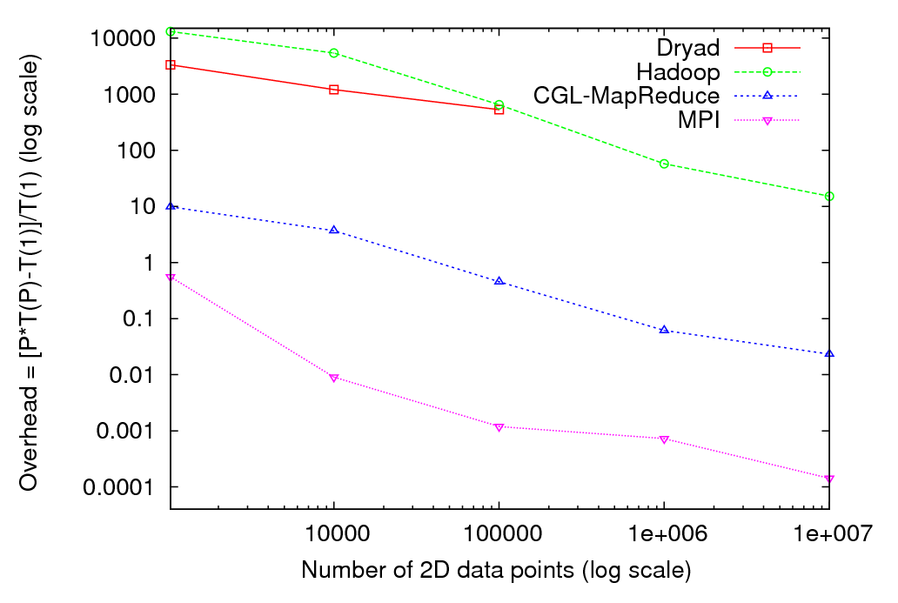
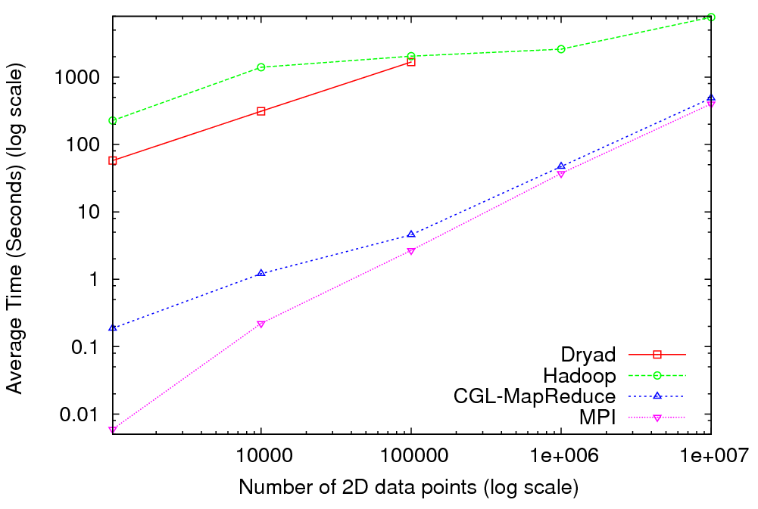
Kmeans Clustering in MapReduce
So Dryad will be better when uses pipes not files as communication
“CGL-MapReduce
Millisecond MPI”
“Microsecond MPI”

Slide 34
MapReduce in MPI.NET(C#)
A couple of Setup calls and one for Reduce ….
Follow a data decomposed MPI calculation (the map) with NO communication by
MPI_communicator.Allreduce<UserDataStructure>(LocalStructure, UserReductionRoutine) with Struct UserDataStructure instance LocalStructure and a general reduction routine ReducedStruct = UserReductionRoutine(Struct1, Struct2)
Or for example MPI_communicator.Allreduce<double>( Histogram, Operation<double>.Add) with Histogram as a double array gives particle physics Root application to summing histograms
Could drive with higher level language which could choose Dryad or MPI depending on needed trade-offs

Slide 35
Data Intensive Cloud Architecture
MPI/GPU Engines
Instruments
User Data
Specialized
Cloud
Cloud
Users
Files
Files
Files
Files
Dryad/Hadoop should manage decomposed data from database/file to Windows cloud (Azure) to Linux Cloud and specialized engines (MPI, GPU …)
Does Dryad replace Workflow? How does it link to MPI-based datamining?

Slide 36
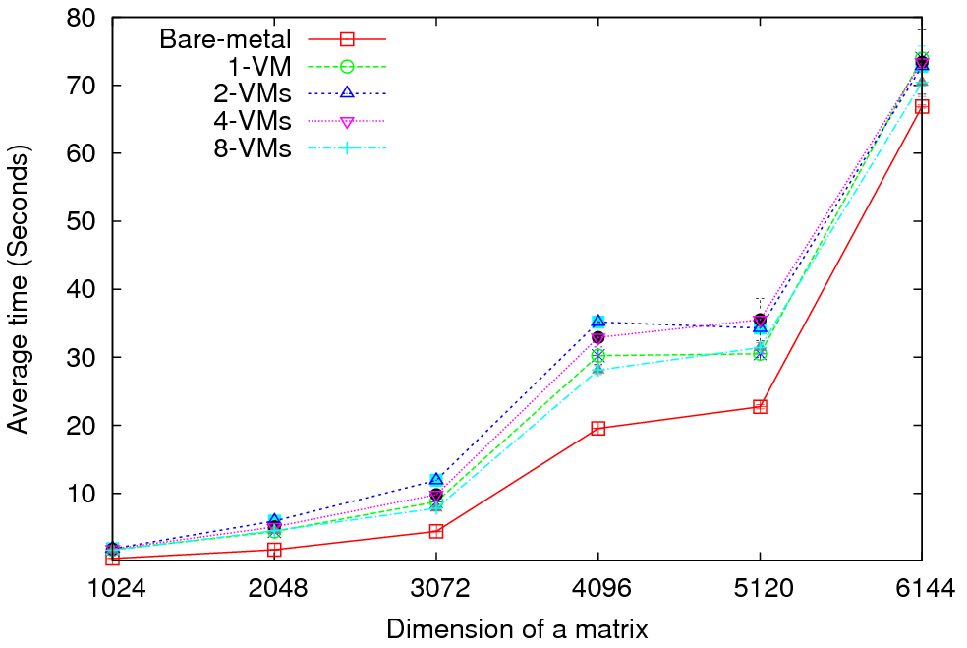
Matrix Multiplication - Performance
Eucalyptus (Xen) versus “Bare Metal Linux” on communication Intensive trivial problem (2D Laplace) and matrix multiplication
Cloud Overhead ~3 times Bare Metal; OK if communication modest
Notes:
MPI Cloud Overhead
1 VM = 1 VM in each node, each VM having access to all the CPU cores (8)
and all the memory (30 GB).
2 VMs = 2 VMs in each node, each VM having access to 4 CPU cores and 15 GB
of memory.
4 VMs = 4 VMs in each node, each VM having access to 2 CPU cores and 7.5 GB
of memory.
8 VMs = 8 VMs in each node, each VM having access to 1 CPU core and 3.75 GB
of memory.
Each node has the following hardware configuration.
2 Quad Core (Intel Xeon) processors (Total of 8 cores)
32 GB of memory.
Kmeans used all the 128 processors cores in 16 nodes.
Matrix multiplication uses only 64 cores in 8 nodes.

Slide 37
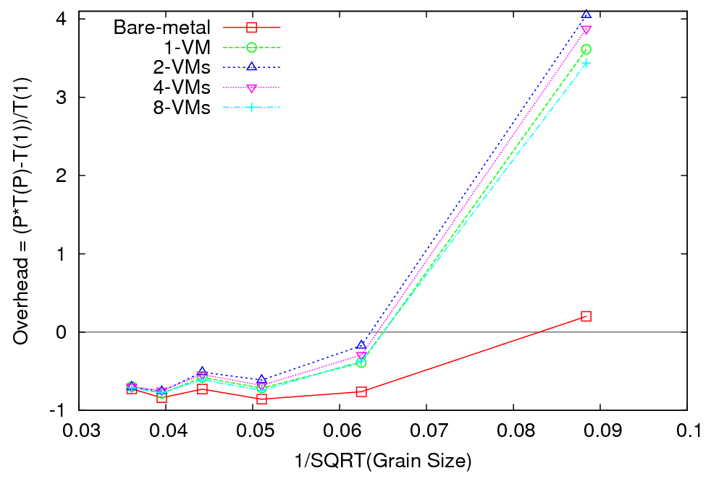
Matrix Multiplication - Overhead

Slide 38
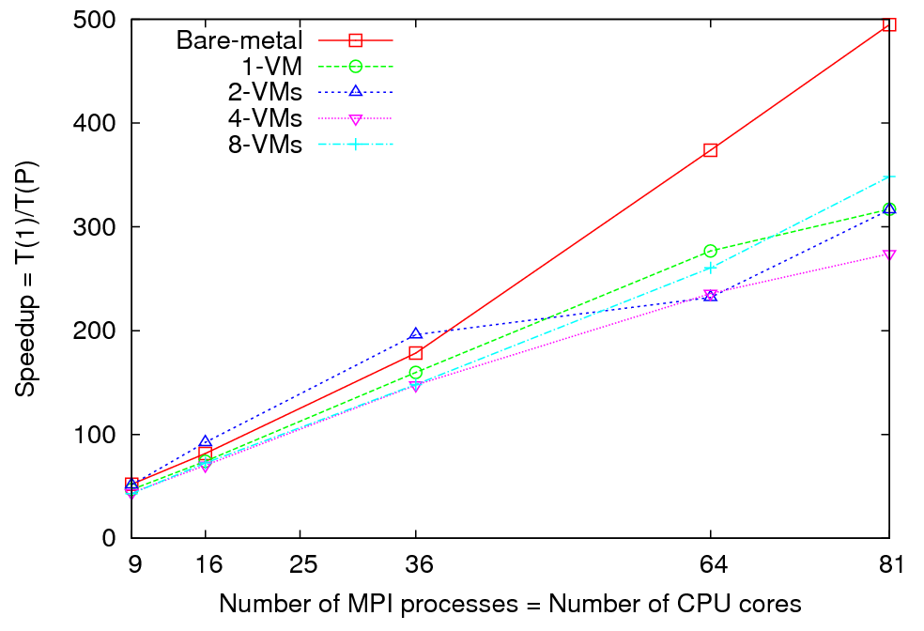
Matrix Multiplication - Speedup
Notes:
Performance and Overhead results are obtained using 8 nodes (64 cores) (Using a MPI grid of 8x8) Size of a matrix is shown in X axis. For speedup results I used a matrix of size 5184x5184 Number of MPI processes= Number of CPU cores is shown in X axis.

Slide 39
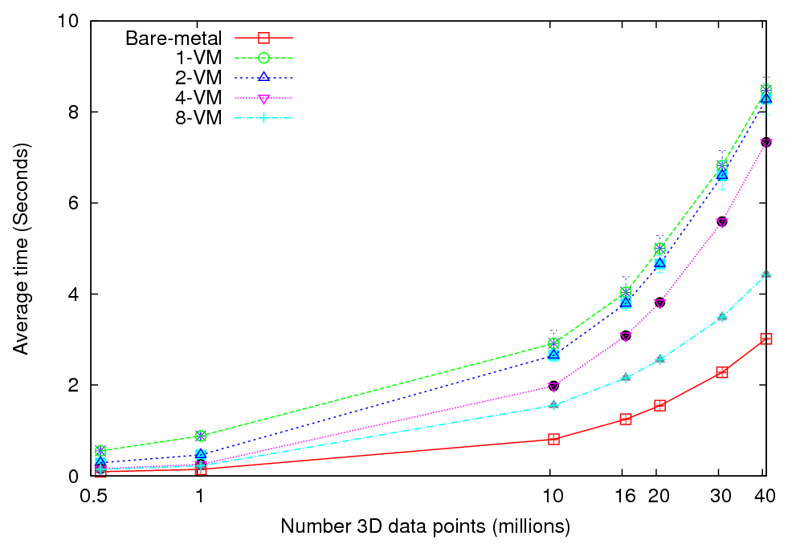
Kmeans Clustering - Performance
More VMs = better utilization?

Slide 40
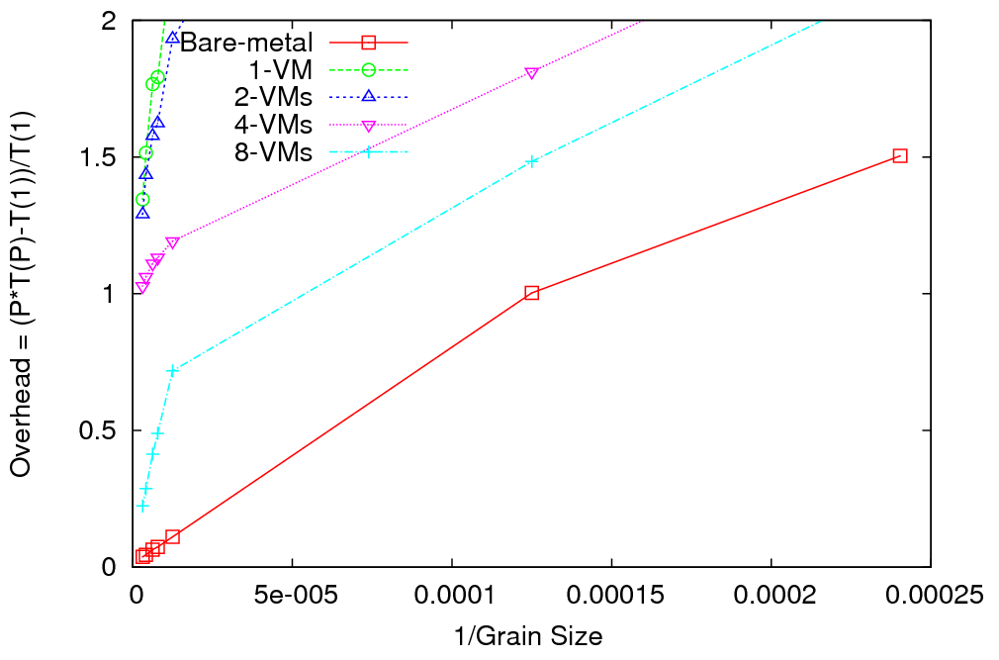
Kmeans Clustering - Overhead
Notes:
1 VM 8 cores per VM
8 VM’s 1 core per VM

Slide 41
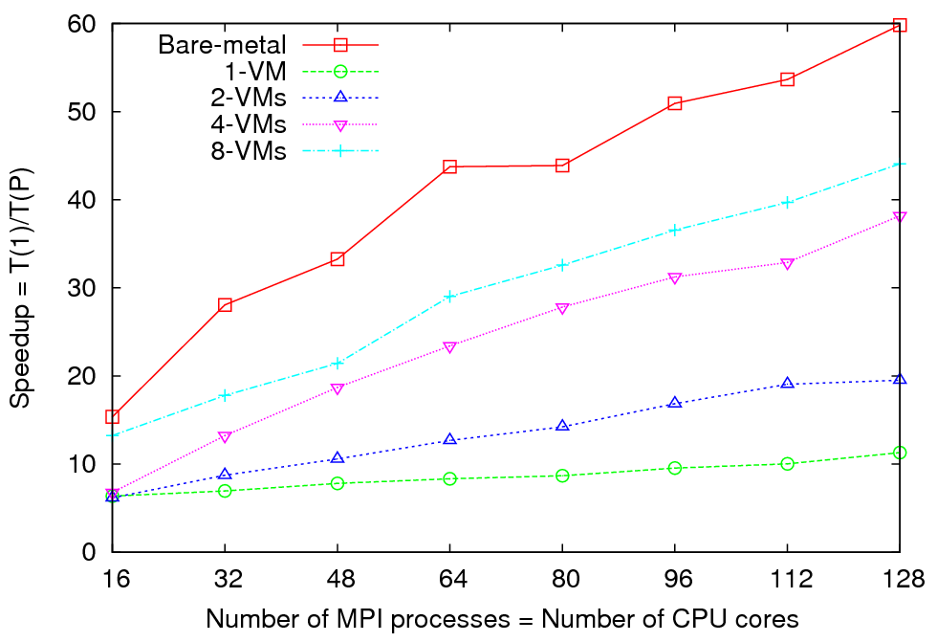
Kmeans Clustering - Speedup
Notes:
Performance and Overhead results are obtained using 16 nodes (128 cores) Each MPI process processes X/128 number of 3D data points. (0.5< X <40 ) millions. For speedup results, I used 860160 ( 0.8 million) 3D data points. Number of MPI processes= Number of CPU cores is shown in X axis.

Slide 42
Geoffrey Fox
Indiana University
501 N Morton Suite 224
Bloomington IN 47404
gcf@indiana.edu
http://www.infomall.org

