Slide 1
For Testbeds
TM
Notes:
1

Slide 2
What is CloudStack?
Secure, multi-tenant cloud orchestration platform
Turnkey platform for delivering IaaS clouds
Hypervisor agnostic
Massively scalable, secure and open
Open source, open standards
Deploys on premise or as a hosted solution
Deliver cloud services faster and at a fraction of the cost
Build your cloud the way the world’s most successful clouds are built

Slide 3
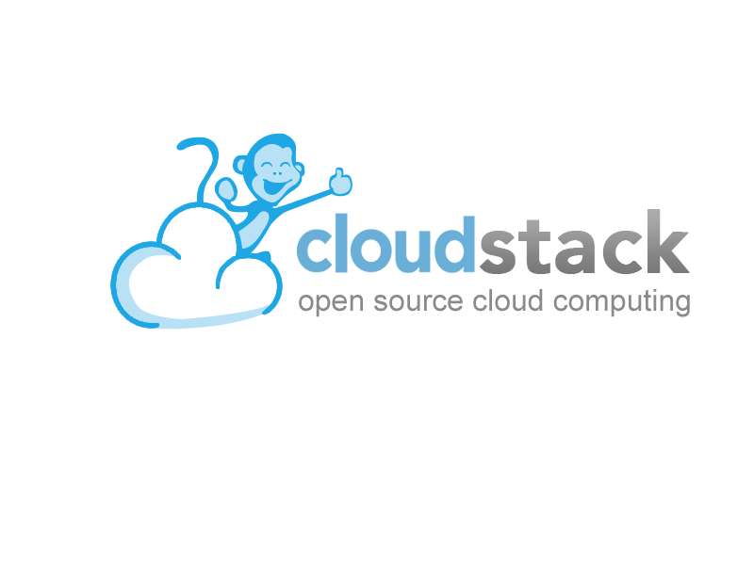
Apache Software Foundation

Slide 4
Why OpenSource ?
Continuous access to source code. Insurance against vendor lock-in
Apache has open governance policy. No single vendor can control the project
Rich partner integrations in IaaS, PaaS & SaaS layers
Leverage developers for innovation & accelerated development
Large community to share knowledge, tools & best practices
To Become the CloudPlatform of
Apache Software Foundation

Slide 5
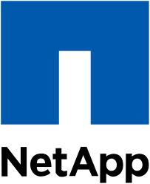
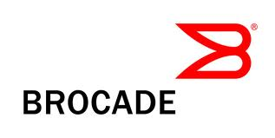
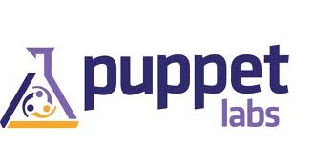
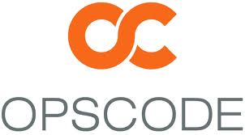
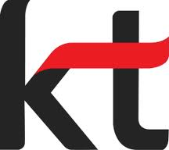
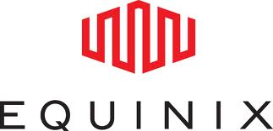
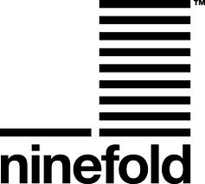
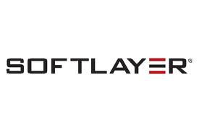
Post-Apache Community Momentum
Visits to CloudStack.org
598,651
CloudStack Community Members
32,000
185,515
8,000
15,683
2,000
June ’11
Pre-Acquisition
September ’11
Post-Acquisition
April ’12
Post-Apache
June ’11
Pre-Acquisition
September ’11
Post-Acquisition
April ’12
Post-Apache
16,511
Monthly Downloads of CloudStack
*
*
12,950
*
5,088
*
*
*
June ’11
Pre-Acquisition
September ’11
Post-Acquisition
April ’12
Post-Apache
*
CloudStack EcoSystem Partners

Slide 6
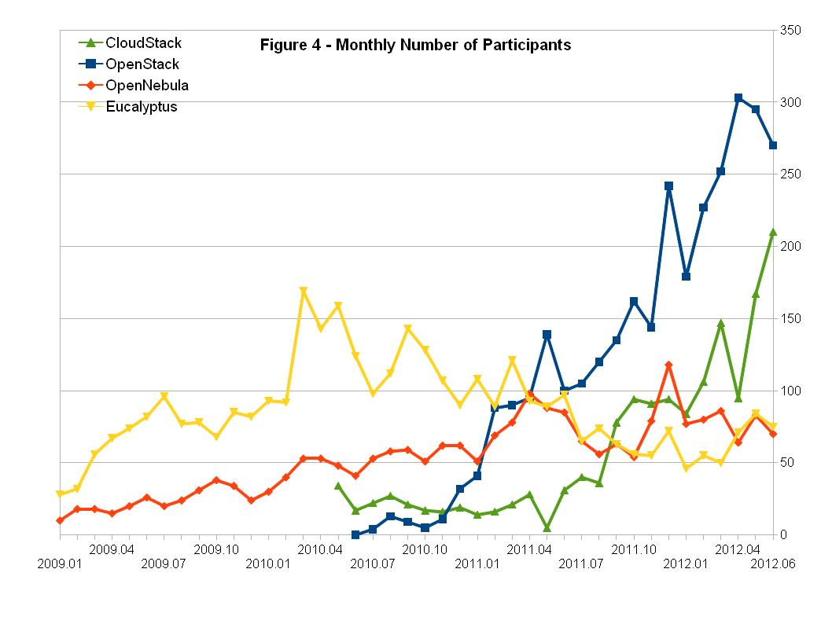
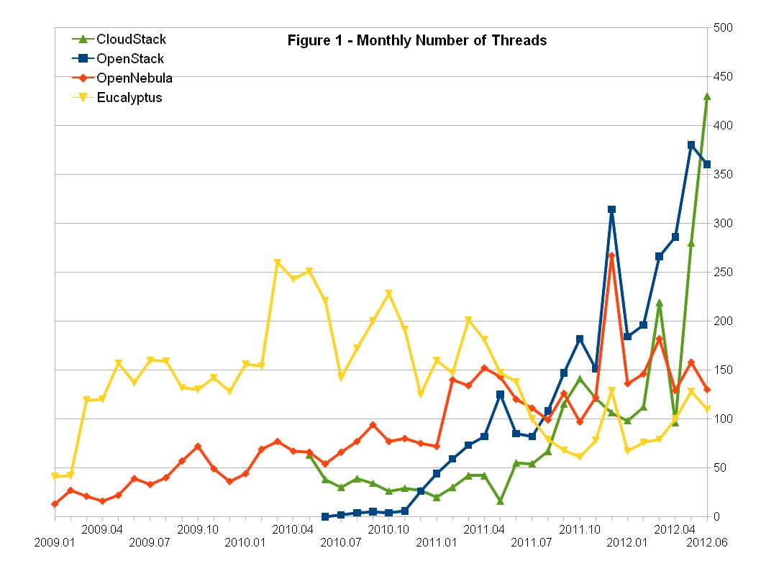
Q2 2012 Apache CloudStack Community Snapshot
 | Pre Apache Move (Jan 2012) | June Actuals
# of companies endorsing project | 1 | 68
# of companies participating | 10 | 140
# of developers working on project | 40 | 238
# Citrix CloudPlatform deployments in production | 82 | 130

Slide 7
CloudStack Supports Multiple Cloud Strategies
Private Clouds
Public Clouds
On-premise Enterprise Cloud
Hosted
Enterprise Cloud
Multi-tenant Public Cloud
Dedicated resources
Security & total control
Internal network
Managed by Enterprise or 3rd party
Dedicated resources
Security
SLA bound
3rd party owned and operated
Mix of shared and dedicated resources
Elastic scaling
Pay as you go
Public internet, VPN access

Slide 8
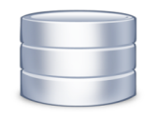
CloudStack Provides On-demand Access to Infrastructure Through a Self-Service Portal
Org A
Org B
Admin
Admin
Users
End User
Users
Users
Compute
Network
Storage
Admin

Slide 9
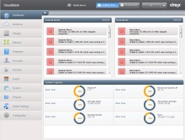
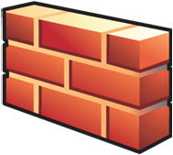
CloudStack is Full-Service Orchestration Platform
API (EC2 & CS)
Self-service Portal
Metering
Image Mgmt.
Dashboard
Identity Mgmt.
Load Balancers
FWs & VPNs
Storage
Compute
Network

Slide 10
Open Platform to Suit Customer Needs
Compute
Hypervisor
XenServer
VMware
Oracle VM
KVM
Bare metal
Storage
Block & Object
Local Disk
iSCSI
Fiber Channel
NFS
Swift
Network
Network & Network Services
Network Type
Isolation
Firewall
Load balancer
VPN

Slide 11
Why CloudStack for TestBeds?
Baremetal provisioning
Highly Scalable – we have a customer in production with over 30K nodes under a single management domain
Robust multi-tenancy
Highly automated
Supports heterogeneous platforms
Open Source, Open APIs, community driven
Local Storage support
Mature platform with over 100 productive customers

Slide 12
Call to Action
Join the community – visit cloudstack.org
Download, try, contribute!!!

