Slide 1
Cloudmesh Resource Shifting
2
1

Slide 2
Cloudmesh: from IaaS(NaaS) to Workflow (Orchestration)
Virtual Cluster
Heat
Python
Components
chef
apt-get/yum
Infrastructure
VMs, NaaS
Baremetal
Workflow
iPython
(Pegasus)
Data
Images

Slide 3
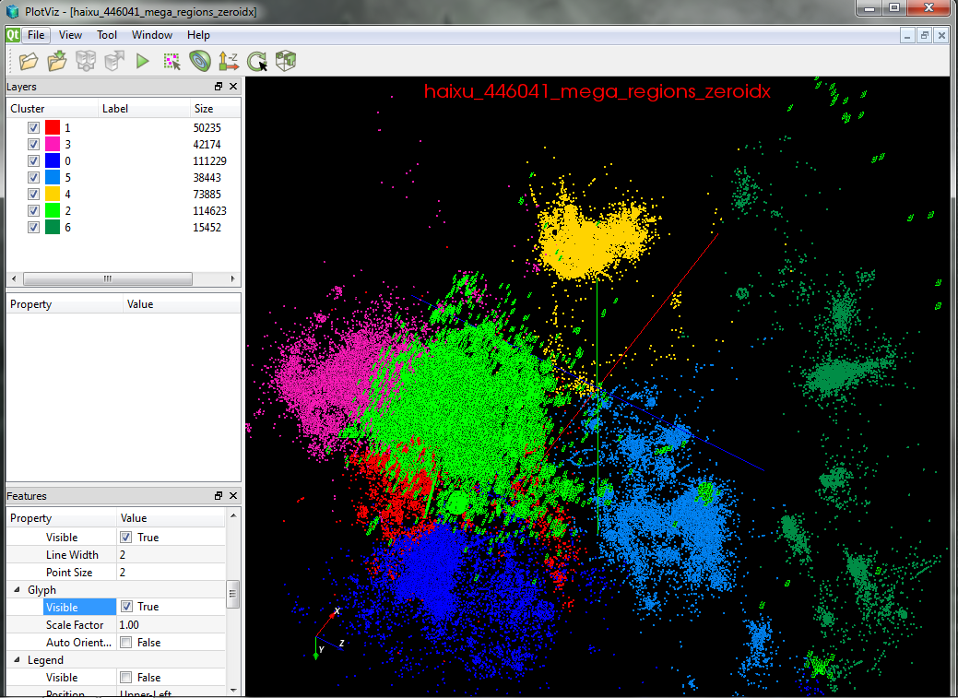
Genomic Sequence Analysis Automation
Application Functions
Cloudmesh
Workflow/Experiment
Management
Cloudmesh
Provisioning
Workflow Functions:
File Transfer
PBS Job submission
Dynamic script creation
Submission history
storage/retrieval
Cluster A
Cluster B
History Trace of job submissions
Cluster C
Cluster D
Provisioning of either: baremetal, IaaS, existing HPC cluster

Slide 4
PROTOTYPE

Slide 5
… baremetal provisioner

Slide 6
… baremetal provisioner policies
Display Policy

Slide 7
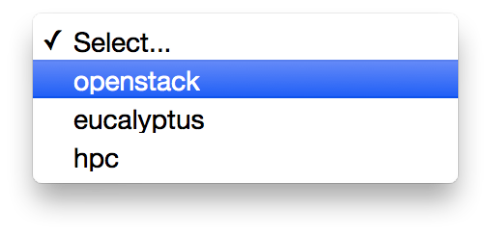
… provisioning by selection
Select Predefined
Provisioned Service type

Slide 8
… provisioning by specification
Provision nodes by name

Slide 9
View the parallel provisioning tasks execution from AMPQ

Slide 10
Older

Slide 11
Login to Federated Environment
Login
For FG integrated account management with XSEDE
Menu with options for status, vm management,HPC queues

Slide 12
… after login you get to a start page

Slide 13
… showing the profile
Profile

Slide 14
… register a cloud
Register

Slide 15
India clouds registered.
Adding others is easy

Slide 16
… register a commercial cloud
Register a commercial cloud

Slide 17
… register clouds
Multiple clouds are registered

Slide 18
… VMs
Serach
VMs
Panel with VM Table (HP)

Slide 19
… VMs
Summary
Panel with VM Table (india)

Slide 20
… interacting with VMs with one button
Delete
Add with defaults
Login
Info
IP

Slide 21
… setting default Flavor
Default
Flavor

Slide 22
… setting default images
Default
Search
Images

Slide 23
… adding a VM
Add
Default Image
Default Flavor
Added Image

Slide 24
… refresh the status
Image Build

Slide 25
… assigning IP
Assign IP

Slide 26
… queue info
Queue Info

Slide 27
… assigning IP
Jobs
Jobs

Slide 28
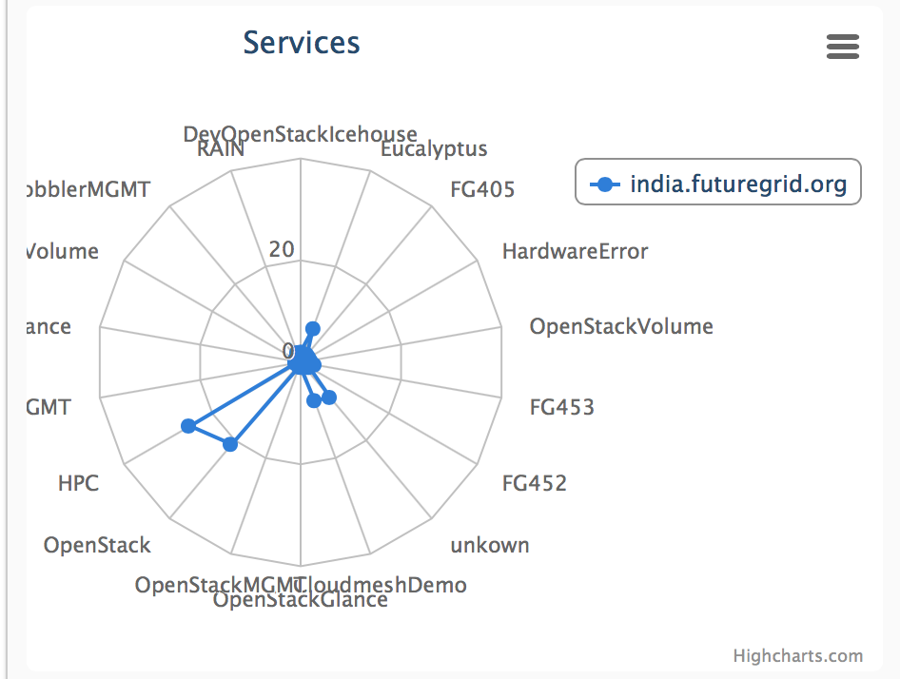
… baremetal service status
Service Histogram
Radar Chart

Slide 29
… baremetal provisioner

Slide 31
Not yet completed …
Ran out of time to implement this

Slide 32
… federated service view

Slide 33
… provisioning multiple machines through DAG

Slide 34
Inventory

Slide 35
Federated cloud metrics

Slide 36
Rack Diagram

