Slide 1
Virtual Clusters Production Experience
Gregor von Laszewski, IU
Fugang Wang, IU
Dmitry Mishin
Trevor Cooper
Christopher Irving
Phil Papadopoulos
Geoffrey C. Fox

Slide 2
Agenda
Overview
Features
Architecture
Access
Use Cases
Observations
Future Plans

Slide 3
Overview

Slide 4
Virtual Clusters
Goal Provide a near bare metal HPC performance and management experience
Targets Projects that:
Cannot fit typical batch operation in XSEDE, or
Can not or do not want to buy hardware, or
Have intermittent needs (resource bursting).
But, must be able to manage their own cluster

Slide 5
Highlighted Features
On the same machine where we offer traditional production HPC service, we also offer
Customizable HPC environment with
Different OSes (even Windows), service stacks, software stacks
Environments are leveraging virtualization technologies but with HPC in mind (e.g., sophisticated configurable virtual clusters with high performance capability)
=> Bare metal experience in either system management view or performance perspective

Slide 6
Architecture

Slide 7
System Design
Projects have persistent VM for cluster management
Modest: single core, 1-2 GB of RAM
Standard compute nodes are scheduled as containers via batch system
One virtual compute node per container (physical host)
Virtual disk images stored as ZFS datasets
Read-only iSCSI target and parallel data migration provides instant-on behavior
Periodic sync-back of changes shortens node cycle/recycle time
VM use allocated, tracked and reported in the same way as any other batch job

Slide 8
Enabling Technologies
Technology | Capability
KVM | Virtual Machine Creation
SR-IOV | Near native IB performance in Virtual Machines
Rocks | Systems Management
ZFS + IMG-STORAGE | Virtual Machine Disk Image Management
VLANs | Virtual Cluster Private Management Network Isolation
PKEYs | Virtual Cluster Infiniband Network Isolation
Nucleus API | Virtual Machine Management and Provisioning, Status and Console Access
Cloudmesh Client | Convenient Access and Automation Support

Slide 9
System-Admin-Customized HPC 1:1 physical-to-virtual compute node
public network
physical
virtual
virtual
Virtual Frontend
Hosting
Frontend
Disk Image Vault
Virtual
Frontend
Virtual
Frontend
private
private
private
Compute
Compute
Compute
Virtual
Compute
Compute
Compute
Compute
Virtual
Compute
Virtual
Compute
Virtual
Compute
Compute
Compute
Compute
Virtual
Compute
Virtual
Compute

Slide 10
User Perspective User is a system administrator –we give them their own HPC cluster
Active virtual compute nodes
Scheduling
Storage management
Coordinating network changes
VM launch & shutdown
Nucleus
Attached and synchronized
Request nodes
Console & power
API
Active
Disk
Images
Compute
Cloudmesh Client
Compute
Persistent
Virtual
Frontend
Compute
Inactive
Disk
Images

Slide 11
Production Data Storage/Filesystems
Local SSD storage on each compute node
Local (SDSC) network access same as compute nodes
Modest (TB) storage available via NFS now
Integration of custom storage into the production system (example Kansas)
Possible Future Feature:
Limited number of large SSD nodes (1.4TB) for large VM images

Slide 12
Access

Slide 13
Cloudmesh Client Tool
Easy to use CLI and command shell, allowing the use of Comet as infrastructure for virtual cluster management.
Enables access to hybrid clouds
OpenStack, (EC2, AWS, Azure);
possible to extend to other systems like Jetstream, Bridges etc.
Customizable stacks that can target specific application user communities.
Reference: https://github.com/cloudmesh/client

Slide 14
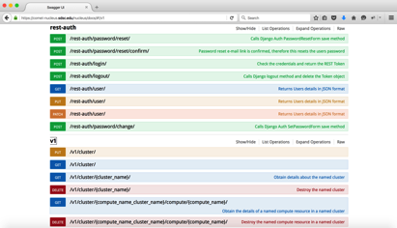
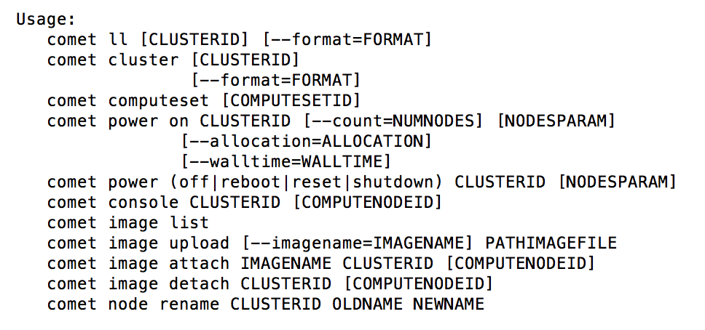
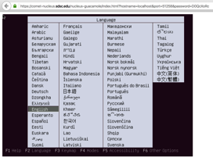
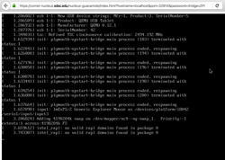
Accessing Production Virtual Cluster Capabilities
REST API
Command line interface
Command shell for scripting
Console Access
(Portal)
Rocks, Slurm, etc. are hidden

Slide 15
Comet Cloudmesh Client (selected commands)
cm comet cluster ID
Show the cluster details
cm comet start ID vm-ID-[0-3] --walltime=6h
Power 3 nodes on for 6 hours
cm comet image attach image.iso ID vm-ID-0
Attach an ISO image to boot from
cm comet power on ID vm-ID-0
Boot a compute node
cm comet console ID
Console access of VC frontend

Slide 16
Cloudmesh Supports Continuous Improvement
Requirements
Gradual test and improvement of virtual cluster leading form prototype to production
Benefit
Cloudmesh Client integrates in this continuous improvement paradigm

Slide 17
Layered Architecture
Benefits
Easy extensibility
Rapid integration of new features based on cluster admin and user needs
Integration of clouds, HPC, containers, microservices
Support of sophisticated software stack deployments
Integration into scripts

Slide 18
Operational Status

Slide 19
Successful Operation
Developed a functional cloud environment leveraging:
Rocks, FutureGrid, Cloudmesh client
Our ability to integrate with the standard HPC environment
DEV system for early cluster admin access (3 groups) and tutorial/trial access (~10 groups), as well as system development and feature improvement.
Production system is deployed and active
OSG has been running virtual clusters for multiple allocations.
UFL, KAN, RACD, Kepler-GW, are currently configuring their virtual clusters
OpenTOPO, Telescp, mghpcc, NSG, ABCD are in OnRamp phase

Slide 20
Active and On-ramping Virtual Clusters
Project | Group/Institute | Purpose | Status
OSG | Open Science Grid | OSG/CMS/LIGO/IceCube/others | Running in Production
Lifemapper | Biodiversity Institute, University of Kansas | Species Biodiversity Mapping and Prediction | Ready in Production
UFL | University of Florida | PRAGMA/GLEON Lake Expedition | Ready in Production
RACD | XSEDE | XSEDE SD&I Test Cluster | Ready in Production
OpenTOPO | OpenTopography / SDSC | High Res Topography Data and Tools | Ready in Production
Kepler-GW | SDSC | Machine learning & performance study | Ready in Production
TELESCP | CAIDA / SDSC | Network traffic monitoring | On-ramping
MGHPCC | MGHPC / Harvard | Campus Champion-alike | On-ramping
NSG | SDSC | Neuroscience Gateway | On-ramping
ABCD | UCSD | Brain Development and Child Health | On-ramping
NBDRA | NIST | Prototype the NIST Big Data Reference Architecture | On-ramping

Slide 21
Case Studies

Slide 22
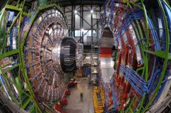
Case Study: Open Science Grid (OSG)
Supporting small scale multi-core, (future: large memory & GPU) , large IO jobs, i.e., functions as a portal to Comet via the virtual cluster interface in order to provide capabilities that are otherwise rare on OSG.
One admin to manage a VC with many nodes, and to submit jobs on behalf of multiple allocations (LIGO-gravitational wave, CMS-dark matter, IceCube, etc.)
Feedback/Justification from OSG
The VC interface is a very powerful tool for experts.
Was very easy for OSG to use the VC interface.
a day or two and we were running close to the full diversity of science on the VC onramp environment.
Having access to a virtual cluster on Comet that can be customized opens the door for a whole new set of applications we were never able to support before.
IceCube Neutrino Observatory https://icecube.wisc.edu/science/highlights
CMS Detector/LHC http://cms.web.cern.ch/news/what-cms

Slide 23
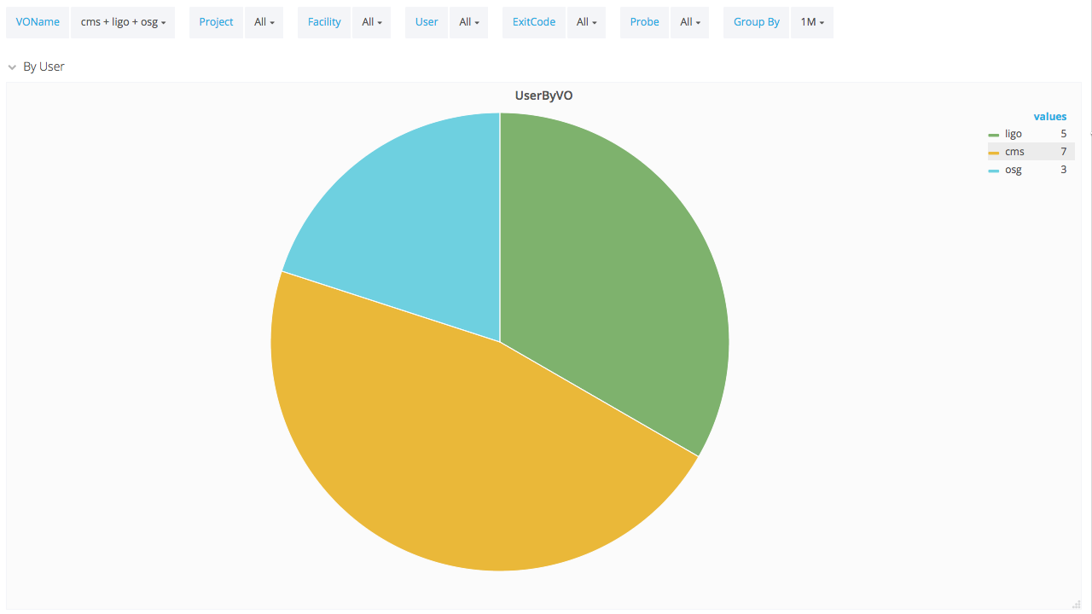
Case Study: Open Science Grid Reporting via XDMoD
OSG VC allows multiple XSEDE allocations to run and report usage via XDMoD
Demonstrates that users can provide detailed runtime information
Integration with XDMOD

Slide 24
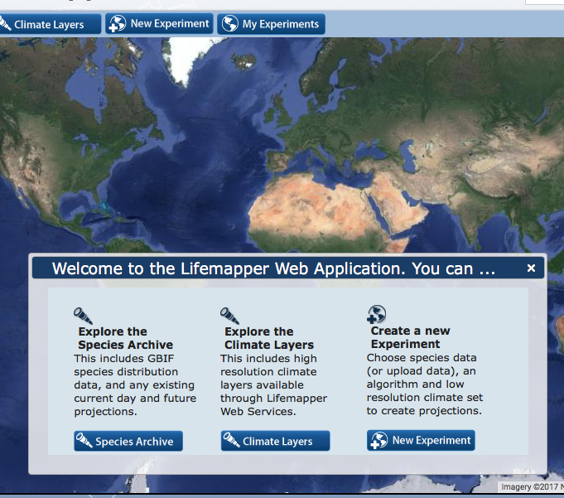
University of Kansas - Lifemapper
Lifemapper (Lm) is a high-throughput species distribution (range) modeling system created to compute, archive and web publish, species distribution models using all available online species occurrence data.
From the Lifemapper team: “Our continuing work with SDSC has led us to the conclusion that deploying our software on a virtual cluster on SDSC’s Comet cluster would leverage both our existing Rocks-based software stack, and also the virtual cluster support unique to Comet”

Slide 25
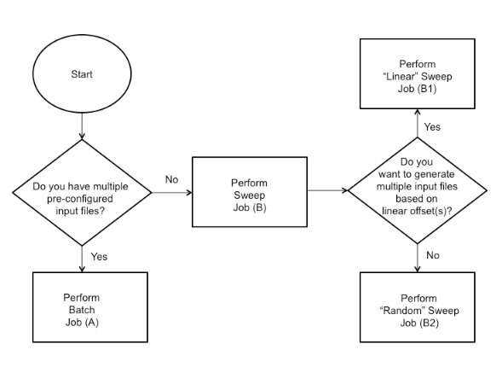
Case study: University of Florida -GRAPLEr (GLEON Research and PRAGMA Lake Expedition)
GRAPLEr, a distributed computing system, integrates and applies overlay virtual network, high-throughput computing (HTC), and Web service technologies to allow lake ecology modelers to dispatch the execution of large numbers of simulations from their own R/R-studio desktop environment
From the GRAPLEr team: “Comet virtual clusters are an ideal match for this project because it allows unprecedented flexibility in configuring, and dynamic joining/leaving of resources in a GRAPLEr pool. Our architecture is based on the ability to create virtual clusters that we can configure with our own software stack, on demand - unlike other HPC resources, which lack this flexibility, the Comet virtual cluster is a natural fit for our project.”
GRAPLEr Workflow

Slide 26
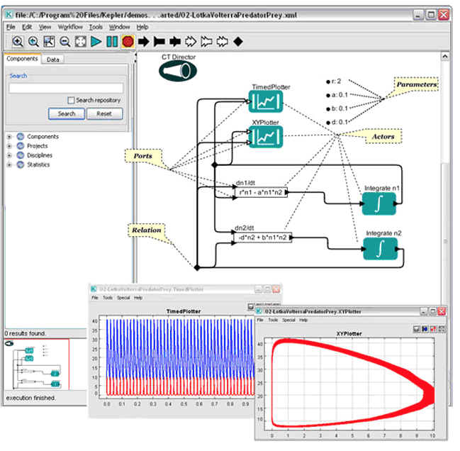
Case Study: Kepler Gateway
Execution engine that decides the optimal execution strategy to perform a workflow on a set of available resources. Utilizes machine-learning techniques to predict resource usage and execution times of complex workflows on distributed platforms.
Project Team Feedback:
Large memory node with the flexibility to deploy a gateway node that is not available elsewhere
The console access is pretty handy
Representative Kepler Workflow

Slide 27
NIST Big Data Reference Architecture (NBDRA)
Defining of vendor neutral big data architecture framework
Leverage HPC
Leverage cloud
Leverage microservices
Leverage DevOps
Leverage software stacks
Cloudmesh Client is significantly impacting Volume 8 of the NBDRA
Access hybrid clouds OpenStack, (EC2, AWS, Azure); possible to extend to other systems like Jetstream, Bridges etc.
Customizable launchers available through command line or browser – can target specific application user communities.
Key advantage:
Comet allows access to HPC and virtualization environments.
Comet Cloudmesh client proves that NBDRA can be implemented
Reference: https://github.com/cloudmesh/client

Slide 28
Cloudmesh supports NIST Big Data Architecture
Requirements
Big Data Support
IaaS support
PaaS support
Integration of a variety of technologies through stacks
No vendor lock in
Comet brings
HPC
Virtualization
Containers via VC
Microservices via VC
Cloudmesh brings
Easy abstraction
Management

Slide 29
Observations

Slide 30
Observations and Lessons learned
"Targeting experienced cluster admins" versus "possibly less experienced cluster admins"
Some admins could be students
A set of standard best practice recipes and/or some templating that helps VC admin deploy and configure their VC.
Integration of “software/cluster stacks”
Request for storage requirements integrated in VC request
Focused on compute. But projects with larger storage request is not uncommon
Desirable improvement of tracking of usage of the VC and inside the VC
Reporting mechanisms implemented by VC admins to track and report usage of VC resources
User-driven features help shaping VC capabilities
Scenarios of power management of compute nodes
What info is needed to be provided via API/CLI

Slide 31
Future Plans

Slide 32
Future Plans: Production Systems Tools and Services
VC capability improvement
Increasing walltime, Dynamically extending walltime
Start compute nodes within an existing reservation
Provide automated estimate when a node is available
Make available other hardware to VC nodes, e.g. GPU
Cloudmesh client tool improvement
Plugin mechanism to separate the Comet code
Leverage software stack deployments by others
Cloudemsh client allows the deployment of software stacks.
Collect such stacks and make them available

Slide 33
Future Plans: Collecting Usage Statistics
Provide guidance for integrated usage statistics in VC’s
VC admin have access to the cluster
Exposing usage statistics needs to be integrated by the VC admin
Approach: Work with VC admin to identify templates and best practice on a case-by-base basis
We have proposed the following for feedback by VC admins:
Characterization of science directorate
Number of unique users that ran in the VC/Gateway
Number of jobs that executed within the VC. If the definition of job within the particular VC is something non-traditional, then this should be communicated as part of the reporting
Measures of resource usages such as number of cores/job, and length of the job in core-hours
Total core-hours consumed by the VC during the reporting period

Slide 34
Future Plans: Outreach Strategy
Work with cluster admins in the On-ramp phase to help them to transition to production
Provide additional tutorials and documentation
Identify new cluster admins and communities
Leverage the experience from IU in the outreach activities by increasing the role on the initial on-ramping phase.

Slide 35
Conclusion

Slide 36
Conclusion
Virtual clusters on Comet provide an opportunity for communities to set up custom OS and software stack.
Command line tool and shell provides VC admins with easy access.
Console access is available.
Preservation of performance of HPC infrastructure while accessing it through virtualized resources. Confirmed by application benchmarks.
Significant ”sophisticated” production use on Comet by Open Science Grid (OSG). More is coming (~5 ready in Production, ~5 on-ramping)
Improvements of the process for metrics and resource monitoring have started

