Slide 1
Building Effective CyberGIS: FutureGrid
Marlon Pierce, Geoffrey Fox
Indiana University

Slide 2
Some Worthy Characteristics of CyberGIS
Open
Services, algorithms, data, standards, infrastructure
Reproducible
Can someone else reproduce your results, your conclusions?
Sustainable
Can you reproduce your results in 6 months? 6 years?
Would you want to?
Would the infrastructure be there for you?
Democratic
Access by citizen scientists, smaller colleges, minority serving institutions, K12 students, …

Slide 3
GIS Services
Web 2.0 Portals, Social Networks
Data mining, assimilation, workflow
Higher Level Services
Documentation
Services
Ontologies, Metadata
Curation
Developer APIs and Services
Existing Middleware
Cloud Middleware
Core Cloud Platform asa a Service (PaaS)
VM Based Infrastructure as a Service (IaaS)
Real Machine Images
Production Clouds
Amazon, Microsoft, Government, Campus
Infrastructure
Storage, Computing, Networking
Data Provider APIs, Services
Existing Middleware
Cloud Middleware
Core Cloud Platform as a Service (PaaS)
DESDynI InSAR DAta
Instrumentation Observation
Remote Ice Sheet Sensing
Data Providers
Comprehensive Ocean Data
Polar Science Data
Computational Model Outputs

Slide 4
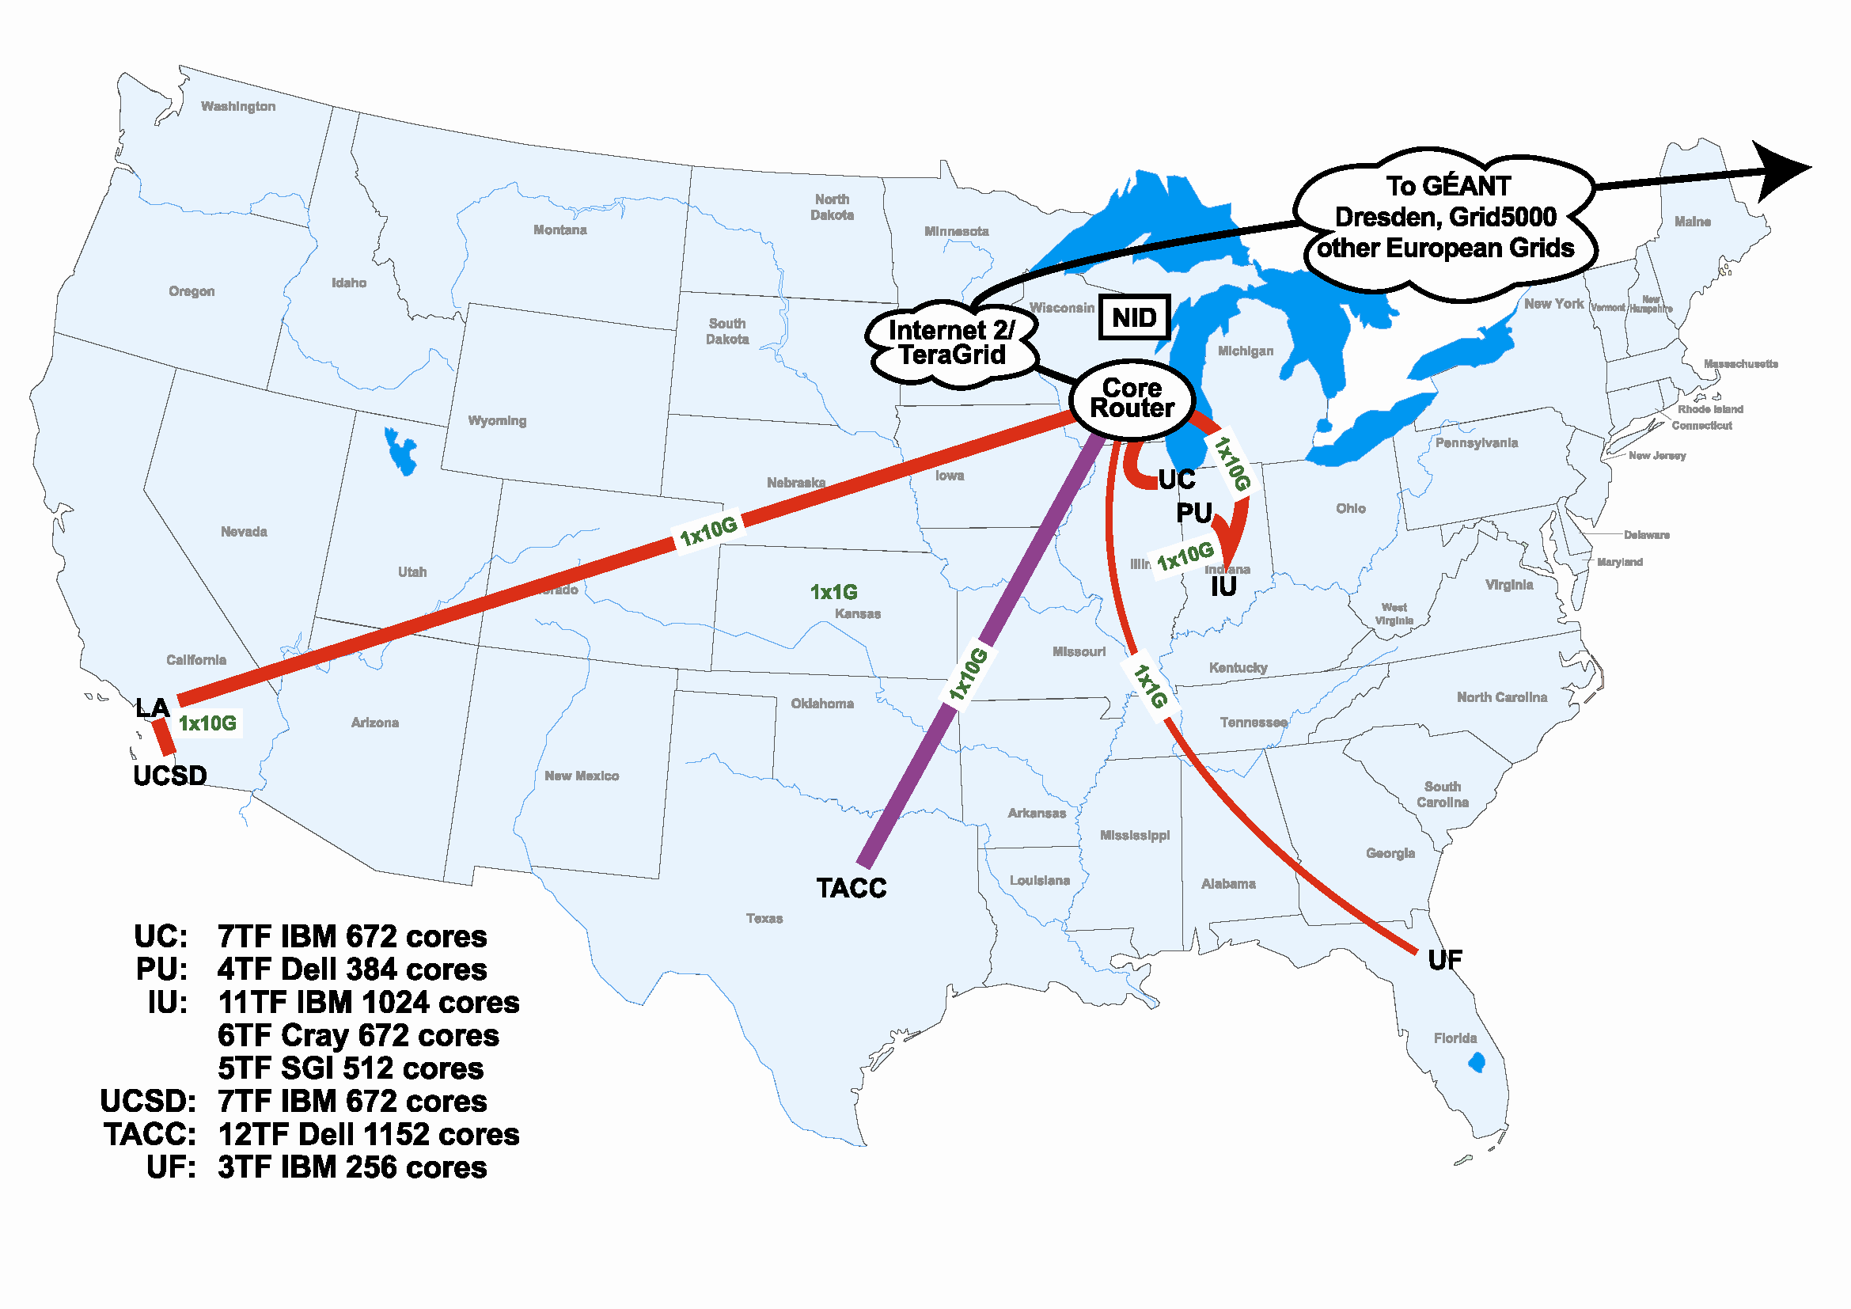
FutureGrid Hardware
http://futuregrid.org

Slide 5
Backup

Slide 6
Storage Hardware
System Type | Capacity (TB) | File System | Site | Status
DDN 9550 (Data Capacitor) | 339 | Lustre | IU | Existing System
DDN 6620 | 120 | GPFS | UC | New System
SunFire x4170 | 72 | Lustre/PVFS | SDSC | New System
Dell MD3000 | 30 | NFS | TACC | New System
FutureGrid has dedicated network (except to TACC) and a network fault and delay generator
Can isolate experiments on request; IU runs Network for NLR/Internet2
Additional partner machines could run FutureGrid software and be supported (but allocated in specialized ways)

Slide 7
Network Impairments Device
Spirent XGEM Network Impairments Simulator for jitter, errors, delay, etc
Full Bidirectional 10G w/64 byte packets
up to 15 seconds introduced delay (in 16ns increments)
0-100% introduced packet loss in .0001% increments
Packet manipulation in first 2000 bytes
up to 16k frame size
TCL for scripting, HTML for human configuration

Slide 8
Compute Hardware
System type | # CPUs | # Cores | TFLOPS | Total RAM (GB) | Secondary Storage (TB) | Site | Status
Dynamically configurable systems
IBM iDataPlex | 256 | 1024 | 11 | 3072 | 339* | IU | New System
Dell PowerEdge | 192 | 1152 | 8 | 1152 | 15 | TACC | New System
IBM iDataPlex | 168 | 672 | 7 | 2016 | 120 | UC | New System
IBM iDataPlex | 168 | 672 | 7 | 2688 | 72 | SDSC | Existing System
Subtotal | 784 | 3520 | 33 | 8928 | 546
Systems possibly not dynamically configurable
Cray XT5m | 168 | 672 | 6 | 1344 | 339* | IU | New System
Shared memory system TBD | 40 | 480 | 4 | 640 | 339* | IU | New System 4Q2010
Cell BE Cluster | 4 | 80 | 1 | 64 |  | IU | Existing System
IBM iDataPlex | 64 | 256 | 2 | 768 | 1 | UF | New System
High Throughput Cluster | 192 | 384 | 4 | 192 |  | PU | Existing System
Subtotal | 468 | 1872 | 17 | 3008 | 1
Total | 1252 | 5392 | 50 | 11936 | 547

Slide 9
Storage Hardware
System Type | Capacity (TB) | File System | Site | Status
DDN 9550 (Data Capacitor) | 339 | Lustre | IU | Existing System
DDN 6620 | 120 | GPFS | UC | New System
SunFire x4170 | 72 | Lustre/PVFS | SDSC | New System
Dell MD3000 | 30 | NFS | TACC | New System
FutureGrid has dedicated network (except to TACC) and a network fault and delay generator
Can isolate experiments on request; IU runs Network for NLR/Internet2
Additional partner machines could run FutureGrid software and be supported (but allocated in specialized ways)

Slide 10
Network Impairments Device
Spirent XGEM Network Impairments Simulator for jitter, errors, delay, etc
Full Bidirectional 10G w/64 byte packets
up to 15 seconds introduced delay (in 16ns increments)
0-100% introduced packet loss in .0001% increments
Packet manipulation in first 2000 bytes
up to 16k frame size
TCL for scripting, HTML for human configuration

Slide 11
FutureGrid Partners
Indiana University (Architecture, core software, Support)
Purdue University (HTC Hardware)
San Diego Supercomputer Center at University of California San Diego (INCA, Monitoring)
University of Chicago/Argonne National Labs (Nimbus)
University of Florida (ViNE, Education and Outreach)
University of Southern California Information Sciences Institute (Pegasus to manage experiments)
University of Tennessee Knoxville (Benchmarking)
University of Texas at Austin/Texas Advanced Computing Center (Portal)
University of Virginia (OGF, Advisory Board and allocation)
Center for Information Services and GWT-TUD from Technische Universtität Dresden Germany. (VAMPIR)
Blue institutions have FutureGrid hardware

Slide 12
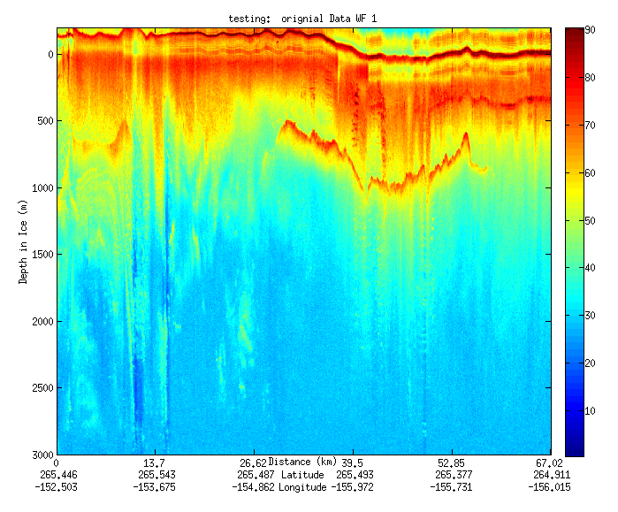
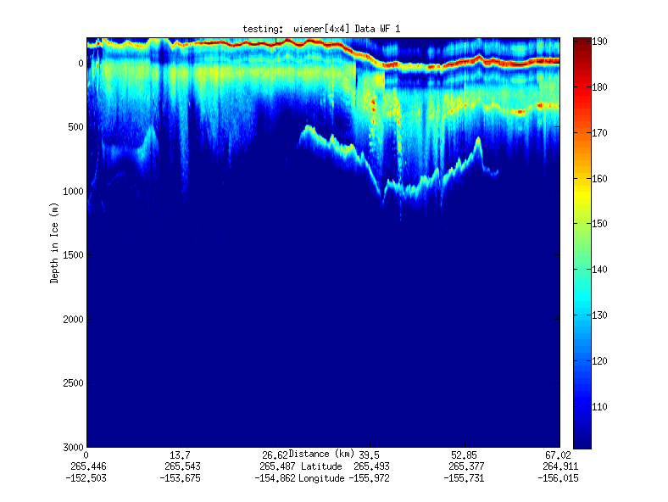
Geospatial Examples on Cloud Infrastructure
Image processing and mining
SAR Images from Polar Grid (Matlab)
Apply to 20 TB of data
Could use MapReduce
Flood modeling
Chaining flood models over a geographic area.
Parameter fits and inversion problems.
Deploy Services on Clouds – current models do not need parallelism
Real time GPS processing (QuakeSim)
Services and Brokers (publish subscribe Sensor Aggregators) on clouds
Performance issues not critical
Filter

Slide 13
Changing resolution of GIS Clustering
Total
Asian
Hispanic
Renters
GIS Clustering
30 Clusters
30 Clusters
10 Clusters
Notes:
Same display as last slide but using Google Earth
This shows the clusters for 4 population types available in raw census data
Total
Asian
Hispanic
Renters
It has on right 10 clusters shown as black dots for total. Scale is bottom right
Left is 30 clusters with scale on left edge
These maps overlay a density map of census data converting Shape files from US Census to Google KML
This used Shape2Earth program

Slide 14
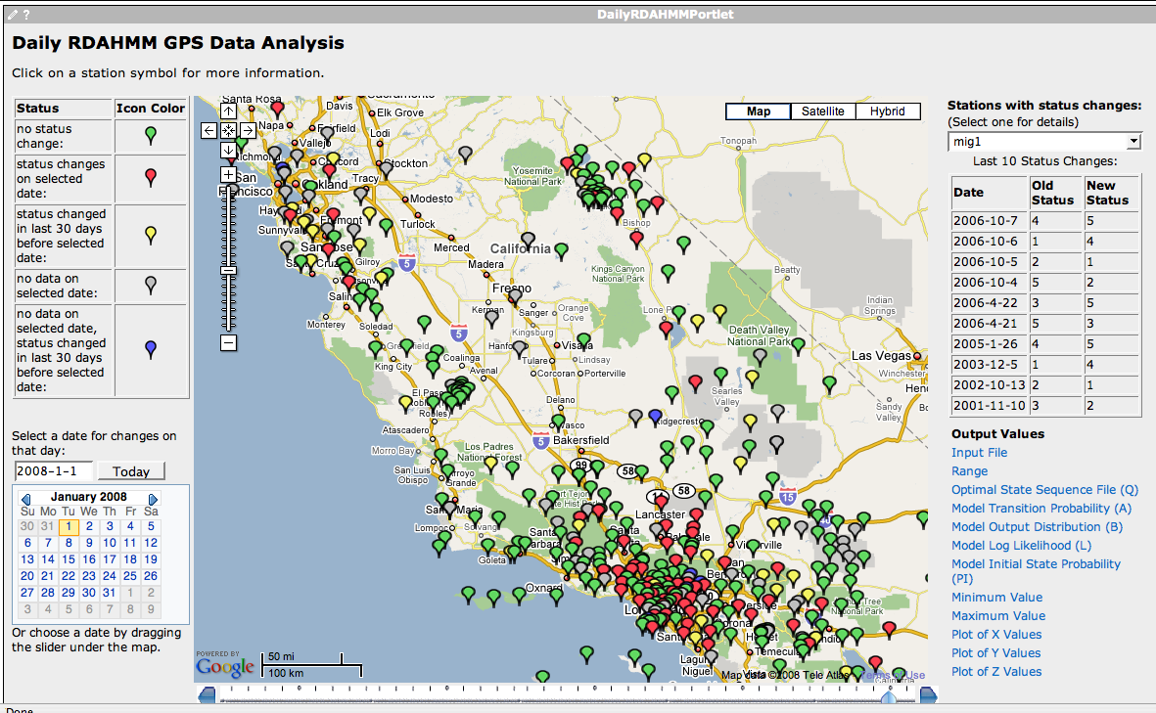
Daily RDAHMM Updates
Daily analysis and
event classification
of GPS data from
REASoN’s GRWS.

