Slide 1
Introduction to Programming Paradigms Activity at Data Intensive Workshop
Shantenu Jha represented by
Geoffrey Fox
gcf@indiana.edu
http://www.infomall.org http://www.futuregrid.org
http://salsahpc.indiana.edu/
Director, Digital Science Center, Pervasive Technology Institute
Associate Dean for Research and Graduate Studies, School of Informatics and Computing
Indiana University Bloomington

Slide 2
Programming Paradigms for Data-Intensive Science: DIR Cross-Cutting Theme
No special/specific set speaker for this cross-cutting theme
  Other than Introduction (this) and Wrap-Up (Fri)
  No formal theoretical framework
Challenge is to understand through presentations/discussions:
  High-level Questions (next slides)
  In general: How data-intensive analysis, simulations are programmatically addressed (i.e. how implemented)?
  Specifically: Understand which approaches were employed and why?
    Which programming approaches work? Which don’t, e.g., X could have been used but wasn’t as it was out of fashion
Programming Paradigms includes languages and perhaps more importantly run-time as only with a great run-time can you support a great language

Slide 3
Programming Paradigms for Data-Intensive Science: High-level Questions
Several recent advances towards programmatically addressing data-intensive applications requirements, e.g., Dataflow, Workflow, Mash-up, Dryad, MapReduce, Sawzall, Pig (higher level MapReduce), etc
Survey of Existing and Emerging Programming Paradigms.
  Advantages & Applicability of different programming approaches?
  e.g. workflow tackles functional parallelism; MapReduce/MPI data parallelism?
A mapping between application requirements and existing programming approaches:
  What is missing? How can these be met?
  Which programming approaches are widely used? Which aren’t?
  Is it clear what difficulties are we are trying to solve?
  Ease of programming, performance (real-time latency, CPU use), fault tolerance, ease of implementation on dynamic distributed resources.
  Do we need classic parallel computing or just pleasing parallel/MapReduce (cf. parallel R in Research Village)?
Many approaches are tied to a specific data model (e.g., Hadoop with HDFS).
  Is this lack of interoperability and extensibility a limitation and can it be overcome?
  Or does it reflect how applications are developed i.e. that previous programming models tied compute to memory, not to file/database (? MPI-IO)

Slide 4
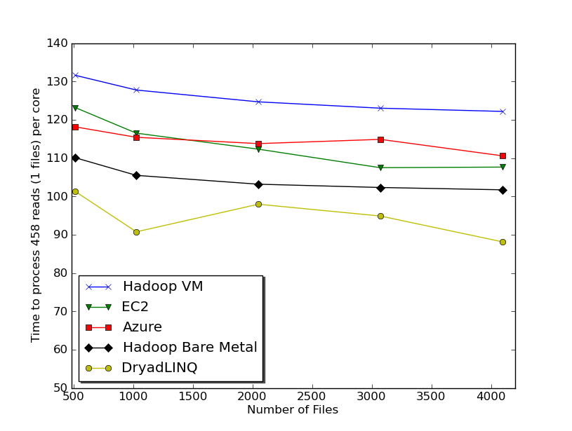

Slide 5
Dryad versus MPI for Smith Waterman
Flat is perfect scaling

Slide 6






MapReduce “File/Data Repository” Parallelism
Map = (data parallel) computation reading and writing data
Reduce = Collective/Consolidation phase e.g. forming multiple global sums as in histogram
Instruments
Iterative MapReduce
Map Map Map Map
Reduce Reduce Reduce
Communication
Reduce
Portals
/Users
Disks
Map₁
Map₂
Map₃

Slide 7

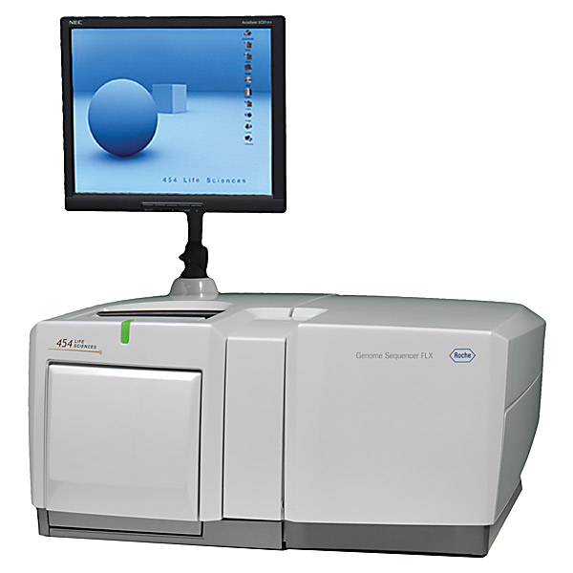
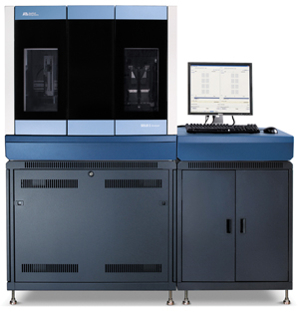
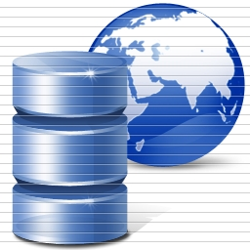
DNA Sequencing Pipeline
Illumina/Solexa Roche/454 Life Sciences Applied Biosystems/SOLiD
Internet
~300 million base pairs per day leading to
~3000 sequences per day per instrument
? 500 instruments at ~0.5M$ each
Read Alignment
Pairwise
clustering
Form block
Pairings
Sequence
alignment
Dissimilarity
Matrix
N(N-1)/2 values
Visualization
Plotviz
FASTA File
N Sequences
Blocking
MPI
MDS
MapReduce

Slide 8
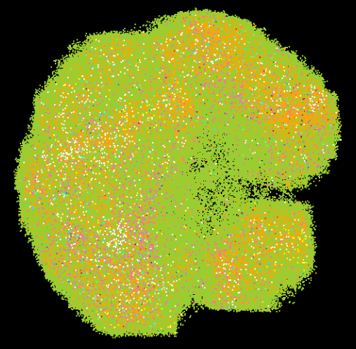

Cheminformatics/Biology MDS and Clustering Results
Generative Topographic Mapping
GTM for 930k genes and diseases
Map 166 dimensional PubChem data to 3D to allow browsing. Genes (green color) and diseases (others) are plotted in 3D space, aiming at finding cause-and-effect relationships.
Currently parallel R. For 60M PubChem full data set will implement in C++
Metagenomics
This visualizes results fromdimension reduction to 3D of 30000 gene sequences from an environmental sample. The many different genes are classified by clustering algorithm and visualized by MDS dimension reduction

Slide 9
Application Classes
(Parallel software/hardware in terms of 5 “Application architecture” Structures)
1 | Synchronous | Lockstep Operation as in SIMD architectures
2 | Loosely Synchronous | Iterative Compute-Communication stages with independent compute (map) operations for each CPU. Heart of most MPI jobs
3 | Asynchronous | Compute Chess; Combinatorial Search often supported by dynamic threads
4 | Pleasingly Parallel | Each component independent – in 1988, Fox estimated at 20% of total number of applications | Grids
5 | Metaproblems | Coarse grain (asynchronous) combinations of classes 1)-4). The preserve of workflow. | Grids
6 | MapReduce++ | It describes file(database) to file(database) operations which has three subcategories. Pleasingly Parallel Map Only Map followed by reductions Iterative “Map followed by reductions” – Extension of Current Technologies that supports much linear algebra and datamining | Clouds
Notes:
CGL-MapReduce is an example of MapReduce++ -- supports MapReduce model with iteration (data stays in memory and communication via streams not files)

Slide 10
Applications & Different Interconnection Patterns
Map Only | Classic MapReduce | Iterative Reductions Twister | Loosely Synchronous
CAP3 Analysis Document conversion (PDF -> HTML) Brute force searches in cryptography Parametric sweeps | High Energy Physics (HEP) Histograms SWG gene alignment Distributed search Distributed sorting Information retrieval | Expectation maximization algorithms Clustering Linear Algebra | Many MPI scientific applications utilizing wide variety of communication constructs including local interactions
- CAP3 Gene Assembly - PolarGrid Matlab data analysis | - Information Retrieval - HEP Data Analysis - Calculation of Pairwise Distances for ALU Sequences | Kmeans Deterministic Annealing Clustering - Multidimensional Scaling MDS | - Solving Differential Equations and - particle dynamics with short range forces
http://www.iterative
mapreduce.org/
Input
iterations
Input
Input
map
map
map
Pij
reduce
Output
reduce
cf. Szalay comment on need for multi-resolution algorithms with dynamic stopping
Domain of MapReduce and Iterative Extensions
MPI

Slide 11
Programming Paradigms for Data-Intensive Science: DIR Cross-Cutting Theme
Tuesday: Roger Barga (Microsoft Research) on Emerging Trends and Converging Technologies in Data Intensive Scalable Computing [Will partially cover Dryad] Cancelled
Thursday: Joel Saltz (Medical image process & CaBIG) [workflow approaches]
Monday: Xavier Llora (Experience with Meandre)
Wednesday Afternoon Break Out: The aim of this session will be to take a mid-workshop stock of how the exchanges, discussions and proceedings so far, have influenced our perception of Programming Paradigms for data-intensive research. Many of the issues laid out in this opening talk (on Programming Paradigms) will be revisited.
Friday Morning: The future of languages for DIR (Shantenu Jha)
Hopefully elements and insights into answers to High-level Questions (slide 3) addressed in many talks including
  Alex Szalay (JHU) Strategies for exploiting large data;
  Thore Graepel (Microsoft Research) on Analyzing large-scale complex data streams from online services;
  Chris Williams (University of Edinburgh) on The complexity dimension in data analysis; and
  Andrew McCallum (University of Massachusetts Amherst) on "Discovering patterns in text and relational data with Bayesian latent-variable models.

