Slide 1
XSEDE TAS
Scientific Impact and FutureGrid Lessons
Presentation: Improving the Link Between Publications & User Facilities, ORNL, Thursday, Jan-9-2013, more than 12 participants
Teleconference, Organizer Terry Jones, ORNL
Gregor von Laszewski (IU), Fugang Wang (IU), Geoffrey C. Fox
laszewski@gmail.com
Steve Gallo (UB) & Tom Furlani (UB)

Slide 2
Agenda
Objective
Approach
How did we obtain data
The metrics derived
Software system design and implementation
Results
Future plan and discussions

Slide 3
Objective
Provide information to the funding agency and the XSEDE management about scientific impact of research conducted with XSEDE resources
Assist in collecting the information semi-automatically.
It seems objective may be similar for DOE …
Provide information to the funding agency and the DOE management about scientific impact of research conducted with DOE resources
  Differences:
    We can federate based on publication requirements between DOE Labs, preprint databases
    Extends not only to publication but to possible datasets (NeXus, …)
    Resources are not just super computers, it could be a beamline, experiment setup, but also a data collection.

Slide 4
TAS Objective - Measurement
Measure the scientific impact of XSEDE as a single entity
  How many publications produced by XSEDE users/projects;
  How many citations to those publications received;
  Other metrics
Measure how the impact metrics of individual users, projects, field of science, resources, etc. compare to each other
  When evaluating a proposal request, what is the criteria to judge whether the proposal is potentially leading to good research and broader impact, and how to get metrics to back up this?
  When correlating the impact metrics to the resources allocated (or consumed), how does one project or fos compare to the peers?

Slide 5
FutureGrid Objective - Collection
Assist in collecting results as part of the user management.
Simplify the input of publication data.
Allow a wide variety of input formats.
Problem:
  Users have lots of other things to do and avoid reporting.
  Users affiliation may change and reports are incomplete.

Slide 6
Approach
Get the relevant publication and citation data
  All publications authored by XSEDE users
    Google; Microsoft Academic Search; ISI; NSF award search data
  Publications that are identified as related to XSEDE (as a result of using XSEDE resources)
    User uploaded publications via XSEDE portal
Using the publication and citation data to derive metrics for scientific output impact
Notes:
Publication and citation data for each individual XD user are the raw data to be used to derive various metrics.
Automated way vs user provided data. The former is to evaluate the researchers’ impact in general; the latter to get XD related publications, and then to get XD related impact metrics.

Slide 7
Data Acquisition
Publication data:
Automatic approach
  Mining the NSF award search data provided by NSF;
  Utilizing services from Google Scholar, Microsoft Academic Search, etc.;
  Mashup data from different sources;
Requiring user input
  FG portal has pioneered a means for users to upload their publication data
  XD portal now also provides a means for users to upload their publication data. However currently the data gathered is very limited.
    We offer service interface to the XD portal exposing the publication data we obtained so users could have an easier way to populate and confirm the publication data (XSEDE portal team is developing the UI to integrate this service).
  Users provide their public profile id in a 3rd party online biblio management system like Google Scholar, and we then do the automatic retrieval;
Citation data:
From Google Scholar,
From ISI Web of Science.
Notes:
Automatic approach – to get the ‘in general’ metrics indicating individual researcher’s achievement.
User provided data – a) via XD portal, XD related publications to compute XD related metrics. The data is very limited since the biblio upload is an optional but not required, and users typically don’t feel motivated to do that. While getting more such data, the XD related metrics would be increasing significantly.
User provided data – b) Based on Google scholar profile id to retrieve the publication list has been done in the proof of concept work. So if the users are providing such information via the XD portal or via POPS as part of the allocation request process, we can try this approach to automatically get user vetted publications list.
Citation data via Google Scholar seems working fine, although quite slowly. In the future this process might be kept running to find citation for new publications; or updating the old data if all completed.

Slide 8
Metrics
Intuitive Metrics: Number of publications, Number of citations
H-index
  Derived based on productivity (quantity of papers published) and impact (based on citation)
  h as the number of papers with citation number higher or equal to h
  Proposed by J. E. Hirsch on 2005
    http://www.pnas.org/content/102/46/16569
  H-index(m) to compare veteran researchers with junior researchers
G-index
  Similar to h-index but it uses average citations so you got rewarded if you have a paper with very high citations
  Proposed by Leo Egghe on 2006
    http://link.springer.com/article/10.1007%2Fs11192-006-0144-7
Other Metrics – i10-index (number of publications with at least 10 citations)
Does a researcher keep up with the good research he/she usually does more recently – Metrics from only recent publications (last 5 years)
Notes:
The metrics currently defined; and the ‘recent’ versions for all of them.

Slide 9
Software Design and Implementation
Pluggable data sources via mining databases and/or accessing 3rd party service APIs
Mashup database providing common interface to collaborating systems like XDMOD
Service layer and web presentation
The core system code base is in python.
  Would allow integration with LDAP, DOE certs, OpenID, …
Uses REST framework for the service interface and Web GUI
MySQL is the currently adopted database solution but we will be using NoSQL alternatives where appropriate.
Notes:
The 3 highlighted points of the architecture view.
Currently the framework is implemented like this, while we haven’t tried all the items mentioned in the 3rd party layer yet.

Slide 10
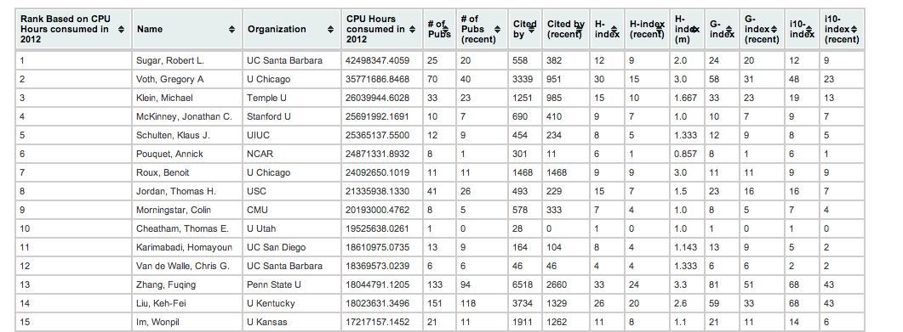
Results – Impact in general
Obtained 122k publication entries for all XSEDE users
  from the Nov 2012 NSF award search data
Citation data from Google Scholar and metrics based on that available for all XD PIs active (based on XD resource usage) in 2012 (1469 in total).
  This accounts for 27.8% of all publications collected, or ~34k out of ~122k.
As an alternative, finished citation count data retrieval from ISI Web of Science for all the publications.
Data Source Disclaimer:
The NSF award search data through October 2012
The citation data were obtained from Google Scholar.
The user information were obtained from XDcDB.
The usage data were obtained from XDMOD
Notes:
Publication data are based on all the data we have – the mashup data including the NSF data and the XD portal data.
Since the major portion of the data are from NSF award search, an in that source most authors have incomplete author names (last name, first initial e.g.) so the metrics could appear higher than it should be for some users with common names.

Slide 11
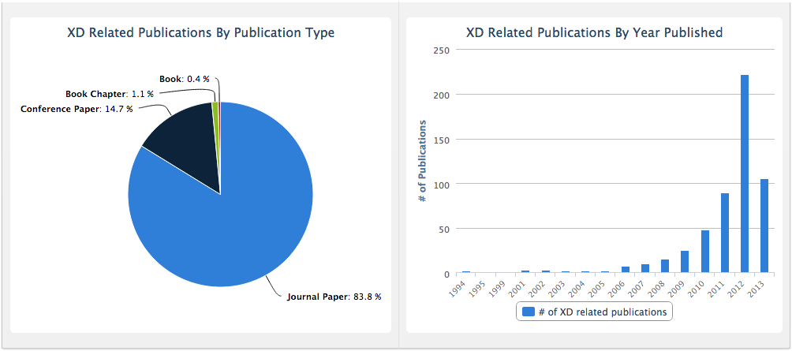
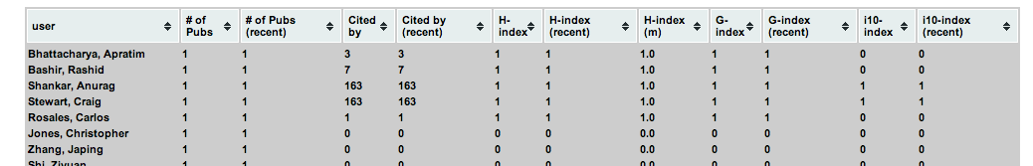
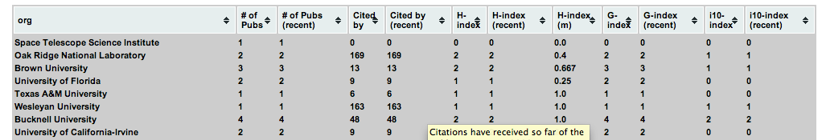
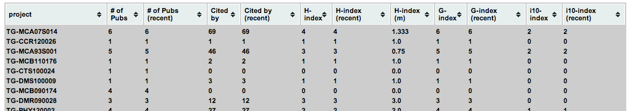
Results – Impact XD related only
XD users: 830
Organizations: 212
XSEDE projects: 290
Number of publications: 757
Total citations received from these publications: 10802
(User reported publications via XD portal, as of Dec 16, 2013)
Notes:
Based on all user uploaded publications. Citation data are from Google Scholar.
How to motivate more users to upload their publications, and also upload the complete list of publications.

Slide 12
Results – Impact metrics vs XD allocations
Limited correlation observed between allocations vs metrics (npubs, ncited, hindex) on individual project level
Correlation on Field of Science (FOS)
  R²: 0.55
  Dot/circle size proportional to number of projects in that FOS (size)
  It suggests that FOS size contributes to the linear relationship
  Allocation distribution is lognormal alike when using average per project within each FOS
  http://fgdev.pti.indiana.edu:8088/fosvsalloc
Dataset to small?

Slide 13
Achievements
Constructed a UNIQUE mashup database containing the consolidated data.
  Mined NSF award search data and retrieved publications for all XD users (122k).
  Fetching citation data for some publications via Google Scholar (~30% done).
  Fetched citation data for all publications via ISI Web of Science.
  Fetched publication data from XDcDB (757 entries as of Dec 16 2013)
Defined and calculated metrics (# of pubs; # of citations; h-index; and g-index; etc.) for a portion of users as a proof of concept
  Impact in general – Completed for all PIs who had active usage in 2012.
  XD Related – Based on all currently available user uploaded publications (757 of them as of Dec 2013)
Data is presented via the REST service framework.
  http://fgdev.pti.indiana.edu:8088/xdportalpub/
  planned to be integrated within XDMOD framework
Conducted correlation analyses of the metrics vs. the allocation for users, projects, and Field of Science.

Slide 14
Ongoing work
Visualization of the complex connections
  Users/authors; projects; fos; etc.
Insight when correlating our collected data to other data sources (e.g., some data from our collaborator at Clemson)
Name ambiguity as a challenge when trying to utilize individual level general impact data
  Social networks, …

Slide 15
Can we adapt it for DOE? Yes.
REST service
  Independent UI
  Simple UI provided as prototype by IU
User Management
  DOE certs, openID, registration process of users at beamlines
We could support more than Publications
  Data sets, Experiments, NeXus, …
  Full text search required …
Integration with DOE publication departments at the Labs

Slide 16
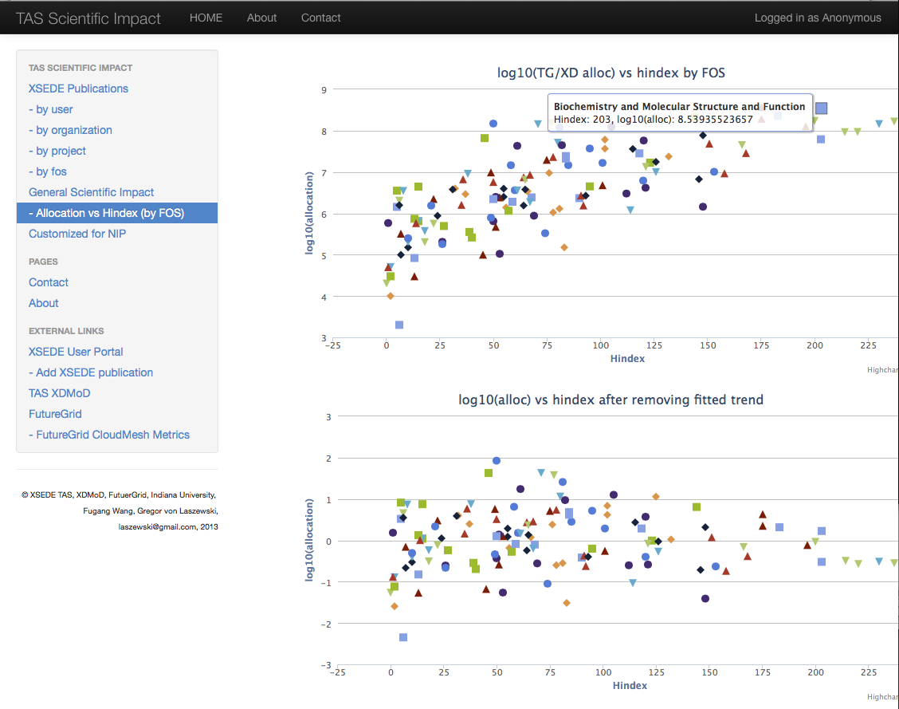
Screenshoots

Slide 17
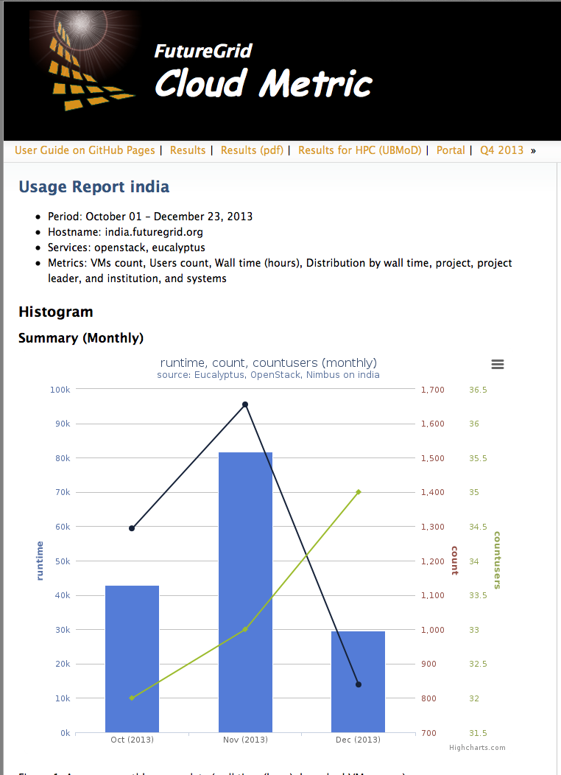
Cloud Metric
Runtime data
What do users/projects do on current system
Will be coupled with Impact metrics to give system staff hints about users

