Slide 1
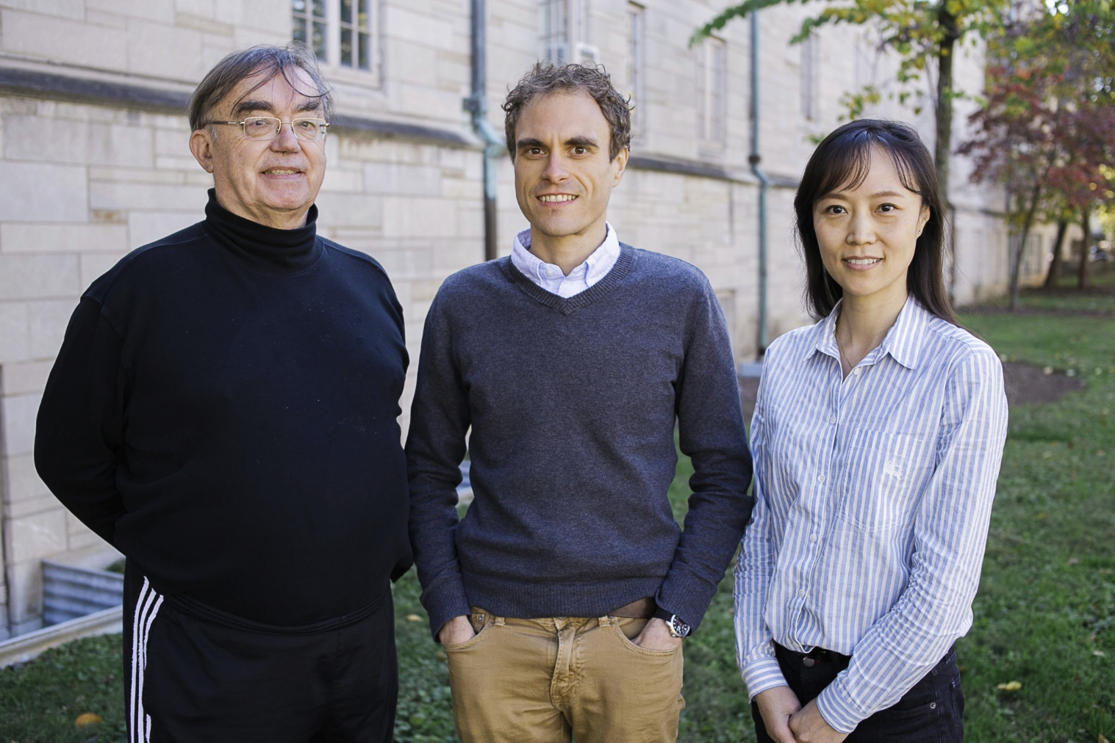
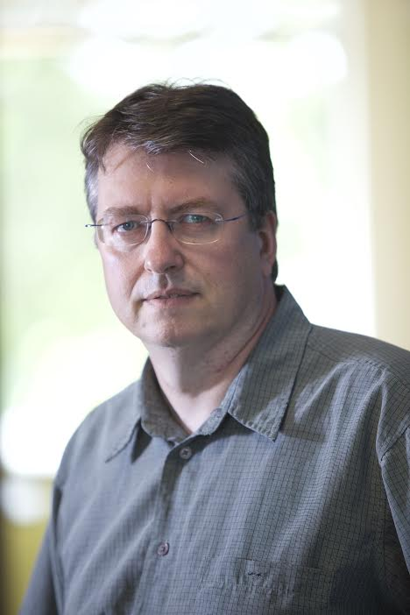
Data Science at
Digital Science Center
Indiana University Faculty
Geoffrey Fox, David Crandall, Judy Qiu, Gregor von Laszewski

Slide 2
Work on Applications Algorithms Systems Software
Biology/Bioinformatics
Computational Finance
Network Science and Epidemiology
Analysis of Biomolecular Simulations
Analysis of Remote Sensing Data
Computer Vision
Pathology Images
Real time robot data
Parallel Algorithms and Software
  Deep Learning
  Clustering
  Dimension Reduction
  Image Analysis
  Graph

Slide 3
Digital Science Center Research Areas
Digital Science Center Facilities
RaPyDLI Deep Learning Environment
SPIDAL Scalable Data Analytics Library
MIDAS Big Data Software
Big Data and HPC Convergence Diamonds Application Classification and Benchmarks
CloudIOT Internet of Things Environment
Cloudmesh Cloud and Bare metal Automation
XSEDE TAS Monitoring citations and system metrics
Data Science Education with MOOC’s

Slide 4
DSC Computing Systems
128 node Haswell based system (Juliet)
  128 GB memory per node
  Substantial conventional disk per node (8TB) plus PCI based SSD
  Infiniband with SR-IOV
  24 and 36 core nodes (3456 total cores)
Working with SDSC on NSF XSEDE Comet System (Haswell 47,776 cores)
Older machines
  India (128 nodes, 1024 cores), Bravo (16 nodes, 128 cores), Delta(16 nodes, 192 cores), Echo(16 nodes, 192 cores), Tempest (32 nodes, 768 cores) with large memory, large disk and GPU
Optimized for Cloud research and Large scale Data analytics exploring storage models, algorithms
Build technology to support high performance virtual clusters

Slide 5
Cloudmesh Software Defined System Toolkit
Cloudmesh Open source http://cloudmesh.github.io/ supporting
  The ability to federate a number of resources from academia and industry. This includes existing FutureSystems infrastructure, Amazon Web Services, Azure, HP Cloud, Karlsruhe using several IaaS frameworks
  IPython-based workflow as an interoperable onramp
Supports reproducible computing environments
Uses internally Libcloud and Cobbler
Celery Task/Query manager (AMQP - RabbitMQ)
MongoDB
Gregor von Laszewski
Fugang Wang
Notes:
Due to its integrated services Cloudmesh provides the ability to be an onramp for other clouds.
It provides information services to various system level sensors to give access to sensor and utilization data. Internally, it can be used to optimize the system usage.
The provisioning experience from FutureGrid has taught us that we need to provide
the creation of new clouds (rain)
the repartitioning of resources between services (cloud shifting)
and the integration of external cloud resources in case of over provisioning (cloud bursting)
As we deal with many IaaS frameworks, we need an abstraction layer on top of the IaaS framework.
Experiment management is conducted with workflows controlled in shells, Python/iPython, as well as systems such as OpenStack's Heat.
Accounting is supported through additional services such as user management and charge rate management.
Not all features are yet implemented. Figure shows the main functionality that we target at this time to implement.

Slide 6
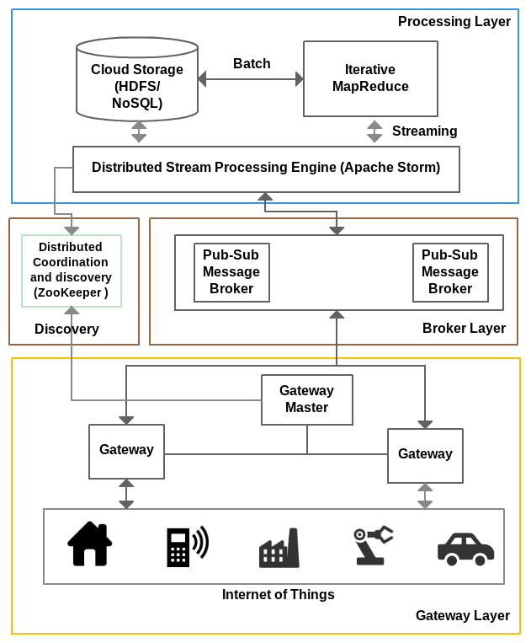
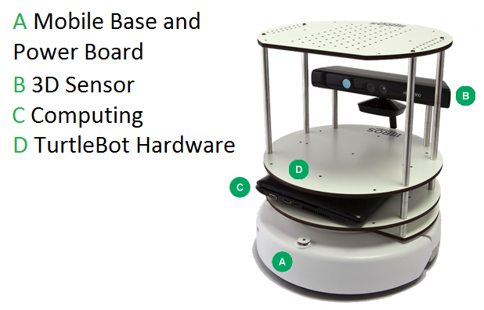
IOTCloud
Device → Pub-Sub→Storm → Datastore → Data Analysis
Apache Storm provides scalable distributed system for processing data streams coming from devices in real time.
For example Storm layer can decide to store the data in cloud storage for further analysis or to send control data back to the devices
Evaluating Pub-Sub Systems ActiveMQ, RabbitMQ, Kafka, Kestrel
Turtlebot and Kinect

Slide 7
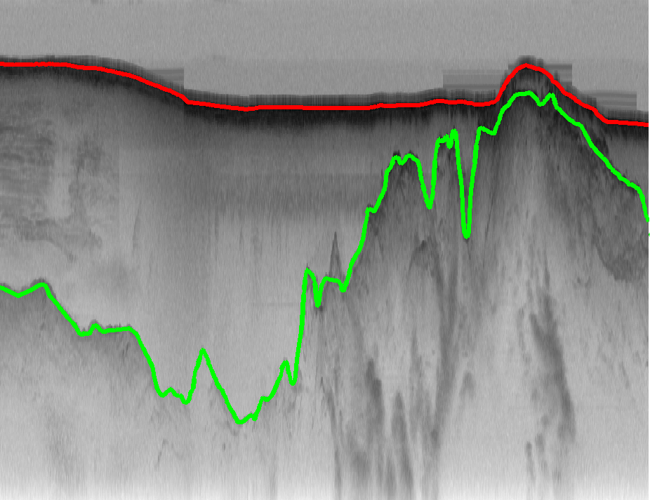
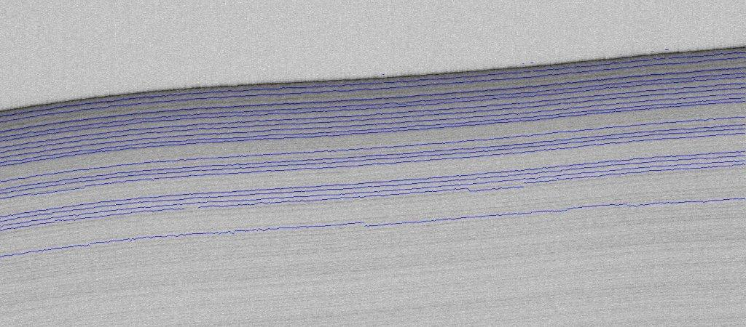
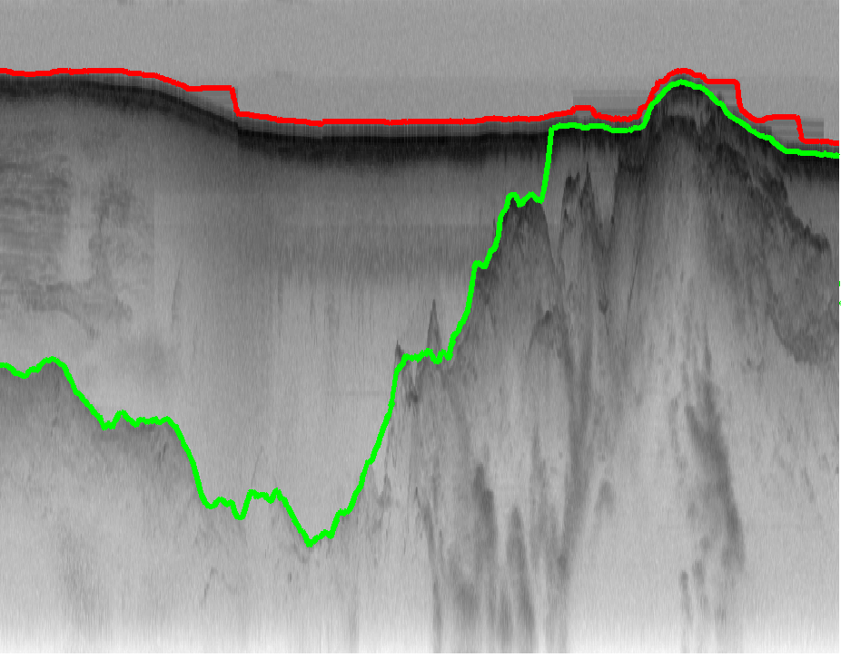
Ground Truth Glacier Beds
Snow Radar
Lee 2015
Crandall 2012

Slide 8
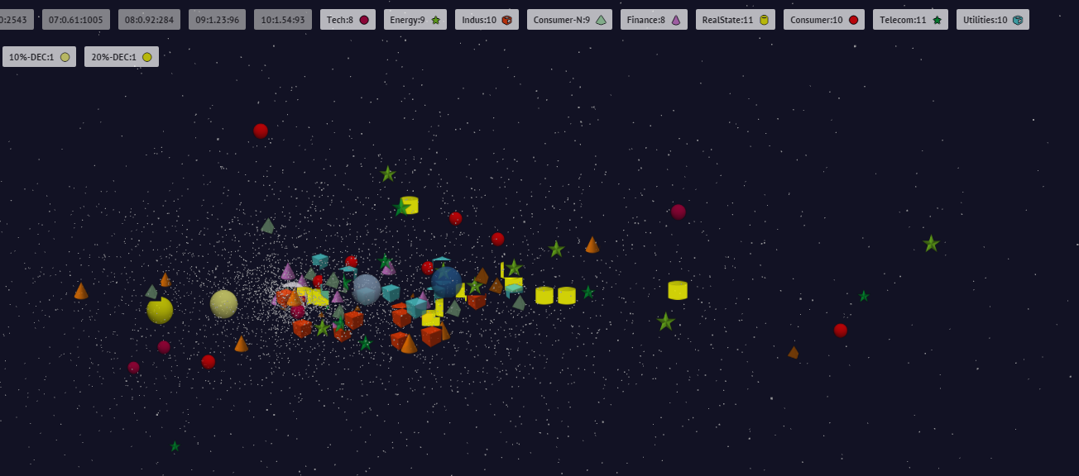
10 year US Stock daily price time series mapped to 3D (work in progress)
3400 stocks
Sector Groupings
up
One year 2004 Velocities or Positions

Slide 9
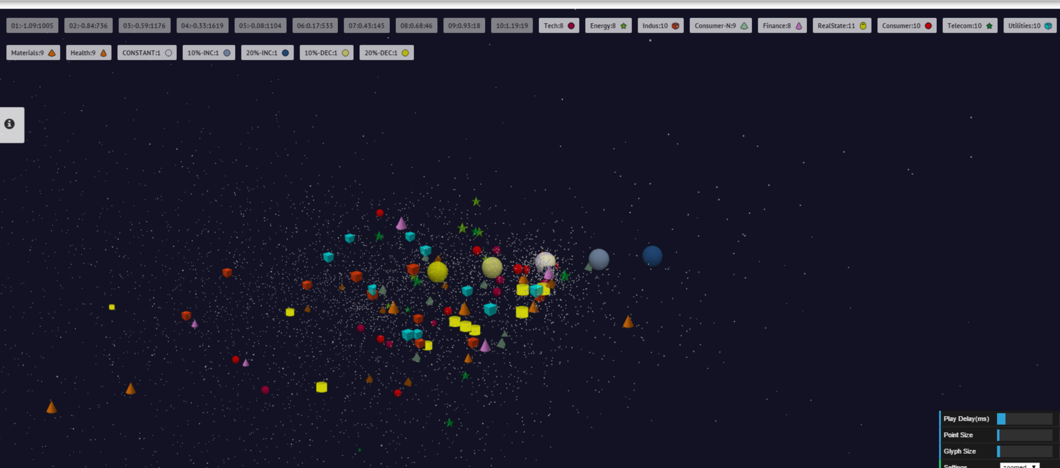
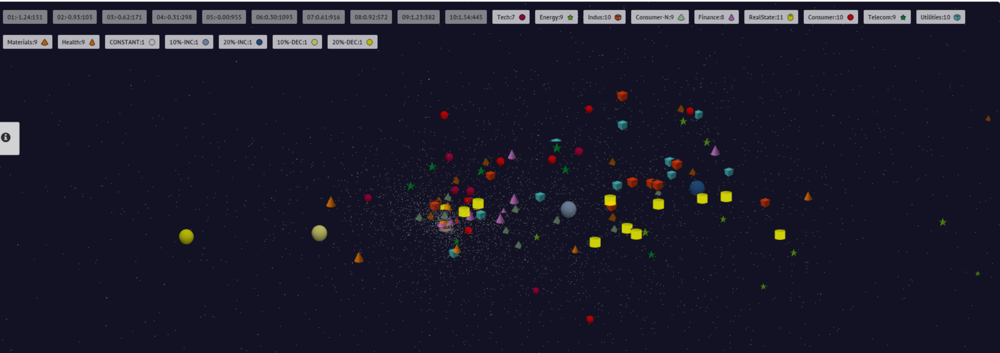
End 2008 Positions
July 21 2007 Positions

Slide 10
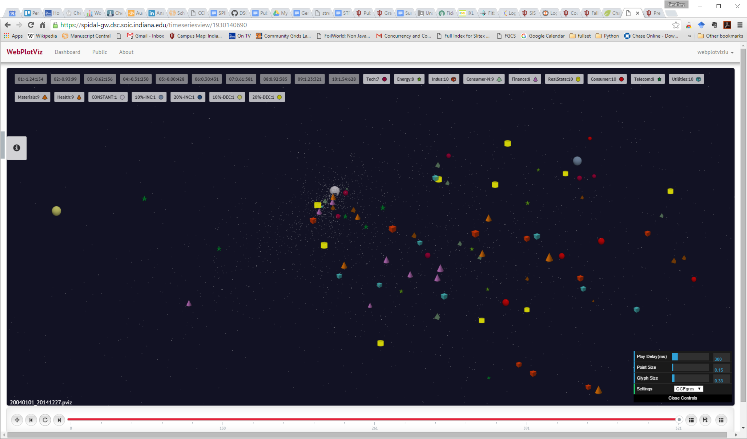
End of 2014 Positions

Slide 11
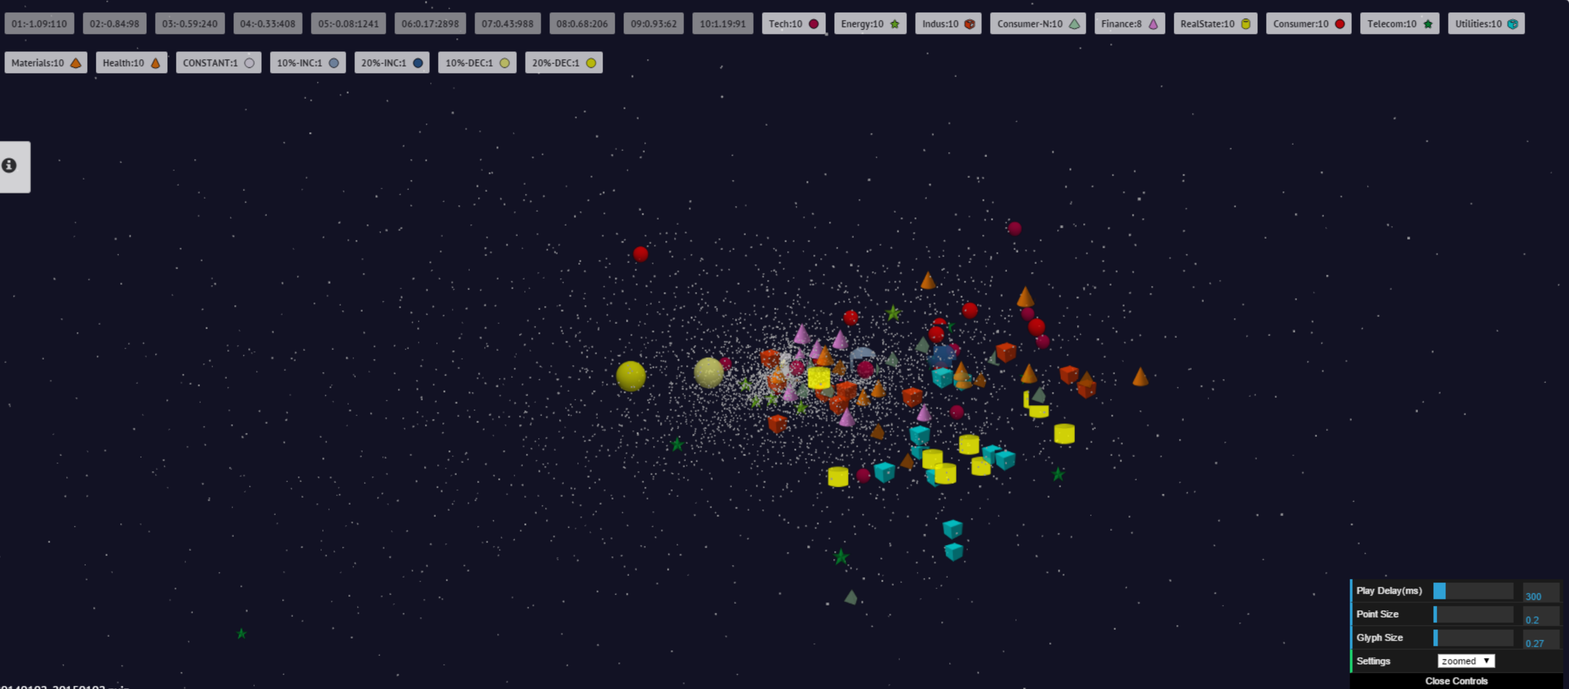
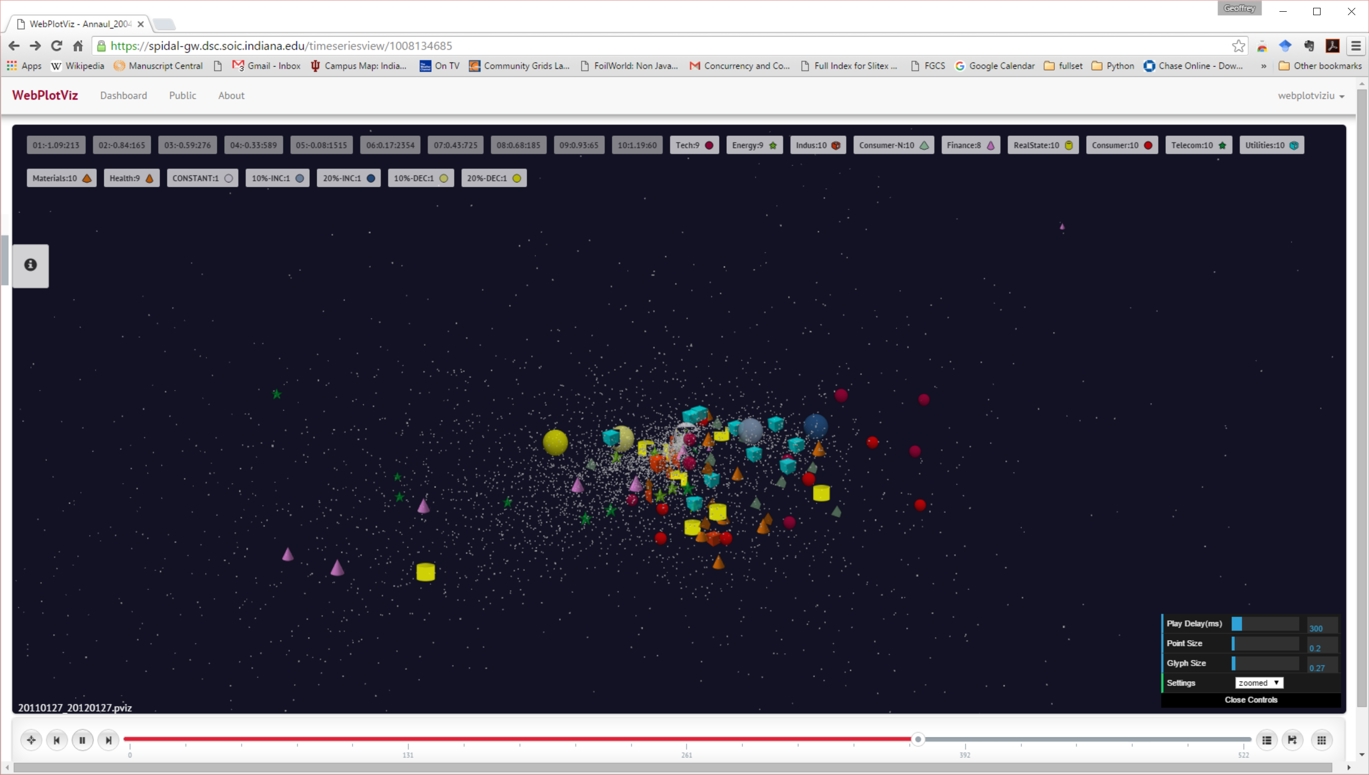
Jan 1 2015 velocities
Jan 27 2012 velocities

Slide 12

Protein Universe Browser for COG Sequences with a few illustrative biologically identified clusters

Slide 13
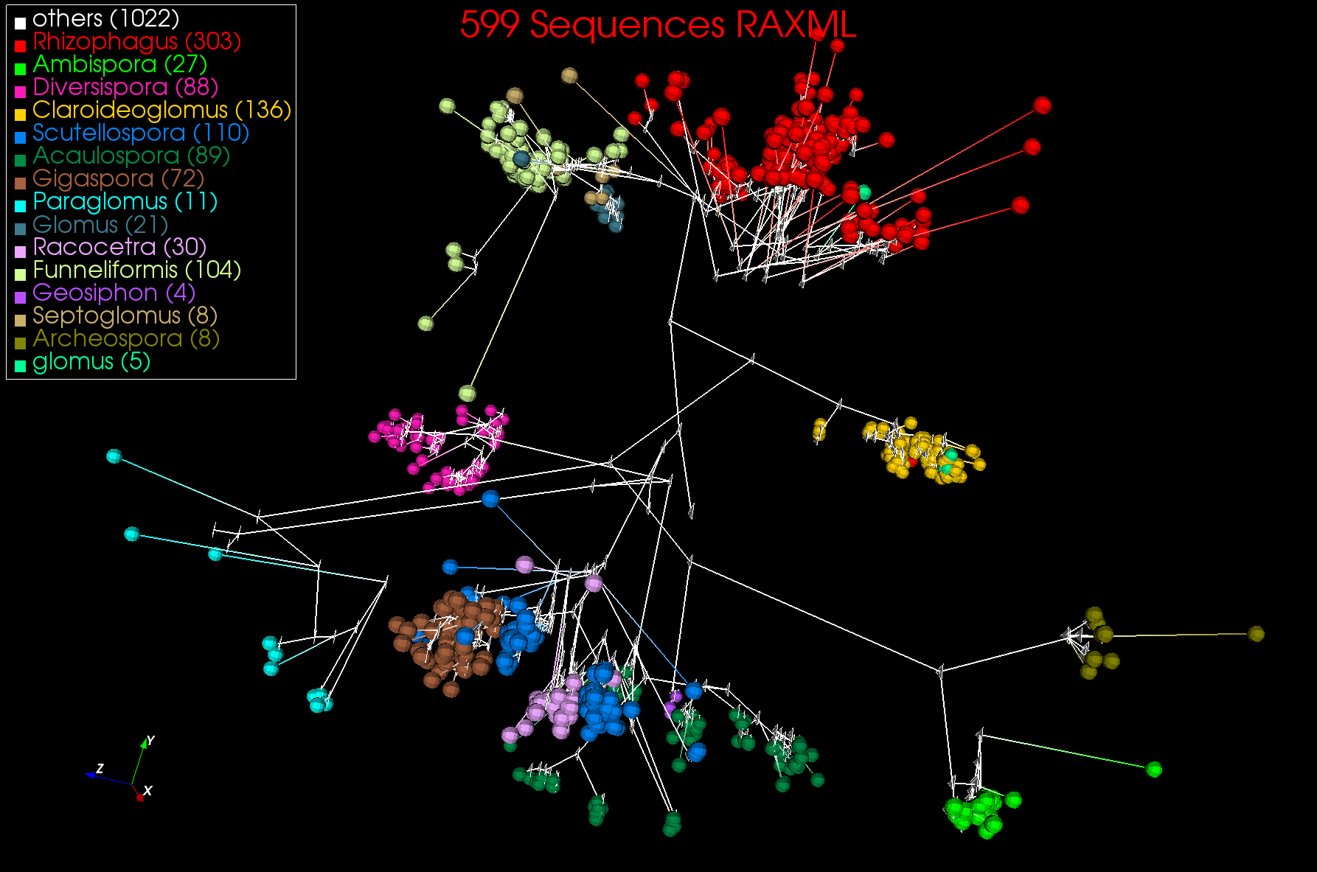
3D Phylogenetic Tree from WDA SMACOF

Slide 14
Big Data and (Exascale) Simulation Convergence I
Our approach to Convergence is built around two ideas that avoid addressing the hardware directly as with modern DevOps technology it isn’t hard to retarget applications between different hardware systems.
Rather we approach Convergence through applications and software. We break applications into data plus model and introduce 64 facets of Convergence Diamonds that describe both Big Simulation and Big Data applications and so allow one to more easily identify good approaches to implement Big Data and Exascale applications in a uniform fashion.
The software approach builds on the HPC-ABDS High Performance Computing enhanced Apache Big Data Software Stack concept (http://dsc.soic.indiana.edu/publications/HPC-ABDSDescribed_final.pdf, http://hpc-abds.org/kaleidoscope/ )
This arranges key HPC and ABDS software together in 21 layers showing where HPC and ABDS overlap. It for example, introduces a communication layer to allow ABDS runtime like Hadoop Storm Spark and Flink to use the richest high performance capabilities shared with MPI Generally it proposes how to use HPC and ABDS software together.
  Layered Architecture offers some protection to rapid ABDS technology change (for ABDS independent of HPC)

Slide 15
Big Data - Big Simulation (Exascale) Convergence
Lets distinguish Data and Model (e.g. machine learning analytics) in Big Data problems
Then in Big Data, typically Data is large but Model varies
  E.g. LDA with many topics or deep learning has large model
  Clustering or Dimension reduction can be quite small
Simulations can also be considered as Data and Model
  Model is solving particle dynamics or partial differential equations
  Data could be small when just boundary conditions or
  Data large with data assimilation (weather forecasting) or when data visualizations produced by simulation
In each case, Data often static between iterations (unless streaming), model varies between iterations

Slide 16
51 Detailed Use Cases: Contributed July-September 2013
Covers goals, data features such as 3 V’s, software, hardware
26 Features for each use case
Biased to science
http://bigdatawg.nist.gov/usecases.php
https://bigdatacoursespring2014.appspot.com/course (Section 5)
Government Operation(4): National Archives and Records Administration, Census Bureau
Commercial(8): Finance in Cloud, Cloud Backup, Mendeley (Citations), Netflix, Web Search, Digital Materials, Cargo shipping (as in UPS)
Defense(3): Sensors, Image surveillance, Situation Assessment
Healthcare and Life Sciences(10): Medical records, Graph and Probabilistic analysis, Pathology, Bioimaging, Genomics, Epidemiology, People Activity models, Biodiversity
Deep Learning and Social Media(6): Driving Car, Geolocate images/cameras, Twitter, Crowd Sourcing, Network Science, NIST benchmark datasets
The Ecosystem for Research(4): Metadata, Collaboration, Language Translation, Light source experiments
Astronomy and Physics(5): Sky Surveys including comparison to simulation, Large Hadron Collider at CERN, Belle Accelerator II in Japan
Earth, Environmental and Polar Science(10): Radar Scattering in Atmosphere, Earthquake, Ocean, Earth Observation, Ice sheet Radar scattering, Earth radar mapping, Climate simulation datasets, Atmospheric turbulence identification, Subsurface Biogeochemistry (microbes to watersheds), AmeriFlux and FLUXNET gas sensors
Energy(1): Smart grid

Slide 17
Problem Architecture View of Ogres (Meta or MacroPatterns)
Pleasingly Parallel – as in BLAST, Protein docking, some (bio-)imagery including Local Analytics or Machine Learning – ML or filtering pleasingly parallel, as in bio-imagery, radar images (pleasingly parallel but sophisticated local analytics)
Classic MapReduce: Search, Index and Query and Classification algorithms like collaborative filtering (G1 for MRStat in Features, G7)
Map-Collective: Iterative maps + communication dominated by “collective” operations as in reduction, broadcast, gather, scatter. Common datamining pattern
Map-Point to Point: Iterative maps + communication dominated by many small point to point messages as in graph algorithms
Map-Streaming: Describes streaming, steering and assimilation problems
Shared Memory: Some problems are asynchronous and are easier to parallelize on shared rather than distributed memory – see some graph algorithms
SPMD: Single Program Multiple Data, common parallel programming feature
BSP or Bulk Synchronous Processing: well-defined compute-communication phases
Fusion: Knowledge discovery often involves fusion of multiple methods.
Dataflow: Important application features often occurring in composite Ogres
Use Agents: as in epidemiology (swarm approaches) This is Model
Workflow: All applications often involve orchestration (workflow) of multiple components
Notes:
Big dwarfs are Ogres
Implement Ogres in ABDS+

Slide 18
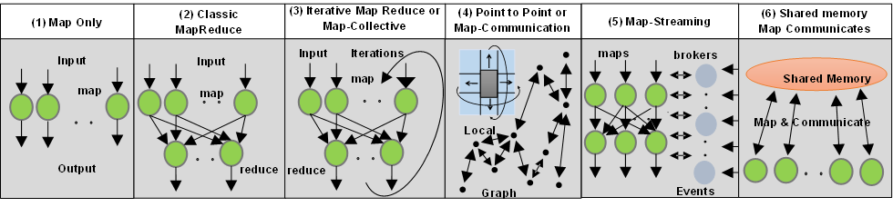
6 Forms of MapReduce cover “all” circumstances
Describes
- Problem (Model reflecting data)
- Machine
- Software
Architecture

Slide 19
Big Data and (Exascale) Simulation Convergence II
Green implies HPC
Integration

Slide 21
Things to do for Big Data and (Exascale) Simulation Convergence III
Converge Applications: Separate data and model to classify Applications and Benchmarks across Big Data and Big Simulations to give Convergence Diamonds with 64 facets
  Indicated how to extend Big Data Ogres (50) to Big Simulations by looking separately at model and data in Ogres
  Diamonds have four views or collections of facets: Problem Architecture; Execution; Data Source and Style; Processing view covering Big Data and Big Simulation Processing
  Facets cover data, model or their combination – the problem or application
    16 System Facets; 16 Data Facets; 32 Model Facets
  Note Simulation Processing View has similarities to old parallel computing benchmarks

Slide 22
Things to do for Big Data and (Exascale) Simulation Convergence IV
Convergence Benchmarks: we will use benchmarks that cover the facets of the convergence diamonds i.e. cover big data and simulations;
  As we separate data and model, compute intensive simulation benchmarks (e.g. solve partial differential equation) will be linked with data analytics (the model in big data)
  IU focus SPIDAL (Scalable Parallel Interoperable Data Analytics Library) with high performance clustering, dimension reduction, graphs, image processing as well as MLlib will be linked to core PDE solvers to explore the communication layer of parallel middleware
  Maybe integrating data and simulation is an interesting idea in benchmark sets
Convergence Programming Model
  Note parameter servers used in machine learning will be mimicked by collective operators invoked on distributed parameter (model) storage
  E.g. Harp as Hadoop HPC Plug-in
  There should be interest in using Big Data software systems to support exascale simulations
  Streaming solutions from IoT to analysis of astronomy and LHC data will drive high performance versions of Apache streaming systems

Slide 23
Things to do for Big Data and (Exascale) Simulation Convergence V
Converge Language: Make Java run as fast as C++ (Java Grande) for computing and communication – see following slide
  Surprising that so much Big Data work in industry but basic high performance Java methodology and tools missing
  Needs some work as no agreed OpenMP for Java parallel threads
  OpenMPI supports Java but needs enhancements to get best performance on needed collectives (For C++ and Java)
  Convergence Language Grande should support Python, Java (Scala), C/C++ (Fortran)

Slide 24
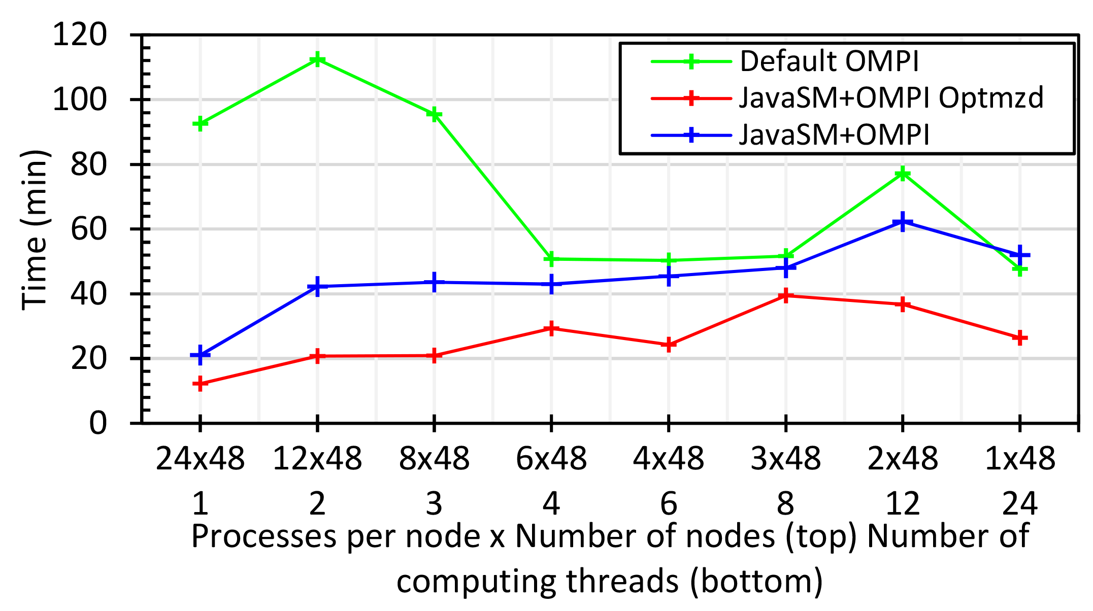
Java MPI performs better than Threads I
128 24 core Haswell nodes
Default MPI much worse than threads
Optimized MPI using shared memory node-based messaging is much better than threads

Slide 25
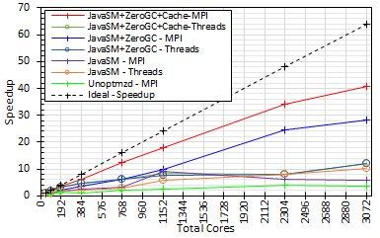
Java MPI performs better than Threads II
128 24 core Haswell nodes
200K Dataset Speedup

Slide 26
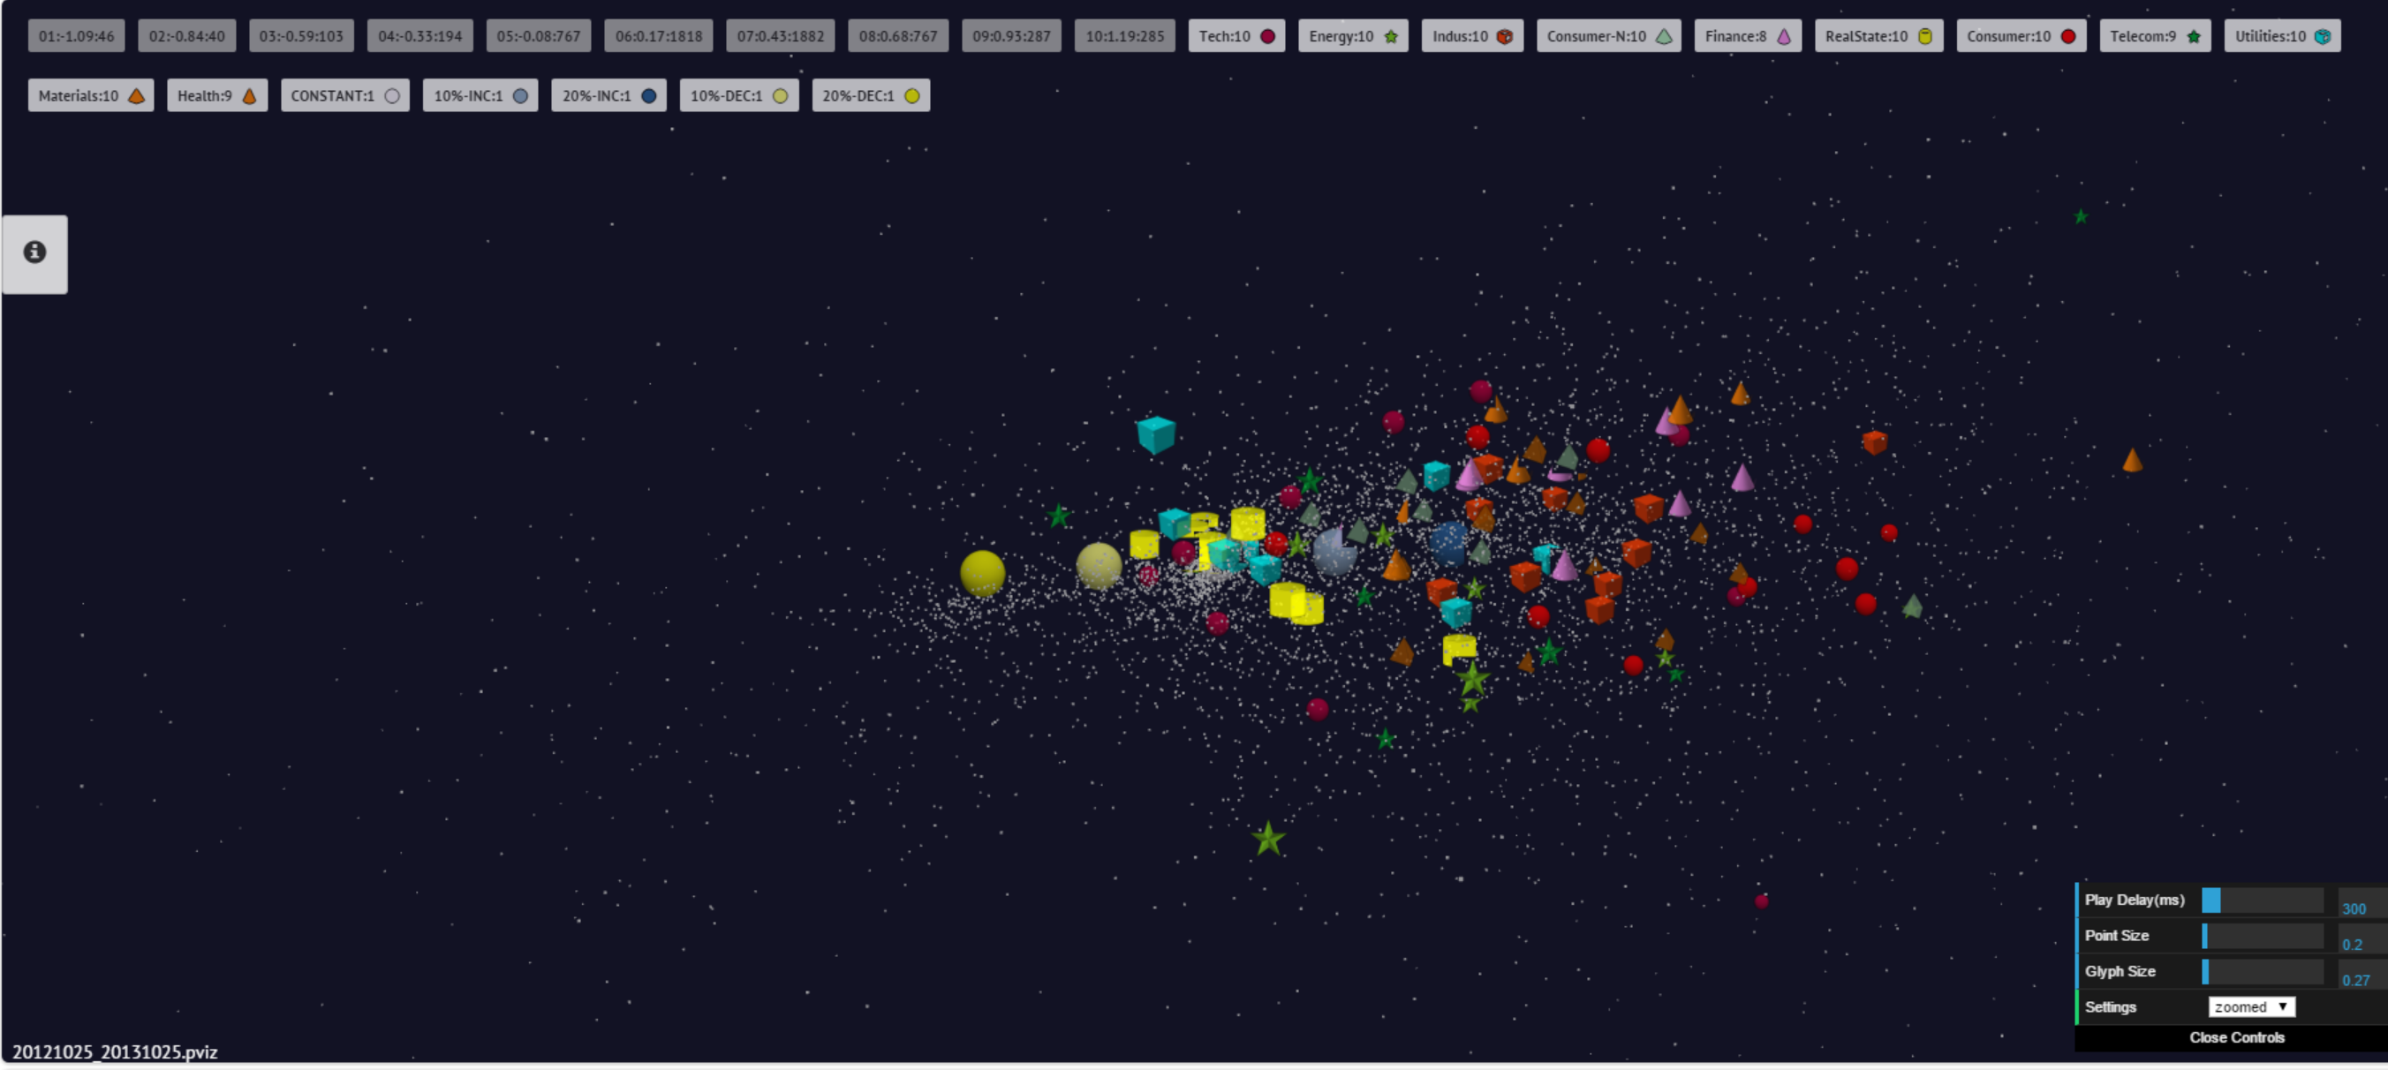
Oct 25 2013 velocities

