Slide 1
Data Science at
Digital Science Center@SOIC
November 5 2014
Geoffrey Fox
Judy Qiu
gcf@indiana.edu, xqiu@Indiana.edu
http://www.infomall.org
School of Informatics and Computing
Digital Science Center
Indiana University Bloomington

Slide 2
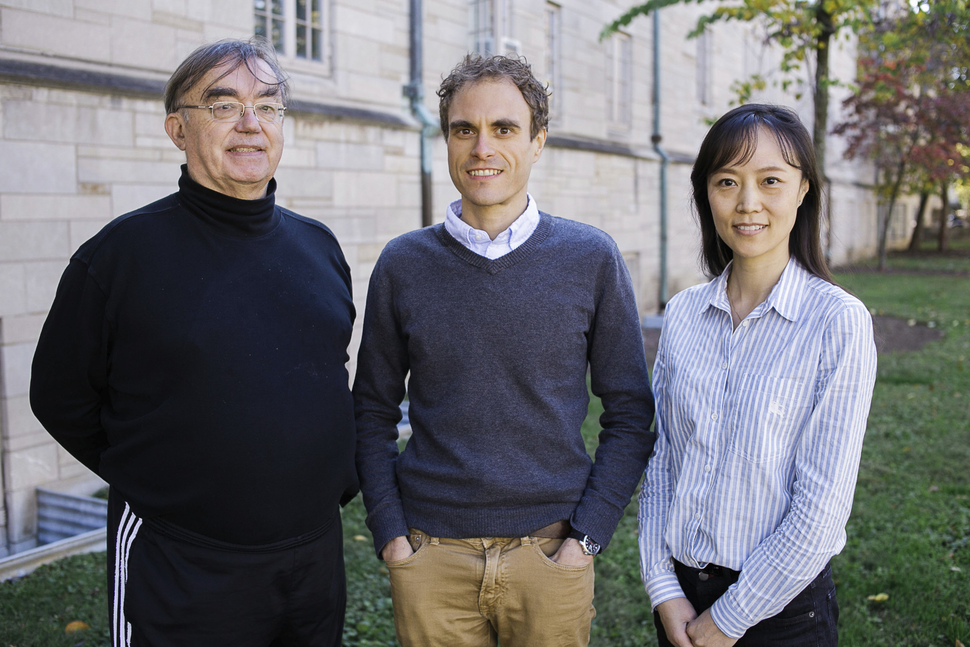
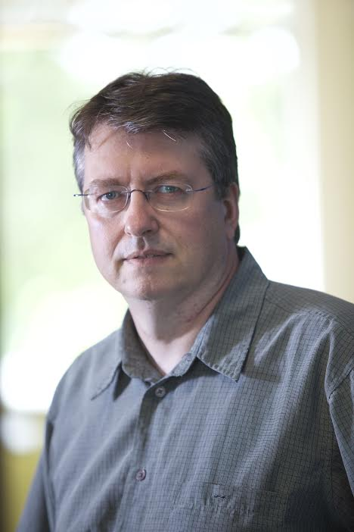
Digital Science Center Leadership
Indiana University Faculty
Geoffrey Fox, David Crandall, Judy Qiu, Gregor von Laszewski

Slide 3
Data Science Center Research Areas
Digital Science Center Facilities
RaPyDLI Deep Learning Environment
HPC-ABDS and Cloud DIKW Big Data Environments
Java Grande Runtime
CloudIOT Internet of Things Environment
SPIDAL Scalable Data Analytics Library
Big Data Ogres Classification and Benchmarks
Cloudmesh Cloud and Bare metal Automation
Data Science Education with MOOC’s

Slide 4
DSC Computing Systems
Working with SDSC on NSF XSEDE Comet System (Haswell)
Adding 64-128 node Haswell based system (Juliet)
  128-256 GB memory per node
  Substantial conventional disk per node (8TB) plus PCI based SSD
  Infiniband with SR-IOV
Older machines
  India (128 nodes, 1024 cores), Bravo (16 nodes, 128 cores), Delta(16 nodes, 192 cores), Echo(16 nodes, 192 cores), Tempest (32 nodes, 768 cores) with large memory, large disk and GPU
  Cray XT5m with 672 cores
Optimized for Cloud research and Large scale Data analytics exploring storage models, algorithms
Bare-metal v. Openstack virtual clusters
Extensively used in Education

Slide 5
NSF Data Science Project I
3 yr. XPS: FULL: DSD: Collaborative Research: Rapid Prototyping HPC Environment for Deep Learning IU, Tennessee (Dongarra), Stanford (Ng)
“Rapid Python Deep Learning Infrastructure” (RaPyDLI) Builds optimized Multicore/GPU/Xeon Phi kernels (best exascale dataflow) with Python front end for general deep learning problems with ImageNet exemplar. Leverage Caffe from UCB.
Large neural networks combined with large datasets (typically imagery, video, audio, or text) are increasingly the top performers in benchmark tasks for vision, speech, and Natural Language Processing. Training often requires customization of the neural network architecture, learning criteria, and dataset pre-processing.
Classified OUT
IN

Slide 6
NSF Data Science Project II
5 yr. Datanet: CIF21 DIBBs: Middleware and High Performance Analytics Libraries for Scalable Data Science IU, Rutgers (Jha), Virginia Tech (Marathe), Kansas (Paden), Stony Brook (Wang), Arizona State(Beckstein), Utah(Cheatham)
HPC-ABDS: Cloud-HPC interoperable software performance of HPC (High Performance Computing) and the rich functionality of the commodity Apache Big Data Stack.
SPIDAL (Scalable Parallel Interoperable Data Analytics Library): Scalable Analytics for Biomolecular Simulations, Network and Computational Social Science, Epidemiology, Computer Vision, Spatial Geographical Information Systems, Remote Sensing for Polar Science and Pathology Informatics.

Slide 7
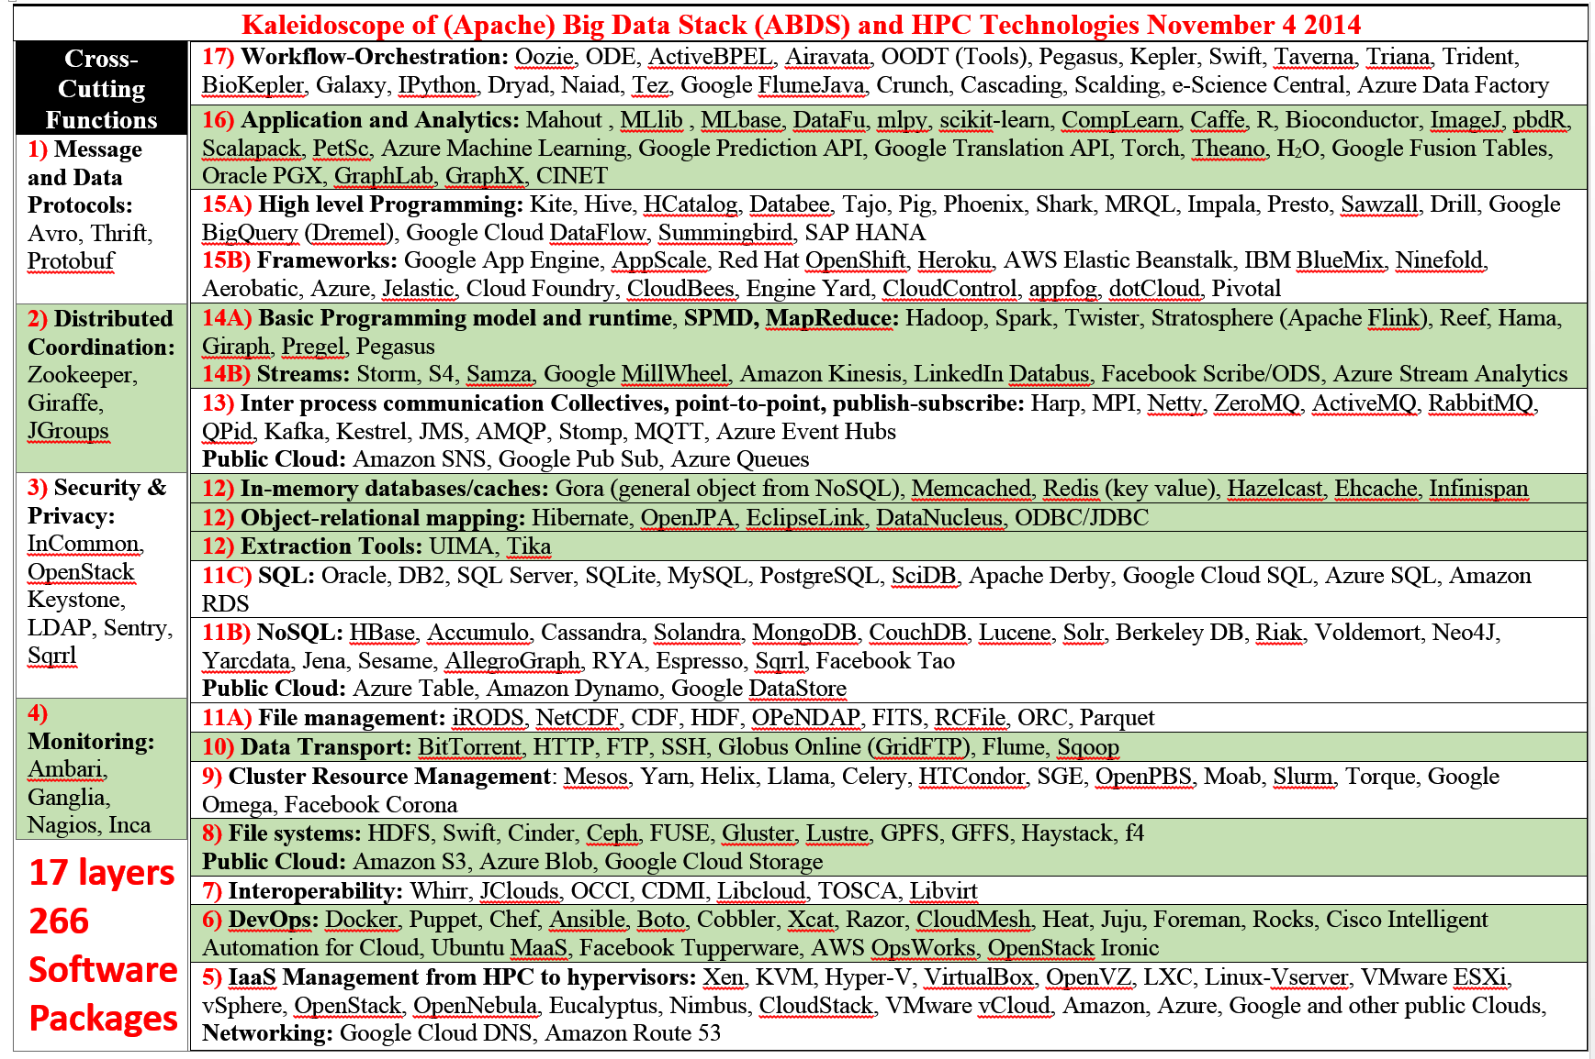
Big Data Software Model

Slide 8
Harp Plug-in to Hadoop
Make ABDS high performance – do not replace it!
Work of Judy Qiu and Bingjing Zhang.
Left diagram shows architecture of Harp Hadoop Plug-in that adds high performance communication, Iteration (caching) and support for rich data abstractions including key-value
Right side shows efficiency for 16 to 128 nodes (each 32 cores) on WDA-SMACOF dimension reduction dominated by conjugate gradient

Slide 9
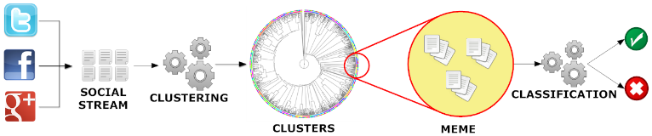
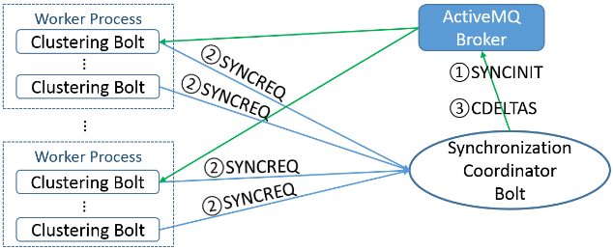
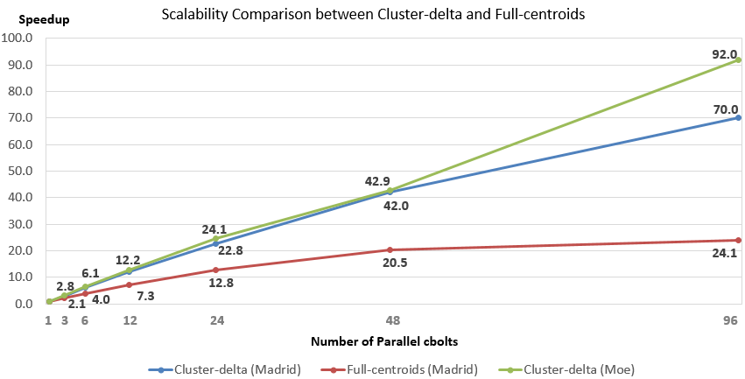
Parallel Tweet Clustering with Storm
Sequential
Judy Qiu and Xiaoming Gao
Storm Bolts coordinated by ActiveMQ to synchronize parallel cluster center updates
Speedup on up to 96 bolts on two clusters Moe and Madrid
Red curve is old algorithm; green and blue new

Slide 10
Java Grande and C# on 40K point DAPWC Clustering
Very sensitive to threads v MPI
C# Hardware 0.7 performance Java Hardware
C#
Java
64 Way parallel
128 Way parallel
256 Way
parallel
TXP
Nodes
Total

Slide 11
Cloud DIKW based on HPC-ABDS to integrate streaming and batch Big Data
System Orchestration / Dataflow / Workflow
Archival Storage – NOSQL like Hbase
Batch Processing (Iterative MapReduce)
Analytics
Raw Data
Data
Information
Knowledge
Wisdom
Decisions
Analytics
Streaming Processing (Iterative MapReduce)
Storm
Storm
Storm
Storm
Storm
Storm
Pub-Sub
Internet of Things (Smart Grid)

Slide 12
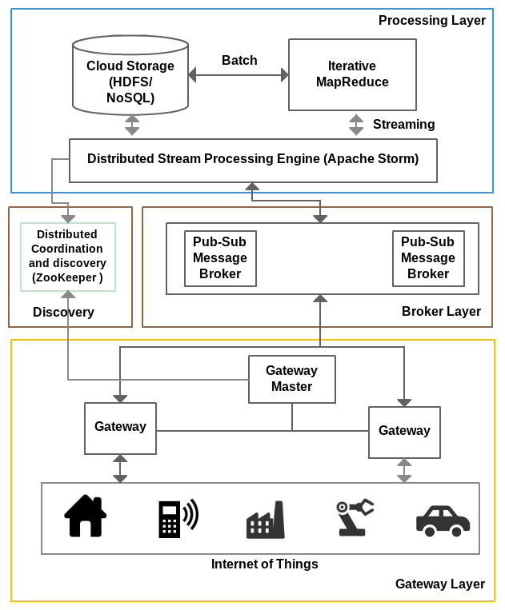
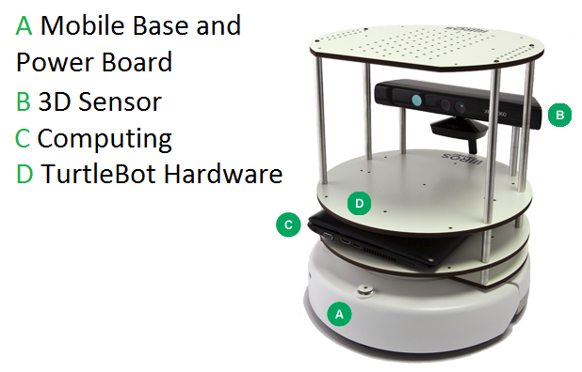
IOTCloud
Device → Pub-Sub→Storm → Datastore → Data Analysis
Apache Storm provides scalable distributed system for processing data streams coming from devices in real time.
For example Storm layer can decide to store the data in cloud storage for further analysis or to send control data back to the devices
Evaluating Pub-Sub Systems ActiveMQ, RabbitMQ, Kafka, Kestrel
Turtlebot and Kinect

Slide 13
RabbitMQ out-performs Kafka with Storm
Kafka Latency
RabbitMQ Latency

Slide 14
Big Data Ogres and their Facets
51 Big Data use cases: http://bigdatawg.nist.gov/usecases.php
Ogres classify Big Data Applications with facets and benchmarks
Facets I: Features identified from 51 use cases: PP(26), MR(18), MR-Statistics(7), MR-Iterative(23), Graph(9), Fusion(11), Streaming/DDDAS(41), Classify(30), Search/Query(12), Collaborative Filtering(4), LML(36), GML(23), Workflow(51), GIS(16), HPC(5), Agents(2)
  MR MapReduce; L/GML Local/Global Machine Learning
Facets II: Some broad features familiar from past like
  BSP (Bulk Synchronous Processing) or not?
  SPMD (Single Program Multiple Data) or not?
  Iterative or not?
  Regular or Irregular?
  Static or dynamic?,
  communication/compute and I-O/compute ratios
  Data abstraction (array, key-value, pixels, graph…)
Facets III: Data Processing Architectures

Slide 15
Core Analytics Facet I
Map-Only
  Pleasingly parallel - Local Machine Learning LML
MapReduce:
  Search/Query/Index
  Summarizing statistics as in LHC Data analysis (histograms) Recommender Systems (Collaborative Filtering)
  Linear Classifiers (Bayes, Random Forests)
Alignment and Streaming Genomic Alignment, Incremental Classifiers
Global Analytics: Nonlinear Solvers (structure depends on objective function)
  Stochastic Gradient Descent SGD and approximations to Newton’s Method
  Levenberg-Marquardt solver

Slide 16
Core Analytics Facet II
Global Analytics: Map-Collective (See Mahout, MLlib)
Often use matrix-matrix,-vector operations, solvers (conjugate gradient)
  Clustering (many methods), Mixture Models, LDA (Latent Dirichlet Allocation), PLSI (Probabilistic Latent Semantic Indexing)
  SVM and Logistic Regression
  Outlier Detection (several approaches)
  PageRank, (find leading eigenvector of sparse matrix)
  SVD (Singular Value Decomposition)
  MDS (Multidimensional Scaling)
  Learning Neural Networks (Deep Learning)
  Hidden Markov Models
Graph Analytics (Global Analytics subset)
Graph Structure and Graph Simulation
Communities, subgraphs/motifs, diameter, maximal cliques, connected components, Betweenness centrality, shortest path
Linear/Quadratic Programming, Combinatorial Optimization, Branch and Bound

Slide 17

Protein Universe Browser for COG Sequences with a few illustrative biologically identified clusters

Slide 18
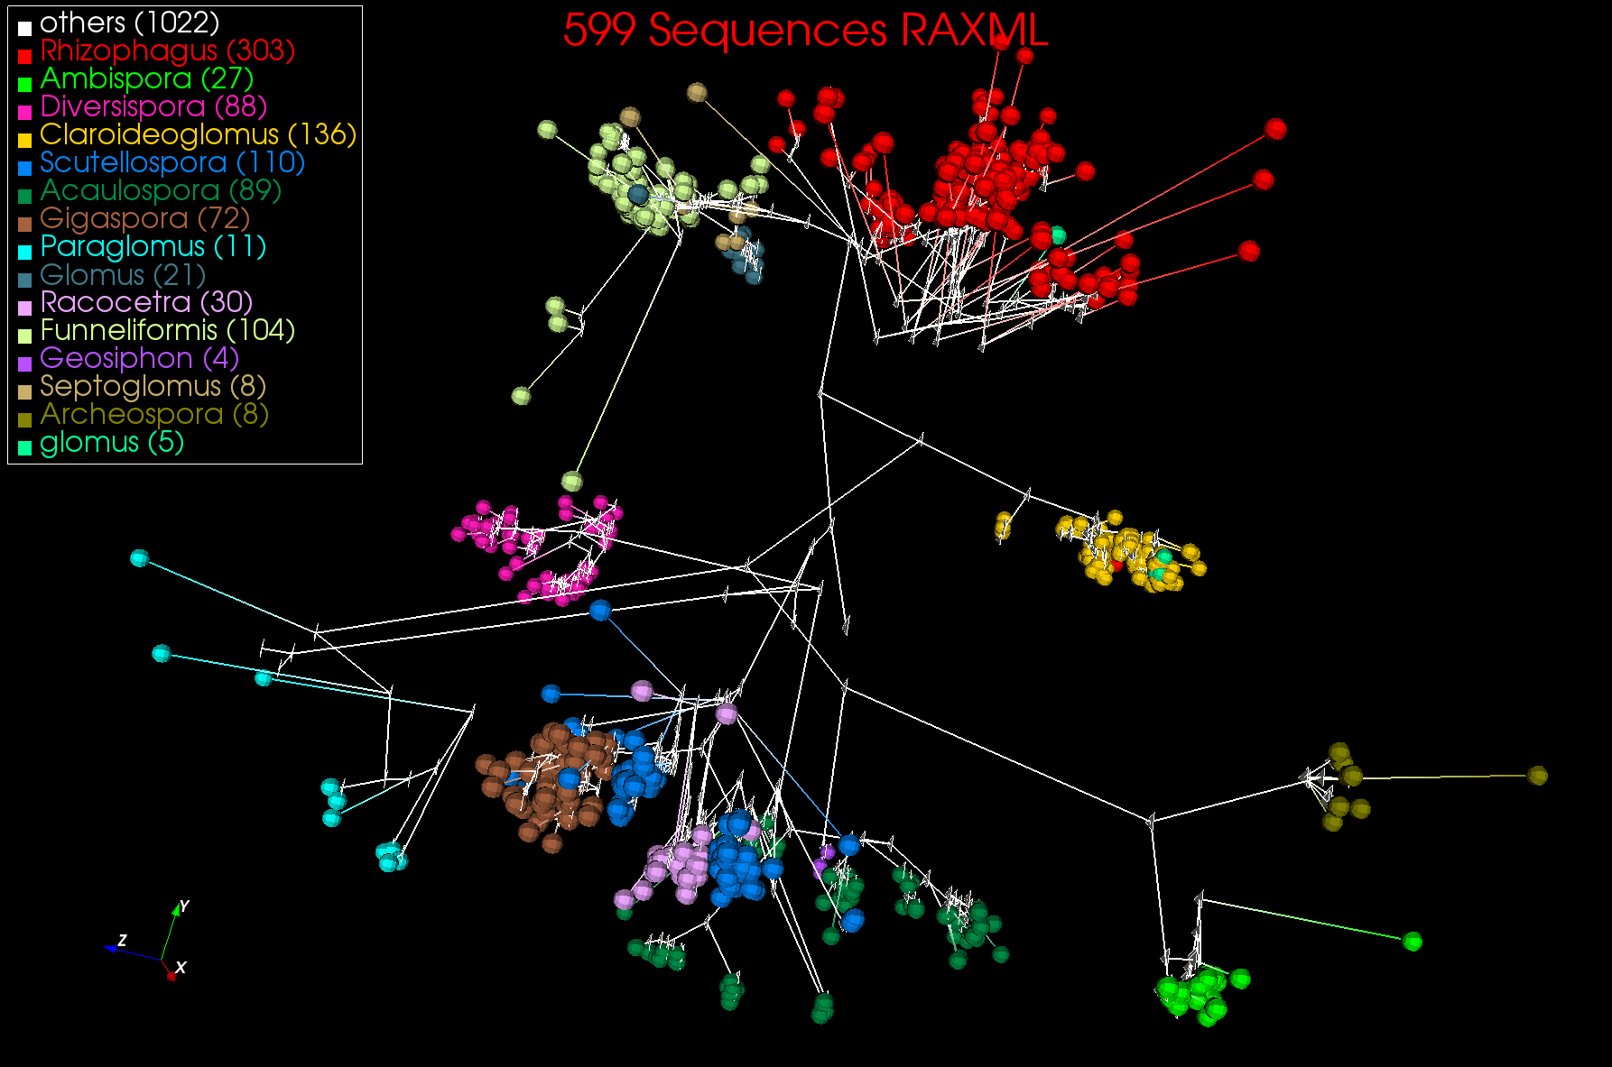
3D Phylogenetric Tree from WDA SMACOF

Slide 19
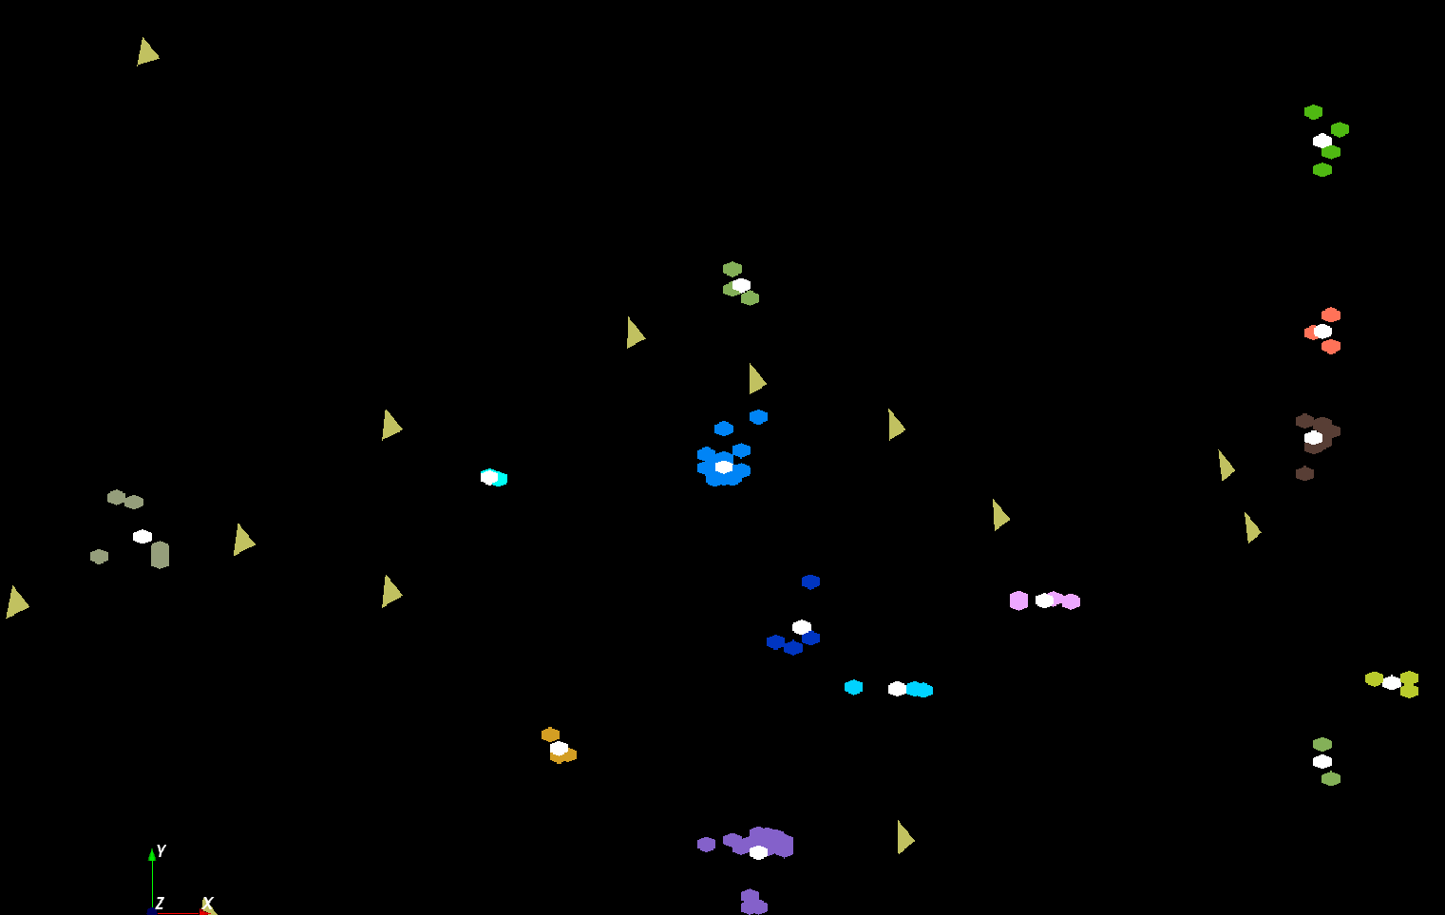
LC-MS Proteomics Mass Spectrometry
The brownish triangles are peaks outside any cluster.
The colored hexagons are peaks inside clusters with the white hexagons being determined cluster center
Fragment of 30,000 Clusters
241605 Points

Slide 20
Cloudmesh Software Defined System Toolkit
Cloudmesh Open source http://cloudmesh.github.io/ supporting
  The ability to federate a number of resources from academia and industry. This includes existing FutureSystems infrastructure, Amazon Web Services, Azure, HP Cloud, Karlsruhe using several IaaS frameworks
  IPython-based workflow as an interoperable onramp
Supports reproducible computing environments
Uses internally Libcloud and Cobbler
Celery Task/Query manager (AMQP - RabbitMQ)
MongoDB
Notes:
Due to its integrated services Cloudmesh provides the ability to be an onramp for other clouds.
It provides information services to various system level sensors to give access to sensor and utilization data. Internally, it can be used to optimize the system usage.
The provisioning experience from FutureGrid has taught us that we need to provide
the creation of new clouds (rain)
the repartitioning of resources between services (cloud shifting)
and the integration of external cloud resources in case of over provisioning (cloud bursting)
As we deal with many IaaS frameworks, we need an abstraction layer on top of the IaaS framework.
Experiment management is conducted with workflows controlled in shells, Python/iPython, as well as systems such as OpenStack's Heat.
Accounting is supported through additional services such as user management and charge rate management.
Not all features are yet implemented. Figure shows the main functionality that we target at this time to implement.

Slide 21
Scientific Impact of High End Resources (XSEDE TAS)
Is there some way to provide an indication about the impact of providing such facilities?
Using EXTENSIVE Bibliometric data as criteria as mashup
  Sources: NSF, ISI Web of Science, (Google), XSEDE
  140K publications, 20K XSEDE users, ~5K externally verified publications, 2M related publication database
Metrics
  Number of Publications, citations, projects, users, researchers
  H-index, G-Index, I-index, …
  Correlation to externally vetted data, journal impact , …
Unique data set to conduct extensive analysis.
  Previous effort only analyzed about 1% of the data
  We are not aware of similar comprehensive efforts.
Portal
  Users can look up their own data
Generally useable and can be adapted this for your resources, department, ….
Gregor von Laszewski
Fugang Wang

Slide 22
IU TAS Architecture
IU TAS
Interface
Layer
REST API
Portal
IU TAS
Service
Layer
IU TAS REST Services
XSEDE
Portal
IU TAS Publications Mashup
IU TAS
Publication
Mashup
NSF Award
DB Mining
3rd Party
Queries
IU NSF Awards
Publication data
for XSEDE Users
3rd Party Data
XD Entities
Mashup
Microsoft Academic Search
Google Scholar (User profiles)
UB TAS Databases &Reports
XSEDE Databases
NSF Database
ISI Web of Science
XDMoD
Warehous
XDcDB Mirror
Publications & Accounts
XSEDE
Quarterly Reports
POPS
Proposal Data
NSF Awards
Original
Data Source
Citeseer, PUBMed, ACM, IEEE, …
Mendeley

Slide 23
Comparing XSEDE Supported Publications with Peers
Conclusion: XSEDE publications tend to be more highly cited than their peers
~ 1500 XSEDE supported publications appeared in these top 10 journals (by # of XSEDE supported publications published)
Comparing each single publication with all peers appeared in the same issue. Get percentile ranking based on citation data (per ISI Web of Science data).
Percentage of how many belongs to each quarter (top 25% to bottom 25%).
In general trends towards higher quarter.
Differences among fields (Physics, Astrophysics, Astronomical; Chemistry; etc.)

Slide 24
More details ….
XSEDE supported publications between peers based on citation count. Compares 66 journals (contain at least 10 XSEDE publications published since 2005), and the XSEDE publications’ performance on them comparing to the peers within the same issues.
Result: XSEDE provides advantage in comparison to peer publications not using XSEDE

Slide 25
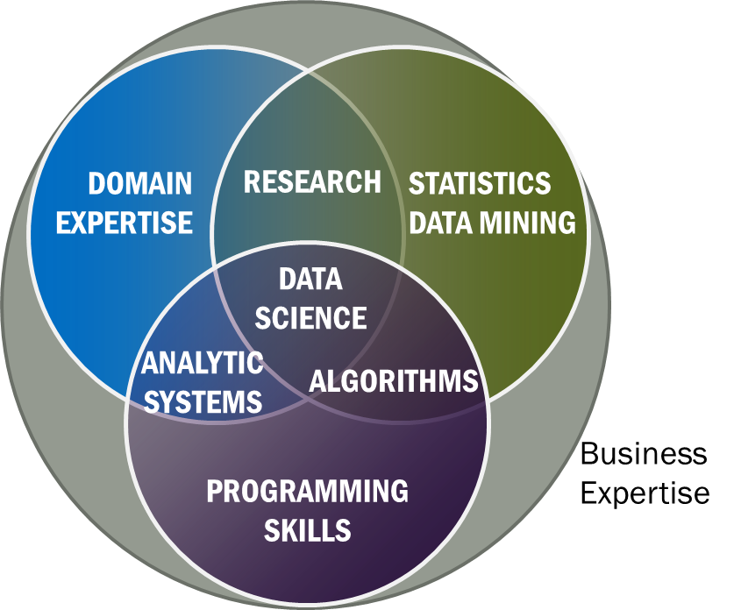
Data Science Definition from NIST Public Working Group
Data Science is the extraction of actionable knowledge directly from data through a process of discovery, hypothesis, and analytical hypothesis analysis.
A Data Scientist is a practitioner who has sufficient knowledge of the overlapping regimes of expertise in business needs, domain knowledge, analytical skills and programming expertise to manage the end-to-end scientific method process through each stage in the big data lifecycle.
See Big Data Definitions in http://bigdatawg.nist.gov/V1_output_docs.php
Notes:
Big Data refers to digital data volume, velocity and/or variety whose management requires scalability across coupled horizontal resources
Data Science is the extraction of actionable knowledge directly from data through a process of discovery, hypothesis, and analytical hypothesis analysis.
A Data Scientist is a practitioner who has sufficient knowledge of the overlapping regimes of expertise in business needs, domain knowledge, analytical skills and programming expertise to manage the end-to-end scientific method process through each stage in the big data lifecycle.

Slide 26
IU Data Science Program
Program managed by cross disciplinary Faculty in Data Science. Currently Statistics and Informatics and Computing School (31 faculty) but will expand scope to full campus
A purely online 4-course Certificate in Data Science has been running since January 2014 (with 70 students total in 2 semesters)
  4 students will get certificate end of this semester
  Most students are professionals taking courses in “free time”
A campus wide Ph.D. Minor in Data Science has been proposed.
Courses labelled as “Decision-maker” and “Technical” paths where McKinsey says an order of magnitude more (1.5 million by 2018) unmet job openings in Decision-maker track

Slide 27

McKinsey Institute on Big Data Jobs
There will be a shortage of talent necessary for organizations to take advantage of big data. By 2018, the United States alone could face a shortage of 140,000 to 190,000 people with deep analytical skills as well as 1.5 million managers and analysts with the know-how to use the analysis of big data to make effective decisions.
Decision Maker Path aimed at 1.5 million jobs. Technical Path covers the 140,000 to 190,000
http://www.mckinsey.com/mgi/publications/big_data/index.asp.

Slide 28
IU Data Science Program: Masters
Masters Fully approved by University and State October 14 2014 and starts January 2015
Blended online and residential (any combination)
  Online offered at in-state rates (~$1100 per course)
Informatics, Computer Science, Information and Library Science in School of Informatics and Computing and the Department of Statistics, College of Arts and Science, IUB
30 credits (10 conventional courses)
Basic (general) Masters degree plus tracks
  Currently only track is “Computational and Analytic Data Science ”
  Other tracks expected such as Biomedical Data Science

Slide 29
Background on MOOC’s
MOOC’s are a “disruptive force” in the educational environment
  Coursera, Udacity, Khan Academy and many others
MOOC’s have courses and technologies
Google Course Builder and OpenEdX are open source MOOC technologies
Blackboard, Canvas and others are learning management systems with (some) MOOC support
The MOOC version of Fox’s Big Data Applications and Analytics course has ~2000 students enrolled.
Coursera Offerings have much larger enrollment

Slide 30
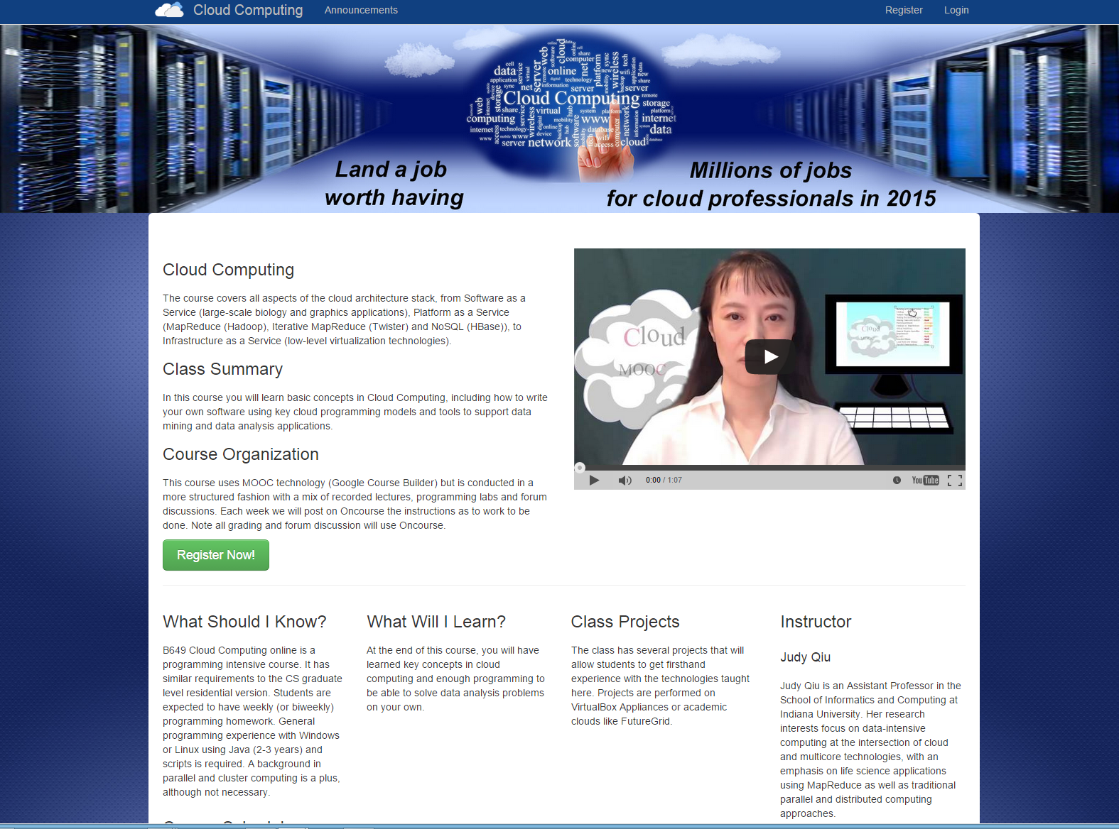

Slide 31
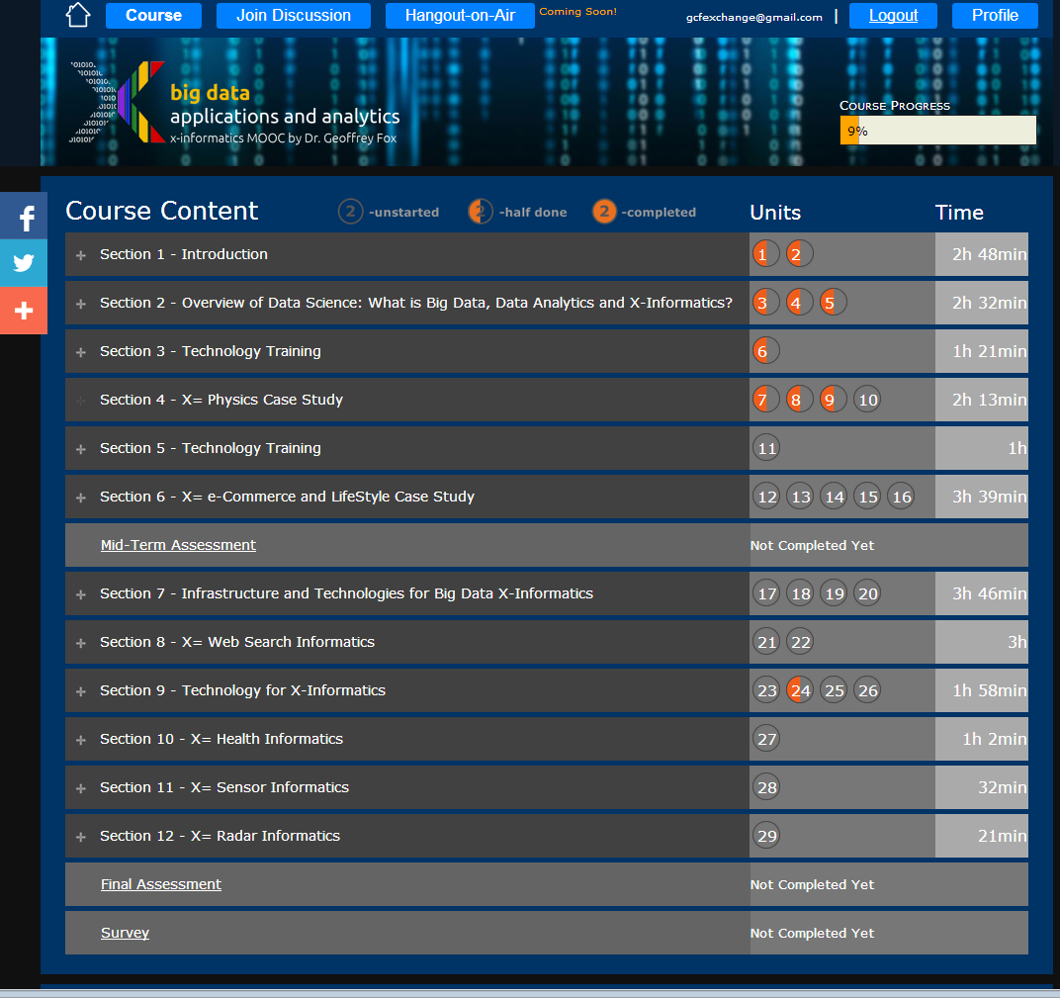
Example
Google
Course Builder
MOOC
4 levels
Course
Section (12)
Units(29)
Lessons(~150)
Units are ~ traditional lecture
Lessons are ~10 minute segments
http://x-informatics.appspot.com/course

Slide 32
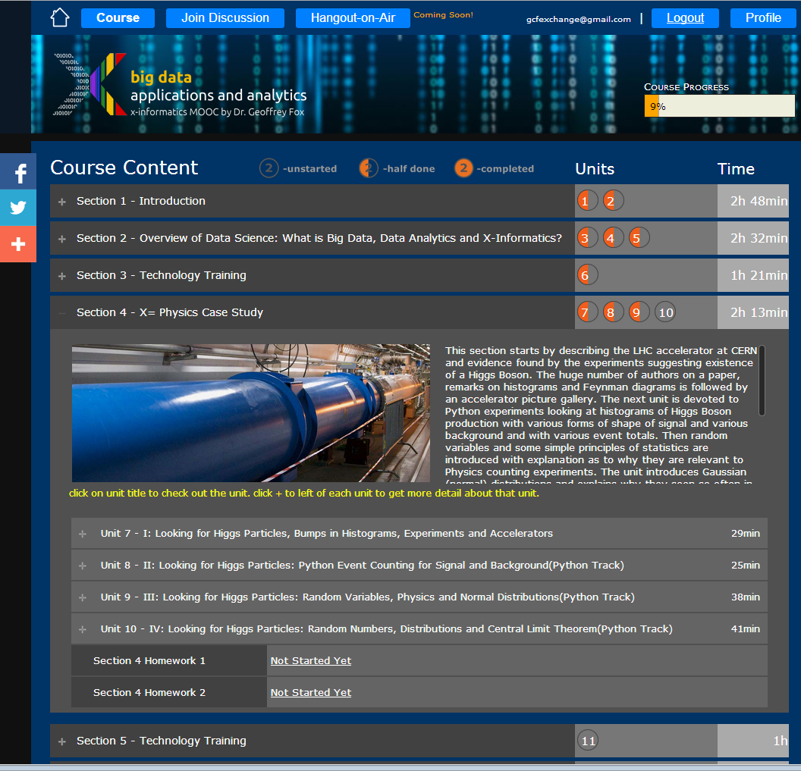
Example
Google
Course Builder
MOOC
The Physics Section expands to 4 units and 2 Homeworks
Unit 9 expands to 5 lessons
Lessons played on Youtube
“talking head video + PowerPoint”
http://x-informatics.appspot.com/course

Slide 33
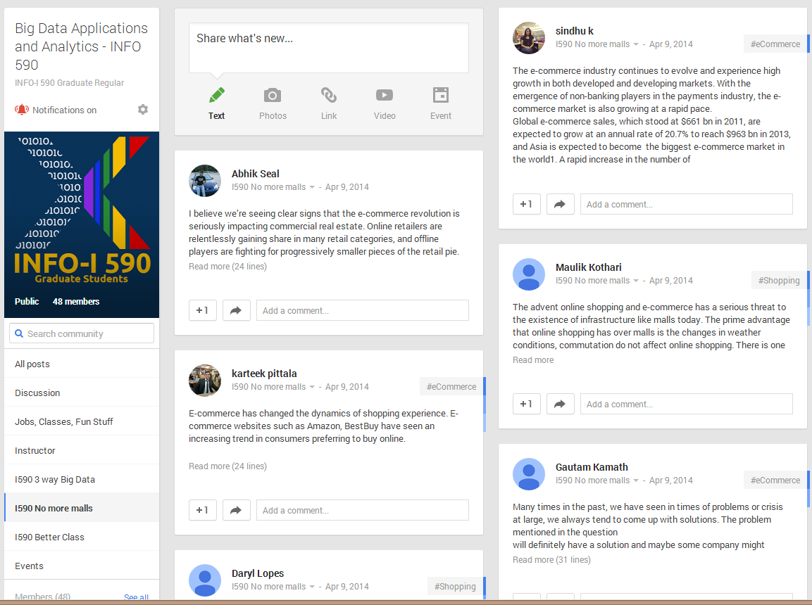
The community group for one of classes and one forum (“No more malls”)

Slide 34
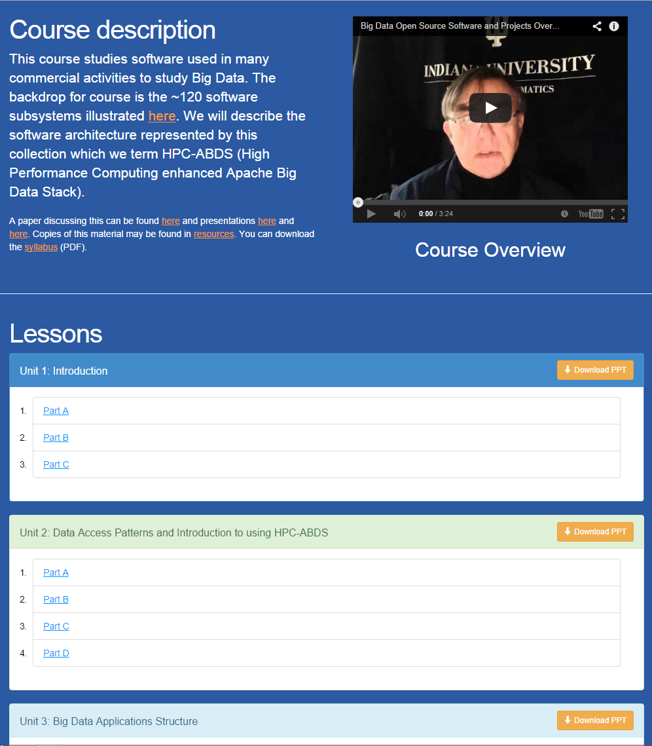
Office Mix Site
Lectures
Made as ~15 minute lessons linked here
Metadata on Microsoft Site

Slide 35
Potpourri of Online Technologies
Canvas (Indiana University Default): Best for interface with IU grading and records
Google Course Builder: Best for management and integration of components
Ad hoc web pages: alternative easy to build integration
Mix: Simplest faculty preparation interface
Adobe Presenter/Camtasia: More powerful video preparation that support subtitles but not clearly needed
Google Community: Good social interaction support
YouTube: Best user interface for videos
Hangout: Best for instructor-students online interactions (one instructor to 9 students with live feed). Hangout on air mixes live and streaming (30 second delay from archived YouTube) and more participants

