Slide 1
Digital Science Center
June 25, 2010, IIT
Geoffrey Fox
Judy Qiu
gcf@indiana.edu www.infomall.org
School of Informatics and Computing
and Community Grids Laboratory,
Digital Science Center
Pervasive Technology Institute
Indiana University

Slide 2
PTI Activities in Digital Science Center
Community Grids Laboratory led by Fox
Gregor von Lazewski: FutureGrid architect, GreenIT
Marlon Pierce: Grids, Services, Portals including Earthquake Science, Chemistry and Polar Science applications
Judy Qiu: Multicore and Data Intensive Computing (Cyberinfrastructure) including Biology and Cheminformatics applications
Open Software Laboratory led by Andrew Lumsdaine
Software like MPI, Scientific Computing Environments
Parallel Graph Algorithms
Complex Networks and Systems led by Alex Vespignani
Very successful H1N1 spread simulations run on Big Red
Can be extended to other epidemics and to “critical infrastructure” simulations such as transportation

Slide 3
FutureGrid Concepts
Support development of new applications and new middleware using Cloud, Grid and Parallel computing (Nimbus, Eucalyptus, Hadoop, Globus, Unicore, MPI, OpenMP. Linux, Windows …) looking at functionality, interoperability, performance
Put the “science” back in the computer science of grid computing by enabling replicable experiments
Open source software built around Moab/xCAT to support dynamic provisioning from Cloud to HPC environment, Linux to Windows ….. with monitoring, benchmarks and support of important existing middleware
June 2010 Initial users; September 2010 All hardware (except IU shared memory system) accepted and significant use starts; October 2011 FutureGrid allocatable via TeraGrid process

Slide 4
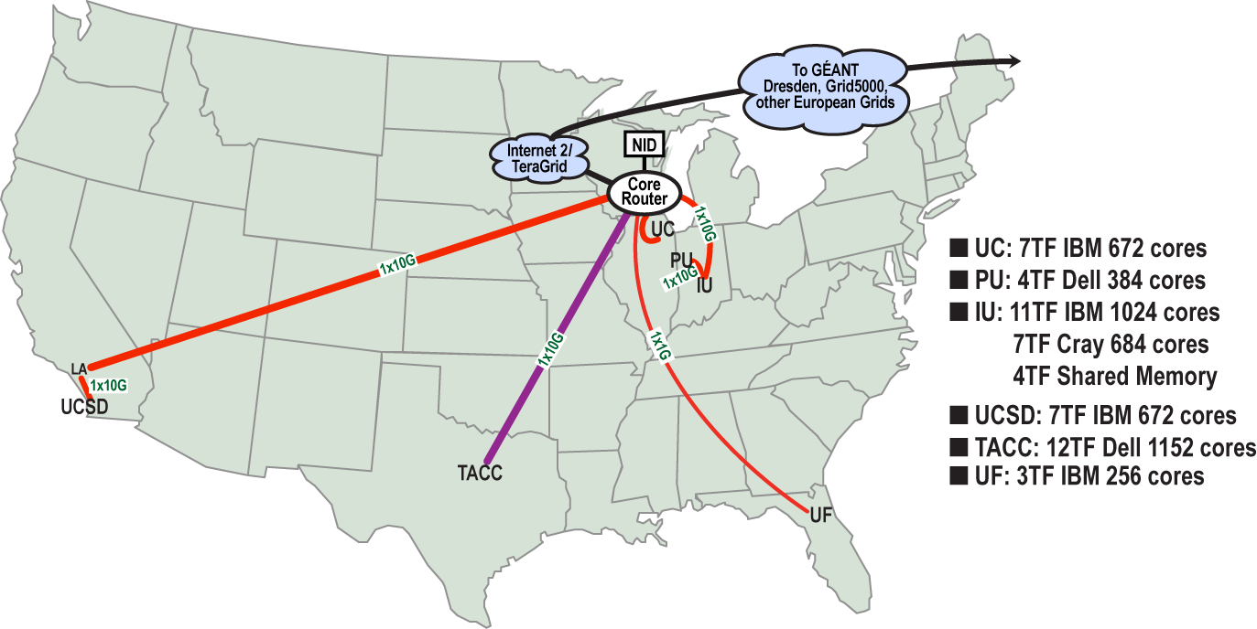
FutureGrid: a Grid/Cloud Testbed
IU Cray operational, IU IBM (iDataPlex) completed stability test May 6
UCSD IBM operational, UF IBM stability test completed June 12
Network, NID and PU HTC system operational
UC IBM stability test completed June 7; TACC Dell awaiting completion of installation
NID: Network Impairment Device
Private Public
FG Network

Slide 5
FutureGrid Partners
Indiana University (Architecture, core software, Support)
Collaboration between research and infrastructure groups
Purdue University (HTC Hardware)
San Diego Supercomputer Center at University of California San Diego (INCA, Monitoring)
University of Chicago/Argonne National Labs (Nimbus)
University of Florida (ViNE, Education and Outreach)
University of Southern California Information Sciences (Pegasus to manage experiments)
University of Tennessee Knoxville (Benchmarking)
University of Texas at Austin/Texas Advanced Computing Center (Portal)
University of Virginia (OGF, Advisory Board and allocation)
Center for Information Services and GWT-TUD from Technische Universtität Dresden. (VAMPIR)
Red institutions have FutureGrid hardware

Slide 7
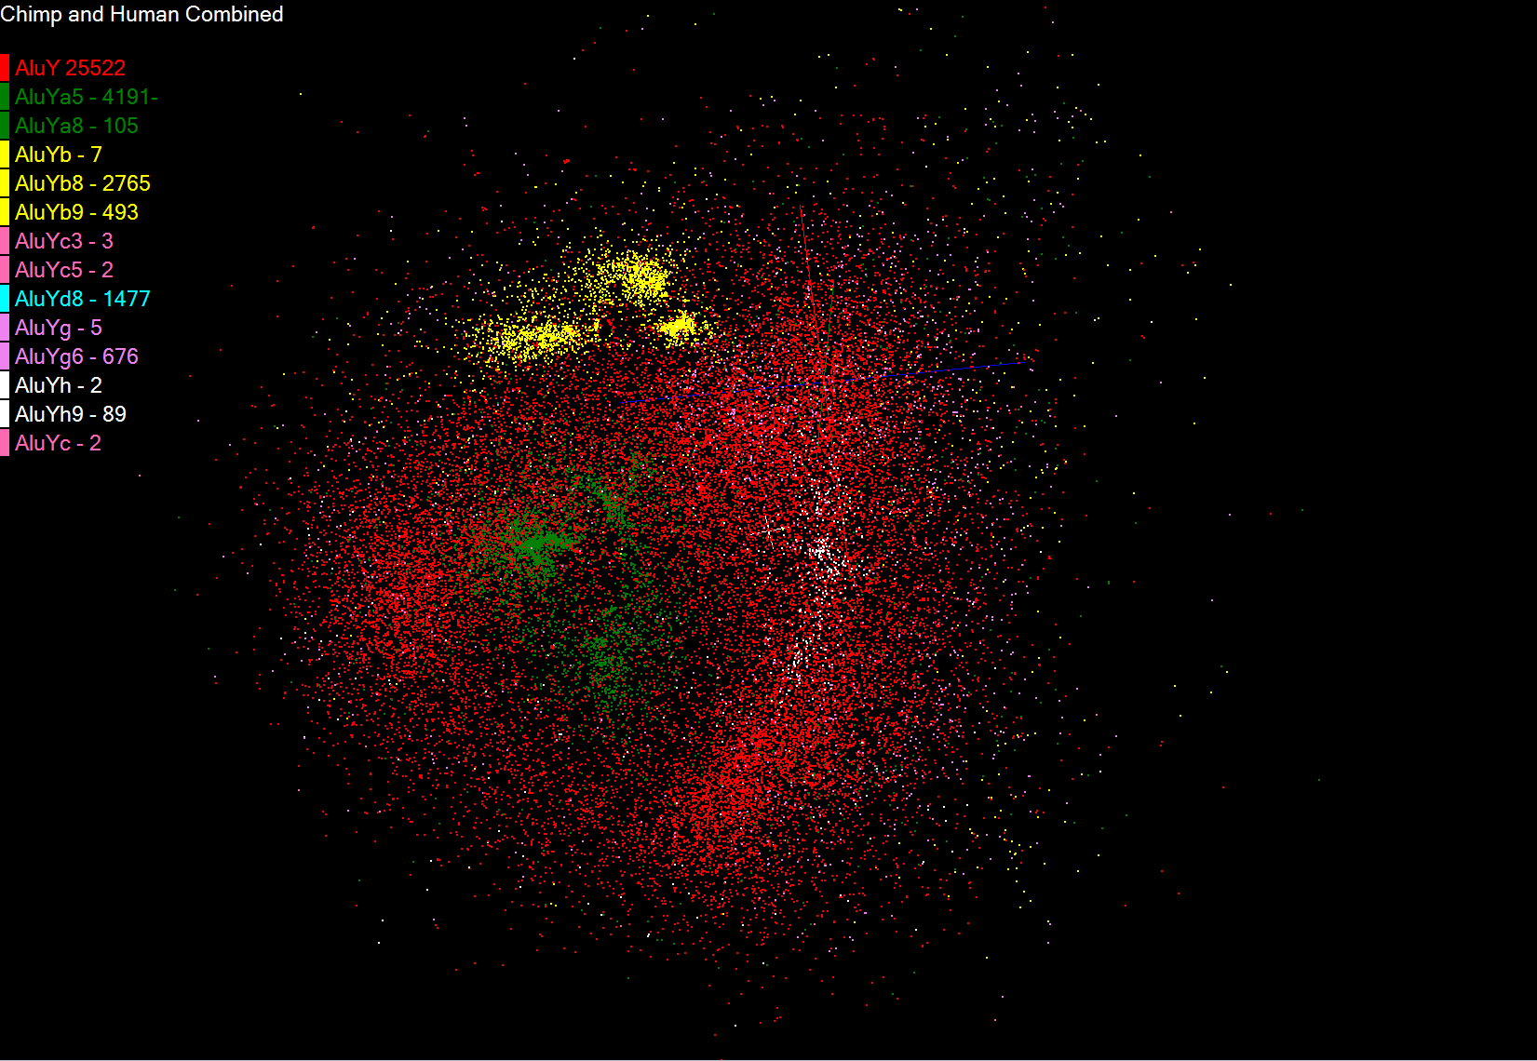
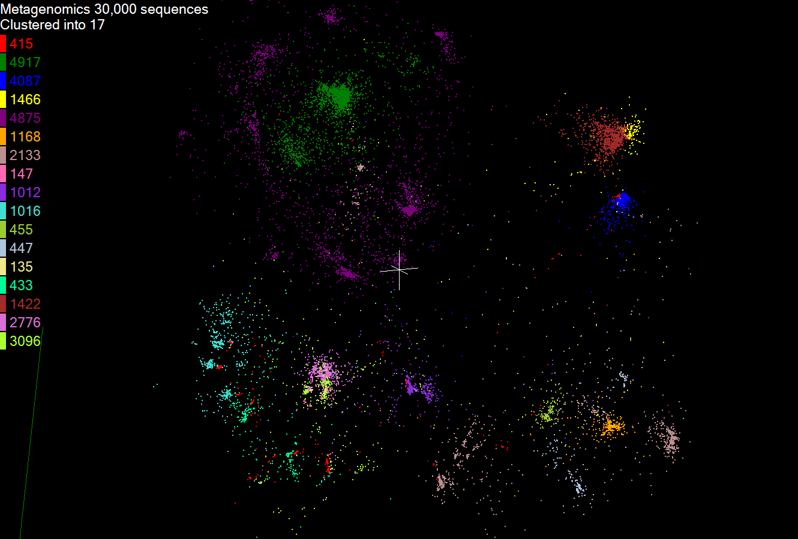
Biology MDS and Clustering Results
Alu Families
This visualizes results of Alu repeats from Chimpanzee and Human Genomes. Young families (green, yellow) are seen as tight clusters. This is projection of MDS dimension reduction to 3D of 35399 repeats – each with about 400 base pairs
Metagenomics
This visualizes results of dimension reduction to 3D of 30000 gene sequences from an environmental sample. The many different genes are classified by clustering algorithm and visualized by MDS dimension reduction

Slide 8
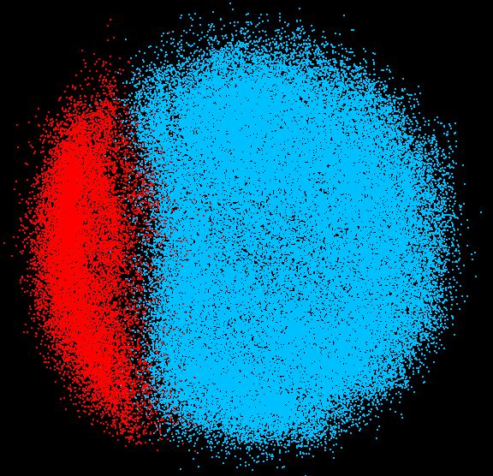
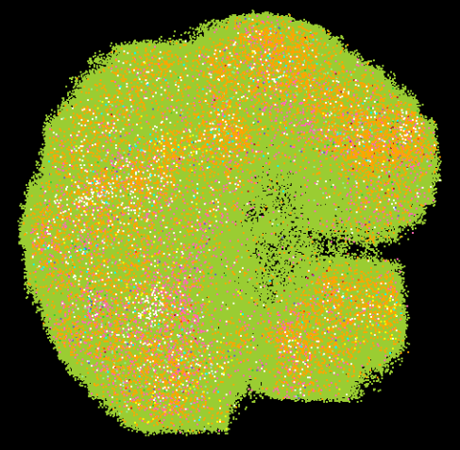
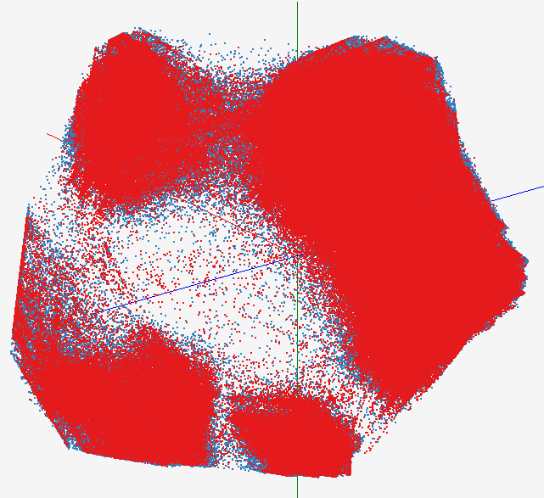
High Performance Data Visualization
Developed parallel MDS and GTM algorithm to visualize large and high-dimensional data
Processed 0.1 million PubChem data having 166 dimensions
Parallel interpolation can process up to 60M PubChem points
GTM with interpolation for 2M PubChem data
2M PubChem data is plotted in 3D with GTM interpolation approach. Red points are 100k sampled data and blue points are 4M interpolated points.
MDS for 100k PubChem data
100k PubChem data having 166 dimensions are visualized in 3D space. Colors represent 2 clusters separated by their structural proximity.
GTM for 930k genes and diseases
Genes (green color) and diseases (others) are plotted in 3D space, aiming at finding cause-and-effect relationships.
PubChem project, http://pubchem.ncbi.nlm.nih.gov/

Slide 9
Hadoop/Dryad Comparison Inhomogeneous Data I
Inhomogeneity of data does not have a significant effect when the sequence lengths are randomly distributed
Dryad with Windows HPCS compared to Hadoop with Linux RHEL on Idataplex (32 nodes)

Slide 10
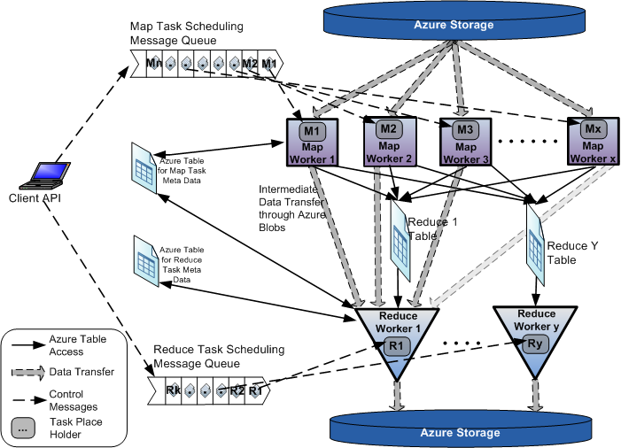
AzureMapReduce

Slide 11
Early Results with AzureMapreduce
Compare
Hadoop - 4.44 ms Hadoop VM - 5.59 ms DryadLINQ - 5.45 ms Windows MPI - 5.55 ms

