Slide 1
Research in Digital Science Center
Geoffrey Fox, August 25, 2017
Digital Science Center
Department of Intelligent Systems Engineering
gcf@indiana.edu, http://www.dsc.soic.indiana.edu/, http://spidal.org/
Judy Qiu, David Crandall, Gregor von Laszewski, Dennis Gannon
Supun Kamburugamuve, Pulasthi Wickramasinghe, Hyungro Lee, Jerome Mitchell
Bo Peng, Langshi Chen, Kannan Govindarajan, Fugang Wang
Internal collaboration. Biology, Physics, SICE
Outside Collaborators in funded projects: Arizona, Kansas, NIST, Purdue, Rutgers, San Diego Supercomputer Center, Stanford, SUNY Stony Brook, Virginia Tech, Univ. of Tennessee Knoxsville, UIUC, Utah

Slide 2
Digital Science Center
Big Data Engineering (Data Science) and parallel computing research with technology and applied collaborators
  System architecture, performance
Run computer infrastructure for Cloud and HPC research
  64 node system Tango with high performance disks (SSD, NVRam = 5x SSD and 25xHDD) and Intel KNL (Knights Landing) manycore (68-72) chips. Omnipath interconnect
  128 node system Juliet with two 12-18 core Haswell chips, SSD and conventional HDD disks. Infiniband Interconnect
  16 GPU, 4 Haswell node deep learning system Romeo
  All can run HDFS and store data on nodes
  200 older nodes for Docker, OpenStack and general use
Teach basic and advanced Cloud Computing and bigdata courses
Supported by Gary Miksik, Allan Streib, Laura Pettit (partial)

Slide 3
DSC Research Activities
Building SPIDAL Scalable HPC machine Learning Library
Applying current SPIDAL in Biology, Network Science, Pathology
Polar (Radar) Image Processing (Crandall)
Data analysis of experimental physics scattering results
Work with NIST on Big Data Standards and non-proprietary Frameworks
Integration of Clouds&HPC; Big Data&Simulations (international community)
Harp HPC Machine Learning Framework (Qiu)
Twister2 HPC Event Driven Distributed Programming model
IoTCloud. Cloud control of robots – licensed to C2RO (Montreal)
Cloud Research and DevOps for Software Defined Systems (von Laszewski)
Network for Computational Nanotechnology – Engineered nanoBIO Node

Slide 4
Engineered nanoBIO Node NSF EEC-1720625
Starts September 1, 2017 $4M over 5 years
Involves ISE Bioengineering (Macklin, Glazier) and Nanoengineering (Jadhao) faculty, Chemistry (Douglas to help code validation), PTI Gateway group, Purdue and UIUC as separately funded nanoMFG node
Deploys simulation and data analysis (from SPIDAL) tools on nanoHUB with a strong emphasis on backend parallel codes with multiscale physics
  Functional nanoparticles and nanostructures with user-selected properties,
  Nanodevice-cell interactions and phenotype links,
  Enable the engineering of multicellular systems
  Visualize trajectories in simulations
Strong Education and Research components and will fund outreach and software engineering

Slide 5





NSF 1443054: CIF21 DIBBs: Middleware and High Performance Analytics Libraries for Scalable Data Science
Ogres Application Analysis
HPC-ABDS and HPC-FaaS Software
Harp and Twister2 Building Blocks
SPIDAL Data Analytics Library
$5M 5 years
Software: MIDAS
HPC-ABDS

Slide 6
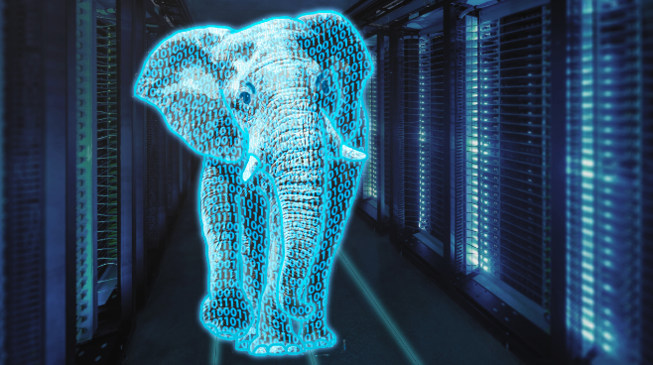
Core SPIDAL Parallel HPC Library with Collective Used
DA-MDS Rotate, AllReduce, Broadcast
Directed Force Dimension Reduction AllGather, Allreduce
Irregular DAVS Clustering Partial Rotate, AllReduce, Broadcast
DA Semimetric Clustering Rotate, AllReduce, Broadcast
K-means AllReduce, Broadcast, AllGather DAAL
SVM AllReduce, AllGather
SubGraph Mining AllGather, AllReduce
Latent Dirichlet Allocation Rotate, AllReduce
Matrix Factorization (SGD) Rotate DAAL
Recommender System (ALS) Rotate DAAL
Singular Value Decomposition (SVD) AllGather DAAL
QR Decomposition (QR) Reduce, Broadcast DAAL
Neural Network AllReduce DAAL
Covariance AllReduce DAAL
Low Order Moments Reduce DAAL
Naive Bayes Reduce DAAL
Linear Regression Reduce DAAL
Ridge Regression Reduce DAAL
Multi-class Logistic Regression Regroup, Rotate, AllGather
Random Forest AllReduce
Principal Component Analysis (PCA) AllReduce DAAL
DAAL implies integrated with Intel DAAL Optimized Data Analytics Library (Runs on KNL!)
Judy Qiu invited Talk at SC17 http://sc17.supercomputing.org/2017/08/22/5863/

Slide 7
Components of Big Data Stack
Google likes to show a timeline; we can build on (Apache version of) this
2002 Google File System GFS ~HDFS (Level 8)
2004 MapReduce Apache Hadoop (Level 14A)
2006 Big Table Apache Hbase (Level 11B)
2008 Dremel Apache Drill (Level 15A)
2009 Pregel Apache Giraph (Level 14A)
2010 FlumeJava Apache Crunch (Level 17)
2010 Colossus better GFS (Level 18)
2012 Spanner horizontally scalable NewSQL database ~CockroachDB (Level 11C)
2013 F1 horizontally scalable SQL database (Level 11C)
2013 MillWheel ~Apache Storm, Twitter Heron (Google not first!) (Level 14B)
2015 Cloud Dataflow Apache Beam with Spark or Flink (dataflow) engine (Level 17)
Functionalities not identified: Security(3), Data Transfer(10), Scheduling(9), DevOps(6), serverless computing (where Apache has OpenWhisk) (5)
HPC-ABDS Levels in ()

Slide 8

HPC Runtime versus ABDS distributed Computing Model on Data Analytics
Hadoop writes to disk and is slowest; Spark and Flink spawn many processes and do not support AllReduce directly;
MPI does in-place combined reduce/broadcast and is fastest
Need Polymorphic Reduction capability choosing best implementation
Use HPC architecture with
  Mutable model
  Immutable data

Slide 9
Some Important Trends
Rich software stacks:
  HPC (High Performance Computing) for Parallel Computing
  Apache for Big Data Software Stack ABDS including some edge computing (streaming data)
Parallel and distributed computing have different requirements but often similar functionalities
  Apache stack ABDS typically uses distributed computing concepts
  For example, Reduce operation is different in MPI (Harp) and Spark
Big Data requirements are not clear but there are a few key use types
  Pleasingly parallel processing (including local machine learning LML)
  Database model with queries again supported by MapReduce for horizontal scaling
  Global Machine Learning GML with single job using multiple nodes as classic parallel computing
  Deep Learning certainly needs HPC – possibly only multiple small systems
Current workloads stress 1) and 2) and are suited to current clouds and to ABDS (with no HPC)
  This explains why Spark with poor GML performance is so successful
Serverless (server hidden) computing attractive to user:
“No server is easier to manage than no server”

Slide 10
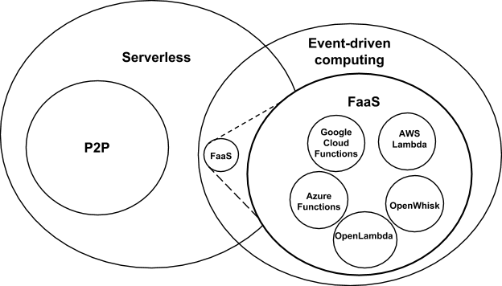
Event-Driven and Serverless Computing
Hopefully will change
Cloud-owner Provided Cloud-native platform for
Short-running, Stateless computation and
Event-driven applications which
Scale up and down instantly and automatically and
Charges for actual usage at a millisecond granularity
Note GridSolve was FaaS
Notes:
Short-running, Stateless computation may go away

Slide 11



Implementing Twister2 to support a Grid linked to an HPC Cloud
Cloud
HPC
Cloud
HPC
Fog
Cloud
HPC
HPC Cloud can
be federated
Centralized HPC Cloud + IoT Devices
Centralized HPC Cloud + Edge = Fog + IoT Devices

Slide 12
Twister2: “Next Generation Grid - Edge – HPC Cloud”
Original 2010 Twister paper has 878 citations; it was a particular approach to MapCollective iterative processing for machine learning
Re-engineer current Apache Big Data and HPC software systems as a toolkit
Support a serverless (cloud-native) dataflow event-driven HPC-FaaS (microservice) framework running across application and geographic domains.
  Support all types of Data analysis from GML to Edge computing
Build on Cloud best practice but use HPC wherever possible to get high performance
Smoothly support current paradigms Hadoop, Spark, Flink, Heron, MPI, DARMA …
Use interoperable common abstractions but multiple polymorphic implementations.
  i.e. do not require a single runtime
Focus on Runtime but this implies HPC-FaaS programming and execution model
This defines a next generation Grid based on data and edge devices – not computing as in old Grid
See long paper http://dsc.soic.indiana.edu/publications/Twister2.pdf

