Slide 1
Research in Digital Science Center
Geoffrey Fox, August 13, 2018
Digital Science Center
Department of Intelligent Systems Engineering
gcf@indiana.edu, http://www.dsc.soic.indiana.edu/, http://spidal.org/
Judy Qiu, David Crandall, Gregor von Laszewski, Dennis Gannon
Supun Kamburugamuve, Bo Peng, Langshi Chen, Kannan Govindarajan, Fugang Wang
nanoBIO Collaboration with several SICE faculty
CyberTraining Collaboration with several SICE faculty
Internal collaboration. Biology, Physics, SICE
Outside Collaborators in funded projects: Arizona, Kansas, Purdue, Rutgers, San Diego Supercomputer Center, SUNY Stony Brook, Virginia Tech, UIUC and Utah
BDEC, NIST and Fudan University

Slide 2
Digital Science Center Themes
Global AI and Modeling Supercomputer
Linking Intelligent Cloud to Intelligent Edge
High-Performance Big-Data Computing
Big Data and Extreme-scale Computing (BDEC)
Using High Performance Computing ideas/technologies to give higher functionality and performance systems

Slide 3
Cloud Computing for an AI First Future
Artificial Intelligence is a dominant disruptive technology affecting all our activities including business, education, research, and society.
Further, several companies have proposed AI first strategies.
The AI disruption is typically associated with big data coming from edge, repositories or sophisticated scientific instruments such as telescopes, light sources and gene sequencers.
AI First requires mammoth computing resources such as clouds, supercomputers, hyperscale systems and their distributed integration.
AI First clouds are related to High Performance Computing HPC -- Cloud or Big Data integration/convergence
Hardware, Software, Algorithms, Applications
Interdisciplinary Interactions

Slide 4
Digital Science Center/ISE Infrastructure
Run computer infrastructure for Cloud and HPC research
  16 K80 and 16 Volta GPU, 8 Haswell node Romeo used in Deep Learning Course E533 and Research (Volta have NVLink)
  26 nodes Victor/Tempest Infiniband/Omnipath Intel Xeon Platinum 48 core nodes
  64 node system Tango with high performance disks (SSD, NVRam = 5x SSD and 25xHDD) and Intel KNL (Knights Landing) manycore (68-72) chips. Omnipath interconnect
  128 node system Juliet with two 12-18 core Haswell chips, SSD and conventional HDD disks. Infiniband Interconnect
  FutureSystems Bravo Delta Echo old but useful; 48 nodes
  All have HPC networks and all can run HDFS and store data on nodes
Teach ISE basic and advanced Cloud Computing and bigdata courses
  E222 Intelligent Systems II (Undergraduate)
  E534 Big Data Applications and Analytics
  E516 Introduction to Cloud Computing
  E616 Advanced Cloud Computing
Supported by Gary Miksik, Allan Streib
Switch focus to Docker+Kubernetes
Use Github for all non-FERPA course material. Have collected large number of open source written-up projects

Slide 5
Digital Science Center Research Activities
Building SPIDAL Scalable HPC machine Learning Library
Applying current SPIDAL in Biology, Network Science (OSoMe), Pathology, Racing Cars
Harp HPC Machine Learning Framework (Qiu)
Twister2 HPC Event Driven Distributed Programming model (replace Spark)
Cloud Research and DevOps for Software Defined Systems (von Laszewski)
Intel Parallel Computing Center @IU (Qiu)
Fudan-Indiana Universities’ Institute for High-Performance Big-Data Computing (??)
Work with NIST on Big Data Standards and non-proprietary Frameworks
Engineered nanoBIO Node NSF EEC-1720625 with Purdue and UIUC
Polar (Radar) Image Processing (Crandall); being used in production
Data analysis of experimental physics scattering results
IoTCloud. Cloud control of robots – licensed to C2RO (Montreal)
Big Data on HPC Cloud

Slide 6


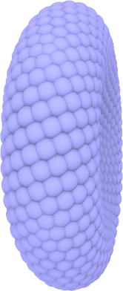
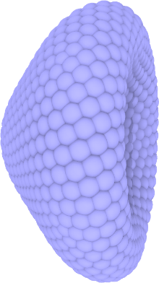
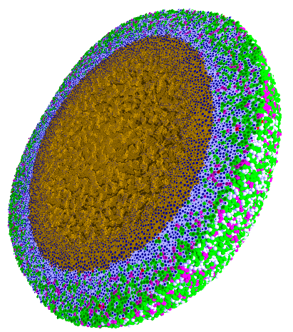
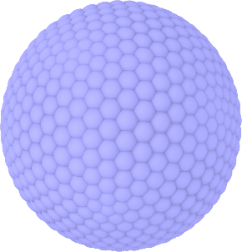
Engineered nanoBIO Node
Indiana University: Intelligent Systems Engineering, Chemistry, Science Gateways Community Institute
The Engineered nanoBIO node at Indiana University (IU) will develop a powerful set of integrated computational nanotechnology tools that facilitate the discovery of customized, efficient, and safe nanoscale devices for biological applications. Applications and Frameworks will be deployed and supported on nanoHUB.
Use in Undergraduate and masters programs in ISE for Nanoengineering and Bioengineering
  ISE (Intelligent Systems Engineering) as a new department developing courses from scratch (67 defined in first 2 years)
Research Experiences for Undergraduates throughout year
Annual engineered nanoBIO workshop
Summer Camps for Middle and High School Students
Online (nanoHUB and YouTube) courses with accessible content on nano and bioengineering
Research and Education tools build on existing simulations, analytics and frameworks: Physicell and CompuCell3D
PhysiCell
NP Shape Lab:

Slide 7
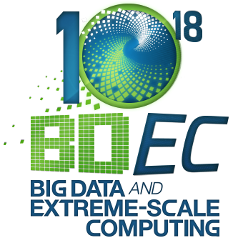
Big Data and Extreme-scale Computing (BDEC) http://www.exascale.org/bdec/
BDEC Pathways to Convergence Report
Next Meeting November, 2018 Bloomington Indiana USA. First day is evening reception with meeting focus “Defining application requirements for a data intensive computing continuum”
Later meeting February 19-21 Kobe, Japan (National infrastructure visions); Q2 2019 Europe (Exploring alternative platform architectures); Q4, 2019 USA (Vendor/Provider perspectives); Q2, 2020 Europe (? Focus); Q3-4, 2020 Final meeting Asia (write report)
http://www.exascale.org/bdec/sites/www.exascale.org.bdec/files/whitepapers/bdec2017pathways.pdf

Slide 10
Integrating HPC and Apache Programming Environments
Harp-DAAL with a kernel Machine Learning library exploiting the Intel node library DAAL and HPC style communication collectives within the Hadoop ecosystem. The broad applicability of Harp-DAAL is supporting many classes of data-intensive computation, from pleasingly parallel to machine learning and simulations. Main focus is launching from Hadoop (Qiu)
Twister2 is a toolkit of components that can be packaged in different ways
  Integrated batch or streaming data capabilities familiar from Apache Hadoop, Spark, Heron and Flink but with high performance.
  Separate bulk synchronous and data flow communication;
  Task management as in Mesos, Yarn and Kubernetes
  Dataflow graph execution models
  Launching of the Harp-DAAL library
  Streaming and repository data access interfaces,
  In-memory databases and fault tolerance at dataflow nodes. (use RDD to do classic checkpoint-restart)

Slide 11
Qiu/Fox Core SPIDAL Parallel HPC Library with Collective Used
DA-MDS Rotate, AllReduce, Broadcast
Directed Force Dimension Reduction AllGather, Allreduce
Irregular DAVS Clustering Partial Rotate, AllReduce, Broadcast
DA Semimetric Clustering (Deterministic Annealing) Rotate, AllReduce, Broadcast
K-means AllReduce, Broadcast, AllGather DAAL
SVM AllReduce, AllGather
SubGraph Mining AllGather, AllReduce
Latent Dirichlet Allocation Rotate, AllReduce
Matrix Factorization (SGD) Rotate DAAL
Recommender System (ALS) Rotate DAAL
Singular Value Decomposition (SVD) AllGather DAAL
QR Decomposition (QR) Reduce, Broadcast DAAL
Neural Network AllReduce DAAL
Covariance AllReduce DAAL
Low Order Moments Reduce DAAL
Naive Bayes Reduce DAAL
Linear Regression Reduce DAAL
Ridge Regression Reduce DAAL
Multi-class Logistic Regression Regroup, Rotate, AllGather
Random Forest AllReduce
Principal Component Analysis (PCA) AllReduce DAAL
DAAL implies integrated on node with Intel DAAL Optimized Data Analytics Library (Runs on KNL!)

Slide 12
Big Data and Simulation Difficulty in Parallelism
Size of Synchronization constraints
Loosely Coupled
Tightly Coupled
HPC Clouds: Accelerators
High Performance Interconnect
HPC Clouds/Supercomputers
Memory access also critical
Commodity Clouds
Size of Disk I/O
MapReduce as in scalable databases
Global Machine Learning
e.g. parallel clustering
Deep Learning
Graph Analytics e.g. subgraph mining
LDA
Pleasingly Parallel
Often independent events
Unstructured Adaptive Sparse
Current major Big Data category
Linear Algebra at core (often not sparse)
Structured Adaptive Sparse
Parameter sweep simulations
Largest scale simulations
Just two problem characteristics
There is also data/compute distribution seen in grid/edge computing
Exascale Supercomputers

