Slide 1
Research in Digital Science Center
Geoffrey Fox, August 20, 2018
Digital Science Center
Department of Intelligent Systems Engineering
gcf@indiana.edu, http://www.dsc.soic.indiana.edu/, http://spidal.org/
Judy Qiu, David Crandall, Gregor von Laszewski, Dennis Gannon
Supun Kamburugamuve, Bo Peng, Langshi Chen, Kannan Govindarajan, Fugang Wang
nanoBIO Collaboration with several SICE faculty
CyberTraining Collaboration with several SICE faculty
Internal collaboration. Biology, Physics, SICE
Outside Collaborators in funded projects: Arizona, Kansas, Purdue, Rutgers, San Diego Supercomputer Center, SUNY Stony Brook, Virginia Tech, UIUC and Utah
BDEC, NIST and Fudan University in unfunded collaborations

Slide 2
Digital Science Center Themes
Global AI and Modeling Supercomputer
Linking Intelligent Cloud to Intelligent Edge
High-Performance Big-Data Computing
Big Data and Extreme-scale Computing (BDEC)
Using High Performance Computing ideas/technologies to give higher functionality and performance systems

Slide 3
Cloud Computing for an AI First Future
Artificial Intelligence is a dominant disruptive technology affecting all our activities including business, education, research, and society.
Further, several companies have proposed AI first strategies.
The AI disruption is typically associated with big data coming from edge, repositories or sophisticated scientific instruments such as telescopes, light sources and gene sequencers.
AI First requires mammoth computing resources such as clouds, supercomputers, hyperscale systems and their distributed integration.
AI First clouds are related to High Performance Computing HPC -- Cloud or Big Data integration/convergence
Hardware, Software, Algorithms, Applications
Interdisciplinary Interactions

Slide 4
Digital Science Center/ISE Infrastructure
Run computer infrastructure for Cloud and HPC research
  16 K80 and 16 Volta GPU, 8 Haswell node Romeo used in Deep Learning Course E533 and Research (Volta have NVLink)
  26 nodes Victor/Tempest Infiniband/Omnipath Intel Xeon Platinum 48 core nodes
  64 node system Tango with high performance disks (SSD, NVRam = 5x SSD and 25xHDD) and Intel KNL (Knights Landing) manycore (68-72) chips. Omnipath interconnect
  128 node system Juliet with two 12-18 core Haswell chips, SSD and conventional HDD disks. Infiniband Interconnect
  FutureSystems Bravo Delta Echo old but useful; 48 nodes
  All have HPC networks and all can run HDFS and store data on nodes
Teach ISE basic and advanced Cloud Computing and bigdata courses
  E222 Intelligent Systems II (Undergraduate)
  E534 Big Data Applications and Analytics
  E516 Introduction to Cloud Computing
  E616 Advanced Cloud Computing
Supported by Gary Miksik, Allan Streib
Switch focus to Docker+Kubernetes
Use Github for all non-FERPA course material. Have collected large number of open source written-up projects

Slide 5
Digital Science Center Research Activities
Building SPIDAL Scalable HPC machine Learning Library
Applying current SPIDAL in Biology, Network Science (OSoMe), Pathology, Racing Cars
Harp HPC Machine Learning Framework (Qiu)
Twister2 HPC Event Driven Distributed Programming model (replace Spark)
Cloud Research and DevOps for Software Defined Systems (von Laszewski)
Intel Parallel Computing Center @IU (Qiu)
Fudan-Indiana Universities’ Institute for High-Performance Big-Data Computing (??)
Work with NIST on Big Data Standards and non-proprietary Frameworks
Engineered nanoBIO Node NSF EEC-1720625 with Purdue and UIUC
Polar (Radar) Image Processing (Crandall); being used in production
Data analysis of experimental physics scattering results
IoTCloud. Cloud control of robots – licensed to C2RO (Montreal)
Big Data on HPC Cloud

Slide 6


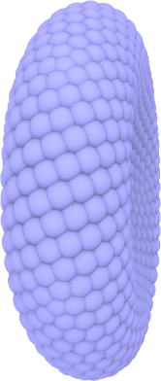
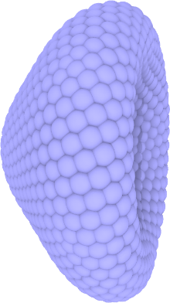
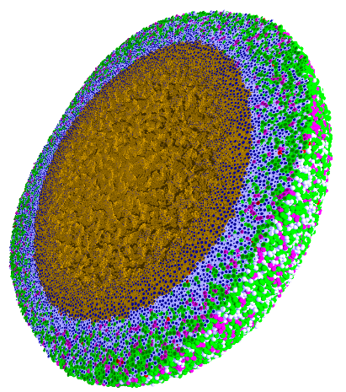
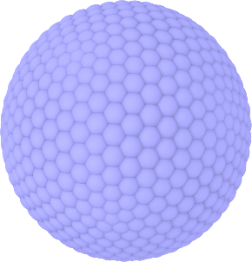
Engineered nanoBIO Node
Indiana University: Intelligent Systems Engineering, Chemistry, Science Gateways Community Institute
The Engineered nanoBIO node at Indiana University (IU) will develop a powerful set of integrated computational nanotechnology tools that facilitate the discovery of customized, efficient, and safe nanoscale devices for biological applications. Applications and Frameworks will be deployed and supported on nanoHUB.
Use in Undergraduate and masters programs in ISE for Nanoengineering and Bioengineering
  ISE (Intelligent Systems Engineering) as a new department developing courses from scratch (67 defined in first 2 years)
Research Experiences for Undergraduates throughout year
Annual engineered nanoBIO workshop
Summer Camps for Middle and High School Students
Online (nanoHUB and YouTube) courses with accessible content on nano and bioengineering
Research and Education tools build on existing simulations, analytics and frameworks: Physicell and CompuCell3D
PhysiCell
NP Shape Lab:

Slide 7

Big Data and Extreme-scale Computing (BDEC) http://www.exascale.org/bdec/
BDEC Pathways to Convergence Report
Next Meeting November, 2018 Bloomington Indiana USA. First day is evening reception with meeting focus “Defining application requirements for a data intensive computing continuum”
Later meeting February 19-21 Kobe, Japan (National infrastructure visions); Q2 2019 Europe (Exploring alternative platform architectures); Q4, 2019 USA (Vendor/Provider perspectives); Q2, 2020 Europe (? Focus); Q3-4, 2020 Final meeting Asia (write report)
http://www.exascale.org/bdec/sites/www.exascale.org.bdec/files/whitepapers/bdec2017pathways.pdf

Slide 10
Integrating HPC and Apache Programming Environments
Harp-DAAL with a kernel Machine Learning library exploiting the Intel node library DAAL and HPC style communication collectives within the Hadoop ecosystem. The broad applicability of Harp-DAAL is supporting many classes of data-intensive computation, from pleasingly parallel to machine learning and simulations. Main focus is launching from Hadoop (Qiu)
Twister2 is a toolkit of components that can be packaged in different ways
  Integrated batch or streaming data capabilities familiar from Apache Hadoop, Storm, Heron, Spark, and Flink but with high performance.
  Separate bulk synchronous and data flow communication;
  Task management as in Mesos, Yarn and Kubernetes
  Dataflow graph execution models
  Launching of the Harp-DAAL library
  Streaming and repository data access interfaces,
  In-memory databases and fault tolerance at dataflow nodes. (use RDD to do classic checkpoint-restart)

Slide 11
Study Microsoft Research Topics
Microsoft Research has about 1000 researchers and has 800 interns per year – apply!
They just held a faculty summit largely focused on systems for AI
https://www.microsoft.com/en-us/research/event/faculty-summit-2018/
With an inspirational overview positioning their work as building designing and using the "Global AI Supercomputer" concept linking intelligent Cloud to Intelligent Edge https://www.youtube.com/watch?v=jsv7EWhCqIQ&feature=youtu.be

Slide 12
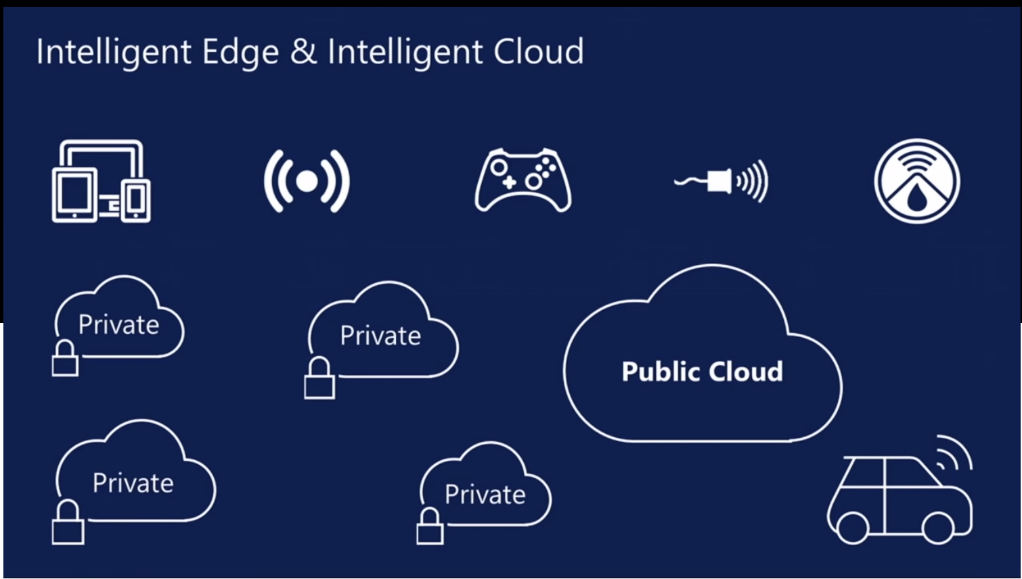
aa
aa

Slide 13
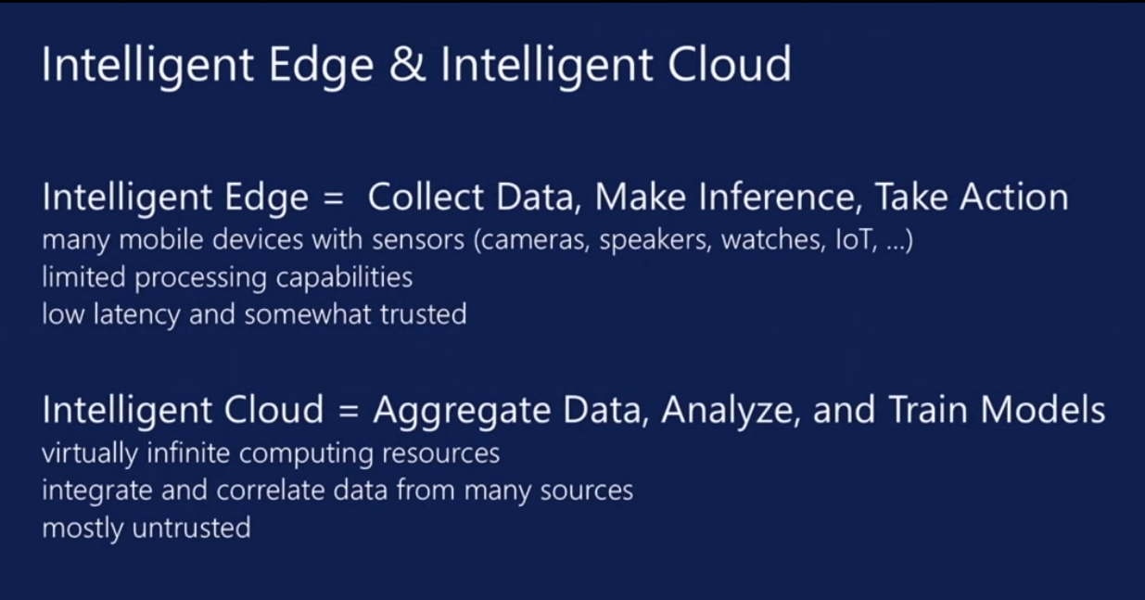
aa
aa

Slide 14
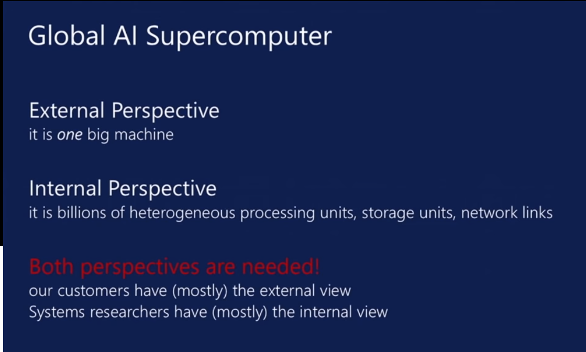
aa
aa

Slide 15
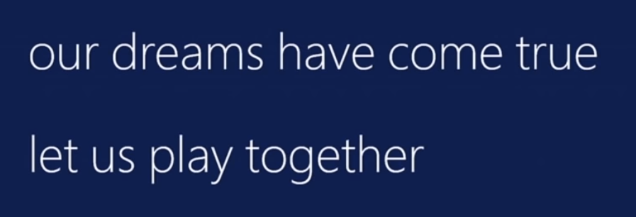
Collaborating on the Global AI Supercomputer GAISC
Microsoft says:
We can only “play together” and link functionalities from Google,Amazon, Facebook, Microsoft, Academia if we have open API’s and open code to customize
Open source Apache software
Academia needs to use and define their own projects
We want to use AI supercomputer to study early universe as well as producing annoying advertisements (goal of most elite CS researchers)

Slide 16
HPC-ABDS
Integrated wide range of HPC and Big Data technologies.
I gave up updating list in January 2016!

Slide 17
Components of Big Data Stack
Google likes to show a timeline; we can build on (Apache version of) this
2002 Google File System GFS ~HDFS (Level 8)
2004 MapReduce Apache Hadoop (Level 14A)
2006 Big Table Apache Hbase (Level 11B)
2008 Dremel Apache Drill (Level 15A)
2009 Pregel Apache Giraph (Level 14A)
2010 FlumeJava Apache Crunch (Level 17)
2010 Colossus better GFS (Level 18)
2012 Spanner horizontally scalable NewSQL database ~CockroachDB (Level 11C)
2013 F1 horizontally scalable SQL database (Level 11C)
2013 MillWheel ~Apache Storm, Twitter Heron (Google not first!) (Level 14B)
2015 Cloud Dataflow Apache Beam with Spark or Flink (dataflow) engine (Level 17)
Functionalities not identified: Security(3), Data Transfer(10), Scheduling(9), DevOps(6), serverless computing (where Apache has OpenWhisk) (5)
HPC-ABDS Levels in ()

Slide 18
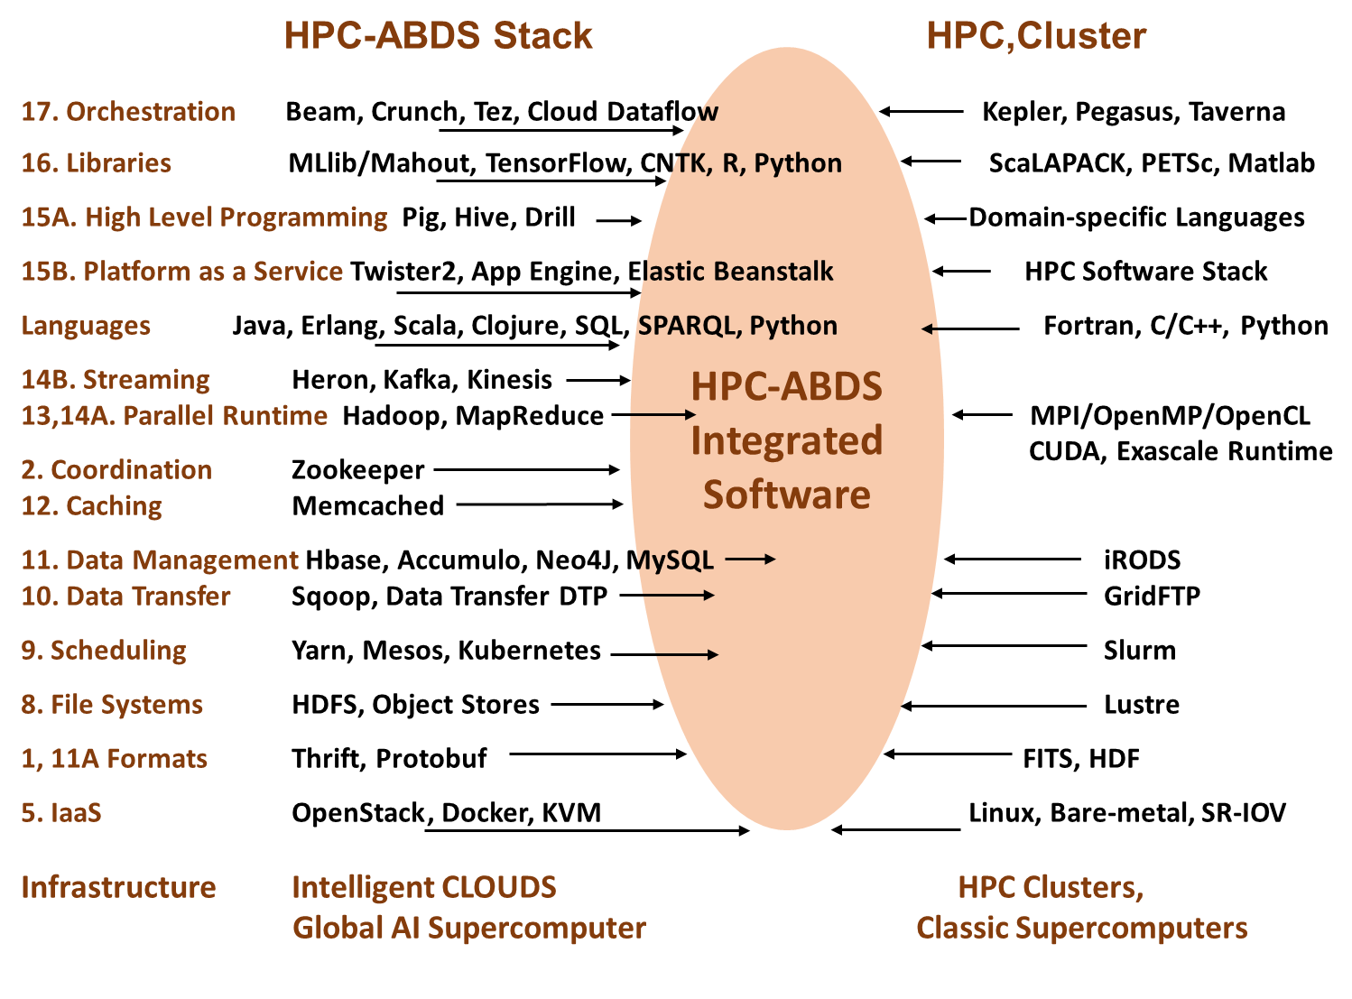
Different choices in software systems in Clouds and HPC. HPC-ABDS takes cloud software augmented by HPC when needed to improve performance
Uses 16 of 21HPC-ABDS layers plus languages

Slide 19
Functionality of 21 HPC-ABDS Layers in Global AI Supercomputer
Message Protocols:
Distributed Coordination:
Security & Privacy:
Monitoring:
IaaS Management from HPC to hypervisors:
DevOps:
Interoperability:
File systems:
Cluster Resource Management:
Data Transport:
A) File management
B) NoSQL
C) SQL
In-memory databases & caches / Object-relational mapping / Extraction Tools
Inter process communication Collectives, point-to-point, publish-subscribe, MPI:
A) Basic Programming model and runtime, SPMD, MapReduce:
B) Streaming:
A) High level Programming:
B) Frameworks
Application and Analytics:
Workflow-Orchestration:
Lesson of large number (350). This is a rich software environment that academia cannot “compete” with. Need to use and not regenerate except in special cases!

Slide 20
Topics in Microsoft Faculty Summit I
Systems Research | Fueling Future Disruptions
Welcome: https://youtu.be/_IF9esNec3E
Introduction: https://youtu.be/RnzjxXOqovc
Summary: Global AI Supercomputer: Intelligent Cloud and Intelligent Edge: https://youtu.be/jsv7EWhCqIQ
Entrepreneurship and Systems Research https://youtu.be/vszcATWtr2U
Azure and Intelligent Cloud
Inside Microsoft Azure Datacenter Architecture:
The Art of Building a Reliable Cloud Network https://youtu.be/Iiwb7ysxyck
AI and Intelligent Systems
Free Inference and Instant Training: Breakthroughs and Implications https://youtu.be/Tkl6ERLWAbA. 3 slidesets
Knowledge Systems and AI
AI Infrastructure and Tools. 1 slideset

Slide 21
Topics in Microsoft Faculty Summit II
AI to Control (AI) Systems
Database and Data Analytic Systems https://youtu.be/nxEIfluXQ_A 3 slidesets
AI for AI Systems https://youtu.be/MqBOuoLflpU. 2 slidesets
The Good, the Bad, and the Ugly of ML for Networked Systems. 3 slidesets
Edge Computing
Intelligent Edge. 4 slidesets
Security and Privacy
Verification and Secure Systems https://youtu.be/J9977DaNAlc 2 slidesets
Confidential Computing. 4 slidesets
CPU & DRAM Bugs: Attacks & Defenses. 3 slidesets
Current Trends in Blockchain Technology https://youtu.be/QcRQRUlk5Xs. 3 slidesets

Slide 22
Topics in Microsoft Faculty Summit III
Physical Systems
Hardware-accelerated Networked Systems. 2 slidesets
Programmable Hardware for Distributed Systems. 1 slideset
Future of Cloud Storage Systems. 2 slidesets
Quantum Computers: Software and Hardware Architecture. 2 slidesets
Software Engineering
Continuous Deployment: Current and Future Challenges. 2 slidesets

Slide 23
Major Digital Science Center Projects
Harp (Judy Qiu will describe in E500 and feature in her E599 High Performance Big Data Systems) is open source Machine Learning Library for GAISC – algorithms and parallel software
Twister2 is a high performance system outperforming Spark and Hadoop and is programming and runtime environment for GAISC for both batch and streaming applications
Cloudmesh (Gregor von Laszewski) is Python DevOps tool for defining and creating “software-defined systems” interoperably for different environment as GAISC must run on many core infrastructures
FutureSystems is our infrastructure optimized for cloud computing and high performance
Applications: Bioinformatics (Precision Health), Indy car, Cloud controlled robots, Ice-sheets radar analysis, particle physics, Network science, Pathology, geospatial applications, nanoBIO, Biomolecular simulation data analysis
Benchmarking and Application classification: the Ogres with NIST

Slide 24
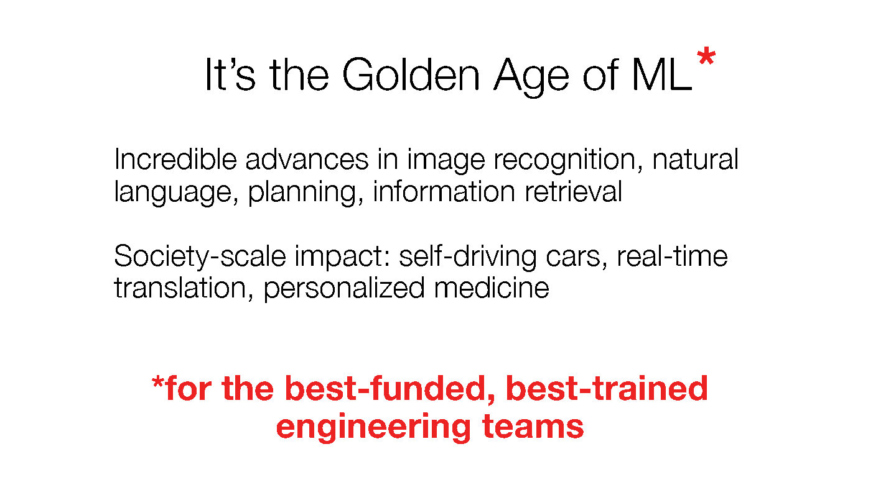
Zaharia has a well-funded well trained team. We compete with a few good key ideas and a different choice of applications. We also do education with up to date courses

Slide 25
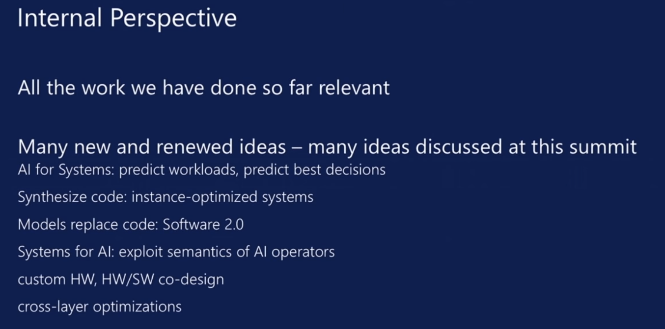
aa
aa

Slide 26
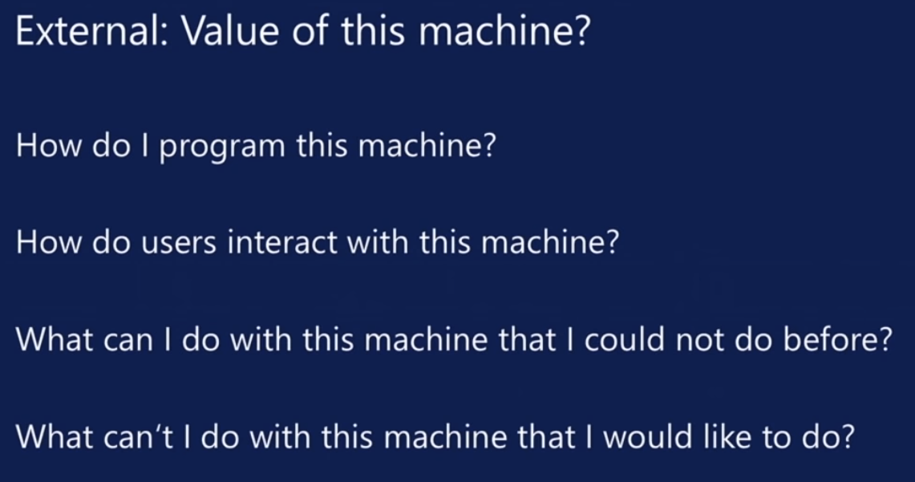
aa
aa

Slide 27
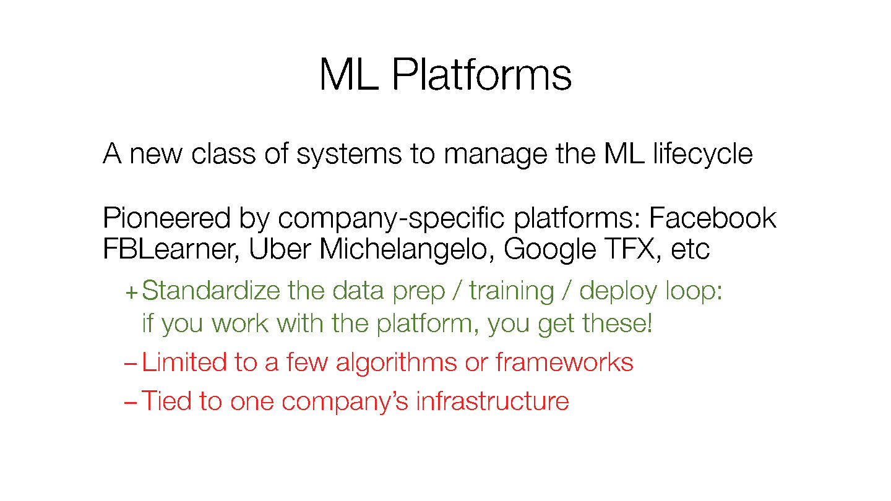
Zaharia discussed ML Platforms. This is Twister2 plus Harp

Slide 28
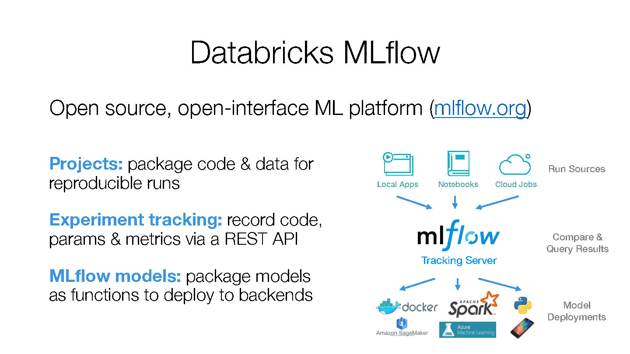
Zaharia discussed MLflow. Twister2 will do with higher performance

Slide 29
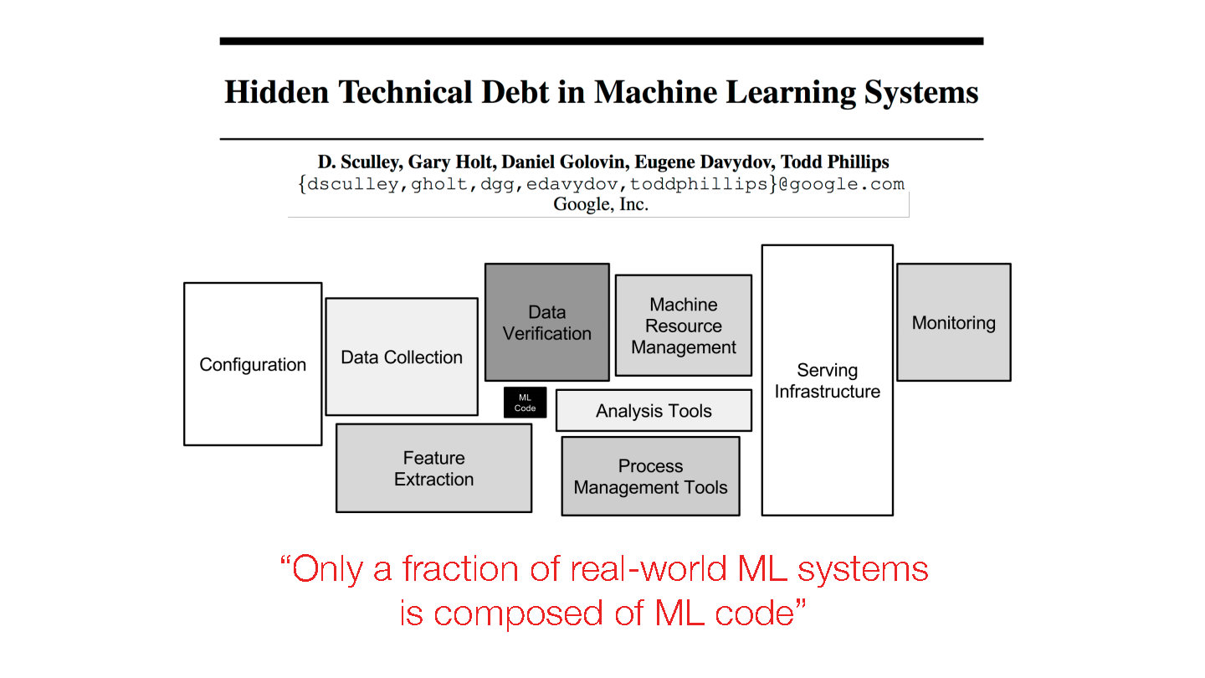
We like Zaharia are motivated by this slide. Data engineering is our focus and this is needed for Machine Learning to be useful.
Gartner says that 3 times as many jobs for data engineers as data scientists.
NIPS 2015 http://papers.nips.cc/paper/5656-hidden-technical-debt-in-machine-learning-systems.pdf

Slide 30
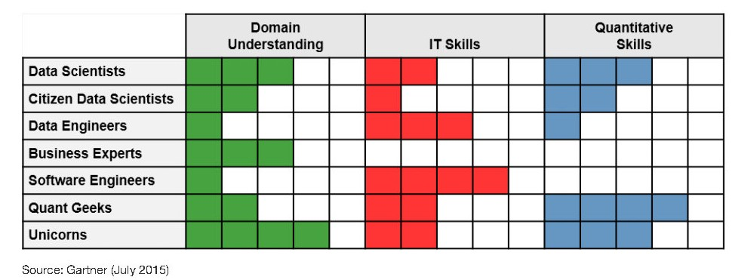
Gartner on Data Engineering
Gartner says that job numbers in data science teams are
10% - Data Scientists
20% - Citizen Data Scientists ("decision makers")
30% - Data Engineers
20% - Business experts
15% - Software engineers
5% - Quant geeks
~0% - Unicorns
(very few exist!)

Slide 31
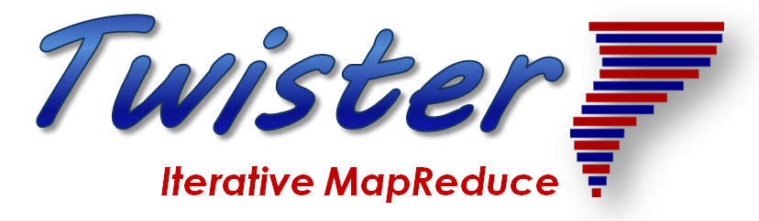
Application Structure
2
http://www.iterativemapreduce.org/

Slide 32
Distinctive Features of Applications
Ratio of data to model sizes: vertical axis on next slide
Importance of Synchronization – ratio of inter-node communication to node computing: horizontal axis on next slide
Sparsity of Data or Model; impacts value of GPU’s or vector computing
Irregularity of Data or Model
Geographic distribution of Data as in edge computing; use of streaming (dynamic data) versus batch paradigms
Dynamic model structure as in some iterative algorithms

Slide 33
Big Data and Simulation Difficulty in Parallelism
Size of Synchronization constraints
Loosely Coupled
Tightly Coupled
HPC Clouds: Accelerators
High Performance Interconnect
HPC Clouds/Supercomputers
Memory access also critical
Commodity Clouds
Size of Disk I/O
MapReduce as in scalable databases
Global Machine Learning
e.g. parallel clustering
Deep Learning
Graph Analytics e.g. subgraph mining
LDA
Pleasingly Parallel
Often independent events
Unstructured Adaptive Sparse
Current major Big Data category
Linear Algebra at core (often not sparse)
Structured Adaptive Sparse
Parameter sweep simulations
Largest scale simulations
Just two problem characteristics
There is also data/compute distribution seen in grid/edge computing
Exascale Supercomputers

Slide 34
Requirements
On general principles parallel and distributed computing have different requirements even if sometimes similar functionalities
  Apache stack ABDS typically uses distributed computing concepts
  For example, Reduce operation is different in MPI (Harp) and Spark
Large scale simulation requirements are well understood BUT
Big Data requirements are not agreed but there are a few key use types
  Pleasingly parallel processing (including local machine learning LML) as of different tweets from different users with perhaps MapReduce style of statistics and visualizations; possibly Streaming
  Database model with queries again supported by MapReduce for horizontal scaling
  Global Machine Learning GML with single job using multiple nodes as classic parallel computing
  Deep Learning certainly needs HPC – possibly only multiple small systems
Current workloads stress 1) and 2) and are suited to current clouds and to Apache Big Data Software (with no HPC)
  This explains why Spark with poor GML performance can be so successful

Slide 35
Local and Global Machine Learning
Many applications use LML or Local machine Learning where machine learning (often from R or Python or Matlab) is run separately on every data item such as on every image
But others are GML Global Machine Learning where machine learning is a basic algorithm run over all data items (over all nodes in computer)
  maximum likelihood or χ² with a sum over the N data items – documents, sequences, items to be sold, images etc. and often links (point-pairs).
  GML includes Graph analytics, clustering/community detection, mixture models, topic determination, Multidimensional scaling, (Deep) Learning Networks
Note Facebook may need lots of small graphs (one per person and ~LML) rather than one giant graph of connected people (GML)

Slide 36
Five Major Application Structures
Global Machine Learning
Always Classic Cloud Workload
Add High Performance Big Data Workload
Note Problem and System Architecture ae similar as efficient execution says they must match

Slide 37
Comparing Spark, Flink and MPI
2
http://www.iterativemapreduce.org/

Slide 38
Machine Learning with MPI, Spark and Flink
Three algorithms implemented in three runtimes
  Multidimensional Scaling (MDS)
  Terasort
  K-Means (drop as no time and looked at later)
Implementation in Java
  MDS is the most complex algorithm - three nested parallel loops
  K-Means - one parallel loop
  Terasort - no iterations
With care, Java performance ~ C performance
Without care, Java performance << C performance (details omitted)

Slide 39



Multidimensional Scaling: 3 Nested Parallel Sections
Kmeans also bad – see later
Flink
Spark
MPI
MPI Factor of 20-200 Faster than Spark/Flink
MDS execution time with 32000 points on varying number of nodes. Each node runs 20 parallel tasks
Spark, Flink No Speedup
MDS execution time on 16 nodes with 20 processes in each node with varying number of points

Slide 40


Terasort
Sorting 1TB of data records
Terasort execution time in 64 and 32 nodes. Only MPI shows the sorting time and communication time as other two frameworks doesn't provide a clear method to accurately measure them. Sorting time includes data save time.
MPI-IB - MPI with Infiniband
Partition the data using a sample and regroup

Slide 41
Architecture
2
http://www.iterativemapreduce.org/

Slide 42
Features of High Performance Big Data Processing Systems
Application Requirements: The structure of application clearly impacts needed hardware and software
  Pleasingly parallel
  Workflow
  Global Machine Learning
Data model: SQL, NoSQL; File Systems, Object store; Lustre, HDFS
Distributed data from distributed sensors and instruments (Internet of Things) requires Edge computing model
  Device – Fog – Cloud model and streaming data software and algorithms
Hardware: node (accelerators such as GPU or KNL for deep learning) and multi-node architecture configured as AI First HPC Cloud;
  Disks speed and location
This implies software requirements
Analytics
Data management
Streaming or Repository access or both

Slide 43
Ways of adding High Performance to Global AI Supercomputer
Fix performance issues in Spark, Heron, Hadoop, Flink etc.
  Messy as some features of these big data systems intrinsically slow in some (not all) cases
  All these systems are “monolithic” and difficult to deal with individual components
Execute HPBDC from classic big data system with custom communication environment – approach of Harp for the relatively simple Hadoop environment
Provide a native Mesos/Yarn/Kubernetes/HDFS high performance execution environment with all capabilities of Spark, Hadoop and Heron – goal of Twister2
Execute with MPI in classic (Slurm, Lustre) HPC environment
Add modules to existing frameworks like Scikit-Learn or Tensorflow either as new capability or as a higher performance version of existing module.

Slide 44
Twister2 Components I
Area | Component | Implementation | Comments: User API
Architecture Specification | Coordination Points | State and Configuration Management; Program, Data and Message Level | Change execution mode; save and reset state
 | Execution Semantics | Mapping of Resources to Bolts/Maps in Containers, Processes, Threads | Different systems make different choices - why?
 | Parallel Computing | Spark Flink Hadoop Pregel MPI modes | Owner Computes Rule
Job Submission | (Dynamic/Static) Resource Allocation | Plugins for Slurm, Yarn, Mesos, Marathon, Aurora | Client API (e.g. Python) for Job Management
Task System | Task migration | Monitoring of tasks and migrating tasks for better resource utilization | Task-based programming with Dynamic or Static Graph API; FaaS API; Support accelerators (CUDA,KNL)
 | Elasticity | OpenWhisk
 | Streaming and FaaS Events | Heron, OpenWhisk, Kafka/RabbitMQ
 | Task Execution | Process, Threads, Queues
 | Task Scheduling | Dynamic Scheduling, Static Scheduling, Pluggable Scheduling Algorithms
 | Task Graph | Static Graph, Dynamic Graph Generation

Slide 45
Twister2 Components II
Area | Component | Implementation | Comments
Communication API | Messages | Heron | This is user level and could map to multiple communication systems
 | Dataflow Communication | Fine-Grain Twister2 Dataflow communications: MPI,TCP and RMA Coarse grain Dataflow from NiFi, Kepler? | Streaming, ETL data pipelines; Define new Dataflow communication API and library
 | BSP Communication Map-Collective | Conventional MPI, Harp | MPI Point to Point and Collective API
Data Access | Static (Batch) Data | File Systems, NoSQL, SQL | Data API
 | Streaming Data | Message Brokers, Spouts
Data Management | Distributed Data Set | Relaxed Distributed Shared Memory(immutable data), Mutable Distributed Data | Data Transformation API; Spark RDD, Heron Streamlet
Fault Tolerance | Check Pointing | Upstream (streaming) backup; Lightweight; Coordination Points; Spark/Flink, MPI and Heron models | Streaming and batch cases distinct; Crosses all components
Security | Storage, Messaging, execution | Research needed | Crosses all Components

Slide 46
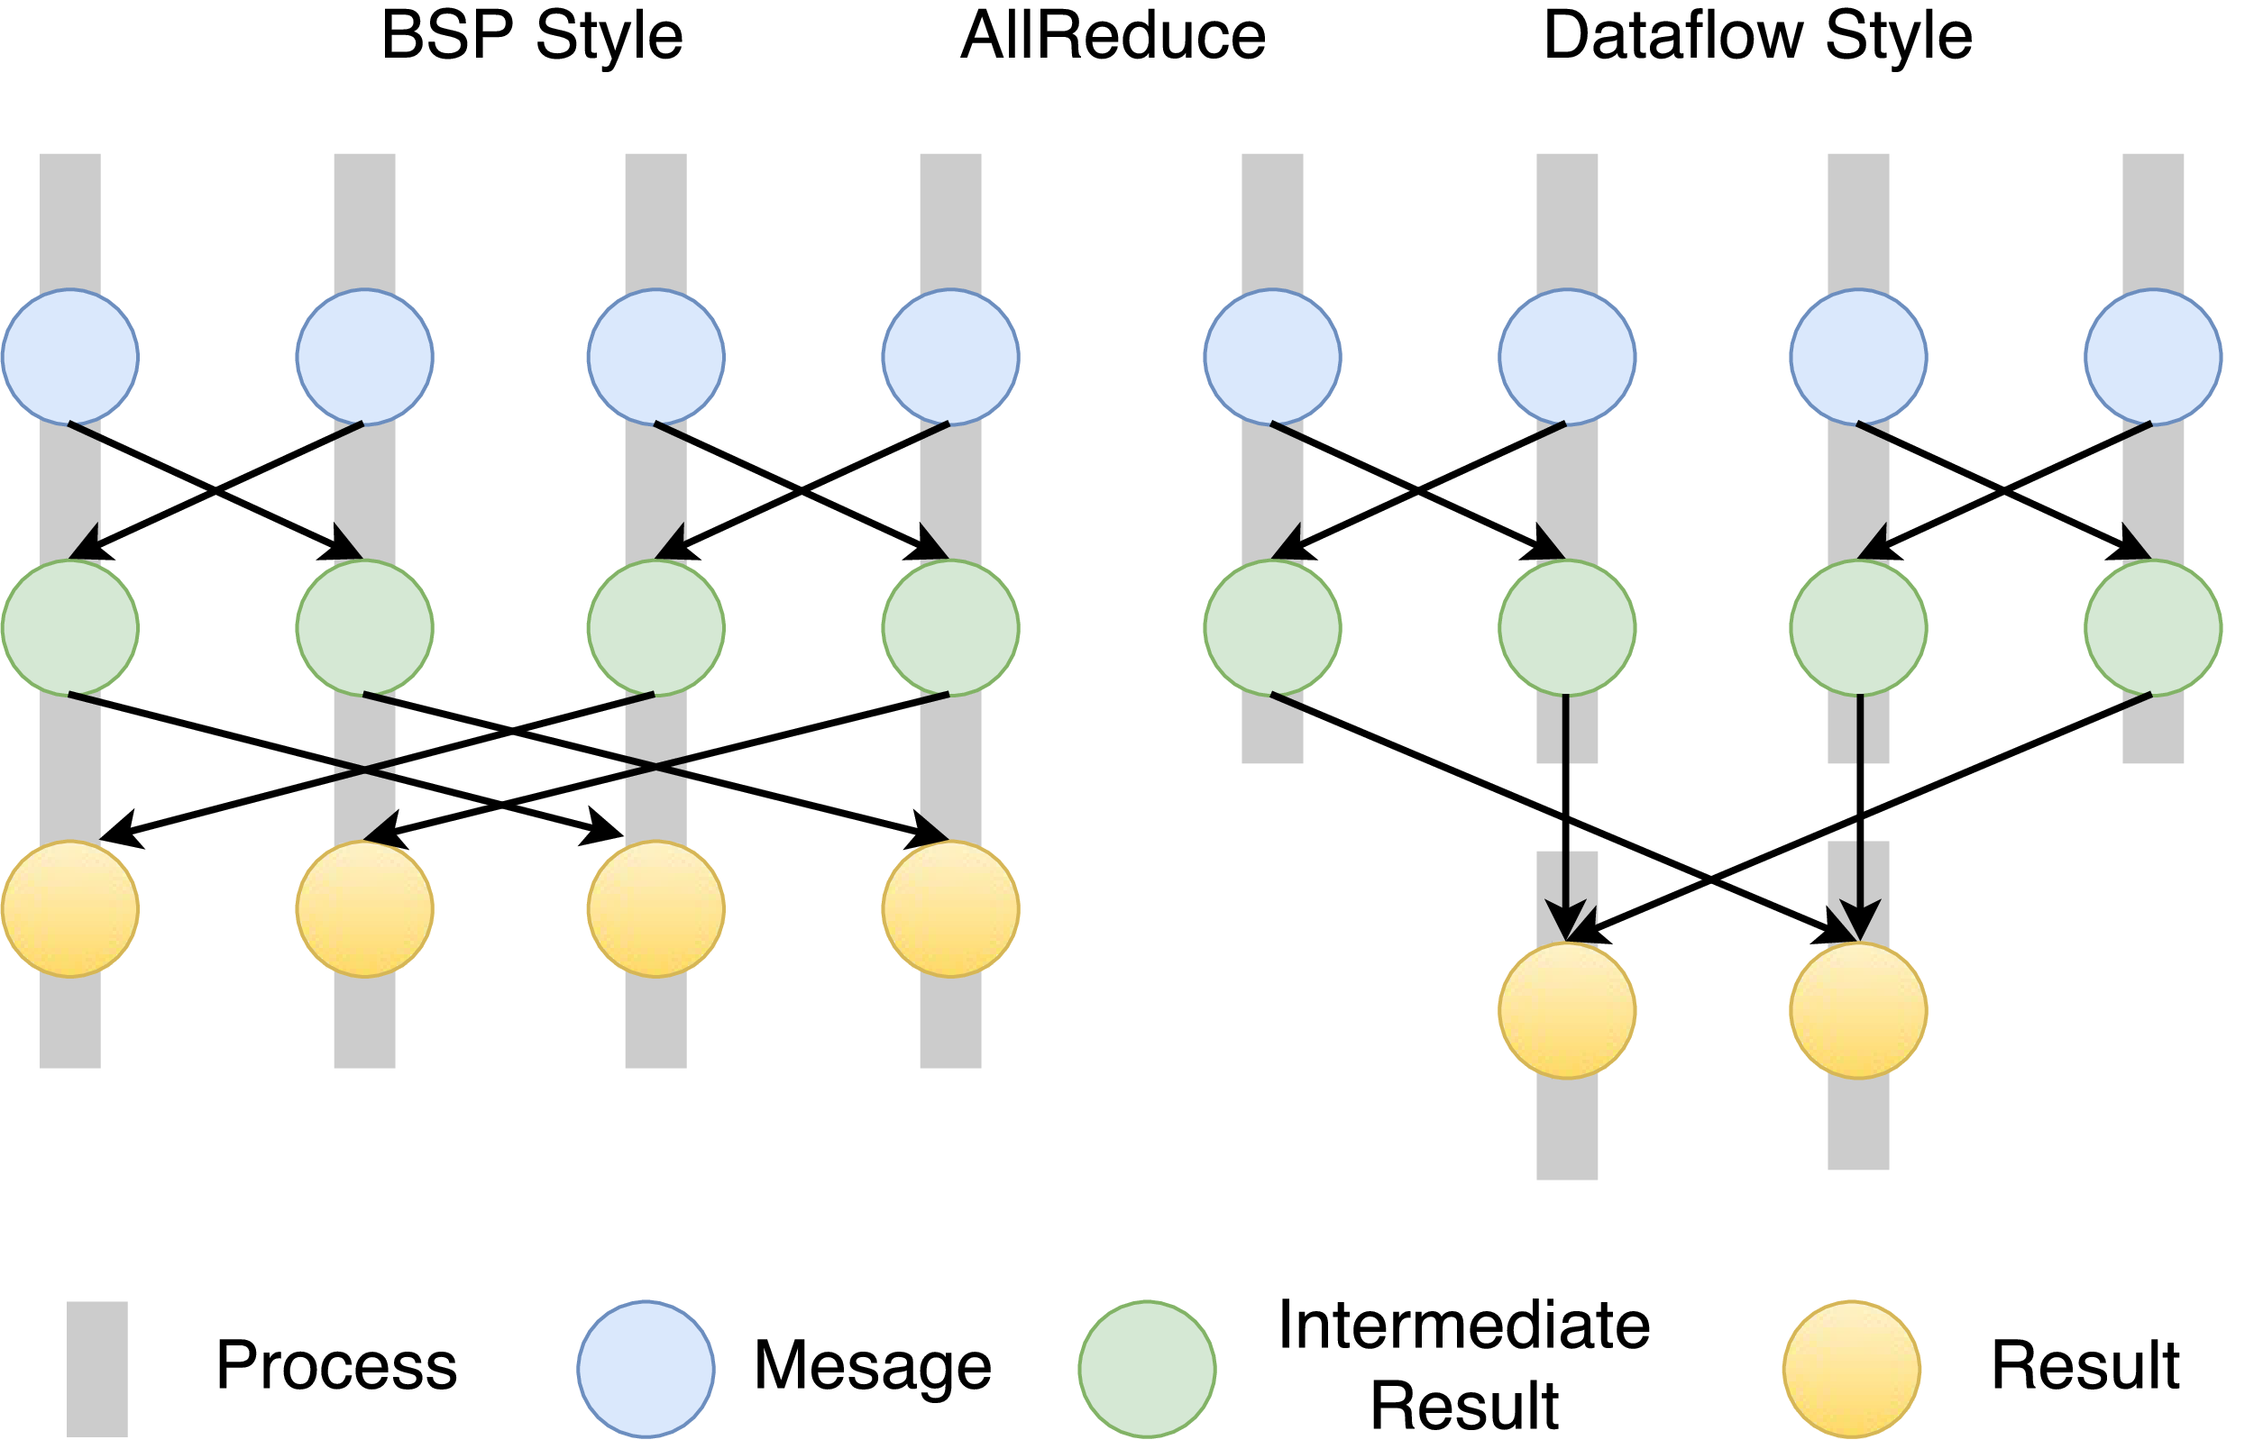
Twister2 Dataflow Communications
Twister:Net offers two communication models
BSP (Bulk Synchronous Processing) message-level communication using TCP or MPI separated from its task management plus extra Harp collectives
DFW a new Dataflow library built using MPI software but at data movement not message level
  Non-blocking
  Dynamic data sizes
  Streaming model
    Batch case is modeled as a finite stream
  The communications are between a set of
  tasks in an arbitrary task graph
  Key based communications
  Data-level Communications spilling to disks
  Target tasks can be different from source tasks

Slide 47
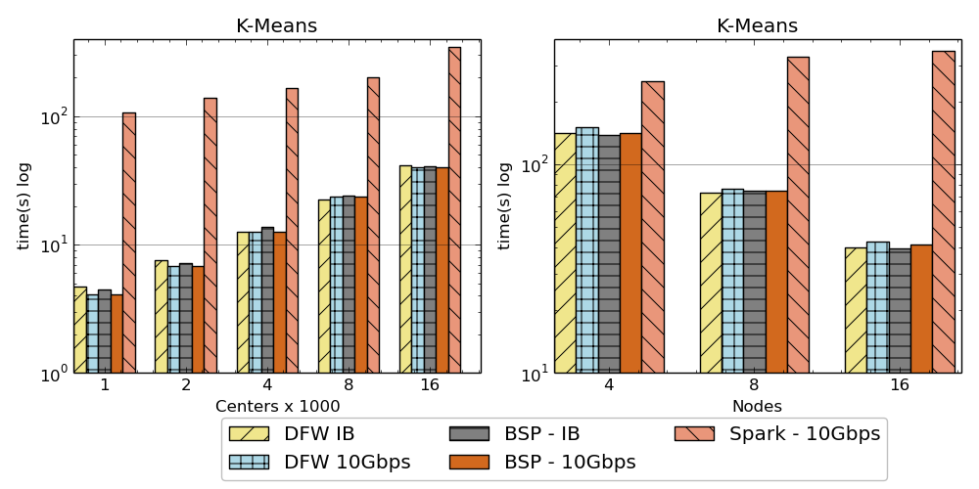
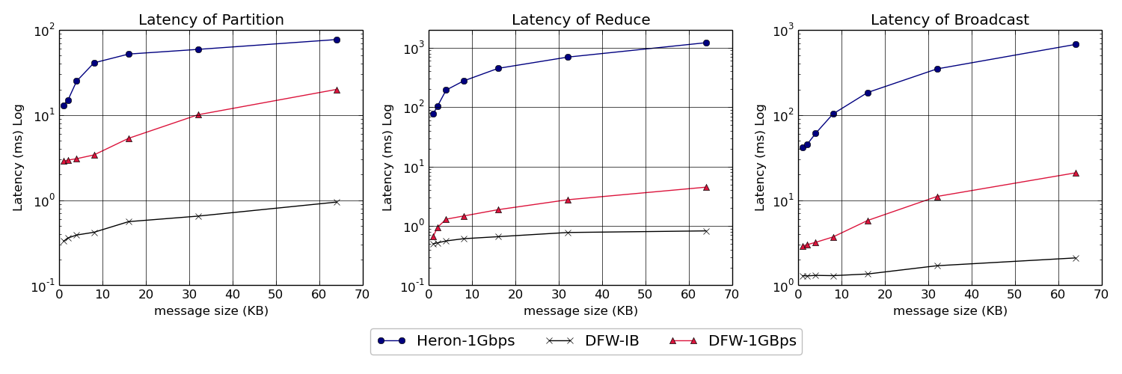
Twister:Net and Apache Heron and Spark
Left: K-means job execution time on 16 nodes with varying centers, 2 million points with 320-way parallelism. Right: K-Means wth 4,8 and 16 nodes where each node having 20 tasks. 2 million points with 16000 centers used.
Latency of Apache Heron and Twister:Net DFW (Dataflow) for Reduce, Broadcast and Partition operations in 16 nodes with 256-way parallelism

Slide 48

Dataflow at Different Grain sizes
Coarse Grain Dataflows links jobs in such a pipeline
Visualization
Dimension
Reduction
Data preparation
Clustering
But internally to each job you can also elegantly express algorithm as dataflow but with more stringent performance constraints
Corresponding to classic Spark K-means Dataflow
P = loadPoints()
C = loadInitCenters()
for (int i = 0; i < 10; i++) {
T = P.map().withBroadcast(C)
C = T.reduce() }
Internal Execution
Dataflow Nodes
Reduce
Iterate
HPC
Communication
Maps
Iterate

Slide 49
Fault Tolerance and State
Similar form of check-pointing mechanism is used already in HPC and Big Data
  although HPC informal as doesn’t typically specify as a dataflow graph
  Flink and Spark do better than MPI due to use of database technologies; MPI is a bit harder due to richer state but there is an obvious integrated model using RDD type snapshots of MPI style jobs
Checkpoint after each stage of the dataflow graph (at location of intelligent dataflow nodes)
  Natural synchronization point
  Let’s allows user to choose when to checkpoint (not every stage)
  Save state as user specifies; Spark just saves Model state which is insufficient for complex algorithms

Slide 50
Futures
Implementing Twister2 for Global AI Supercomputer
2
http://www.iterativemapreduce.org/

Slide 51
Twister2 Timeline: End of September 2018
Twister:Net Dataflow Communication API
  Dataflow communications with MPI or TCP
Data access
  Local File Systems
  HDFS Integration
Task Graph
  Streaming Batch analytics – Iterative jobs
  Data pipelines
Deployments on Docker, Kubernetes, Mesos (Aurora), Slurm

Slide 52
Twister2 Timeline: Middle of December 2018
Harp for Machine Learning (Custom BSP Communications)
  Rich collectives
  Around 30 ML algorithms
Naiad model based Task system for Machine Learning
Link to Pilot Jobs
Fault tolerance as in Heron and Spark
  Streaming
  Batch
Storm API for Streaming
RDD API for Spark batch

Slide 53
Twister2 Timeline: After December 2018
Native MPI integration to Mesos, Yarn
Dynamic task migrations
RDMA and other communication enhancements
Integrate parts of Twister2 components as big data systems enhancements (i.e. run current Big Data software invoking Twister2 components)
  Heron (easiest), Spark, Flink, Hadoop (like Harp today)
Support different APIs (i.e. run Twister2 looking like current Big Data Software)
  Hadoop
  Spark (Flink)
  Storm
Refinements like Marathon with Mesos etc.
Function as a Service and Serverless
Support higher level abstractions
  Twister:SQL (major Spark use case)

Slide 54
Qiu/Fox Core SPIDAL Parallel HPC Library with Collective Used
DA-MDS Rotate, AllReduce, Broadcast
Directed Force Dimension Reduction AllGather, Allreduce
Irregular DAVS Clustering Partial Rotate, AllReduce, Broadcast
DA Semimetric Clustering (Deterministic Annealing) Rotate, AllReduce, Broadcast
K-means AllReduce, Broadcast, AllGather DAAL
SVM AllReduce, AllGather
SubGraph Mining AllGather, AllReduce
Latent Dirichlet Allocation Rotate, AllReduce
Matrix Factorization (SGD) Rotate DAAL
Recommender System (ALS) Rotate DAAL
Singular Value Decomposition (SVD) AllGather DAAL
QR Decomposition (QR) Reduce, Broadcast DAAL
Neural Network AllReduce DAAL
Covariance AllReduce DAAL
Low Order Moments Reduce DAAL
Naive Bayes Reduce DAAL
Linear Regression Reduce DAAL
Ridge Regression Reduce DAAL
Multi-class Logistic Regression Regroup, Rotate, AllGather
Random Forest AllReduce
Principal Component Analysis (PCA) AllReduce DAAL
DAAL implies integrated on node with Intel DAAL Optimized Data Analytics Library (Runs on KNL!)

Slide 55
Summary of High-Performance Big Data Computing Environments
Participating in the designing, building and using the Global AI Supercomputer
  Cloudmesh build interoperable Cloud systems (von Laszewski)
  Harp is parallel high performance machine learning (Qiu)
  Twister2 can offer the major Spark Hadoop Heron capabilities with clean high performance
  nanoBIO Node build Bio and Nano simulations (Jadhao, Macklin, Glazier)
  Polar Grid building radar image processing algorithms
  Other applications – Pathology, Precision Health, Network Science, Physics, Analysis of simulation visualizations
Try to keep system infrastructure up to date and optimized for data-intensive problems (fast disks on nodes)

Slide 56
Spare
2
http://www.iterativemapreduce.org/

Slide 57
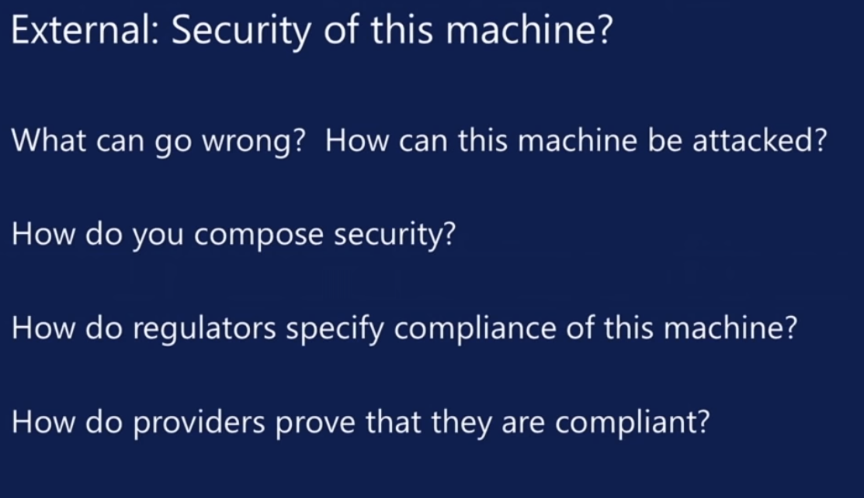
aa
aa

Slide 58
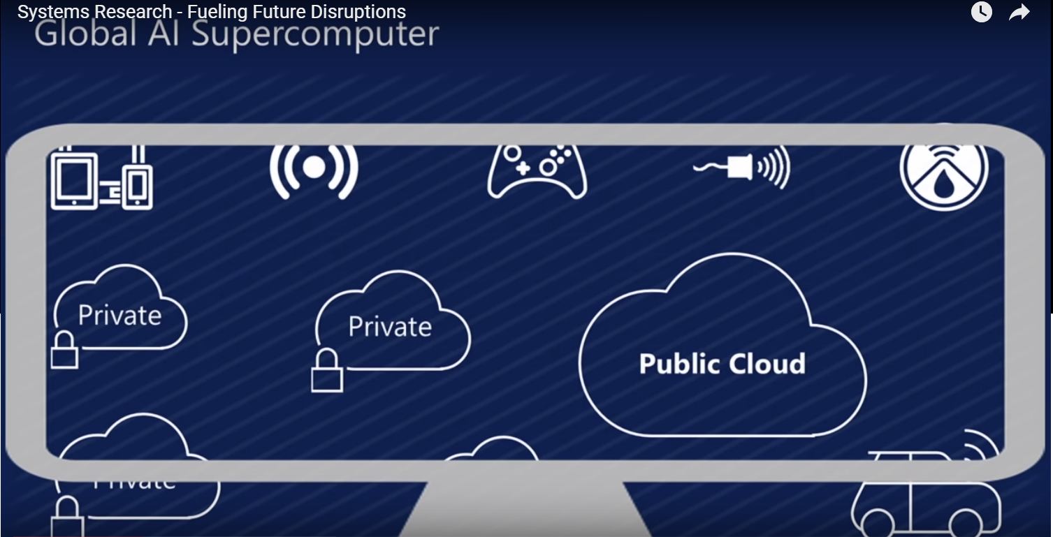
aa
aa

