Slide 1
PHI Research in Digital Science Center
Geoffrey Fox, August 24, 2018
Digital Science Center
Department of Intelligent Systems Engineering
gcf@indiana.edu, http://www.dsc.soic.indiana.edu/, http://spidal.org/
Judy Qiu, Gregor von Laszewski
Joshua Ballard (50%), Supun Kamburugamuve, Bo Peng, Langshi Chen, Kannan Govindarajan, Fugang Wang
Work with Intel Parallel Computing Center @IU
High performance computing enhanced Apache Big Data Stack HPC-ABDS or
Ensure that the Global AI and Modelling Supercomputer has Super performance

Slide 2
aa
aa

Slide 3
aa
aa

Slide 4
Collaborating on the Global AI and Modelling Supercomputer
Microsoft says:
We can only “play together” and link functionalities from Google,Amazon, Facebook, Microsoft, Academia if we have open API’s and open code to customize
Use open source Apache software; produce open source Apache projects
Academia needs to use and define their own open source projects
We want to use AI and modelling supercomputer to study precision health and the early universe as well as the industry goal of producing annoying advertisements

Slide 5
Integrating HPC and Apache Programming Environments
Harp-DAAL with a kernel Machine Learning library exploiting the Intel node library DAAL and HPC style communication collectives within the Hadoop ecosystem. The broad applicability of Harp-DAAL is supporting many classes of data-intensive computation, from pleasingly parallel to machine learning and simulations. Released for Hadoop (Qiu)
Twister2 is a toolkit of components that can be packaged in different ways
Integrated batch or streaming data capabilities familiar from Apache Hadoop, Spark, Heron and Flink but with high performance.
Separate bulk synchronous and data flow communication;
Task management as in Mesos, Yarn and Kubernetes
Dataflow graph execution models
Launching of the Harp-DAAL library
Streaming and repository data access interfaces,
In-memory databases and fault tolerance at dataflow nodes. (use RDD to do classic checkpoint-restart) . Released in basic form September and for Spark December 2018

Slide 6
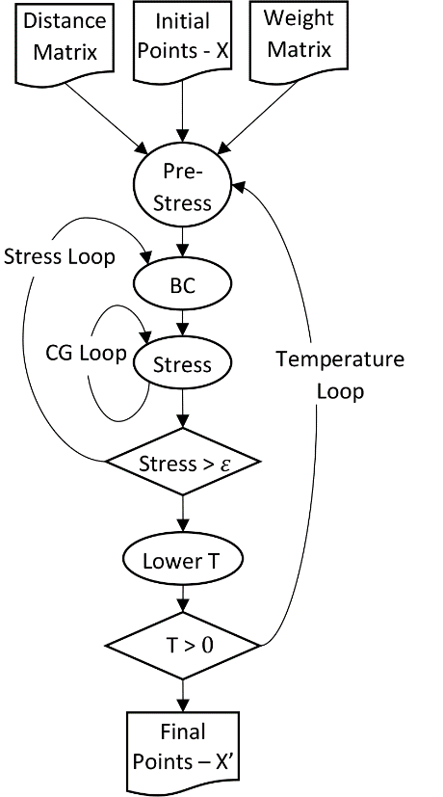
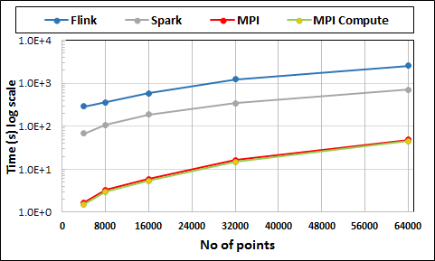
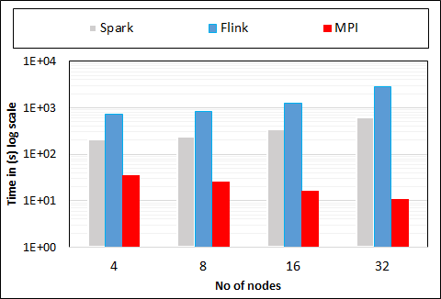
Multidimensional Scaling: 3 Nested Parallel Sections
Kmeans also bad
Flink
Spark
MPI
MPI Factor of 20-200 Faster than Spark/Flink
MDS execution time with 32000 points on varying number of nodes. Each node runs 20 parallel tasks
Spark, Flink No Speedup
MDS execution time on 16 nodes with 20 processes in each node with varying number of points

Slide 7
Qiu/Fox Core SPIDAL Parallel HPC Library with Collective Used
DA-MDS Rotate, AllReduce, Broadcast
Directed Force Dimension Reduction AllGather, Allreduce
Irregular DAVS Clustering Partial Rotate, AllReduce, Broadcast
DA Semimetric Clustering (Deterministic Annealing) Rotate, AllReduce, Broadcast
K-means AllReduce, Broadcast, AllGather DAAL
SVM AllReduce, AllGather
SubGraph Mining AllGather, AllReduce
Latent Dirichlet Allocation Rotate, AllReduce
Matrix Factorization (SGD) Rotate DAAL
Recommender System (ALS) Rotate DAAL
Singular Value Decomposition (SVD) AllGather DAAL
QR Decomposition (QR) Reduce, Broadcast DAAL
Neural Network AllReduce DAAL
Covariance AllReduce DAAL
Low Order Moments Reduce DAAL
Naive Bayes Reduce DAAL
Linear Regression Reduce DAAL
Ridge Regression Reduce DAAL
Multi-class Logistic Regression Regroup, Rotate, AllGather
Random Forest AllReduce
Principal Component Analysis (PCA) AllReduce DAAL
DAAL implies integrated on node with Intel DAAL Optimized Data Analytics Library

Slide 8
Big Data and Extreme-scale Computing (BDEC) Consortium http://www.exascale.org/bdec/
BDEC Pathways to Convergence Report
Next Meeting November 28-30, 2018 Bloomington Indiana USA. First day is evening reception with meeting focus “Defining application requirements for a data intensive computing continuum”
Later meeting February 19-21 Kobe, Japan (National infrastructure visions); Q2 2019 Europe (Exploring alternative platform architectures); Q4, 2019 USA (Vendor/Provider perspectives); Q2, 2020 Europe (? Focus); Q3-4, 2020 Final meeting Asia (write report)
http://www.exascale.org/bdec/sites/www.exascale.org.bdec/files/whitepapers/bdec2017pathways.pdf

