Slide 1
Research in Digital Science Center
Geoffrey Fox, January 19, 2018
Digital Science Center
Department of Intelligent Systems Engineering
gcf@indiana.edu, http://www.dsc.soic.indiana.edu/, http://spidal.org/
Judy Qiu, David Crandall, Gregor von Laszewski, Dennis Gannon
Supun Kamburugamuve, Pulasthi Wickramasinghe, Hyungro Lee, Jerome Mitchell
Bo Peng, Langshi Chen, Kannan Govindarajan, Fugang Wang
Internal collaboration. Biology, Physics, SICE
Outside Collaborators in funded projects: Arizona, Kansas, Purdue, Rutgers, San Diego Supercomputer Center, SUNY Stony Brook, Virginia Tech, UIUC and Utah
NIST and Fudan University

Slide 2
Digital Science Center Research Activities
Building SPIDAL Scalable HPC machine Learning Library
Applying current SPIDAL in Biology, Network Science (OSoMe), Pathology
Harp HPC Machine Learning Framework (Qiu)
Twister2 HPC Event Driven Distributed Programming model (replace Spark)
Cloud Research and DevOps for Software Defined Systems (von Laszewski)
Intel Parallel Computing Center @IU (Qiu, Gottlieb)
Fudan-Indiana Universities’ Institute for Transformational High-Performance Big-Data Computing
Work with NIST on Big Data Standards and non-proprietary Frameworks
Engineered nanoBIO Node NSF EEC-1720625 with Purdue and UIUC
Polar (Radar) Image Processing (Crandall); being used in production
Data analysis of experimental physics scattering results
IoTCloud. Cloud control of robots – licensed to C2RO (Montreal)
Big Data on HPC Cloud

Slide 3
Digital Science Center/ISE Infrastructure
Run computer infrastructure for Cloud and HPC research
  16 K80 and 16 Volta GPU, 8 Haswell node Romeo used in Deep Learning Course E533 and Research (Volta have NVLink)
  26 nodes Victor/Tempest Infiniband/Omnipath Intel Xeon Platinum 48 core nodes
  64 node system Tango with high performance disks (SSD, NVRam = 5x SSD and 25xHDD) and Intel KNL (Knights Landing) manycore (68-72) chips. Omnipath interconnect
  128 node system Juliet with two 12-18 core Haswell chips, SSD and conventional HDD disks. Infiniband Interconnect
  FutureSystems Bravo Delta Echo old but useful; 48 nodes
  All have HPC networks and all can run HDFS and store data on nodes
Teach ISE basic and advanced Cloud Computing and bigdata courses
  E222 Intelligent Systems II (Undergraduate)
  E534 Big Data Applications and Analytics
  E516 Introduction to Cloud Computing
  E616 Advanced Cloud Computing
Supported by Gary Miksik, Allan Streib
Switch focus to Docker+Kubernetes
Use Github for all non-FERPA course material. Have collected large number of open source written-up projects

Slide 4


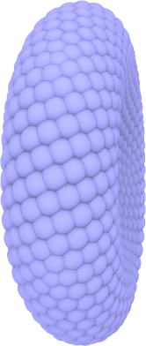
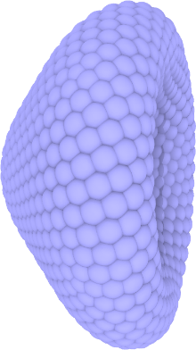
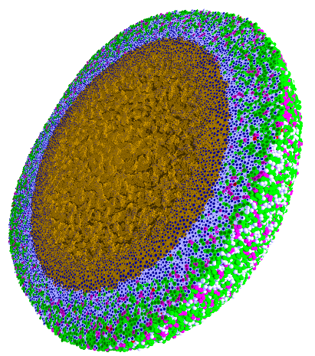
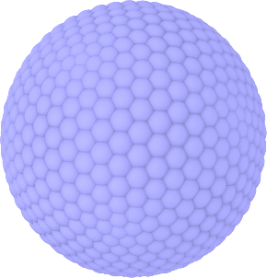
Engineered nanoBIO Node
Indiana University: Intelligent Systems Engineering, Chemistry, Science Gateways Community Institute
The Engineered nanoBIO node at Indiana University (IU) will develop a powerful set of integrated computational nanotechnology tools that facilitate the discovery of customized, efficient, and safe nanoscale devices for biological applications. Applications and Frameworks will be deployed and supported on nanoHUB.
Use in Undergraduate and masters programs in ISE for Nanoengineering and Bioengineering
  ISE (Intelligent Systems Engineering) as a new department developing courses from scratch (67 defined in first 2 years)
Research Experiences for Undergraduates throughout year
Annual engineered nanoBIO workshop
Summer Camps for Middle and High School Students
Online (nanoHUB and YouTube) courses with accessible content on nano and bioengineering
Research and Education tools build on existing simulations, analytics and frameworks: Physicell and CompuCell3D
PhysiCell
NP Shape Lab:

Slide 5





NSF 1443054: CIF21 DIBBs: Middleware and High Performance Analytics Libraries for Scalable Data Science
Ogres Application Analysis
HPC-ABDS and HPC-FaaS Software
Harp and Twister2 Building Blocks
SPIDAL Data Analytics Library
Software: MIDAS
HPC-ABDS

Slide 6
NSF 1443054: CIF21 DIBBs: Middleware and High Performance Analytics Libraries for Scalable Data Science

Slide 7
Qiu/Fox Core SPIDAL Parallel HPC Library with Collective Used
DA-MDS Rotate, AllReduce, Broadcast
Directed Force Dimension Reduction AllGather, Allreduce
Irregular DAVS Clustering Partial Rotate, AllReduce, Broadcast
DA Semimetric Clustering (Deterministic Annealing) Rotate, AllReduce, Broadcast
K-means AllReduce, Broadcast, AllGather DAAL
SVM AllReduce, AllGather
SubGraph Mining AllGather, AllReduce
Latent Dirichlet Allocation Rotate, AllReduce
Matrix Factorization (SGD) Rotate DAAL
Recommender System (ALS) Rotate DAAL
Singular Value Decomposition (SVD) AllGather DAAL
QR Decomposition (QR) Reduce, Broadcast DAAL
Neural Network AllReduce DAAL
Covariance AllReduce DAAL
Low Order Moments Reduce DAAL
Naive Bayes Reduce DAAL
Linear Regression Reduce DAAL
Ridge Regression Reduce DAAL
Multi-class Logistic Regression Regroup, Rotate, AllGather
Random Forest AllReduce
Principal Component Analysis (PCA) AllReduce DAAL
DAAL implies integrated on node with Intel DAAL Optimized Data Analytics Library (Runs on KNL!)

Slide 8
Twister2: “Next Generation Grid - Edge – HPC Cloud”
Original 2010 Twister paper has 928 citations; it was a particular approach to MapCollective iterative processing for machine learning
Re-engineer current Apache Big Data and HPC software systems as a toolkit
Support a serverless (cloud-native) dataflow event-driven HPC-FaaS (microservice) framework running across application and geographic domains.
  Support all types of Data analysis from Parallel Machine Learning to Edge computing
Build on Cloud best practice but use HPC wherever possible to get high performance
Smoothly support current paradigms Hadoop, Spark, Flink, Heron, MPI, DARMA …
Use interoperable common abstractions but multiple polymorphic implementations.
  i.e. do not require a single runtime
Focus on Runtime but this implies HPC-FaaS programming and execution model
This defines a next generation Grid based on data and edge devices – not computing as in old Grid
See long paper http://dsc.soic.indiana.edu/publications/Twister2.pdf

Slide 9
Components of Twister2
Dataflow coordination Points, Execution Semantics (plan map resources to execution unit), Parallel Computing Paradigm,(Dynamic/Static) Resource Allocation
Task migration, Elasticity, Streaming and FaaS Events, Task Execution, Task Scheduling, Task Graph
Messages, Dataflow Communication, BSP Communication, Map-Collective
Static (Batch) Data access/store, Streaming Data, Distributed Data Set, Check Pointing
Security

