Slide 1
Data Science and Online Education
DTW: 2015 Data Teaching Workshop – 2nd IEEE STC CC and RDA Workshop on Curricula and Teaching Methods in Cloud Computing, Big Data, and Data Science
as part of CloudCom 2015 (http://2015.cloudcom.org/), Vancouver, Nov 30-Dec 3, 2015.
November 30, 2015
Geoffrey Fox, Sidd Maini, Howard Rosenbaum, David Wild
gcf@indiana.edu http://www.infomall.org
School of Informatics and Computing
Digital Science Center
Indiana University Bloomington

Slide 2
School of Informatics and Computing

Slide 3
Background of the School
The School of Informatics was established in 2000 as first of its kind in the United States.
Computer Science was established in 1971 and became part of the school in 2005.
Library and Information Science was established in 1951 and became part of the school in 2013.
Now named the School of Informatics and Computing.
Data Science added January 2014
Engineering to be added Fall 2016

Slide 4
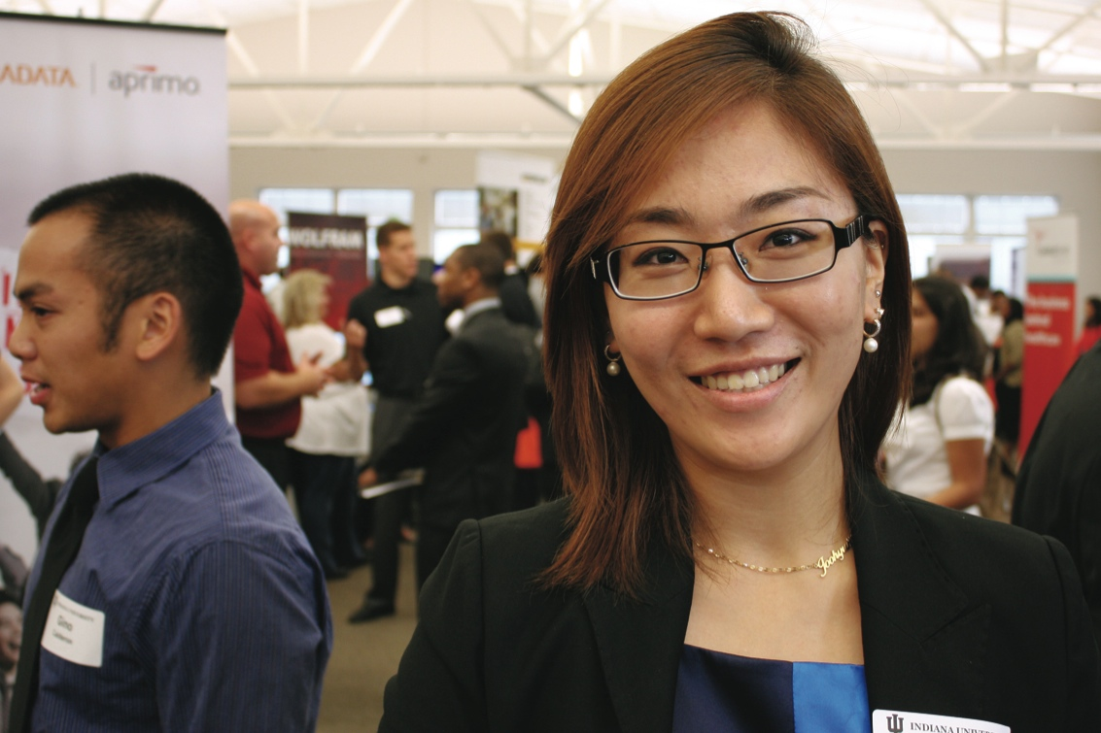
What Is Our School About?
The broad range of computing and information technology: science, a broad range of applications and human and societal implications.
United by a focus on information and technology, our extensive programs include:
Computer Science
Informatics
Information Science
Library Science
Data Science (virtual - started)
Engineering (real – starts fall 2016)

Slide 5
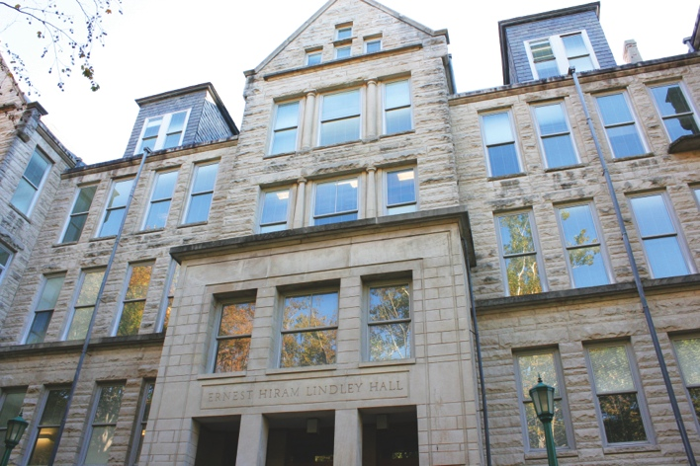
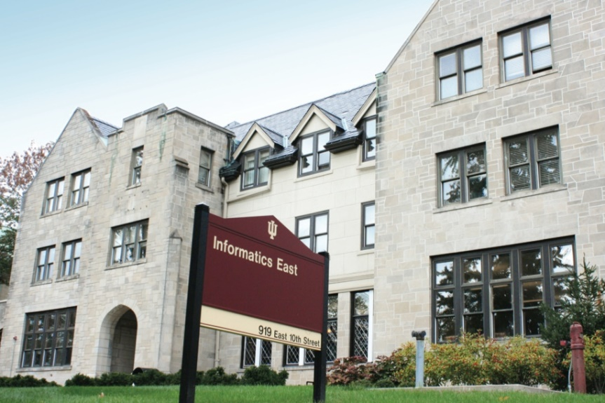
Size of School (2015-2016)
Faculty 104
(90 tenure track)
Students
Undergraduate 1,404
Graduate Certificate 37
Master’s 719
Ph.D. 282
Female Undergraduates 22%
Female Graduate Students 48%
Data Science Masters at 176 is non trivial size

Slide 6
Data Science

Slide 7
SOIC Data Science Program
Cross Disciplinary Faculty – 31 in School of Informatics and Computing, a few in statistics and expanding across campus
Affordable online and traditional residential curricula or mix thereof
Masters, Certificate, PhD Minor in place; Full PhD being proposed
http://www.soic.indiana.edu/graduate/degrees/data-science/index.html
Note data science mentioned in faculty advertisements but unlike other parts of School, there are no dedicated faculty
It is around 7% of School looking at fraction of enrolled students summing graduate and undergraduate levels

Slide 8
IU Data Science Program and Degrees
Program managed by cross disciplinary Faculty in Data Science. Currently Statistics and Informatics and Computing School but plans to expand scope to full campus
A purely online 4-course Certificate in Data Science has been running since January 2014
Some switched to Online Masters
Most students are professionals taking courses in “free time”
A campus wide Ph.D. Minor in Data Science has been approved.
Masters in Data Science (10-course) approved October 2014
Exploring PhD in Data Science
Courses labelled as “Decision-maker” and “Technical” paths where McKinsey says an order of magnitude more (1.5 million by 2018) unmet job openings in Decision-maker track

Slide 9
IU Data Science Program: Masters
Masters Fully approved by University and State October 14 2014 and started January 2015
Blended online and residential (any combination)
Online offered at in-state rates (~$1100 per course)
Hybrid (online for a year and then residential) surprisingly not popular
Informatics, Computer Science, Information and Library Science in School of Informatics and Computing and the Department of Statistics, College of Arts and Science, IUB
30 credits (10 conventional courses)
Basic (general) Masters degree plus tracks
Currently only track is “Computational and Analytic Data Science”
Other tracks expected such as Biomedical Data Science

Slide 10
Data Science Enrollment Fall 2015
Certificate in Data Science (started January 2014)
Current 34
Online Masters in Data Science (started January 2015)
Current 82
Transfers from certificate gave a head start
Residential Masters in Data Science (started January 2015)
Current 62
Data Science total enrollment Fall 2015 178
Fall 2015, about 300 new applicants to program (2/3 residential, 1/3 online); cap enrollment
Spring 2016 total applicants: 175 Current total accepts 114
Spring 2016 admits(accepts) Residential 74(58), Online 60(51), Certificate 5(5)
Applicants and Spring 2016

Slide 11
Advertising Campaign
Program | Adwords timeframe | Adwords Cost | # clicks | CTR | CPC | # applications
Security | 12/1-4/30 | $13K | 2,577 | 0.20% | $5.10 | 26
Data Science | 10/31-3/30 | $17K | 38,544 | 1.28% | $0.43 | 267
ILS | 9/1-4/30 | $18K | 4,382 | 0.11% | $4.08 | 199
Comparison of “Adwords” results for Three Masters Programs
Security Informatics
Data Science
Information and Library Science
CPC Cost per Click and CTR is Click Through Rate
Note Data Science 30% of top 10 page views over last 6 months

Slide 12
3 Types of Students
Professionals wanting skills to improve job or “required” by employee to keep up with technology advances
Traditional sources of IT Masters
Students in non IT fields wanting to do “domain specific data science”

Slide 13
Basic Masters Course Requirements
One course from each of three technology areas
I. Data analysis and statistics
II. Data lifecycle (includes “handling of research data”)
III. Data management and infrastructure
One course from (big data) application course cluster
Other courses chosen from list maintained by Data Science Program curriculum committee (or outside this with permission of advisor/ Curriculum Committee)
Capstone project optional
All students assigned an advisor who approves course choice.
Due to variation in preparation label courses
Decision Maker
Technical
Corresponding to two categories in McKinsey report – note Decision Maker had an order of magnitude more job openings expected

Slide 14
Computational Science
Computational science has important similarities to data science but with a simulation rather than data analysis flavor.
Although a great deal of effort went into with meetings and several academic curricula/programs, it didn’t take off
In my experience not a lot of students were interested and
The academic job opportunities were not great
Data science has more jobs; maybe it will do better?
Can we usefully link these concepts?
PS both use parallel computing!
In days gone by, I did research in particle physics phenomenology which in retrospect was an early form of data science using models extensively

Slide 15
Online Education

Slide 16
Potpourri of Online Technologies
Canvas (Indiana University Default): Best for interface with IU grading and records
Google Course Builder: Best for management and integration of components
Ad hoc web pages: alternative easy to build integration
Microsoft Mix: Simplest faculty preparation interface
Adobe Presenter/Camtasia: More powerful video preparation that support subtitles but not clearly needed
Google Community: Good social interaction support
YouTube: Best user interface for videos (without Mix PowerPoint support)
Hangout: Best for instructor-students online interactions (one instructor to 9 students with live feed). Hangout on air mixes live and streaming (30 second delay from archived YouTube) and more participants
OpenEdX at one time future of Google Course Builder and getting easier to use but still significant effort
Google-groups and Slack used for student-student/teacher interactions

Slide 17
Components of an (Online) Learning Management System
Features in LMS are often not competitive with standalone solutions so tendency to use multiple technologies even though this leads to confused interface
Post Assignments OpenEdX and Canvas
Grading Results Canvas
Discussions OpenEdX
Formal interaction between students and AI’s/Instructor Google-groups
Informal interactions - Slack
Posting of videos and other online resources – OpenEdX
Online sessions with remote students – Hangout or Adobe Connect

Slide 18
Overview
136 users
Technical Support
Channels
Open
Private
Direct Messaging
Collaboration
Projects
Assignments
Informal
Not graded
Statistics*
4K+ messages
36% private channels
25% public channels
39% Direct Messages
Topics of Interest
#introductions channel used to share expertise
Summary of Slack Messaging

Slide 19
Comparison of Technologies
Slack
Direct Messaging with Public & Private Channels
Canvas
Open Discussions
Group or Individual Email to students
Open Edx Discussions
Discussions on topics
No Email Notification
Good search and very intuitive
Flexible Email Notifications & Alerts
Detailed analytics on paid plans
No Analytics
No Analytics

Slide 20
Summary

Slide 21
Lessons / Insights
Data Science is a very healthy area
At IU, I expect to grow in interest although set up as a program has strange and potentially negative side effects
Not clear if Online education is taking off but may be distorted by US Company hiring practices
I teach all my classes – residential or online -- with online lectures
All of this straightforward but hard work
Current open source and proprietary MOOC software not very satisfactory; “easy” to do better
Best technical solutions are confusing as involve multiple technologies with each faculty making different choices
No reason to differentiate MOOC and general LMS

