Slide 1
Data Science and Online Education
DTW: 2015 Data Teaching Workshop – 2nd IEEE STC CC and RDA Workshop on Curricula and Teaching Methods in Cloud Computing, Big Data, and Data Science
as part of CloudCom 2015 (http://2015.cloudcom.org/), Vancouver, Nov 30-Dec 3, 2015.
November 30, 2015
Geoffrey Fox, Sidd Maini, Howard Rosenbaum, David Wild
gcf@indiana.edu http://www.infomall.org
School of Informatics and Computing
Digital Science Center
Indiana University Bloomington

Slide 2
School of Informatics and Computing

Slide 3

Background of the School
The School of Informatics was established in 2000 as first of
its kind in the United States.
Computer Science was established in 1971 and became part
of the school in 2005.
Library and Information Science
was established in 1951 and
became part of the school
in 2013.
Now named the School of
Informatics and Computing.
Data Science added January 2014
Engineering to be added Fall 2016

Slide 4

What Is Our School About?
The broad range of computing and information technology: science, a broad range of applications and human and
societal implications.
United by a focus on
information and technology,
our extensive programs
include:
  Computer Science
  Informatics
  Information Science
  Library Science
  Data Science (virtual - started)
  Engineering (real – starts fall 2016)

Slide 5
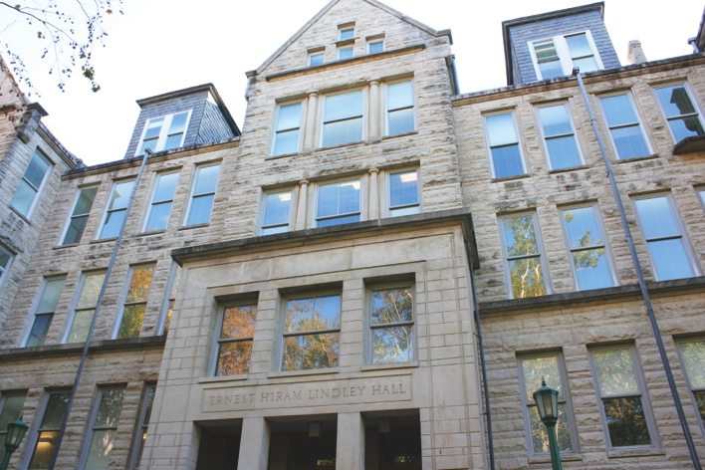
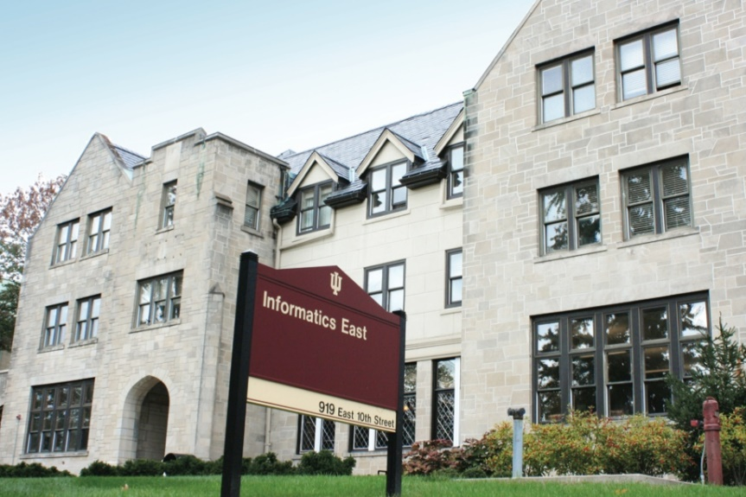
Size of School
(2015-2016)
Faculty 104
  (90 tenure track)
Students
Undergraduate 1,404
Graduate Certificate 37
Master’s 719
Ph.D. 282
Female Undergraduates 22%
Female Graduate Students 48%

Slide 6
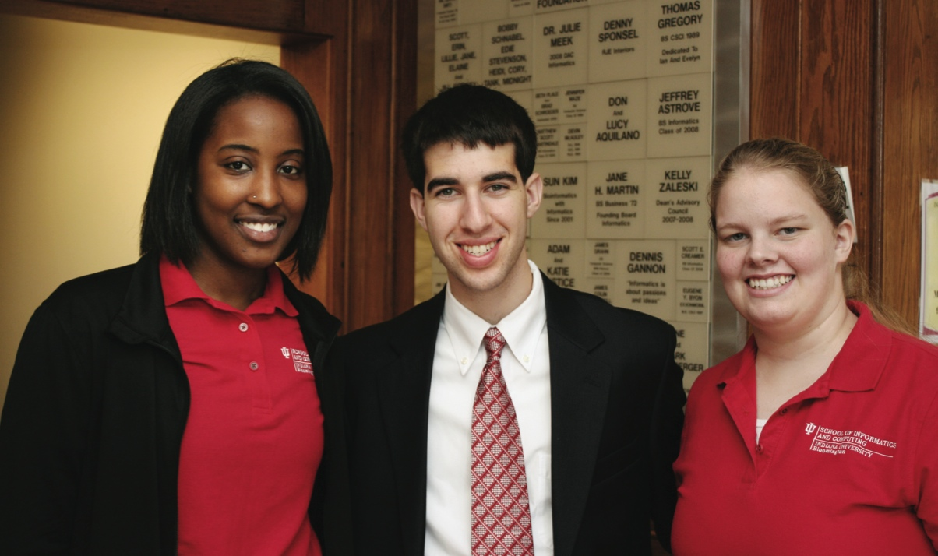

Undergraduate Degree Programs
Computer Science (B.S. and B.A.)
Informatics (B.S.)
Intelligent Systems Engineering (B.S. – starting 2016)

Slide 7
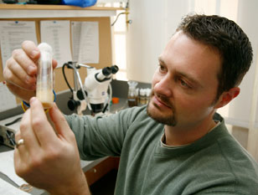

Graduate Degree Programs
Ph.D.
  Computer Science
  Informatics (first in U.S.)
  Information Science
  Intelligent Systems Engineering (starting 2016)
  Data Science (proposing)
Master’s
  Bioinformatics
  Computer Science
  Data Science (online, in residence, or hybrid)
  Human Computer Interaction/Design
  Informatics
  Information Science
  Intelligent Systems Engineering (starting 2017)
  Library Science
  Proactive Health Informatics
  Security Informatics

Slide 8
Data Science

Slide 9

SOIC Data Science Program
Cross Disciplinary Faculty – 31 in School of Informatics and Computing, a few in statistics and expanding across campus
Affordable online and traditional residential curricula or mix thereof
Masters, Certificate, PhD Minor in place; Full PhD being studied
http://www.soic.indiana.edu/graduate/degrees/data-science/index.html
Note data science mentioned in faculty advertisements but unlike other parts of School, there are no dedicated faculty
It is around 7% of School looking at fraction of enrolled students summing graduate and undergraduate levels

Slide 10
IU Data Science Program and Degrees
Program managed by cross disciplinary Faculty in Data Science. Currently Statistics and Informatics and Computing School but plans to expand scope to full campus
A purely online 4-course Certificate in Data Science has been running since January 2014
  Some switched to Online Masters
  Most students are professionals taking courses in “free time”
A campus wide Ph.D. Minor in Data Science has been approved.
Masters in Data Science (10-course) approved October 2014
Exploring PhD in Data Science
Courses labelled as “Decision-maker” and “Technical” paths where McKinsey says an order of magnitude more (1.5 million by 2018) unmet job openings in Decision-maker track

Slide 11

McKinsey Institute on Big Data Jobs
http://www.mckinsey.com/mgi/publications/big_data/index.asp
There will be a shortage of talent necessary for organizations to take advantage of big data. By 2018, the United States alone could face a shortage of 140,000 to 190,000 people with deep analytical skills as well as 1.5 million managers and analysts with the know-how to use the analysis of big data to make effective decisions.
IU Data Science Decision Maker Path aimed at 1.5 million jobs. Technical Path covers the 140,000 to 190,000

Slide 12
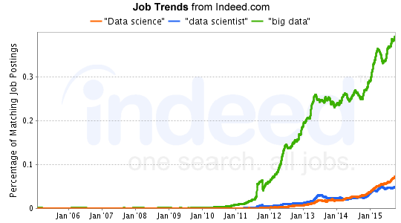
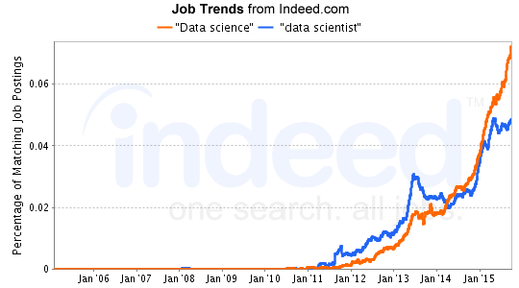
Job Trends
Charts Jan 6 2015
Big Data much larger than data science
19 May 2015 Jobs
3475 for “data science“
2277 for “data scientist“
19488 for “big data”
7 Dec 2015 Jobs
5014 for “data science“
2830 for “data scientist“
22388 for “big data”
http://www.indeed.com/jobtrends?q=%22Data+science%22%2C+%22data+scientist%22%2C+%22big+data%22%2C&l=

Slide 13
What is Data Science?
The next slide gives a definition arrived by a NIST study group fall 2013.
The previous slide says there are several jobs but that’s not enough! Is this a field – what is it and what is its core?
  The emergence of the 4th or data driven paradigm of science illustrates significance - http://research.microsoft.com/en-us/collaboration/fourthparadigm/
  Discovery is guided by data rather than by a model
  The End of (traditional) science http://www.wired.com/wired/issue/16-07 is famous here
Another example is recommender systems in Netflix, e-commerce etc.
  Here data (user ratings of movies or products) allows an empirical prediction of what users like
  Here we define points in spaces (of users or products), cluster them etc. – all conclusions coming from data

Slide 14
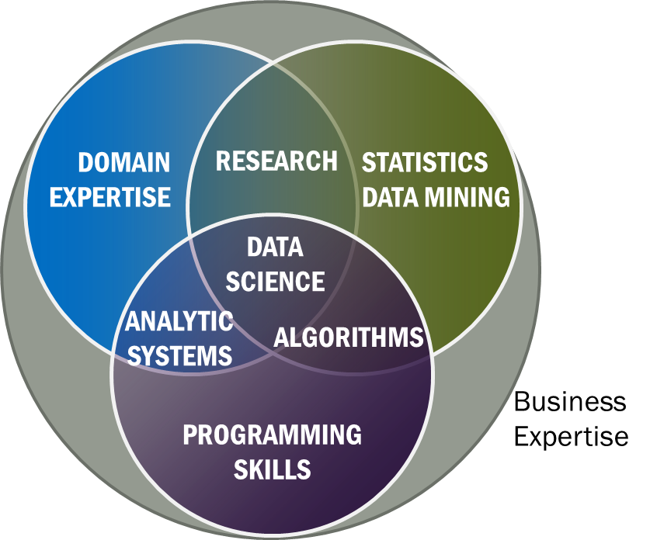
Data Science Definition from NIST Public Working Group
Data Science is the extraction of actionable knowledge directly from data through a process of discovery, hypothesis, and analytical hypothesis analysis.
A Data Scientist is a practitioner who has sufficient knowledge of the overlapping regimes of expertise in business needs, domain knowledge, analytical skills and programming expertise to manage the end-to-end scientific method process through each stage in the big data lifecycle.
See Big Data Definitions in http://bigdatawg.nist.gov/V1_output_docs.php
Notes:
Big Data refers to digital data volume, velocity and/or variety whose management requires scalability across coupled horizontal resources
Data Science is the extraction of actionable knowledge directly from data through a process of discovery, hypothesis, and analytical hypothesis analysis.
A Data Scientist is a practitioner who has sufficient knowledge of the overlapping regimes of expertise in business needs, domain knowledge, analytical skills and programming expertise to manage the end-to-end scientific method process through each stage in the big data lifecycle.

Slide 15
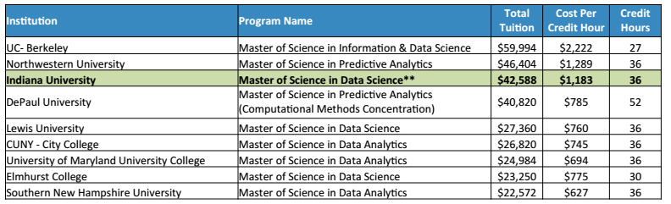
Some Existing Online Data Science Activities
Indiana University Masters is “blended”: online and/or residential; other universities offer residential
We discount online classes so that total cost of 10 ONLINE courses is ~$11,500 (in state price)
$35,490
30

Slide 16
Computational Science
Computational science has important similarities to data science but with a simulation rather than data analysis flavor.
Although a great deal of effort went into with meetings and several academic curricula/programs, it didn’t take off
  In my experience not a lot of students were interested and
  The academic job opportunities were not great
Data science has more jobs; maybe it will do better?
Can we usefully link these concepts?
PS both use parallel computing!
In days gone by, I did research in particle physics phenomenology which in retrospect was an early form of data science using models extensively

Slide 17
Data Science Curriculum

Slide 18
IU Data Science Program: Masters
Masters Fully approved by University and State October 14 2014 and started January 2015
Blended online and residential (any combination)
  Online offered at in-state rates (~$1100 per course)
  Hybrid (online for a year and then residential) surprisingly not popular
Informatics, Computer Science, Information and Library Science in School of Informatics and Computing and the Department of Statistics, College of Arts and Science, IUB
30 credits (10 conventional courses)
Basic (general) Masters degree plus tracks
  Currently only track is “Computational and Analytic Data Science”
  Other tracks expected such as Biomedical Data Science

Slide 19
Data Science Enrollment Fall 2015
Certificate in Data Science (started January 2014)
  Current 34
Online Masters in Data Science (started January 2015)
  Current 82
  Transfers from certificate gave a head start
Residential Masters in Data Science (started January 2015)
  Current 62
Data Science total enrollment Fall 2015 178
Fall 2015, about 300 new applicants to program (2/3 residential, 1/3 online); cap enrollment
Spring 2016 total applicants:175 Current total accepts 114
Spring 2016 admits(accepts)
Residential 74(58), Online 60(51), Certificate 5(5)
Applicants and Spring 2016

Slide 20
Advertising Campaign
Program | Adwords timeframe | Adwords Cost | # clicks | CTR | CPC | # applications
Security | 12/1-4/30 | $13K | 2,577 | 0.20% | $5.10 | 26
Data Science | 10/31-3/30 | $17K | 38,544 | 1.28% | $0.43 | 267
ILS | 9/1-4/30 | $18K | 4,382 | 0.11% | $4.08 | 199
Comparison of “Adwords” results for Three Masters Programs
Security Informatics
Data Science
Information and Library Science
CPC Cost per Click and CTR is Click Through Rate
Note Data Science 30% of top 10 page views over last 6 months

Slide 21
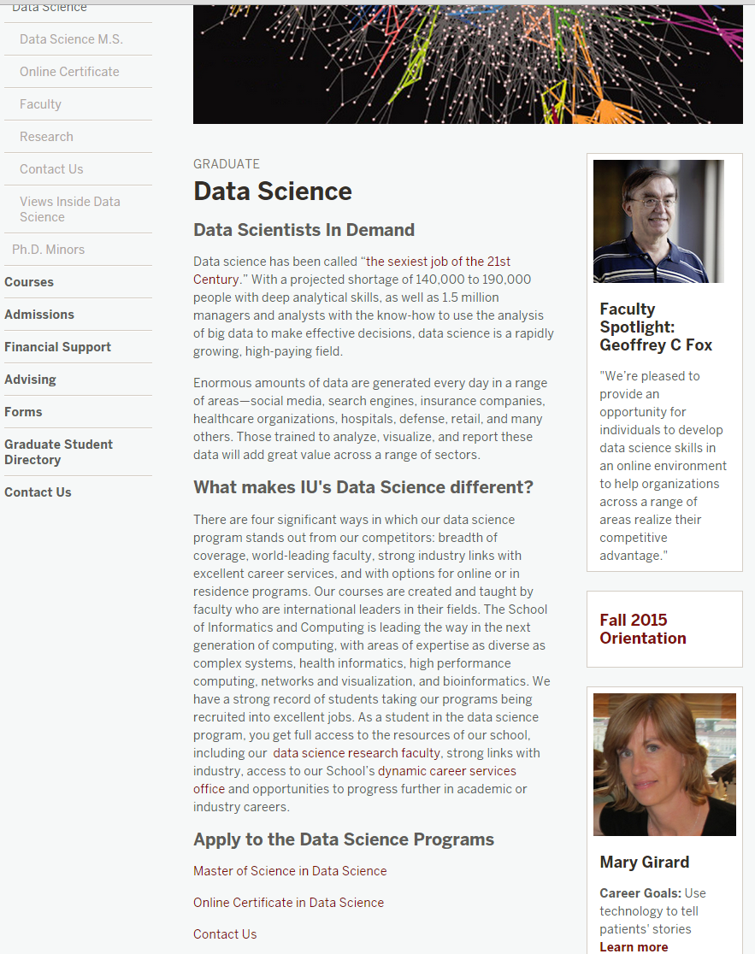
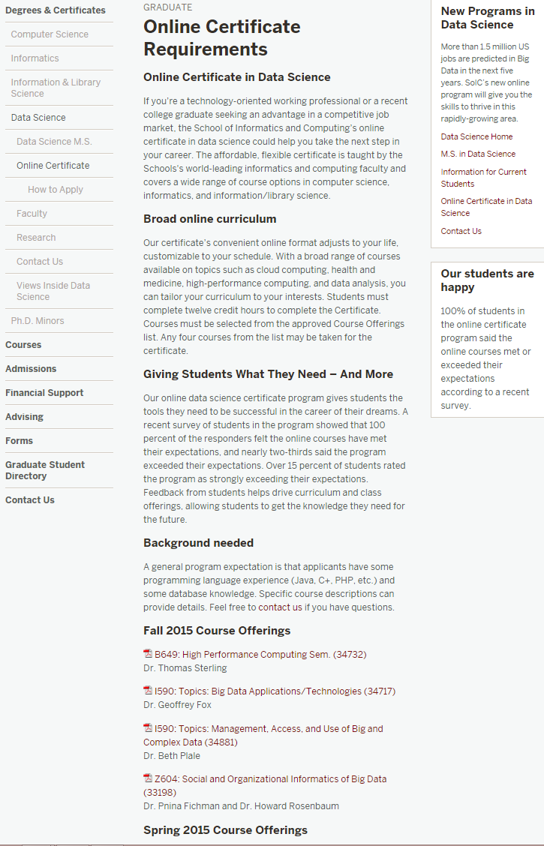
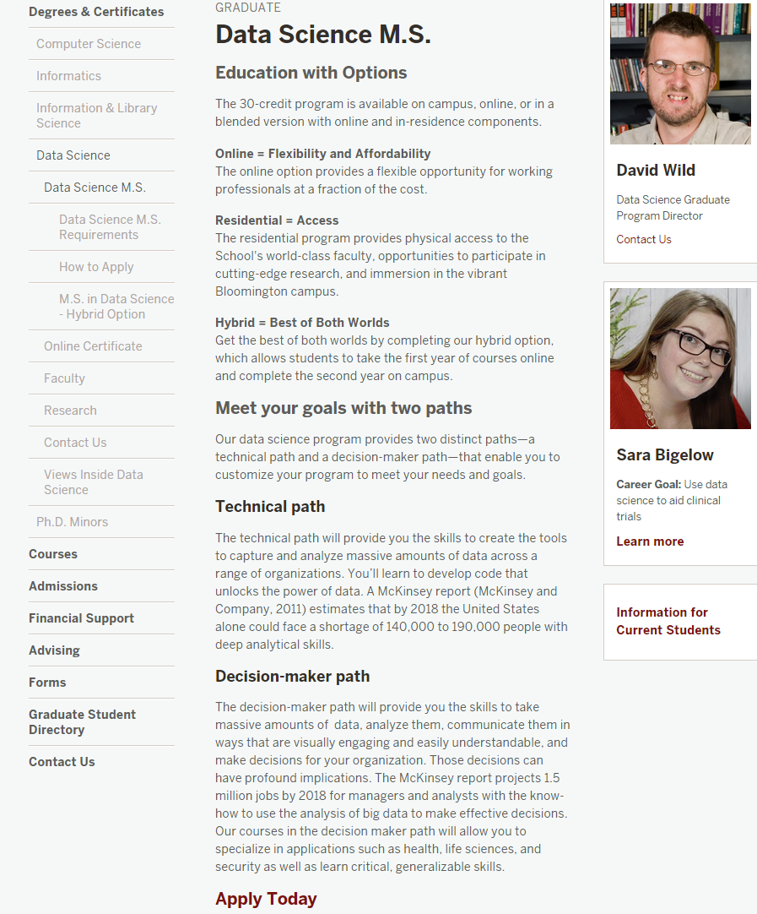
Indiana University Data Science Site

Slide 22
3 Types of Students
Professionals wanting skills to improve job or “required” by employee to keep up with technology advances
Traditional sources of IT Masters
Students in non IT fields wanting to do “domain specific data science”

Slide 23
What do students want?
Degree with some relevant curriculum
  Data Science and Computer Science distinct BUT
Important goal often “Optional Practical Training” OPT allowing graduated students visa to work for US companies
  Must have spent at least a year in US in residential program
Residential CS Masters (at IU) 95% foreign students
Online program students quite varied but mostly USA professionals aiming to improve/switch job

Slide 24
IU and Competition
With Computer Science, Informatics, ILS, Statistics, IU has particularly broad unrivalled technology base
  Other universities have more domain data science than IU
Existing Masters in US in table. Many more certificates and related degrees (such as business analytics)
School | Program | Campus | Online | Degree
Columbia University | Data Science | Yes | No | MS 30 cr
Illinois Institute of Technology | Data Science | Yes | No | MS 33 cr
New York University | Data Science | Yes | No | MS 36 cr
University of California Berkeley School of Information | Master of Information and Data Science | Yes | Yes | M.I.D.S
University of Southern California | Computer Science with Data Science | Yes | No | MS 27 cr

Slide 25
Data Science Curriculum
Faculty in Data Science is “virtual department”
4 course Certificate: purely online, started January 2014
10 course Masters: online/residential, started January 2015

Slide 26
Basic Masters Course Requirements
One course from two of three technology areas
  I. Data analysis and statistics
  II. Data lifecycle (includes “handling of research data”)
  III. Data management and infrastructure
One course from (big data) application course cluster
Other courses chosen from list maintained by Data Science Program curriculum committee (or outside this with permission of advisor/ Curriculum Committee)
Capstone project optional
All students assigned an advisor who approves course choice.
Due to variation in preparation label courses
  Decision Maker
  Technical
Corresponding to two categories in McKinsey report – note Decision Maker had an order of magnitude more job openings expected

Slide 27
Computational and Analytic Data Science track
For this track, data science courses have been reorganized into categories reflecting the topics important for students wanting to prepare for computational and analytic data science careers for which a strong computer science background is necessary. Consequently, students in this track must complete additional requirements,
1) A student has to take at least 3 courses (9 credits) from Category 1 Core Courses. Among them, B503 Analysis of Algorithms is required and the student should take at least 2 courses from the following 3:
  B561 Advanced Database Concepts,
  [STAT] S520 Introduction to Statistics OR (New Course) Probabilistic Reasoning
  B555 Machine Learning OR I590 Applied Machine Learning
2) A student must take at least 2 courses from Category 2 Data Systems, AND, at least 2 courses from Category 3 Data Analysis. Courses taken in Category 1 can be double counted if they are also listed in Category 2 or Category 3.
3) A student must take at least 3 courses from Category 2 Data Systems, OR, at least 3 courses from Category 3 Data Analysis. Again, courses taken in Category 1 can be double counted if they are also listed in Category 2 or Category 3. One of these courses must be an application domain course

Slide 28
Admissions Criterion
Decided by Data Science Program Curriculum Committee
Need some computer programming experience (either through coursework or experience), and a mathematical background and knowledge of statistics will be useful
Tracks can impose stronger requirements
3.0 Undergraduate GPA
A 500 word personal statement
GRE scores are required for all applicants.
3 letters of recommendation

Slide 29
Geoffrey Fox’s
Online Data Science Classes I
Same class offered as
MOOC
Residential class
Online class for credit

Slide 30
Some Online Data Science Classes
BDAA: Big Data Applications & Analytics
  Used to be called X-Informatics
  ~40 hours of video mainly discussing applications (The X in X-Informatics or X-Analytics) in context of big data and clouds https://bigdatacourse.appspot.com/course
BDOSSP: Big Data Open Source Software and Projects http://bigdataopensourceprojects.soic.indiana.edu/
  ~27 Hours of video discussing HPC-ABDS and use on FutureSystems for Big Data software
Both divided into sections (coherent topics), units (~lectures) and lessons (5-20 minutes) in which student is meant to stay awake

Slide 31
Big Data Applications & Analytics Topics
1 Unit: Organizational Introduction
1 Unit: Motivation: Big Data and the Cloud; Centerpieces of the Future Economy
3 Units: Pedagogical Introduction: What is Big Data, Data Analytics and X-Informatics
SideMOOC: Python for Big Data Applications and Analytics: NumPy, SciPy, MatPlotlib
SideMOOC: Using FutureSystems for Java and Python
4 Units: X-Informatics with X= LHC Analysis and Discovery of Higgs particle
  Integrated Technology: Explore Events; histograms and models; basic statistics (Python and some in Java)
3 Units on a Big Data Use Cases Survey
SideMOOC: Using Plotviz Software for Displaying Point Distributions in 3D
3 Units: X-Informatics with X= e-Commerce and Lifestyle
Technology (Python or Java): Recommender Systems - K-Nearest Neighbors
Technology: Clustering and heuristic methods
1 Unit: Parallel Computing Overview and familiar examples
4 Units: Cloud Computing Technology for Big Data Applications & Analytics
2 Units: X-Informatics with X = Web Search and Text Mining and their technologies
Technology for Big Data Applications & Analytics : Kmeans (Python/Java)
Technology for Big Data Applications & Analytics: MapReduce
Technology for Big Data Applications & Analytics : Kmeans and MapReduce Parallelism (Python/Java)
Technology for Big Data Applications & Analytics : PageRank (Python/Java)
3 Units: X-Informatics with X = Sports
1 Unit: X-Informatics with X = Health
1 Unit: X-Informatics with X = Internet of Things & Sensors
1 Unit: X-Informatics with X = Radar for Remote Sensing
Red = Software

Slide 32
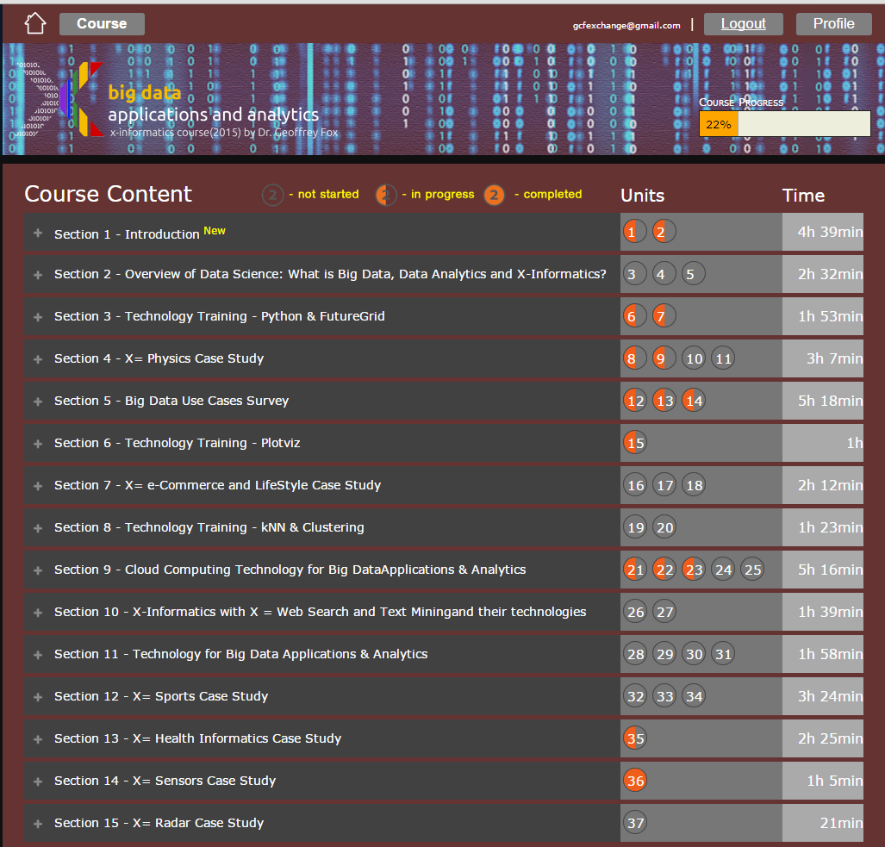
Example
Google
Course Builder MOOC
4 levels
Course
Sections (15)
Units(37)
Lessons(~250)
Video 38.5 hrs
Units are roughly traditional lecture
Lessons are ~15 minute segments
http://x-informatics.appspot.com/course
https://bigdatacoursespring2015.appspot.com/course

Slide 33
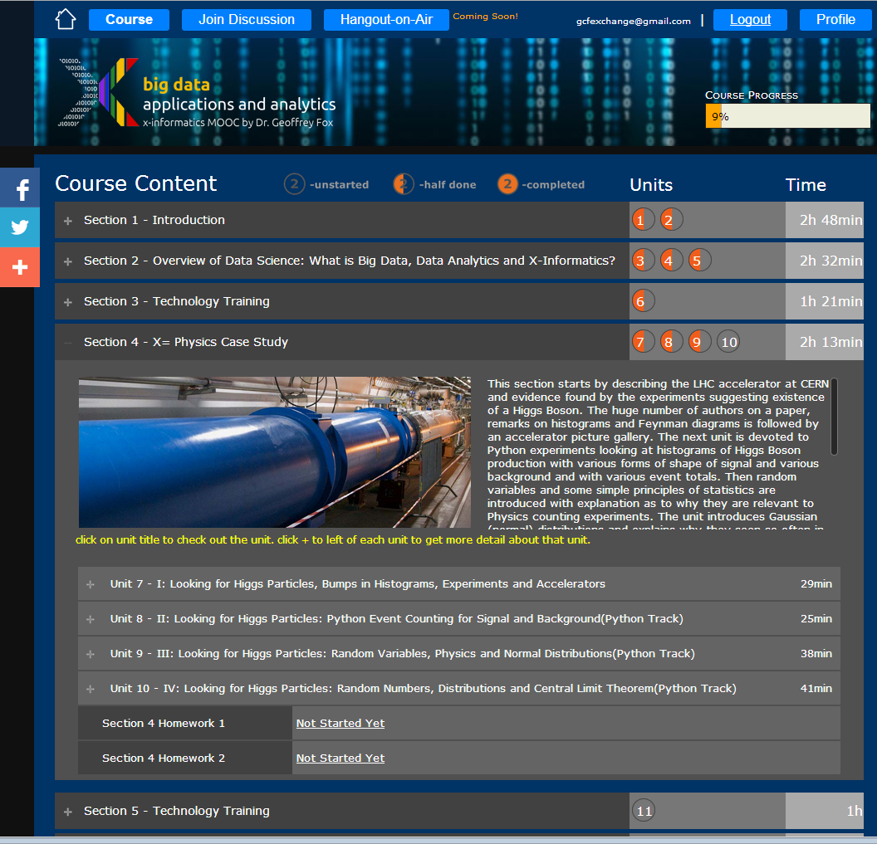
Example
Google
Course Builder
MOOC
The Physics Section expands to 4 units and 2 Homeworks
Unit 9 expands to 5 lessons
Lessons played on YouTube
“talking head video + PowerPoint”
http://x-informatics.appspot.com/course

Slide 34
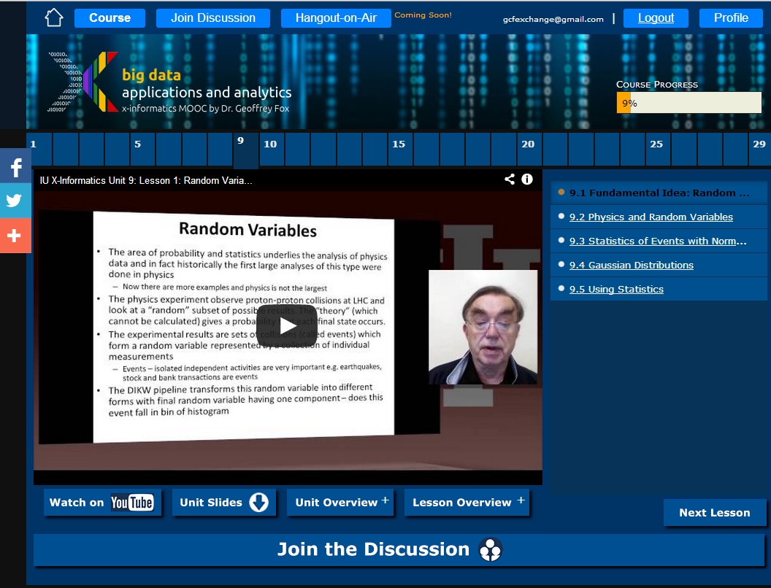

Slide 35
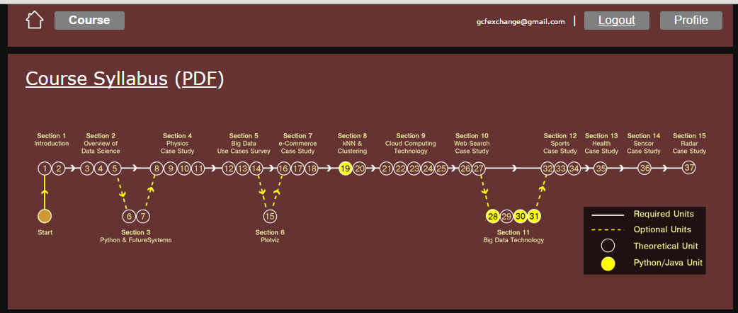
Course Home Page showing Syllabus
Note that we have a course – section – unit – lesson hierarchy (supported by Mooc Builder) with abstracts available at each level of hierarchy. The home page has overview information (shown earlier) plus a list of all sections and a syllabus shown above.

Slide 36
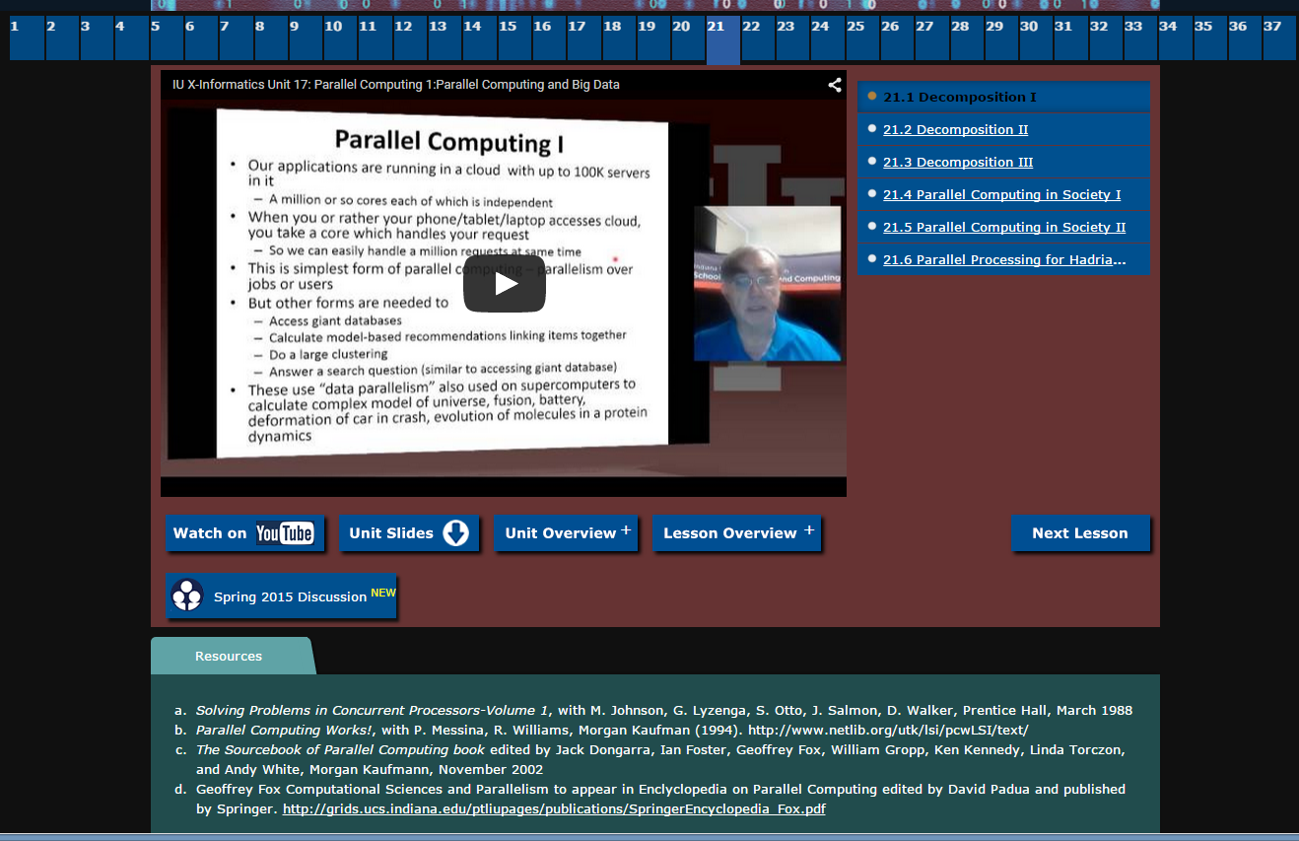
A typical lesson (the first in unit 21) Note links to all 37 units across the top

Slide 37
MOOC Version
Offered at https://bigdatacourse.appspot.com/preview
Open to everybody
Uses no University resources
Updated December 2014
One of two SoIC MOOCs named one of “7 great MOOCs for techies” by ComputerWorld http://www.computerworld.com/article/2849569/7-great-moocs-for-techies-all-free-starting-soon.html November 2014
May 14 2015 3562 enrolled – small by MOOC standards
Students from 108 countries
  1020 USA
  916 India
  180 Brazil
  ~130 France, Spain, UK
Student Starting Level

Slide 38
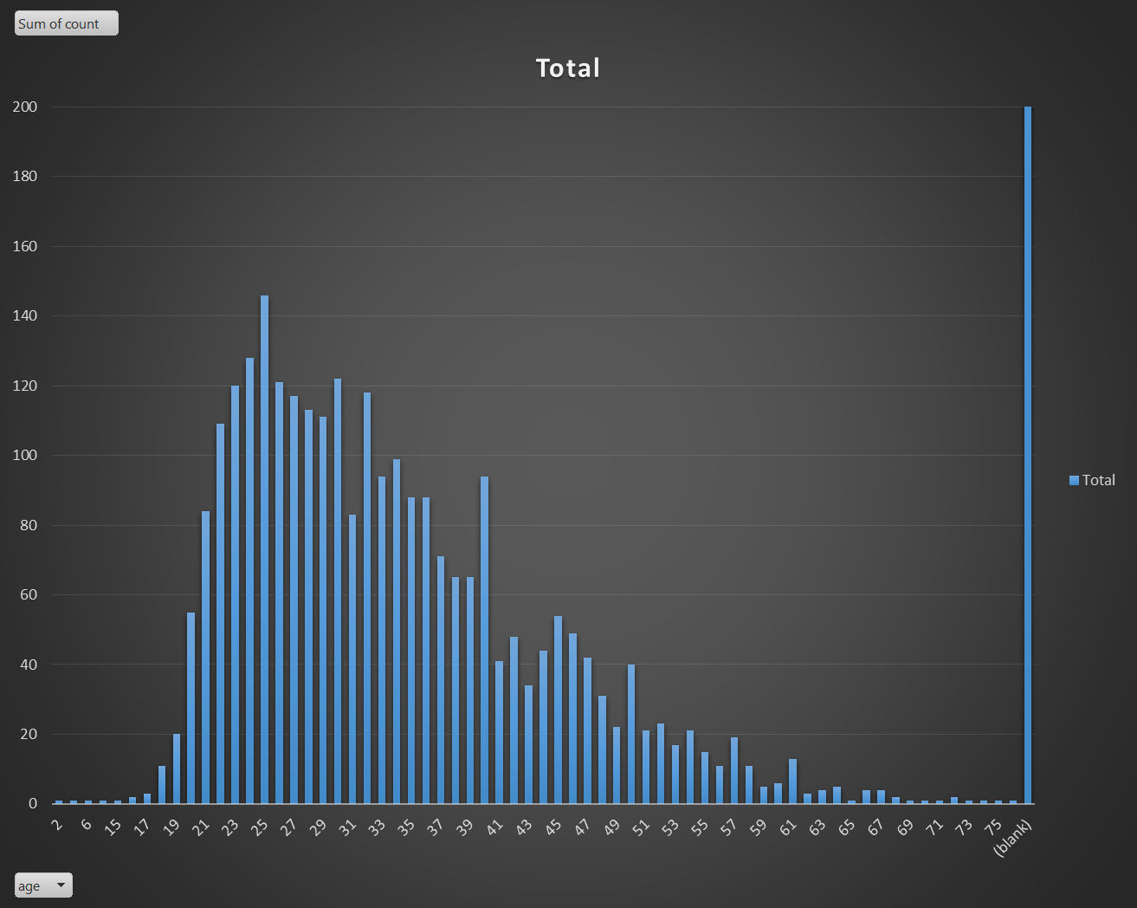
Age Distribution: Average 34

Slide 39
Homeworks
These are online within Google Course Builder for the MOOC with peer assessment. In the 3 credit offerings, all graded material (homework and projects) is conducted traditionally through Indiana University Oncourse (superceded by Canvas).
Oncourse was additionally used to assign which videos should be watched each week and the discussion forum topics described later (these were just “special homeworks in Oncourse).
In the non-residential data science certificate class, the students were on a variable schedule (as typically working full time and many distractions; one for example had faculty position interviews) and considerable latitude was given for video and homework completion dates.

Slide 40
Discussion Forums
Each offering had a separate set of electronic discussion forums which were used for class announcements (replicating Oncourse) and for assigned discussions.
Following slide illustrates an assigned discussion on the implications of the success of e-commerce for the future of “real malls”. The students were given “participation credit” for posting here and these were very well received.
Later offerings made greater use of these forums. Based on student feedback, we encouraged even greater participation through students both posting and commenting.
Note I personally do not like specialized (walled garden) forums and the class forums were set up using standard Google Community Groups with a familiar elegant interface. These community groups also link well to Google Hangouts described later.
As well as interesting topics, all class announcements were made in the “Instructor” forum repeating information posted at Oncourse. Of course no sensitive material such as returned homework was posted on Google site.

Slide 41
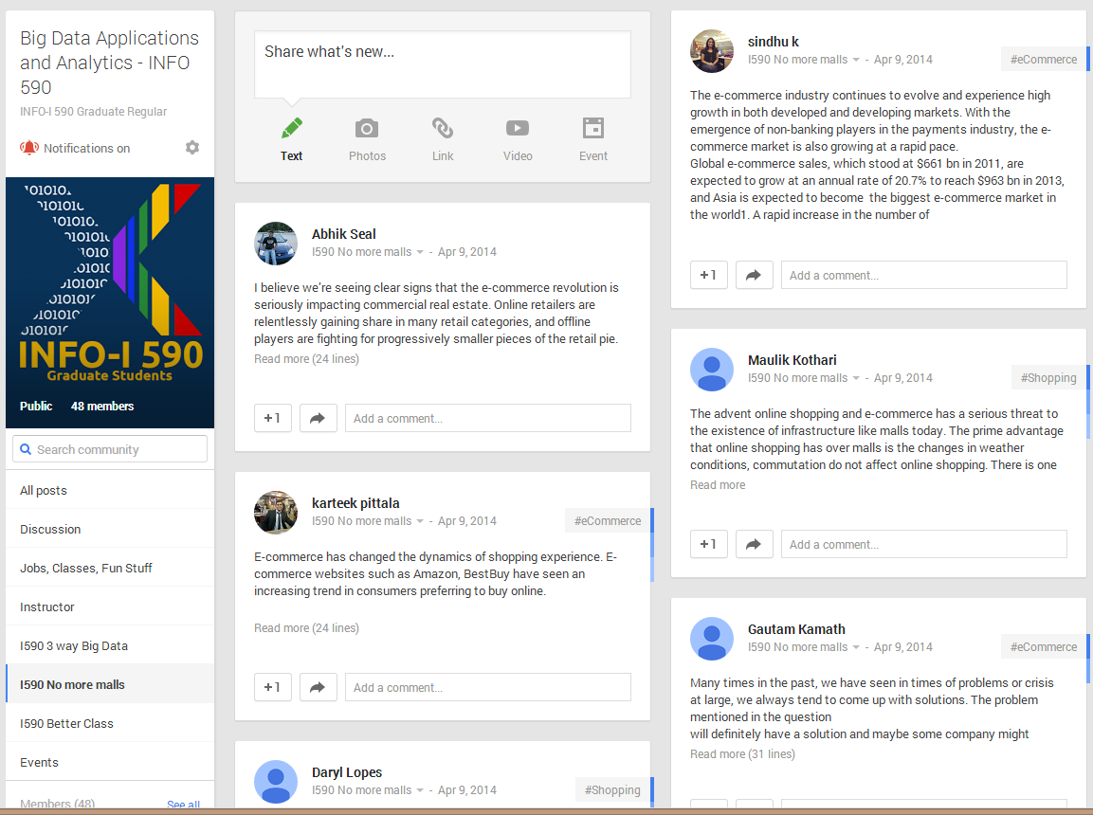
The community group for one of classes and one forum (“No more malls”)

Slide 42
Hangouts and Adobe Connect
For the purely online offering, we supplemented the asynchronous material described above with real-time interactive Google Hangout video sessions.
Given varied time zones and weekday demands on students, these were held at 1pm Eastern on Sundays.
Google Hangouts are conveniently scheduled from community page and offer interactive video and chat capabilities that were well received. Other technologies such as Skype are also possible.
Hangouts are restricted to 10-15 people which was sufficient for this section but in general insufficient. Not all of 12 students attended a given class.
The Hangouts focused on general data science issues and the mechanics of the class.
Augment Hangout by non-video Adobe Connect session

Slide 43
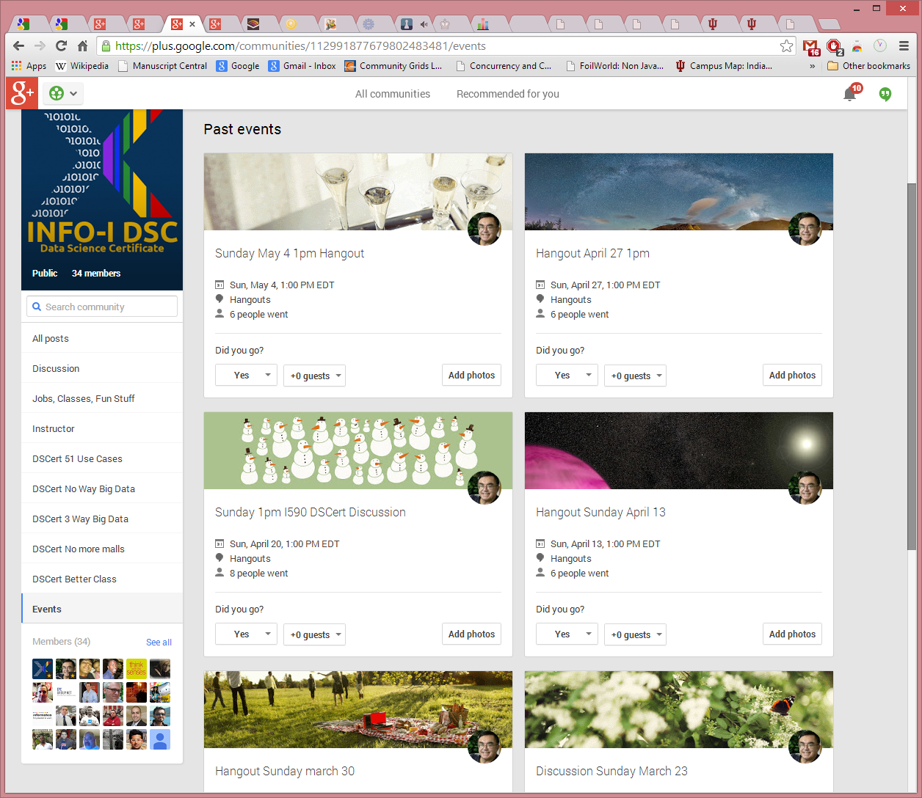
Figure 6: Community Events for Online Data Science Certificate Course

Slide 44
In class Sessions
The residential sections had regular in class sessions; one 90 minute session per class each week. This was originally two sessions but reduced to one partly because online videos turned these into “flipped classes” with less need for in class time and partly to accommodate more students (77 total graduate and undergraduate) in two groups with separate classes.
These classes were devoted to discussions of course material, homework and largely the discussion forum topics. This part of course was not greatly liked by the students – especially the undergraduate section which voted in favor of a model with only the online components (including the discussion forums which they recommended expanding).
In particular the 9.30am start time was viewed as too early and intrinsically unattractive.

Slide 45
Geoffrey Fox’s
Online Data Science Classes II

Slide 47
Big Data & Open Source Software Projects Overview
This course studies DevOps and software used in many commercial activities to study Big Data.
The backdrop for course is the ~350 software subsystems HPC-ABDS (High Performance Computing enhanced - Apache Big Data Stack) illustrated at http://hpc-abds.org/kaleidoscope/
The cloud computing architecture underlying ABDS and contrast of this with HPC.
The main activity of the course is building a significant project using multiple HPC-ABDS subsystems combined with user code and data.
Projects will be suggested or students can chose their own
http://cloudmesh.github.io/introduction_to_cloud_computing/class/lesson/projects.html
For more information, see: http://bigdataopensourceprojects.soic.indiana.edu/ and
http://cloudmesh.github.io/introduction_to_cloud_computing/class/bdossp_sp15/week_plan.html
25 Hours of Video
Probably too much for semester class

Slide 48
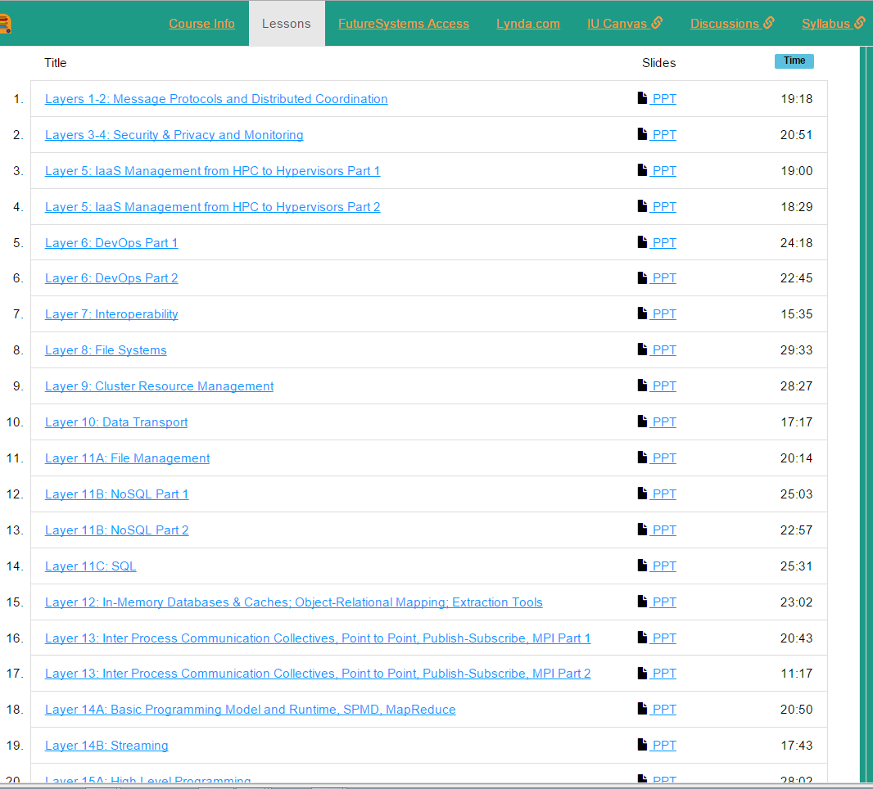

Slide 49
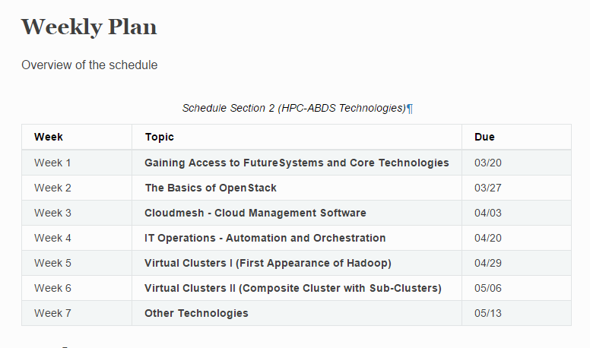

Slide 50
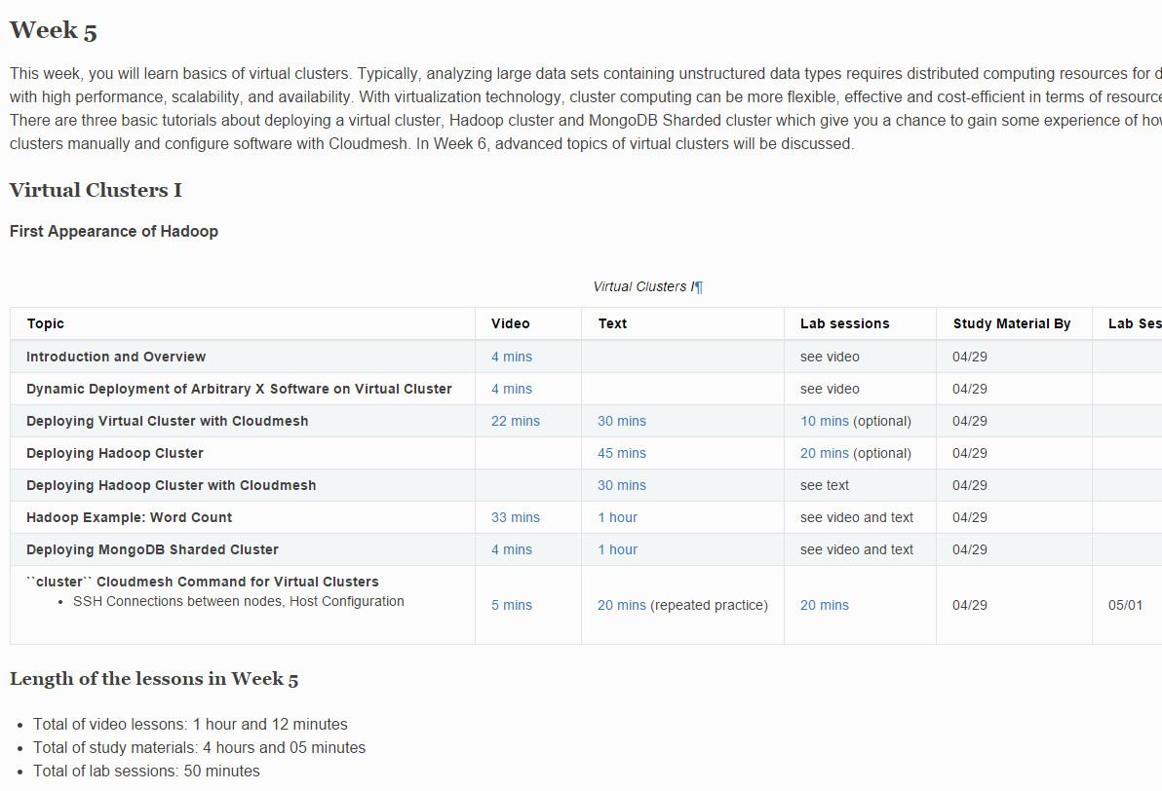

Slide 51
Unexpected Lessons
We learnt some things from current offering of BDOSSP class
  40 online students from around the world
The hyperlinking of material caused students NOT to go through material systematically
  Suggest go to structured hierarchy as in BDAA Course
  Followed from use of Canvas as mundane LMS plus multiple web resources (Microsoft Office Mix and our computer support pages)
Students did not use email and discussion groups in Canvas; we switched to emails and list serves to the their main (not IU) email
Very erratic progress due to different time zones and interruption of full time job for each student
  Difficult to have communal “help” sessions and to give interactive support at time student wanted
OpenStack fragile!

Slide 52
MOOC’s

Slide 53
Background on MOOC’s
MOOC’s are a “disruptive force” in the educational environment
  Coursera, Udacity, Khan Academy and many others
MOOC’s have courses and technologies
Google Course Builder and OpenEdX are open source MOOC technologies
Blackboard and others are learning management systems with (some) MOOC support
Coursera Udacity etc. have internal proprietary MOOC software
This software is LMS++
LMS= Learning Management system

Slide 54
MOOC Style Implementations
Courses from commercial sources, universities and partnerships
Courses with 100,000 students (free)
Georgia Tech a leader in rigorous academic curriculum – MOOC style Masters in Computer Science (pay tuition, get regular GT degree)
Interesting way to package tutorial material for computers and software e.g.
  E.g. Course online programming laboratories supported by MOOC modules on how to use system

Slide 55
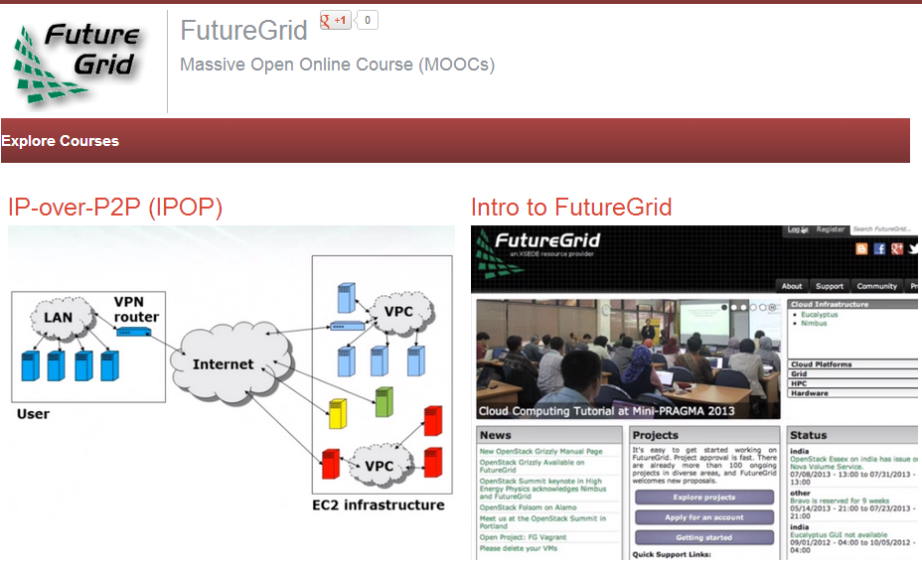

Slide 56
MOOCs in SC community
Activities like CI-Tutor and HPC University are community activities that have collected much re-usable education material
MOOC’s naturally support re-use at lesson or higher level
  e.g. include MPI on XSEDE MOOC as part of many parallel programming classes
Need to develop agreed ways to use backend servers (HPC or Cloud) to support MOOC laboratories
  Students should be able to take MOOC classes from tablet or phone
Parts of MOOC’s (Units or Sections) can be used as modules to enhance classes in outreach activities

Slide 57
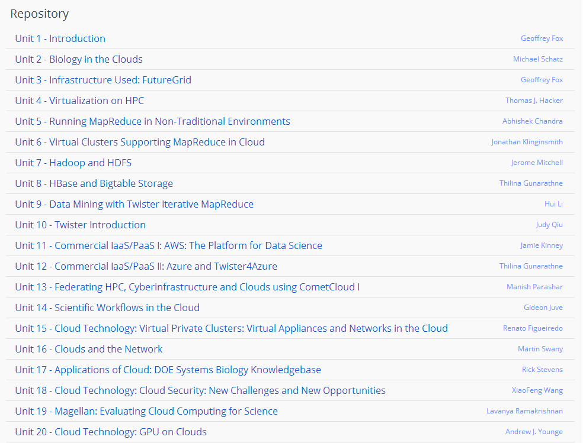
Cloud MOOC Repository
http://iucloudsummerschool.appspot.com/preview

Slide 58
Online Education

Slide 59
Potpourri of Online Technologies
Canvas (Indiana University Default): Best for interface with IU grading and records
Google Course Builder: Best for management and integration of components
Ad hoc web pages: alternative easy to build integration
Microsoft Mix: Simplest faculty preparation interface
Adobe Presenter/Camtasia: More powerful video preparation that support subtitles but not clearly needed
Google Community: Good social interaction support
YouTube: Best user interface for videos (without Mix PowerPoint support)
Hangout: Best for instructor-students online interactions (one instructor to 9 students with live feed). Hangout on air mixes live and streaming (30 second delay from archived YouTube) and more participants
OpenEdX at one time future of Google Course Builder and getting easier to use but still significant effort
Google-groups and Slack used for student-student/teacher interactions

Slide 60
Components of an (Online) Learning Management System
Features in LMS are often not competitive with standalone solutions so tendency to use multiple technologies even though this leads to confused interface
Post Assignments OpenEdX and Canvas
Grading Results Canvas
Discussions OpenEdX
Formal interaction between students and AI’s/Instructor Google-groups
Informal interactions - Slack
Posting of videos and other online resources – OpenEdX
Online sessions with remote students – Hangout or Adobe Connect

Slide 61
Four Online Platforms I
 | CourseBuilder | OpenEdx | IU Canvas | OfficeMix Plugin for Powerpoint
OpenSource | Yes | Yes | No | N/A
Microsoft Integration (Office 365, Onedrive, Azure cloud) | No | Yes. Predicted to be included in the upcoming release. | No | N/A
Analytics | Some analytics included but not comprehensive. Still needs more development. | No analytics included but there is a version 0 alpha release Analytics API available for use. External apps can be developed | Very basic | Very basic but more useful than Canvas
Peer reviews | Yes | Yes | Yes | No

Slide 62
Four Online Platforms II
 | CourseBuilder | OpenEdx | IU Canvas | OfficeMix Plugin for Powerpoint
LTI Compliance (Learning Technologies Integration) | Yes. CB as a LTI provider or consumer. | Yes. | Yes. Functionality might be limited by IU. | N/A
Ease of use and customization scale | 5/10 for students, faculty, developers | 7/10 – ease of use by students, faculty 3/10 – customization by developer | N/A | PowerPoint Slide labelled Videos could be an advantage
Ease of Deployment | 10/10 | 1/10 | N/A | N/A
Cost | Almost none; Can rise with increase usage of cloud transactions but usually a very low cost operation | Very expensive to deploy and maintain the servers; Need a dedicated staff for administering servers; | IU provided | N/A
1 – not easy
10 – very easy

Slide 63
Four Online Platforms III
 | CourseBuilder | OpenEdx | IU Canvas | OfficeMix Plugin for Powerpoint
Unique Features and Functionality | Skill maps BigQuery for Analytics | Good UI for course administration; Integrated forums, grading, content area, and much more. | Export/Import Grades | Enables faculty to record their own videos and insert interactive content such as quizzes, programming test-bed etc.
Common features | Certificates Generation Supported; Quizzes; Assessments; Peer Reviews; Autograding | Certificate Generation Supported; Quizzes; Assessments; Autograding; | Quizzes; Assessments; Peer Review | N/A

Slide 64
Use of Slack Messaging

Slide 65
Overview
136 users
Technical Support
Channels
Open
Private
Direct Messaging
Collaboration
Projects
Assignments
Informal
Not graded
Statistics*
4K+ messages
36% private channels
25% public channels
39% Direct Messages
Topics of Interest
#introductions channel used to share expertise
Summary

Slide 66
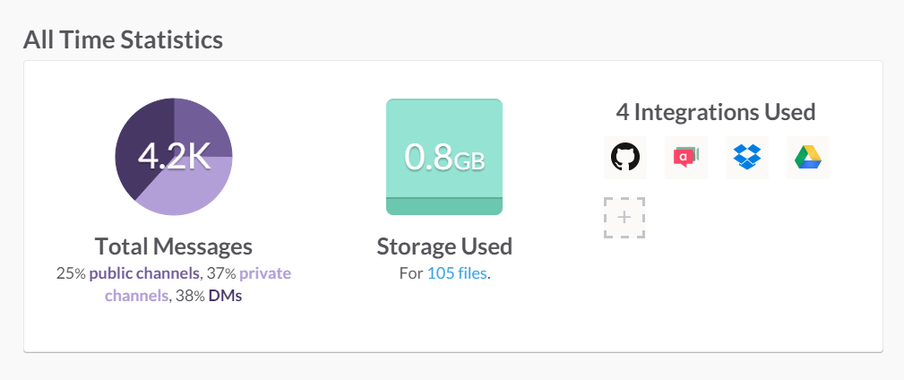
Updated 11/24/2015

Slide 67



Comparison of Technologies
Slack
Direct Messaging with Public & Private Channels
Canvas
Open Discussions
Group or Individual Email to students
Open Edx Discussions
Discussions on topics
No Email Notification
Good search and very intuitive
Flexible Email Notifications & Alerts
Detailed analytics on paid plans
No Analytics
No Analytics

Slide 68




Highlights of Use of Slack
Successful – Higher usage of private channels + direct messaging (75%)
Direct Messaging – Have completely private and secure discussion with a colleague
Allow various channels of communication – private/open/direct messaging
Sharing files
80+ Third-party Integrations:
…and more

Slide 69
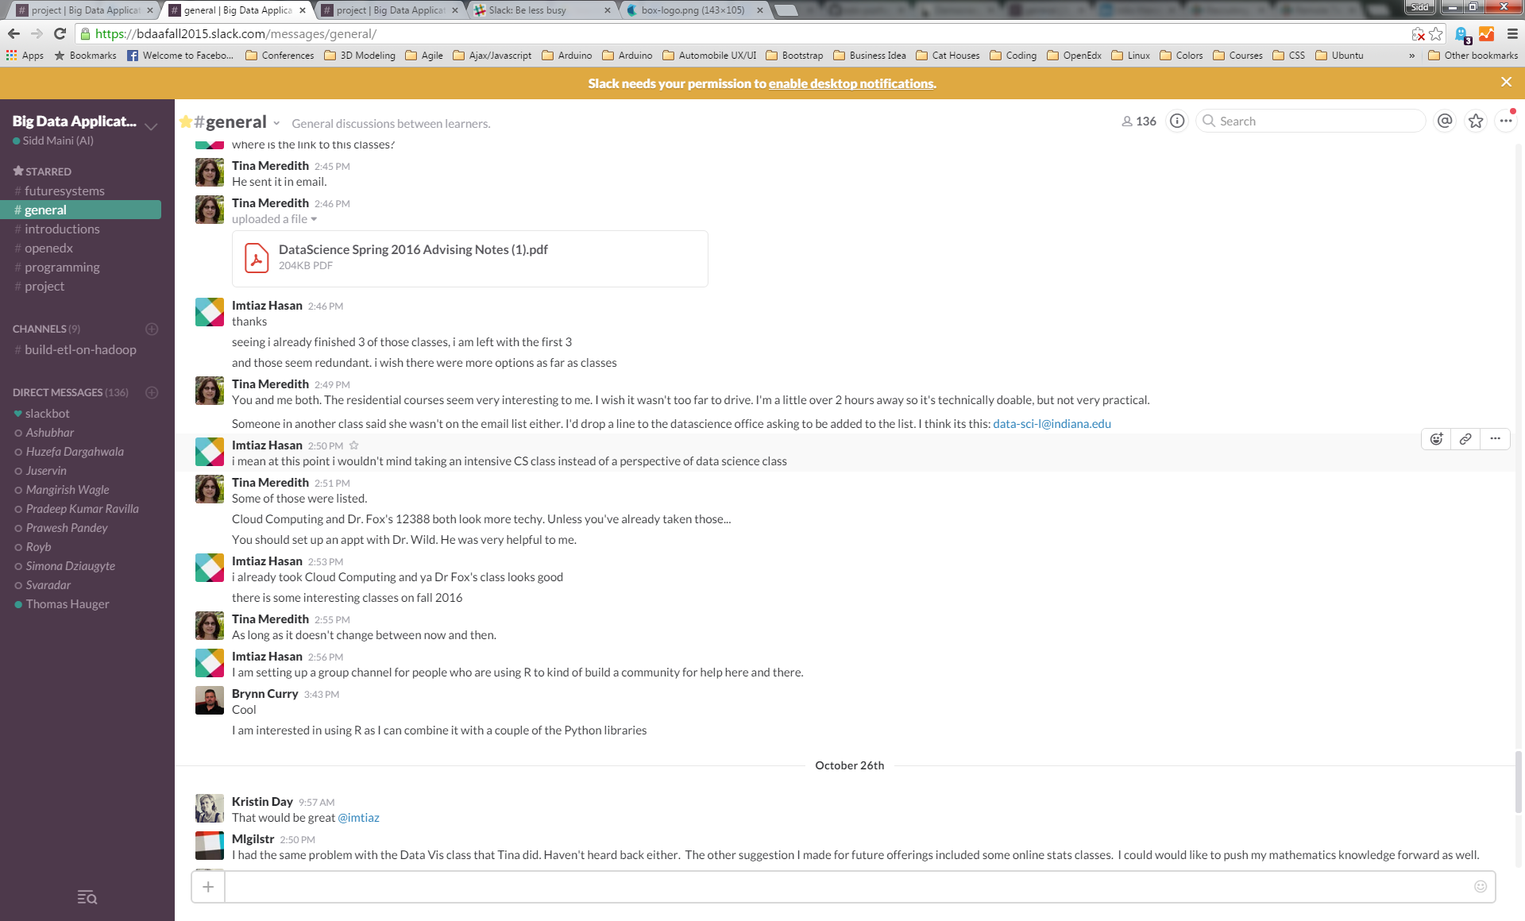

Slide 70
Summary

Slide 71
Lessons / Insights
Data Science is a very healthy area
At IU, I expect to grow in interest although set up as a program has strange side effects
Not clear if Online education is taking off but may be distorted by US Company hiring practices
I teach all my classes – residential or online -- with online lectures
All of this straightforward but hard work
Current open source and proprietary MOOC software not very satisfactory; “easy” to do better
No reason to differentiate MOOC and general LMS

Slide 72
Details of Masters Degree
Computational and Analytic Data Science track

Slide 73
Computational and Analytic Data Science track
Category 1: Core Courses
CSCI B503 Analysis of Algorithms
CSCI B555 Machine Learning OR INFO I590 Applied Machine Learning
CSCI B561 Advanced Database Concepts
STAT S520 Introduction to Statistics OR (New Course) Probabilistic Reasoning
Category 2: Data Systems
CSCI B534 Distributed Systems CSCI B561 Advanced Database Concepts, CSCI B662 Database Systems & Internal Design
CSCI B649 Cloud Computing CSCI B649 Advanced Topics in Privacy
CSCI P538 Computer Networks
INFO I533 Systems & Protocol Security & Information Assurance
ILS Z534: Information Retrieval: Theory and Practice

Slide 74
Computational and Analytic Data Science track
Category 3: Data Analysis
CSCI B565 Data Mining
CSCI B555 Machine Learning
INFO I590 Applied Machine Learning
INFO I590 Complex Networks and Their Applications
STAT S520 Introduction to Statistics
(New Course) Probabilistic Reasoning
(New Course CSCI) Algorithms for Big Data
Category 4: Elective Courses
CSCI B551 Elements of Artificial Intelligence
CSCI B553 Probabilistic Approaches to Artificial Intelligence
CSCI B659 Information Theory and Inference
CSCI B661 Database Theory and Systems Design
INFO I519 Introduction to Bioinformatics
INFO I520 Security For Networked Systems
INFO I529 Machine Learning in Bioinformatics
INFO I590 Relational Probabilistic Models
ILS Z637 - Information Visualization
Every course in 500/600 SOIC related to data that is not in the list
All courses from STAT that are 600 and above

Slide 75
Details of Masters Degree
General Track

Slide 76
General Track: Areas I and II
I. Data analysis and statistics: gives students skills to develop and extend algorithms, statistical approaches, and visualization techniques for their explorations of large scale data. Topics include data mining, information retrieval, statistics, machine learning, and data visualization and will be examined from the perspective of “big data,” using examples from the application focus areas described in Section IV.
II. Data lifecycle: gives students an understanding of the data lifecycle, from digital birth to long-term preservation. Topics include data curation, data stewardship, issues related to retention and reproducibility, the role of the library and data archives in digital data preservation and scholarly communication and publication, and the organizational, policy, and social impacts of big data.

Slide 77
General Track: Areas III and IV
III. Data management and infrastructure: gives students skills to manage and support big data projects. Data have to be described, discovered, and actionable. In data science, issues of scale come to the fore, raising challenges of storage and large-scale computation. Topics in data management include semantics, metadata, cyberinfrastructure and cloud computing, databases and document stores, and security and privacy and are relevant to both data science and “big data” data science.
IV. Big data application domains: gives students experience with data analysis and decision making and is designed to equip them with the ability to derive insights from vast quantities and varieties of data. The teaching of data science, particularly its analytic aspects, is most effective when an application area is used as a focus of study. The degree will allow students to specialize in one or more application areas which include, but are not limited to Business analytics, Science informatics, Web science, Social data informatics, Health and Biomedical informatics.

Slide 78
I. Data Analysis and Statistics
CSCI B503 Analysis of Algorithms
CSCI B553 Probabilistic Approaches to Artificial Intelligence
CSCI B652: Computer Models of Symbolic Learning
CSCI B659 Information Theory and Inference
CSCI B551: Elements of Artificial Intelligence
CSCI B555: Machine Learning
CSCI B565: Data Mining
INFO I573: Programming for Science Informatics
INFO I590 Visual Analytics
INFO I590 Relational Probabilistic Models
INFO I590 Applied Machine Learning
ILS Z534: Information Retrieval: Theory and Practice
ILS Z604: Topics in Library and Information Science: Big Data Analysis for Web and Text
ILS Z637: Information Visualization
STAT S520 Intro to Statistics
STAT S670: Exploratory Data Analysis
STAT S675: Statistical Learning & High-Dimensional Data Analysis
(New Course CSCI) Algorithms for Big Data
(New Course CSCI) Probabilistic Reasoning
All courses from STAT that are 600 and above

Slide 79
II. Data Lifecycle
INFO I590: Data Provenance
INFO I590 Complex Systems
ILS Z604 Scholarly Communication
ILS Z636: Semantic Web
ILS Z652: Digital Libraries
ILS Z604: Data Curation
(New Course INFO): Social and Organizational Informatics of Big Data
(New Course ILS: Project Management for Data Science
(New Course ILS): Big Data Policy

Slide 80
III. Data Management and Infrastructure
CSCI B534: Distributed Systems
CSCI B552: Knowledge-Based Artificial Intelligence
CSCI B561: Advanced Database Concepts
CSCI B649: Cloud Computing (offered online)
CSCI B649 Advanced Topics in Privacy
CSCI B649: Topics in Systems: Cloud Computing for Data Intensive Sciences
CSCI B661: Database Theory and System Design
CSCI B662 Database Systems & Internal Design
CSCI B669: Scientific Data Management and Preservation
CSCI P536: Operating Systems
CSCI P538 Computer Networks
INFO I520 Security For Networked Systems
INFO I525: Organizational Informatics and Economics of Security
INFO I590 Complex Networks and their Applications
INFO I590: Topics in Informatics: Data Management for Big Data
INFO I590: Topics in Informatics: Big Data Open Source Software and Projects
ILS S511: Database
Every course in 500/600 SOIC related to data that is not in the list

Slide 81
IV. Application areas
CSCI B656: Web mining
CSCI B679: Topics in Scientific Computing: High Performance Computing
INFO I519 Introduction to Bioinformatics
INFO I529 Machine Learning in Bioinformatics
INFO I533 Systems & Protocol Security & Information Assurance
INFO I590: Topics in Informatics: Big Data Applications and Analytics
INFO I590: Topics in Informatics: Big Data in Drug Discovery, Health and Translational Medicine
ILS Z605: Internship in Data Science
Kelley School of Business: business analytics course(s)
Other courses from Indiana University e.g. Physics Data Analysis

Slide 82
Typical Paths through Degree

Slide 83
Technical Track of General DS Masters
Year 1 Semester 1:
  INFO 590: Topics in Informatics: Big Data Applications and Analytics
  ILS Z604: Big Data Analytics for Web and Text
  STAT S520: Intro to Statistics
Year 1: Semester 2:
  CSCI B661: Database Theory and System Design
  ILS Z637: Information Visualization
  STAT S670: Exploratory Data Analysis
Year 1: Summer:
  CSCI B679: Topics in Scientific Computing: High Performance Computing
Year 2: Semester 3:
  CSCI B555: Machine Learning
  STAT S670: Exploratory Data Analysis
  CSCI B649: Cloud Computing

Slide 84
Computational and Analytic Data Science track
Year 1 Semester 1:
  B503 Analysis of Algorithms
  B561 Advanced Database Concepts
  S520 Introduction to Statistics
Year 1: Semester 2:
  B649 Cloud Computing
  Z534: Information Retrieval: Theory and Practice
  B555 Machine Learning
Year 1: Summer:
  ILS 605: Internship in Data Science
Year 2: Semester 3:
  B565 Data Mining
  I520 Security For Networked Systems
  Z637 - Information Visualization

Slide 85
An Information-oriented Track
Year 1 Semester 1:
  INFO 590: Topics in Informatics: Big Data Applications and Analytics
  ILS Z604 Big Data Analytics for Web and Text.
  STAT S520 Intro to Statistics
Year 1: Semester 2:
  CSCI B661 Database Theory and System Design
  ILS Z637: Information Visualization
  ILS Z653: Semantic Web
Year 1: Summer:
  ILS 605: Internship in Data Science
Year 2: Semester 3:
  ILS Z604 Data Curation
  ILS Z604 Scholarly Communication
  INFO I590: Data Provenance

