Slide 1
Data Intensive Biomedical Computing Systems
Statewide IT Conference
October 1, 2009, Indianapolis
Judy Qiu
xqiu@indiana.edu www.infomall.org/salsa
Community Grids Laboratory
Pervasive Technology Institute
Indiana University
Notes:
SALSA is
Service Aggregated Linked Sequential Activities

Slide 2
Collaborators in SALSA Project
Microsoft Research
Technology Collaboration
Azure (Clouds)
Dennis Gannon
Dryad (Parallel Runtime)
Roger Barga
Christophe Poulain
CCR (Threading)
George Chrysanthakopoulos
DSS (Services)
Henrik Frystyk Nielsen
Indiana University
SALSA Technology Team
Geoffrey Fox
Judy Qiu
Scott Beason
Jaliya Ekanayake
Thilina Gunarathne
Thilina Gunarathne
Jong Youl Choi
Yang Ruan
Seung-Hee Bae
Hui Li
Saliya Ekanayake
Applications
Bioinformatics, CGB
Haixu Tang, Mina Rho,
Peter Cherbas, Qunfeng Dong
IU Medical School
Gilbert Liu
Demographics (Polis Center)
Neil Devadasan
Cheminformatics
David Wild, Qian Zhu
Physics
CMS group at Caltech (Julian Bunn)
Community Grids Lab
and UITS RT – PTI

Slide 3
Data Intensive (Science) Applications
Applications
Biology: Expressed Sequence Tag (EST) sequence assembly (CAP3)
Biology: Pairwise Alu sequence alignment (SW)
Health: Correlating childhood obesity with environmental factors
Cheminformatics: Mapping PubChem data into low dimensions to aid drug discovery
Data mining Algorithm
Clustering (Pairwise , Vector)
MDS, GTM, PCA, CCA
Visualization
PlotViz
Cloud Technologies
(MapReduce, Dryad, Hadoop)
Classic HPC
MPI
FutureGrid/VM
Bare metal
(Computer, network, storage)
Notes:
We suggest that the data deluge will demand more robust algorithms in many areas and these algorithms will be highly I/O and compute intensive
Clustering N= 200,000 sequences using deterministic annealing will require around 750 cores and this need scales like N²
NSF Track 1 – Blue Waters in 2011 – could be saturated by 5,000,000 point clustering

Slide 4
Data Intensive Architecture
Instruments
User Data
Files
Files
Files
Visualization
User Portal
Knowledge
Discovery
Users
Files
Files
Files
Initial
Processing
Higher Level
Processing
Such as R
PCA, Clustering
Correlations …
Maybe MPI
Prepare for
Viz
MDS
Notes:
From 1980-2000?, we largely looked at HPC for simulation; now we have data deluge
1) Data starts on some disk/sensor/instrument
It needs to be decomposed/partitioned; often partitioning natural from source of data
2) One runs a filter of some sort extracting data of interest and (re)formatting it
Pleasingly parallel with often “millions” of jobs
Communication latencies can be many milliseconds and can involve disks
3) Using same (or map to a new) decomposition, one runs a possibly parallel application that could require iterative steps between communicating processes or could be pleasing parallel
Communication latencies may be at most some microseconds and involves shared memory or high speed networks
Workflow links 1) 2) 3) with multiple instances of 2) 3)
Pipeline or more complex graphs
Filters are “Maps” or “Reductions” in MapReduce language

Slide 5






MapReduce “File/Data Repository” Parallelism
Instruments
Map = (data parallel) computation reading and writing data
Reduce = Collective/Consolidation phase e.g. forming multiple global sums as in histogram
Communication via Messages/Files
Portals
/Users
Disks
Map₁
Map₂
Map₃
Reduce
Computers/Disks

Slide 6
Cloud Computing: Infrastructure and Runtimes
Cloud infrastructure: outsourcing of servers, computing, data, file space, etc.
  Handled through Web services that control virtual machine lifecycles.
Cloud runtimes: tools (for using clouds) to do data-parallel computations.
  Apache Hadoop, Google MapReduce, Microsoft Dryad, and others
  Designed for information retrieval but are excellent for a wide range of science data analysis applications
  Can also do much traditional parallel computing for data-mining if extended to support iterative operations
  Not usually on Virtual Machines

Slide 7
Application Classes
Application—parallel software/hardware in terms of 5 “Application Architecture” Structures
  1) Synchronous – Lockstep Operation as in SIMD architectures
  2) Loosely Synchronous – Iterative Compute-Communication stages with independent compute (map) operations for each CPU. Heart of most MPI jobs
  3) Asynchronous – Compute Chess; Combinatorial Search often supported by dynamic threads
  4) Pleasingly Parallel – Each component independent – in 1988, I estimated at 20% total in hypercube conference
  5) Metaproblems – Coarse grain (asynchronous) combinations of classes 1)-4). The preserve of workflow.
Grids greatly increased work in classes 4) and 5)
The above largely described simulations and not data processing. Now we should admit the class which crosses classes 2) 4) 5) above
  6) MapReduce++ which describe file(database) to file(database) operations
  6a) Pleasing Parallel Map Only
  6b) Map followed by reductions
  6c) Iterative “Map followed by reductions” – Extension of Current Technologies that supports much linear algebra and datamining
Note overheads in 1) 2) 6c) go like Communication Time/Calculation Time and basic MapReduce pays file read/write costs while MPI is microseconds

Slide 8
Applications & Different Interconnection Patterns
Map Only | Classic MapReduce | Iterative Reductions | Loosely Synchronous
CAP3 Analysis Document conversion (PDF -> HTML) Brute force searches in cryptography Parametric sweeps | High Energy Physics (HEP) Histograms Distributed search Distributed sorting Information retrieval | Expectation maximization algorithms Clustering Linear Algebra | Many MPI scientific applications utilizing wide variety of communication constructs including local interactions
- CAP3 Gene Assembly - PolarGrid Matlab data analysis | - Information Retrieval - HEP Data Analysis - Calculation of Pairwise Distances for ALU Sequences | Kmeans Deterministic Annealing Clustering - Multidimensional Scaling MDS | - Solving Differential Equations and - particle dynamics with short range forces
Input
iterations
Input
Input
map
map
map
Pij
reduce
Output
reduce
Domain of MapReduce and Iterative Extensions
MPI

Slide 9
Cluster Configurations
Feature | GCB-K18 @ MSR | iDataplex @ IU | Tempest @ IU
CPU | Intel Xeon CPU L5420 2.50GHz | Intel Xeon CPU L5420 2.50GHz | Intel Xeon CPU E7450 2.40GHz
# CPU /# Cores per node | 2 / 8 | 2 / 8 | 4 / 24
Memory | 16 GB | 32GB | 48GB
# Disks | 2 | 1 | 2
Network | Giga bit Ethernet | Giga bit Ethernet | Giga bit Ethernet / 20 Gbps Infiniband
Operating System | Windows Server Enterprise - 64 bit | Red Hat Enterprise Linux Server -64 bit | Windows Server Enterprise - 64 bit
# Nodes Used | 32 | 32 | 32
Total CPU Cores Used | 256 | 256 | 768
DryadLINQ
Hadoop / MPI
DryadLINQ / MPI

Slide 10
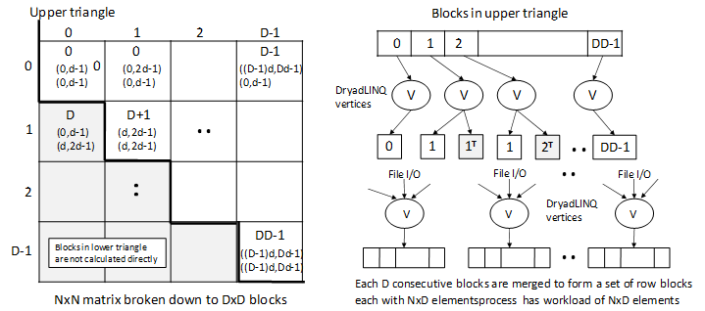
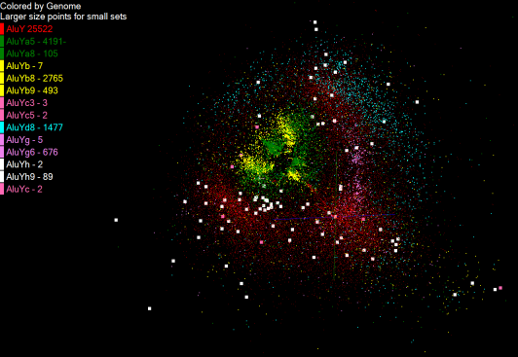
Pairwise Distances – ALU Sequencing
125 million distances
4 hours & 46 minutes
Calculate pairwise distances for a collection of genes (used for clustering, MDS)
O(N^2) problem
“Doubly Data Parallel” at Dryad Stage
Performance close to MPI
Performed on 768 cores (Tempest Cluster)
Processes work better than threads when used inside vertices
100% utilization vs. 70%
Notes:
1~180 lines without threading in DryadLINQ, with threading, it is about 400 lines
MPI ~500 lines
The Alu clustering problem [27] is one of the most challenging problems for sequencing clustering because Alus represent the largest repeat families in human genome. There are about 1 million copies of Alu sequences in human genome, in which most insertions can be found in other primates and only a small fraction (~ 7000) are human-specific. This indicates that the classification of Alu repeats can be deduced solely from the 1 million human Alu elements. Notable, Alu clustering can be viewed as a classical case study for the capacity of computational infrastructures because it is not only of great intrinsic biological interests, but also a problem of a scale that will remain as the upper limit of many other clustering problem in bioinformatics for the next few years, e.g. the automated protein family classification for a few millions of proteins predicted from large metagenomics projects. In our work here we examine Alu samples of 35339 and 50,000 sequences.

Slide 11
Alu and Sequencing Workflow
Data is a collection of N sequences – 100’s of characters long
  These cannot be thought of as vectors because there are missing characters
  “Multiple Sequence Alignment” (creating vectors of characters) doesn’t seem to work if N larger than O(100)
Can calculate N² dissimilarities (distances) between sequences (all pairs)
Find families by clustering (much better methods than Kmeans). As no vectors, use vector free O(N²) methods
Map to 3D for visualization using Multidimensional Scaling MDS – also O(N²)
N = 50,000 runs in 10 hours (all above) on 768 cores
Our collaborators just gave us 170,000 sequences and want to look at 1.5 million – will develop new algorithms!
MapReduce++ will do all steps as MDS, Clustering just need MPI Broadcast/Reduce

Slide 12


Slide 13
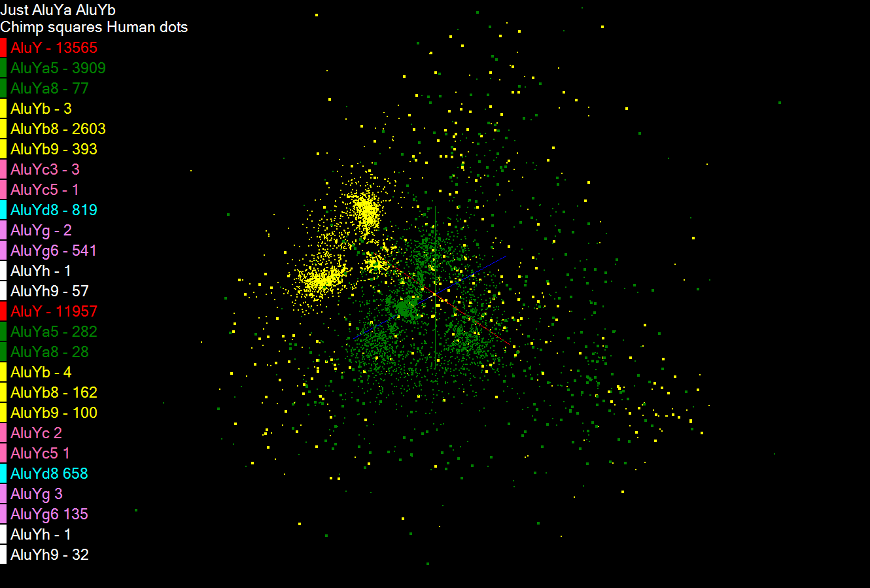

Slide 14
Pairwise Clustering
30,000 Points on Tempest

Slide 15
Dryad versus MPI for Smith Waterman
Flat is perfect scaling

Slide 16
Dryad versus MPI for Smith Waterman
Flat is perfect scaling

Slide 17
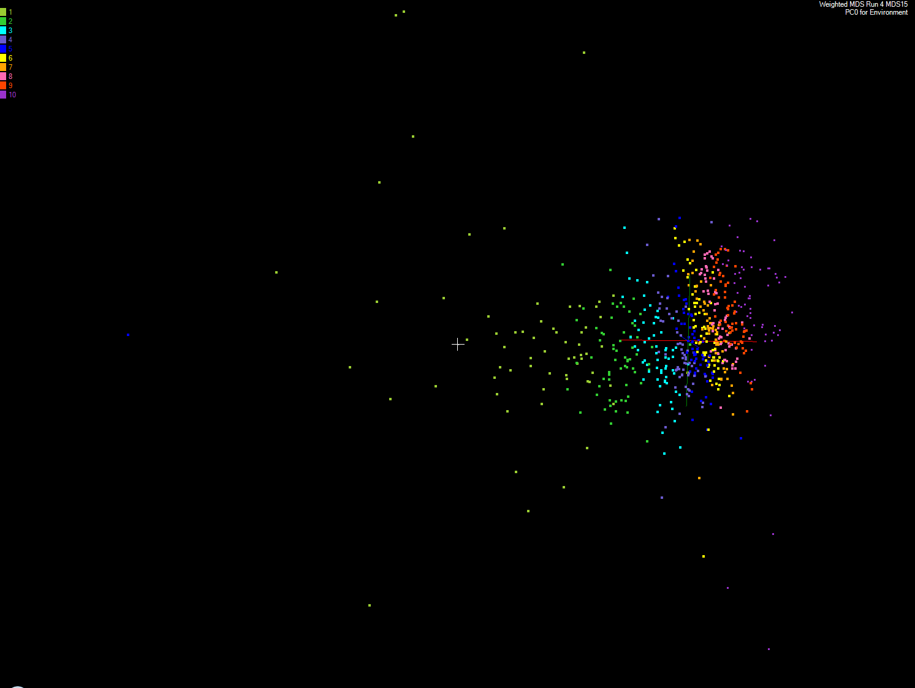
Apply MDS to Patient Record Data
and correlation to GIS properties
MDS and Primary PCA Vector
MDS of 635 Census Blocks with 97 Environmental Properties
Shows expected Correlation with Principal Component – color varies from greenish to reddish as projection of leading eigenvector changes value
Ten color bins used

Slide 18
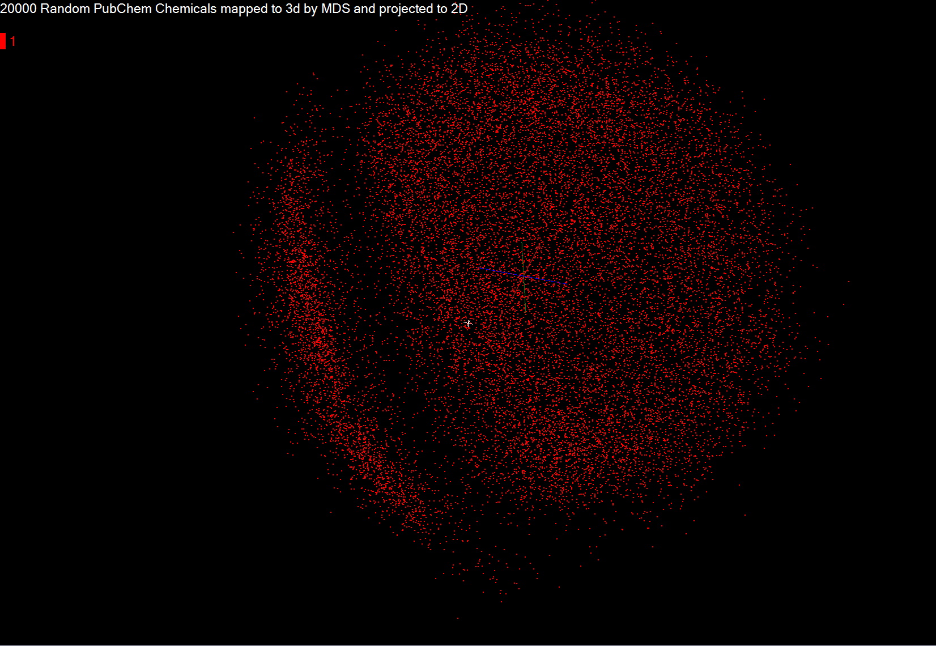

Slide 19
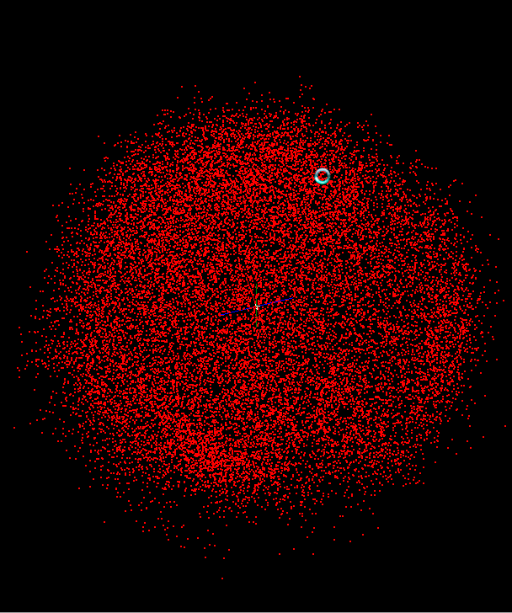

Slide 20
DryadLINQ on Cloud
HPC release of DryadLINQ requires Windows Server 2008
Amazon does not provide this VM yet
Used GoGrid cloud provider
Before Running Applications
  Create VM image with necessary software
    E.g. NET framework
  Deploy a collection of images (one by one – a feature of GoGrid)
  Configure IP addresses (requires login to individual nodes)
  Configure an HPC cluster
  Install DryadLINQ
  Copying data from “cloud storage”
  We configured a 32 node virtual cluster in GoGrid

Slide 21
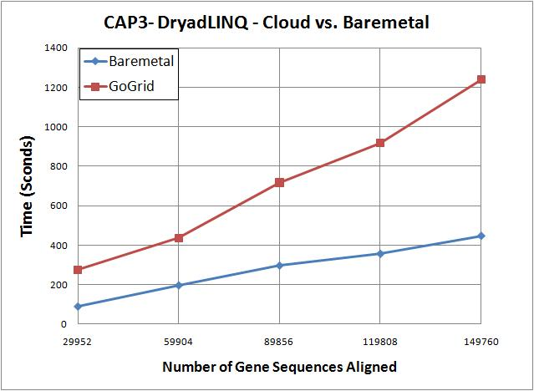
DryadLINQ on Cloud contd..
CAP3 works on cloud
Used 32 CPU cores
100% utilization of virtual CPU cores
3 times more time in cloud than the bare-metal runs on different
CloudBurst and Kmeans did not run on cloud
VMs were crashing/freezing even at data partitioning
  Communication and data accessing simply freeze VMs
  VMs become unreachable
We expect some communication overhead, but the above observations are more GoGrid related than to Cloud

Slide 22
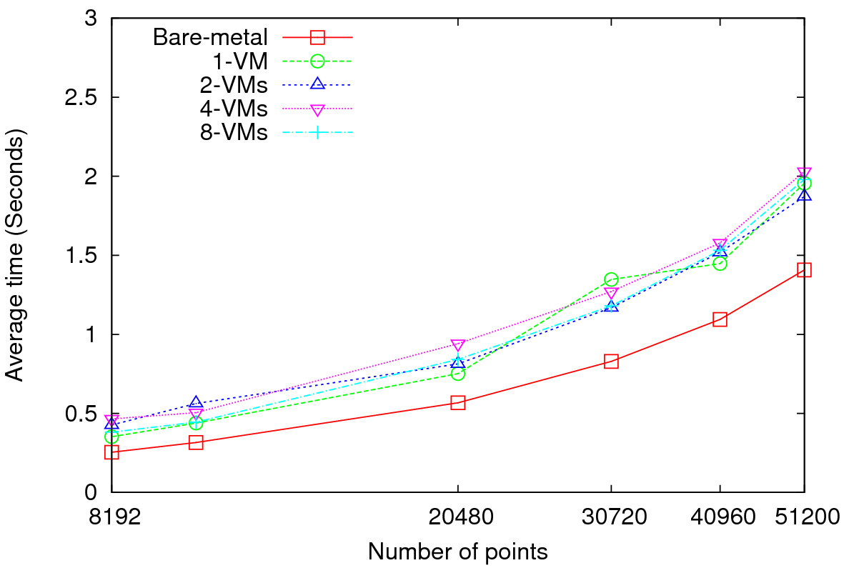
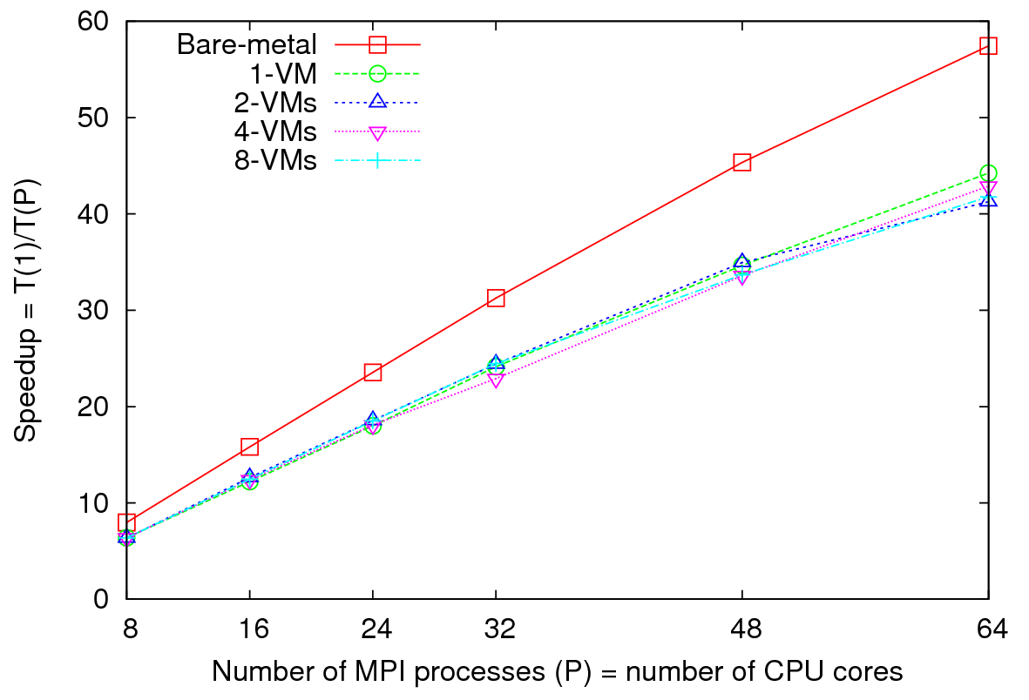
MPI on Clouds
Parallel Wave Equation Solver
Performance - 64 CPU cores
Total Speedup – 30720 data points
Clear difference in performance and speedups between VMs and bare-metal
Very small messages (the message size in each MPI_Sendrecv() call is only 8 bytes)
More susceptible to latency
At 51200 data points, at least 40% decrease in performance is observed in VMs

Slide 23
Scheduling of Tasks
DryadLINQ Job
Partitions
/vertices
DryadLINQ schedules
Partitions to nodes
Hadoop Schedules map/reduce tasks
directly to CPU cores
1
PLINQ sub tasks
PLINQ explores
Further parallelism
2
Threads
Threads map PLINQ
Tasks to CPU cores
3
CPU cores
Problem
1
4 CPU cores
4 CPU cores
Partitions
1
2
3
Time
Partitions
1
2
3
Time
Better utilization when tasks are homogenous
Under utilization when tasks are non-homogenous

Slide 24
Summary: Key Features of our Approach
Initially we will make key capabilities available as services that we eventually implement on virtual clusters (clouds) to address very large problems
  Basic Pairwise dissimilarity calculations
  R (done already by us and others)
  MDS in various forms
  Vector and Pairwise Deterministic annealing clustering
Point viewer (Plotviz) either as download (to Windows!) or as a Web service
Note all our code written in C# (high performance managed code) and runs on Microsoft HPCS 2008 (with Dryad extensions)

Slide 25
Project website www.infomall.org/SALSA

