Slide 1
Theme 5: High-performance computing for PHI (Fox)
Some Typical Slides
Slide 2: HPCCloud Software Systems compared to classic HPC
Slide 3: 350 HPC-ABDS Software Systems
Slide 4: HPCCloud Hybrid system architecture
Slide 5: Performance of Big Data tools compared to HPC on Multidimensional scaling
Slide 6: Visualizing features in pathology images
Slide 7: Visualizing Fungi gene clusters
Slide 8: Visualizing and Determining Mass Spectrometer Peak Clusters
The last three have a link to online visualization and come from large parallel jobs
Slide 9: Tango

Slide 2
Big Data ABDS HPCCloud 3.0 HPC, Cluster
17. Orchestration Beam, Crunch, Tez, Cloud Dataflow Kepler, Pegasus, Taverna
16. Libraries MLlib/Mahout, TensorFlow, CNTK, R, Python ScaLAPACK, PETSc, Matlab
15A. High Level Programming Pig, Hive, Drill Domain-specific Languages
15B. Platform as a Service App Engine, BlueMix, Elastic Beanstalk XSEDE Software Stack
Languages Java, Erlang, Scala, Clojure, SQL, SPARQL, Python Fortran, C/C++, Python
14B. Streaming Storm, Kafka, Kinesis
13,14A. Parallel Runtime Hadoop, MapReduce MPI/OpenMP/OpenCL
2. Coordination Zookeeper
12. Caching Memcached
11. Data Management Hbase, Accumulo, Neo4J, MySQL iRODS
10. Data Transfer Sqoop GridFTP
9. Scheduling Yarn, Mesos Slurm
8. File Systems HDFS, Object Stores Lustre
1, 11A Formats Thrift, Protobuf FITS, HDF
5. IaaS OpenStack , Docker Linux, Bare-metal, SR-IOV
Infrastructure CLOUDS Clouds and/or HPC SUPERCOMPUTERS
HPC-ABDS Integrated
Software
CUDA, Exascale Runtime

Slide 3
HPC-ABDS

Slide 4
HPCCloud Convergence Architecture
Running same HPC-ABDS software across all platforms but data management machine has different balance in I/O, Network and Compute from “model” machine
  Note data storage approach: HDFS v. Object Store v. Lustre style file systems is still rather unclear
The Model behaves similarly whether from Big Data or Big Simulation.
Data Management Model for Big Data
and Big Simulation
HPCCloud Capacity-style Operational Model matches hardware features with application requirements

Slide 5
Typical Performance Results HPC-ABDS on Machine Learning MDS
The gain (over 100) from using HPC (MPI) over major big data tools is apparent
The paper explains why this is and how to correct big data tools
32000 Points
16 Nodes

Slide 6
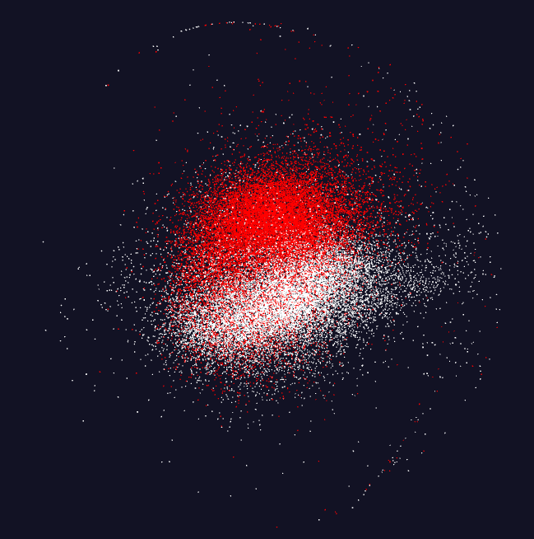
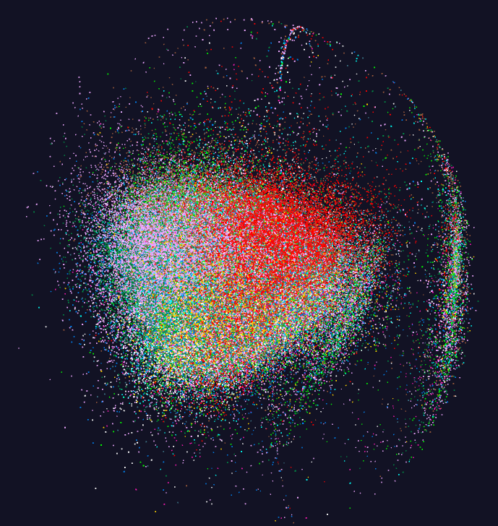
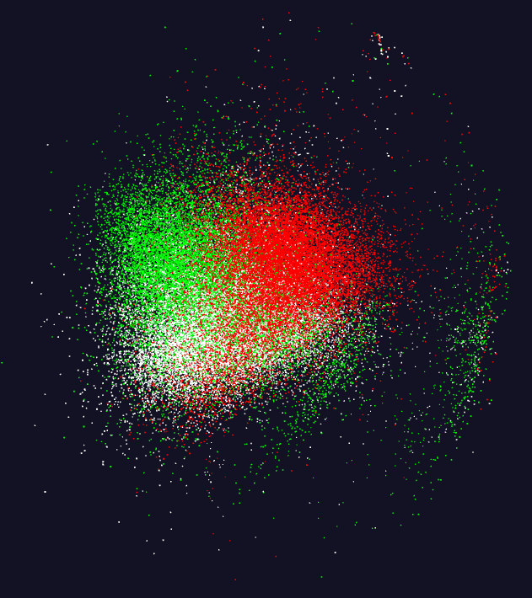
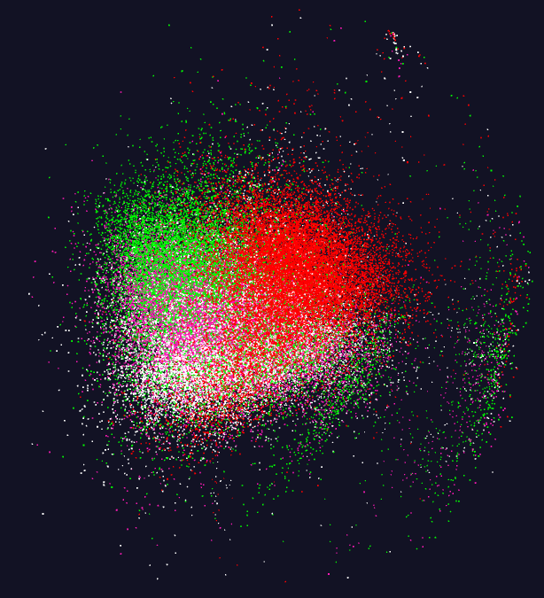
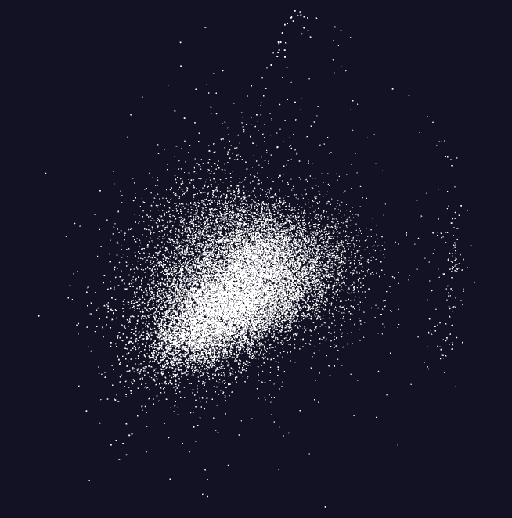
Pathology Image Features (cells)
11 Images
20,000 features per image.
96 properties per feature but projected to 3D for visualization – colored by image
Parallel MPI job
https://spidal-gw.dsc.soic.indiana.edu/public/resultsets/1678860580

Slide 7
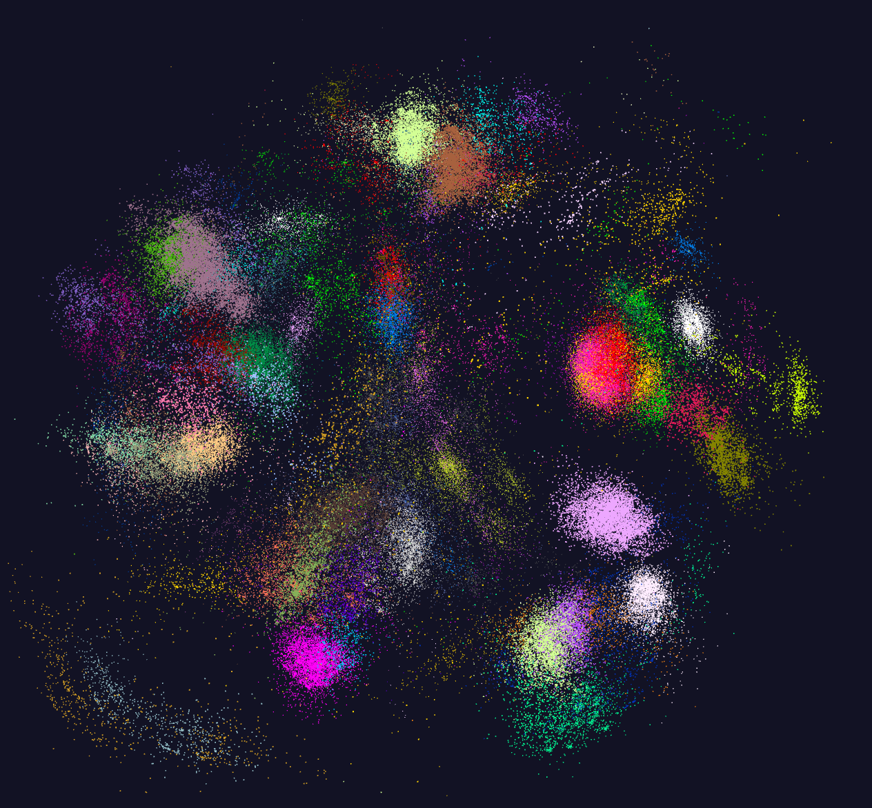
https://spidal-gw.dsc.soic.indiana.edu/public/resultsets/1273112137
170,000 distinct Fungi sequences.
64 clusters
Projected to 3D and visualized. Colored by cluster
Pipeline of 2 MPI jobs

Slide 8
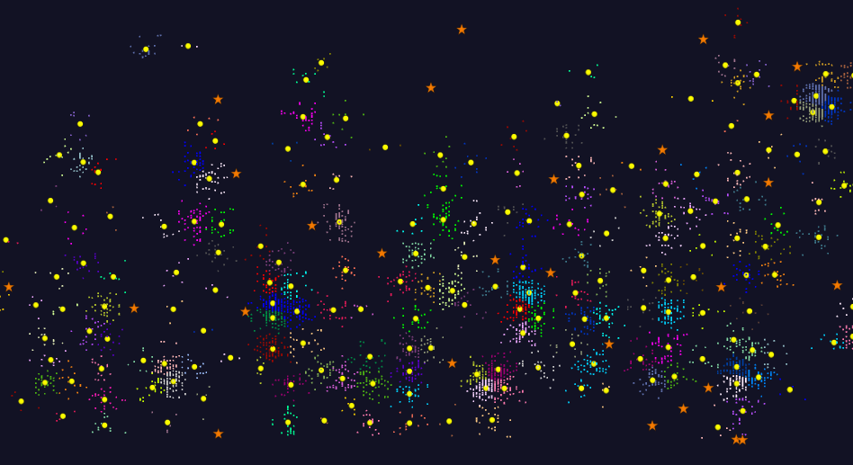
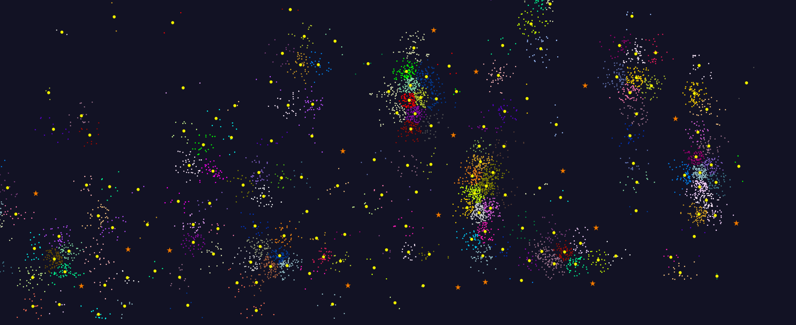
2D Vector Clustering with cutoff at 3 σ
Orange Star – outside all clusters; yellow circle cluster centers
LCMS Mass Spectrometer Peak Clustering with MPI. Charge 2 Sample with 10.9 million points and 420,000 clusters visualized in WebPlotViz. Nature Article "Proteogenomics connects somatic mutations to signalling in breast cancer".
https://spidal-gw.dsc.soic.indiana.edu/public/resultsets/1657429765

Slide 9
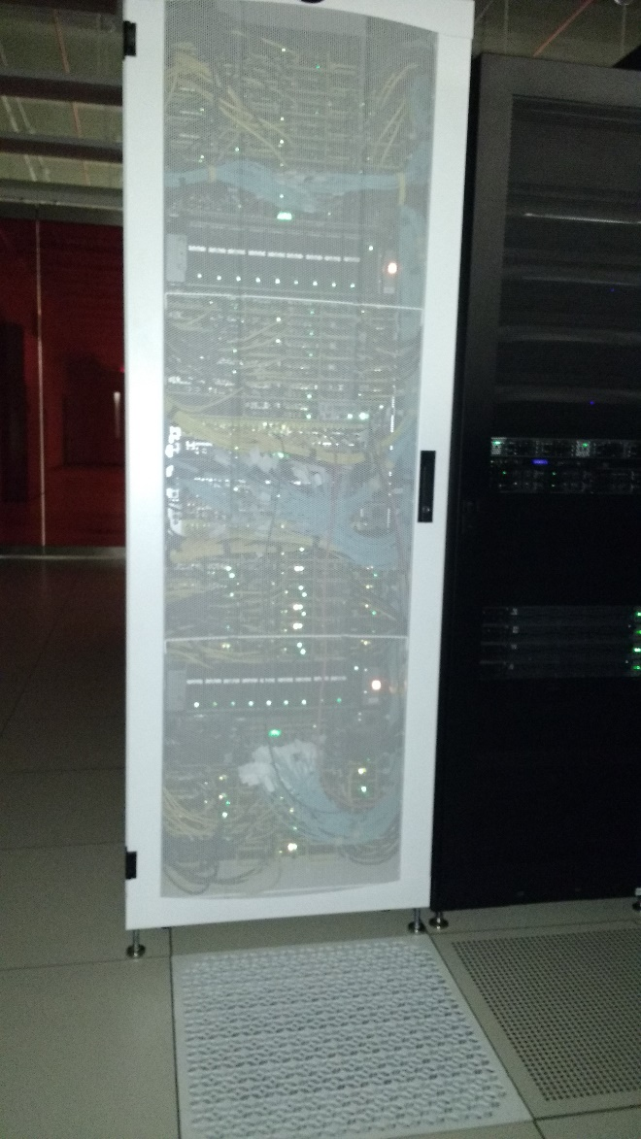
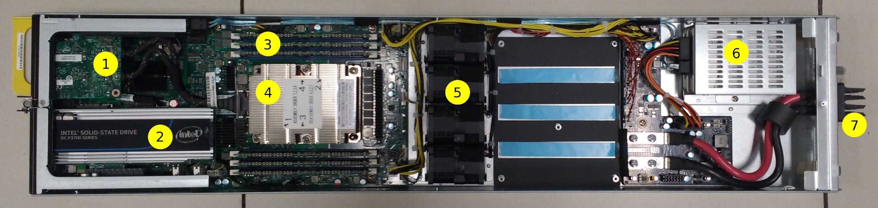
Tango Knights Landing System
OmniPath I/O 100 or 200 Gbit/sec
Intel DC P3700 Series PCIe NVram SSD 0.8TB (2,800 / 1,900MB/s Read / Write; 25-50x HDD)
196 GB RAM
Xeon Phi Processor (under heat sink) 7290 (72 cores, 1.5 GHz) or 7250 (68 cores, 1.4 Ghz) 16GB on chip memory
Cooling fans
2 x SATA SSDs Intel S3610 1.6TB each (550/520 MB/s Read/Write)
DC power input from chassis rails.
64 nodes

