Slide 1
Interactive Website (https://dexterrules.github.io/SC-Demo-17/SC-Demo.html)

Slide 3
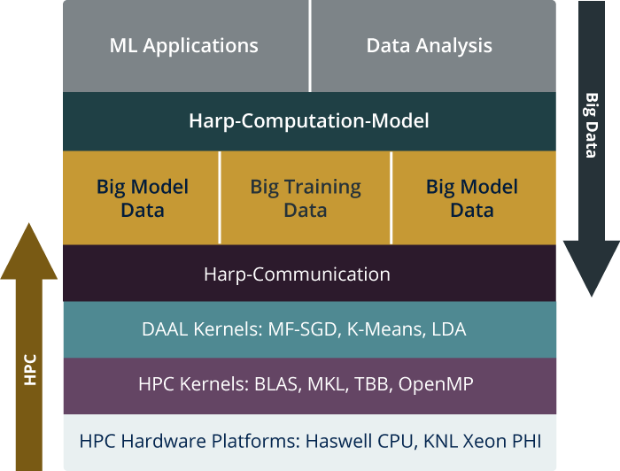
HPC-ABDS is Cloud-HPC interoperable software with the performance of HPC (High Performance Computing) and the rich functionality of the commodity Apache Big Data Stack. This concept is illustrated by Harp-DAAL.
High Level Usability: Python Interface, well documented and packaged modules
Middle Level Data-Centric Abstractions: Computation Model and optimized communication patterns
Low Level optimized for Performance: HPC kernels Intel® DAAL and advanced hardware platforms such as Xeon and Xeon Phi
Harp-DAAL

Slide 4
Datasets: 5 million points, 10 thousand centroids, 10 feature dimensions
10 to 20 nodes of Intel KNL7250 processors
Harp-DAAL has 15x speedups over Spark MLlib
Datasets: 500K or 1 million data points of feature dimension 300
Running on single KNL 7250 (Harp-DAAL) vs. single K80 GPU (PyTorch)
Harp-DAAL achieves 3x to 6x speedups
Datasets: Twitter with 44 million vertices, 2 billion edges, subgraph templates of 10 to 12 vertices
25 nodes of Intel Xeon E5 2670
Harp-DAAL has 2x to 5x speedups over state-of-the-art MPI-Fascia solution

Slide 5
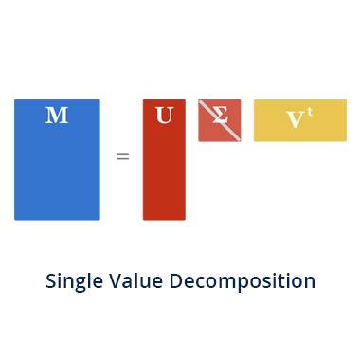
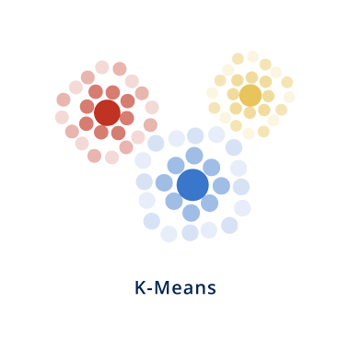
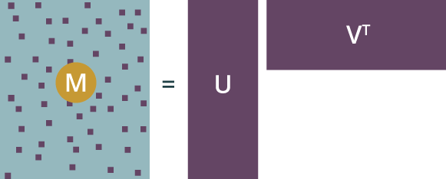
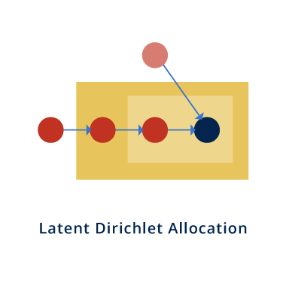
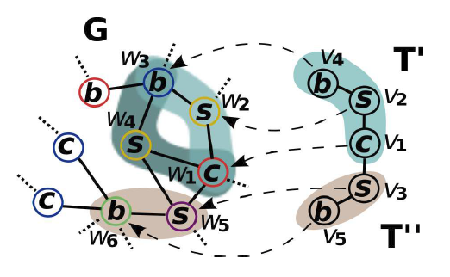
Explore Algorithms
PCA
Alternating least squares (ALS)
MatrixFactorization-SGD
SubGraph Counting

Slide 6
Distributed Memory
Computation Models Model-Centric Synchronization Paradigm
broadcast
regroup
sendEvent
reduce
push & pull
getEvent
Computation Models
allgather
rotate
waitEvent
allreduce
Communication Operations
Locking
Rotation
Shared Memory
Schedulers
Intel® DAAL, MKL High Performance Library
Allreduce
Asynchronous
Dynamic Scheduler
Static Scheduler
Solutions to Big Data Problems

Slide 7
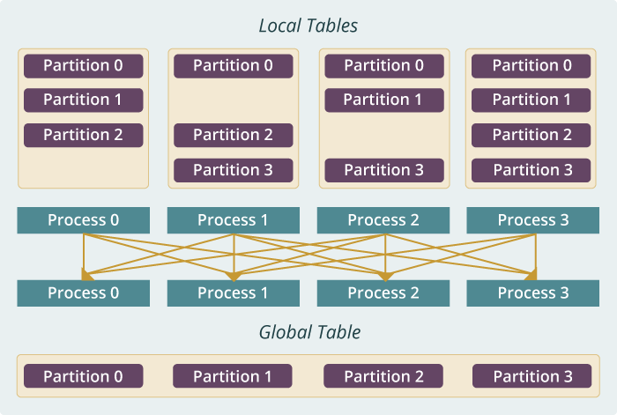
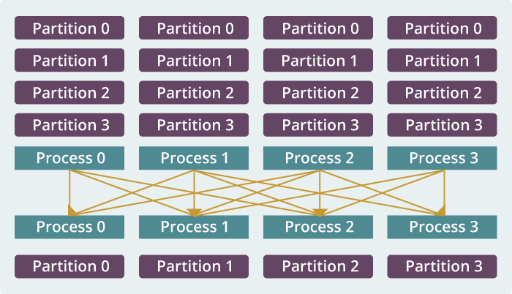
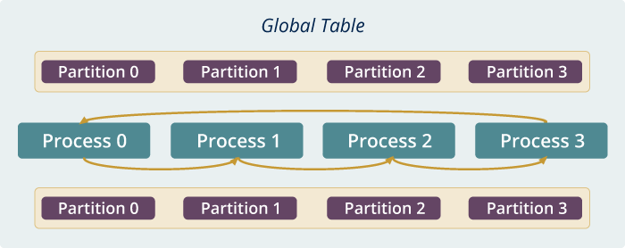
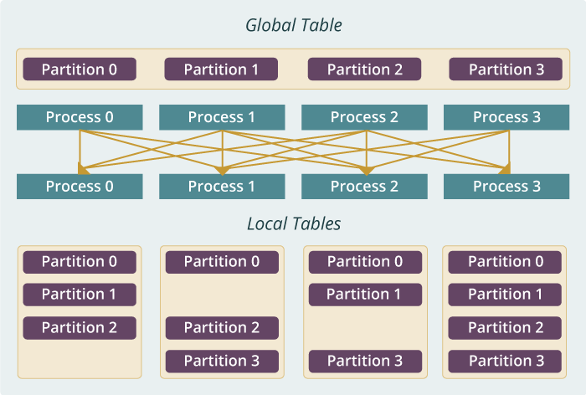
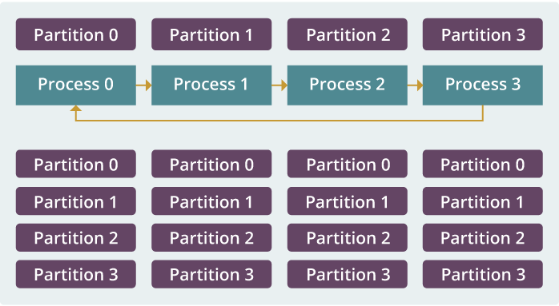
Example: K-means Clustering
The Allreduce Computation Model
Model
Worker
Worker
Worker
When the model size cannot be held in each machine’s memory
When the model size is small
When the model size is large but can still be held in each machine’s memory
broadcast
regroup
push & pull
allreduce
reduce
allgather
rotate

Slide 8
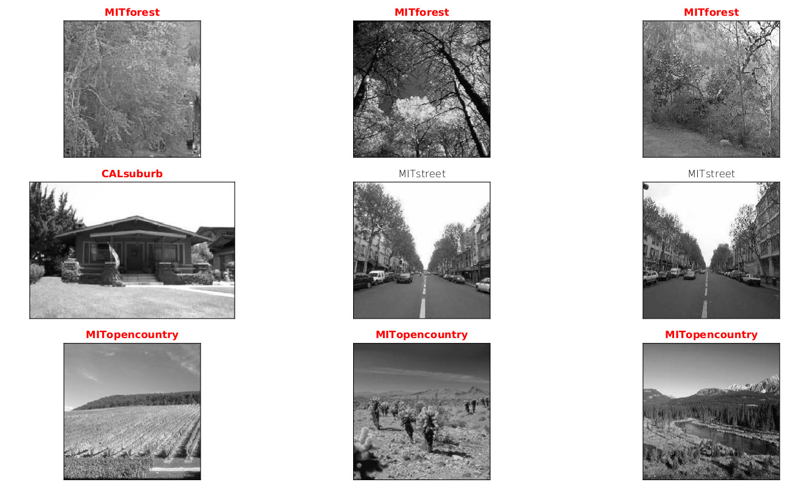
result: sample images of the result clusters, one row for each cluster
Result

Slide 9
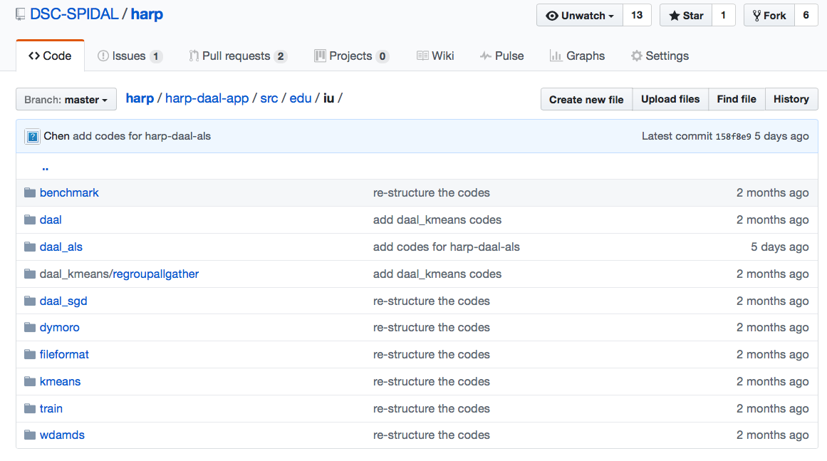
Harp-DAAL: Prototype and Production Code
Available at https://dsc-spidal.github.io/harp
Source codes became available on Github in February, 2017.
Harp-DAAL follows the same standard of DAAL’s original codes
Twelve Applications
Harp-DAAL Kmeans
Harp-DAAL MF-SGD
Harp-DAAL MF-ALS
Harp-DAAL SVD
Harp-DAAL PCA
Harp-DAAL Neural Networks
Harp-DAAL Naïve Bayes
Harp-DAAL Linear Regression
Harp-DAAL Ridge Regression
Harp-DAAL QR Decomposition
Harp-DAAL Low Order Moments
Harp-DAAL Covariance

