Slide 1
Image Management and Rain on FutureGrid:
A practical Example
Presented by
Javier Diaz, Fugang Wang, Gregor von Laszewski

Slide 2
Index
Introduction (Motivation, Terminology, Architecture)
Command line interface (CLI) vs FG shell
Show the use Image Repository
Show the use Image Generation
Show the use Image Deployment
Show the use of Rain

Slide 3
Motivation
The goal is to create and maintain platforms in custom FG images that can be retrieved, deployed, and provisioned on demand
Imagine the following scenario for FG:
  fg-generate –o centos –v 5 -s mpich2,gcc,fftw2, (store img in repo with id 1234)
  fg-deploy –x india –r 1234 (deployed on india as centosjdiaz1234)
  fg-rain –m 9 -i centosjdiaz1234 –j myscript.sh

Slide 4
Terminology
Image Management provides the low level software (create, customize, store, share and deploy/stage images) needed to achieve Dynamic Provisioning and Rain
Dynamic Provisioning is in charge of providing machines with the requested OS. The requested OS must have been previously deployed in the infrastructure
RAIN is our highest level component that uses Dynamic Provisioning and Image Management to provide custom environments that may or may not exits. Therefore, a Rain request may involve the creation, deployment and provision of one or more images in a set of machines

Slide 5
Architecture
Notes:
IM provides a unified environment to create and maintain VM and bare-metal images
Integrate images through a repository to instantiate services on demand with RAIN
Essentially enables the rapid development and deployment of Platform services on FutureGrid infrastructure

Slide 6
CLI vs FG Shell
The FG shell provides a interface to use the FG tools
Image Management is fully integrated in the Shell
Advantages of the Shells:
  The user password is only asked when the user starts the shell
  Help command shows user list of available commands as well as specific command’s help
  History of executed commands (only FG commands)
  Users can record work session in files

Slide 7
Image Repository
Service to query, store, and update images through a unique and common interface

Slide 8
Image Repository Examples
Query the image repository
  CLI: fg-repo –u jdiaz –q “* where os=centos_5”
  Shell: list * where os=centos
Upload an Image
  CLI: fg-repo –u jdiaz –p imagefile.tgz “os=centos&vmtype=kvm&description=my image”
  Shell: put imagefile.tgz os=centos&vmtype=kvm&description=my image
Authentication OK
2 items found
imgId=215369546596144595085417, os=centos_5, arch=x86_64, owner=jdiaz, description=None, tag=jdiaz2699012769, vmType=none, imgType=machine, permission=private, status=available
imgId=68725515834828774883357, os=centos_5, arch=x86_64, owner=jdiaz, description=None, tag=jdiaz1786816389, vmType=none, imgType=machine, permission=private, status=available
Checking quota and Generating an ImgId
Authentication OK
Uploading image. You may be asked for ssh/passphrase password
Imagefile.tgz 100% 53 0.1KB/s 00:00
Registering the image
The image has been uploaded and registered with id 211913675261934066702430

Slide 9
Image Repository Examples
Add User
  CLI: fg-repo –u jdiaz --useradd userId
  Shell: user –a userIds
Image Usage
  CLI: fg-repo –u jdiaz --histimg
  Shell: histimage
Authentication OK
User created successfully.
Remember that you still need to activate this user (see setuserstatus command)
  Authentication OK
  imgId=191563243441508818679593, createdDate(UTC)=2011-10-13 21:43:30, lastAccess(UTC)=2011-10-24 17:37:45, accessCount=16,
  imgId=111462205747829171557134, createdDate(UTC)=2011-10-14 20:36:40, lastAccess(UTC)=2011-10-21 13:48:04, accessCount=4,
  imgId=21870735808909675281040, createdDate(UTC)=2011-10-07 20:36:33, lastAccess(UTC)=2011-10-07 20:36:33, accessCount=0,

Slide 10
Image Generation
  Creates and customizes images according to user requirements:
  OS type
  OS version
  Architecture
  Software Packages
Image is stored in the Image Repository or returned to the users
Images are not aimed to any specific infrastructure

Slide 11
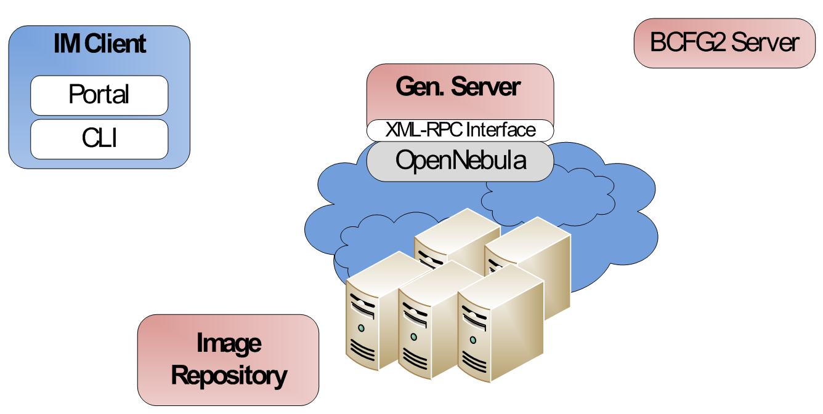
Generate an Image
fg-generate –u jdiaz –o centos –v 5 –a x86_64 –s python26
Client output:
Image generator client...
Please insert the password for the user jdiaz
Password:
Selected Architecture: x86_64
Connecting server: i120:56791
Your image request is in the queue to be processed
------wait here if too many request are being processed------
Your image request is being processed
Generating the image
------wait here until finished------
Your image has be uploaded in the repository with ID=915678426632408832461797
The image and the manifest generated are packaged in a tgz file.
Please be aware that this FutureGrid image does not have kernel and fstab. Thus, it is not built for any deployment type. To deploy the new image, use the IMDeploy command.
Generate img
Deploy VM
And
Gen. Img
1
2
3
Store in the Repo
or
Return it to user

Slide 12
Image Deployment
Customizes (network IP, DNS, file system table, kernel modules, etc) and deploys images for specific infrastructures
Two main infrastructures types
  HPC deployment: it means that we are going to create network bootable images that can run in bare metal machines
  Cloud deployment: it means that we are going to convert the images in VMs

Slide 13
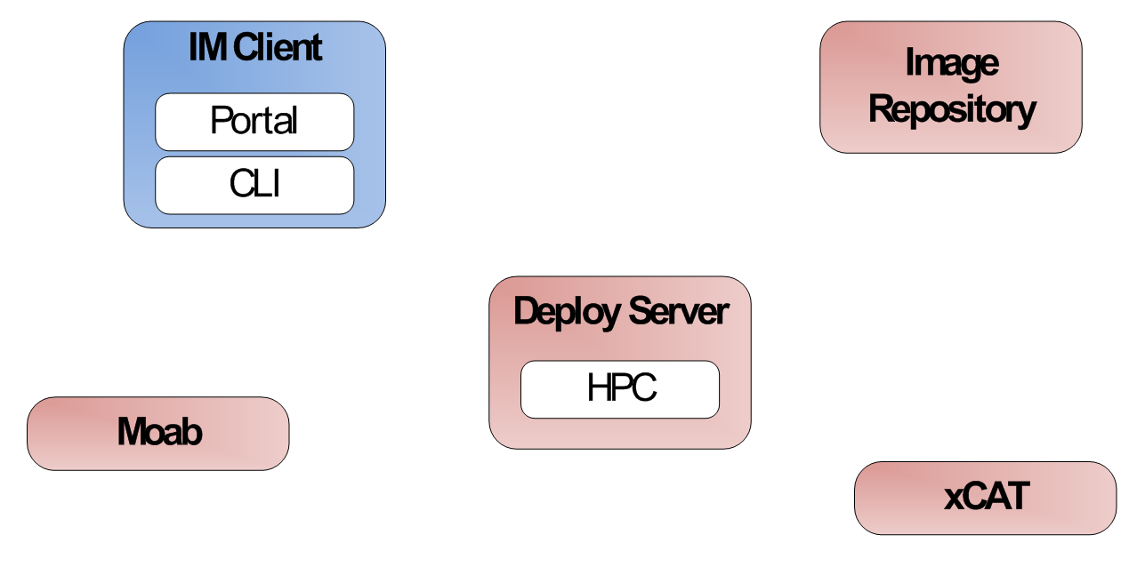
Deploy/Stage an Image for HPC
fg-deploy –u jdiaz –r 2131235123 –x india
Client output:
Starting image deployer...
Please insert the password for the user jdiaz
Password:
Connecting to xCAT server
------wait here if an image is being deployed-----
Authentication OK
Customizing and deploying image on xCAT
------wait here until finished-----
Connecting to Moab server
Your image has been deployed in xCAT as centosjavi960524558.
Please allow a few minutes for xCAT to register the image before attempting to use it.
To boot an machine using your image: qsub -l os=<imagename>
To check the status of the job you can use checkjob and showq commands
Deploy img from Repo
Get img from Repo
1
2
Register img in Moab and recycle sched
5
Customize img
6
3
Return info about the img
Register img in xCAT (cp files/modify tables)
4

Slide 14
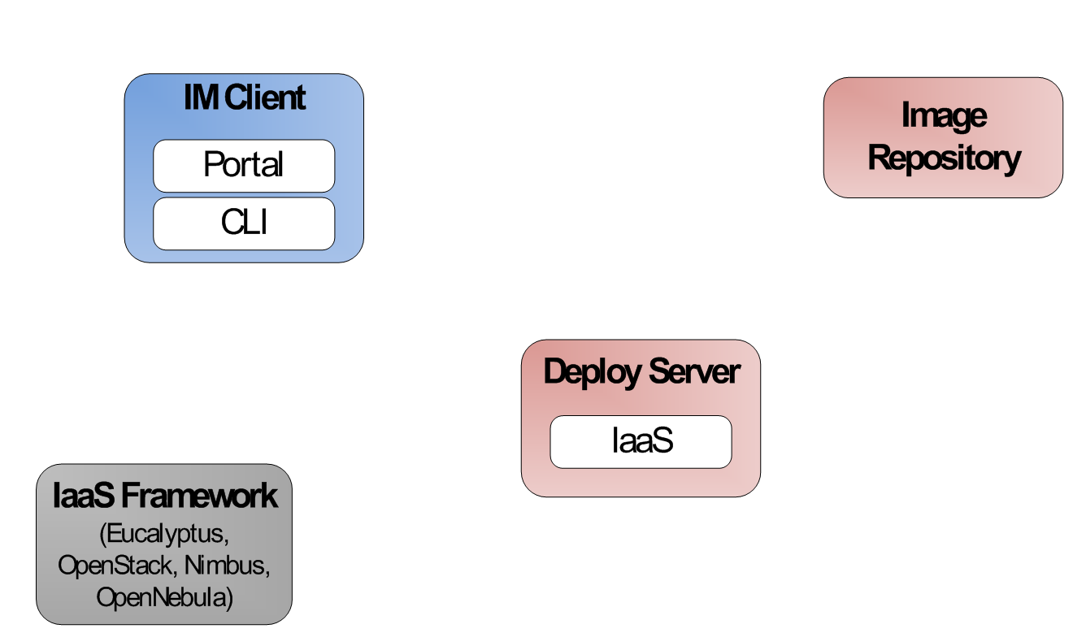
Deploy/Stage an Image stored in the Repository to OpenStack
fg-deploy –u jdiaz –r 2131235123 -s –v ~/novarc
Client output:
Starting image deployer...
Please insert the password for the user jdiaz
Password:
Authentication OK
------wait here until finished-----
Retrieving image. You may be asked for ssh/passphrase password
centos5jdiaz2250444196.img 100% 1496MB 65.0MB/s 00:23
euca-bundle-image ….
euca-upload-image …
euca-register …
IMAGE emi-437C1239
Your image has been registered on OpenStack with the id emi-437C1239
To launch a VM you can use euca-run-instances -k keyfile -n <#instances> id
Remember to load you Eucalyptus environment before you run the instance (source eucarc)
More information is provided in More information is provided in https://portal.futuregrid.org/tutorials/oss and in https://portal.futuregrid.org/tutorials/eucalyptus
Deploy img from Repo
Get img from Repo
1
2
Upload the img to the Cloud
Customize img
5
4
Return img to client
3

Slide 15
Deploy/Stage an Image from the disk to Eucalyptus
fg-deploy –u jdiaz –i jdiaz2250444196.tgz –e –v ~/eucarc
Client output:
Starting image deployer...
Authentication OK
Uploading image. You may be asked for ssh/passphrase password
jdiaz2250444196.tgz 100% 290MB 32.2MB/s 00:08
------wait here until finished-----
Retrieving image. You may be asked for ssh/passphrase password
centos5jdiaz2250444196.img 100% 1496MB 65.0MB/s 00:23
euca-bundle-image ….
euca-upload-image …
euca-register …
IMAGE emi-437C1239
Your image has been registered on Eucalyptus with the id emi-437C1239
To launch a VM you can use euca-run-instances -k keyfile -n <#instances> id
Remember to load you Eucalyptus environment before you run the instance (source eucarc)
More information is provided in https://portal.futuregrid.org/tutorials/eucalyptus
Deploy this img (send img files to server)
1
Upload the img to the Cloud
Customize img
4
3
Return img to client
2

Slide 16
List Images Deployed on xCAT/Moab
fg-deploy –u jdiaz -l –x india
List deployed Images
Client output:
Starting image deployer...
Please insert the password for the user jdiaz
Password:
Connecting to xCAT server
Authentication OK
Connecting to Moab server
The list of available images on xCAT/Moab is:
centosjdiaz960524558
centosfuwang1549296807
You can get more details by querying the image repository using IRClient.py -q command and the query string: "* where tag=imagename".
NOTE: To query the repository you need to remove the OS from the image name (centos,ubuntu,debian,rhel...). The real name starts with the username.
1
Return Images both know about
4
Tell me what images you know
Tell me what images you know
3
2

Slide 17
RAIN
In FG, dynamic provisioning goes beyond the services offered by common scheduling tools that provide such features
Rain (Runtime Adaptable INsertion Configurator)
We want to provide custom HPC environment, Cloud environment, or virtual networks on-demand with little effort

Slide 18
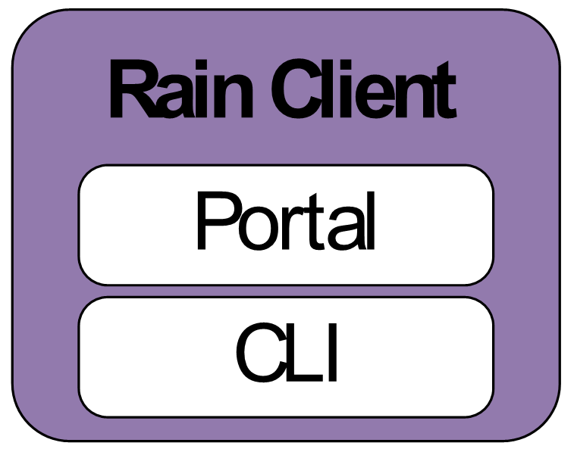
Rain an Image and execute a task (baremetal)
fg-rain –u jdiaz –r 123123123 –x india –j testjob.sh –m 2
Run job in my image stored in the repo
7
qsub, monitor status, completion status and indiacate output files
Client output:
Starting rain...
Please insert the password for the user jdiaz
Password:
----- Deploy the image. Same logs as before ---
Job id is: 200941
Wait until the job finishes
State: Idle
State: Idle
State: Running
State: Running
State: Completed
Completion Code: 0 Time: Fri Oct 28 15:05:02
The Standard output is in the file: salida.txt
The Error output is in the file: jobscript.e200941
1
Deploy img
2
Deploy img from Repo
Get img from Repo
3
4
Register img in Moab and recycle sched
7
Customize img
8
Return info about the img
5
Register img in xCAT (cp files/modify tables)
6

Slide 19
Rain: Execute a task in a deployed image (baremetal)
fg-rain –u jdiaz –i centosjavi23123 –x india –j testjob.sh –m 2
Client output:
Starting rain...
Please insert the password for the user jdiaz
Password:
Job id is: 200941
Wait until the job finishes
State: Idle
State: Idle
State: Running
State: Running
State: Completed
Completion Code: 0 Time: Fri Oct 28 15:05:02
The Standard output is in the file: salida.txt
The Error output is in the file: jobscript.e200941
Run job in my image that is deployed
1
2
qsub, monitor status, completion status and indiacate output files

Slide 20
Rain: Execute a task in a deployed image (OpenStack)
fg-rain –u jdiaz –i i-00000061 –s –v ~/novarc –j testjob.sh –m 2
Client output:
Starting rain...
Please insert the password for the user jdiaz
Password:
Launching image
Waiting for running state in all the VMs
--- Prints status each X seconds---
Number of instances booted 2
Instance i-000009e9 associated with address 149.165.146.152
Instance i-000009ea associated with address 149.165.146.155
Waiting to have access to Instance i-000009e9 associated with address 149.165.146.152
Waiting to have access to Instance i-000009ea associated with address 149.165.146.155
All VMs are accessible: True
Creating temporal sshkey files
Copying temporal private and public ssh-key files to VMs
Configuring ssh in VM and mounting home directory (assumes that sshfs and ldap is installed)
Copying temporal private and public ssh-key files to VMs
Configuring ssh in VM and mounting home directory (assumes that sshfs and ldap is installed)
Running Job
--- Waits until job is done---
Job Done
Run job via ssh and wait until finished
Run job in my image that is deployed
1
5
Boot VMs
2
Wait for access to VMs
Cloud Framework
Configure VMs for user and mount his home directory in /tmp using sshfs
4
3
VM
VM
VM
VM
VM
VM

Slide 21
Some Numbers… (I)

Slide 22
Some Numbers… (II)

Slide 23
Manual and Tutorials
Tutorial: https://portal.futuregrid.org/tutorials/image_management_and_rain
Manuals
  fg-shell: https://portal.futuregrid.org/man/fg-shell
  fg-repo: https://portal.futuregrid.org/man/fg-repo
  fg-generate: https://portal.futuregrid.org/man/fg-generate
  fg-deploy: https://portal.futuregrid.org/man/fg-deploy

