Slide 1
Image Management and Rain on FutureGrid
Javier Diaz - javier.diazmontes@gmail.com
Fugang Wang – kevinwangfg@gmail.com
Gregor von Laszewski - laszewski@gmail.com
(585)298-5285

Slide 2
Motivation
Allow users to take control of installing the OS on a system on bare matel (without the administrator)
By providing users with the ability to create their own environments to run their projects (OS, packages, software)
Users can deploy their environments in both baremetal and virtualized infrastructures
Security is important

Slide 3
Architecture
Notes:
IM provides a unified environment to create and maintain VM and bare-metal images
Integrate images through a repository to instantiate services on demand with RAIN
Essentially enables the rapid development and deployment of Platform services on FutureGrid infrastructure

Slide 4
Image Generation
Creates and customizes images according to user requirements
Images are not aimed to any specific infrastructure

Slide 5
Image Deployment
Customizes and deploys images for specific infrastructures
Two main infrastructures types:
HPC Deployment
Cloud Deployment
https://portal.futuregrid.org

Slide 6
RAIN
Dynamically provide custom HPC environment, Cloud environment, or virtual networks on-demand with little effort

Slide 7
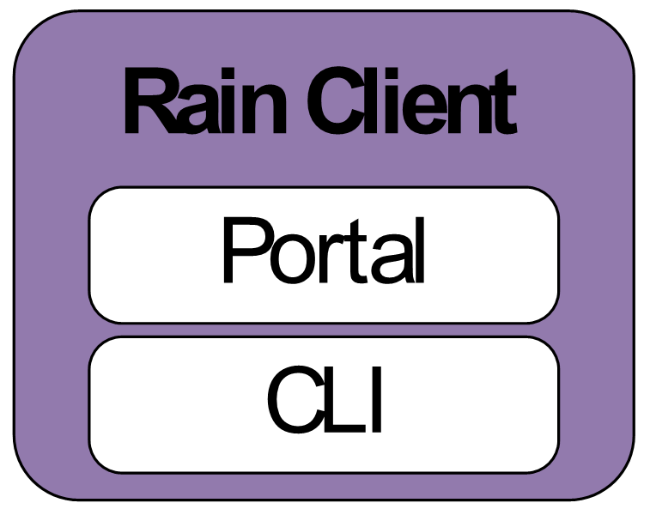
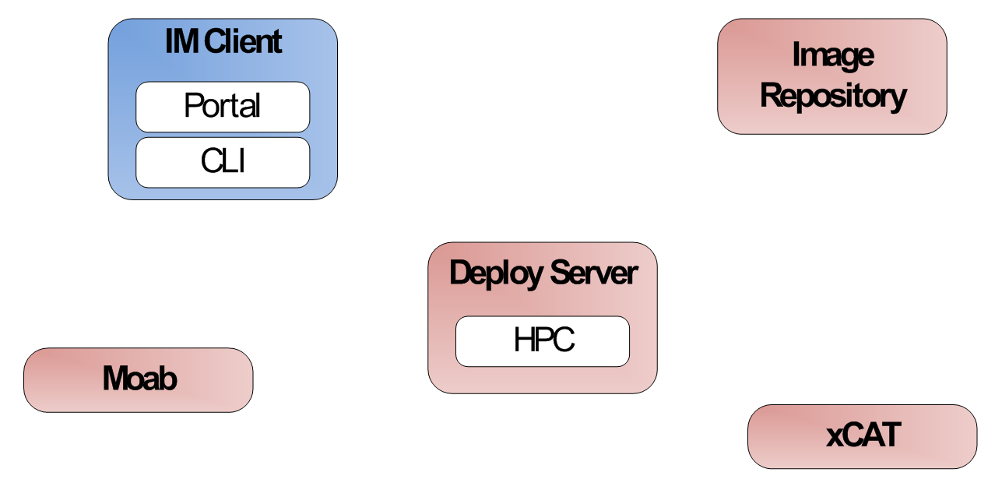
Rain an Image and execute a task (baremetal)
qsub, monitor status, completion status and indiacate output files
Run job in my image stored in the repo
7
1
Deploy img
2
Deploy img from Repo
Get img from Repo
3
4
Register img in Moab and recycle sched
7
Customize img
8
Return info about the img
5
Register img in xCAT (cp files/modify tables)
6

Slide 8
Rain: Execute a task in a deployed image (OpenStack)
Run job via ssh and wait until finished
Run job in my image that is deployed
1
5
Boot VMs
2
Wait for access to VMs
Cloud Framework
Configure VMs for user and mount his home directory in /tmp using sshfs
4
3
VM
VM
VM
VM
VM
VM

