Slide 1
NSF Dibbs Award
5 yr. Datanet: CIF21 DIBBs: Middleware and High Performance Analytics Libraries for Scalable Data Science IU(Fox, Qiu, Crandall, von Laszewski), Rutgers (Jha), Virginia Tech (Marathe), Kansas (Paden), Stony Brook (Wang), Arizona State(Beckstein), Utah(Cheatham)
HPC-ABDS: Cloud-HPC interoperable software performance of HPC (High Performance Computing) and the rich functionality of the commodity Apache Big Data Stack.
SPIDAL (Scalable Parallel Interoperable Data Analytics Library): Scalable Analytics for Biomolecular Simulations, Network and Computational Social Science, Epidemiology, Computer Vision, Spatial Geographical Information Systems, Remote Sensing for Polar Science and Pathology Informatics.

Slide 2
 | Year 1 | Year 2 | Years 3-5
SPIDAL | Community requirement and technology evaluation | SPIDAL-MIDAS Interface and SPIDAL V1.0 | Integrated testing with Algorithms & MIDAS. Extend to V2.0
MIDAS | (i) Arch and design spec (ii) In-memory pilot abstract., integrate with XSEDE | SPIDAL scheduling components and execution proceesing. MIDAS on Blue Waters. V1.0 release | Scalability testing, adaptors for new platforms, Support for tools and developers, Optimization, Phase II of execution-processing models,V2.0
Community: HPC Biomolecular Simulations | Community requirements gathering | CPPTRAJ to integrate with MIDAS for ensemble analysis on Blue Waters | (i) Parallel Trajectory and MDAnalysis with MR (ii) iBIOMES data mgmt. in MIDAS (iii) End-to-end Integration of CPPTraj-MIDAS with SPIDAL (iv) Use SPIDAL Kmeans (v) Tutorials and outreach
Community: Network Science and Comp. Social Science | i) Gather community requirement ii) study existing network analytic algorithms | i) Giraph-based clustering and community detection problems ii) Integ of CINET in SPIDAL | i) Algorithm implementation for subgraph problems ii) Develop new algorithms as necessary
Community: Computational Epidemiology | Community requirement gathering | Design i) Wrapper for EpiSimdemics and EpiFast ii) Giraph simulation tool | i) Implement the wrappers ii) Start implementing Giraph-based tool iii) Integrate EpiSimdemics and Epifast with SPIDAL
Community: Spatial | Community reqs Spatial queries library and 2D parallel | spatial 2D clustering and Geospatial & pathology apps | (i) Implementation of 3D spatial queries. (ii) Application to 3D pathology
Community: Pathology | (i) Implementation of 2D image preproc., segment and feature extraction and tumor research | Image registration, object matching & feature extraction (3D) Integrate MIDAS | Continued implementation of 3D image processing library Application to liver and neuroblastoma
Community: Computer vision: | Port image processing, feature extraction, image matching, pleasingly parallel ML algos | Implement ML and optimization algorithms; large-scale image recognition | Continue implementing ML and global optimization; large-scale 3D recognition in social images
Community: Radar informatics: | single-echogram layer finding, tile matching | (i) Develop and implement continent-scale layer finding | Develop and implement (i) change detection and (ii) flow field estimation in satellite images.

Slide 3
Machine Learning in Network Science, Imaging in Computer Vision, Pathology, Polar Science, Biomolecular Simulations
Algorithm | Applications | Features | Status | Parallelism
Graph Analytics
Community detection | Social networks, webgraph | Graph . | P-DM | GML-GrC
Subgraph/motif finding | Webgraph, biological/social networks |  | P-DM | GML-GrB
Finding diameter | Social networks, webgraph |  | P-DM | GML-GrB
Clustering coefficient | Social networks |  | P-DM | GML-GrC
Page rank | Webgraph |  | P-DM | GML-GrC
Maximal cliques | Social networks, webgraph |  | P-DM | GML-GrB
Connected component | Social networks, webgraph |  | P-DM | GML-GrB
Betweenness centrality | Social networks | Graph, Non-metric, static | P-Shm | GML-GRA
Shortest path | Social networks, webgraph |  | P-Shm
Spatial Queries and Analytics
Spatial relationship based queries | GIS/social networks/pathology informatics | Geometric | P-DM | PP
Distance based queries |  |  | P-DM | PP
Spatial clustering |  |  | Seq | GML
Spatial modeling |  |  | Seq | PP
GML Global (parallel) ML
GrA Static GrB Runtime partitioning

Slide 4
Some specialized data analytics in SPIDAL
Algorithm | Applications | Features | Status | Parallelism
Core Image Processing
Image preprocessing | Computer vision/pathology informatics | Metric Space Point Sets, Neighborhood sets & Image features | P-DM | PP
Object detection & segmentation |  |  | P-DM | PP
Image/object feature computation |  |  | P-DM | PP
3D image registration |  |  | Seq | PP
Object matching |  | Geometric | Todo | PP
3D feature extraction |  |  | Todo | PP
Deep Learning
Learning Network, Stochastic Gradient Descent | Image Understanding, Language Translation, Voice Recognition, Car driving | Connections in artificial neural net | P-DM | GML
aa
PP Pleasingly Parallel (Local ML)
Seq Sequential Available
GRA Good distributed algorithm needed
Todo No prototype Available
P-DM Distributed memory Available
P-Shm Shared memory Available

Slide 5
Some Core Machine Learning Building Blocks
Algorithm | Applications | Features | Status | //ism
DA Vector Clustering | Accurate Clusters | Vectors | P-DM | GML
DA Non metric Clustering | Accurate Clusters, Biology, Web | Non metric, O(N²) | P-DM | GML
Kmeans; Basic, Fuzzy and Elkan | Fast Clustering | Vectors | P-DM | GML
Levenberg-Marquardt Optimization | Non-linear Gauss-Newton, use in MDS | Least Squares | P-DM | GML
SMACOF Dimension Reduction | DA- MDS with general weights | Least Squares, O(N²) | P-DM | GML
Vector Dimension Reduction | DA-GTM and Others | Vectors | P-DM | GML
TFIDF Search | Find nearest neighbors in document corpus | Bag of “words” (image features) | P-DM | PP
All-pairs similarity search | Find pairs of documents with TFIDF distance below a threshold
 |  |  | Todo | GML
Support Vector Machine SVM | Learn and Classify | Vectors | Seq | GML
Random Forest | Learn and Classify | Vectors | P-DM | PP
Gibbs sampling (MCMC) | Solve global inference problems | Graph | Todo | GML
Latent Dirichlet Allocation LDA with Gibbs sampling or Var. Bayes | Topic models (Latent factors) | Bag of “words” | P-DM | GML
Singular Value Decomposition SVD | Dimension Reduction and PCA | Vectors | Seq | GML
Hidden Markov Models (HMM) | Global inference on sequence models | Vectors | Seq | PP & GML

Slide 6
Relevant DSC and XSEDE Computing Systems
DSC adding128 node Haswell based (2 chips, 24 or 36 cores per node) system (Juliet)
128 GB memory per node
Substantial conventional disk per node (8TB) plus PCI based 400 GB SSD
Infiniband with SR-IOV
Back end Lustre
Older or Very Old (tired) machines
India (128 nodes, 1024 cores), Bravo (16 nodes, 128 cores), Delta(16 nodes, 192 cores), Echo(16 nodes, 192 cores), Tempest (32 nodes, 768 cores); some with large memory, large disk and GPU
Cray XT5m with 672 cores
Optimized for Cloud research and Large scale Data analytics exploring storage models, algorithms
Bare-metal v. Openstack virtual clusters
Extensively used in Education
XSEDE – Wrangler and Comet likely to be especially useful

Slide 7
Big Data Software Model

Slide 8
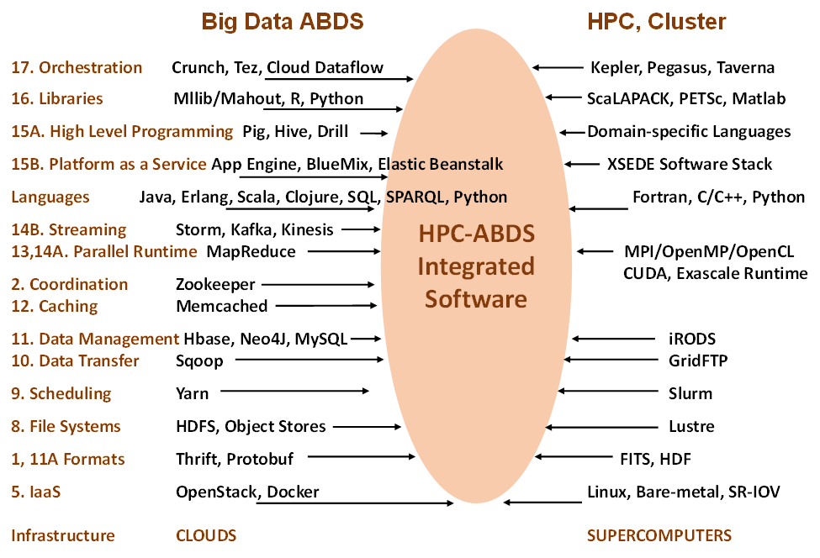

Slide 9
HPC ABDS SYSTEM (Middleware)
>~ 266 Software Projects
System Abstraction/Standards
Data Format and Storage
HPC ABDS Hourglass
HPC Yarn for Resource management
Horizontally scalable parallel programming model
Collective and Point to Point Communication
Support for iteration (in memory processing)
Application Abstractions/Standards
Graphs, Networks, Images, Geospatial ..
Scalable Parallel Interoperable Data Analytics Library (SPIDAL)
High performance Mahout, R, Matlab …..
High Performance Applications

Slide 10
Applications SPIDAL MIDAS ABDS
Govt. Operations | Commercial Defense |  | Healthcare, Life Science |  |  | Deep Learning, Social Media |  | Research Ecosystems | Astronomy, Physics |  | Earth, Env., Polar Science |  | Energy
(Inter)disciplinary Workflow
Analytics Libraries
Native ABDS SQL-engines, Storm, Impala, Hive, Shark |  | Native HPC MPI |  | HPC-ABDS MapReduce
 |  |  |  | Map Only, PP Many Task |  |  | Classic MapReduce |  |  | Map Collective |  | Map – Point to Point, Graph
MIddleware for Data-Intensive Analytics and Science (MIDAS) API
Communication (MPI, RDMA, Hadoop Shuffle/Reduce, HARP Collectives, Giraph point-to-point) |  |  |  |  |  |  | Data Systems and Abstractions (In-Memory; HBase, Object Stores, other NoSQL stores, Spatial, SQL, Files)
Higher-Level Workload Management (Tez, Llama) |  |  |  |  | Workload Management (Pilots, Condor) |  |  |  |  | Framework specific Scheduling (e.g. YARN)
External Data Access (Virtual Filesystem, GridFTP, SRM, SSH) |  |  |  |  |  |  | Cluster Resource Manager (YARN, Mesos, SLURM, Torque, SGE)
Compute, Storage and Data Resources (Nodes, Cores, Lustre, HDFS)
Community & Examples
SPIDAL
Programming & Runtime Models
MIDAS
Resource Fabric

