Slide 1
SPIDAL Project Datanet: CIF21 DIBBs: Middleware and High Performance Analytics Libraries for Scalable Data Science
NSF14-43054 started October 1, 2014
Indiana University (Fox, Qiu, Crandall, von Laszewski)
Rutgers (Jha)
Virginia Tech (Marathe)
Kansas (Paden)
Stony Brook (Wang)
Arizona State (Beckstein)
Utah (Cheatham)
A co-design project: Software, algorithms, applications

Slide 2
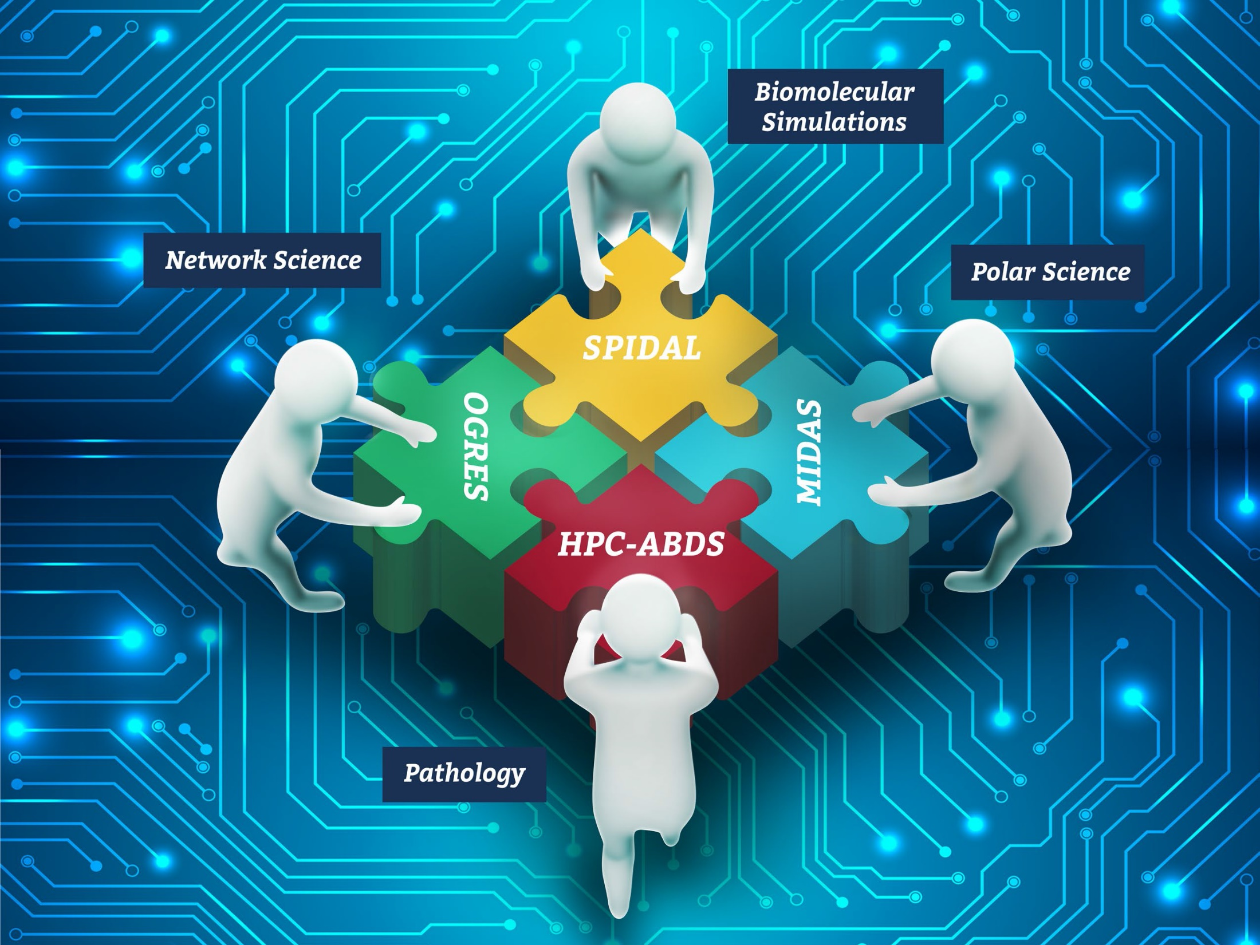
NSF 1443054: CIF21 DIBBs: Middleware and High Performance Analytics Libraries for Scalable Data Science PI: Geoffrey C. Fox
Software: MIDAS HPC-ABDS
gcf@indiana.edu

Slide 4
Status of NSF 1443054 Project
Big Data Application Analysis identifies features of data intensive applications that need to be supported in software and represented in benchmarks. This analysis was started for proposal and has been extended to support HPC-Simulations-Big Data convergence.
The project is a collaboration between computer and domain scientists in application areas in Biomolecular Simulations, Network Science, Epidemiology, Computer Vision, Spatial Geographical Information Systems, Remote Sensing for Polar Science and Pathology Informatics.
HPC-ABDS as Cloud-HPC interoperable software with performance of HPC (High Performance Computing) and the rich functionality of the commodity Apache Big Data Stack was a bold idea developed for proposal. We have successfully delivered and extended this approach, which is one of ideas described in Exascale Big Data report.

Slide 5
Status of NSF 1443054 Project
MIDAS integrating middleware that links HPC and ABDS now has several components including an architecture for Big Data analytics, an integration of HPC in communication and scheduling on ABDS;
Added HPC to Apache Hadoop, Heron, Spark, Flink
SPIDAL (Scalable Parallel Interoperable Data Analytics Library) now has over 20 members with domain specific and core algorithms.
Benchmarks. We reached out to database community with keynote and paper at WBDB2015 Benchmarking Workshop.
Language: SPIDAL Java runs as fast as C++
Designed and Proposed HPCCloud as hardware-software infrastructure supporting
Big Data Big Simulation Convergence
Big Data Management via Apache Stack ABDS
Big Data Analytics using SPIDAL and other libraries

Slide 6
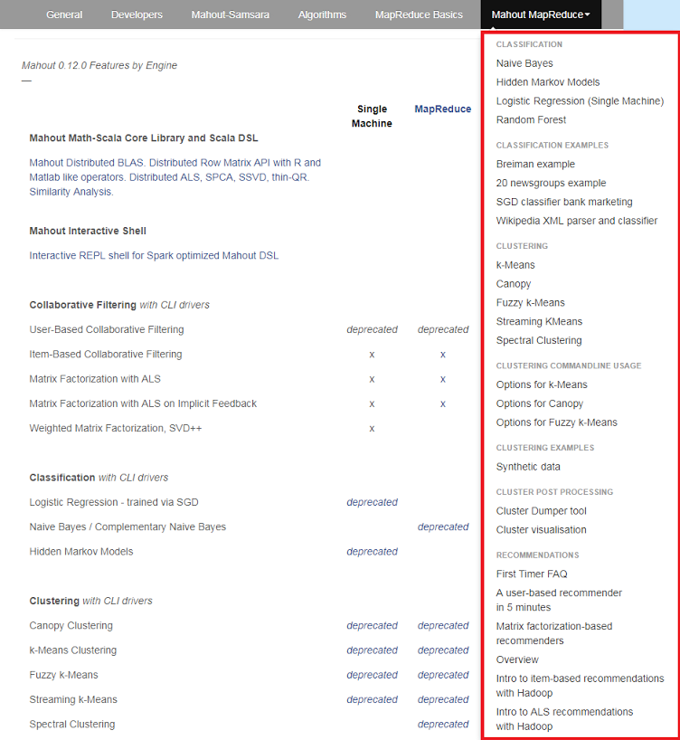
Mahout and SPIDAL
Mahout was Hadoop machine learning library but largely abandoned as Spark outperformed Hadoop
SPIDAL outperforms Spark Mllib and Flink due to better communication and in-place dataflow.
SPIDAL also has community algorithms
Biomolecular Simulation
Graphs for Network Science
Image processing for pathology and polar science

Slide 7
Core SPIDAL Parallel HPC Library with Collective Used
DA-MDS Multidimensional scaling Rotate, AllReduce, Broadcast
Directed Force Dimension Reduction AllGather, Allreduce
Irregular DAVS Clustering Partial Rotate, AllReduce, Broadcast
DA Semimetric Clustering Rotate, AllReduce, Broadcast
K-means AllReduce, Broadcast, AllGather DAAL
SVM AllReduce, AllGather
SubGraph Mining AllGather, AllReduce
Latent Dirichlet Allocation Rotate, AllReduce
Matrix Factorization (SGD) Rotate DAAL
Recommender System (ALS) Rotate DAAL
Singular Value Decomposition (SVD) AllGather DAAL
QR Decomposition (QR) Reduce, Broadcast DAAL
Neural Network AllReduce DAAL
Covariance AllReduce DAAL
Low Order Moments Reduce DAAL
Naive Bayes Reduce DAAL
Linear Regression Reduce DAAL
Ridge Regression Reduce DAAL
Multi-class Logistic Regression Regroup, Rotate, AllGather
Random Forest AllReduce
Principal Component Analysis (PCA) AllReduce DAAL
DAAL implies integrated with Intel DAAL Optimized Data Analytics Library (Runs on KNL!)

Slide 8
Challenge: Broad Deployment at Scale
Classic Software Engineering:
apply lessons like SPIDAL Java uniformly to SPIDAL library members
Package and testing for each component of SPIDAL and MIDAS
Supported deployment
User training
proactive outreach to users and service providers
Offer HPC-ABDS Capabilities as Platform as a Service with each capability specified as Ansible role giving function as a service
Will allow HPC, Cloud and converged infrastructure HPCCloud
Define good API’s to each function – current Apache libraries not well designed
Demonstrate test applications as software as a service on virtual clusters
Show that service providers (XSEDE) can deploy on variety of hardware
We have/will give a 6 hour tutorial on MIDAS and SPIDAL at a European winter school in February 2017, 2018

