Slide 1
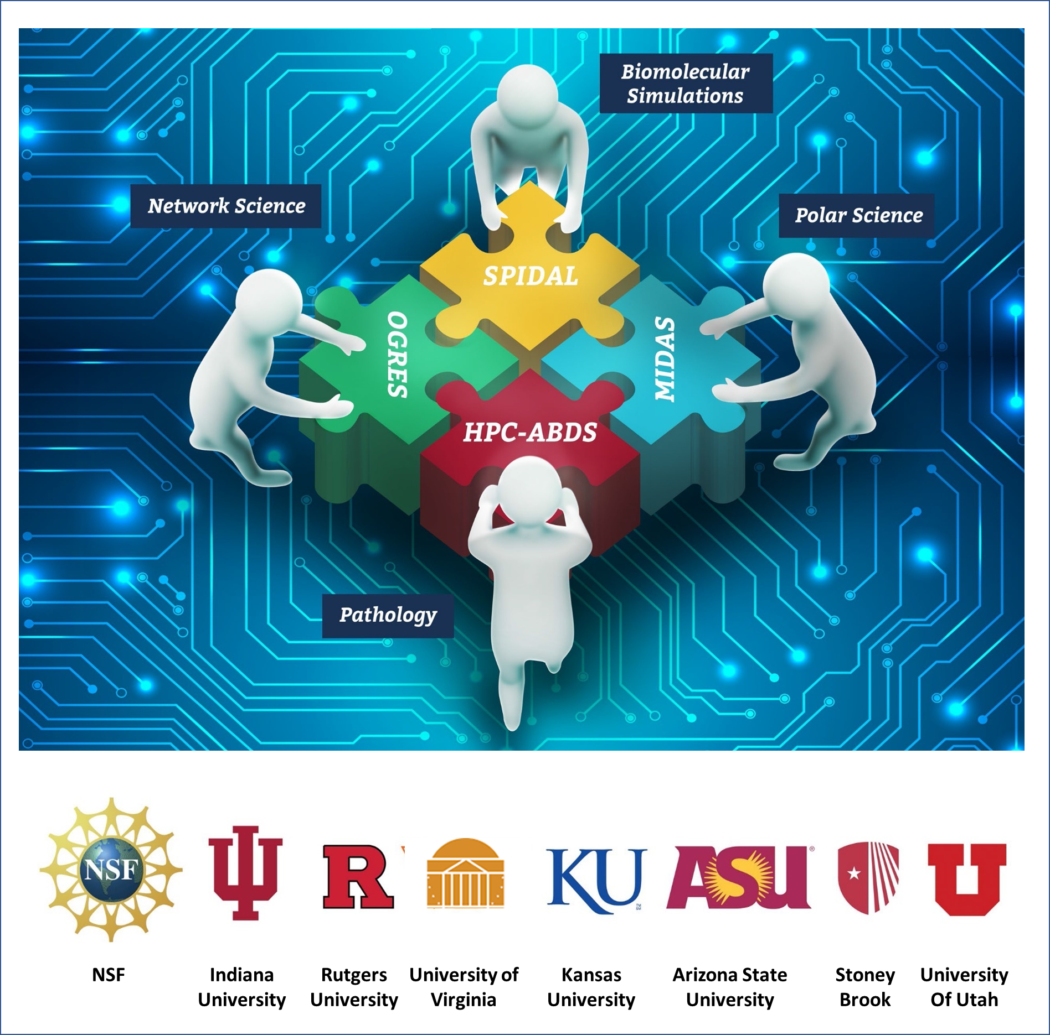
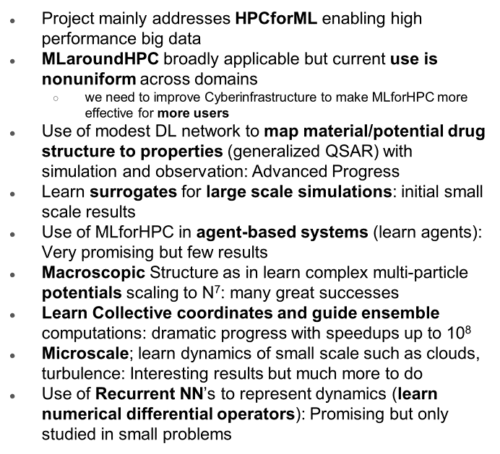
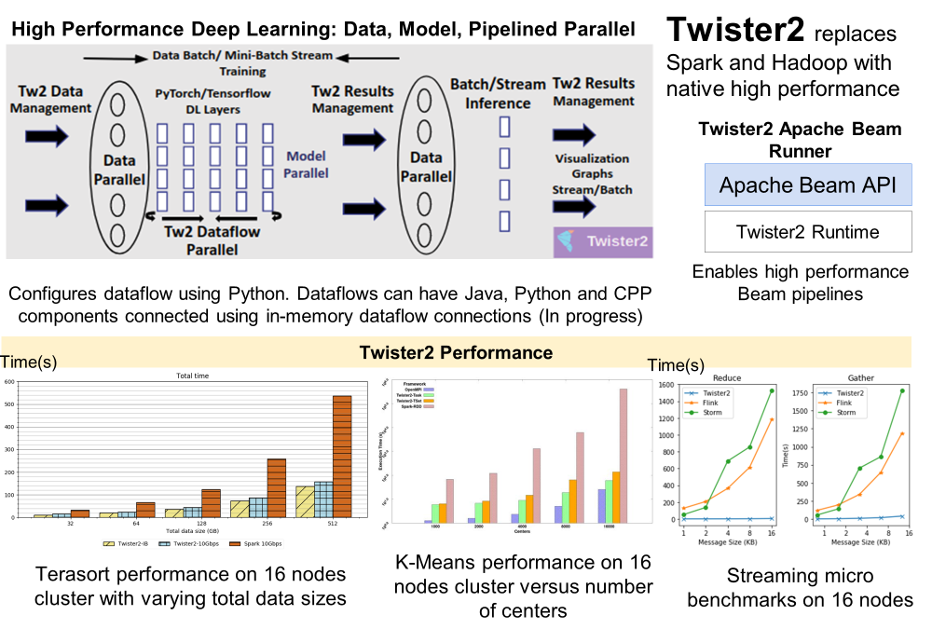
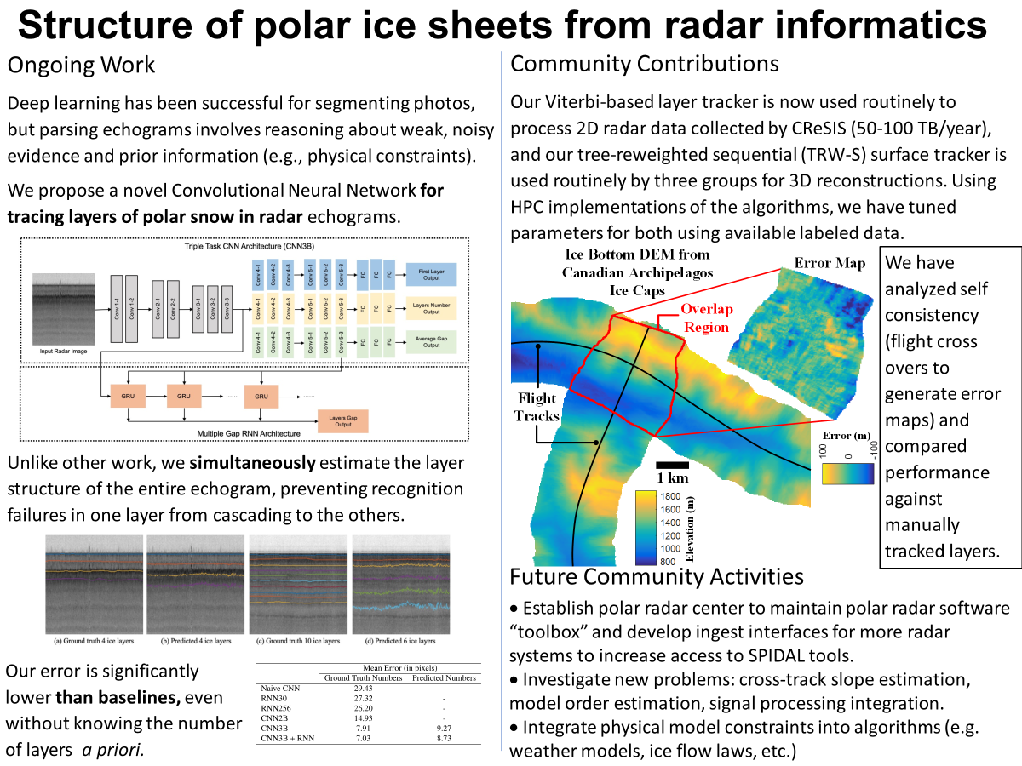
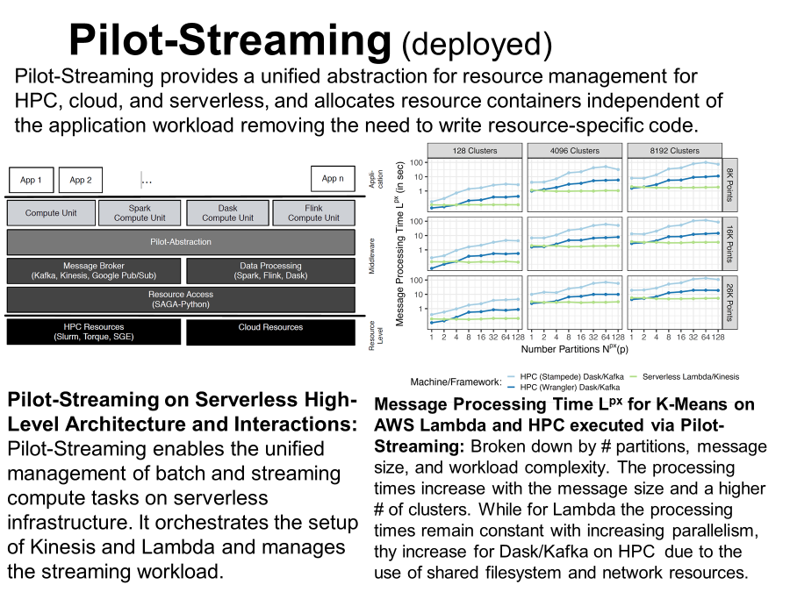
CIF21 DIBBs: Middleware and High Performance Analytics Libraries for Scalable Data Science PI: G. Fox, Co-PIs: Madhav Marathe, Shantenu Jha, Judy Qiu, Fusheng Wang Institutions: Arizona State, Indiana (lead), Kansas, Rutgers, Stony Brook, Virginia, and Utah.
Award #: 1443054
Community Driven
High-Performance Big Data
for bio-physical applications based on HPC, distributed systems, network science, GIS and machine/deep learning
Completed Activities
MLforHPC and HPCforML
HPC Big Data Cloud Convergence
Polar Science Community
Streaming Data Systems
Network Science Community
Health Science Community
Biomolecular Science Simulation Community

Slide 2
CIF21 DIBBs: Middleware and High Performance Analytics Libraries for Scalable Data Science PI: G. Fox, Co-PIs: Madhav Marathe, Shantenu Jha, Judy Qiu, Fusheng Wang Institutions: Arizona State, Indiana (lead), Kansas, Rutgers, Stony Brook, Virginia, and Utah.
Award #: 1443054
Community Driven
High-Performance Big Data
for bio-physical applications based on HPC, distributed systems, network science, GIS and machine/deep learning
Completed Activities
MLforHPC and HPCforML
HPC Big Data Cloud Convergence
Polar Science Community
Streaming Data Systems
Network Science Community
Health Science Community
Biomolecular Science Simulation Community

