Slide 1
NSF14-43054 start October 1, 2014 Datanet: CIF21 DIBBs: Middleware and High Performance Analytics Libraries for Scalable Data Science
Indiana University (Fox, Qiu, Crandall, von Laszewski),
Rutgers (Jha)
Virginia Tech (Marathe)
Kansas (Paden)
Stony Brook (Wang)
Arizona State(Beckstein)
Utah(Cheatham)
Overview by Gregor von Laszewski April 6 2016
http://spidal.org/
http://news.indiana.edu/releases/iu/2014/10/big-data-dibbs-grant.shtml
http://www.nsf.gov/awardsearch/showAward?AWD_ID=1443054

Slide 2
Some Important Components of SPIDAL Dibbs
NIST Big Data Application Analysis – features of data intensive appls
HPC-ABDS: Cloud-HPC interoperable software performance of HPC (High Performance Computing) and the rich functionality of the commodity Apache Big Data Stack.
This is reservoir of software subsystems – nearly all from outside project and mix of HPC and Big Data communities
Leads to Big Data – Simulation - HPC Convergence
MIDAS: Integrating Middleware – from project
Applications: Biomolecular Simulations, Network and Computational Social Science, Epidemiology, Computer Vision, Spatial Geographical Information Systems, Remote Sensing for Polar Science and Pathology Informatics.
SPIDAL (Scalable Parallel Interoperable Data Analytics Library): Scalable Analytics for
Domain specific data analytics libraries – mainly from project
Add Core Machine learning Libraries – mainly from community
Performance of Java and MIDAS Inter- and Intra-node
Benchmarks – project adds to community; See WBDB 2015 Seventh Workshop on Big Data Benchmarking

Slide 3
64 Features in 4 views for Unified Classification of Big Data and Simulation Applications
Both
Analytics
(Model for Data)
Simulations
(Nearly all Data)
(All Model)
(Mix of Data and Model)
(Nearly all Data+Model)

Slide 4
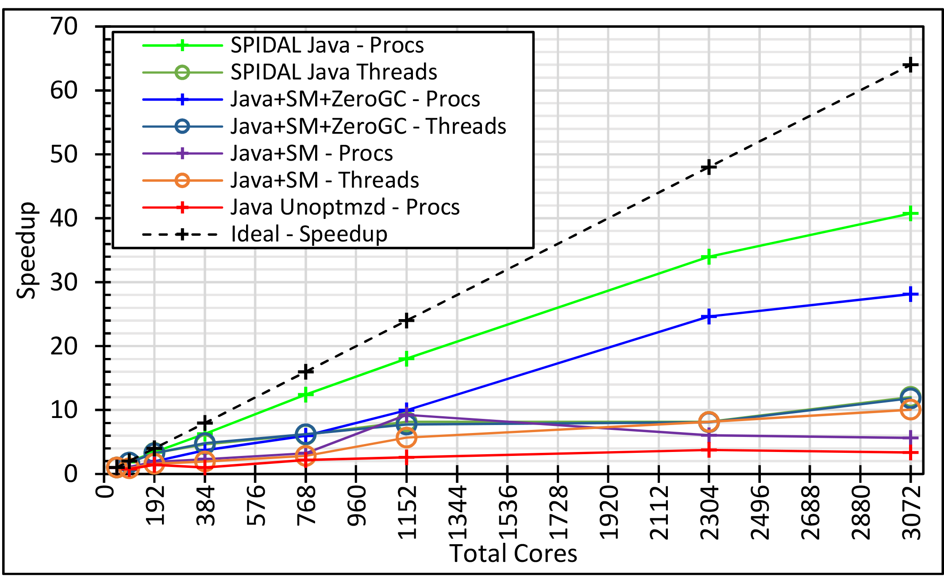
Java MPI performs better than Threads 128 24 core Haswell nodes on SPIDAL DA-MDS Code
Best MPI; inter and intra node
Best Threads intra node
MPI inter node

Slide 5
Big Data and (Exascale) Simulation Convergence II

Slide 6
HPC-ABDS Mapping of Activities
Level 17: Orchestration: Apache Beam (Google Cloud Dataflow) integrated with Cloudmesh
Level 16: Applications. Datamining for molecular dynamics, Image processing for remote sensing and pathology, graphs, streaming
Level 16: Algorithms. MLlib, Mahout, SPIDAL
Release SPIDAL Clustering, Dimension Reduction (multi-dimensional scaling), Web point set visualization
Level 14: Programming. Storm, Heron, Hadoop, Spark, Flink. Inter and Intra-node performance
Level 13: Communication. Enhanced Storm and Hadoop using HPC runtime technologies
Level 11: Data management. Hbase and MongoDB integrated via use of Beam and other Apache tools
Level 9: Cluster Management. Integrate Pilot Jobs with Yarn, Spark, Hadoop
Level 6: DevOps. Python Cloudmesh virtual Cluster Interoperability

