Slide 1
NSF14-43054 started October 1, 2014
Datanet: CIF21 DIBBs: Middleware and High Performance Analytics Libraries for Scalable Data Science
Indiana University (Fox, Qiu, Crandall, von Laszewski)
Rutgers (Jha)
Virginia Tech (Marathe)
Kansas (Paden)
Stony Brook (Wang)
Arizona State (Beckstein)
Utah (Cheatham)
Overview by Geoffrey Fox, May 17, 2016
http://spidal.org/
http://news.indiana.edu/releases/iu/2014/10/big-data-dibbs-grant.shtml
http://www.nsf.gov/awardsearch/showAward?AWD_ID=1443054

Slide 2
Some Important Components of SPIDAL Dibbs
NIST Big Data Application Analysis – features of data intensive Applications.
HPC-ABDS: Cloud-HPC interoperable software performance of HPC (High Performance Computing) and the rich functionality of the commodity Apache Big Data Stack.
  This is a reservoir of software subsystems – nearly all from outside the project and being a mix of HPC and Big Data communities.
  Leads to Big Data – Simulation – HPC Convergence.
MIDAS: Integrating Middleware – from project.
Applications: Biomolecular Simulations, Network and Computational Social Science, Epidemiology, Computer Vision, Spatial Geographical Information Systems, Remote Sensing for Polar Science and Pathology Informatics.
SPIDAL (Scalable Parallel Interoperable Data Analytics Library):
Scalable Analytics for:
  Domain specific data analytics libraries – mainly from project.
  Add Core Machine learning libraries – mainly from community.
  Performance of Java and MIDAS Inter- and Intra-node.
Benchmarks – project adds to communityWBDB2015 Benchmarking Workshop
Implementations: XSEDE and Blue Waters as well as clouds (OpenStack, Docker)

Slide 3
Big Data - Big Simulation (Exascale) Convergence
Discuss Data and Model together as built around problems which combine them, but we can get insight by separating which allows better understanding of Big Data - Big Simulation “convergence”
Big Data implies Data is large but Model varies
  e.g. LDA with many topics or deep learning has large model
  Clustering or Dimension reduction can be quite small
Simulations can also be considered as Data and Model
  Model is solving particle dynamics or partial differential equations
  Data could be small when just boundary conditions
  Data large with data assimilation (weather forecasting) or when data visualizations are produced by simulation
Data often static between iterations (unless streaming); Model varies between iterations
Take 51 NIST and other use cases → derive multiple specific features
Generalize and systematize with features termed “facets”
50 Facets (Big Data) or 64 Facets (Big Simulation and Data) divided into 4 sets or views where each view has “similar” facets
  Allows one to study coverage of benchmark sets and architectures

Slide 4
64 Features in 4 views for Unified Classification of Big Data and Simulation Applications
Both
Simulations
Analytics
(Model for Data)
(Nearly all Data)
(All Model)
(Mix of Data and Model)
(Nearly all Data+Model)

Slide 5
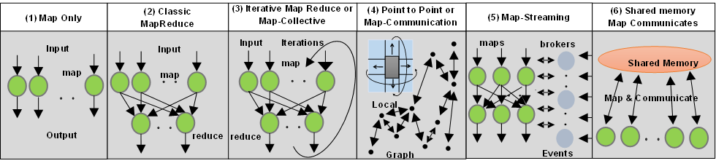
6 Forms of MapReduce
Cover “all” circumstances
Describes
- Problem (Model reflecting data)
- Machine
- Software
Architecture

Slide 6
HPC-ABDS

Slide 7
HPC-ABDS Mapping of Activities
Green is MIDAS
Level 17: Orchestration: Apache Beam (Google Cloud Dataflow) integrated with Cloudmesh on HPC cluster
Level 16: Applications: Datamining for molecular dynamics, Image processing for remote sensing and pathology, graphs, streaming, bioinformatics, social media, financial informatics, text mining
Level 16: Algorithms: Generic and custom for applications SPIDAL
Level 14: Programming: Storm, Heron (Twitter replaces Storm), Hadoop, Spark, Flink. Improve Inter- and Intra-node performance
Level 13: Communication: Enhanced Storm and Hadoop using HPC runtime technologies, Harp
Level 11: Data management: Hbase and MongoDB integrated via use of Beam and other Apache tools; enhance Hbase
Level 9: Cluster Management: Integrate Pilot Jobs with Yarn, Mesos, Spark, Hadoop; integrate Storm and Heron with Slurm
Level 6: DevOps: Python Cloudmesh virtual Cluster Interoperability

Slide 8
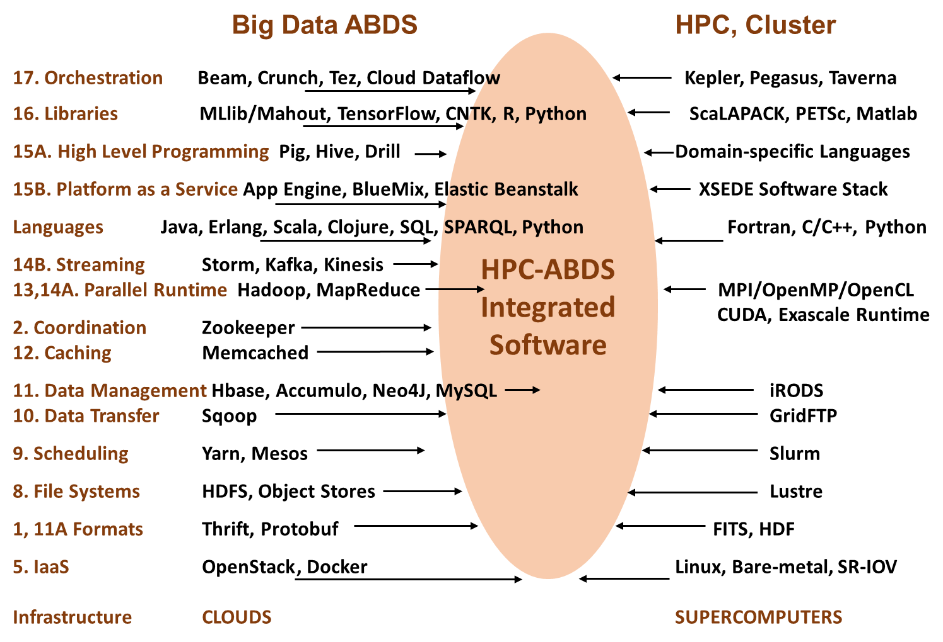

Slide 9
MIDAS: Software Activities in DIBBS
Developing HPC-ABDS concept to integrate HPC and Apache Technologies
Java: relook at Java Grande to make performance “best simply possible”
DevOps: Cloudmesh provides interoperability between HPC and Cloud (OpenStack, AWS, Docker) platforms based on virtual clusters with software defined systems using Ansible (Chef )
Scheduling: Integrate Slurm and Pilot jobs with Yarn & Mesos (ABDS schedulers), Programming layer (Hadoop, Spark, Flink, Heron/Storm)
Communication and scientific data abstractions: Harp plug-in to Hadoop outperforms ABDS programming layers
Data Management: use Hbase, MongoDB with customization
Workflow: Use Apache Crunch and Beam (Google Cloud Data flow) as they link to other ABDS technologies.
Starting to integrate MIDAS components and move into algorithms of SPIDAL Library

Slide 10

Java MPI performs better than Threads
128 24 core Haswell nodes on SPIDAL DA-MDS Code
SM = Optimized Shared memory for intra-node MPI
Best MPI; inter and intra node
Best Threads intra node
And MPI inter node
HPC into Java Runtime and Programming Model

Slide 11
Cloudmesh Interoperability DevOps Tool
Model: Define software configuration with tools like Ansible; instantiate on a virtual cluster
An easy-to-use command line program/shell and portal to interface with heterogeneous infrastructures
  Supports OpenStack, AWS, Azure, SDSC Comet, virtualbox, libcloud supported clouds as well as classic HPC and Docker infrastructures
  Has an abstraction layer that makes it possible to integrate other IaaS frameworks
  Uses defaults that help interacting with various clouds
  Managing VMs across different IaaS providers is easy
  The client saves state between consecutive calls
Demonstrated interaction with various cloud providers:
  FutureSystems, Chameleon Cloud, Jetstream, CloudLab, Cybera, AWS, Azure, virtualbox
Status: AWS, and Azure, VirtualBox, Docker need improvements; we focus currently on Comet and NSF resources that use OpenStack
Currently evaluating 40 team projects from “Big Data Open Source Software Projects Class” which used this approach running on VirtualBox, Chameleon and FutureSystems

Slide 12
Cloudmesh Interoperability DevOps Tool
Model: Define software configuration with tools like Ansible; instantiate on a virtual cluster
An easy-to-use command line program/shell and portal to interface with heterogeneous infrastructures
  Supports OpenStack, AWS, Azure, SDSC Comet, virtualbox, libcloud supported clouds as well as classic HPC and Docker infrastructures
  Has an abstraction layer that makes it possible to integrate other IaaS frameworks
  Uses defaults that help interacting with various clouds
  Managing VMs across different IaaS providers is easy
  The client saves state between consecutive calls
Demonstrated interaction with various cloud providers:
  FutureSystems, Chameleon Cloud, Jetstream, CloudLab, Cybera, AWS, Azure, virtualbox
Status: AWS, and Azure, VirtualBox, Docker need improvements; we focus currently on Comet and NSF resources that use OpenStack
Currently evaluating 40 team projects from “Big Data Open Source Software Projects Class” which used this approach running on VirtualBox, Chameleon and FutureSystems
HPC Cloud Interoperability Layer

Slide 13
Cloudmesh Client - Architecture
Component View
Layered View
Systems Configuration

Slide 14
Cloudmesh Client – OSG management
OSG: Open Science Grid.
LIGO data analysis was conducted on Comet supported by the Cloudmesh client.
Funded by NSF Comet.
While using Comet it is possible to use the same images that are used on the internal OSG cluster.
This reduces overall management effort.
The client is used to manage the VMs.
Cloudmesh

Slide 15
Cloudmesh Client –
In support of Experiment Workflow
Manage VMs and virtual clusters
Choose general Infrastructure HPC to Clouds
Create
IaaS
Deploy PaaS
Deploy
Data
Execute
Scripts
Evaluate
Repeat
Cloudmesh
Client
Scripts
Variables
Shared state
Integrate with Ansible
Integration
into Ipython and Apache Beam
Buildin gcopy and rsync commands
Cloudmesh scripts
Integrate with shell
Integrate with Python

Slide 16
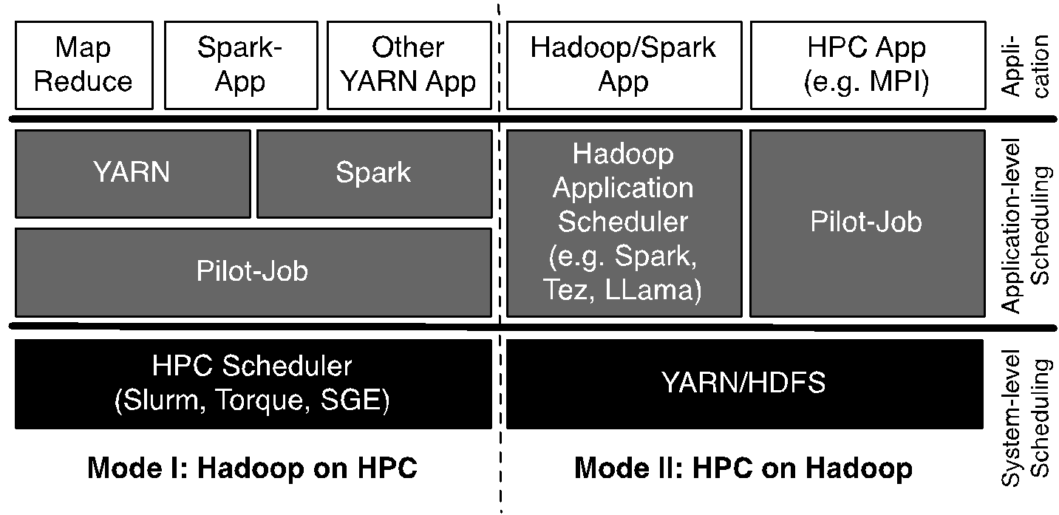
Pilot-Hadoop/Spark Architecture
HPC into Scheduling Layer
http://arxiv.org/abs/1602.00345

Slide 17
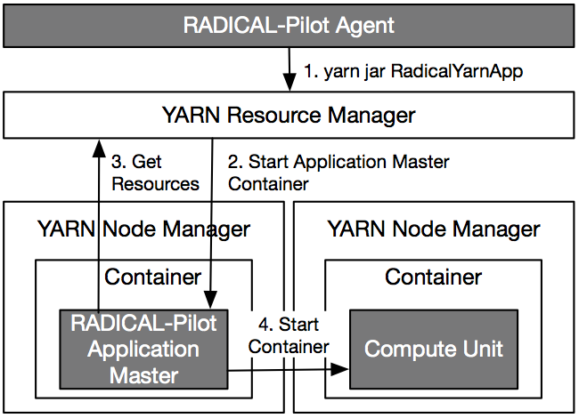
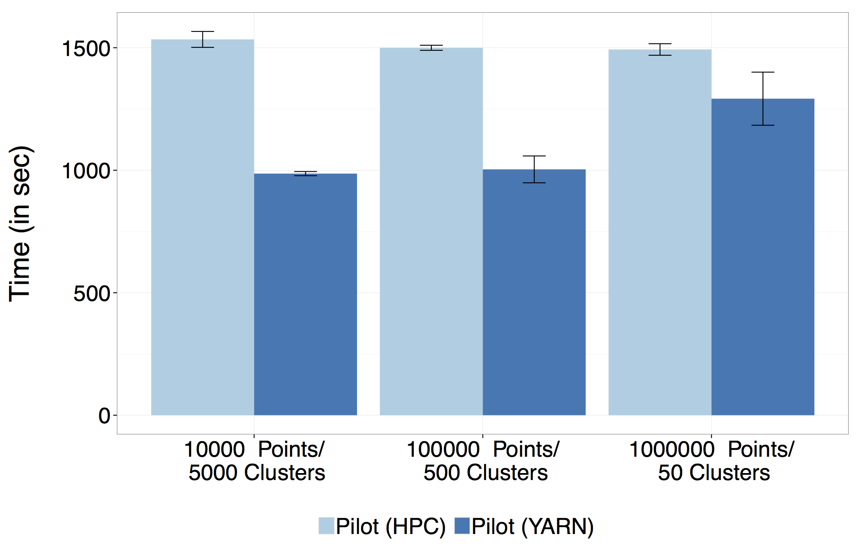
Pilot-Hadoop Example

Slide 18
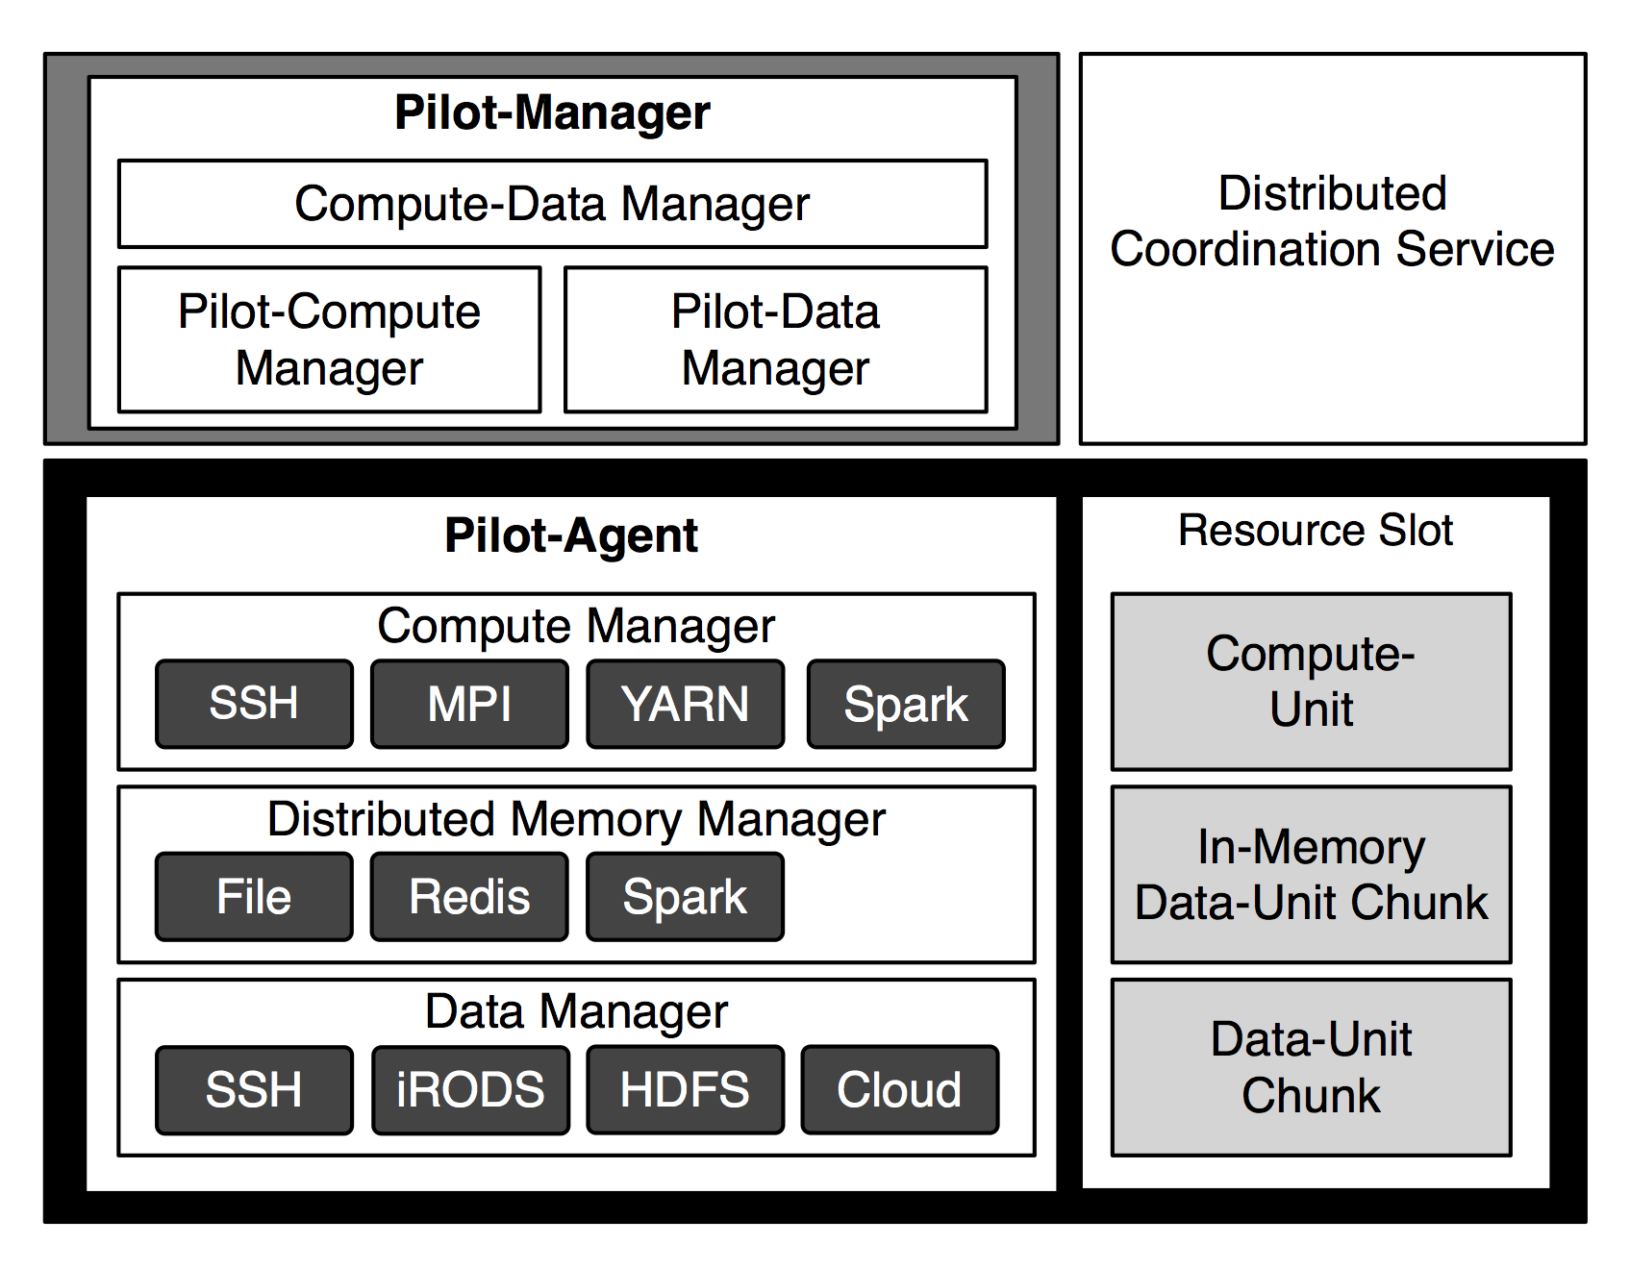
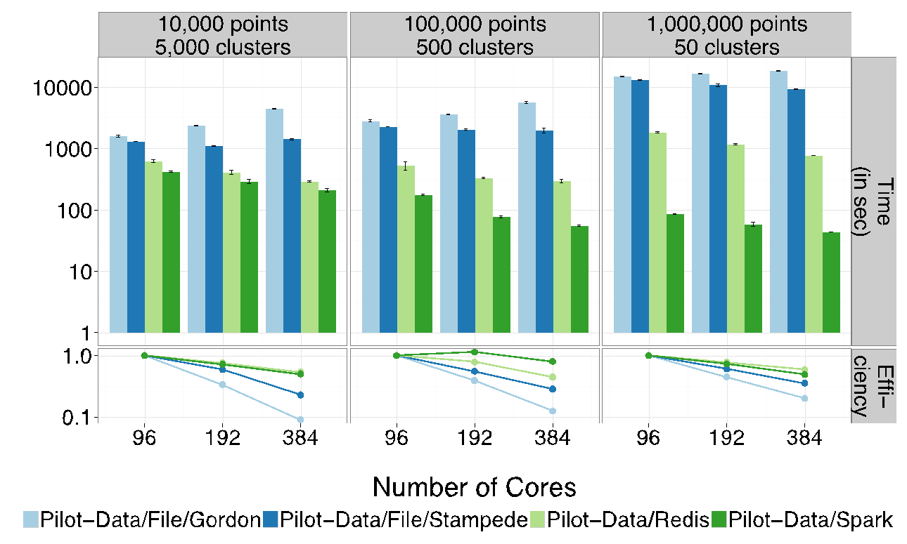
Pilot-Data/Memory for Iterative
Processing
Scalable K-Means
Provide common API for distributed
cluster memory
Notes:
Prototype supporting Redis and Spark backend available
Developed different Application benchmarks: Kmeans, Pairwise Distance, Connected Components
Current: Characterization of Applications to understand when/where to use Pilot-Memory

Slide 19
Harp Implementations
Basic Harp: Iterative communication and scientific data abstractions
Careful support of distributed data AND distributed model
Avoids parameter server approach but distributes model over worker nodes and supports collective communication to bring global model to each node
Applied first to Latent Dirichlet Allocation LDA with large model and data
HPC into Programming/communication Layer

Slide 20
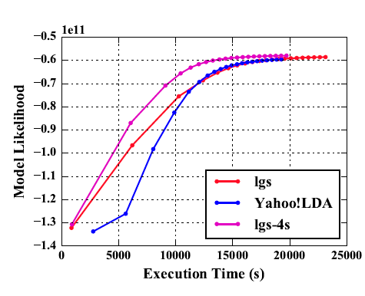
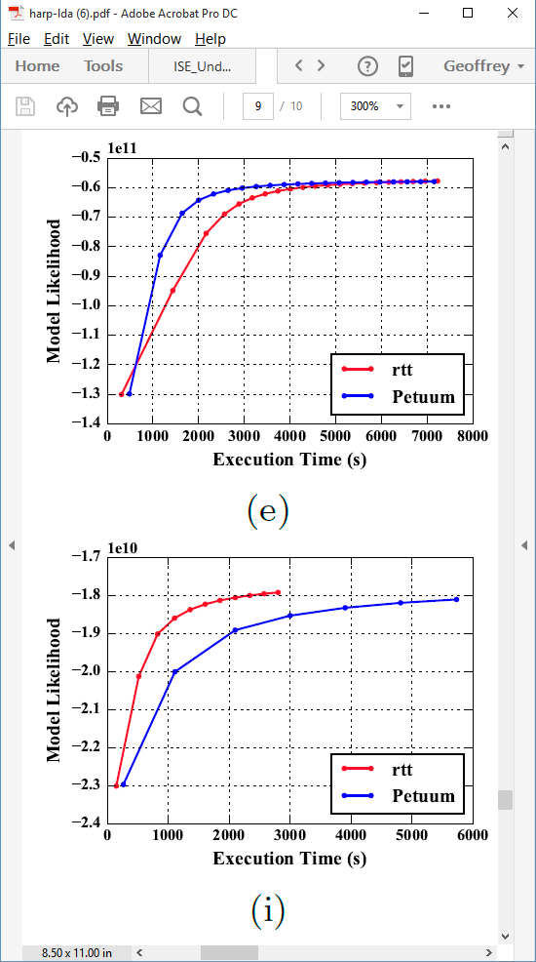
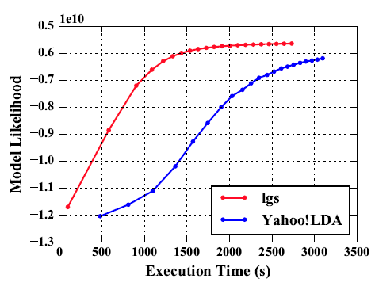
Latent Dirichlet Allocation on 100 Haswell nodes: red is Harp (lgs and rtt)
Clueweb
Clueweb
enwiki
Bi-gram

Slide 21
Harp LDA on Big Red II Supercomputer (Cray)
Harp LDA Scaling Tests
Harp LDA on Juliet (Intel Haswell)
  Big Red II: tested on 25, 50, 75, 100 and 125 nodes; each node uses 32 parallel threads; Gemini interconnect
  Juliet: tested on 10, 15, 20, 25, 30 nodes; each node uses 64 parallel threads on 36 core Intel Haswell nodes (each with 2 chips); Infiniband interconnect
Corpus: 3,775,554 Wikipedia documents, Vocabulary: 1 million words;
Topics: 10k topics; alpha: 0.01; beta: 0.01; iteration: 200

Slide 22
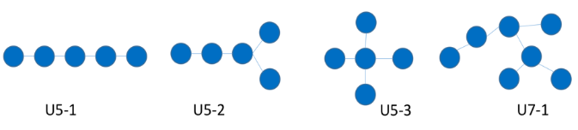
SPIDAL Algorithms – Subgraph mining
Finding patterns in graphs is very important
  Counting the number of embeddings of a given labeled/unlabeled template subgraph
  Finding the most frequent subgraphs/motifs efficiently from a given set of candidate templates
  Computing the graphlet frequency distribution.
Reworking existing parallel VT algorithm Sahad with MIDAS middleware giving HarpSahad which runs 5 (Google) to 9 (Miami) times faster than original Hadoop version
Work in progress
Templates
Datasets:
Network | No. Of Nodes (in million) | No. Of Edges (in million) | Size (MB)
Web-google | 0.9 | 4.3 | 65
Miami | 2.1 | 51.2 | 740

Slide 23
SPIDAL Algorithms – Random Graph Generation
Random graphs, important and needed with particular degree distribution and clustering coefficients.
  Preferential attachment (PA) model, Chung-Lu (CL), stochastic Kronecker, stochastic block model (SBM), and block two–level Erdos-Renyi (BTER)
  Generative algorithms for these models are mostly sequential and take a prohibitively long time to generate large-scale graphs.
SPIDAL working on developing efficient parallel algorithms for generating random graphs using different models with new DG method with low memory and high performance, almost optimal load balancing and excellent scaling.
  Algorithms are about 3-4 times faster than the previous ones.
  Generate a network with 250 billion edges in 12 seconds using 1024 processors.
Needs to be packaged for SPIDAL using MIDAS (currently MPI)

Slide 24
SPIDAL Algorithms – Triangle Counting
Triangle counting; important special case of subgraph mining and specialized programs can outperform general program
Previous work used Hadoop but MPI based PATRIC is much faster
SPIDAL version uses much more efficient decomposition (non-overlapping graph decomposition) – a factor of 25 lower memory than PATRIC
Next graph problem – Community detection
MPI version complete. Need to package for SPIDAL and add MIDAS -- Harp
SPIDAL

Slide 25
SPIDAL Algorithms – Core I
Several parallel core machine learning algorithms; need to add SPIDAL Java optimizations to complete parallel codes except MPI MDS
  https://www.gitbook.com/book/esaliya/global-machine-learning-with-dsc-spidal/details
O(N²) distance matrices calculation with Hadoop parallelism and various options (storage MongoDB vs. distributed files), normalization, packing to save memory usage, exploiting symmetry
WDA-SMACOF: Multidimensional scaling MDS is optimal nonlinear dimension reduction enhanced by SMACOF, deterministic annealing and Conjugate gradient for non-uniform weights. Used in many applications
  MPI (shared memory) and MIDAS (Harp) versions
MDS Alignment to optimally align related point sets, as in MDS time series
WebPlotViz data management (MongoDB) and browser visualization for 3D point sets including time series. Available as source or SaaS
MDS as χ² using Manxcat. Alternative more general but less reliable solution of MDS. Latest version of WDA-SMACOF usually preferable
Other Dimension Reduction: SVD, PCA, GTM to do

Slide 26
SPIDAL Algorithms – Core II
Latent Dirichlet Allocation LDA for topic finding in text collections; new algorithm with MIDAS runtime outperforming current best practice
DA-PWC Deterministic Annealing Pairwise Clustering for case where points aren’t in a vector space; used extensively to cluster DNA and proteomic sequences; improved algorithm over other published. Parallelism good but needs SPIDAL Java
DAVS Deterministic Annealing Clustering for vectors; includes specification of errors and limit on cluster sizes. Gives very accurate answers for cases where distinct clustering exists. Being upgraded for new LC-MS proteomics data with one million clusters in 27 million size data set
K-means basic vector clustering: fast and adequate where clusters aren’t needed accurately
Elkan’s improved K-means vector clustering: for high dimensional spaces; uses triangle inequality to avoid expensive distance calcs
Future work – Classification: logistic regression, Random Forest, SVM, (deep learning); Collaborative Filtering, TF-IDF search and Spark MLlib algorithms
Harp-DaaL extends Intel DAAL’s local batch mode to multi-node distributed modes
  Leveraging Harp’s benefits of communication for iterative compute models

Slide 27
SPIDAL Algorithms – Optimization I
Manxcat: Levenberg Marquardt Algorithm for non-linear χ² optimization with sophisticated version of Newton’s method calculating value and derivatives of objective function. Parallelism in calculation of objective function and in parameters to be determined. Complete – needs SPIDAL Java optimization
Viterbi algorithm, for finding the maximum a posteriori (MAP) solution for a Hidden Markov Model (HMM). The running time is O(n*s^2) where n is the number of variables and s is the number of possible states each variable can take. We will provide an "embarrassingly parallel" version that processes multiple problems (e.g. many images) independently; parallelizing within the same problem not needed in our application space. Needs Packaging in SPIDAL
Forward-backward algorithm, for computing marginal distributions over HMM variables. Similar characteristics as Viterbi above. Needs Packaging in SPIDAL

Slide 28
SPIDAL Algorithms – Optimization II
Loopy belief propagation (LBP) for approximately finding the maximum a posteriori (MAP) solution for a Markov Random Field (MRF). Here the running time is O(n^2*s^2*i) in the worst case where n is number of variables, s is number of states per variable, and i is number of iterations required (which is usually a function of n, e.g. log(n) or sqrt(n)). Here there are various parallelization strategies depending on values of s and n for any given problem.
  We will provide two parallel versions: embarrassingly parallel version for when s and n are relatively modest, and parallelizing each iteration of the same problem for common situation when s and n are quite large so that each iteration takes a long time relative to number of iterations required.
  Needs Packaging in SPIDAL
Markov Chain Monte Carlo (MCMC) for approximately computing marking distributions and sampling over MRF variables. Similar to LBP with the same two parallelization strategies. Needs Packaging in SPIDAL

Slide 29
Imaging Applications: Remote Sensing, Pathology, Spatial Systems
Both Pathology/Remote sensing working on 3D images
Each pathology image could have 10 billion pixels, and we may extract a million spatial objects per image and 100 million features (dozens to 100 features per object) per image. We often tile the image into 4K x 4K tiles for processing. We develop buffering-based tiling to handle boundary-crossing objects. For each typical research study, we may have hundreds to thousands of pathology images
Remote sensing aimed at radar images of ice and snow sheets
2D problems need modest parallelism “intra-image” but often need parallelism over images
3D problems need parallelism for an individual image
Use Optimization algorithms to support applications (e.g. Markov Chain, Integer Programming, Bayesian Maximum a posteriori, variational level set, Euler-Lagrange Equation)
Classification (deep learning convolution neural network, SVM, random forest, etc.) will be important

Slide 30
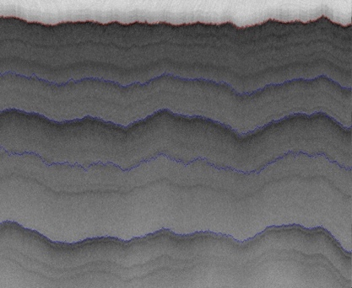
2D Radar Polar Remote Sensing
Need to estimate structure of earth (ice, snow, rock) from radar signals from plane in 2 or 3 dimensions.
Original 2D analysis ([11])used Hidden Markov Methods; better results using MCMC (our solution)
Extending to snow radar layers

Slide 31
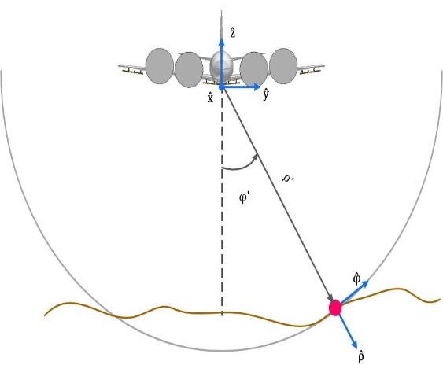
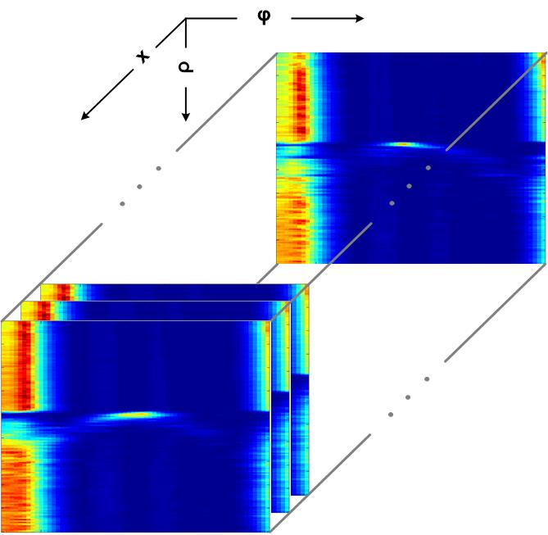
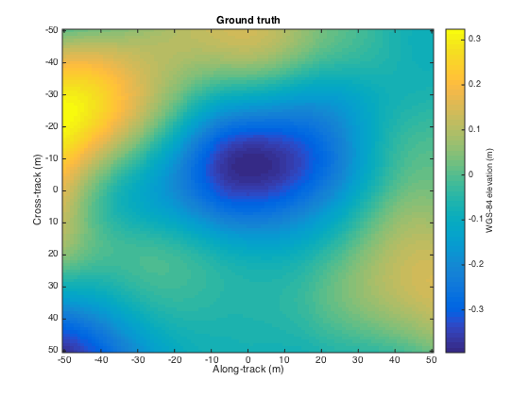
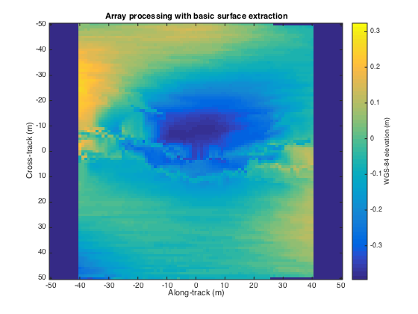
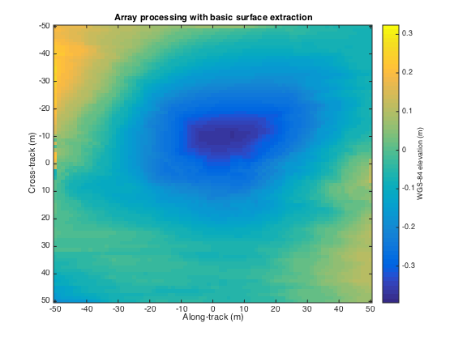
3D Radar Polar Remote Sensing
Uses LBP to analyze 3D radar images
Radar gives a cross-section view, parameterized by angle and range, of the ice structure, which yields a set of 2-d tomographic slices (right) along the flight path.
Each image represents a 3d depth map, with along track and cross track dimensions on the x-axis and y-axis respectively, and depth coded as colors.
Reconstructing bedrock in 3D, for (left) ground truth, (center) existing algorithm based on maximum likelihood estimators, and (right) our technique based on a Markov Random Field formulation.

Slide 32
Algorithms – Nuclei Segmentation for Pathology Images
Segment boundaries of nuclei from pathology
images and extract features for each nucleus
Consist of tiling, segmentation,
vectorization, boundary object aggregation
Could be executed on MapReduce
(MIDAS Harp)
Execution pipeline on MapReduce (MIDAS Harp)
Nuclear segmentation algorithm

Slide 33
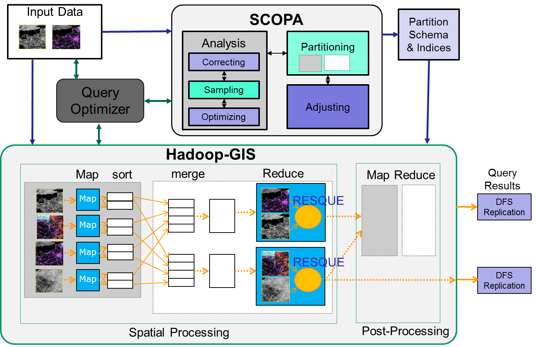
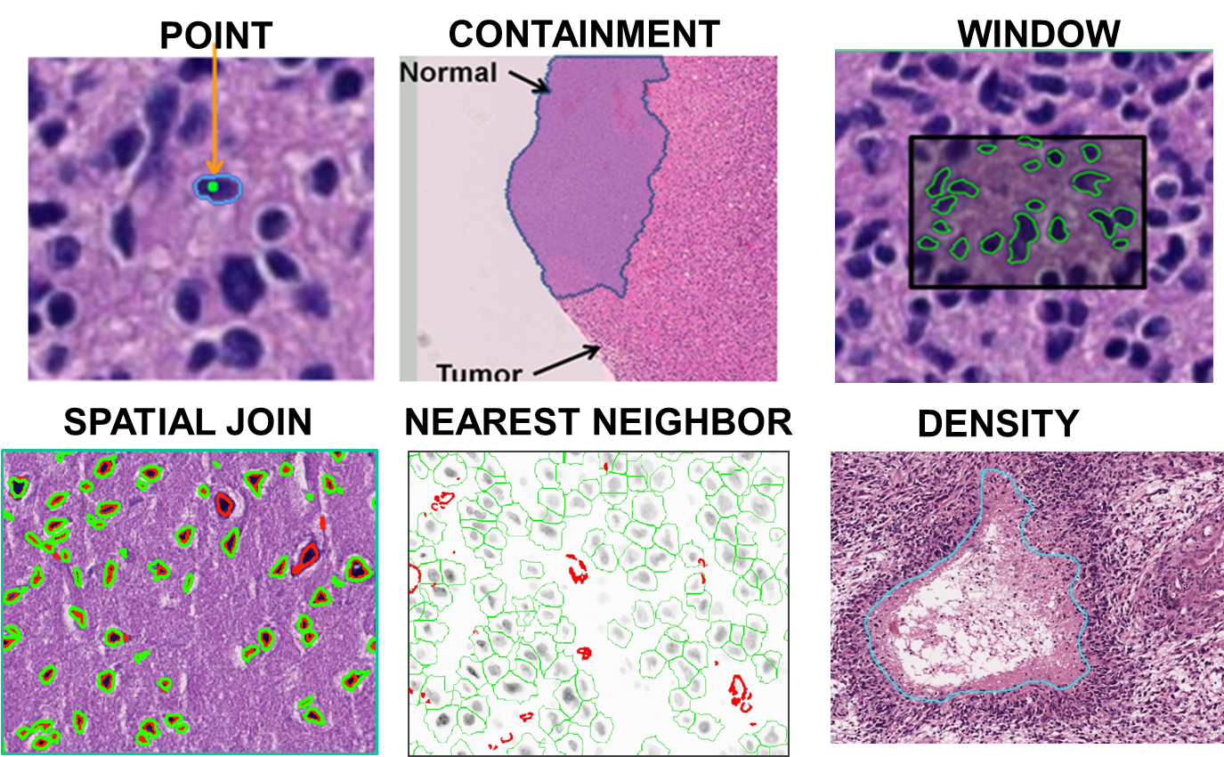
Algorithms – Spatial Querying Methods
Hadoop-GIS is a general framework to support high performance spatial queries and analytics for spatial big data on MapReduce.
It supports multiple types of spatial queries on MapReduce through spatial partitioning, customizable spatial query engine and on-demand indexing.
SparkGIS is a variation of Hadoop-GIS which runs on Spark to take advantage of in-memory processing.
Will extend Hadoop/Spark to Harp MIDAS runtime.
2D complete; 3D in progress
Spatial Queries
Architecture of Spatial Query Engine

Slide 34
Some Applications Enabled
KU/IU: Remote Sensing in Polar Regions
SB: Digital Pathology Imaging
SB: Large scale GIS applications, including public health
VT: Graph Analysis in studies of networks in many areas
UT, ASU, Rutgers: Analysis of Biomolecular simulations
Applications not part of Dibbs project but algorithms/software used
IU: Bioinformatics and Financial Modeling with MDS
Integration with Network Science Infrastructure
  VT/IU: CINET: SPIDAL algorithms will be made available
  IU: Osome Observatory on Social Media, currently Twitter https://peerj.com/preprints/2008/ using enhanced HBase
  IU: Topic Analysis of text data
IU/Rutgers: Streaming with HPC enhanced Storm/Heron

Slide 35

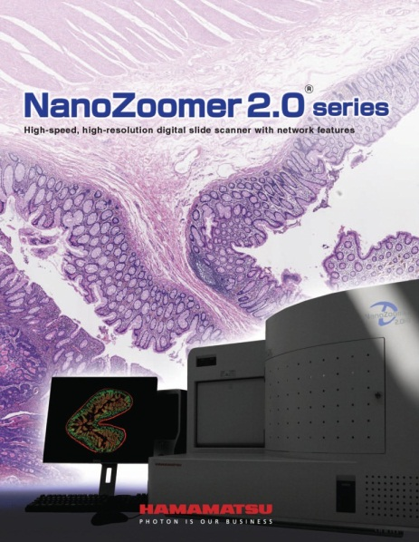
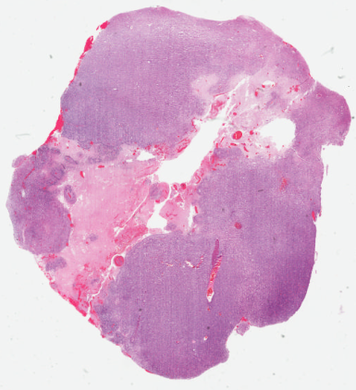
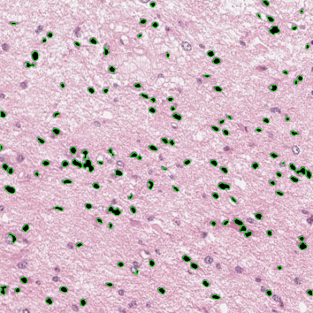
Enabled Applications – Digital Pathology
Glass Slides
Scanning
Whole Slide Images
Image Analysis
Digital pathology images scanned from human tissue specimens provide rich information about morphological and functional characteristics of biological systems.
Pathology image analysis has high potential to provide diagnostic assistance, identify therapeutic targets, and predict patient outcomes and therapeutic responses.
It relies on both pathology image analysis algorithms and spatial querying methods.
Extremely large image scale.

Slide 36
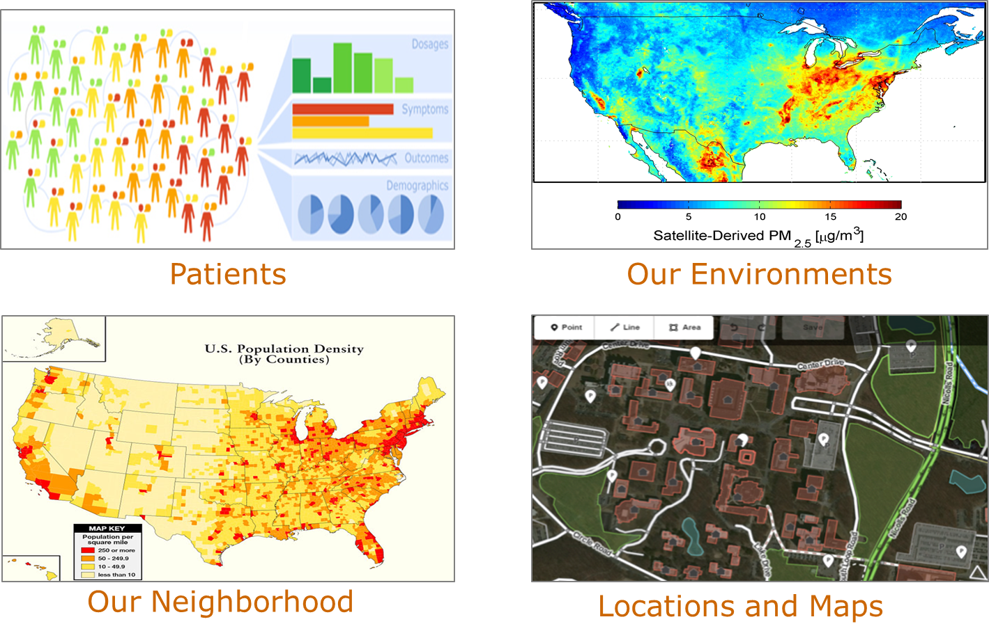
Applications – Public Health
GIS-oriented public health research has a strong focus on the locations of patients and the agents of disease, and studies the spatial patterns and variations.
Integrating multiple spatial big data sources at fine spatial resolutions allow public health researchers and health officials to adequately identify, analyze, and monitor health problems at the community level.
This will rely on high performance spatial querying methods on data integration.
Note synergy between GIS and Large image processing as in pathology.

Slide 37
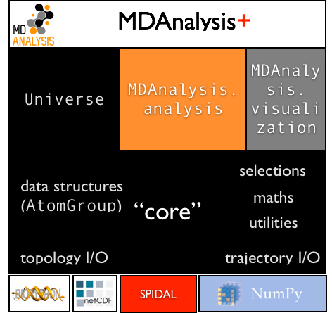
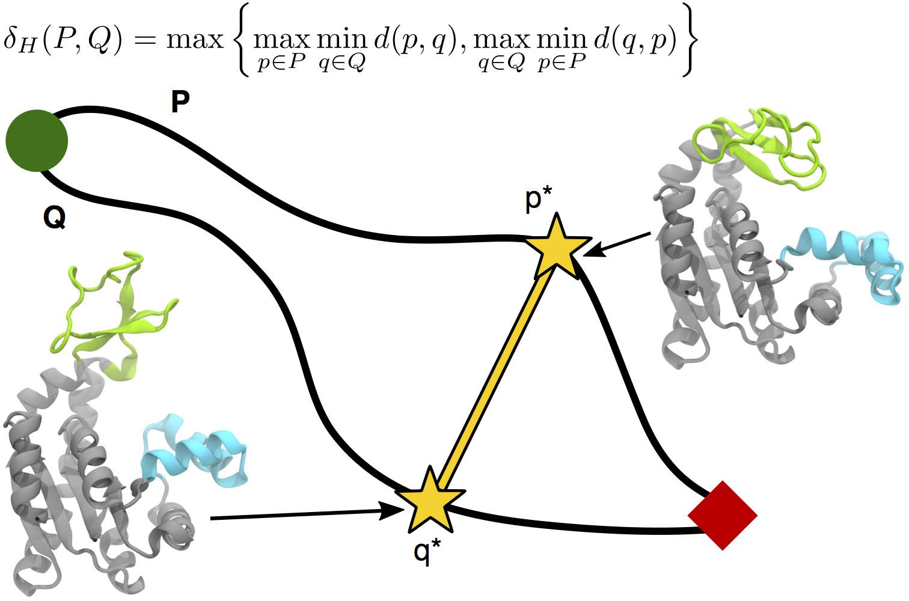
Biomolecular Simulation Data Analysis
Utah (CPPTraj), Arizona State (MDAnalysis), Rutgers
Parallelize key algorithms including O(N²) distance computations between trajectories
Integrate SPIDAL O(N²) distance and clustering libraries
Path Similarity Analysis (PSA) with Hausdorff distance

Slide 38
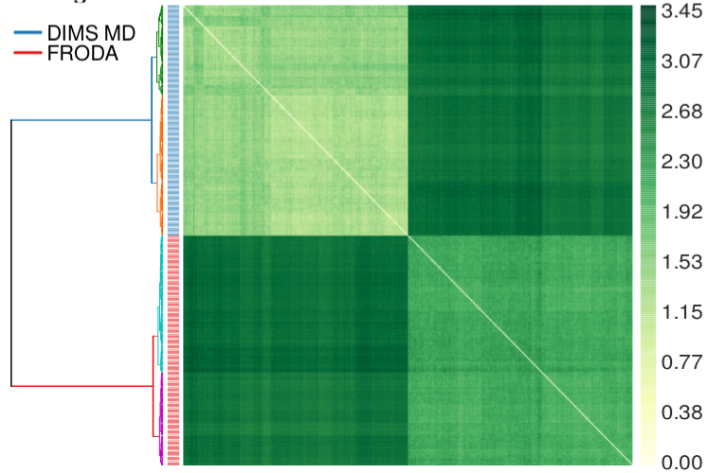
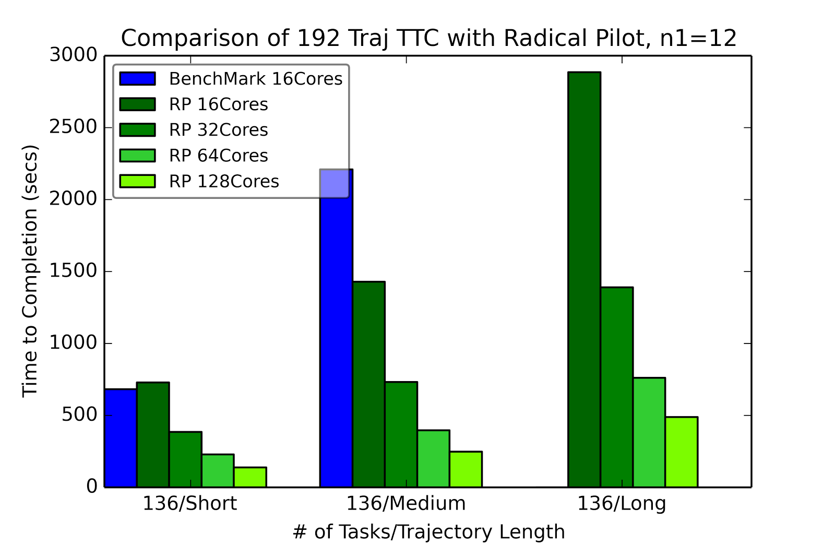
RADICAL-Pilot Hausdorff distance: all-pairs problem
Clustered distances for two methods for sampling macromolecular transitions (200 trajectories each) showing that both methods produce distinctly different pathways.
RADICAL Pilot benchmark run for three different test sets of trajectories, using 12x12 “blocks” per task.

Slide 39
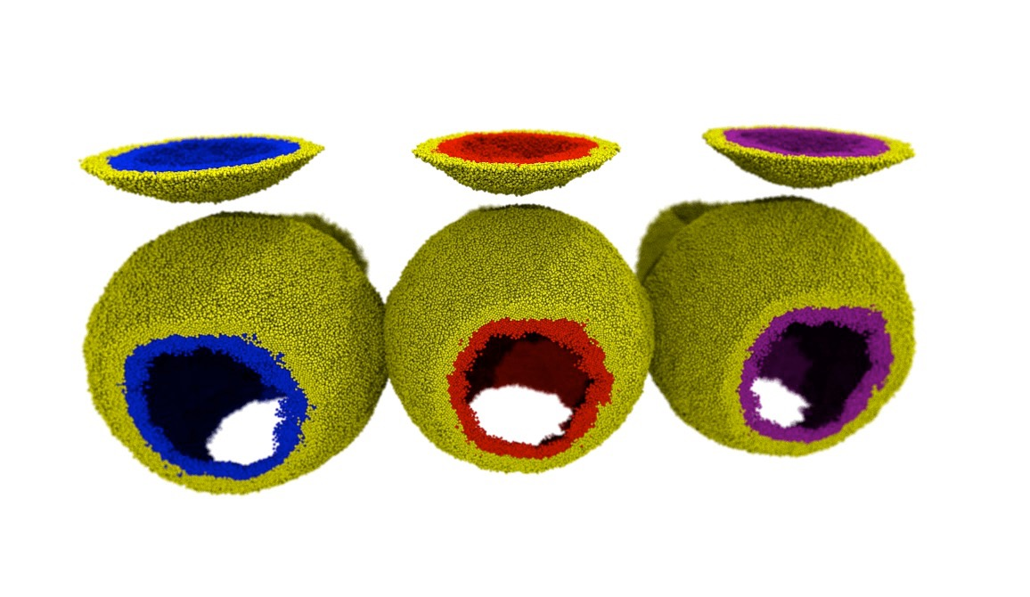
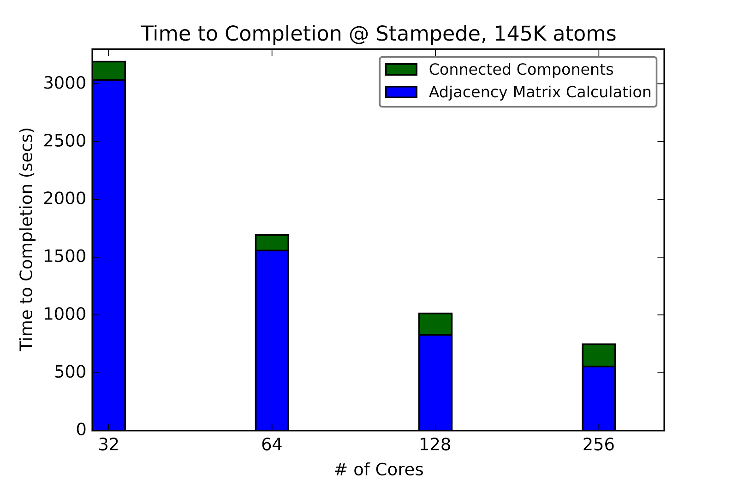
Classification of lipids in membranes
Biological membranes are lipid bilayers with distinct inner and outer surfaces that are formed by lipid mono layers (leaflets). Movement of lipids between leaflets or change of topology (merging of leaflets during fusion events) is difficult to detect in simulations.
Lipids colored by leaflet
Same color: continuous leaflet.

Slide 40
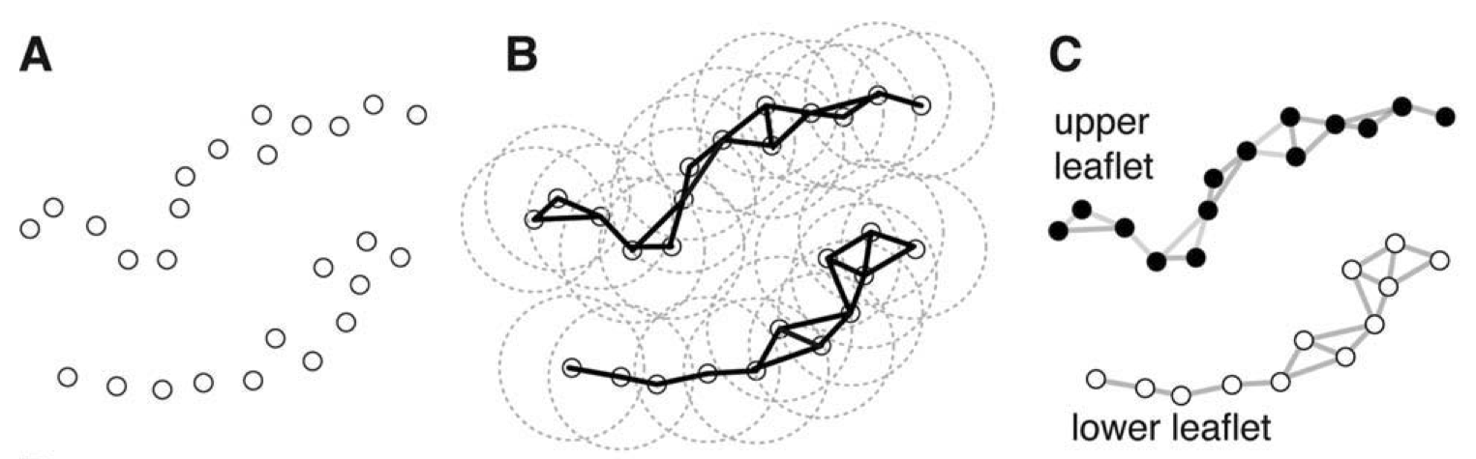
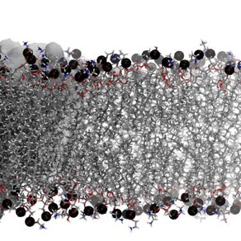
LeafletFinder
LeafletFinder is a graph-based algorithm to detect continuous lipid membrane leaflets in a MD simulation*. The current implementation is slow and does not work well for large systems (>100,000 lipids).
Phosphate atom coordinates
Build nearest-neighbors adjacency matrix
Find largest connected subgraphs
* N. Michaud-Agrawal, E. J. Denning, T. B. Woolf, and O. Beckstein. MDAnalysis: A toolkit for the analysis of molecular dynamics simulations. J Comp Chem, 32:2319–2327, 2011.

Slide 41
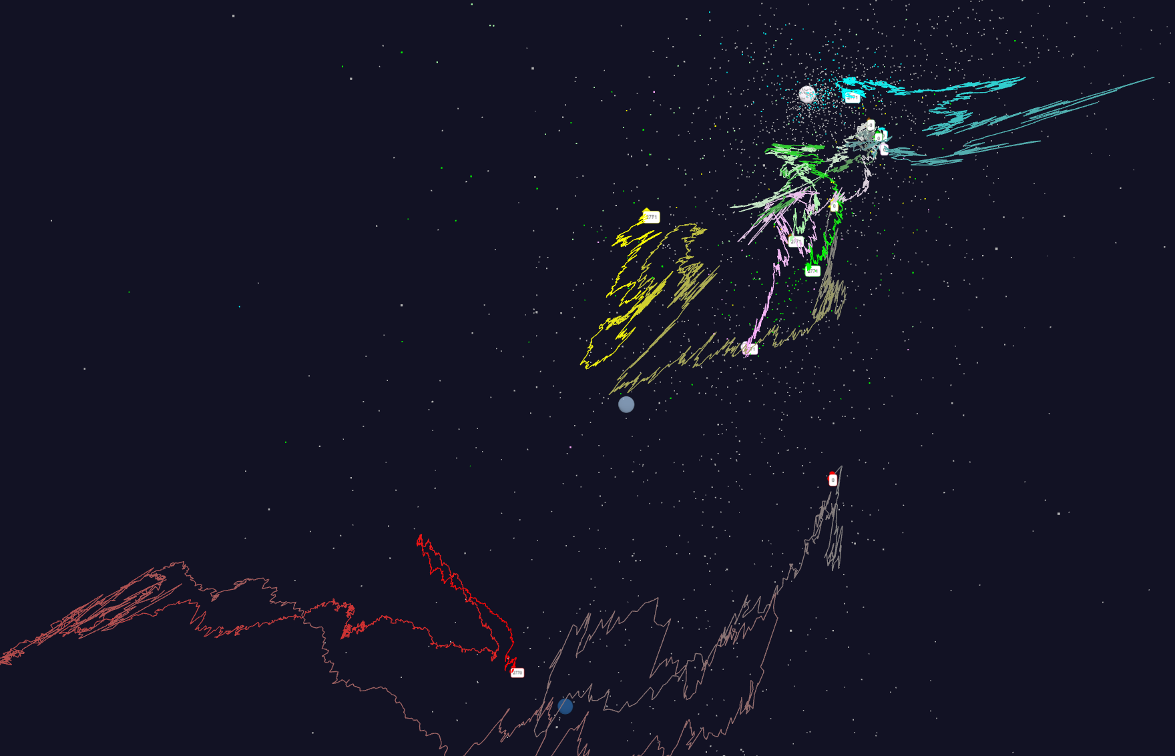
Time series of Stock Values projected to 3D
Using one day stock values measured from January 2004 and starting after one year January 2005 (Filled circles are final values)
Origin
0% change
Finance
Energy
Dow Jones
S&P
Mid Cap
+10%
Apple
+20%

