Slide 1
SALSA and Cheminformatics
SALSA Group
February 12 2010

Slide 2
Disease-Gene Data Analysis
Workflow
Disease
-. 34K total -. 32K unique CIDs
Union
PubChem
MDS/GTM
3D Map
With
Labels
Gene
-. 77K unique CIDs
-. 930K disease and gene data
-. 2M total -. 147K unique CIDs
(Num of data)

Slide 3
MDS/GTM with PubChem
Project data in the lower-dimensional space by reducing the original dimension
Preserve similarity in the original space as much as possible
GTM needs only vector-based data
MDS can process more general form of input (pairwise similarity matrix)
We have used only 166-bit fingerprints so far for measuring similarity (Euclidean distance)

Slide 4
PlotViz
Interactive exploring data in the 3D space
Updated to provide richer meta data
IUPAC names, chemical names, …
Chemical structure images, …
Need to add more
Can be mixed with external data sources (web site or database)
Jittering to avoid overlapping

Slide 5
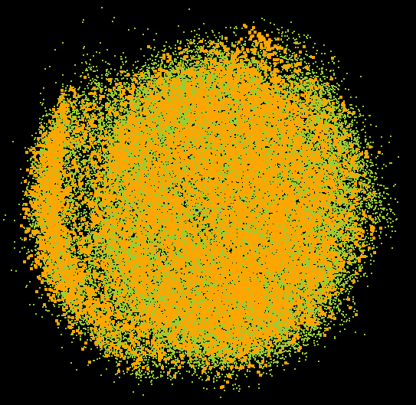
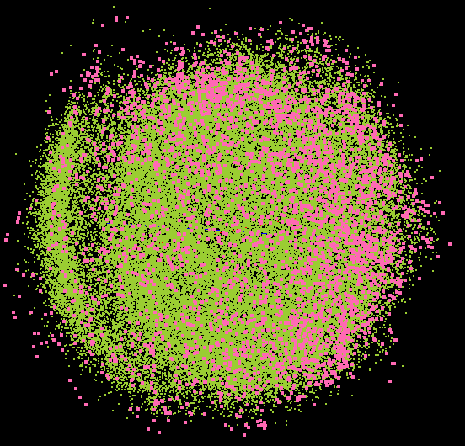
PlotViz Screenshot (I) - MDS

Slide 6
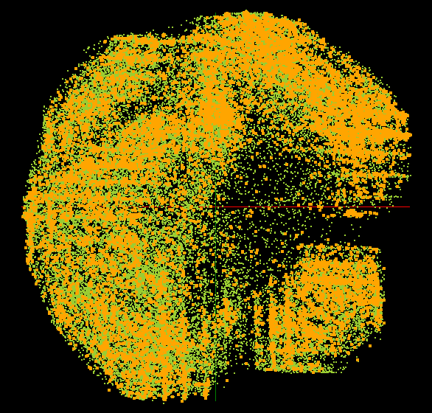
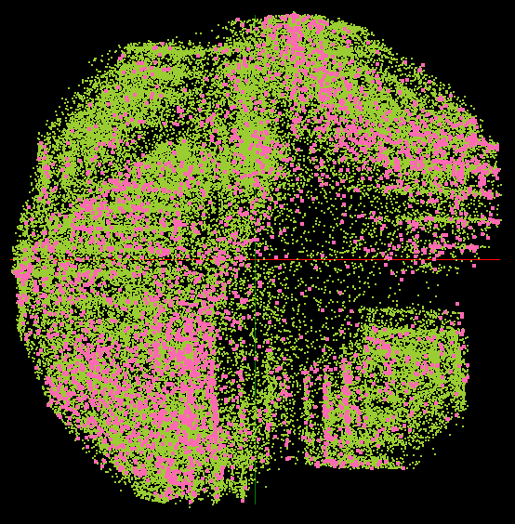
PlotViz Screenshot (II) - GTM

Slide 7
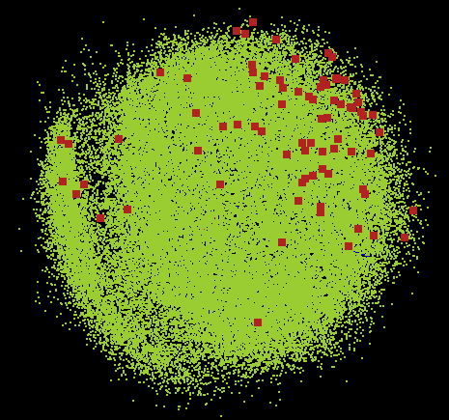
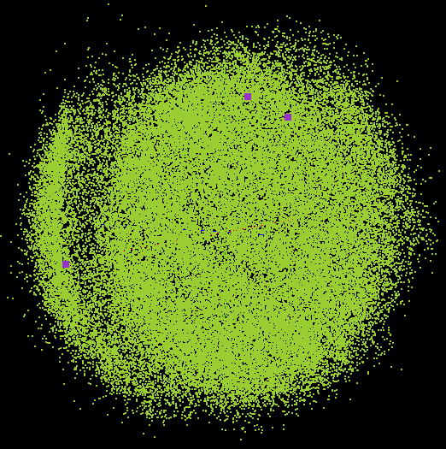
PlotViz Screenshot (III) - MDS

Slide 8
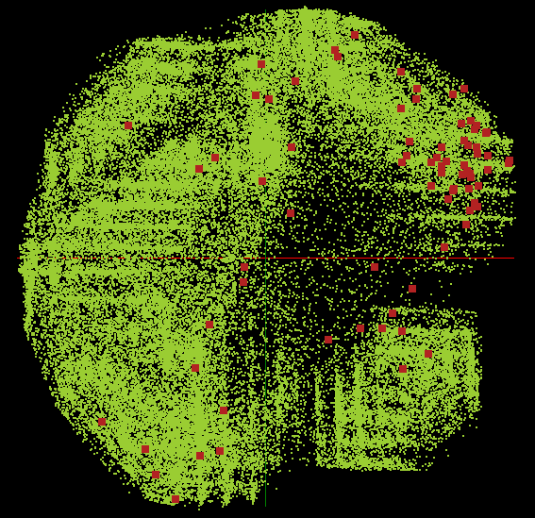
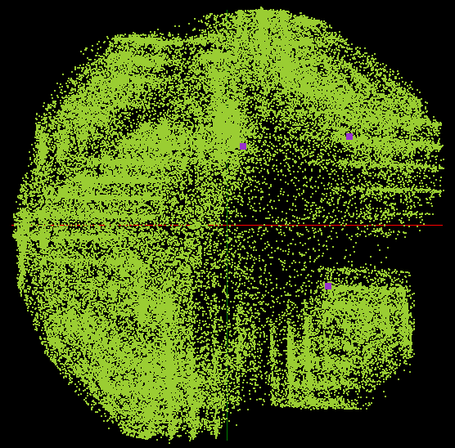
PlotViz Screenshot (IV) - GTM

Slide 9
Discussions
Relationship of disease <-> gene <-> PubChem
Fingerprint only vs. other properties
Data size : optimal size or limits
Suggested functions for PlotViz improvement

