Slide 1
Building a Library at the Nexus of High Performance Computing and Big Data
ScaDS and BBDC Big Data All-Hands-Meeting
June 2-3 2016 Dresden
https://www.scads.de/en/ahm-2016
Geoffrey Fox
June 3, 2016
gcf@indiana.edu
http://www.dsc.soic.indiana.edu/, http://spidal.org/ http://hpc-abds.org/kaleidoscope/
Department of Intelligent Systems Engineering
School of Informatics and Computing, Digital Science Center
Indiana University Bloomington

Slide 2
Abstract
Two major trends in computing systems are the growth in high performance computing (HPC) with an international exascale initiative, and the big data phenomenon with an accompanying cloud infrastructure of well publicized dramatic and increasing size and sophistication.
We describe a classification of applications that considers separately "data" and "model" and allows one to get a unified picture of large scale data analytics and large scale simulations. We introduce the High Performance Computing enhanced Apache Big Data software Stack HPC-ABDS and give several examples of advantageously linking HPC and ABDS. In particular we discuss a Scalable Parallel Interoperable Data Analytics Library SPIDAL that is being developed to embody these ideas. SPIDAL covers some core machine learning, image processing, graph, simulation data analysis and network science kernels.
We give examples of data analytics running on HPC systems including details on persuading Java to run fast.

Slide 3
Some Confusing Issues; Missing Requirements; Missing Consensus I
Different Problem Types
  Data Management v. Data Analytics
  Every problem has Data & Model; which is Big/Important?
  Streaming v Batch; Interactive v Batch
  Science Requirements v. Commercial Requirements; are they similar?; what are important problems ; how big are they and are they global or locally parallel?
Broad Execution Issues
  Pleasingly Parallel (Local Machine Learning) v. Global Machine Learning
  Fine grain v. Coarse Grain parallelism; workflow (dataflow with directed graph) v. parallel computing (tight synchronization and ~BSP))
  Threads v Processes
  Objects v files; HDFS v Lustre

Slide 4
Local and Global Machine Learning
Many applications use LML or Local machine Learning where machine learning (often from R or Python or Matlab) is run separately on every data item such as on every image
But others are GML Global Machine Learning where machine learning is a basic algorithm run over all data items (over all nodes in computer)
  maximum likelihood or χ² with a sum over the N data items – documents, sequences, items to be sold, images etc. and often links (point-pairs).
  GML includes Graph analytics, clustering/community detection, mixture models, topic determination, Multidimensional scaling, (Deep) Learning Networks
Note Facebook may need lots of small graphs (one per person and ~LML) rather than one giant graph of connected people (GML)

Slide 5
Some confusing issues; Missing Requirements; Missing Consensus II
Qualitative Aspects of Approach
  Need for Interdisciplinary Collaboration
  Trade-off between Performance and Productivity
  What about software sustainability? Should we do all with Apache?
  Academic v. Industry; who is leading?
Many choices in all parts of System
  Virtualization: HPC v Docker v OpenStack (OpenNebula)
  Apache Beam v. Kepler for orchestration and lots of other HPC v “Apache” or “Apache v Apache” choices e.g. Beam v. Crunch v. NiFi
  What Language should be used: Python/R/Matlab, C++, Java …
  350 Software systems in HPC-ABDS collection with lots of choice
  HPC simulation stack well defined and highly optimized; user makes few choices

Slide 6
Some confusing issues; Missing Requirements; Missing Consensus III
What is the appropriate hardware?
  Depends on answers to “what are requirements” and software choices
  What is flexible cost effective hardware; at universities? In public clouds?
  HPC v. HTC (high throughput) v. Cloud
  Value of GPU’s and other innovative node hardware
Miscellaneous Issues
  Big Data Performance analysis often rudimentary (compared to HPC)
  What is the Big Data Stack?
  Trade-off between “integrated systems” versus using a collection of independent components
  What are parallelization challenges? Library of “hand optimized” code versus automatic parallelization and domain specific libraries
  Can DevOps be used more systematically to promote interoperability
  Orchestration v. Management; TOSCA v. BPEL (Heat v. Beam)

Slide 7
Some confusing issues; Missing Requirements; Missing Consensus IV
Status of field
  What problems need to be solved?
  What is pretty universally agreed?
  What is understood (by some) but not broadly agreed?
  What is not understood and needs substantial more work?
  Is there an interesting Big Data Exascale Convergence?
  Role of Data Science? Curriculum of Data Science?
  Role of Benchmarks

Slide 8
SPIDAL Project
Datanet: CIF21 DIBBs: Middleware and High Performance Analytics Libraries for Scalable Data Science
NSF14-43054 started October 1, 2014
Indiana University (Fox, Qiu, Crandall, von Laszewski)
Rutgers (Jha)
Virginia Tech (Marathe)
Kansas (Paden)
Stony Brook (Wang)
Arizona State (Beckstein)
Utah (Cheatham)

Slide 9
Main Components of SPIDAL Project
NIST Big Data Application Analysis – features of data intensive Applications.
HPC-ABDS: Cloud-HPC interoperable software performance of HPC (High Performance Computing) and the rich functionality of the commodity Apache Big Data Stack.
  This is a reservoir of software subsystems – nearly all from outside the project and being a mix of HPC and Big Data communities.
  Leads to Big Data – Simulation – HPC Convergence.
MIDAS: Integrating Middleware – from project.
Applications: Biomolecular Simulations, Network and Computational Social Science, Epidemiology, Computer Vision, Geographical Information Systems, Remote Sensing for Polar Science and Pathology Informatics, Streaming for robotics, streaming stock analytics
SPIDAL (Scalable Parallel Interoperable Data Analytics Library): Scalable Analytics for:
  Domain specific data analytics libraries – mainly from project.
  Add Core Machine learning libraries – mainly from community.
  Performance of Java and MIDAS Inter- and Intra-node.
Implementations: HPC as well as clouds (OpenStack, Docker)

Slide 10
NIST Big Data Initiative
Use Cases and Properties
Led by Chaitin Baru, Bob Marcus, Wo Chang

Slide 11
51 Detailed Use Cases: Contributed July-September 2013
Covers goals, data features such as 3 V’s, software, hardware
26 Features for each use case
Biased to science
http://bigdatawg.nist.gov/usecases.php
https://bigdatacoursespring2014.appspot.com/course (Section 5)
Government Operation(4): National Archives and Records Administration, Census Bureau
Commercial(8): Finance in Cloud, Cloud Backup, Mendeley (Citations), Netflix, Web Search, Digital Materials, Cargo shipping (as in UPS)
Defense(3): Sensors, Image surveillance, Situation Assessment
Healthcare and Life Sciences(10): Medical records, Graph and Probabilistic analysis, Pathology, Bioimaging, Genomics, Epidemiology, People Activity models, Biodiversity
Deep Learning and Social Media(6): Driving Car, Geolocate images/cameras, Twitter, Crowd Sourcing, Network Science, NIST benchmark datasets
The Ecosystem for Research(4): Metadata, Collaboration, Language Translation, Light source experiments
Astronomy and Physics(5): Sky Surveys including comparison to simulation, Large Hadron Collider at CERN, Belle Accelerator II in Japan
Earth, Environmental and Polar Science(10): Radar Scattering in Atmosphere, Earthquake, Ocean, Earth Observation, Ice sheet Radar scattering, Earth radar mapping, Climate simulation datasets, Atmospheric turbulence identification, Subsurface Biogeochemistry (microbes to watersheds), AmeriFlux and FLUXNET gas sensors
Energy(1): Smart grid

Slide 12
Features of 51 Use Cases I
PP (26) “All” Pleasingly Parallel or Map Only
MR (18) Classic MapReduce MR (add MRStat below for full count)
MRStat (7) Simple version of MR where key computations are simple reduction as found in statistical averages such as histograms and averages
MRIter (23) Iterative MapReduce or MPI (Flink, Spark, Twister)
Graph (9) Complex graph data structure needed in analysis
Fusion (11) Integrate diverse data to aid discovery/decision making; could involve sophisticated algorithms or could just be a portal
Streaming (41) Some data comes in incrementally and is processed this way
Classify (30) Classification: divide data into categories
S/Q (12) Index, Search and Query

Slide 13
Features of 51 Use Cases II
CF (4) Collaborative Filtering for recommender engines
LML (36) Local Machine Learning (Independent for each parallel entity) – application could have GML as well
GML (23) Global Machine Learning: Deep Learning, Clustering, LDA, PLSI, MDS,
  Large Scale Optimizations as in Variational Bayes, MCMC, Lifted Belief Propagation, Stochastic Gradient Descent, L-BFGS, Levenberg-Marquardt . Can call EGO or Exascale Global Optimization with scalable parallel algorithm
Workflow (51) Universal
GIS (16) Geotagged data and often displayed in ESRI, Microsoft Virtual Earth, Google Earth, GeoServer etc.
HPC (5) Classic large-scale simulation of cosmos, materials, etc. generating (visualization) data
Agent (2) Simulations of models of data-defined macroscopic entities represented as agents

Slide 14
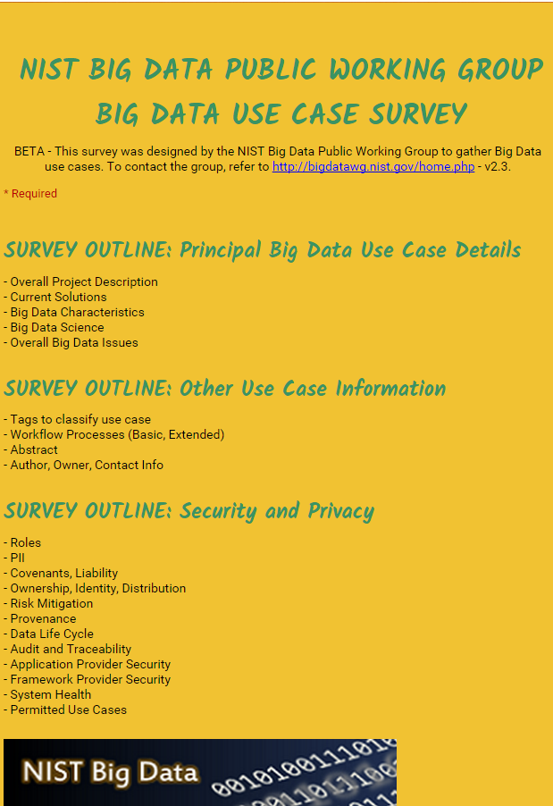
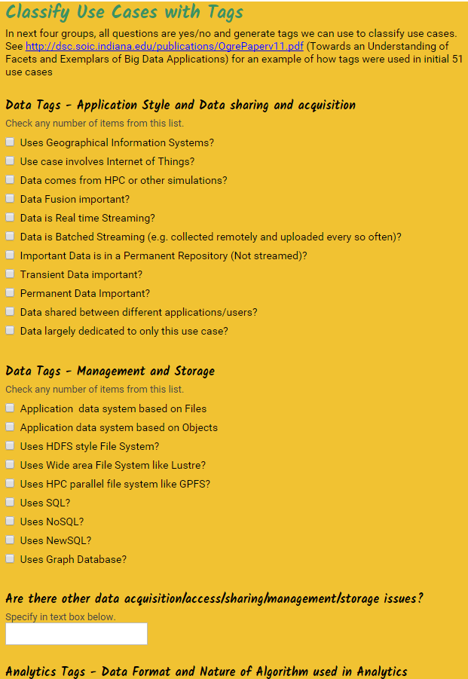
http://hpc-abds.org/kaleidoscope/survey/
Online Use Case Form

Slide 15
Other Use Case Discussions

Slide 16
7 Computational Giants of
NRC Massive Data Analysis Report
http://www.nap.edu/catalog.php?record_id=18374 Big Data Models?
G1: Basic Statistics e.g. MRStat
G2: Generalized N-Body Problems
G3: Graph-Theoretic Computations
G4: Linear Algebraic Computations
G5: Optimizations e.g. Linear Programming
G6: Integration e.g. LDA and other GML
G7: Alignment Problems e.g. BLAST

Slide 17
HPC (Simulation) Benchmark Classics
Linpack or HPL: Parallel LU factorization
for solution of linear equations
NPB version 1: Mainly classic HPC solver kernels
  MG: Multigrid
  CG: Conjugate Gradient
  FT: Fast Fourier Transform
  IS: Integer sort
  EP: Embarrassingly Parallel
  BT: Block Tridiagonal
  SP: Scalar Pentadiagonal
  LU: Lower-Upper symmetric Gauss Seidel
Simulation Models

Slide 18
13 Berkeley Dwarfs
Dense Linear Algebra
Sparse Linear Algebra
Spectral Methods
N-Body Methods
Structured Grids
Unstructured Grids
MapReduce
Combinational Logic
Graph Traversal
Dynamic Programming
Backtrack and
Branch-and-Bound
Graphical Models
Finite State Machines
Largely Models for Data or Simulation
First 6 of these correspond to Colella’s original. (Classic simulations)
Monte Carlo dropped.
N-body methods are a subset of Particle in Colella.
Note a little inconsistent in that MapReduce is a programming model and spectral method is a numerical method.
Need multiple facets to classify use cases!

Slide 19
Data and Model in Big Data and Simulations
Need to discuss Data and Model as problems combine them, but we can get insight by separating which allows better understanding of Big Data - Big Simulation “convergence” (or differences!)
Big Data implies Data is large but Model varies
  e.g. LDA with many topics or deep learning has large model
  Clustering or Dimension reduction can be quite small for model
Simulations can also be considered as Data and Model
  Model is solving particle dynamics or partial differential equations
  Data could be small when just boundary conditions
  Data large with data assimilation (weather forecasting) or when data visualizations are produced by simulation
Data often static between iterations (unless streaming); Model varies between iterations

Slide 20
Classifying Use cases

Slide 21
Classifying Use Cases
Take 51 NIST and other use cases → derive multiple specific features
Generalize and systematize with features termed “facets”
50 Facets (Big Data) termed Ogres divided into 4 sets or views where each view has “similar” facets
Add simulations and look separately at Data and Model gives 64 Facets describing Big Simulation and Data termed Convergence Diamonds
Allows one to study coverage of benchmark sets and architectures

Slide 23
4 Views of Ogres or
Convergence Diamonds
Macropatterns and Problem Architecture Views: Unchanged from Ogres
Execution View: Significant changes to separate Data and Model and add characteristics of Simulation models
Data Source and Style View: Same for Ogres and Diamonds – present but less important for Simulations compared to big data
Processing View is a mix of Big Data Processing View and Big Simulation Processing View and includes some facets like “uses linear algebra” needed in both: has specifics of key simulation kernels and in particular includes NAS Parallel Benchmarks and Berkeley Dwarfs

Slide 24
64 Features in 4 views for Unified Classification of Big Data and Simulation Applications
Both
Simulations
Analytics
(Model for Data)
(Nearly all Data)
(All Model)
(Mix of Data and Model)
(Nearly all Data+Model)

Slide 25
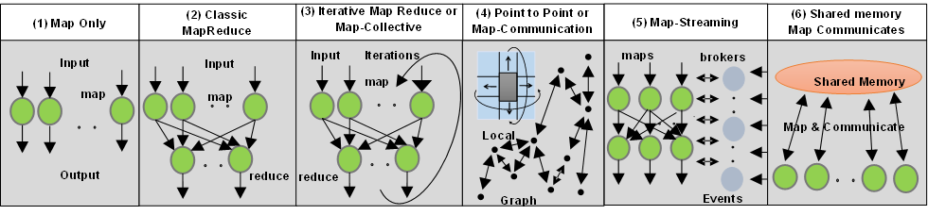
6 Forms of MapReduce
Cover “all” circumstances
Describes Architecture of
- Problem (Model reflecting data)
- Machine
- Software

Slide 26
64 Facets of Convergence Diamonds (skip detailed discussion)

Slide 27
HPC-ABDS

Slide 28
HPC-ABDS

Slide 29
Functionality of 21 HPC-ABDS Layers
Message Protocols:
Distributed Coordination:
Security & Privacy:
Monitoring:
IaaS Management from HPC to hypervisors:
DevOps:
Interoperability:
File systems:
Cluster Resource Management:
Data Transport:
A) File management
B) NoSQL
C) SQL
In-memory databases&caches / Object-relational mapping / Extraction Tools
Inter process communication Collectives, point-to-point, publish-subscribe, MPI:
A) Basic Programming model and runtime, SPMD, MapReduce:
B) Streaming:
A) High level Programming:
B) Frameworks
Application and Analytics:
Workflow-Orchestration:
Here are 21 functionalities. (including 11, 14, 15 subparts)
4 Cross cutting at top
17 in order of layered diagram starting at bottom

Slide 30
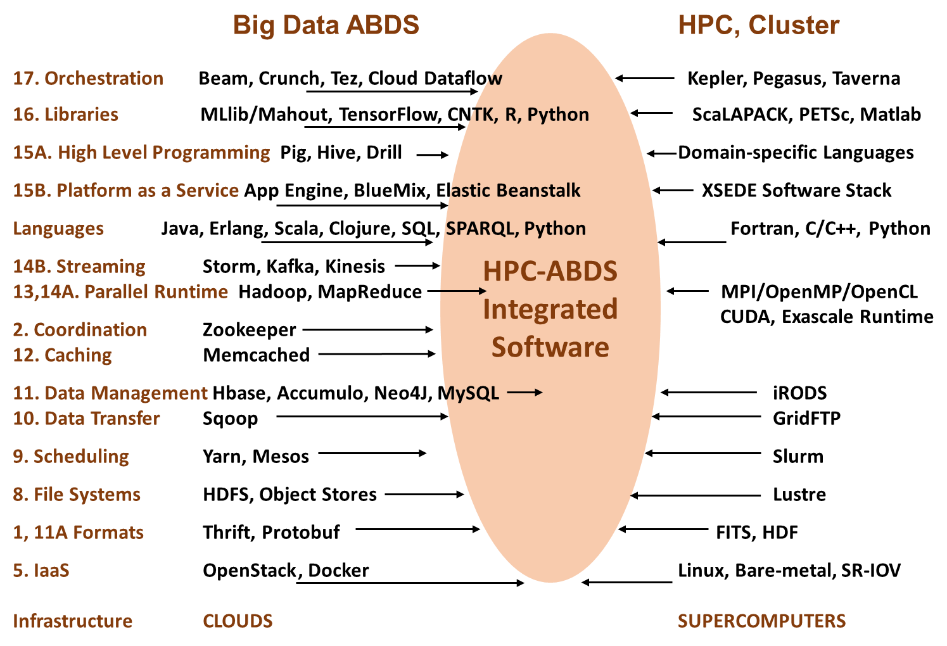

Slide 31
Implementing HPC-ABDS
Build HPC data analytics library – NSF14-43054 Dibbs SPIDAL building blocks
Define Java Grande as approach and runtime
Software Philosophy – enhance existing ABDS rather than building standalone software
  Use Heron, Storm, Hadoop, Spark, Flink, Hbase, Yarn, Mesos
  Define MPI to be best-possible inter-process communication; may need to enhance MPI distribution as HPC nearest neighbor and big data mainly collectives
Working with Apache; how should one do this?
  Establish a standalone HPC project
  Join existing Apache projects and contribute HPC enhancements
Experimenting first with Twitter (Apache) Heron to build HPC Heron that supports science use cases (big images) based on earlier Storm work

Slide 32
HPC-ABDS Mapping of Activities
Green is MIDAS
Black is SPIDAL
Level 17: Orchestration: Apache Beam (Google Cloud Dataflow) integrated with Cloudmesh on HPC cluster
Level 16: Applications: Datamining for molecular dynamics, Image processing for remote sensing and pathology, graphs, streaming, bioinformatics, social media, financial informatics, text mining
Level 16: Algorithms: Generic and custom for applications SPIDAL
Level 14: Programming: Storm, Heron (Twitter replaces Storm), Hadoop, Spark, Flink. Improve Inter- and Intra-node performance; science data structures
Level 13: Runtime Communication: Enhanced Storm and Hadoop (Spark, Flink, Giraph) using HPC runtime technologies, Harp
Level 11: Data management: Hbase and MongoDB integrated via use of Beam and other Apache tools; enhance Hbase
Level 9: Cluster Management: Integrate Pilot Jobs with Yarn, Mesos, Spark, Hadoop; integrate Storm and Heron with Slurm
Level 6: DevOps: Python Cloudmesh virtual Cluster Interoperability

Slide 33
Java Grande
Revisited on 3 data analytics codes
Clustering
Multidimensional Scaling
Latent Dirichlet Allocation all sophisticated algorithms

Slide 34
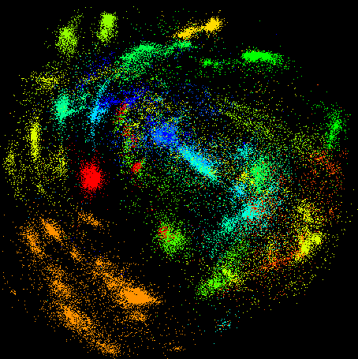
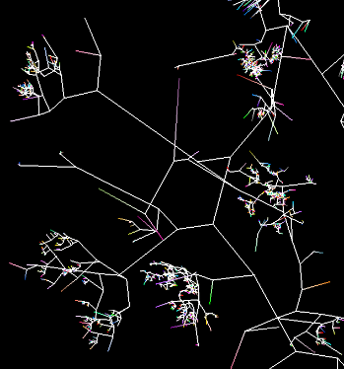
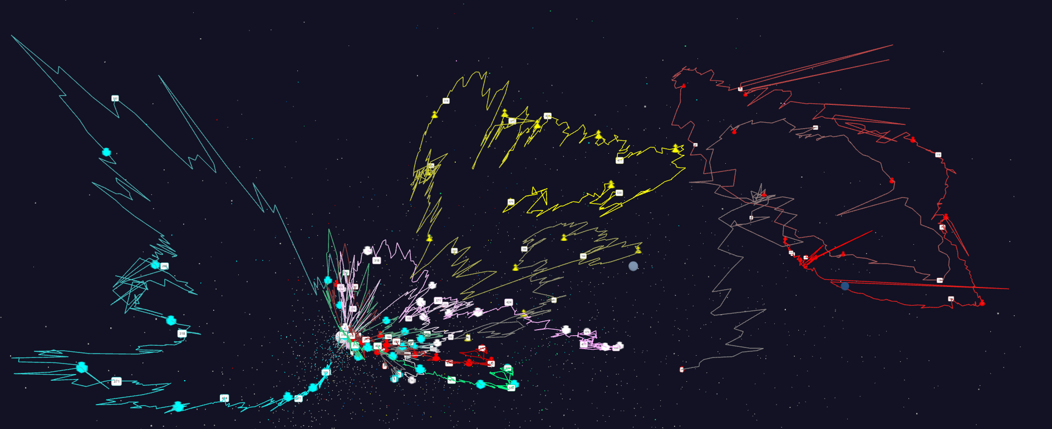
Some large scale analytics
100,000 fungi
Sequences
Eventually
120 clusters
3D phylogenetic
tree
Jan 1 2004 → December 2015
Daily Stock Time Series in 3D

Slide 35
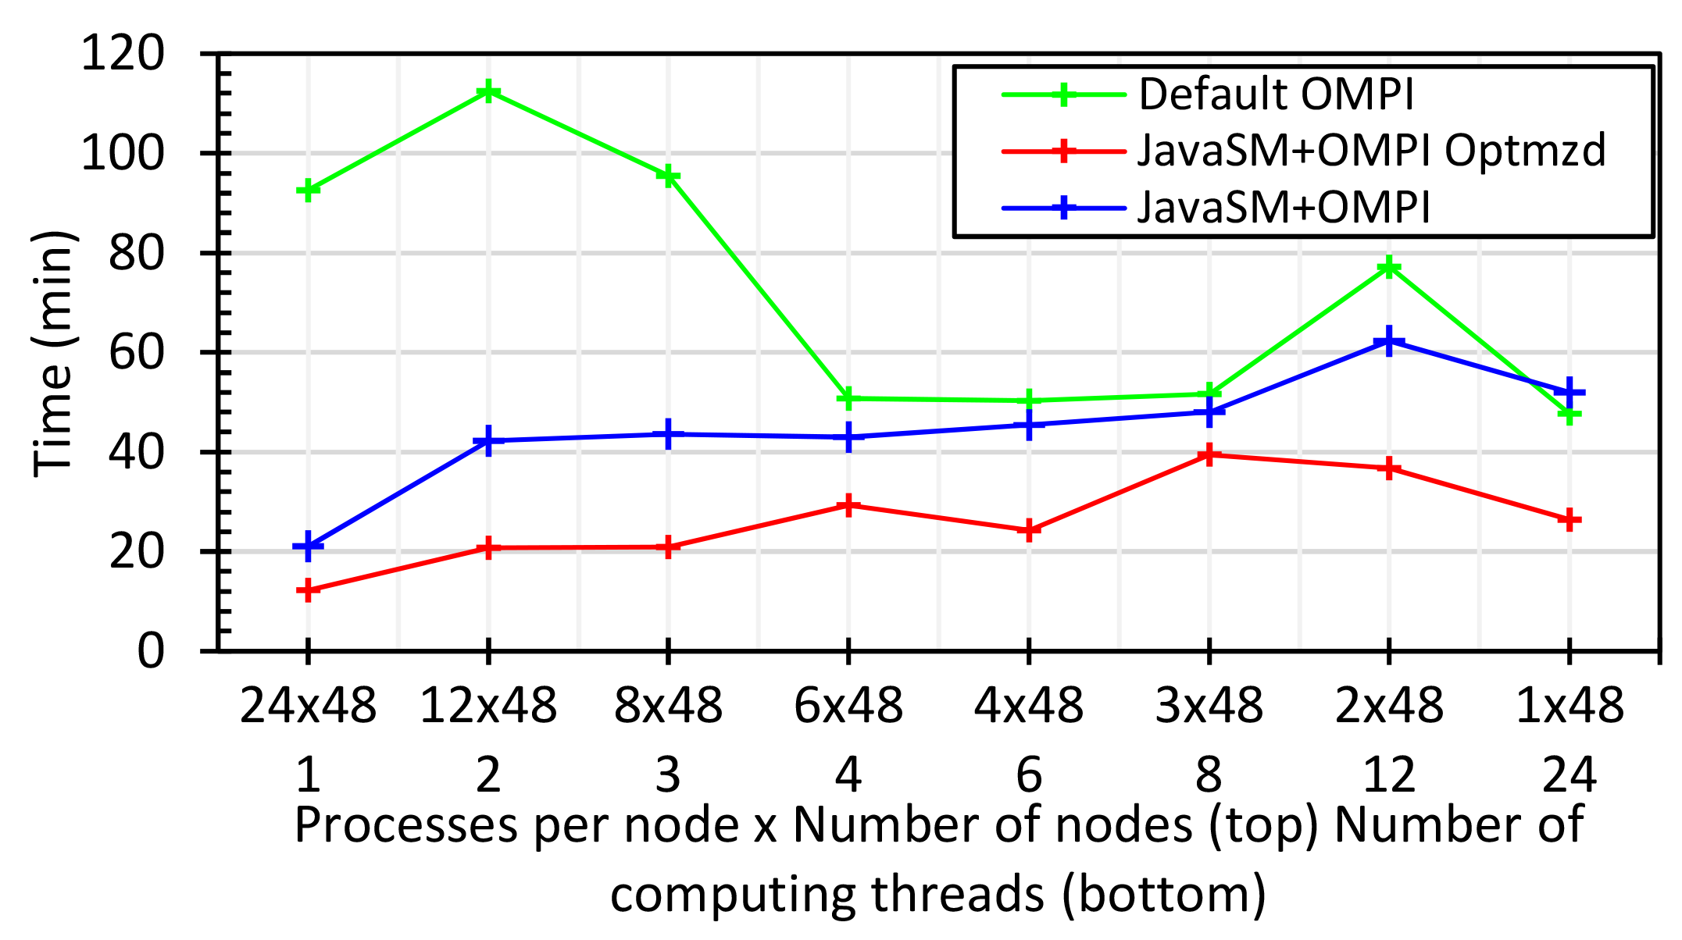
Java MPI performs better than Threads I
48 24 core Haswell nodes 200K DA-MDS Dataset size
Default MPI much worse than threads
Optimized MPI using shared memory node-based messaging is much better than threads

Slide 36

Java MPI performs better than Threads II
128 24 core Haswell nodes on SPIDAL DA-MDS Code
Speedup compared to 1 process per node on 48 nodes
Best MPI; inter and intra node
MPI; inter/intra node; Java not optimized
Best Threads intra node; MPI inter node

Slide 37
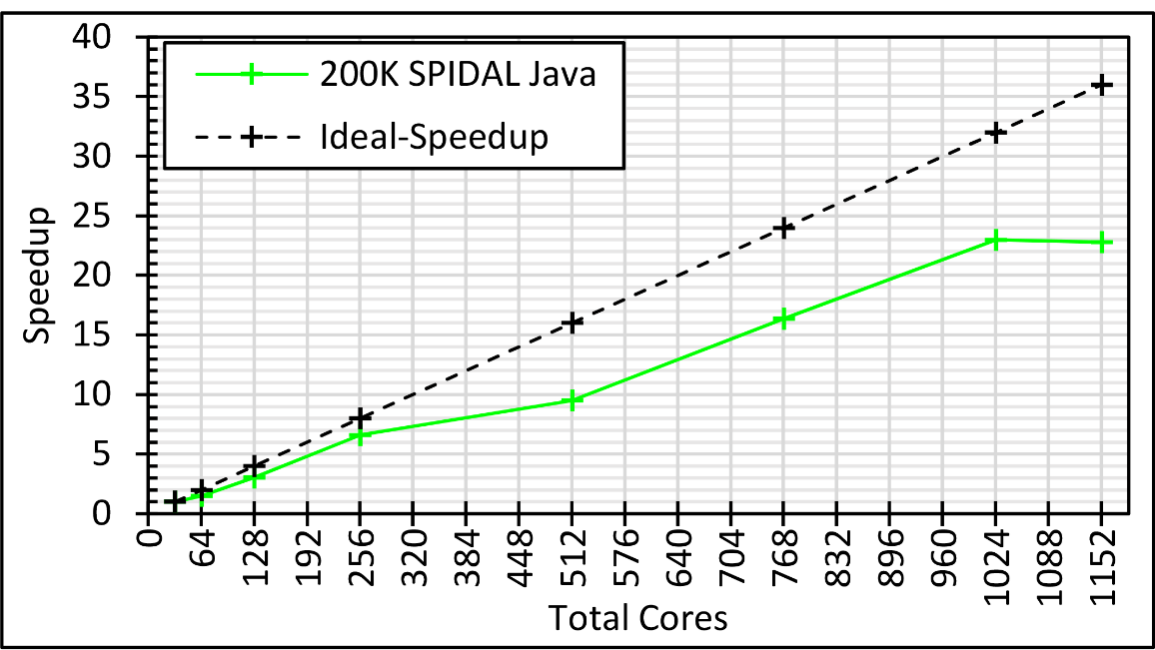
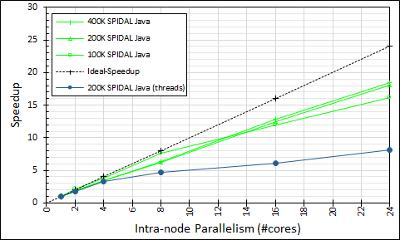
Intra-node Parallelism
All Processes: 32 nodes with 1-36 cores each; speedup compared to 32 nodes with 1 process; optimized Java
Processes (Green) and Threads (Blue) on 48 nodes with 1-24 cores; speedup compared to 48 nodes with 1 process; optimized Java

Slide 38
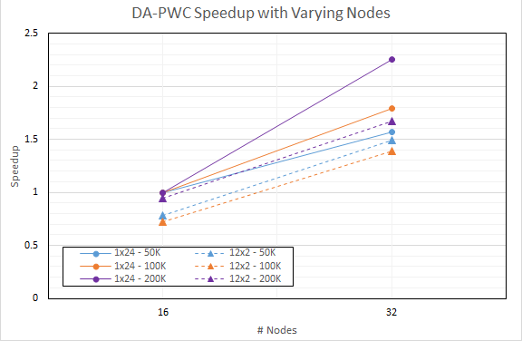
DA-PWC Non Vector Clustering
Speedup referenced to 1 Thread, 24 processes, 16 nodes
Increasing problem size
Circles 24 processes
Triangles: 12 threads, 2 processes on each node

Slide 39
Big Data Exascale convergence
1. Data + Model classification
2. Use HPC-ABDS on multiple hardware systems optimized for HTC HPC

Slide 40
DevOps

Slide 41
Cloudmesh Interoperability DevOps Tool
Model: Define software configuration with tools like Ansible; instantiate on a virtual cluster
An easy-to-use command line program/shell and portal to interface with heterogeneous infrastructures
  Supports OpenStack, AWS, Azure, SDSC Comet, virtualbox, libcloud supported clouds as well as classic HPC and Docker infrastructures
  Has an abstraction layer that makes it possible to integrate other IaaS frameworks
  Uses defaults that help interacting with various clouds
  Managing VMs across different IaaS providers is easy
  The client saves state between consecutive calls
Demonstrated interaction with various cloud providers:
  FutureSystems, Chameleon Cloud, Jetstream, CloudLab, Cybera, AWS, Azure, virtualbox
Status: AWS, and Azure, VirtualBox, Docker need improvements; we focus currently on Comet and NSF resources that use OpenStack
Currently evaluating 40 team projects from “Big Data Open Source Software Projects Class” which used this approach running on VirtualBox, Chameleon and FutureSystems
HPC Cloud Interoperability Layer

Slide 42
Constructing HPC-ABDS Exemplars
This is one of next steps in NIST Big Data Working Group
Philosophy: jobs will run on virtual clusters defined on variety of infrastructures: HPC, SDSC Comet, OpenStack, Docker, AWS, Virtualbox
Jobs are defined hierarchically as a combination of Ansible (preferred over Chef as Python) scripts
Scripts are invoked on Infrastructure (Cloudmesh Tool)
INFO 524 “Big Data Open Source Software Projects” IU Data Science class required final project to be defined in Ansible and decent grade required that script worked (On NSF Chameleon and FutureSystems)
  80 students gave 37 projects with ~20 pretty good such as
  “Machine Learning benchmarks on Hadoop with HiBench” Hadoop/YARN, Spark, Mahout, Hbase
  “Human and Face Detection from Video” Hadoop, Spark, OpenCV, Mahout, MLLib
Build up curated collection of Ansible scripts defining use cases for benchmarking, standards, education
Fall 2015 class INFO 523 was less constrained; 45 Projects: 91 technologies, 39 datasets

Slide 43
2. Perform real time analytics on data source streams and notify users when specified events occur
Specify filter
Filter Identifying Events
Fetch streamed Data
Post Selected Events
Streaming Data
Posted Data
Identified Events
Streaming Data
Streaming Data
Archive
Repository
Storm (Heron), Kafka, Hbase, Zookeeper

Slide 44



5. Perform interactive analytics on data in analytics-optimized database
Mahout, R SPIDAL
Hadoop, Spark, Flink, Giraph, Pig …
Data Storage: HDFS, Hbase, MongoDB
Data, Streaming, Batch …..

Slide 45
5A. Perform interactive analytics on observational scientific data
Science Analysis Code, Mahout, R, SPIDAL
Grid or Many Task Software, Hadoop, Spark, Giraph, Pig …
Data Storage: HDFS, Hbase, File Collection
Direct Transfer
Transport batch of data to primary analysis data system
Streaming Twitter data for Social Networking
Local Accumulate and initial computing
NIST examples include LHC, Remote Sensing, Astronomy and Bioinformatics
Record Scientific Data in “field”

Slide 46
Streaming Applications and Technology

Slide 47
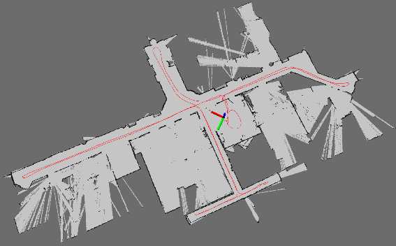
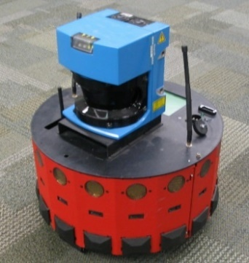
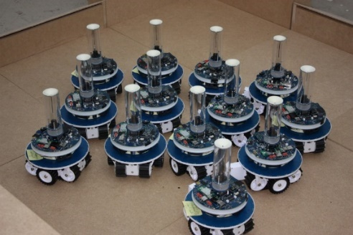
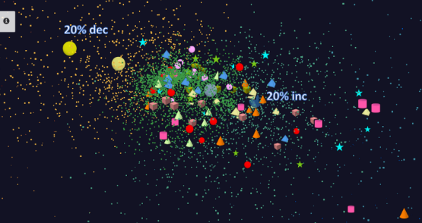
Adding HPC to Storm & Heron for Streaming
Robotics Applications
Time series data visualization in real time
Simultaneous Localization and Mapping
N-Body Collision
Avoidance
Map Built from
Robot data
Robot with a Laser Range Finder
Robots need to avoid collisions when they move
Map High dimensional data to 3D visualizer
Apply to Stock market data tracking 6000 stocks

Slide 48
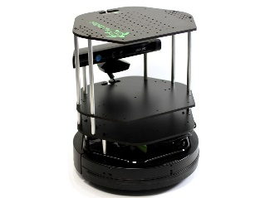
Data Pipeline
Sending to
pub-sub
Sending to
Persisting
storage
Multiple
streaming
workflows
Streaming
workflow
A stream application with some tasks running in parallel
Gateway
Message Brokers
RabbitMQ, Kafka
Streaming Workflows
Apache Heron and Storm
End to end delays without any processing is less than 10ms
Storm does not support “real parallel processing” within bolts – add optimized inter-bolt communication
Hosted on HPC and OpenStack cloud

Slide 49
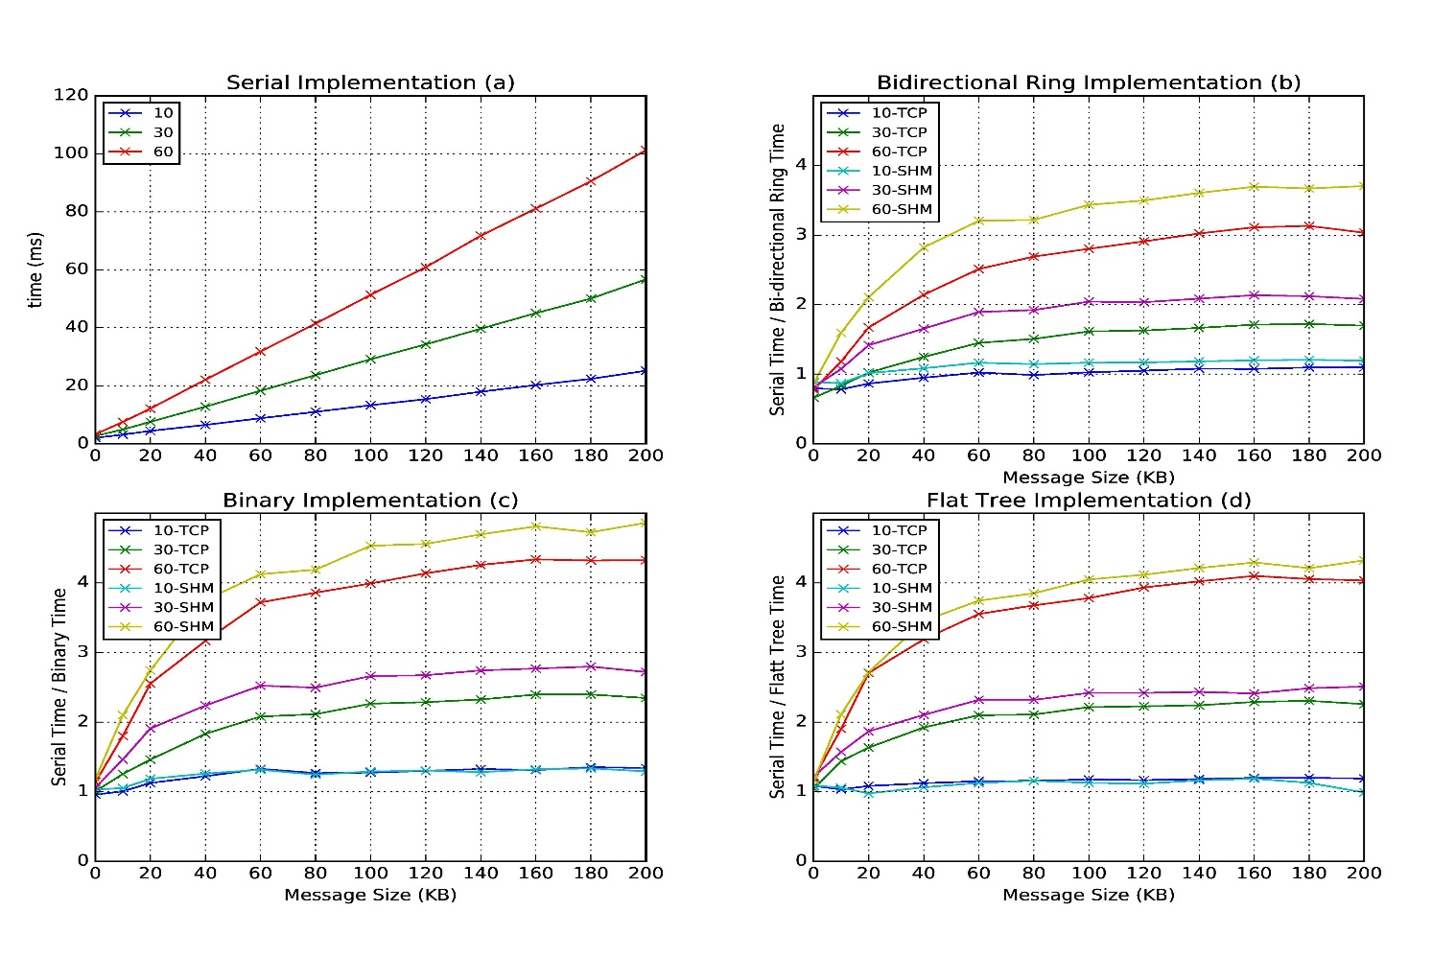
Improvement of Storm (Heron) using HPC communication algorithms

Slide 50
MIDAS

Slide 51
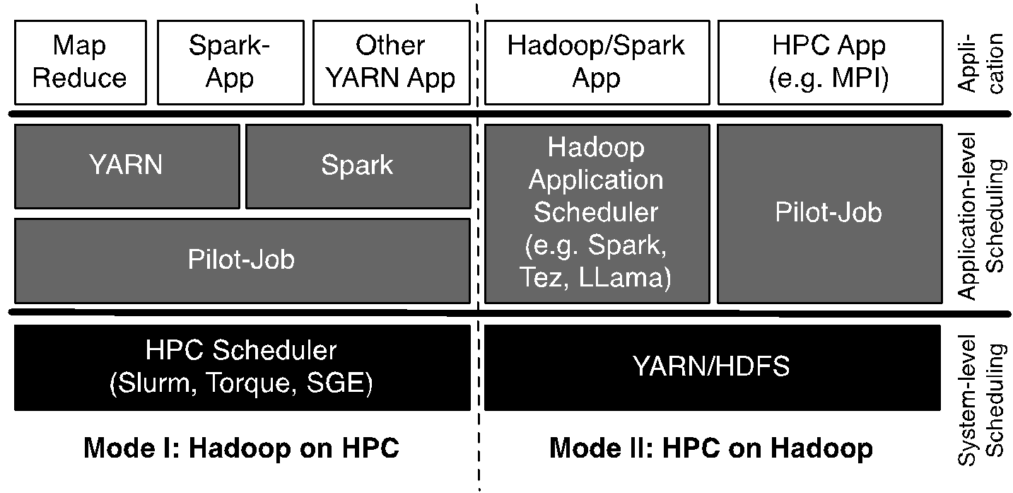
Pilot-Hadoop/Spark Architecture
HPC into Scheduling Layer
http://arxiv.org/abs/1602.00345

Slide 52
Harp (Hadoop Plugin) Implementations
Basic Harp: Iterative HPC communication; scientific data abstractions
Careful support of distributed data AND distributed model
Avoids parameter server approach but distributes model over worker nodes and supports collective communication to bring global model to each node
Applied first to Latent Dirichlet Allocation LDA with large model and data
HPC into Programming/communication Layer

Slide 53
SPIDAL Algorithms

Slide 54
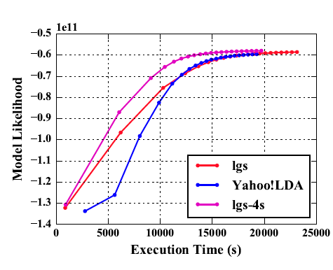
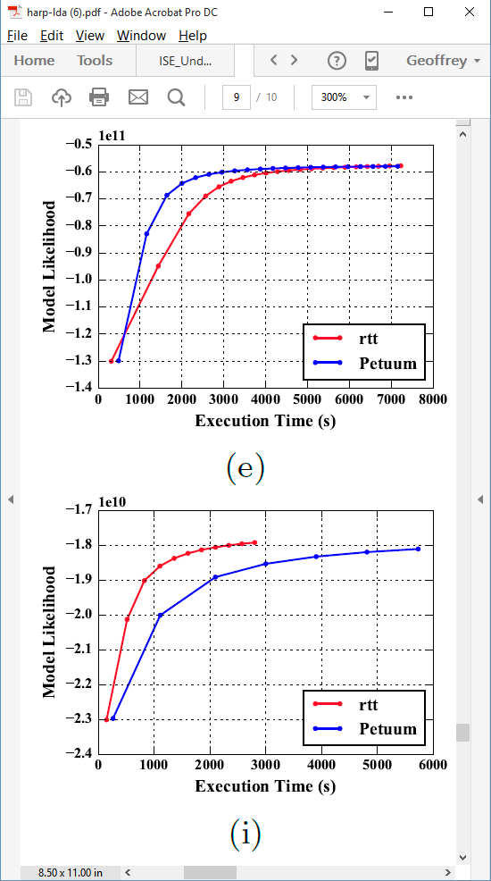
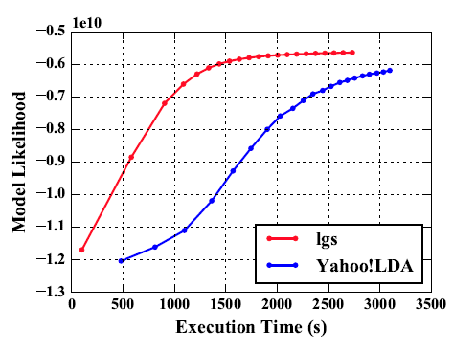
Latent Dirichlet Allocation on 100 Haswell nodes: red is Harp (lgs and rtt)
Clueweb
Clueweb
enwiki
Bi-gram

Slide 55
Harp LDA on Big Red II Supercomputer (Cray)
Harp LDA Scaling Tests
Harp LDA on Juliet (Intel Haswell)
  Big Red II: tested on 25, 50, 75, 100 and 125 nodes; each node uses 32 parallel threads; Gemini interconnect
  Juliet: tested on 10, 15, 20, 25, 30 nodes; each node uses 64 parallel threads on 36 core Intel Haswell nodes (each with 2 chips); Infiniband interconnect
Corpus: 3,775,554 Wikipedia documents, Vocabulary: 1 million words;
Topics: 10k topics; alpha: 0.01; beta: 0.01; iteration: 200

Slide 56
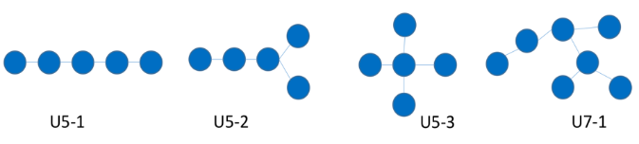
SPIDAL Algorithms – Subgraph mining
Finding patterns in graphs is very important
  Counting the number of embeddings of a given labeled/unlabeled template subgraph
  Finding the most frequent subgraphs/motifs efficiently from a given set of candidate templates
  Computing the graphlet frequency distribution.
Reworking existing parallel VT algorithm Sahad with MIDAS middleware giving HarpSahad which runs 5 (Google) to 9 (Miami) times faster than original Hadoop version
Work in progress
Templates
Datasets:
Network | No. Of Nodes (in million) | No. Of Edges (in million) | Size (MB)
Web-google | 0.9 | 4.3 | 65
Miami | 2.1 | 51.2 | 740

Slide 57
SPIDAL Algorithms – Random Graph Generation
Random graphs, important and needed with particular degree distribution and clustering coefficients.
  Preferential attachment (PA) model, Chung-Lu (CL), stochastic Kronecker, stochastic block model (SBM), and block two–level Erdos-Renyi (BTER)
  Generative algorithms for these models are mostly sequential and take a prohibitively long time to generate large-scale graphs.
SPIDAL working on developing efficient parallel algorithms for generating random graphs using different models with new DG method with low memory and high performance, almost optimal load balancing and excellent scaling.
  Algorithms are about 3-4 times faster than the previous ones.
  Generate a network with 250 billion edges in 12 seconds using 1024 processors.
Needs to be packaged for SPIDAL using MIDAS (currently MPI)

Slide 58
SPIDAL Algorithms – Triangle Counting
Triangle counting; important special case of subgraph mining and specialized programs can outperform general program
Previous work used Hadoop but MPI based PATRIC is much faster
SPIDAL version uses much more efficient decomposition (non-overlapping graph decomposition) – a factor of 25 lower memory than PATRIC
Next graph problem – Community detection
MPI version complete. Need to package for SPIDAL and add MIDAS -- Harp
SPIDAL

Slide 59
SPIDAL Algorithms – Core I
Several parallel core machine learning algorithms; need to add SPIDAL Java optimizations to complete parallel codes except MPI MDS
  https://www.gitbook.com/book/esaliya/global-machine-learning-with-dsc-spidal/details
O(N²) distance matrices calculation with Hadoop parallelism and various options (storage MongoDB vs. distributed files), normalization, packing to save memory usage, exploiting symmetry
WDA-SMACOF: Multidimensional scaling MDS is optimal nonlinear dimension reduction enhanced by SMACOF, deterministic annealing and Conjugate gradient for non-uniform weights. Used in many applications
  MPI (shared memory) and MIDAS (Harp) versions
MDS Alignment to optimally align related point sets, as in MDS time series
WebPlotViz data management (MongoDB) and browser visualization for 3D point sets including time series. Available as source or SaaS
MDS as χ² using Manxcat. Alternative more general but less reliable solution of MDS. Latest version of WDA-SMACOF usually preferable
Other Dimension Reduction: SVD, PCA, GTM to do

Slide 60
SPIDAL Algorithms – Core II
Latent Dirichlet Allocation LDA for topic finding in text collections; new algorithm with MIDAS runtime outperforming current best practice
DA-PWC Deterministic Annealing Pairwise Clustering for case where points aren’t in a vector space; used extensively to cluster DNA and proteomic sequences; improved algorithm over other published. Parallelism good but needs SPIDAL Java
DAVS Deterministic Annealing Clustering for vectors; includes specification of errors and limit on cluster sizes. Gives very accurate answers for cases where distinct clustering exists. Being upgraded for new LC-MS proteomics data with one million clusters in 27 million size data set
K-means basic vector clustering: fast and adequate where clusters aren’t needed accurately
Elkan’s improved K-means vector clustering: for high dimensional spaces; uses triangle inequality to avoid expensive distance calcs
Future work – Classification: logistic regression, Random Forest, SVM, (deep learning); Collaborative Filtering, TF-IDF search and Spark MLlib algorithms
Harp-DaaL extends Intel DAAL’s local batch mode to multi-node distributed modes
  Leveraging Harp’s benefits of communication for iterative compute models

Slide 61
SPIDAL Algorithms – Optimization I
Manxcat: Levenberg Marquardt Algorithm for non-linear χ² optimization with sophisticated version of Newton’s method calculating value and derivatives of objective function. Parallelism in calculation of objective function and in parameters to be determined. Complete – needs SPIDAL Java optimization
Viterbi algorithm, for finding the maximum a posteriori (MAP) solution for a Hidden Markov Model (HMM). The running time is O(n*s^2) where n is the number of variables and s is the number of possible states each variable can take. We will provide an "embarrassingly parallel" version that processes multiple problems (e.g. many images) independently; parallelizing within the same problem not needed in our application space. Needs Packaging in SPIDAL
Forward-backward algorithm, for computing marginal distributions over HMM variables. Similar characteristics as Viterbi above. Needs Packaging in SPIDAL

Slide 62
SPIDAL Algorithms – Optimization II
Loopy belief propagation (LBP) for approximately finding the maximum a posteriori (MAP) solution for a Markov Random Field (MRF). Here the running time is O(n^2*s^2*i) in the worst case where n is number of variables, s is number of states per variable, and i is number of iterations required (which is usually a function of n, e.g. log(n) or sqrt(n)). Here there are various parallelization strategies depending on values of s and n for any given problem.
  We will provide two parallel versions: embarrassingly parallel version for when s and n are relatively modest, and parallelizing each iteration of the same problem for common situation when s and n are quite large so that each iteration takes a long time relative to number of iterations required.
  Needs Packaging in SPIDAL
Markov Chain Monte Carlo (MCMC) for approximately computing marking distributions and sampling over MRF variables. Similar to LBP with the same two parallelization strategies. Needs Packaging in SPIDAL

Slide 63
Applications
And some algorithms

Slide 64
Imaging Applications: Remote Sensing, Pathology, Spatial Systems
Both Pathology/Remote sensing working on 2D moving to 3D images
Each pathology image could have 10 billion pixels, and we may extract a million spatial objects per image and 100 million features (dozens to 100 features per object) per image. We often tile the image into 4K x 4K tiles for processing. We develop buffering-based tiling to handle boundary-crossing objects. For each typical study, we may have hundreds to thousands of pathology images
Remote sensing aimed at radar images of ice and snow sheets; as data from aircraft flying in a line, we can stack radar 2D images to get 3D
2D problems need modest parallelism “intra-image” but often need parallelism over images
3D problems need parallelism for an individual image
Use Optimization algorithms to support applications (e.g. Markov Chain, Integer Programming, Bayesian Maximum a posteriori, variational level set, Euler-Lagrange Equation)
Classification (deep learning convolution neural network, SVM, random forest, etc.) will be important

Slide 65
The end.
Applications continue
And some algorithms

Slide 66
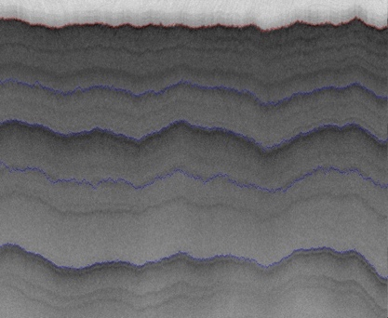
2D Radar Polar Remote Sensing
Need to estimate structure of earth (ice, snow, rock) from radar signals from plane in 2 or 3 dimensions.
Original 2D analysis ([11])used Hidden Markov Methods; better results using MCMC (our solution)
Extending to snow radar layers

Slide 67
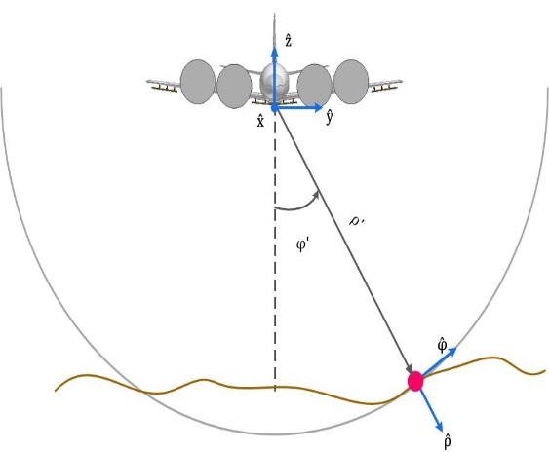
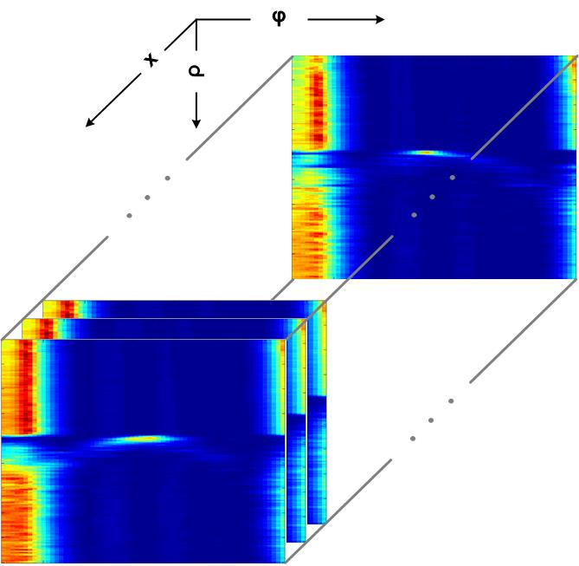
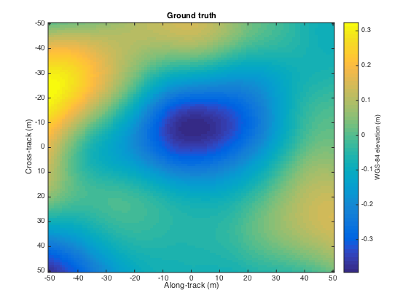
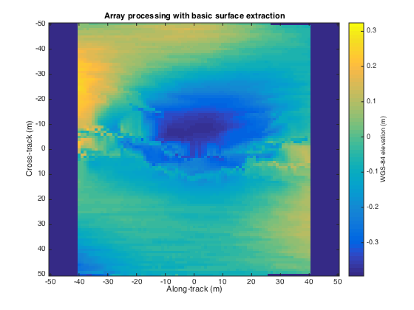
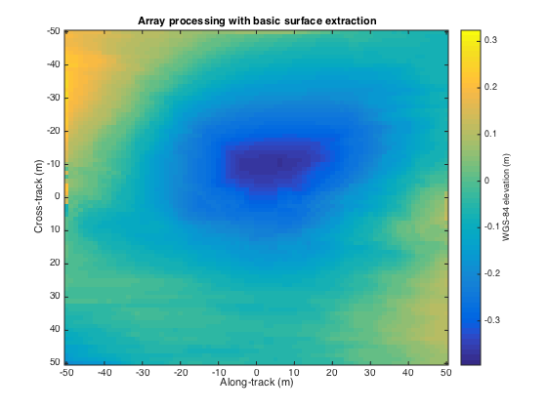
3D Radar Polar Remote Sensing
Uses LBP to analyze 3D radar images
Radar gives a cross-section view, parameterized by angle and range, of the ice structure, which yields a set of 2-d tomographic slices (right) along the flight path.
Each image represents a 3d depth map, with along track and cross track dimensions on the x-axis and y-axis respectively, and depth coded as colors.
Reconstructing bedrock in 3D, for (left) ground truth, (center) existing algorithm based on maximum likelihood estimators, and (right) our technique based on a Markov Random Field formulation.

Slide 68
Algorithms – Nuclei Segmentation for Pathology Images
Segment boundaries of nuclei from pathology
images and extract features for each nucleus
Consist of tiling, segmentation,
vectorization, boundary object aggregation
Could be executed on MapReduce
(MIDAS Harp)
Execution pipeline on MapReduce (MIDAS Harp)
Nuclear segmentation algorithm

Slide 69
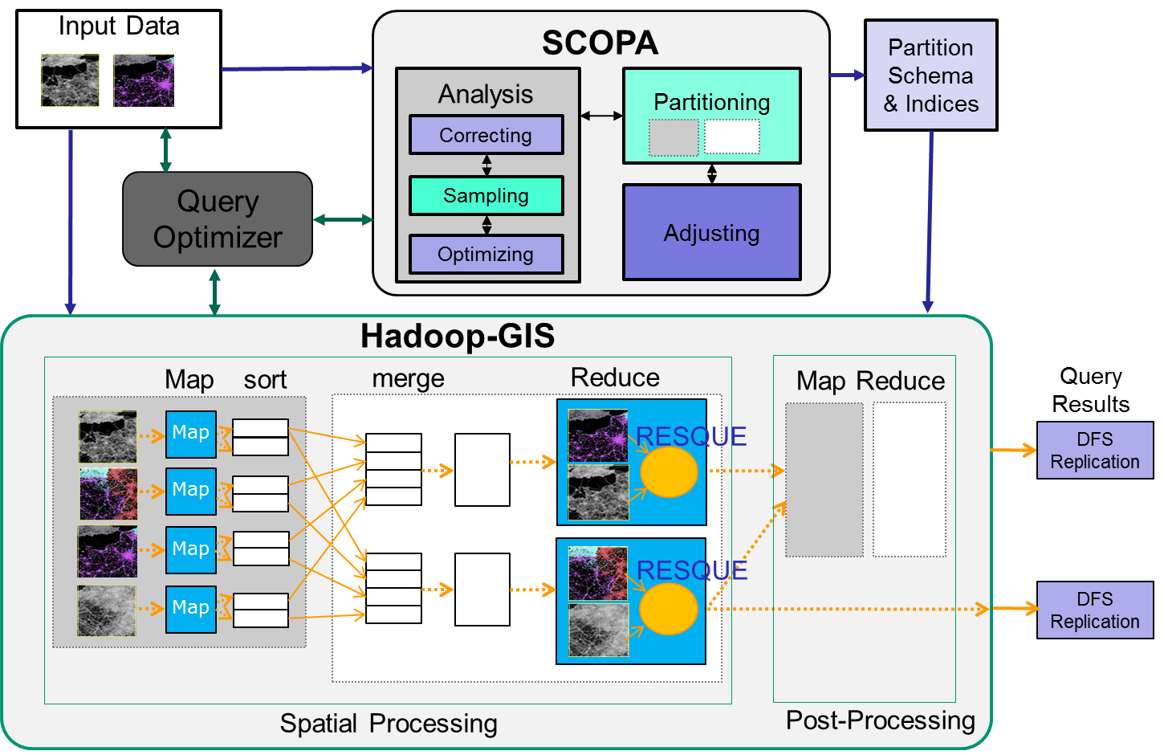
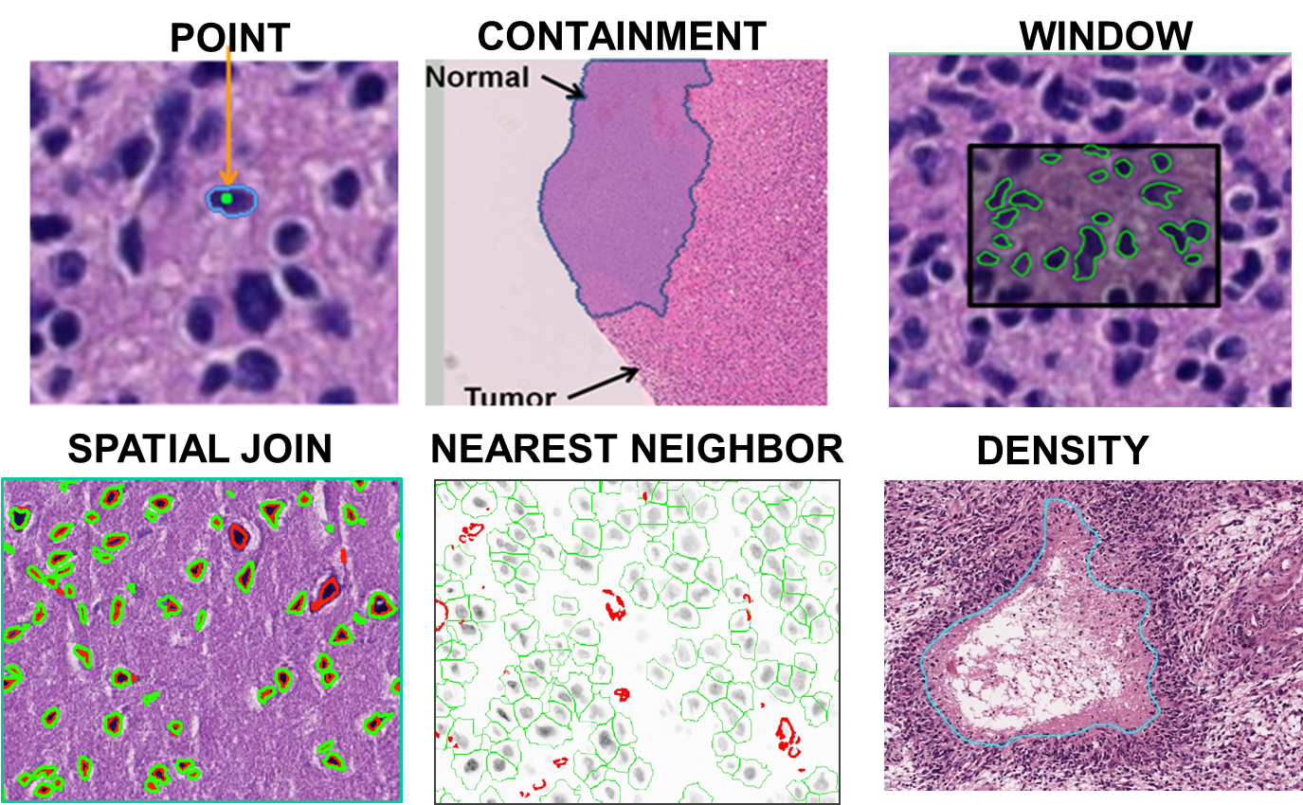
Algorithms – Spatial Querying Methods
Hadoop-GIS is a general framework to support high performance spatial queries and analytics for spatial big data on MapReduce.
It supports multiple types of spatial queries on MapReduce through spatial partitioning, customizable spatial query engine and on-demand indexing.
SparkGIS is a variation of Hadoop-GIS which runs on Spark to take advantage of in-memory processing.
Will extend Hadoop/Spark to Harp MIDAS runtime.
2D complete; 3D in progress
Spatial Queries
Architecture of Spatial Query Engine

Slide 70
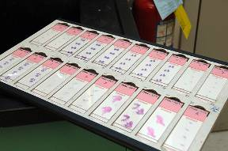
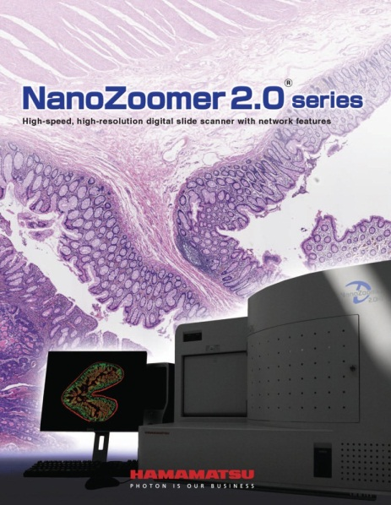
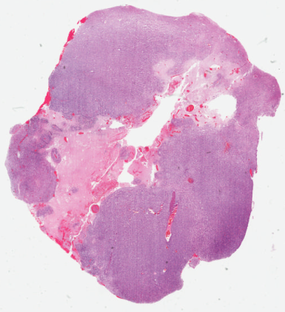
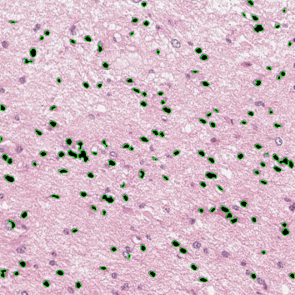
Enabled Applications – Digital Pathology
Glass Slides
Scanning
Whole Slide Images
Image Analysis
Digital pathology images scanned from human tissue specimens provide rich information about morphological and functional characteristics of biological systems.
Pathology image analysis has high potential to provide diagnostic assistance, identify therapeutic targets, and predict patient outcomes and therapeutic responses.
It relies on both pathology image analysis algorithms and spatial querying methods.
Extremely large image scale.

Slide 71
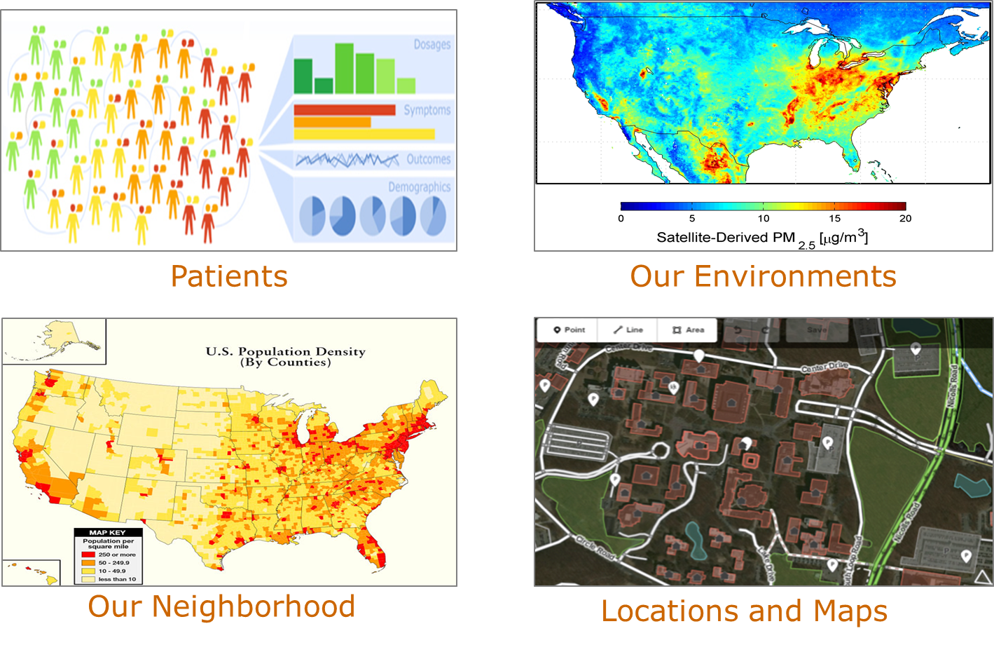
Applications – Public Health
GIS-oriented public health research has a strong focus on the locations of patients and the agents of disease, and studies the spatial patterns and variations.
Integrating multiple spatial big data sources at fine spatial resolutions allow public health researchers and health officials to adequately identify, analyze, and monitor health problems at the community level.
This will rely on high performance spatial querying methods on data integration.
Note synergy between GIS and Large image processing as in pathology.

Slide 72
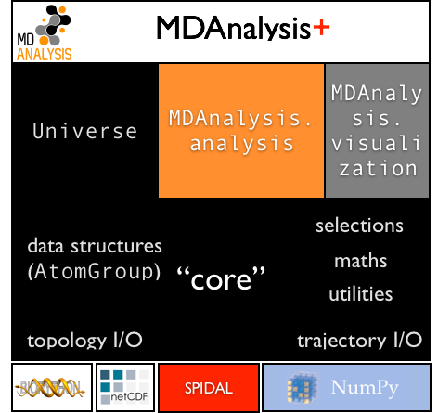
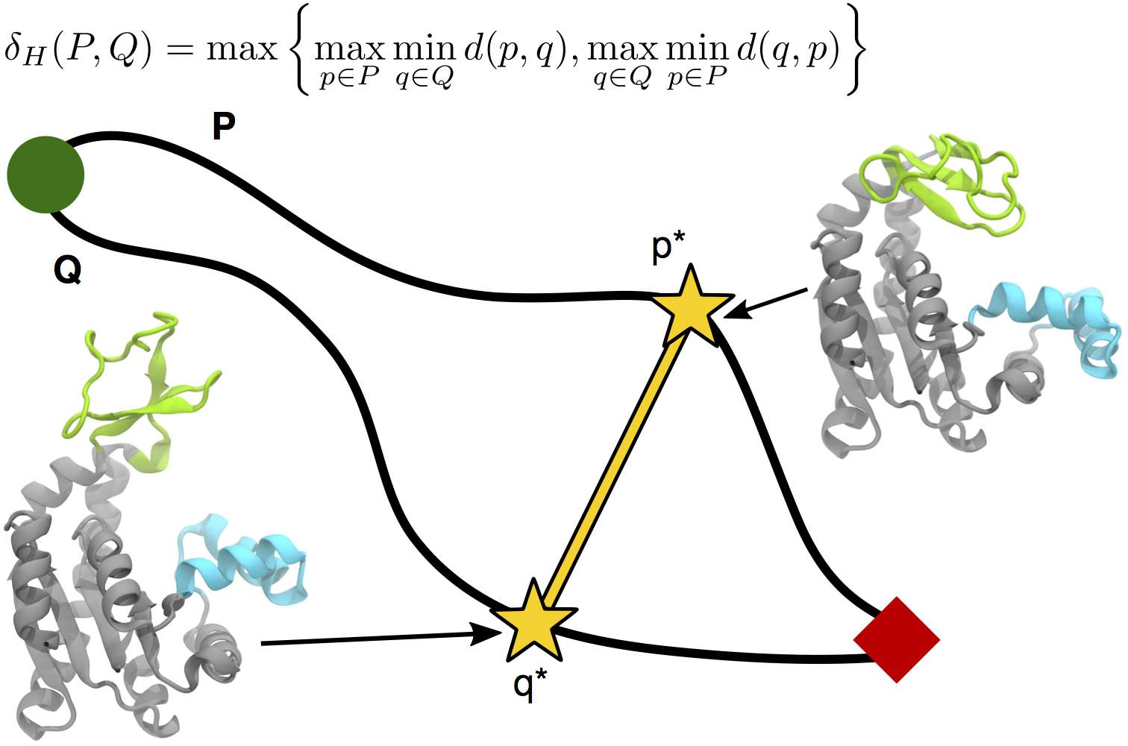
Biomolecular Simulation Data Analysis
Utah (CPPTraj), Arizona State (MDAnalysis), Rutgers
Parallelize key algorithms including O(N²) distance computations between trajectories
Integrate SPIDAL O(N²) distance and clustering libraries
Path Similarity Analysis (PSA) with Hausdorff distance

Slide 73
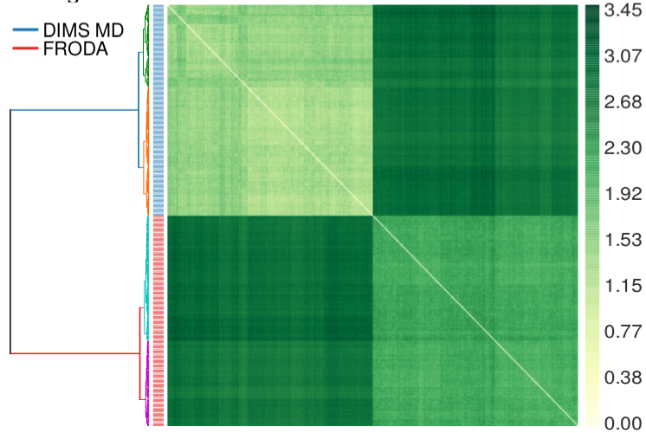
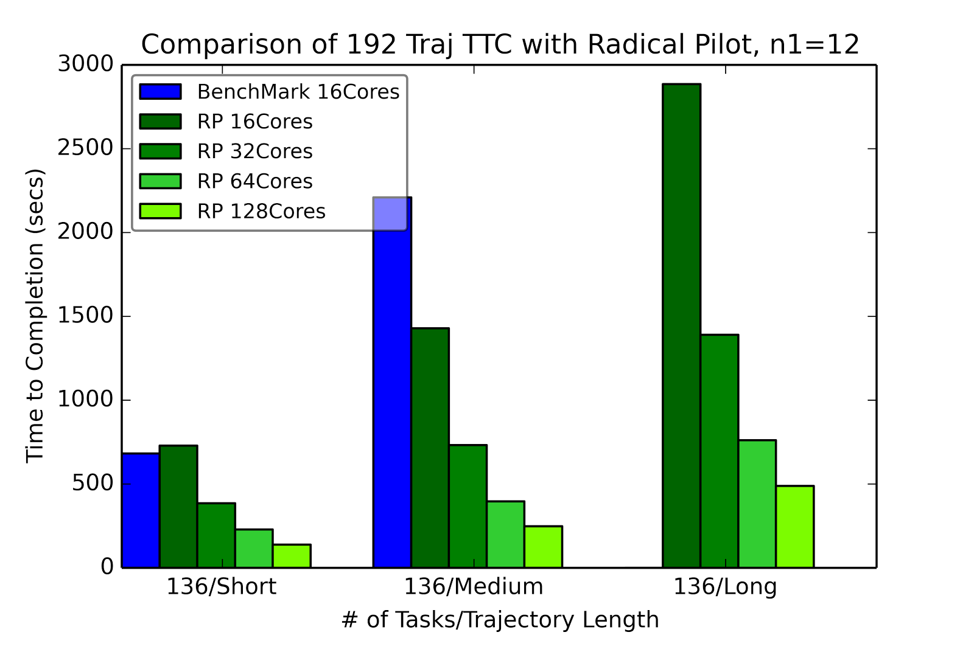
RADICAL-Pilot Hausdorff distance: all-pairs problem
Clustered distances for two methods for sampling macromolecular transitions (200 trajectories each) showing that both methods produce distinctly different pathways.
RADICAL Pilot benchmark run for three different test sets of trajectories, using 12x12 “blocks” per task.

Slide 74
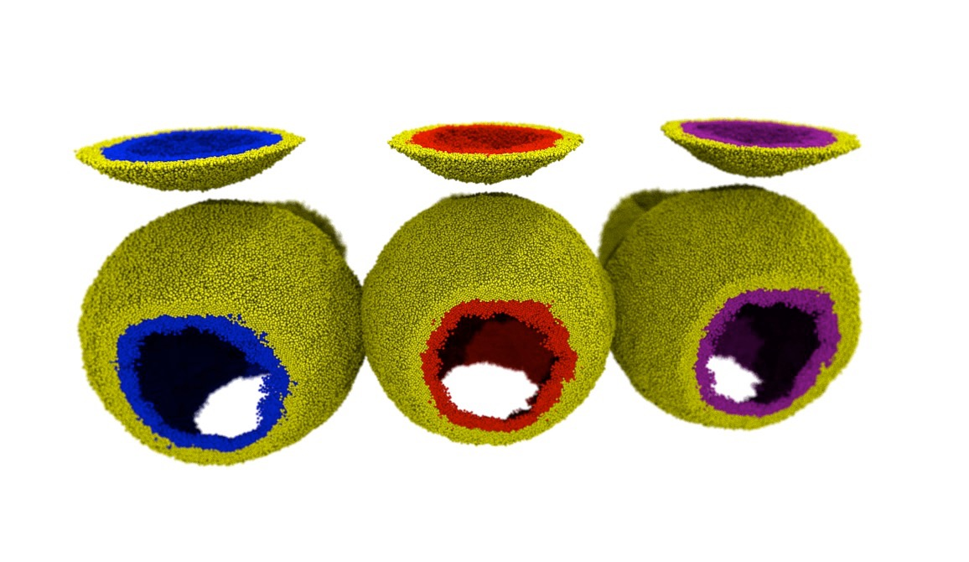
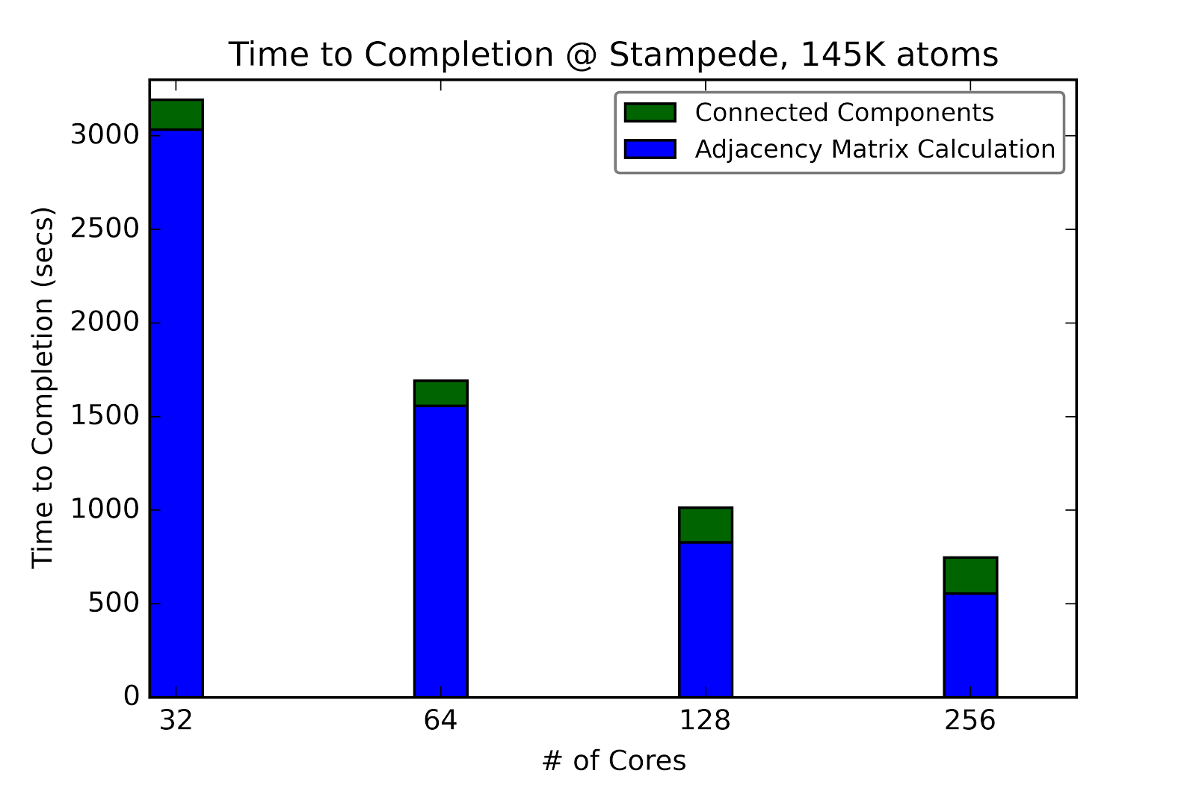
Classification of lipids in membranes
Biological membranes are lipid bilayers with distinct inner and outer surfaces that are formed by lipid mono layers (leaflets). Movement of lipids between leaflets or change of topology (merging of leaflets during fusion events) is difficult to detect in simulations.
Lipids colored by leaflet
Same color: continuous leaflet.

Slide 75
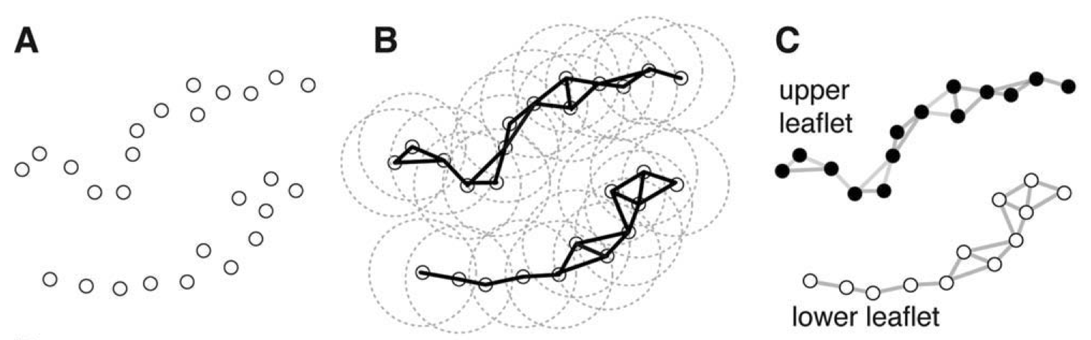
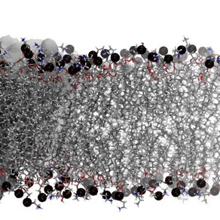
LeafletFinder
LeafletFinder is a graph-based algorithm to detect continuous lipid membrane leaflets in a MD simulation*. The current implementation is slow and does not work well for large systems (>100,000 lipids).
Phosphate atom coordinates
Build nearest-neighbors adjacency matrix
Find largest connected subgraphs
* N. Michaud-Agrawal, E. J. Denning, T. B. Woolf, and O. Beckstein. MDAnalysis: A toolkit for the analysis of molecular dynamics simulations. J Comp Chem, 32:2319–2327, 2011.

Slide 76
64 Facets of Convergence Diamonds

Slide 77
Problem Architecture View (Meta or MacroPatterns)
Pleasingly Parallel – as in BLAST, Protein docking, some (bio-)imagery including Local Analytics or Machine Learning – ML or filtering pleasingly parallel, as in bio-imagery, radar images (pleasingly parallel but sophisticated local analytics)
Classic MapReduce: Search, Index and Query and Classification algorithms like collaborative filtering (G1 for MRStat in Features, G7)
Map-Collective: Iterative maps + communication dominated by “collective” operations as in reduction, broadcast, gather, scatter. Common datamining pattern
Map-Point to Point: Iterative maps + communication dominated by many small point to point messages as in graph algorithms
Map-Streaming: Describes streaming, steering and assimilation problems
Shared Memory: Some problems are asynchronous and are easier to parallelize on shared rather than distributed memory – see some graph algorithms
SPMD: Single Program Multiple Data, common parallel programming feature
BSP or Bulk Synchronous Processing: well-defined compute-communication phases
Fusion: Knowledge discovery often involves fusion of multiple methods.
Dataflow: Important application features often occurring in composite Ogres
Use Agents: as in epidemiology (swarm approaches) This is Model only
Workflow: All applications often involve orchestration (workflow) of multiple components
Most (11 of total 12) are properties of Data+Model
Notes:
Big dwarfs are Ogres
Implement Ogres in ABDS+

Slide 78
Diamond Facets in Processing (runtime) View I used in Big Data and Big Simulation
Pr-1M Micro-benchmarks ogres that exercise simple features of hardware such as communication, disk I/O, CPU, memory performance
Pr-2M Local Analytics executed on a single core or perhaps node
Pr-3M Global Analytics requiring iterative programming models (G5,G6) across multiple nodes of a parallel system
Pr-12M Uses Linear Algebra common in Big Data and simulations
  Subclasses like Full Matrix
  Conjugate Gradient, Krylov, Arnoldi iterative subspace methods
  Structured and unstructured sparse matrix methods
Pr-13M Graph Algorithms (G3) Clear important class of algorithms -- as opposed to vector, grid, bag of words etc. – often hard especially in parallel
Pr-14M Visualization is key application capability for big data and simulations
Pr-15M Core Libraries Functions of general value such as Sorting, Math functions, Hashing
Notes:
Big dwarfs are Ogres
Implement Ogres in ABDS+

Slide 79
Diamond Facets in Processing (runtime) View II used in Big Data
Pr-4M Basic Statistics (G1): MRStat in NIST problem features
Pr-5M Recommender Engine: core to many e-commerce, media businesses; collaborative filtering key technology
Pr-6M Search/Query/Index: Classic database which is well studied (Baru, Rabl tutorial)
Pr-7M Data Classification: assigning items to categories based on many methods
  MapReduce good in Alignment, Basic statistics, S/Q/I, Recommender, Classification
Pr-8M Learning of growing importance due to Deep Learning success in speech recognition etc..
Pr-9M Optimization Methodology: overlapping categories including
  Machine Learning, Nonlinear Optimization (G6), Maximum Likelihood or χ² least squares minimizations, Expectation Maximization (often Steepest descent), Combinatorial Optimization, Linear/Quadratic Programming (G5), Dynamic Programming
Pr-10M Streaming Data or online Algorithms. Related to DDDAS (Dynamic Data-Driven Application Systems)
Pr-11M Data Alignment (G7) as in BLAST compares samples with repository
Notes:
Big dwarfs are Ogres
Implement Ogres in ABDS+

Slide 80
Diamond Facets in Processing (runtime) View III used in Big Simulation
Pr-16M Iterative PDE Solvers: Jacobi, Gauss Seidel etc.
Pr-17M Multiscale Method? Multigrid and other variable resolution approaches
Pr-18M Spectral Methods as in Fast Fourier Transform
Pr-19M N-body Methods as in Fast multipole, Barnes-Hut
Pr-20M Both Particles and Fields as in Particle in Cell method
Pr-21M Evolution of Discrete Systems as in simulation of Electrical Grids, Chips, Biological Systems, Epidemiology. Needs Ordinary Differential Equation solvers
Pr-22M Nature of Mesh if used: Structured, Unstructured, Adaptive
Covers NAS Parallel Benchmarks and Berkeley Dwarfs
Notes:
Big dwarfs are Ogres
Implement Ogres in ABDS+

Slide 81
Data Source and Style Diamond View I
SQL NewSQL or NoSQL: NoSQL includes Document,
Column, Key-value, Graph, Triple store; NewSQL is SQL redone to exploit NoSQL performance
Other Enterprise data systems: 10 examples from NIST integrate SQL/NoSQL
Set of Files or Objects: as managed in iRODS and extremely common in scientific research
File systems, Object, Blob and Data-parallel (HDFS) raw storage: Separated from computing or colocated? HDFS v Lustre v. Openstack Swift v. GPFS
Archive/Batched/Streaming: Streaming is incremental update of datasets with new algorithms to achieve real-time response (G7); Before data gets to compute system, there is often an initial data gathering phase which is characterized by a block size and timing. Block size varies from month (Remote Sensing, Seismic) to day (genomic) to seconds or lower (Real time control, streaming)
  Streaming divided into categories overleaf
Notes:
Big dwarfs are Ogres
Implement Ogres in ABDS+

Slide 82
Data Source and Style Diamond View II
  Streaming divided into 5 categories depending on event size and synchronization and integration
  Set of independent events where precise time sequencing unimportant.
  Time series of connected small events where time ordering important.
  Set of independent large events where each event needs parallel processing with time sequencing not critical
  Set of connected large events where each event needs parallel processing with time sequencing critical.
  Stream of connected small or large events to be integrated in a complex way.
Shared/Dedicated/Transient/Permanent: qualitative property of data; Other characteristics are needed for permanent auxiliary/comparison datasets and these could be interdisciplinary, implying nontrivial data movement/replication
Metadata/Provenance: Clear qualitative property but not for kernels as important aspect of data collection process
Internet of Things: 24 to 50 Billion devices on Internet by 2020
HPC simulations: generate major (visualization) output that often needs to be mined
Using GIS: Geographical Information Systems provide attractive access to geospatial data
Notes:
Big dwarfs are Ogres
Implement Ogres in ABDS+

Slide 83
Big Data Exascale convergence

Slide 84
Big Data and (Exascale) Simulation Convergence I
Our approach to Convergence is built around two ideas that avoid addressing the hardware directly as with modern DevOps technology it isn’t hard to retarget applications between different hardware systems.
Rather we approach Convergence through applications and software.
Convergence Diamonds Convergence unify Big Simulation and Big Data applications and so allow one to more easily identify good approaches to implement Big Data and Exascale applications in a uniform fashion.
Software convergence builds on the HPC-ABDS High Performance Computing enhanced Apache Big Data Software Stack concept (http://dsc.soic.indiana.edu/publications/HPC-ABDSDescribed_final.pdf, http://hpc-abds.org/kaleidoscope/ )
  This arranges key HPC and ABDS software together in 21 layers showing where HPC and ABDS overlap. It for example, introduces a communication layer to allow ABDS runtime like Hadoop Storm Spark and Flink to use the richest high performance capabilities shared with MPI Generally it proposes how to use HPC and ABDS software together.
  Layered Architecture offers some protection to rapid ABDS technology change

Slide 85
Dual Convergence Architecture
Running same HPC-ABDS across all platforms but data management machine has different balance in I/O, Network and Compute from “model” machine
Data Management Model for Big Data
and Big Simulation

Slide 86
Things to do for Big Data and (Exascale) Simulation Convergence II
Converge Applications: Separate data and model to classify Applications and Benchmarks across Big Data and Big Simulations to give Convergence Diamonds with many facets
  Indicated how to extend Big Data Ogres to Big Simulations by looking separately at model and data in Ogres
  Diamonds have four views or collections of facets: Problem Architecture; Execution; Data Source and Style; Big Data and Big Simulation Processing
  Facets cover data, model or their combination – the problem or application
  Note Simulation Processing View has by construction, similarities to old parallel computing benchmarks

Slide 87
Things to do for Big Data and (Exascale) Simulation Convergence III
Convergence Benchmarks: we will use benchmarks that cover the facets of the convergence diamonds i.e. cover big data and simulations;
  As we separate data and model, compute intensive simulation benchmarks (e.g. solve partial differential equation) will be linked with data analytics (the model in big data)
  IU focus SPIDAL (Scalable Parallel Interoperable Data Analytics Library) with high performance clustering, dimension reduction, graphs, image processing as well as MLlib will be linked to core PDE solvers to explore the communication layer of parallel middleware
  Maybe integrating data and simulation is an interesting idea in benchmark sets
Convergence Programming Model
  Note parameter servers used in machine learning will be mimicked by collective operators invoked on distributed parameter (model) storage
  E.g. Harp as Hadoop HPC Plug-in
  There should be interest in using Big Data software systems to support exascale simulations
  Streaming solutions from IoT to analysis of astronomy and LHC data will drive high performance versions of Apache streaming systems

Slide 88
Things to do for Big Data and (Exascale) Simulation Convergence IV
Converge Language: Make Java run as fast as C++ (Java Grande) for computing and communication
Surprising that so much Big Data work in industry but basic high performance Java methodology and tools missing
  Needs some work as no agreed OpenMP for Java parallel threads
  OpenMPI supports Java but needs enhancements to get best performance on needed collectives (For C++ and Java)
  Convergence Language Grande should support Python, Java (Scala), C/C++ (Fortran)

