Slide 1
Introduction to Cloud Computing and Data Engineering
Geoffrey Fox
Department of Intelligent Systems Engineering
gcf@indiana.edu, http://www.dsc.soic.indiana.edu/
Work with Judy Qiu, and Gregor von Laszewski
`

Slide 2
Overall Summary I
B) Defining Clouds I: Basic definition of cloud and two very simple examples of why virtualization is important.
How clouds are situated wrt HPC and supercomputers
Why multicore chips are important
Typical data center
C) Defining Clouds II: Service-oriented architectures: Software services as Message-linked computing capabilities
The different aaS’s: Network, Infrastructure, Platform, Software
The amazing services that Amazon AWS and Microsoft Azure have
Initial Gartner comments on clouds (they are now the norm) and evolution of servers; serverless and microservices
Gartner hypecycle and priority matrix on Infrastructure Strategies
D) Defining Clouds III: Cloud Market Share
How important are they?
How much money do they make?
E) Virtualization: Virtualization Technologies, Hypervisors and the different approaches
KVM, Xen, Docker and Openstack

Slide 3
Overall Summary II
F) Technology Hypecycle I: Gartner’s Hypecycles and especially that for emerging technologies in 2018, 2017 and 2016
The phases of hypecycles
Priority Matrix with benefits and adoption time
Today clouds have got through the cycle (they have emerged) but features like blockchain, serverless and machine learning are on cycle
Hypecycle and Priority Matrix for Data Center Infrastructure 2017 and 2018
G) Technology Hypecycle II: Emerging Technologies hypecycles and Priority matrix at selected times 2008-2015
Clouds star from 2008 to today
They are mixed up with transformational and disruptive changes
The route to Digital Business (2015)

Slide 4
Overall Summary III
H) Cloud Infrastructure I: Comments on trends in the data center and its technologies
Clouds physically across the world
Green computing
Fraction of world’s computing ecosystem in clouds and associated sizes
I) Cloud Infrastructure II: Gartner hypecycle and priority matrix on Compute Infrastructure
Containers compared to virtual machines
The emergence of artificial intelligence as a dominant force
J) Cloud Software: HPC-ABDS with over 350 software packages and how to use each of 21 layers
Google’s software innovations
MapReduce in pictures
Cloud and HPC software stacks compared
Components need to support cloud/distributed system programming
Single Program/Instruction Multiple Data SIMD SPMD

Slide 5
Overall Summary IV
K) Cloud Applications I: Big Data; a lot of best examples have NOT been updated so some slides old but still make the correct points
Some of the business usage patterns from NIST
L) Cloud Applications II: Clouds in science where area called cyberinfrastructure; the usage pattern from NIST
Artificial Intelligence from Gartner
M) Cloud Applications III: Characterize Applications using NIST approach
Internet of Things
Different types of MapReduce
N) . It asks what is hard?Parallel Computing in general
Big Data and Simulations Compared
What is hard to do?

Slide 6
Overall Summary V
O) Storage: Cloud data approaches
Repositories, File Systems, Data lakes
P) HPC and Clouds: The Branscomb Pyramid
Supercomputers versus clouds
Science Computing Environments
Q) Comparison of Data Analytics with Simulation: Structure of different applications for simulations and Big Data
Software implications
Languages
R) Jobs: Computer Engineering
Clouds
Design
Data Science/Engineering

Slide 7
Overall Summary VI
S) The Future I: Gartner cloud computing hypecycle and priority matrix
Hyperscale computing
Serverless and FaaS
Cloud Native
Microservices
T) The Future and other Issues II: Security
Blockchain
U) The Future and other Issues III: Fault Tolerance

Slide 8
B: Defining Clouds I
Basic definition of cloud and two very simple examples of why virtualization is important.
How clouds are situated wrt HPC and supercomputers
Why multicore chips are important
Typical data center

Slide 9
Predictions/Assumptions
Supercomputers will be essential for large simulations and will run other applications
HPC Clouds or Next-Generation Commodity Systems will be a dominant force
  Merge Cloud HPC and (support of) Edge computing
  Federated Clouds running in multiple giant datacenters offering all types of computing
  Distributed data sources associated with device and Fog processing resources
  Server-hidden computing and Function as a Service FaaS for user pleasure
  “No server is easier to manage than no server”
  Support a distributed event-driven serverless dataflow computing model covering batch and streaming data as HPC-FaaS
  Needing parallel and distributed (Grid) computing ideas
  Span Pleasingly Parallel to Data management to Global Machine Learning

Slide 10
Background Remarks
Use of public clouds increasing rapidly
  Clouds becoming diverse with subsystems containing GPU’s, FPGA’s, high performance networks, storage, memory …
Rich software stacks:
  HPC (High Performance Computing) for Parallel Computing less used than(?)
  Apache for Big Data Software Stack ABDS including center and edge computing (streaming)
Surely Big Data requires High Performance Computing?
Service-oriented Systems, Internet of Things and Edge Computing growing in importance
A lot of confusion coming from different communities (database, distributed, parallel computing, machine learning, computational/data science) investigating similar ideas with little knowledge exchange and mixed up (unclear) requirements
Notes:
Barga Edge and Serverless driving AWS

Slide 11
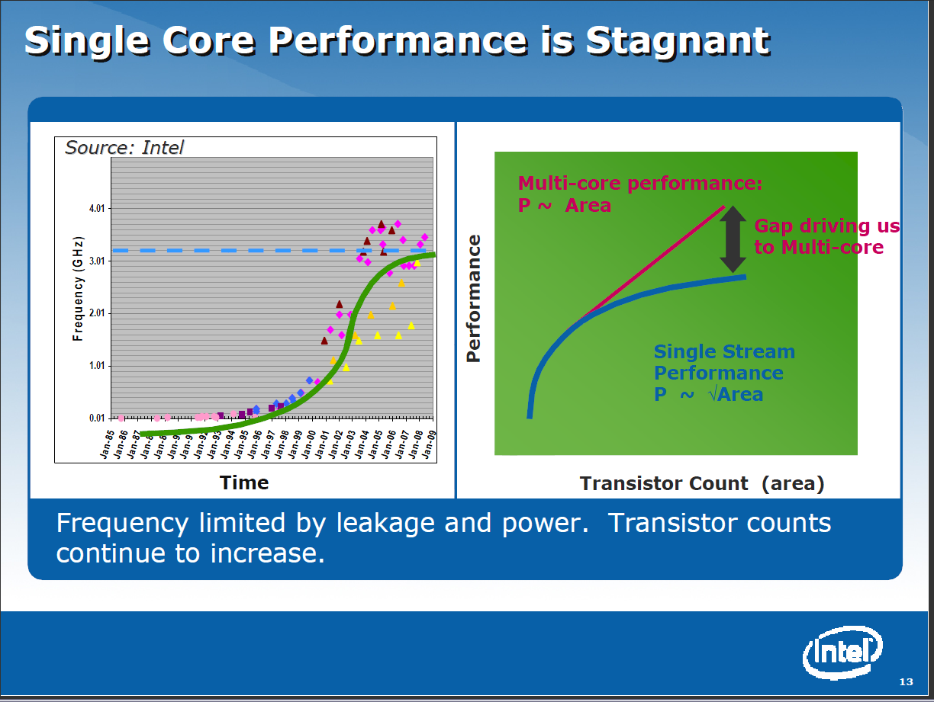
Lots of Computers are needed
Performance of individual CPU’s is limited
Use lots of cores per chip
Use lots of chips per job
Superman versus a bunch of people

Slide 12
OPERATIONALLY Clouds are Clear
Originally a bunch of computers in an efficient data center with an excellent Internet connection
They were produced to meet need of public-facing Web 2.0 e-Commerce/Social Networking sites
Modern clouds have more internal high performance features – networks, CPU accelerators, high speed storage, lots of memory (at times as main workload does work well on “commodity” servers)
They can be considered as “optimal giant data center” plus internet connection
Note enterprises use private clouds that are giant data centers but not optimized for Internet access

Slide 13
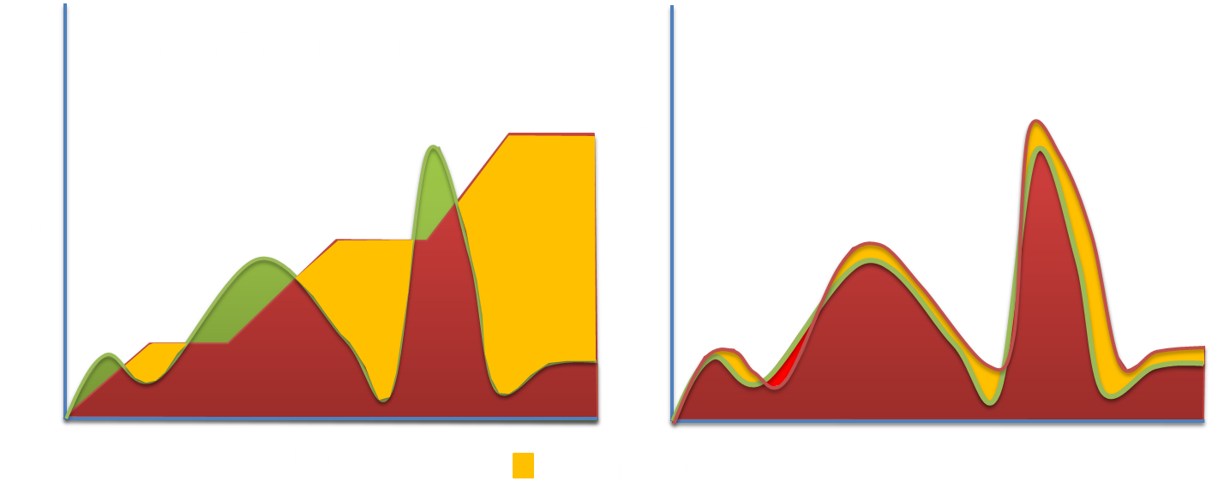
What is a “Cloud”?
Cloud: on-demand, scalable, multi-tenant, self-service compute and storage resources
Underprovisioned
(Courtesy of Microsoft, 2012)

Slide 14



Data Centers Clouds & Economies of Scale
http://research.microsoft.com/en-us/people/barga/sc09_cloudcomp_tutorial.pdf
Range in size from “edge” facilities to megascale.
Economies of scale: Approximate costs for a small size center (1K servers) and a larger, 50K server center.
Each data center is
11.5 times
the size of a football field
Technology | Cost in small-sized Data Center | Cost in Large Data Center | Ratio
Network | $95 per Mbps/ month | $13 per Mbps/ month | 7.1
Storage | $2.20 per GB/ month | $0.40 per GB/ month | 5.7
Administration | ~140 servers/ Administrator | >1000 Servers/ Administrator | 7.1
2 Google warehouses of computers on the banks of the Columbia River, in The Dalles, Oregon
Such centers use 20MW-200MW each with 150 watts per CPU
Save money from large size, positioning with cheap power and access with Internet

Slide 15
Clouds Offer From different points of view
Features from NIST:
  On-demand service (elastic);
  Broad network access;
  Resource pooling;
  Flexible resource allocation;
  Measured service
Economies of scale in performance and electrical power (Green IT)
Powerful new software models
  Platform as a Service is not an alternative to Infrastructure as a Service – it is instead an incredible valued added
  Amazon is as much PaaS as Azure
They are cheaper than classic clusters unless latter 100% utilized

Slide 16
Virtualization made several things more convenient
Virtualization = abstraction; run a job – you know not where
Virtualization = use hypervisor to support “images”
  Allows you to define complete job as an “image” – OS + application
Efficient packing of multiple applications into one server as they don’t interfere (much) with each other if in different virtual machines;
They interfere if put as two jobs in same machine as for example must have same OS and same OS services
Also security model between VM’s more robust than between processes

Slide 17
Old Cloud Use Case I: Microsoft Server Consolidation
http://research.microsoft.com/pubs/78813/AJ18_EN.pdf
Typical data center CPU had 9.75% utilization
Take 5000 SQL servers and rehost on virtual machines with 6:1 consolidation
60% saving

Slide 18
Old Cloud Use Case II: Google gmail example
http://www.google.com/green/pdfs/google-green-computing.pdf
Clouds win by efficient resource use and efficient data centers
Business Type | Number of users | # servers | IT Power per user | PUE (Power Usage effectiveness) | Total Power per user | Annual Energy per user
Small | 50 | 2 | 8W | 2.5 | 20W | 175 kWh
Medium | 500 | 2 | 1.8W | 1.8 | 3.2W | 28.4 kWh
Large | 10000 | 12 | 0.54W | 1.6 | 0.9W | 7.6 kWh
Gmail (Cloud) | ∞ | ∞ | < 0.22W | 1.16 | < 0.25W | < 2.2 kWh

Slide 19
Next Step is Renting out Idle Clouds
Amazon noted it could rent out its idle machines
Use virtualization for maximum efficiency and security
If cloud bigger enough, one gets elasticity – namely you can rent as much as you want except perhaps at peak times
This assumes machine hardware quite cheap and can keep some in reserve
  10% of 100,000 servers is 10,000 servers
I don’t know if Amazon switches off spare computers and powers up on “mothers day”
  Illustrates difficulties in studying field – proprietary secrets
  If switch off one can’t respond quickly
  Some machines are not only idle but switched on. They are preloaded with somewhere so they are ready to go (modern serverless computing model)

Slide 20
C: Defining Clouds II
Service-oriented architectures: Software services as Message-linked computing capabilities
The different aaS’s: Network, Infrastructure, Platform, Software
The amazing services that Amazon AWS and Microsoft Azure have
Initial Gartner comments on clouds (they are now the norm) and evolution of servers; serverless and microservices
2016/2018 Infrastructure Strategies Hype Cycle and Priority Matrix

Slide 21
Service Model is a Messaging Model
This generalizes the Web where every site gobbles up commands from client and returns something – which could be quite complicated
Generalization is “Service Oriented Architecture”
  Everything has an interface that accepts information – in general from another service but perhaps from a client
  Everything spits out information to where instructed to send
Produces cleaner modular systems where each service has its own environment. If you use classic method calls, many more difficult to track dependencies
Note messaging common mode of communication between people and organizations in the real world
Everything is a message of some sort ……
Closely coupled Java/Python Methods …
Coarse Grain Service Model
Module
B
Service
B
Service A
Module A
Messages
Method Calls
.001 to 1 millisecond
0.1 to 1000 millisecond latency

Slide 22
Different aaS (as aService)’s
Support
Computing
aaS
Custom Images
Courses
Consulting
Portals
Archival Storage
IaaS: Infrastructure is “renting” service for hardware
PaaS: Convenient service interface to Systems capabilities
SaaS: Convenient service interface to applications
  New Function as a Service FaaS applies at smaller grain size
NaaS: Summarizes modern “Software Defined Networks”
Support Computing as a service is “my invention” to capture role of IT staff in a world where all infrastructure in the cloud
Software
(Application) SaaS
CS Research Use
Class Use
Research Applications
Commercial Use
Platform
PaaS
Cloud e.g. MapReduce
HPC e.g. PETSc, SAGA
Computer Science
Data Algorithms
Infra
structure
IaaS
Software Defined Computing (virtual Clusters)
Hypervisor, Bare Metal
Operating System
Network
NaaS
Software Defined Networks
OpenFlow GENI

Slide 23
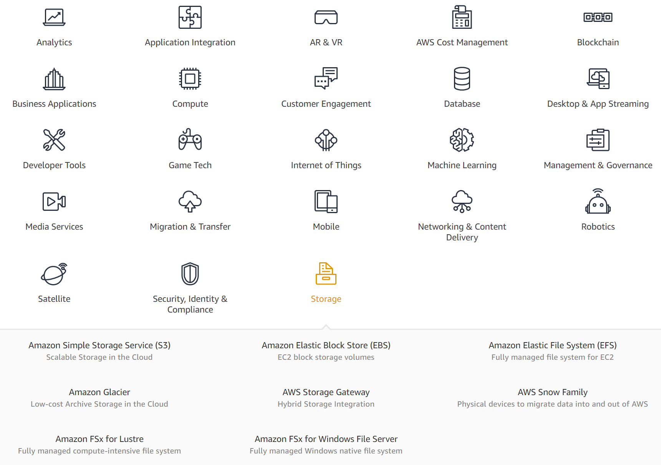
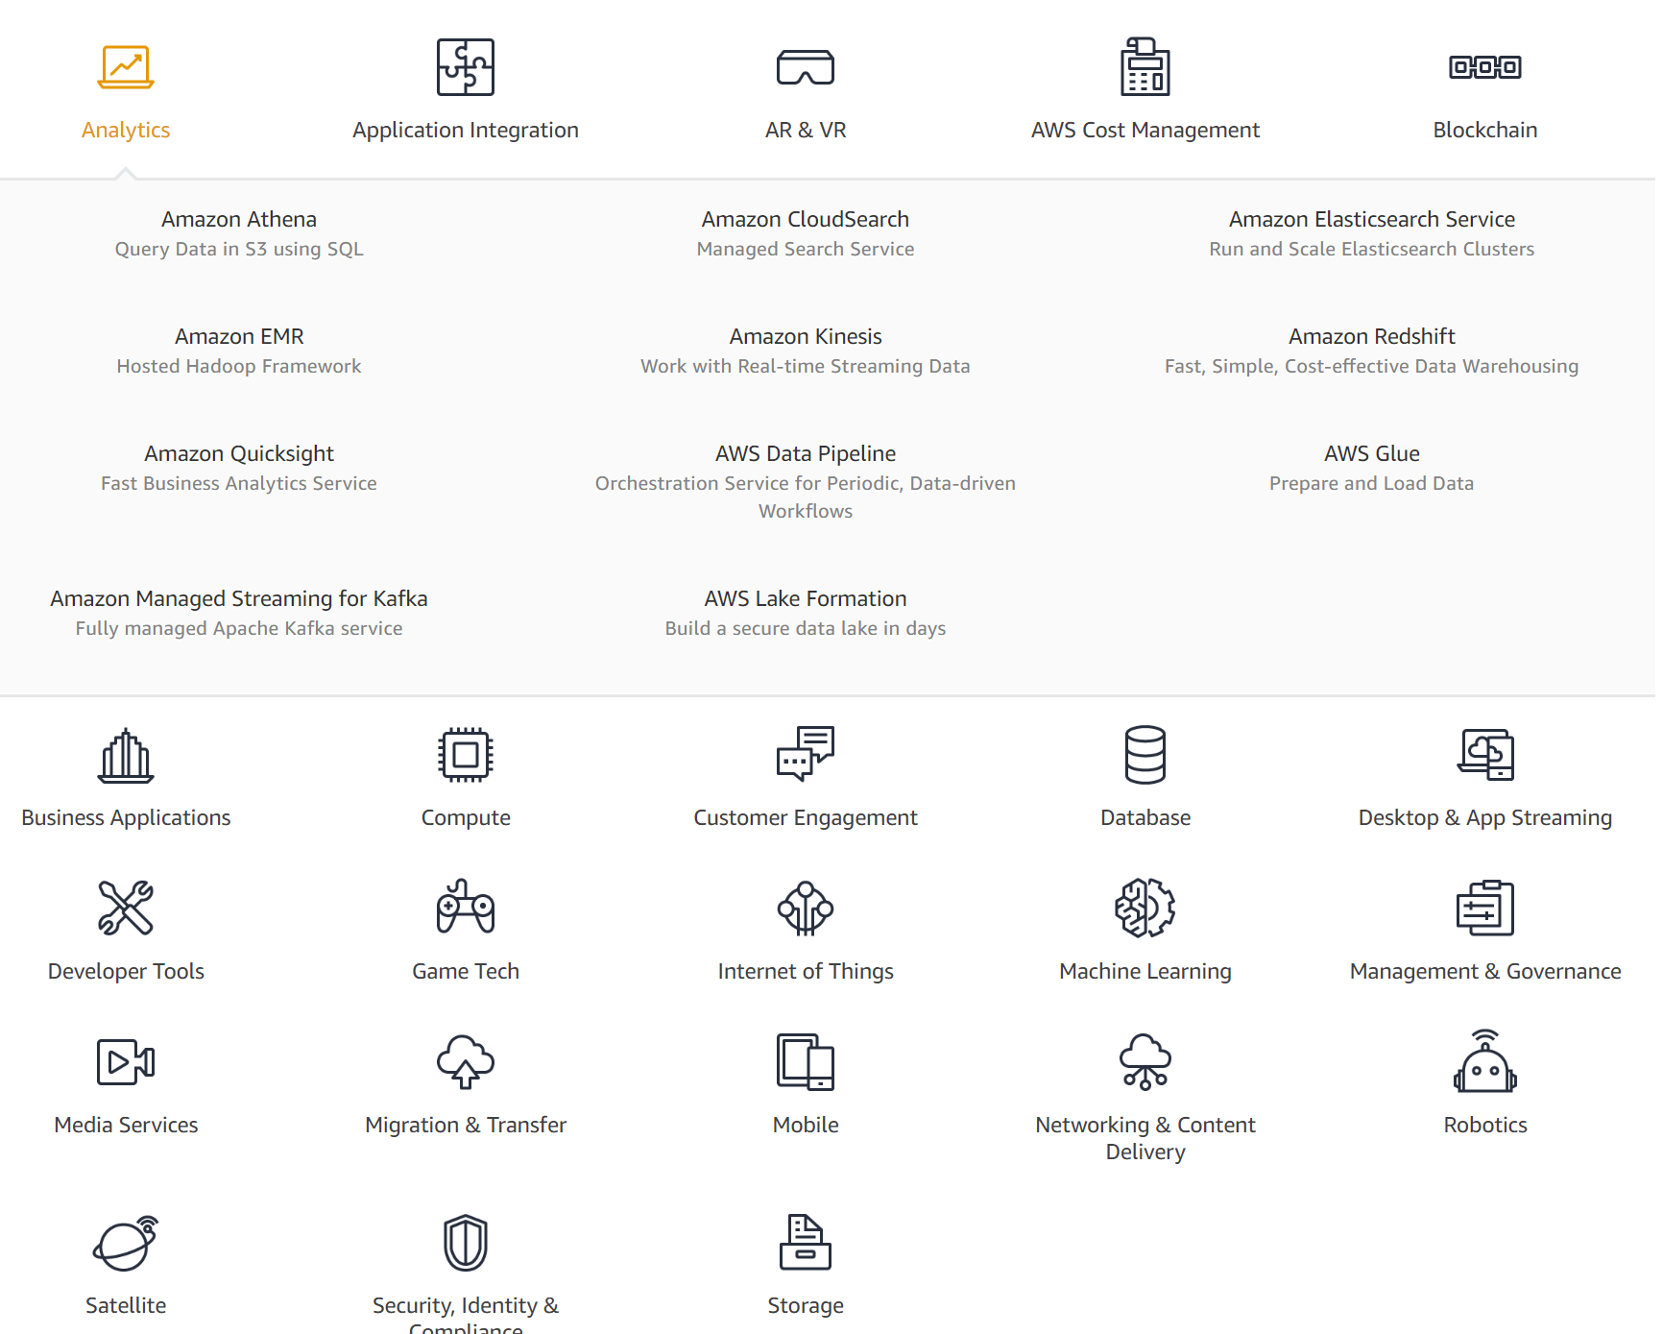
December 2018
Amazon AWS available services
23 categories.
First category expanded into 11 subservices
Last category into 9

Slide 24
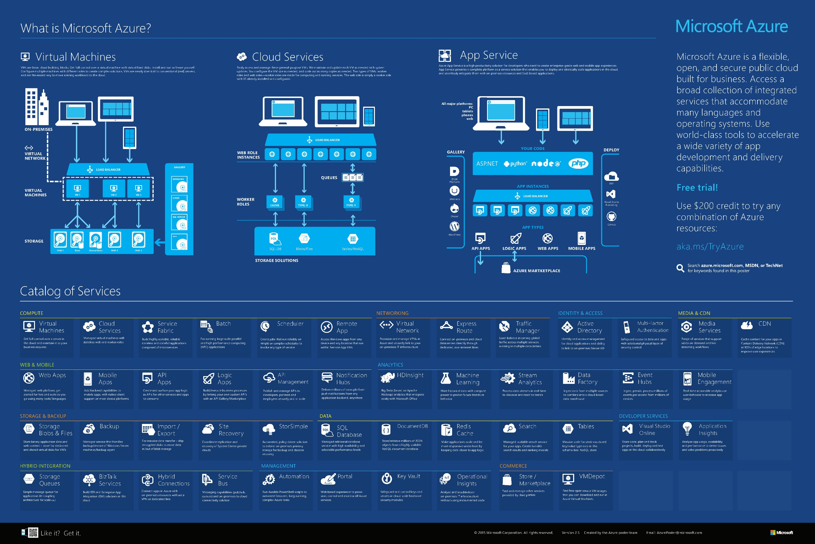
Azure Services 2015

Slide 25
Gartner Remarks on Clouds
As they enters their second decade, Clouds have evolved from a disruptive technology to an expected and prevelant approach to traditional as well as next-generation IT.
  Despite its longevity, cloud computing still suffers from confusion, and long-standing and largely unimportant nontechnical concerns (for example, cost and governance) continue to muddle the opinions and approaches of CIOs, architects and cloud leaders.
  Enabled and fueled by the consumerization of IT, the cloud solutions that individuals and business units (through software as a serviceaaS) have brought into the enterprise are shifting the way IT organizations respond to the immediate and imminent demands of their users.
  A natural continued blurring is occurring in cloud computing. Infrastructure as a service (IaaS) and some PaaS capabilities are increasingly difficult to discern as separate functions.
  Pure public cloud and hosted private offerings are becoming increasingly similar, and higher levels of abstraction are masking more of the underlying details. This blurring will persist and will continue to challenge cloud clarity.

Slide 26
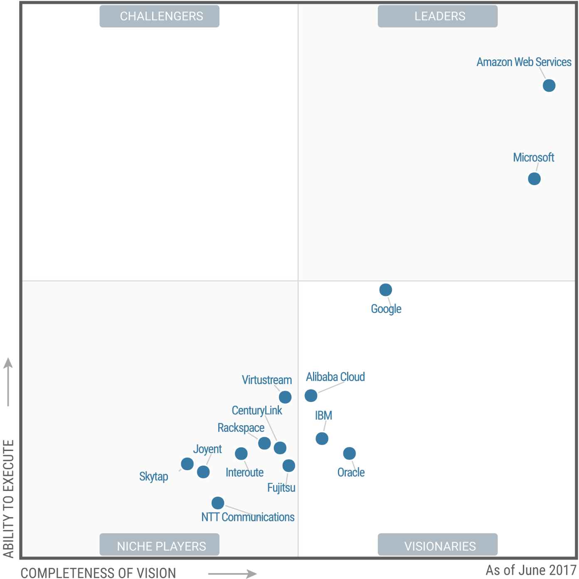
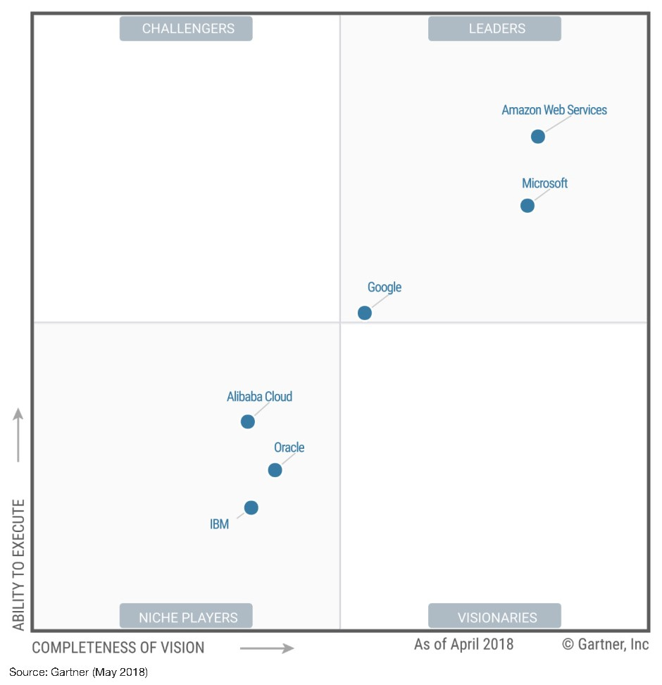
Gartner: Magic Quadrant for Cloud Infrastructure as a Service, Worldwide
Magic Quadrant for Cloud Infrastructure as a Service, Worldwide
Published: 15 June 2017 ID: G00315215;
Updated 23 May 2018 G00336148
Analyst(s): Lydia Leong | Raj Bala | Craig Lowery | Dennis Smith

Slide 27
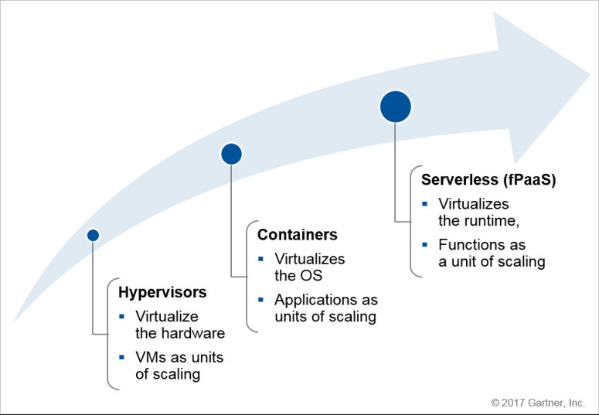
Gartner: The Evolution of Server Computing
Evolution of Server Computing: VMs to Containers to Serverless - Which to Use When?
Published: 26 June 2017 ID: G00325432
Analyst(s): Arun Chandrasekaran

Slide 28
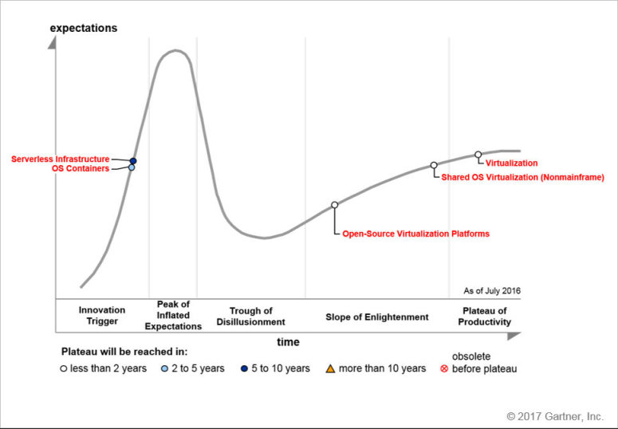
Gartner: Infrastructure Strategies Hype Cycle, 2016
Evolution of Server Computing: VMs to Containers to Serverless - Which to Use When?
Published: 26 June 2017 ID: G00325432
Analyst(s): Arun Chandrasekaran

Slide 29
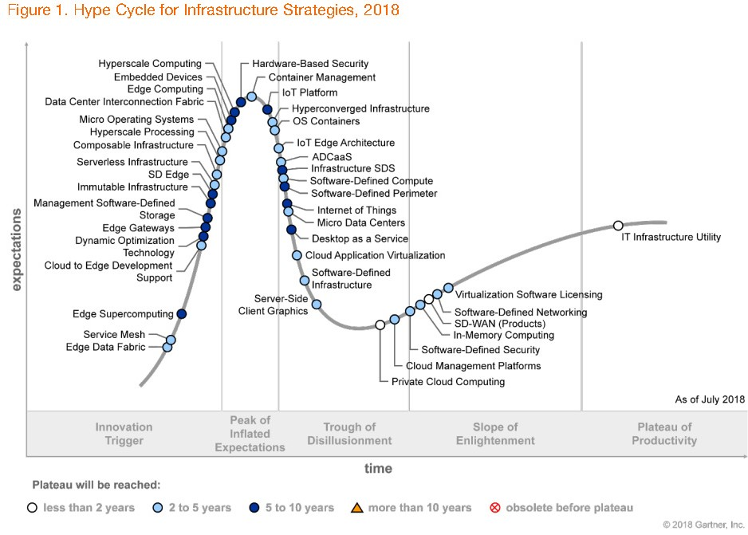
Gartner: Infrastructure Strategies Hype Cycle, 2018
Edge and Software Defined systems
Edge and Software Defined systems
Hype Cycle for Infrastructure Strategies, 2018
Published: 17 July 2018 G00340333
Analyst(s): Philip Dawson, Nathan Hill
29

Slide 30
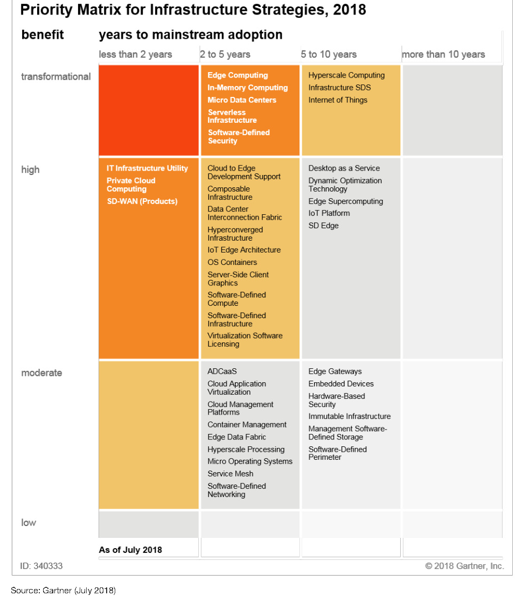
Gartner: Infrastructure Strategies Hype Cycle, 2018: Priority Matrix
Hype Cycle for Infrastructure Strategies, 2018
Published: 17 July 2018 G00340333
Analyst(s): Philip Dawson, Nathan Hill

Slide 31
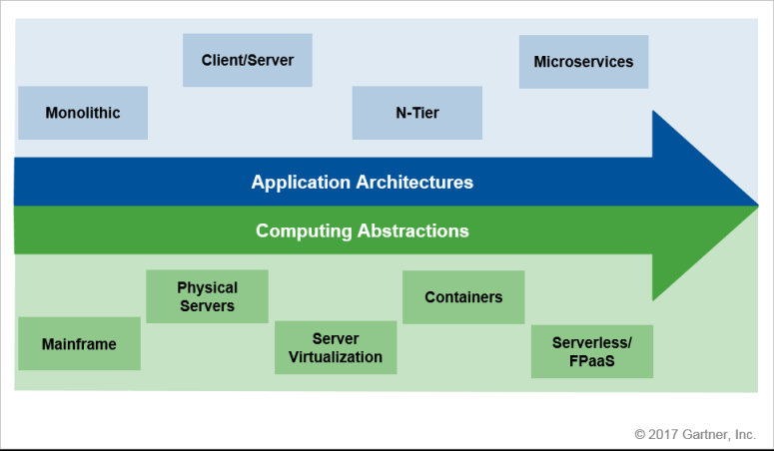
Gartner: The Evolution of Application Architectures and Computing Abstractions
Evolution of Server Computing: VMs to Containers to Serverless - Which to Use When?
Published: 26 June 2017 ID: G00325432
Analyst(s): Arun Chandrasekaran

Slide 32
D: Defining Clouds III
Cloud Market Share
How important are they?
How much money do they make?

Slide 33
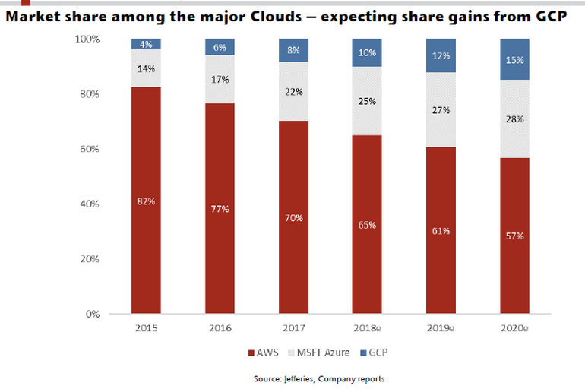
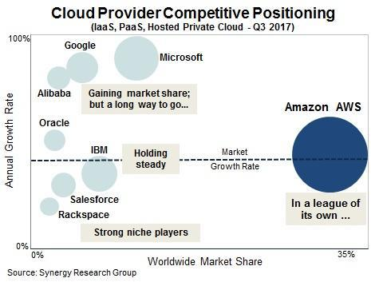
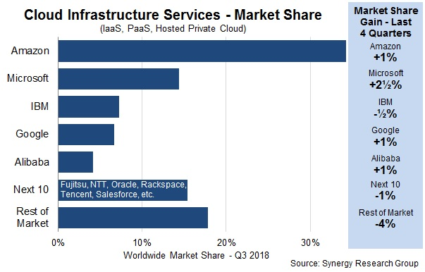
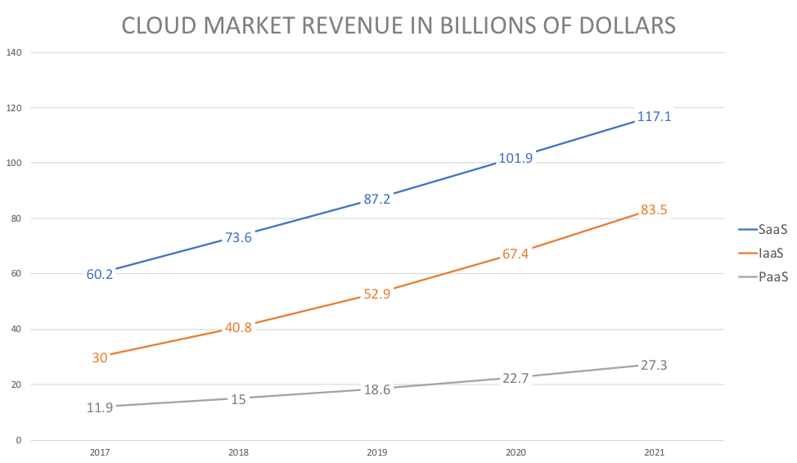
Worldwide Cloud Market Share Q3 2017
Remove Software as a Service e.g. Office 365, gmail etc.
https://techcrunch.com/2017/10/30/aws-continues-to-rule-the-cloud-infrastructure-market/

Slide 34
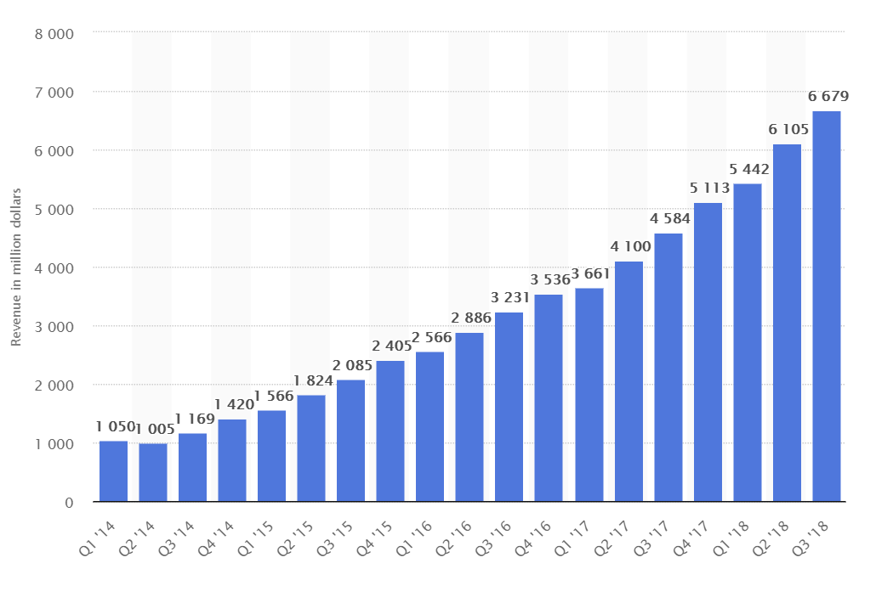
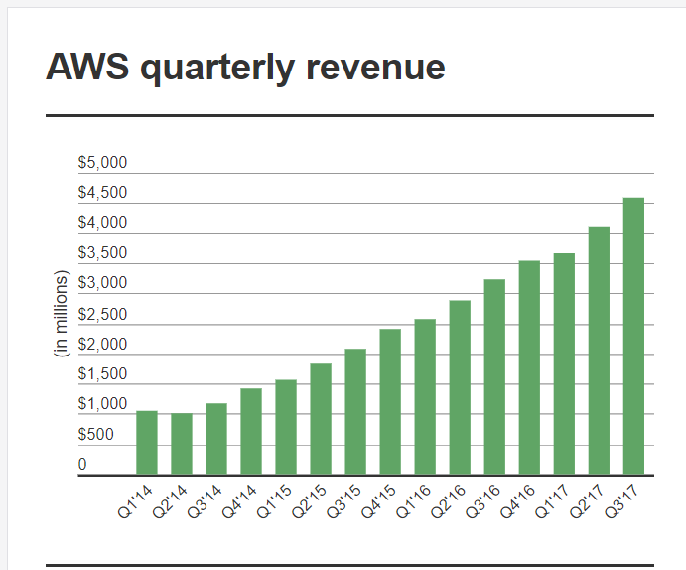
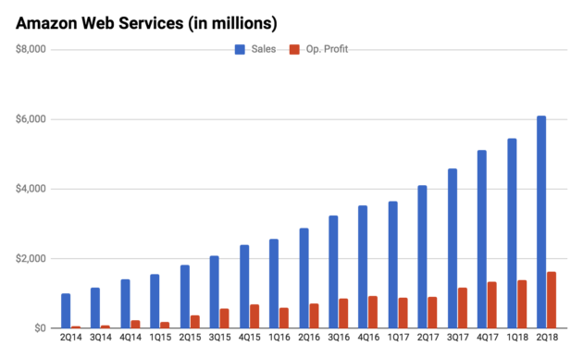
Quarterly AWS Revenues $B

Slide 35
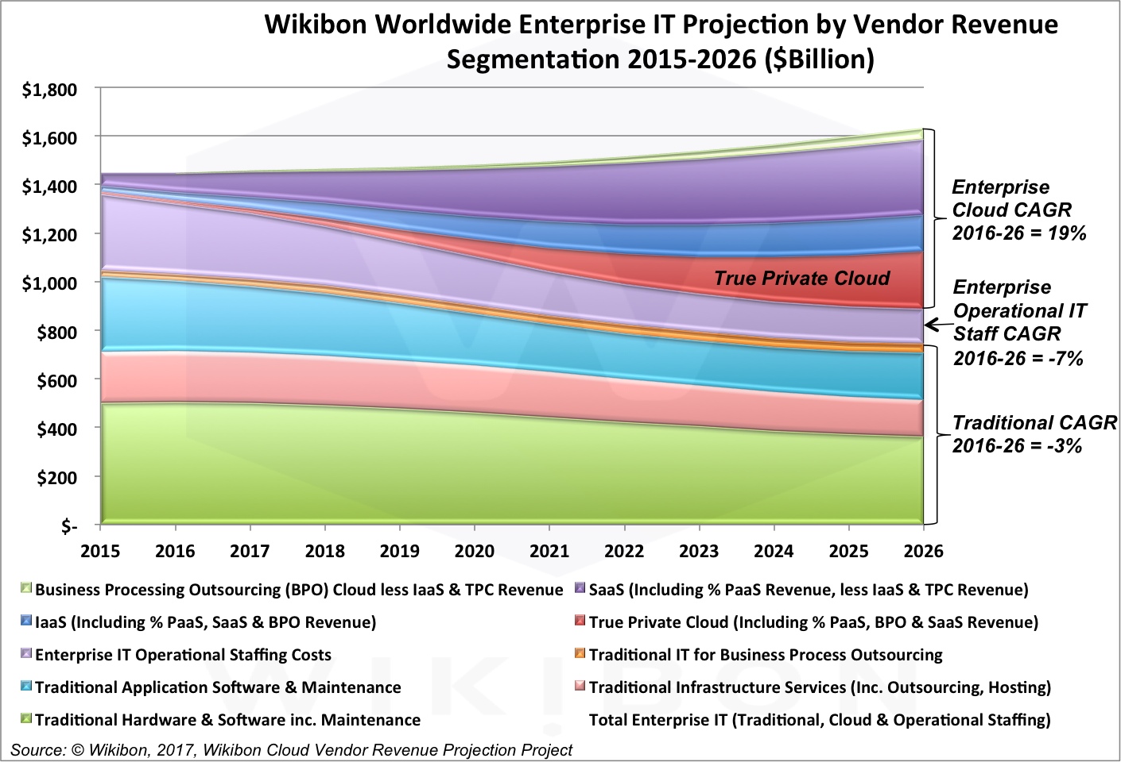
IT Growth by areas
https://www.forbes.com/sites/louiscolumbus/2017/04/29/roundup-of-cloud-computing-forecasts-2017

Slide 36
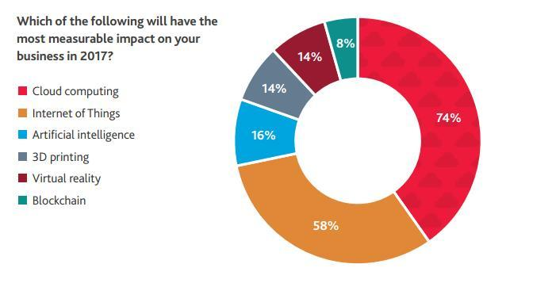
What will impact Enterprise IT?

Slide 37
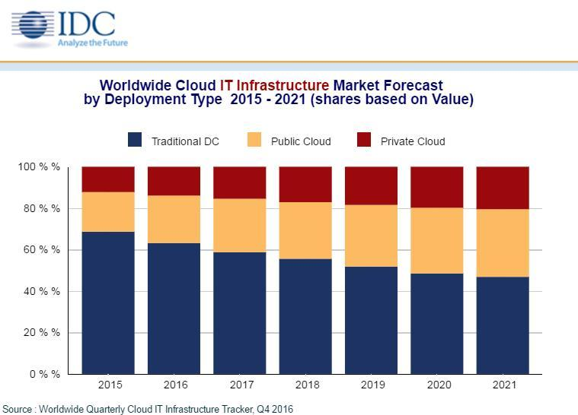
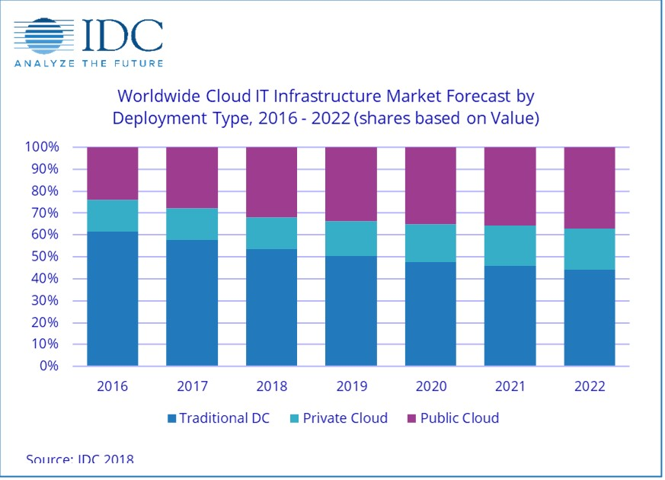
IT Infrastructure Trends
According to IDC, worldwide spending on public cloud computing will increase from $67B in 2015 to $162B in 2020 attaining a 19% CAGR.

Slide 38
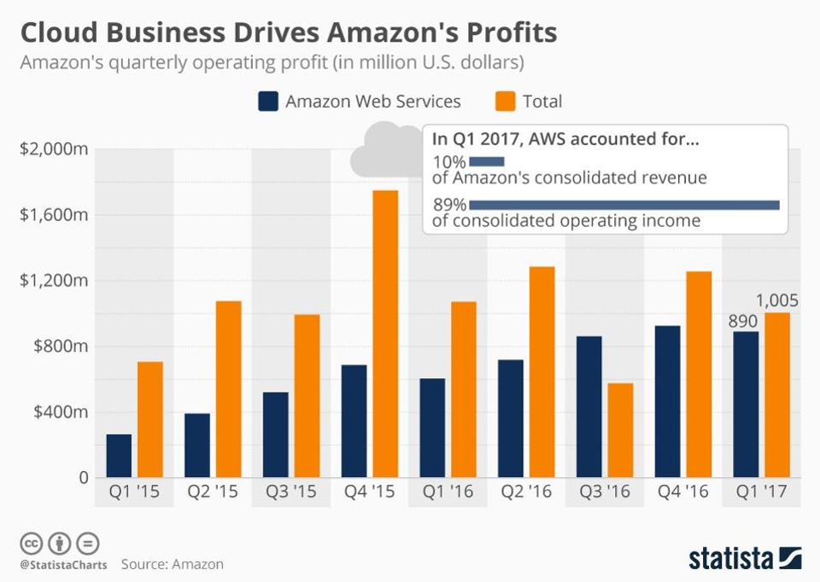
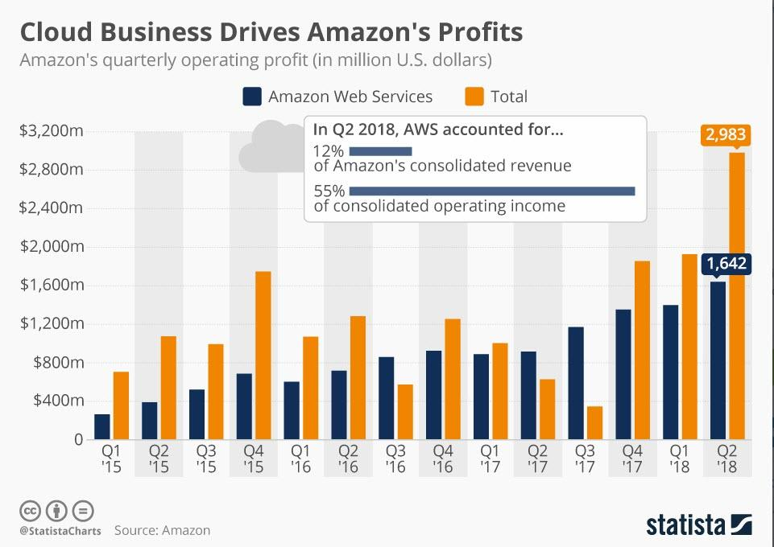
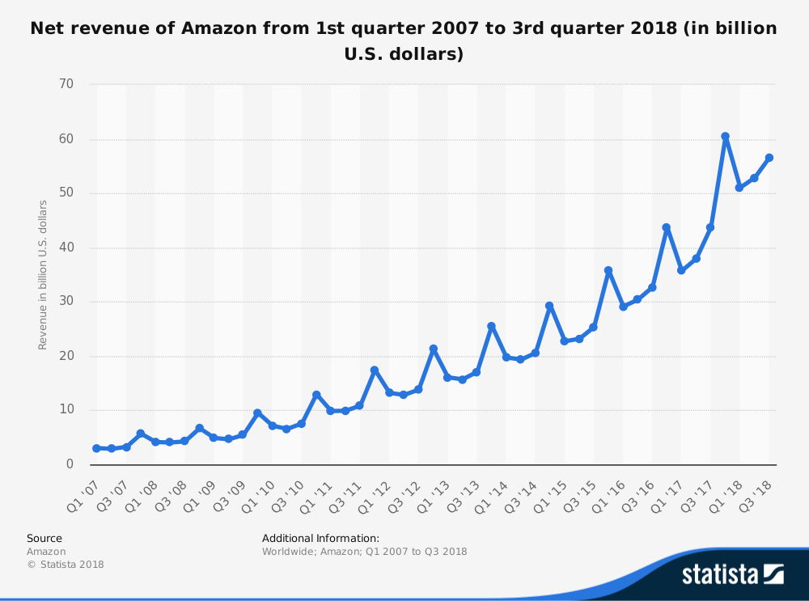
Amazon AWS Income
By 2022, Amazon Web Services (AWS) will reach $43B in revenue, and be 8.2% of all cloud spending.

Slide 39
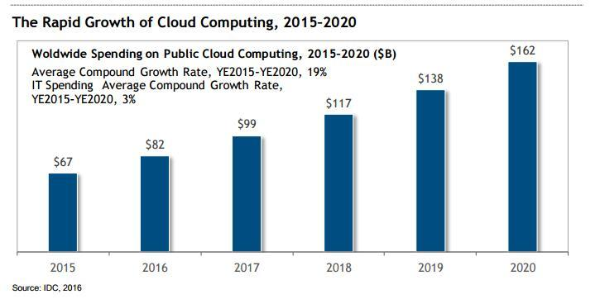
Cloud Computing Spending $B

Slide 40
E: Virtualization
Virtualization Technologies, Hypervisors and the different approaches
KVM Xen, Docker and Openstack
See:
  https://en.wikipedia.org/wiki/Hypervisor
    https://en.wikipedia.org/wiki/Xen
    https://en.wikipedia.org/wiki/Kernel-based_Virtual_Machine (KVM)
    https://en.wikipedia.org/wiki/Operating-system-level_virtualization
    https://medium.com/@dbclin/aws-just-announced-a-move-from-xen-towards-kvm-so-what-is-kvm-2091f123991
  https://nickjanetakis.com/blog/comparing-virtual-machines-vs-docker-containers
  https://en.wikipedia.org/wiki/OpenStack

Slide 41
Virtualization Technologies I
Public Clouds require technology to securely and efficiently run multiple changing jobs on the same set of CPU’s. Sticking software on disks is not really suitable
  There is too much software needed
  The software configurations interfere with each other.
  Such intermingling has serious security concerns.
So one uses some form of virtual machines which imply the real hardware can look like many co-existing virtual machines where each VM can be treated independently
Particularly important with multicore chips as often an individual needs fewer cores (e.g. 1) than those in chip
  In ISE lab, Tango has 68 cores (one chip) per node; Victor (which you will use) has 48 as two 24 core chips
Virtualization has been around along time and pioneered in early IBM mainframes
Often one uses a hypervisor or virtual machine monitor (VMM), which is computer software, firmware or hardware that creates and runs virtual machines.
  A computer on which a hypervisor runs one or more virtual machines is called a host machine, and each virtual machine is called a guest machine.
The term hypervisor is a variant of supervisor, a traditional term for the kernel of an operating system: the hypervisor is the supervisor of the supervisor, with hyper- used as a stronger variant of super-

Slide 42
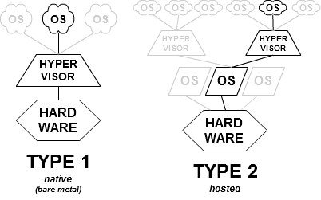
Virtualization Technologies II
Type-1, native or bare-metal hypervisors run directly on the host's hardware to control the hardware and to manage guest operating systems. For this reason, they are sometimes called bare metal hypervisors. E.g. Xen, Microsoft Hyper-V and VMware ESX/ESXi.
Type-2 or hosted hypervisors run on a conventional operating system (OS) just as other computer programs do. A guest operating system runs as a process on the host. e.g. KVM, VMware Workstation, VMware Player, VirtualBox, and QEMU
November 2017 “Tied up in a recent AWS announcement about a new EC2 high-end instance type (the C5) is a strong suggestion that Amazon’s cloud computing giant has begun to shift its hundreds of thousands of physical servers away from the open source Xen hypervisor that’s run them until now, to the open source alternative, KVM.”
Starting in 2005, CPU vendors have added
hardware virtualization assistance to their products
An alternative approach requires modifying the guest
operating-system to make system calls to the hypervisor,
rather than executing machine I/O instructions that the
hypervisor simulates.
This is called paravirtualization in Xen.

Slide 43
Virtualization Technologies III
Operating-system-level virtualization, also known as containerization, refers to an operating system feature in which the kernel allows the existence of multiple isolated user-space instances. Such instances, called containers, partitions, virtualization engines or jails, may look like real computers from the point of view of programs running in them.
A computer program running on an ordinary person's computer's operating system can see all resources (connected devices, files and folders, network shares, CPU power, quantifiable hardware capabilities) of that computer. However, programs running inside a container can only see the container's contents and devices assigned to the container.
Operating-system-level virtualization usually imposes little to no overhead, because programs in virtual partitions use the operating system's normal system call interface and do not need to be subjected to emulation
Operating-system-level virtualization is not as flexible as other virtualization approaches since it cannot host a guest operating system different from the host one, or a different guest kernel.
Docker is a very popular powerful OS level virtualization system built on common Linux capabilities that is easier to use than KVM or Xen and has little performance overhead
Docker is not as secure as hardware virtualization (KVM , Xen) when looking inside a node
Kubernetes manages lots of Docker instances simultaneously to support parallel computing
OpenStack is a huge set of capabilities supporting cloud computing at IaaS level. Mainly they are software emulations of hardware functions like networking so it has poor performance. Typically used with KVM but other choices possible.

Slide 44
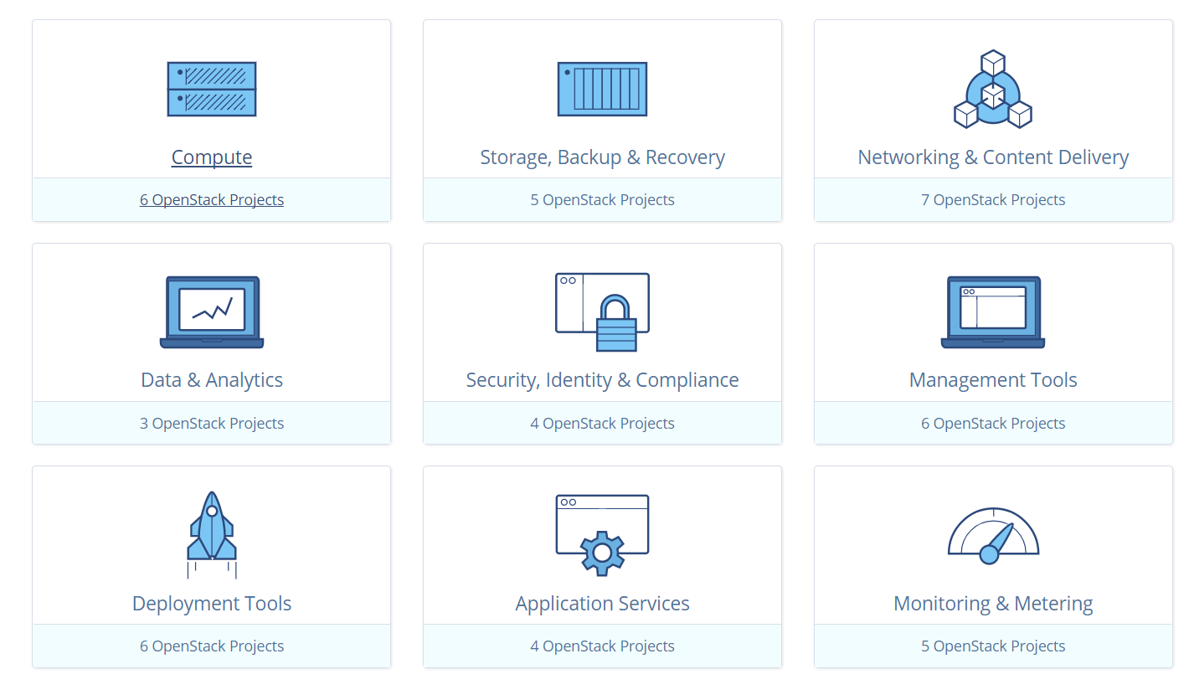
The areas that OpenStack works on

Slide 45
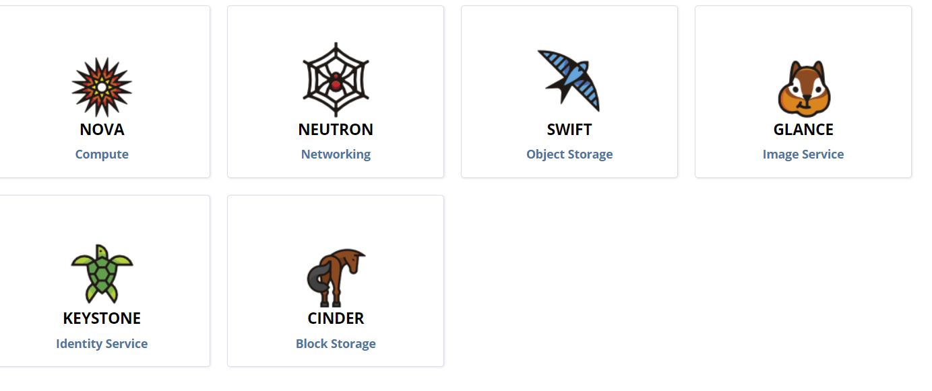
Typical use of OpenStack

Slide 46
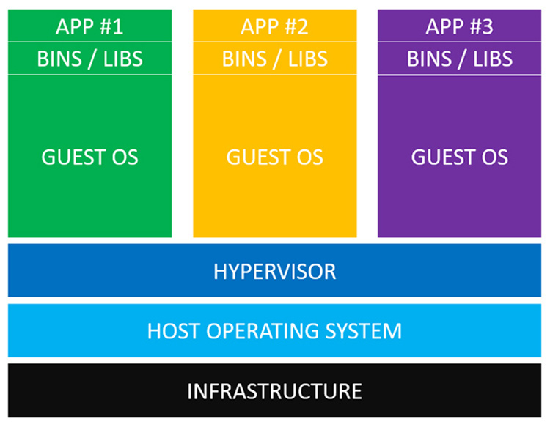
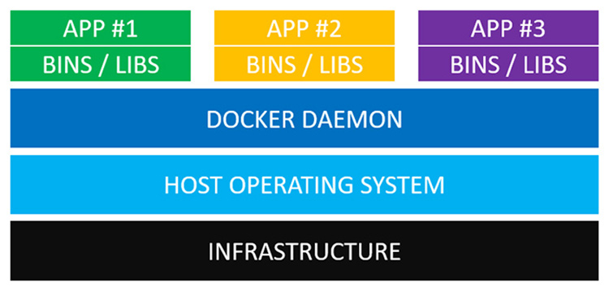
Virtualization Technologies IV
Instead, the Docker daemon communicates directly with the host operating system and knows how to ration out resources for the running Docker containers. It’s also an expert at ensuring each container is isolated from both the host OS and other containers.
The real world difference here means instead of having to wait a minute for a virtual machine to boot up, you can start a docker container in a few milliseconds.
Typical KVM (+ OpenStack) scenario
Typical Docker Scenario

Slide 47
F:Technology Hypecycle I
Gartners Hypecycles and especially that for emerging technologies in 2018, 2017 and 2016
The phases of hypecycles
Priority Matrix with benefits and adoption time
Today clouds have got through the cycle (they have emerged) but features like blockchain, serverless and machine learning are on cycle
Hypecycle and Priority Matrix for Data Center Infrastructure 2017 and 2018

Slide 48
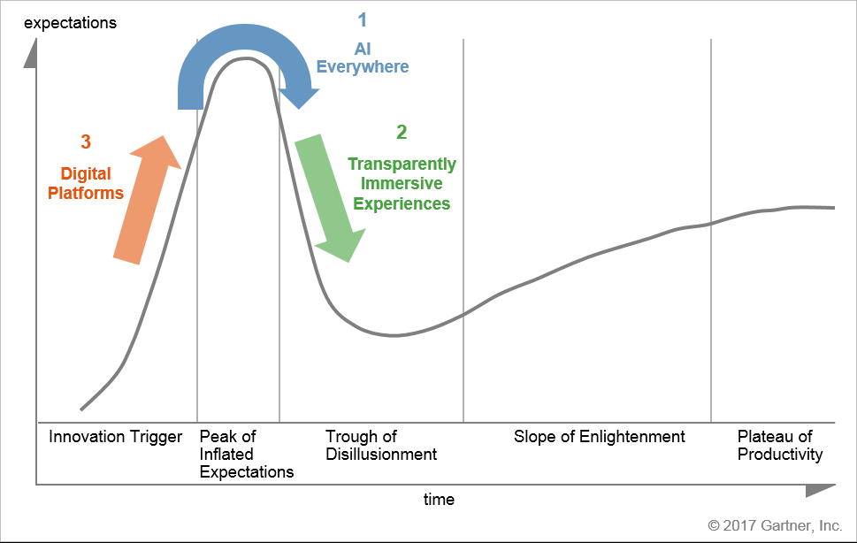
Gartner: How Emerging Technology Trends Move Along the Hype Cycle
Hype Cycle for Emerging Technologies, 2017
Published: 21 July 2017 ID: G00314560
Analyst(s): Mike J. Walker
The emerging technologies on the 2017 Hype Cycle reveal three distinct megatrends

Slide 49
Gartner: Hype Cycle for Emerging Technologies Structure
Innovation Trigger: A breakthrough, public demonstration, product launch or other event generates significant press and industry interest.
Peak of Inflated Expectations: During this phase of overenthusiasm and unrealistic projections, a flurry of well-publicized activity by technology leaders results in some successes, but more failures, as the technology is pushed to its limits. The only enterprises making money are conference organizers and magazine publishers.
Trough of Disillusionment: Because the technology does not live up to its overinflated expectations, it rapidly becomes unfashionable. Media interest wanes, except for a few cautionary tales.
Slope of Enlightenment: Focused experimentation and solid hard work by an increasingly diverse range of organizations lead to a true understanding of the technology's applicability, risks and benefits. Commercial off-the-shelf methodologies and tools ease the development process.
Plateau of Productivity: The real-world benefits of the technology are demonstrated and accepted. Tools and methodologies are increasingly stable as they enter their second and third generations. Growing numbers of organizations feel comfortable with the reduced level of risk; the rapid growth phase of adoption begins. Approximately 20% of the technology's target audience has adopted or is adopting the technology as it enters this phase

Slide 50
Gartner: Hype Cycle for Emerging Technologies, 2018
Many changes from previous years with previous major themes focusing on new capabilities
5 Trends listed alphabetically that capture emerging technologies
  Democratized artificial intelligence (AI)
  Digitalized ecosystems
  Do-it-yourself biohacking
  Transparently immersive experiences
  Ubiquitous infrastructure
We now discuss trends in detail

Slide 51
Democratized artificial intelligence (AI) Trend
Along with being the most disruptive class of technologies, AI technologies will be virtually everywhere over the next 10 years. While these technologies will enable early adopters to adapt to new situations and solve problems that no one has ever encountered previously, we will also see these technologies available to the masses or democratized. Cloud computing, open source and a growing "maker" community further propel AI into everyone's hands. Although it is early, CIOs and IT leaders should encourage developers to experiment with AI developer toolkits and AI PaaS, as well as plan developers' upskilling to get this contingent ready for its new role in AI strategies.
  Key technologies: AI PaaS, artificial general intelligence, autonomous driving Level 4, autonomous driving Level 5, autonomous mobile robots, conversational AI platform, deep neural nets, flying autonomous vehicles, smart robots and virtual assistants.

Slide 52
Digitalized Ecosystems Trend
Emerging technologies require revolutionizing the enabling foundations that provide the volume of data needed, advanced compute power and ubiquity-enabling ecosystems. The shift from compartmentalized technical infrastructure to ecosystem-enabling platforms is laying the foundations for entirely new business models that are forming the bridge between humans and technology. Within these dynamic ecosystems, organizations must proactively understand and redefine their strategy to create platform-based business models, and to exploit internal and external algorithms in order to generate value.
  Key technologies: blockchain, blockchain for data security, digital twin, IoT platform and knowledge graphs.

Slide 53
Do-it-yourself Biohacking Trend
Over the next decade, humanity will begin its "transhuman" era, where biology can be hacked, depending on one's lifestyle interests and health needs. Biohacking falls into four categories: technology augmentation, nutrigenomics, experimental biology and grinder biohacking. However, questions remain about how far society is prepared to accept these kinds of applications and what ethical issues they create. Extending humans will wildly vary in scope and power, from simple diagnostics to neural implants.
  Key technologies: biochips, biotech — cultured or artificial tissue, brain-computer interface, exoskeletons, augmented reality, mixed reality, and smart fabrics.

Slide 54
Transparently Immersive Experiences Trend
Technology has and will continue to become more human-centric to the point where it will introduce transparency between people, businesses and (edge) things. These technologies extend and enable smarter living, work and other spaces we encounter.
  Key technologies: 4D printing, connected home, edge AI, self-healing system technology, silicon anode batteries, smart dust, smart workspace and volumetric displays.

Slide 55
Ubiquitous Infrastructure Trend
Infrastructure is no longer in the way of obtaining an organization's goals. The advent and mass popularity of cloud computing and the many variations have enabled an always-on, available and limitless infrastructure compute environment.
  The cloud-based emerging technologies are the key to enabling this future.

Slide 56
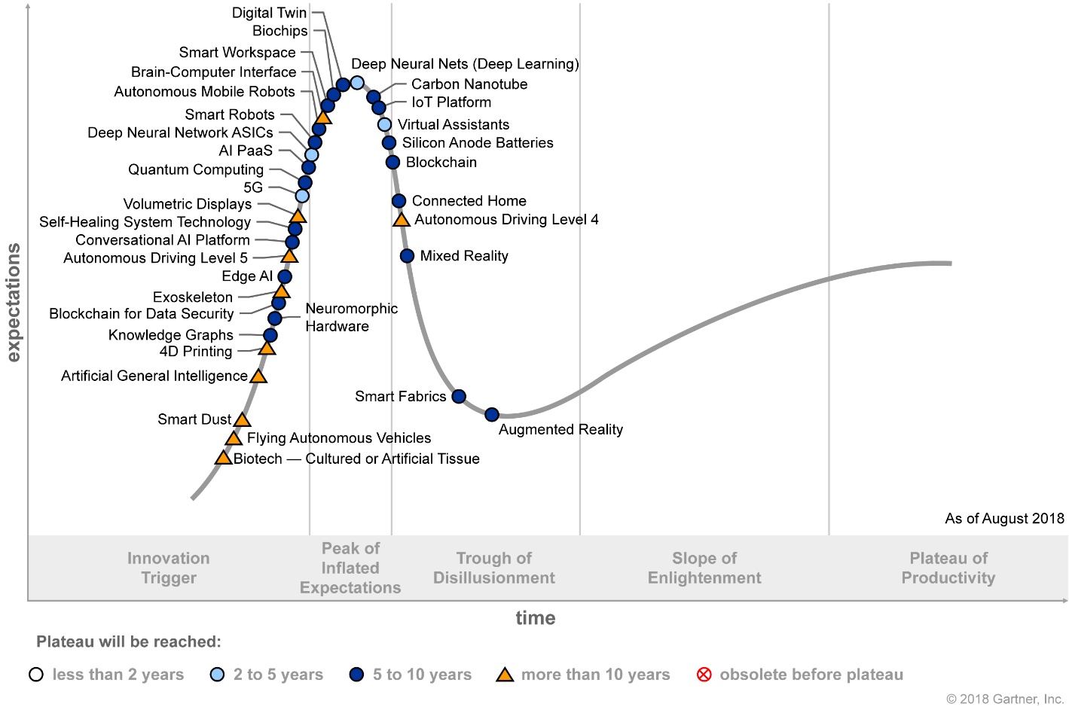
Gartner: Hype Cycle for Emerging Technologies, 2018
Hype Cycle for Emerging Technologies, 2018
Published: 6 August 2018 - ID G00340159
Analyst: Mike J. Walker

Slide 57
Gartner: Hype Cycle for Emerging Technologies, 2018
Major Hype Cycle Changes arriving I
AI PaaS — This new innovation profile shows how the AI PaaS hype is heating up, with the leading cloud service providers' competition using AI PaaS as a lure to their clouds and as a tool to attract developers and data scientists.
Autonomous driving Level 4 — Self-driving vehicles that can operate without human intervention in most situations are classified as Level 4 using the SAE International's rating system. The vehicles will not be capable of driving in all locations or conditions, such as driving during snow or heavy rain, or in areas that have not been electronically mapped, but must always be able to maintain a safe operation even if the driver does not take over.
Autonomous driving Level 5 — or "full" automation is a definition established by the SAE (Society of Automobile Engineers) International that refers to self-driving vehicles that can operate without human intervention in every situation and condition. As a result, there is no longer any requirement for a vehicle to be fitted with pedals, brakes or a steering wheel. The autonomous vehicle system controls all driving tasks..
Autonomous mobile robots — This innovation profile was added given how next-generation AMRs are poised to transform warehouse operations over the coming decades, as these truly become more autonomous and intelligent.
Biochips — While the current market growth is limited due to regulations, high costs and complexity, we see a long-term cross-industry impact due to the many different applications across the board.
Biotech — cultured or artificial tissue — We see enormous potential in this technology being used in the future in soft robots or artificial muscle for more complex robots, medicine, medical treatment, welfare equipment, military, toys and smart structures. Biotechnology is still at the lab development stage and at least 10 years away.
Blockchain for data security — Blockchain-enabled data security applications offer alternative methods to establish trust and resiliency with minimal reliance on centralized arbiters, and track digital assets.
Carbon nanotube — This technology has the potential for a huge impact, particularly when silicon devices reach their minimum size limits, as it offers the promise of low electrical resistance that can be applied to the interconnections within integrated circuits. Individual nanotubes can be readily fabricated, but problems remain with their interconnection and the fabrication of arrays of transistors.
Conversational AI platform — This new innovation profile is on many corporate agendas, spurred by the worldwide success of Amazon Alexa, Google Assistant and others represented by virtual-assistant-enabled wireless speakers at the pinnacle.

Slide 58
Gartner: Hype Cycle for Emerging Technologies, 2018
Major Hype Cycle Changes arriving II
Deep neural network ASICs — This innovation profile was added due to the significant benefits of DNN ASICs in performance and energy consumption when accelerating neural networks.
Edge AI — Gartner profiles this new edge device AI model, which solves challenges around latency issues, enhancing security, addressing privacy issues and improving the customer experience.
Exoskeletons — This technology has been profiled based on the need to become more specific and decompose human augmentation into exoskeletons and other supporting technologies, rather than a broad category of technologies. Exoskeletons have been the bulk of market adoption for human augmentation technology.
Flying autonomous vehicles — The development of flying autonomous vehicles is accelerating rapidly, with prototypes already available and real-world product launches projected for as early as this year.
Knowledge graphs — Gartner finds that organizations can expect significant value from knowledge graphs in many areas such as: reporting, interoperability, collaboration/sharing, audits and data reuse.
Mixed reality — These solutions are poised to enable businesses to bridge their physical and real worlds with virtual and digital ones using sophisticated multichannel and multimodal human-centered visual experiences. Mixed reality could be the immersive solution that will provide the ultimate user experience for everyone.
Self-healing system SHS technology — Emerging SHS technology includes print platforms and connected home solutions. We expect to see accelerating adoption of this technology as it becomes more widely leveraged by providers, and users in the enterprise and consumer markets.
Silicon anode batteries — This technology could increase the energy density of batteries from three to 10 times than current battery technology. This could provide a significant volume and weight savings, and a longer operating lifetime.
Smart fabrics — Smart fabric technology continues to improve with developments in sensor miniaturization and integrations with fabric. Technological advances allow new types of smart fabric every day. While many of the current products are still in testing, we expect use cases of smart fabric to extend beyond sports, professional athletes, healthcare and personal care to wider industries, including automobiles, manufacturing, military, emergency services and engineering.

Slide 59
Gartner: Hype Cycle for Emerging Technologies, 2018
Major Hype Cycle Changes leaving for a reason
Autonomous vehicles replaced with autonomous driving Level 4 and Level 5.
Cognitive computing value unclear
Cognitive expert advisors represented by higher-level concepts like virtual assistants.
Deep reinforcement learning shown to be specialized
Edge computing shifting to an edge AI model.
Enterprise taxonomy and ontology management
Human augmentation morphed into exoskeletons
Matured
Commercial UAVs (drones)
Conversational user interfaces
Machine learning
Serverless PaaS
Software-defined security

Slide 60
Gartner: Hype Cycle for Emerging Technologies, 2017
Major Hype Cycle Changes adding
5G
Artificial General Intelligence
Deep Learning
Deep Reinforcement Learning
Digital Twin
Edge Computing
Serverless PaaS
Cognitive Computing
Major Hype Cycle Changes advancing
Blockchain
Commercial UAV – drones
Software-Defined Security
Brain-Computer Interface

Slide 61
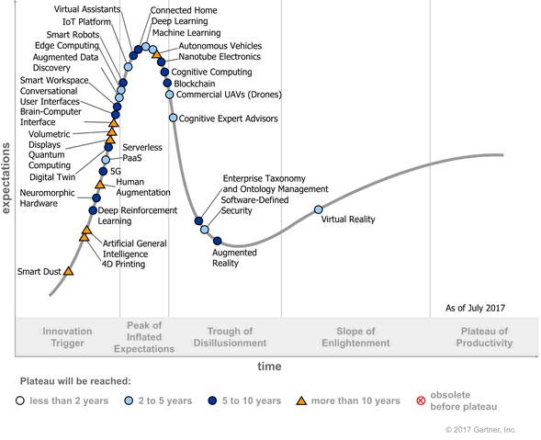
Gartner: Hype Cycle for Emerging Technologies, 2017
Hype Cycle for Emerging Technologies, 2017
Published: 21 July 2017 ID: G00314560
Analyst(s): Mike J. Walker

Slide 62
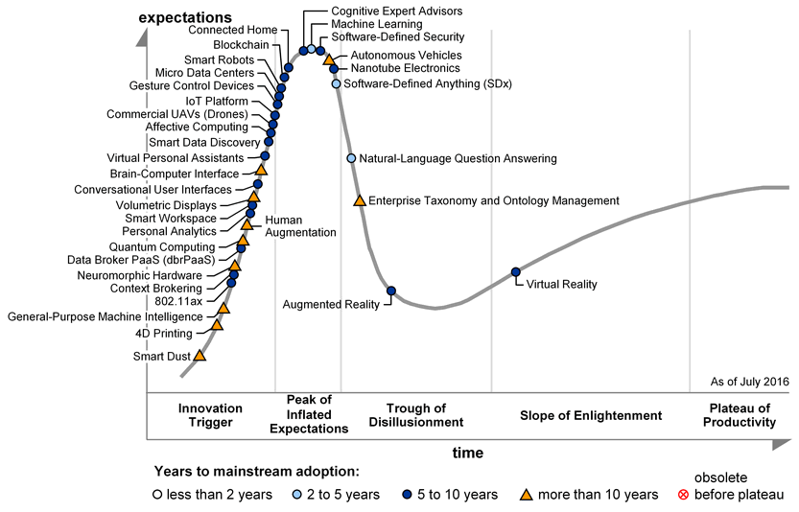
Gartner: Hype Cycle for Emerging Technologies, 2016
Hype Cycle for Emerging Technologies, 2017
Published: 21 July 2017 ID: G00314560
Analyst(s): Mike J. Walker

Slide 63
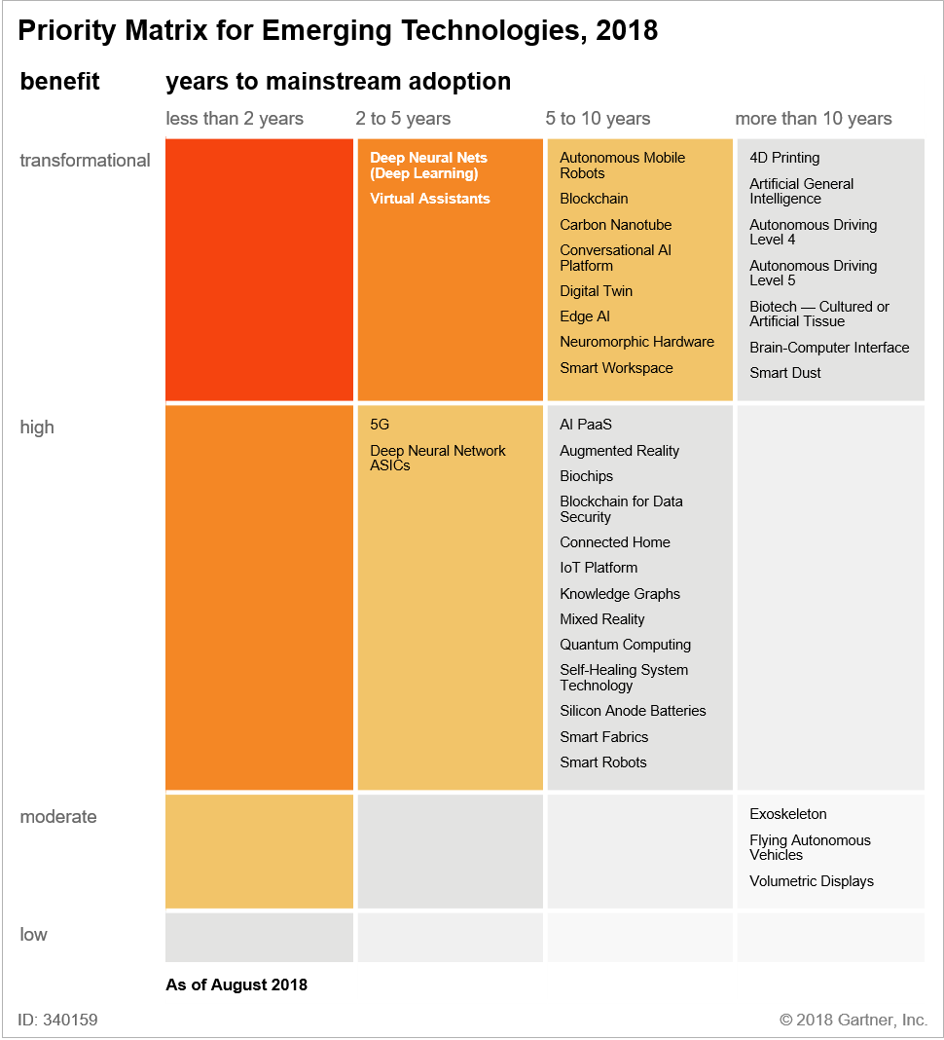
Gartner: Priority Matrix for Emerging Technologies, 2018
Hype Cycle for Emerging Technologies, 2018
Published: 6 August 2018 - ID G00340159
Analyst: Mike J. Walker

Slide 64
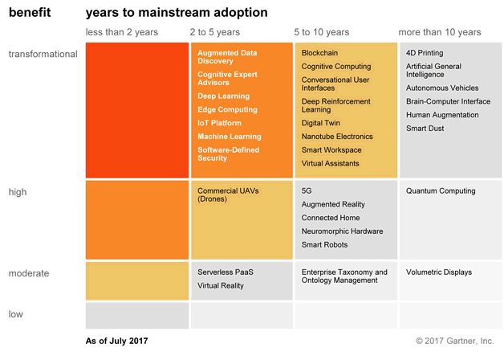
Gartner: Priority Matrix for Emerging Technologies, 2017
Hype Cycle for Emerging Technologies, 2017
Published: 21 July 2017 ID: G00314560
Analyst(s): Mike J. Walker

Slide 65
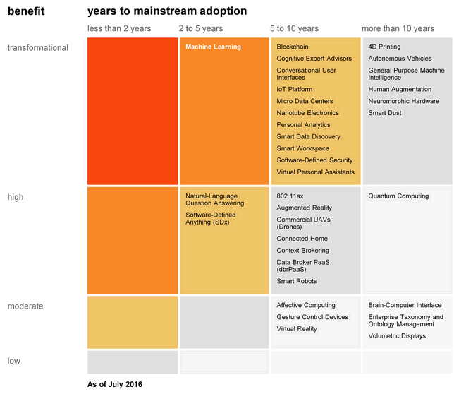
Gartner: Priority Matrix for Emerging Technologies, 2016
Hype Cycle for Emerging Technologies, 2016
ARCHIVED Published: 19 July 2016 ID: G00299893
Analyst(s): Mike J. Walker | Betsy Burton | Michele Cantara

Slide 66
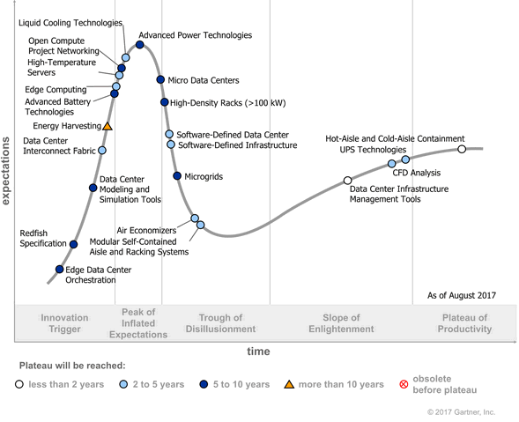
Gartner: Hype Cycle for Data Center Infrastructure, 2017
Hype Cycle for Data Center Infrastructure, 2017
Published: 01 August 2017 ID: G00334282
Analyst(s): Henrique Cecci | Bob Gill | Ron Blair | David J. Cappuccio

Slide 67
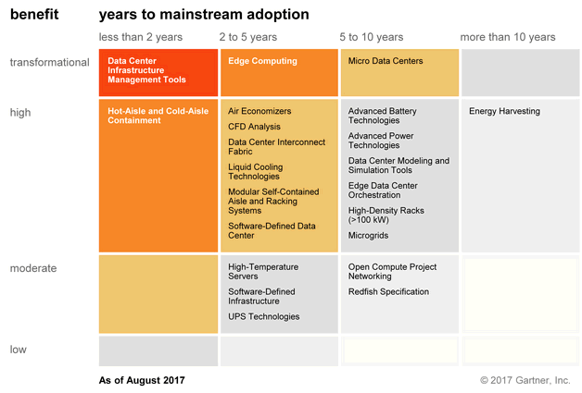
Gartner: Priority Matrix for Data Center Infrastructure, 2017
Hype Cycle for Data Center Infrastructure, 2017
Published: 01 August 2017 ID: G00334282
Analyst(s): Henrique Cecci | Bob Gill | Ron Blair | David J. Cappuccio

Slide 68
G: Technology Hypecycle II
Emerging Technologies hypecycles and Priority matrix at selected times 2008-2015
Clouds star from 2008 to today
They are mixed up with transformational and disruptive changes
The route to Digital Business (2015)

Slide 69
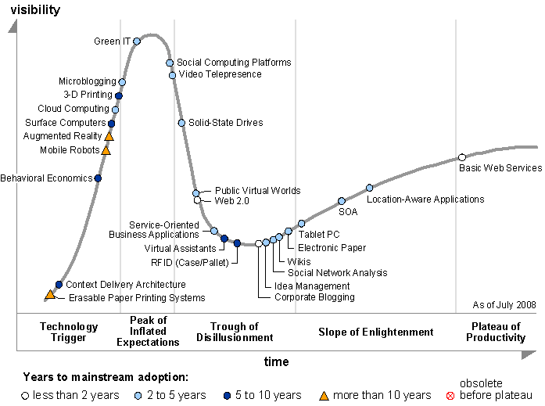
Gartner: Hype Cycle for Emerging Technologies, 2008
Hype Cycle for Emerging Technologies, 2008
ARCHIVED Published: 09 July 2008 ID: G00159496

Slide 70
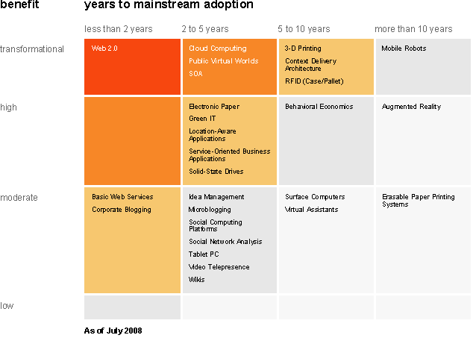
Gartner: Priority Matrix for Emerging Technologies, 2008
Hype Cycle for Emerging Technologies, 2008
ARCHIVED Published: 09 July 2008 ID: G00159496

Slide 71
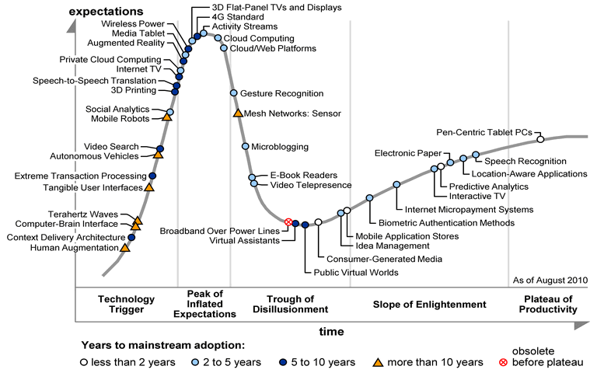
Gartner: Hype Cycle for Emerging Technologies, 2010
Hype Cycle for Emerging Technologies, 2010
ARCHIVED Published: 02 August 2010 ID: G00205757

Slide 72
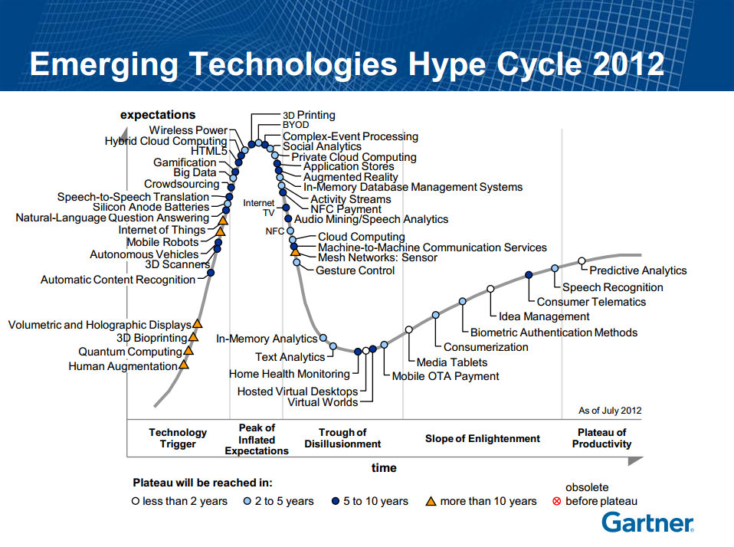
Gartner: Hype Cycle for Emerging Technologies, 2012
Hype Cycle for Emerging Technologies, 2012
ARCHIVED Published: 31 July 2012 ID: G00233931
48 technologies are listed in this year’s hype cycle which is the highest in last ten years. Year 2008 was the lowest (27)
Gartner Says in 2012: We are at an interesting moment — a time when the scenarios we’ve been talking about for a long time are almost becoming reality.

Slide 73
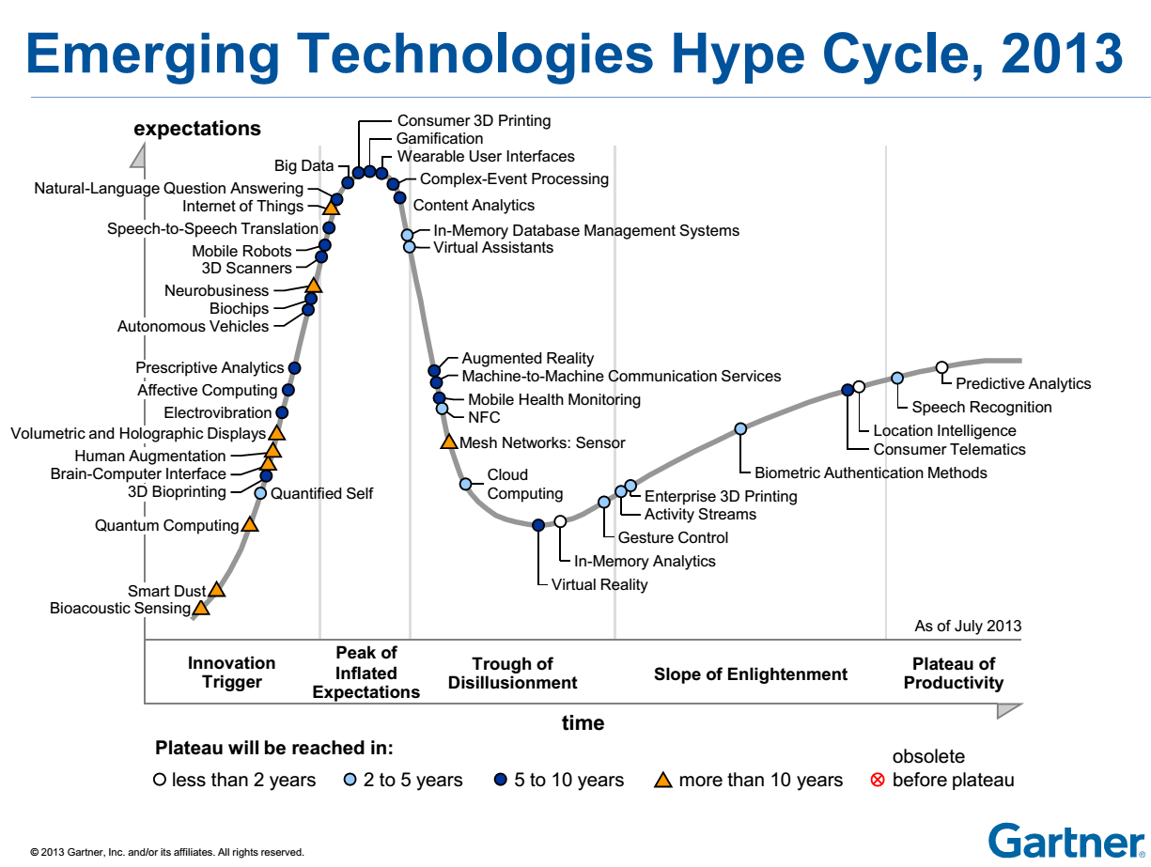
Gartner: Hype Cycle for Emerging Technologies, 2013
Private Cloud Computing is off the chart
http://public.brighttalk.com/resource/core/19507/august_21_hype_cycle_fenn_lehong_29685.pdf

Slide 74
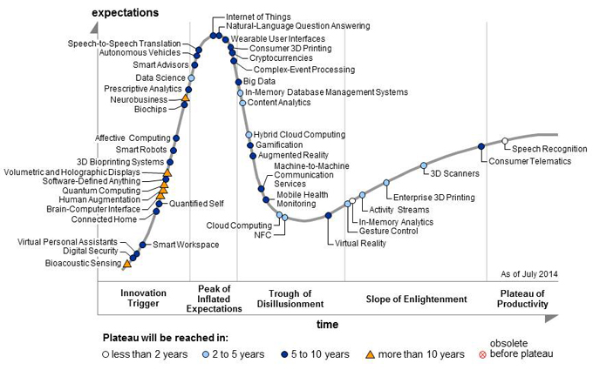
Gartner: Hype Cycle for Emerging Technologies, 2014

Slide 75
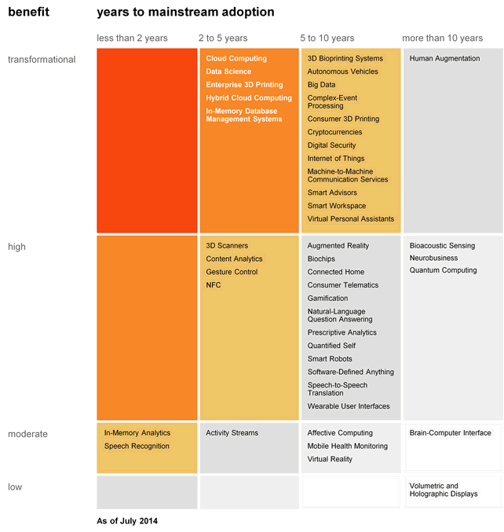
Gartner: Priority Matrix for Emerging Technologies, 2014
Hype Cycle for Emerging Technologies, 2014
ARCHIVED Published: 28 July 2014 ID: G00264126
Analyst(s): Hung LeHong | Jackie Fenn | Rand Leeb-du Toit

Slide 76
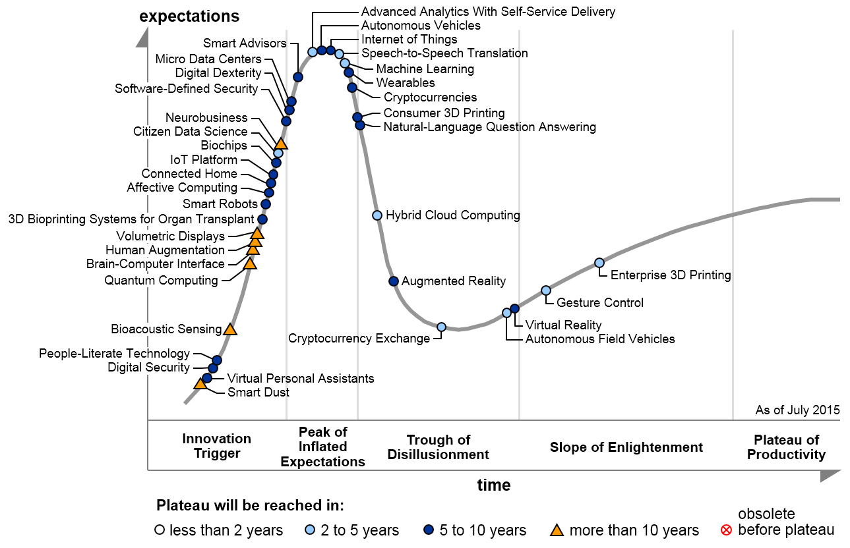
Gartner: Hype Cycle for Emerging Technologies, 2015
Hype Cycle for Emerging Technologies, 2015
ARCHIVED Published: 27 July 2015 ID: G00289755
Analyst(s): Betsy Burton | Mike J. Walker

Slide 77
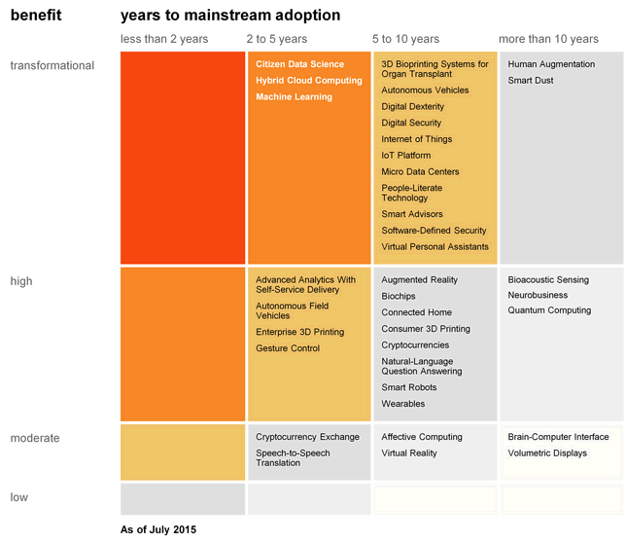
Gartner: Priority Matrix for Emerging Technologies, 2015
Hype Cycle for Emerging Technologies, 2015
ARCHIVED Published: 27 July 2015 ID: G00289755
Analyst(s): Betsy Burton | Mike J. Walker

Slide 78

Gartner 2015 Hype Cycle: The Journey to Digital Business

Slide 79
Gartner 2015 Hype Cycle: Digital Marketing (Stage 4)
The digital marketing stage sees the emergence of the Nexus of Forces (mobile, social, cloud and information).
Enterprises in this stage focus on new and more sophisticated ways to reach consumers who are more willing to participate in marketing efforts to gain greater social connection, or product and service value.
Buyers of products and services have more brand influence than previously. They see their mobile devices and social networks as preferred gateways and enterprises at this stage and grapple with tapping into buyer influence to grow their business.
Enterprises that are seeking to reach this stage should consider the following technologies on the Hype Cycle: Gesture Control, Hybrid Cloud Computing, Internet of Things (IoT), Machine Learning, Hybrid Cloud Computing, People-Literate Technology and Speech-to-Speech Translation.

Slide 80
Gartner 2015 Hype Cycle: Digital Business (Stage 5)
Digital business is the first post-nexus stage on the roadmap and focuses on the convergence of people, business and things.
The Internet of Things (IoT) and the concept of blurring the physical and virtual worlds are strong concepts in this stage.
Physical assets become digitalized and become equal actors in the business value chain, alongside already-digital entities such as systems and apps.
3D printing takes the digitalization of physical items further and provides opportunities for disruptive change in the supply chain and manufacturing.
The ability to digitalize attributes of people (for example, the health vital signs) is also part of this stage.
Even currency (which is often thought of as digital already) can be transformed (for example, cryptocurrencies like bitcoin).
There are many hyped technologies of relevance

Slide 81
Gartner 2015 Hype Cycle: Autonomous (Stage 6)
Autonomous represents the final postnexus stage.
This stage is defined by an enterprise's ability to leverage technologies that provide humanlike or human-replacing capabilities.
Using autonomous vehicles to move people or products and using cognitive systems to recommend a potential structure for an answer to an email, write texts or answer customer questions are all examples that mark the autonomous stage.
Enterprises seeking to reach this stage to gain competitiveness should consider these technologies on the Hype Cycle: Autonomous Vehicles, Bioacoustic Sensing, Biochips, Brain-Computer Interface, Digital Dexterity, Human Augmentation, Machine Learning, Neurobusiness, People-Literate Technology, Quantum Computing, Smart Advisors, Smart Dust, Smart Robots, Virtual Personal Assistants, Virtual Reality, and Volumetric Displays.

Slide 82
H: Cloud Infrastructure I
Comments on trends in the data center and its technologies
Clouds physically across the world
Green computing
Fraction of world’s computing ecosystem in clouds and associated sizes

Slide 83
Cloud Infrastructure
The battle for supremacy among providers of servers for public and private cloud infrastructure is intensifying as more end users and service providers seek to implement effective cloud strategies.
In addition to offering the right server features and functions, server providers are increasingly looking to support the most in-demand management tools, software and services to position themselves as appealing compute foundations. This is true for public, private and/or hybrid cloud implementations.
No server vendor can ignore the threats and opportunities that cloud computing presents. Vendors will fall into three main categories.
  A small number will deliver their own cloud services, and leverage their own hardware designs to create differentiation.
  Most vendors will aim to sell server infrastructure to cloud service providers, but their effectiveness will depend on both technology and margin factors.
  And some vendors will seek to emulate the benefits of cloud computing to augment and extend their on-premises viability

Slide 84
Future Trends in IT: Containers, Serverless, Edge, Decentralization
By 2020, anything other than a cloud-only strategy for new IT initiatives will require justification at more than 30% of large enterprise organizations.
By 2018, 50% of the applications hosted in the public cloud will be considered mission-critical by the organizations that use them.
By 2021, more than half of global enterprises already using cloud today will adopt an all-in cloud strategy.
By 2018, 60% of enterprises will mandate container vulnerability scanning, up from less than 30% in 2016.
By 2019, 40% of container deployments will have adopted a whitelisting-based lockdown approach and deactivated runtime signature-based anti-malware scanning.
By 2019, 90% of enterprises will consider properly secured container deployments as secure as virtual machines, up from less than 20% in 2016.
Good choice of O/S critical for containers
Disable Antivirus and Adopt Application Control Whitelisting; WhiteListing lists allowed applications that have been tested
Security teams are often an inhibitor to innovation. Business, risk and security leaders must investigate the benefits of devolving security teams into the rest of the enterprise.

Slide 85

Amazon Network
https://aws.amazon.com/about-aws/global-infrastructure/

Slide 86

Azure Cloud Data Centers (Microsoft)

Slide 87

Google Cloud Data Centers

Slide 88

IBM Cloud Network
https://www.ibm.com/cloud-computing/bluemix/data-centers

Slide 89


Network Usage by Clouds
Cisco Global Cloud Index Projects Cloud Traffic to Nearly Quadruple Representing 92 Percent of Total Data Center Traffic by 2020
https://www.cisco.com/c/en/us/solutions/collateral/service-provider/global-cloud-index-gci/white-paper-c11-738085.html

Slide 90
Green Clouds
Cloud Centers optimize life cycle costs and power use
http://www.datacenterknowledge.com/archives/2011/05/10/uptime-institute-the-average-pue-is-1-8/
Average PUE = 1.8 (was nearer 3) ; Good Clouds are 1.1-1.2 (PUE defined next slide)
4th generation data centers (from Microsoft) make everything modular so data centers can be built incrementally as in modern manufacturing
http://loosebolts.wordpress.com/2008/12/02/our-vision-for-generation-4-modular-data-centers-one-way-of-getting-it-just-right/
Extends container based third generation

Slide 91



Remembering Grid Computing: IoT and Distributed Center I
Hyperscale data centers will grow from 338 in number at the end of 2016 to 628 by 2021. They will represent 53 percent of all installed data center servers by 2021.
  They form a distributed Compute (on data) grid with some 50 million servers
94 percent of workloads and compute instances will be processed by cloud data centers by 2021-- only six percent will be processed by traditional data centers.
Analysis from CISCO https://www.cisco.com/c/en/us/solutions/collateral/service-provider/global-cloud-index-gci/white-paper-c11-738085.html
Number of Public or Private Cloud Data Center Instances
Number of Cloud Data Centers
Number of instances per server

Slide 92
Remembering Grid Computing: IoT and Distributed Center II
By 2021, Cisco expects IoT connections to reach 13.7 billion, up from 5.8 billion in 2016, according to its Global Cloud Index.
Globally, the data stored in data centers will nearly quintuple by 2021 to reach 1.3ZB by 2021, up 4.6-fold (a CAGR of 36 percent) from 286 exabytes (EB) in 2016.
Big data will reach 403 EB by 2021, up almost eight-fold from 25EB in 2016. Big data will represent 30 percent of data stored in data centers by 2021, up from 18 percent in 2016.
The amount of data stored on devices will be 4.5-times higher than data stored in data centers, at 5.9ZB by 2021.
Driven largely by IoT, the total amount of data created (and not necessarily stored) by any device will reach 847ZB per year by 2021, up from 218ZB per year in 2016.
The Intelligent Edge or IoT is a distributed Data Grid

Slide 93

Mary Meeker identifies even more digital data

Slide 94

Workload and compute instance shift from traditional data centers to cloud data centers

Slide 95
I: Cloud Infrastructure II
Gartner hypecycle and priority matrix on Compute Infrastructure
Containers compared to virtual machines
The emergence of artificial intelligence as a dominant force

Slide 96

Gartner: Hype Cycle for Compute Infrastructure, 2017
Hype Cycle for Compute Infrastructure, 2017
Published: 21 July 2017 ID: G00313672
Analyst(s): George J. Weiss | Chirag Dekate | Martin Reynolds

Slide 97

Gartner: Priority Matrix for Compute Infrastructure, 2017
Hype Cycle for Compute Infrastructure, 2017
Published: 21 July 2017 ID: G00313672
Analyst(s): George J. Weiss | Chirag Dekate | Martin Reynolds

Slide 98
Gartner: Comments on Cloud Computing, 2017
Hype Cycle for Cloud Computing, 2017
Published: 01 August 2017 ID: G00315206
Analyst(s): David Mitchell Smith | Ed Anderson
Cloud computing has reached the Slope of Enlightenment.
Cloud computing hype continues to be high relative to other technologies, even though it is quite far along in the Hype Cycle. Most organizations are becoming increasingly grounded in the practical benefits and risks of cloud computing. Cloud first is becoming a very common description of enterprises' strategies, as cloud adoption is shifting to mainstream use (approaching "new normal" status), including support for production applications and mission-critical operations. Cloud services are heavily favored for new application development, particularly when organizations pursue digital business outcomes.

Slide 99
Evolution from 2017 to 2018
The following 3 topics were removed
  Advanced Server Energy Monitoring
  Integrated Systems: Infrastructure as a Service
  V2P Server Management
These technologies were removed because they had become fully mature. They were on productivity plateau in 2017
In 2018, there are four transformational technologies
  Serverless Infrastructure (also transformational in 2017 but moved from 5-10 to 2-5 years)
  Neuromorphic computing; support neural-net ML directly
  In-memory computing; an old idea
  Next generation memory; last 2 bring data closer to CPU/GPU increasing performance.
    HPE ion migration memristor,
    Intel-Micron's 3D XPoint phase change, and
    spin-transfer torque memory.

Slide 100

Gartner: Hype Cycle for Compute Infrastructure, 2018
Hype Cycle for Compute Infrastructure, 2018
Published: 19 July 2018 ID: G00340106
Analyst(s): Daniel Bowers, Martin Reynolds, Chirag Dekate

Slide 101

Gartner: Priority Matrix for Compute Infrastructure, 2018
Hype Cycle for Compute Infrastructure, 2018
Published: 19 July 2018 ID: G00340106
Analyst(s): Daniel Bowers, Martin Reynolds, Chirag Dekate

Slide 102
Containers and Serverless will dominate innovation
"Software is eating the world," and modern digital businesses that leverage software to analyze data and build applications are doing so rapidly, with agility and a heightened need for resiliency. CIOs and application leaders are under pressure to deliver software more quickly by building scalable platforms, architectures and processes that put delivery back into the hands of the developers.
New computing abstractions, such as Docker containers and serverless computing frameworks, are changing how and where enterprises consume server computing. IT leaders should align their use cases with appropriate computing abstractions to benefit from these innovations.
By 2020, more than 50% of global enterprises will be running containerized applications in production, which is an increase from fewer than 20% today.
By 2020, the leading serverless offerings will expand to support more general-use patterns and will emerge as a leading platform architecture for cloud-native application services.
Virtual machines and containers serve different enterprise needs, with containers gaining adoption for the agile development of cloud-native applications, and VMs remain the mainstay of traditional, monolithic applications

Slide 103
Why use Containers not Virtual Machines
By 2020, more than 50% of enterprises will run mission-critical, containerized cloud-native applications in production, up from less than 5% today.
All of the major public cloud IaaS providers now offer container as a service (CaaS).
When compared to VMs, containers offer three key benefits that have made them appealing to I&O leaders:
  Since they can run on a bare-metal infrastructure, containers can be operated more efficiently than VMs on single tenant server infrastructure.
  Because of their smaller resource footprint, containers can enable a much higher tenant density on a host.
  Containerized applications can be managed more effectively with less configuration drift, as it is possible to more easily redeploy services and automate their life cycle management.
Container adoption has rapidly expanded within enterprise IT in the past two years. This can be attributed to the rise of two key application deployment patterns:
  The rise of cloud native applications: applications that are being written in an abstracted way to take advantage of the native elasticity and programmability of cloud infrastructure.
  The growing interest in microservice architecture and the recognition that containers will be a foundational technology for enabling next-generation microservices-based applications.

Slide 104
Key Trends in Computer Infrastructure
Artificial Intelligence, Internet of Things (Edge Computing) and noncentralized organization
AI on System and AI for system
Increased automation, and use of containers
Skill shortages
New use cases
  Prepare for serverless ecosystems
  Elastic (adaptive) infrastructure strategies
  Real-time use cases (Streaming data).

Slide 105
Artificial Intelligence on the Data Center and for the Data Center
By 2020, 30% of data centers that fail to effectively apply artificial intelligence to support enterprise business will not be operationally and economically viable.
Need Machine Learning to run software defined computer infrastructure.
Artificial Intelligence will
  Monitor, probe and provide feedback on configuration, workload, capacity, security and connectivity.
  Track the environments of other systems in on-premises or in public cloud.
  Adapt to predetermined, defined overall business and IT performance objectives.
  Apply flexible configuration and composability principles to resource utilization and capacity.
  Maintain goal-directed system stability through periods of volatility and change

Slide 106
J: Cloud Software
HPC-ABDS with over 350 software packages and how to use each of 21 layers
Google’s software innovations
MapReduce in pictures
Cloud and HPC software stacks compared
Components need to support cloud/distributed system programming
Single Program/Instruction Multiple Data SIMD SPMD

Slide 107
HPC-ABDS
Integrated wide range of HPC and Big Data technologies.
I gave up updating list in January 2016!

Slide 108
Components of Big Data Stack
Google likes to show a timeline; we can build on (Apache version of) this
2002 Google File System GFS ~HDFS (Level 8)
2004 MapReduce Apache Hadoop (Level 14A)
2006 Big Table Apache Hbase (Level 11B)
2008 Dremel Apache Drill (Level 15A)
2009 Pregel Apache Giraph (Level 14A)
2010 FlumeJava Apache Crunch (Level 17)
2010 Colossus better GFS (Level 18)
2012 Spanner horizontally scalable NewSQL database ~CockroachDB (Level 11C)
2013 F1 horizontally scalable SQL database (Level 11C)
2013 MillWheel ~Apache Storm, Twitter Heron (Google not first!) (Level 14B)
2015 Cloud Dataflow Apache Beam with Spark or Flink (dataflow) engine (Level 17)
Functionalities not identified: Security(3), Data Transfer(10), Scheduling(9), DevOps(6), serverless computing (where Apache has OpenWhisk) (5)
HPC-ABDS Levels in ()

Slide 109
MapReduce Illustrated by Judy Qiu
Introduced by Google MapReduce
Hadoop is an open source MapReduce framework
Dean, J. and S. Ghemawat (2008). "MapReduce: simplified data processing on large clusters." Commun. ACM 51(1): 107-113.
User
Program
Mapper: read input data, emit key/value pairs
Reducer: accept a key and all the values belonging to that key, emits final output
fork
fork
fork
Master
Map
assign
map
assign
reduce
Reduce
Input Data
Worker
write
Output
File 0
Split 0
local
write
Worker
Split 1
read
Worker
Split 2
Output
File 1
Worker
Worker
remote read, sort
Notes:
Word count for example
Sort example

Slide 110

Different choices in software systems in Clouds and HPC. HPC-ABDS takes cloud software augmented by HPC when needed to improve performance
16 of 21 layers plus languages

Slide 111
2 Aspects of Cloud Computing:
Infrastructure and Runtimes
Cloud infrastructure: outsourcing of servers, computing, data, file space, utility computing, etc..
Cloud runtimes or Platform: tools to do data-parallel (and other) computations. Valid on Clouds and traditional clusters
  Apache Hadoop, Google MapReduce, Microsoft Dryad, Bigtable, Chubby and others
  MapReduce designed for information retrieval but is excellent for a wide range of science data analysis applications
  Can also do much traditional parallel computing for data-mining if extended to support iterative operations
  Data Parallel File system as in HDFS and Bigtable

Slide 112
Components of a Big Data Runtime I
Area | Component | Implementation | Comments: User API
Architecture Specification | Coordination Points | State and Configuration Management; Program, Data and Message Level | Change execution mode; save and reset state
 | Execution Semantics | Mapping of Resources to Bolts/Maps in Containers, Processes, Threads | Different systems make different choices - why?
 | Parallel Computing | Spark Flink Hadoop Pregel MPI modes | Owner Computes Rule
Job Submission | (Dynamic/Static) Resource Allocation | Plugins for Slurm, Yarn, Mesos, Marathon, Aurora | Client API (e.g. Python) for Job Management
Task System | Task migration | Monitoring of tasks and migrating tasks for better resource utilization | Task-based programming with Dynamic or Static Graph API; FaaS API; Support accelerators (CUDA,KNL)
 | Elasticity | OpenWhisk
 | Streaming and FaaS Events | Heron, OpenWhisk, Kafka/RabbitMQ
 | Task Execution | Process, Threads, Queues
 | Task Scheduling | Dynamic Scheduling, Static Scheduling, Pluggable Scheduling Algorithms
 | Task Graph | Static Graph, Dynamic Graph Generation

Slide 113
Components of a Big Data Runtime II
Area | Component | Implementation | Comments
Communication API | Messages | Heron | This is user level and could map to multiple communication systems
 | Dataflow Communication | Fine-Grain Twister2 Dataflow communications: MPI,TCP and RMA Coarse grain Dataflow from NiFi, Kepler? | Streaming, ETL data pipelines; Define new Dataflow communication API and library
 | BSP Communication Map-Collective | Conventional MPI, Harp | MPI Point to Point and Collective API
Data Access | Static (Batch) Data | File Systems, NoSQL, SQL | Data API
 | Streaming Data | Message Brokers, Spouts
Data Management | Distributed Data Set | Relaxed Distributed Shared Memory(immutable data), Mutable Distributed Data | Data Transformation API; Spark RDD, Heron Streamlet
Fault Tolerance | Check Pointing | Upstream (streaming) backup; Lightweight; Coordination Points; Spark/Flink, MPI and Heron models | Streaming and batch cases distinct; Crosses all components
Security | Storage, Messaging, execution | Research needed | Crosses all Components

Slide 114
Using HPC-ABDS Layers I
Message Protocols
This layer is unlikely to directly visible in many applications as used in “underlying system”. Thrift and Protobuf have similar functionality and are used to build messaging protocols between components (services) of system
Distributed Coordination
Zookeeper is likely to be used in many applications as it is way that one achieves consistency in distributed systems – especially in overall control logic and metadata. It is for example used in Apache Storm to coordinate distributed streaming data input with multiple servers ingesting data from multiple sensors.
JGroups is less commonly used and is very different. It builds secure multi-cast messaging with a variety of transport mechanisms.
Security & Privacy
Security & Privacy is of course a huge area present implicitly or explicitly in all applications. It covers authentication and authorization of users and the security of running systems. In the Internet there are many authentication systems with sites often allowing you to use Facebook, Microsoft , Google etc. credentials. InCommon, operated by Internet2, federates research and higher education institutions, in the United States with identity management and related services.
LDAP is a simple database (key-value) forming a set of distributed directories recording properties of users and resources according to X.500 standard. It allows secure management of systems. OpenStack Keystone is a role-based authorization and authentication environment to be used in OpenStack private clouds.

Slide 115
Using HPC-ABDS Layers II
Monitoring:
Here Ambari is aimed at installing and monitoring Hadoop systems. Nagios and Ganglia are similar system monitors with ability to gather metrics and produce alerts. Inca is a higher level system allowing user reporting of performance of any sub system. Essentially all systems use monitoring but most users do not add custom reporting.
IaaS Management from HPC to hypervisors:
These technologies underlie all applications. The classic technology OpenStack manages virtual machines and associated capabilities such as storage and networking. The commercial clouds have their own solution and it is possible to move machine images between these different environments. As a special case there is “bare-metal” i.e. the null hypervisor. The DevOps technology Docker is playing an increasing role as a linux container and will be used in this course together with Kubernetes from level 6

Slide 116
Using HPC-ABDS Layers III
DevOps
This describes technologies and approaches that automate the deployment and installation of software systems and underlies “software-defined systems”. At IU, we integrate tools together in Cloudmesh – Libcloud, Cobbler, Chef, Docker, Slurm, Ansible, Puppet. Celery. We saw Docker earlier in 5 on last slide. Kubernetes is used to manage multiple Docker instances
Interoperability
This is both standards and interoperability libraries for services (Whirr), compute (OCCI), virtualization and storage (CDMI)
File systems
One will use files in most applications but the details may not be visible to the user. Maybe you interact with data at level of a data management system or an Object store (OpenStack Swift or Amazon S3). Most science applications are organized around files; commercial systems at a higher level.
Cluster Resource Management
You will certainly need cluster management in your application although often this is provided by the system and not explicit to the user. Yarn from Hadoop is gaining in popularity while Slurm is a basic HPC system as are Moab, SGE, OpenPBS while Condor also well known for scheduling of Grid applications. Mesos is similar to Yarn and is also becoming popular. Many systems are in fact collections of clusters as in data centers or grids. These require management and scheduling across many clusters; the latter is termed meta-scheduling.

Slide 117
Using HPC-ABDS Layers IV
Data Transport
Globus Online or GridFTP is dominant system in HPC community but this area is often not highlighted as often application only starts after data has made its way to disk of system to be used. Simple HTTP protocols are used for small data transfers while the largest ones use the “Fedex/UPS” solution of transporting disks between sites.
A) File management, B) NoSQL, C) SQL
This is a critical area for nearly all applications as it captures areas of file, object, NoSQL and SQL data management. The many entries in area testify to variety of problems (graphs, tables, documents, objects) and importance of efficient solution. Just a little while ago, this area was dominated by SQL databases and file managers.
In-memory databases&caches / Object-relational mapping / Extraction Tools
This is another important area addressing two points. Firstly conversion of data between formats and secondly enabling caching to put as much processing as possible in memory. This is an important optimization with Gartner highlighting this areas in several recent hype charts with In-Memory DBMS and In-Memory Analytics.

Slide 118
Using HPC-ABDS Layers V
Inter process communication Collectives, point-to-point, publish-subscribe, MPI
This describes the different communication models used by the systems in layers 13, 14) below. Results may be very sensitive to choices here as there are big differences from disk-based versus point to point (no disk) for Hadoop v. Harp (MPI)or the different latencies exhibited by publish-subscribe systems. I always recommend Pub-Sub systems like ActiveMQ or RabbitMQ for messaging.
A) Basic Programming model and runtime, SPMD, MapReduce, MPI
B) Streaming
A very important layer defining the cloud (HPC-ABDS) programming model. Includes Hadoop and related tools Spark, Twister, Stratosphere, Hama (iterative MapReduce); Giraph, Pregel, Pegasus (Graphs); Storm, S4, Samza (Streaming); Tez (workflow) and Yarn integration. Most applications use something here!
A) High level Programming
Components at this level are not required but are very interesting and we can expect great progress to come both in improving them and using them. Pig and Sawzall offer data parallel programming models; Hive, HCatalog, Shark, MRQL, Impala, and Drill support SQL interfaces to MapReduce, HDFS and Object stores

Slide 119
Using HPC-ABDS Layers VI
B) Frameworks
This is exemplified by Google App Engine and Azure (when it was called PaaS) but now there are many “integrated environments”.
Application and Analytics
This is the “business logic” of application and where you find machine learning algorithms like clustering. Mahout , MLlib , MLbase are in Apache for Hadoop and Spark processing; R is a central library from statistics community. There are many other important libraries where we mention those in deep learning (CompLearn Caffe), image processing (ImageJ), bioinformatics (Bioconductor) and HPC (Scalapack and PetSc). You will nearly always need these or other software at this level
Workflow-Orchestration
This layer implements orchestration and integration of the different parts of a job. These can be specified by a directed data-flow graph and often take a simple pipeline form illustrated in “access pattern” 10 discussed later. This field was advanced significantly by the Grid community and the systems are quite similar in functionality although their maturity and ease of use can be quite different. The interface is either visual (link programs as bubbles with data flow) or as an XML or program (Python) script.

Slide 120

SPMD Software from Judy Qiu
Single Program Multiple Data (SPMD):
A coarse-grained SIMD approach to programming for MIMD systems.
Data parallel software:
Do the same thing to all elements of a structure (e.g., many matrix algorithms).
Unfortunately, sometimes difficult to apply to complex problems (as were the SIMD machines; MapReduce).
SPMD much more useful than SIMD
What applications are suitable for SPMD? (e.g. WordCount)

Slide 121
K: Cloud Applications I
Big Data; a lot of best examples have NOT been updated so some slides old but still make the correct points
Some of the business usage patterns from NIST

Slide 122

http://cs.metrostate.edu/~sbd/
Oracle ~2010

Slide 123
http://www.kpcb.com/blog/2016-internet-trends-report

Slide 124

20 hours
300 hours per minute Sept 1 2016
Meeker/Wu May 29 2013 Internet Trends D11 Conference

Slide 125
https://www.statisticbrain.com/youtube-statistics/ Sept 1 2016
YouTube Company Statistics | Data
Total number of people who use YouTube | 1,325,000,000
Hours of video uploaded to YouTube every minute | 300 hours
Number of videos viewed on YouTube everyday | 4,950,000,000
Number of unique visits to YouTube every month | 900,000,000
Total number of hours of video watched on YouTube each month | 3.25 billion hours
Number of YouTube videos that have generated over 1 billion views | 10,113
Percent of YouTube visitors that come from outside the U.S. | 70 %
Number of countries with localized versions of YouTube | 42
Total number of languages Youtube is broadcast in | 54
User submitted video with the most views – "Charlie bit my finger" | 829,000,000
854M Sept 1 2017

Slide 126

My Research focus is Science Big Data but note
Note largest science ~200 petabytes = 0.00005 total
Zettabyte ~10¹⁰ Typical Local Storage (100 Gigabytes)
Zettabyte = 1000 Exabytes
Exabyte = 1000 Petabytes
Petabyte = 1000 Terabyte
Terabyte = 1000 Gigabytes
Gigabyte = 1000 Megabytes
Note 7 ZB (7. 10²¹) is about a
terabyte (10¹²) for each person
in world
http://www.kpcb.com/internet-trends

Slide 127
Scale millions of petabytes = zettabytes
http://www.kpcb.com/blog/2016-internet-trends-report

Slide 129

Ruh VP Software GE http://fisheritcenter.haas.berkeley.edu/Big_Data/index.html

Slide 130

MM = Million
Ruh VP Software GE http://fisheritcenter.haas.berkeley.edu/Big_Data/index.html

Slide 131



1. Multiple users performing interactive queries and updates on a database with basic availability and eventual consistency
First of ten access patterns from NIST Public Big Data Working Group. We will show more of these (but not all of them)
These tell you what we need to learn!
Analytics/Query
Programming
Data Store
Orchestration
Generate a SQL Query
Process SQL Query (RDBMS Engine, Hive, Hadoop, Drill)
Data Storage: RDBMS, HDFS, Hbase
Includes access to traditional ACID database
Data, Streaming, Batch …..

Slide 132

3. Move data from external data sources into a highly horizontally scalable data store, transform it using highly horizontally scalable processing (e.g. Map-Reduce), and return it to the horizontally scalable data store (ELT)
http://www.dzone.com/articles/hadoop-t-etl
Transform with Hadoop, Spark, Giraph …
Enterprise
Data
Warehouse
Data Storage: HDFS, Hbase
OLTP Database
Streaming Data
Web Services
ELT is Extract Load Transform

Slide 133
4. Perform batch analytics on the data in a highly horizontally scalable data store using highly horizontally scalable processing (e.g. MapReduce) with a user-friendly interface (e.g. SQL like)
SQL Query General Analytics
HCatalog
Hive
Mahout, R
Hadoop, Spark, Giraph, Pig …
Data Storage: HDFS, Hbase
Data, Streaming, Batch …..

Slide 134
10. Orchestrate multiple sequential and parallel data transformations and/or analytic processing using a workflow manager
This can be used for science by adding data staging phases as in case 5A
Nearly all workloads need to link multiple stages together. That is what workflow or orchestration does.
Technology like Hadoop is mainly aimed at individual stages
Specify Analytics Pipeline
Orchestration Layer (Workflow)
Analytic-3
(Visualize)
Analytic-2
Analytic-1
Hadoop, Spark, Giraph, Pig …
Data Storage: HDFS, Hbase

Slide 135

Example of Pattern 10 from Hortonworks
http://hortonworks.com/hadoop/yarn/

Slide 136


Slide 137
L: Cloud Applications II
Clouds in science where area called cyberinfrastructure; the usage pattern from NIST
Artificial Intelligence from Gartner

Slide 138
What is Cyberinfrastructure
Cyberinfrastructure is (from NSF) infrastructure that supports distributed research and learning (e-Science, e-Research, e-Education)
  Links data, people, computers
Exploits Internet technology (Web2.0 and Clouds) adding (via Grid technology) management, security, supercomputers etc.
It has two aspects: parallel – low latency (microseconds) between nodes and distributed – highish latency (milliseconds) between nodes
Parallel needed to get high performance on individual large simulations, data analysis etc.; must decompose problem
Distributed aspect integrates already distinct components – especially natural for data (as in biology databases etc.)
Cyberinfrastructure spans: High definition videoconferencing linking people across the globe; Digital Library of music, curriculum, scientific papers; Simulating a new battery design (exascale problem); Sharing data from world’s telescopes; Using cloud to analyze your personal genome; Analyzing Tweets…documents to discover which stocks will crash; how disease is spreading; linguistic inference; ranking of institutions; Enabling all to be equal partners in creating knowledge and converting it to wisdom
Notes:
138

Slide 139
e-moreorlessanything
‘e-Science is about global collaboration in key areas of science, and the next generation of infrastructure that will enable it.’ from inventor of e-science term John Taylor Director General of Research Councils UK, Office of Science and Technology
e-Science is about developing tools and technologies that allow scientists to do ‘faster, better or different’ research
Similarly e-Business captures the emerging view of corporations as dynamic virtual organizations linking employees, customers and stakeholders across the world.
This generalizes to e-moreorlessanything including e-DigitalLibrary, e-FineArts, e-HavingFun and e-Education
A deluge of data of unprecedented and inevitable size must be managed and understood.
People (virtual organizations), computers, data (including sensors and instruments) must be linked via hardware and software networks
Notes:
139

Slide 140



Note LHC lies in a tunnel 27 kilometres (17 mi) in circumference
This analysis raw data → reconstructed data → AOD and TAGS → Physics is performed on the multi-tier LHC Computing Grid. Note that every event can be analyzed independently so that many events can be processed in parallel with some concentration operations such as those to gather entries in a histogram. This implies that both Grid and Cloud solutions work with this type of data with currently Grids being the only implementation today.
ATLAS Expt. ATLAS is 45 metres long, 25 metres in diameter, and weighs about 7,000 tons. The experiment is a collaboration involving roughly 3,000 physicists at 175 institutions in 38 countries
Higgs Event
The LHC produces over 50 petabytes of data per year of all varieties and with the exact value depending on duty factor of accelerator (which can be reduced simply to cut electricity cost but also due to malfunction of one or more of the many complex systems) and experiments. The raw data produced by experiments is processed on the LHC Computing Grid, which has some 200,000 Cores arranged in a three level structure. Tier-0 is CERN itself, Tier 1 are national facilities and Tier 2 are regional systems. For example one LHC experiment (CMS) has 7 Tier-1 and 50 Tier-2 facilities. CERN data center has 200 petabytes of data
http://grids.ucs.indiana.edu/ptliupages/publications/Where%20does%20all%20the%20data%20come%20from%20v7.pdf

Slide 141







Tracking the Heavens
“The Universe is now being explored systematically, in a panchromatic way, over a range of spatial and temporal scales that lead to a more complete, and less biased understanding of its constituents, their evolution, their origins, and the physical processes governing them.”
Towards a National Virtual Observatory
Hubble Telescope
Palomar Telescope
Sloan Telescope

Slide 142





Virtual Observatory Astronomy Initiative
Integrates Experiments over wavelengths
Visible
Radio
Far-Infrared
Dust Map
Galaxy Density Map
Visible + X-ray

Slide 143




Polar Grid
Lightweight Cyberinfrastructure to support mobile Data gathering expeditions plus classic central resources (as a cloud)

Slide 144


Genome Sequencing Costs
Illumina HiSeq X 10 can sequence 18,000 genomes per year at $1000 each. Produces 0.6Terabases per day
https://www.genome.gov/sequencingcostsdata/
Note performance of sequencing levelled off since 2015
Cost per Genome

Slide 145
Access Pattern 5A. Perform interactive analytics on observational scientific data
Science Analysis Code, Mahout, R
Science Analysis Code, Mahout, R
Science Analysis Code, Mahout, R
Science Analysis Code, Mahout, R
Grid or Many Task Software, Hadoop, Spark, Giraph, Pig …
Grid or Many Task Software, Hadoop, Spark, Giraph, Pig …
Grid or Many Task Software, Hadoop, Spark, Giraph, Pig …
Grid or Many Task Software, Hadoop, Spark, Giraph, Pig …
Data Storage: HDFS, Hbase, File Collection
Data Storage: HDFS, Hbase, File Collection
Data Storage: HDFS, Hbase, File Collection
Data Storage: HDFS, Hbase, File Collection
Direct Transfer
Transport batch of data to primary analysis data system
Streaming Twitter data for Social Networking
Streaming Twitter data for Social Networking
Streaming Twitter data for Social Networking
Streaming Twitter data for Social Networking
Local Accumulate and initial computing
Local Accumulate and initial computing
Local Accumulate and initial computing
Local Accumulate and initial computing
Following examples are LHC, Remote Sensing, Astronomy and Bioinformatics
Record Scientific Data in “field”
Record Scientific Data in “field”
Record Scientific Data in “field”
Record Scientific Data in “field”

Slide 146
Artificial Intelligence/Deep Learning
Artificial intelligence (AI) forms a core part of end-user digital business strategies.
Many end users today leverage the embedded machine learning (ML) capacities in systems such as SAP, SAS, Informatica and Spark to achieve their ML goals. For these workloads, traditional enterprise stacks can often deliver sufficient capabilities.
However, deep learning (DL) leverages extreme compute power and large datasets to deliver unprecedented accuracy and efficiencies.
  Vendors are addressing the extreme compute requirements for DL training infrastructures by integrating a high density of compute accelerators (such as Nvidia GPUs) architected in scalable platforms.
  Other performance solutions that can scale out efficiently and support a wide range of deep learning frameworks include Tensorflow, Caffe2, Caffe, Theano, Torch, MXNet and Microsoft Cognitive Toolkit (CNTK)

Slide 147
Intelligent Systems ~
Artificial Intelligence ~ Machine Learning
2017 Headlines
The Race For AI: Google, Twitter, Intel, Apple In A Rush To Grab Artificial Intelligence Startups
Google, Facebook, And Microsoft Are Remaking Themselves Around AI
Google: The Full Stack AI Company
Bezos Says Artificial Intelligence to Fuel Amazon's Success
Microsoft CEO says artificial intelligence is the 'ultimate breakthrough'
Tesla’s New AI Guru Could Help Its Cars Teach Themselves
Netflix Is Using AI to Conquer the World... and Bandwidth Issues
How Google Is Remaking Itself As A “Machine Learning First” Company
If You Love Machine Learning, You Should Check Out General Electric
The trouble for all of these companies is that finding the talent needed to drive all this AI work can be difficult. (That is where ISE, the Intelligent Systems Engineering, comes in!)
Notes:
until ISE came along

Slide 148


Slide 149


Slide 150


Slide 151


Slide 152
M: Cloud Applications III
Characterize Applications using NIST approach
Internet of Things
Different types of MapReduce

Slide 153

What Applications work in Clouds
Pleasingly (moving to modestly) parallel applications of all sorts with roughly independent data or spawning independent simulations
  Long tail of science and integration of distributed sensors
Commercial and Science Data analytics that can use MapReduce (some of such apps) or its iterative variants (most other data analytics apps)
Which science applications are using clouds?
  Venus-C (Azure in Europe): 27 applications not using Scheduler, Workflow or MapReduce (except roll your own)
  50% of applications on FutureGrid were from Life Science and later JetStream at IU also has large life science use.
  Locally Lilly corporation is commercial cloud user
  (for drug discovery)
But overall rather little science use of clouds yet
See book at https://cloud4scieng.org/

Slide 154
Internet of Things and the Cloud
It is projected that there will be 24-75 billion devices on the Internet by 2020. Most will be small sensors that send streams of information into the cloud where it will be processed and integrated with other streams and turned into knowledge that will help our lives in a multitude of small and big ways.
The cloud will become increasing important as a controller of and resource provider for the Internet of Things.
As well as today’s use for smart phone and gaming console support, “Intelligent River” “smart homes and grid” and “ubiquitous cities” build on this vision and we could expect a growth in cloud supported/controlled robotics.
Some of these “things” will be supporting science
Natural parallelism over “things”
“Things” are distributed and so form a Grid

Slide 155



Cloud – Fog – Internet of Things
Cloud
HPC
Cloud
HPC
Cloud
HPC
Fog
Centralized HPC Cloud + IoT Devices
Centralized HPC Cloud + Edge = Fog + IoT Devices

Slide 156
What is a Fog?
In the spirit of yesterday’s Grid computing, the Fog is everything
  E.g. cars on a road see a fog as sum of all cars near them
  Smart Home can access all the devices and computing resources in their neighborhood
  This approach has obviously greatest potential performance and could for example allow road vehicles to self organize and avoid traffic jams
  It has the problem that bedeviled yesterday’s Grid; need to manage systems across administrative domains
The simpler scenario is that Fog is restricted to systems that are in same administrative domain as device and cloud
  The system can be designed without worrying about conflicting administration issues
  The Fog for devices in a car, is in SAME car
  The Smart home uses Fog in same home
  We address this simpler case

Slide 157
Streaming Data Category
We will look at several streaming examples later but most of the use cases involve this. Streaming can be seen in many ways
  There are devices – The Internet of Things and various MEMS in smartphones
  There are people tweeting or logging in to the cloud to search. These interactions are streaming
Apache Storm and Heron are critical software here to gather and integrate multiple erratic streams
Also important algorithm challenges to update quickly analyses with streamed data

Slide 158

NIST Big Data Public Working Group
Standards
Best Practice
https://bigdatawg.nist.gov/V2_output_docs.php
Indiana
Indiana Cloudmesh launching Twister2

Slide 159
64 Features in 4 views for Unified Classification of Big Data and Simulation Applications
41/51 Streaming
26/51 Pleasingly Parallel
25/51 Mapreduce

Slide 160
Problem Architecture View (Meta or MacroPatterns)
Pleasingly Parallel – as in BLAST, Protein docking, some (bio-)imagery including Local Analytics or Machine Learning – ML or filtering pleasingly parallel, as in bio-imagery, radar images (pleasingly parallel but sophisticated local analytics)
Classic MapReduce: Search, Index and Query and Classification algorithms like collaborative filtering (G1 for MRStat in Features, G7)
Map-Collective: Iterative maps + communication dominated by “collective” operations as in reduction, broadcast, gather, scatter. Common datamining pattern
Map-Point to Point: Iterative maps + communication dominated by many small point to point messages as in graph algorithms
Map-Streaming: Describes streaming, steering and assimilation problems
Shared Memory: Some problems are asynchronous and are easier to parallelize on shared rather than distributed memory – see some graph algorithms
SPMD: Single Program Multiple Data, common parallel programming feature
BSP or Bulk Synchronous Processing: well-defined division into synchronized compute-communication phases (very common in efficient parallel computing)
Fusion: Knowledge discovery often involves fusion of multiple methods.
Dataflow: Important application features often occurring in composite Ogres
Use Agents: as in epidemiology (swarm approaches) This is Model only
Workflow: All applications often involve orchestration (workflow) of multiple components
Most (11 of total 12) are properties of Data+Model
Notes:
Big dwarfs are Ogres
Implement Ogres in ABDS+

Slide 161
Note Problem and System Architecture as efficient execution says they must match
Global Machine Learning
Classic Cloud Workload
These 3 are focus of my research

Slide 162
Data and Model in Big Data and Simulations I
Need to discuss Data and Model as problems have both intermingled, but we can get insight by separating which allows better understanding of Big Data - Big Simulation “convergence” (or differences!)
The Model is a user construction and it has a “concept”, parameters and gives results determined by the computation. We use term “model” in a general fashion to cover all of these.
Big Data problems can be broken up into Data and Model
  For clustering, the model parameters are cluster centers while the data is set of points to be clustered
  For queries, the model is structure of database and results of this query while the data is whole database queried and SQL query
  For deep learning with ImageNet, the model is chosen network with model parameters as the network link weights. The data is set of images used for training or classification

Slide 163
Data and Model in Big Data and Simulations II
Simulations can also be considered as Data plus Model
  Model can be formulation with particle dynamics or partial differential equations defined by parameters such as particle positions and discretized velocity, pressure, density values
  Data could be small when just boundary conditions
  Data large with data assimilation (weather forecasting) or when data visualizations are produced by simulation
Big Data implies Data is large but Model varies in size
  e.g. LDA (Latent Dirichlet Allocation) with many topics or deep learning has a large model
  Clustering or Dimension reduction can be quite small in model size
Data often static between iterations (unless streaming); Model parameters vary between iterations
Data and Model Parameters are often confused in papers as term data used to describe the parameters of models.
Models in Big Data and Simulations have many similarities and allow convergence

Slide 164
Convergence/Divergence Points for HPC-Cloud-Edge- Big Data-Simulation
Applications – Divide use cases into Data and Model and compare characteristics separately in these two components with 64 Convergence Diamonds (features).
  Identify importance of streaming data, pleasingly parallel, global/local machine-learning
Software – Single model of High Performance Computing (HPC) Enhanced Big Data Stack HPC-ABDS. 21 Layers adding high performance runtime to Apache systems HPC-FaaS Programming Model
  Serverless Infrastructure as a Service IaaS
Hardware system designed for functionality and performance of application type e.g. disks, interconnect, memory, CPU acceleration different for machine learning, pleasingly parallel, data management, streaming, simulations
  Use DevOps to automate deployment of event-driven software defined systems on hardware: HPCCloud 2.0
Total System Solutions (wisdom) as a Service: HPCCloud 3.0

Slide 165
N: Clouds and Parallel Computing
Parallel Computing in general
Big Data and Simulations Compared
What is hard to do?

Slide 166
Parallel Computing
Always done by decomposing data or model parts between computers working together on the same problem
Particles in cosmology
Chess positions in computer chess
Missiles in strategic defense systems
Tweets in Twitter analysis
DNA Fragments in genomics
Documents in producing Google News

Slide 167

Simulation of cosmological cluster (say 10 million stars )
Lots of work per star as very close together
( may need smaller time step)
Little work per star as force changes slowly and can be well approximated by low order multipole expansion
Work varies across the universe
More processors assigned to dense collections of stars

Slide 168


Slide 169

8-person parallel processor
Divide problem into parts; one part for each processor

Slide 170
Amdahl’s Law of Parallel Processing
Speedup S(N) is ratio Time(1 Processor)/Time(N Processors); we want S(N) ≥ 0.8 N
Amdahl’s law said no problem could get a speedup greater than about 10
It is misleading as it was gotten by looking at small or non-parallelizable problems (such as existing software)
For Hadrian’s wall S(N) satisfies our goal as long as l > about 60 meters if l_{overlap} = about 6 meters
  Note independent of N so N can be big if wall big (l is length per mason)
If l is roughly same size as l_{overlap} then we have “too many cooks spoil the broth syndrome”
  One needs large problems to get good parallelism but it is only the large problems that need large scale parallelism to solve effectively

Slide 171

Neural Network
The Web (Services) is also just message passing

Slide 172

Optimal v. stable scattered Decompositions
Perfect but has to be continually changed as system evolves
Optimal overall
Consider a set of locally interacting particles simulated on a 4 processor system
Node
#
Particle
Count
Not perfect but robust as system evolves

Slide 173


Further Decomposition Strategies
California gets its independence
Not all decompositions are quite the same
In defending against missile attacks, you track each missile on a separate node -- geometric again
In playing chess, you decompose chess tree -- an abstract not geometric space
Computer Chess Tree
Current Position
(node in Tree)
First Set Moves
Opponents Counter Moves

Slide 174
Classic Parallel Computing
HPC: Typically SPMD (Single Program Multiple Data) “maps” typically processing particles or mesh points interspersed with multitude of low latency messages supported by specialized networks such as Infiniband and technologies like MPI
  Often run large capability jobs with 100K (going to 1.5M) cores on same job
  National DoE/NSF/NASA facilities run 100% utilization
  Fault fragile and cannot tolerate “outlier maps” taking longer than others
Clouds: MapReduce has asynchronous maps typically processing data points with results saved to disk. Final reduce phase integrates results from different maps
  Fault tolerant and does not require map synchronization
  Map only useful special case
HPC + Clouds: Iterative MapReduce caches results between “MapReduce” steps and supports SPMD parallel computing with large messages as seen in parallel kernels (linear algebra) in clustering and other data mining

Slide 175
Considerations on Big Data v. Clouds/HPC
“High Performance” seems natural for Big Data as this needs a lot of processing and HPC could do it faster?
  Called Hyperscale by Gartner
Cons: But much big data processing involves I/O of distributed data and this dominates over computing accelerated by HPC
  Other problems (such as LHC data processing) are compute dominated but this is pleasingly parallel and so parallel computing and nifty HPC algorithms irrelevant
  Other problems (like basic databases) are essentially MapReduce and also do not have tight synchronization constraints addressed by HPC
Pros: Andrew Ng (Stanford) notes that a leading machine learning group must have both deep learning and HPC excellence.
  Some machine learning like topic modelling (LDA), clustering, deep learning, dimension reduction, graph algorithms involve Map-Collective or Map-Point to Point iterative structure and benefit from HPC
  HPC (MPI) often large factors (10-100) faster than Hadoop, Spark, Flink, Storm

Slide 176
Parallelism over Users and Usages
“Long tail of science” can be an important usage mode of clouds.
In some areas like particle physics and astronomy, i.e. “big science”, there are just a few major instruments generating now petascale data driving discovery in a coordinated fashion.
In other areas such as genomics and environmental science, there are many “individual” researchers with distributed collection and analysis of data whose total data and processing needs can match the size of big science.
Clouds can provide scaling convenient resources for this important aspect of science.
Can be map only use of MapReduce if different usages naturally linked e.g. exploring docking of multiple chemicals or alignment of multiple DNA sequences
  Collecting together or summarizing multiple “maps” is a simple Reduction

Slide 177

Parallel Computing: Big Data and Simulations
All the different programming models (Spark, Flink, Storm, Naiad, MPI/OpenMP) have the same high level approach but application requirements and system architecture can give different appearance
First: Break Problem Data and/or Model-parameters into parts assigned to separate nodes, processes, threads
Then: In parallel, do computations typically leaving data untouched but changing model-parameters. Called Maps in MapReduce parlance; typically owner computes rule.
If Pleasingly parallel, that’s all it is except for management
If Globally parallel, need to communicate results of computations between nodes during job
Communication mechanism (TCP, RDMA, Native Infiniband) can vary
Communication Style (Point to Point, Collective, Pub-Sub) can vary
Possible need for sophisticated dynamic changes in
partioning (load balancing)
Computation either on fixed tasks or flow between tasks
Choices: “Automatic Parallelism or Not”
Choices: “Complicated Parallel Algorithm or Not”
Fault-Tolerance model can vary
Output model can vary: RDD or Files or Pipes

Slide 178
Big Data and Simulation Difficulty in Parallelism
Size of Synchronization constraints
Loosely Coupled
Tightly Coupled
HPC Clouds: Accelerators
High Performance Interconnect
HPC Clouds/Supercomputers
Memory access also critical
Commodity Clouds
Size of Disk I/O
MapReduce as in scalable databases
Global Machine Learning
e.g. parallel clustering
Deep Learning
Graph Analytics e.g. subgraph mining
LDA
Pleasingly Parallel
Often independent events
Unstructured Adaptive Sparse
Current major Big Data category
Linear Algebra at core (often not sparse)
Structured Adaptive Sparse
Parameter sweep simulations
Largest scale simulations
Just two problem characteristics
There is also data/compute distribution seen in grid/edge computing
Exascale Supercomputers

Slide 179
O: Storage
Cloud data approaches
Repositories, File Systems, Data lakes

Slide 180
Cloud Data Models
Clouds have a unique processing model – MapReduce with Hadoop which we discussed
They have also inspired a revolution in data models
  Originally enterprises used databases but
  Science did not as not efficient and “transactions” not typical use
  Rather tended to access large chunks of data and/or did not do SQL queries. Rather used custom user software to access events of interest e.g. events like the Higgs
  LHC explored use of “object oriented” databases (Objectivity) but abandoned
“Web 2.0” applications had same issues as science
  Huge data sizes (in fact larger than science) and non SQL queries
This spurred NOSQL approaches to data and approaches to parallelism

Slide 181
Different formats for data
Traditional Windows or UNIX file systems arranged in a hierarchy with directories
  Generalize to share files across many computers
  Access with standard UNIX I/O commands and in growing fashion via web (as in Oncourse or Dropbox)
Google File System – realized in Hadoop File System HDFS – splits files up for parallelism
  Traditional file systems also had parallel extensions but GFS very explicit
Object stores like Amazon S3 have simpler interface than traditional file systems
Databases are important but are a higher level management system with various alternatives with various access semantics and approaches to “consistency” across large distributed, perhaps replicated, databases

Slide 182
Different Approaches to managing Data
Traditional is Directory structure and file names
  With an add-on metadata store usually put in a database
  Contents of file also can be self managed as with XML files
Also traditional is databases which have tables and indices as core concept
Newer NOSQL approaches are Hbase, Dynamo, Cassandra, MongoDB, CouchDB, Riak
  Amazon SimpleDB and Azure table on public clouds
  These often use an HDFS style storage and store entities in distributed scalable fashion
  No fixed Schema
  “Data center” or “web” scale storage
  Document stores and Column stores depending on decomposition strategy
  Typically linked to Hadoop for processing

Slide 183
Clouds as Support for Data Repositories?
The data deluge needs cost effective computing
  Clouds are by definition cheapest
  Need data and computing co-located
Shared resources essential (to be cost effective and large)
  Can’t have every scientists downloading petabytes to personal cluster
Need to reconcile distributed (initial source of ) data with shared analysis
  Can move data to (discipline specific) clouds
  How do you deal with multi-disciplinary studies
Data repositories of future will have cheap data and elastic cloud analysis support?
  Hosted free if data can be used commercially?

Slide 184
Architecture of Data Repositories?
Traditionally governments set up repositories for data associated with particular missions
  For example EOSDIS (Earth Observation), GenBank (Genomics), NSIDC (Polar science), IPAC (Infrared astronomy)
  LHC/OSG computing grids for particle physics
This is complicated by volume of data deluge, distributed instruments as in gene sequencers (maybe centralize?) and need for intense computing like Blast
  i.e. repositories need lots of computing?

Slide 185
Traditional File System?
S
Data
C
C
C
C
S
C
C
C
C
Archive
Data
S
C
C
C
C
Data
C
C
C
C
S
Data
Compute Cluster
Storage Nodes
Typically a shared file system (Lustre, NFS …) used to support high performance computing
Big advantages in flexible computing on shared data but doesn’t “bring computing to data”
Object stores similar structure (separate data and compute) to this

Slide 186
Data Parallel File System?
Block1
Replicate each block
File1
Block2
……
Breakup
BlockN
C
C
C
C
Data
Data
Data
Data
C
C
C
C
Data
Data
Data
Data
No archival storage and computing brought to data
C
C
C
C
Data
Data
Data
Data
C
C
C
C
Data
Data
Data
Data
Block1
File1
Block2
……
Breakup
Replicate each block
BlockN

Slide 187
Data Lakes
Gartner formally defines the data lake concept as a collection of storage instances of various data assets that are in addition to the originating data sources.
  These assets are stored in a near-exact, or even exact, copy of the source format.
  The purpose of a data lake is to present an unrefined view of data to only the most highly skilled analysts, to help them explore their data refinement and analysis techniques independent of any of the system-of-record compromises that may exist in a traditional analytic data store (such as a data mart or data warehouse).
Through 2018, fewer than 10% of organizations will have formalized their governance approach to using data lakes for their data discovery environments.
Through 2018, 90% of deployed data lakes will become useless because they are overwhelmed with information assets captured for uncertain use cases.
Position the Data Lake as a Source of New Analytical Insights, but Not as the Only Component in Your Data and Analytics Infrastructure

Slide 188
P: HPC and Clouds
The Branscomb Pyramid
Supercomputers versus clouds
Science Computing Environments

Slide 189
Gartner on High-Performance Computing
High-performance computing infrastructures (HPC) are at the heart of most leadership organizations operating in verticals such as manufacturing, oil and gas, life sciences, financial services, and governments.
  HPC applications in these environments are often mission-critical or revenue-critical, and in many cases both.
Unlike traditional compute environments, HPC infrastructures are designed to deliver higher productivity in smaller data center footprints.
Vendors addressing the HPC market design solutions by integrating performance-oriented processors with compute accelerators (like Nvidia GPUs, Intel Xeon Phi or AMD GPUs) across high-bandwidth low-latency networks (such as Mellanox Technologies' InfiniBand, Intel Omni-Path or 40 GbE).
Other key HPC features include high-throughput storage ecosystems architected in efficient platforms to deliver scalable performance for key applications.

Slide 190

This positions clouds at the lower echelons of computing Pyramid. Clouds will move up towards the top and cover more applications
http://research.microsoft.com/en-us/people/barga/sc09_cloudcomp_tutorial.pdf

Slide 191
Features of Data Intensive Applications
Big Data Applications tend to be new and so can consider emerging technologies such as clouds
Machine Learning as data filters of growing importance replacing the simple SQL and SAS (https://en.wikipedia.org/wiki/SAS_(software)) statistics of transactional data of the past
  ML has very different compute needs from classic SQL
Parallel implementations do not have lots of small messages but rather large reduction (aka Collective) operations
  New optimizations e.g. for huge messages
EM (expectation maximization) tends to be good for clouds and Iterative MapReduce
  Quite complicated computations (so compute largish compared to communicate)
  Communication is Reduction operations (global sums or linear algebra in our case)
We looked at Clustering and Multidimensional Scaling using deterministic annealing which are both EM
  See also Latent Dirichlet Allocation and related Information Retrieval algorithms with similar EM structure

Slide 192
Science Computing Environments
Large Scale Supercomputers – Multicore nodes linked by high performance low latency network
  Increasingly with GPU enhancement
  Suitable for highly parallel simulations
High Throughput Systems such as European Grid Initiative EGI or Open Science Grid OSG typically aimed at pleasingly parallel jobs
  Can use “cycle stealing”
  Classic example is LHC data analysis
Grids federate resources as in EGI/OSG or enable convenient access to multiple backend systems including supercomputers
Use Services (SaaS)
  Portals make access convenient and
  Workflow integrates multiple processes into a single job

Slide 193
Clouds HPC and Grids
Synchronization/communication Performance
Grids > Clouds > Classic HPC Systems
Clouds naturally execute effectively Grid workloads but are less clear for closely coupled HPC applications
Classic HPC machines as MPI engines offer highest possible performance on closely coupled problems
The first 4 forms of MapReduce/MPI
  Map Only – pleasingly parallel
  Classic MapReduce as in Hadoop; single Map followed by reduction with fault tolerant use of disk
  Iterative MapReduce use for data mining such as Expectation Maximization in clustering etc.; Cache data in memory between iterations and support the large collective communication (Reduce, Scatter, Gather, Multicast) use in data mining
  Classic MPI! Support small point to point messaging efficiently as used in partial differential equation solvers

Slide 194
Why HPC Cloud architectures?
Exascale simulations needed as have differential equation based models that need small space and time steps and this leads to numerical formulations that need the memory and compute power of an exascale machine to solve individual problems (capability computing)
Big data problems do not have differential operators and it is not obvious that you need a full exascale system to address a single Big Data problem
Rather you will be running lots of jobs that are sometimes pleasingly parallel/MapReduce (Cloud) and sometimes small to medium size HPC jobs which in aggregate are exascale (HPC Cloud) (capacity computing)
  Deep learning doesn’t exhibit massive parallelism due to stochastic gradient descent using small mini-batches of training data
  But deep learning does use small accelerator enhanced HPC clusters.
Note modest size clusters need all the software, hardware and algorithm expertise of HPC.
Systems designed for exascale HPC simulations, should be well suited for HPC cloud if I/O handled correctly (as it is in traditional clouds)
HPCCloud 2.0 uses DevOps to automate deployment on cloud or HPC
HPCCloud 3.0 uses SaaS to deliver Wisdom/Insight as a Service

Slide 195
Q: Comparison of Data Analytics with Simulation
Structure of different applications for simulations and Big Data
Software implications
Languages

Slide 196
Structure of Applications
Real-time (streaming) data is increasingly common in scientific and engineering research, and it is ubiquitous in commercial Big Data (e.g., social network analysis, recommender systems and consumer behavior classification)
  So far little use of commercial and Apache technology in analysis of scientific streaming data
Pleasingly parallel applications important in science (long tail) and data communities
Commercial-Science application differences: Search and recommender engines have different structure to deep learning, clustering, topic models, graph analyses such as subgraph mining
  Latter very sensitive to communication and can be hard to parallelize
  Search typically not as important in Science as in commercial use as search volume scales by number of users
Should discuss data and model separately
  Term data often used rather sloppily and often refers to model

Slide 197
Comparison of Data Analytics with Simulation I
Simulations (models) produce big data as visualization of results – they are data source
  Or consume often smallish data to define a simulation problem
  HPC simulation in (weather) data assimilation is data + model
Pleasingly parallel often important in both
Both are often SPMD and BSP
Non-iterative MapReduce is major big data paradigm
  not a common simulation paradigm except where “Reduce” summarizes pleasingly parallel execution as in some Monte Carlos
Big Data often has large collective communication
  Classic simulation has a lot of smallish point-to-point messages
  Motivates MapCollective model
Simulations characterized often by difference or differential operators leading to nearest neighbor sparsity
Some important data analytics can be sparse as in PageRank and “Bag of words” algorithms but many involve full matrix algorithm

Slide 198


“Force Diagrams” for macromolecules and Facebook

Slide 199
Comparison of Data Analytics with Simulation II
There are similarities between some graph problems and particle simulations with a particular cutoff force.
  Both are MapPoint-to-Point problem architecture
Note many big data problems are “long range force” (as in gravitational simulations) as all points are linked.
  Easiest to parallelize. Often full matrix algorithms
  e.g. in DNA sequence studies, distance δ(i, j) defined by BLAST, Smith-Waterman, etc., between all sequences i, j.
  Opportunity for “fast multipole” ideas in big data. See NRC report
Current Ogres/Diamonds do not have facets to designate underlying hardware: GPU v. Many-core (Xeon Phi) v. Multi-core as these define how maps processed; they keep type of MapReduce used unchanged; maybe should add to our features as ability to exploit vector or SIMD parallelism could be a model facet.

Slide 200
Comparison of Data Analytics with Simulation III
In image-based deep learning, neural network weights are block sparse (corresponding to links to pixel blocks) but can be formulated as full matrix operations on GPUs and MPI in blocks.
In HPC benchmarking, Linpack being challenged by a new sparse conjugate gradient benchmark HPCG, while I am diligently using non- sparse conjugate gradient solvers in clustering and Multi-dimensional scaling.
Simulations tend to need high precision and very accurate results – partly because of differential operators
Big Data problems often don’t need high accuracy as seen in trend to low precision (16 or 32 bit) deep learning networks
  There are no derivatives and the data has inevitable errors
Note parallel machine learning (GML not LML) can benefit from HPC style interconnects and architectures as seen in GPU-based deep learning
  So commodity clouds not necessarily best but modern clouds fine

Slide 201
Implications of Big Data Requirements
“Atomic” Job Size: Very large jobs are critical aspects of leading edge simulation, whereas much data analysis is pleasing parallel and involves many quite small jobs. The latter follows from event structure of much observational science.
  Accelerators produce a stream of particle collisions; telescopes, light sources or remote sensing a stream of images. The many events produced by modern instruments implies data analysis is a computationally intense problem but can be broken up into many quite small jobs.
  Similarly the long tail of science produces streams of events from a multitude of small instruments
Why use HPC machines to analyze data and how large are they? Some scientific data has been analyzed on HPC machines because the responsible organizations had such machines often purchased to satisfy simulation requirements. Whereas high end simulation requires HPC style machines, that is typically not true for data analysis; that is done on HPC machines because they are available

Slide 202
Who uses What Software
HPC/Science use of Big Data Technology now: Some aspects of the Big Data stack are being adopted by the HPC community: Docker and Deep Learning are two examples.
Big Data use of HPC: The Big Data community has used (small) HPC clusters for deep learning, and it uses GPUs and FPGAs for training deep learning systems
Docker v. OpenStack(hypervisor): Docker (or equivalent) is quite likely to be the virtualization approach of choice (compared to say OpenStack) for both data and simulation applications. OpenStack is more complex than Docker and only clearly needed if you share at core level whereas large scale simulations and data analysis seem to just need node level sharing.
  Parallel computing almost implies sharing at node not core level
Science use of Big Data: Some fraction of the scientific community uses Big Data style analysis tools (Hadoop, Spark, Cassandra, Hbase ….)

Slide 203
Choosing Languages
Language choice C++, Fortran, Java, Scala, Python, R, Matlab needs thought. This is a mixture of technical and social issues.
Java Grande was a 1997-2000 activity to make Java run fast and web site still there! http://www.javagrande.org/
Basic Java now much better but object structure, dynamic memory allocation and Garbage collection have their overheads
Java virtual machine JVM dominant Big Data environment?
One can mix languages quite efficiently
  Java MPI as binding to C++ version excellent
Scripting languages Python, R, Matlab address different requirements than Java, C++ ….

Slide 204
R: Jobs
Computer Engineering
Clouds
Design
Data Science/Engineering

Slide 205


Slide 206


Slide 207


Slide 208


Slide 209


Slide 210
http://www.kpcb.com/internet-trends http://dq756f9pzlyr3.cloudfront.net/file/Internet+Trends+2017+Report.pdf

Slide 211

Indeed.com Trends

Slide 212

Indeed.com Trends
Note Job Seeker and Jobs posted reversed

Slide 213

McKinsey Institute on Big Data Jobs
http://www.mckinsey.com/mgi/publications/big_data/index.asp.
There will be a shortage of talent necessary for organizations to take advantage of big data. By 2018, the United States alone could face a shortage of 140,000 to 190,000 people with deep analytical skills as well as 1.5 million managers and analysts with the know-how to use the analysis of big data to make effective decisions.
Informatics/ILS aim at 1.5 million jobs. Computer Engineering and Science covers the “deep talent” 140,000 to 190,000

Slide 214

Gartner says that 3 times as many jobs for data engineers as data scientists.
NIPS 2015 http://papers.nips.cc/paper/5656-hidden-technical-debt-in-machine-learning-systems.pdf

Slide 215

Gartner on Data Engineering
Gartner says that job numbers in data science teams are
10% - Data Scientists
20% - Citizen Data Scientists ("decision makers")
30% - Data Engineers
20% - Business experts
15% - Software engineers
5% - Quant geeks
~0% - Unicorns
(very few exist!)

Slide 216
S: The Future I
Gartner cloud computing hypecycle and priority matrix
Hyperscale computing
Serverless and FaaS
Cloud Native
Microservices

Slide 217


Slide 218


Slide 219
Cloud Futures 2017 from KPCB
http://www.kpcb.com/internet-trends http://dq756f9pzlyr3.cloudfront.net/file/Internet+Trends+2017+Report.pdf

Slide 220

Gartner: Hype Cycle for Cloud Computing, 2017
Hype Cycle for Cloud Computing, 2017
Published: 01 August 2017 ID: G00315206
Analyst(s): David Mitchell Smith | Ed Anderson

Slide 221

Gartner: Priority Matrix for Cloud Computing, 2017
Hype Cycle for Cloud Computing, 2017
Published: 01 August 2017 ID: G00315206
Analyst(s): David Mitchell Smith | Ed Anderson

Slide 222
Some Cloud Computing Capabilities
Hyperscale computing is a set of architectural patterns for delivering scale-out IT capabilities at massive, industrialized scale. These patterns span all layers of the delivery of IT capabilities — data center facilities, hardware and system infrastructure, application infrastructure, and applications. Nonhyperscale components can be layered on top of hyperscale components, but the overall architecture is only "hyperscale" through the level where all components use a hyperscale architecture.
A cloud service brokerage (CSB) is an IT role and business model in which a company or other entity adds value to one or more (public or private) cloud services on behalf of one or more consumers of that service via four primary IT service roles: aggregation, integration, customization brokerage and governance. Internal CSB is the application of the CSB role by internal IT organizations (as an alternative to external service providers) for brokering a combination of public and private cloud services.
Cloudbursting is the use of an alternative set of public or private cloud services as a way to augment and handle peaks in IT system requirements at startup or during runtime. Cloudbursting can span on-premises private cloud with public cloud, and may cross cloud providers or resource pools within a single provider. Typical use cases for cloudbursting include the expansion of IT resources across internal data centers, external data centers, or between internal and external data centers.

Slide 223

Gartner: Hype Cycle for Cloud Computing, 2018
Hype Cycle for Cloud Computing, 2018
Published: 31 July 2018 ID: G00340420
Analyst(s): David Smith, Ed Anderson

Slide 224

Gartner: Priority Matrix for Cloud Computing, 2018
Hype Cycle for Cloud Computing, 2018
Published: 31 July 2018 ID: G00340420
Analyst(s): David Smith, Ed Anderson

Slide 225
2017 evolution to 2018 Cloud Computing Evolution
There are differences between 2017 and 2018 but basic picture unchanged
Cloud Computing is in between plateau of productivity and slope of enlightenment and well established as the dominant data center approach. There are a myriad of associated technologies in various stages of maturity that refine cloud computing.
The 2018 transformational technologies seem very clearly important
  API Economy: Service interfaces that enable function interactions
  Software as a Service: Major usage mode of clouds
  Edge Computing: Major system trend
  Hybrid Cloud Computing: Important mix of private and public clouds
  Machine Learning: Obviously critical technology
  Platform as a Service (PaaS): Another major usage mode of clouds
  Hyperscale Computing: large scale high performance clouds

Slide 226


Serverless Computing and Function as a Service FaaS
When I use a cloud service like CosmosDB or Kinesis do I need to allocate a server and deploy a virtual machine?
  Of course not. Just configure it from the portal and use it.
What if I have a simple function that I want to run
every time I a particular “event” happens:
  a file in the file service is modified
  A specific external event is sent to a cloud event stream
  Somebody added a file to a Github repository.
  It is 2:00 pm.
What are my choices?
  Create a VM or container with my function and
  run it continuously.
  But I don’t want to pay for it when it is being idle.
  (Note typically minimum charge is for one hours use)
Implemented in AWS Lambda, Azure Functions,
Google Functions, IBM (Apache) OpenWhisk

Slide 227

Event-Driven and Serverless Computing
Hopefully will change
Cloud-owner Provided Cloud-native platform for
Short-running, Stateless computation and
Event-driven applications which
Scale up and down instantly and automatically and
Charges for actual usage at a millisecond granularity
Note GridSolve was FaaS
See review http://dx.doi.org/10.13140/RG.2.2.15007.87206
Notes:
Short-running, Stateless computation may go away

Slide 228
Serverless Computing I
By 2020, 90% of serverless deployments will occur outside the purview of central IT organizations when supporting general-use patterns.
This is because rapid scalability, operational simplicity and true on-demand pricing have made serverless offerings popular with developers.
Still, at their current capabilities, serverless offerings are not yet a true substitute for VMs or containers for general purpose use cases. Instead, they are mostly used for event-driven use cases (such as batch computing and back-end services).
Hyperconvergence is a type of infrastructure system with a software-centric architecture that tightly integrates compute, storage, networking and virtualization resources and other technologies from scratch in a commodity hardware box supported by a single vendor.
  IT leaders are inundated by what hyperconvergence means and the potential benefits, often by hype from the vendors.
  The integrated system — contrary to its identification with simplicity — actually puts a heavy burden of complexity on IT leaders who make strategic infrastructure decisions for IT corporate services, operations and development.

Slide 229
Serverless Computing II
Serverless computing offers three primary benefits to developers:
  It supports running code without having to operate the infrastructure (such as servers, storage and network resources). This is highly appealing to developers, as it enhances their productivity and allows them to focus on code development without having to worry about the underlying infrastructure.
  It can enable easier horizontal scaling, due to the autoscaling properties of the back-end resources. Scalability now becomes a software design issue.
  Public cloud-hosted infrastructure as a service (IaaS) serverless frameworks allow for truly on demand consumption, because there are no idle resources or orphaned VMs or containers. Consumers pay exactly for the duration during which the code (functions) will run.
The adoption of serverless computing in the enterprise is still quite nascent.
This is due to the immaturity of the technology for general purpose enterprise workloads, as well as the fact that a majority of workloads today are "request-driven" rather than "event-driven."
However, event-driven workloads will grow in importance as next generation front-ends will be driven by new technologies. These include IoT devices, AI-enabled user experience platforms (such as Amazon Alexa, Apple Siri or Google Now) and virtual reality applications.
  All of these will drive more event-driven, microservice architectures.
  The majority of these deployments will happen outside the purview of central IT

Slide 230

Cloud Native Applications I
https://medium.com/velotio-perspectives/cloud-native-applications-the-why-the-what-the-how-9b2d31897496
https://cloud4scieng.org/2017/09/29/a-state-of-the-cloud-talk-at-iu/
Make best use of the cloud’s special feature
  E.g. elasticity and likelihood of failure
Build application from the ground up from small, stateless “microservice” containers or functions
  Supports scalable parallelism
  Rapid application modification and evolution
  Easily distributed to provide fault tolerance
Examples:
  Netflix, Facebook, Twitter, Google Docs
  Azure CosmosDB – billions of transactions per week
  Azure Event hub – trillions of requests per week
  Azure Cortana – 500 million evals/sec
  Azure IoTHub, Skype, Power BI, CRM Dynamics
  AWS Kinesis and Serverless

Slide 231
Cloud Native: The What
DevOps is the collaboration between software developers and IT operations with the goal of automating the process of software delivery & infrastructure changes.
Continuous Delivery enables applications to released quickly, reliably & frequently, with less risk.
Micro-services is an architectural approach to building an application as a collection of small independent services that run on their own and communicate over HTTP APIs.
Containers provide light-weight virtualisation by dynamically dividing a single server into one or more isolated containers. Containers offer both efficiency & speed compared to standard Virtual Machines (VMs). Containers provide the ability to manage and migrate the application dependencies along with the application. while abstracting away the OS and the underlying cloud platform in many cases.

Slide 232
Cloud Native and Microservices: The Benefits
Self managing infrastructure through automation: The Cloud Native practice goes beyond ad-hoc automation built on top of virtualisation platforms, instead it focuses on orchestration, management and automation of the entire infrastructure right upto the application tier.
Reliable infrastructure & application: Cloud Native practice ensures that it much easier to handle churn, replace failed components and even easier to recover from unexpected events & failures.
Deeper insights into complex applications: Cloud Native tooling provides visualisation for health management, monitoring and notifications with audit logs making applications easy to audit & debug
Security: Enable developers to build security into applications from the start rather than an afterthought.
More efficient use of resources: Containers are lighter in weight that full systems. Deploying applications in containers lead to increased resource utilization.
Software teams have grown in size and the amount of applications and tools that a company needs to be build has grown 10x over last few years. Microservices break large complex applications into smaller pieces so that they can be developed, tested and managed independently. This enables single microservice to be updated or rolled-back without affecting other parts of the application. Also nowadays software teams are distributed and microservices enables each team to own a small piece with service contracts acting as the communication layer.

Slide 233
T: The Future and other Issues II
Security
Blockchain

Slide 234

Cloud Concerns from KPCB
http://www.kpcb.com/internet-trends http://dq756f9pzlyr3.cloudfront.net/file/Internet+Trends+2017+Report.pdf

Slide 235

Gartner on Blockchain
The blockchain revolution began with bitcoin, which used distributed ledger technology to foster trust in a currency and transaction mechanism not backed by any government or traditional institution. Bitcoin still good financial technology (digital currency) for Blockchain
Blockchain technologies enable a standard trust architecture that allows untrusted entities (both human and nonhuman) to undertake commercial transactions and exchange value with a diverse range of assets.
Many blockchain technology and foundational concepts are immature, poorly understood and unproven in mission-critical, scaled business operations.
Blockchain technology has operated outside traditional legal, accounting and institutional governance frameworks, threatening long-standing working practices.Regardless of vendor claims, Gartner
Anticipates that, through 2018, 85% of projects with "blockchain" in their titles will deliver business value without actually using a blockchain. Regardless of whether the technology challenges can be overcome (see "The Bitcoin Blockchain: The Magic and the Myths" ), multiple business issues persist, including legal and regulatory considerations, institutional frameworks, and the very nature of how society functions in a distributed, autonomous, P2P context

Slide 236
BlockChain: Ledgers redone
https://www.slideshare.net/wisniewskakarolina/outthink-blockchain-with-ibm

Slide 237
BlockChain: Ledgers redone
https://www.slideshare.net/wisniewskakarolina/outthink-blockchain-with-ibm

Slide 238
BlockChain: Ledgers redone
https://www.slideshare.net/wisniewskakarolina/outthink-blockchain-with-ibm

Slide 239
https://en.wikipedia.org/wiki/Blockchain
A blockchain, is a continuously growing list of records, called blocks, which are linked and
secured using cryptography. Each block typically contains a hash pointer as a link to a
previous block, a timestamp and transaction data.
By design, blockchains are inherently resistant to modification of the data. It is "an open, distributed ledger that can record transactions between two parties efficiently and in a verifiable and permanent way".
For use as a distributed ledger, a blockchain is typically managed by a peer-to-peer network collectively adhering to a protocol for validating new blocks. Once recorded, the data in any given block cannot be altered retroactively without the alteration of all subsequent blocks, which requires collusion of the network majority.
Blockchains are secure by design and decentralized distributed consensus has therefore been achieved with a blockchain. This makes blockchains potentially suitable for the recording of events, medical records, and other records management activities, such as identity management, transaction processing, documenting provenance, food traceability or voting.
The first blockchain was conceptualized in 2008 by an anonymous person or group known as Satoshi Nakamoto and implemented in 2009 as a core component of bitcoin where it serves as the public ledger for all transactions. The invention of the blockchain for bitcoin made it the first digital currency to solve the double spending problem without the need of a trusted authority or central server.
Double-spending is a potential flaw in a digital cash scheme in which the same single digital token can be spent more than once. This is possible because a digital token consists of a digital file that can be duplicated or falsified

Slide 240
BlockChain: Ledgers redone
https://www.slideshare.net/wisniewskakarolina/outthink-blockchain-with-ibm

Slide 241
Blockchain consortia
Aug 22 2017:” IBM Forges Blockchain Collaboration With Nestlé & Walmart For Global Food Safety” by tracking provenance of food processing https://www.forbes.com/sites/rogeraitken/2017/08/22/ibm-forges-blockchain-collaboration-with-nestle-walmart-for-global-food-safety

Slide 242


Slide 243

KYC Know Your Customer
AML Anti-Money Laundering
Fiat Currency is backed by reputable government. The $ and Euro are Fiat currencies

Slide 244
U: The Future and other Issues III
Fault Tolerance

Slide 245
Fault Tolerance of Data with Amazon S3
The basic simple approach to fault tolerance is replication
Amazon basic S3 designed for 99.999999999% durability and 99.99% availability of objects over a given year.
  Done by replicating each bit of storage ~6 times
Amazon Reduced Redundancy Storage (RRS) has 99.99% durability and same availability as basic
  Implies that average expected loss of 0.01% of objects in a year
  It was 33% cheaper but now is if anything more expensive!!
  Perhaps stored ~4 times
  Use if can regenerate data (and AWS lowers cost)

Slide 246
Fault Tolerance of Programs
Data is relatively easy to make static but programs are harder
  One can of course save the images but what’s hard is saving running programs
Programs can stop but you need to be certain that no messages in system from other programs (processes)
Safest is save “state” (data defining program execution) on disk in such a way that program can read data to restart
  This is MapReduce strategy where processes communicate via disk
  Unfortunately doing messaging via disk is slow
In parallel processing different processes are correlated; when one breaks the others have to wait
  Thus cost of a failure multiplied by number of parallel processes (up to a million today)
  So fault tolerance strategy for loosely coupled processes (typical cloud scenario where recovery approach clear so can allow faults) different from that for tightly coupled case (HPC case where more effort made to avoid faults)

Slide 247
Application Fault Tolerance
Typical commercial Web 2.0 applications can afford to lose data
  If you do a recommendation and miss out 0.1% of ratings, it will make essentially no difference as you are averaging over all the data (in a clever way)
  Of course banking applications cannot make any errors
On the other hand if you are doing a parallel weather simulation decomposed geometrically and the process in charge of Martinsville (a town near Bloomington IN) breaks then that will eventually cause process to break
  Weather information propagates out from Martinsville and will reach Bloomington after an hour or so.
  Another reason why classic HPC is more sensitive to faults

